Slide 1
Welcome!
To the GeoView System Overview Online Training Course
The Alberta Department of Energy provides GeoView as a mapping system to enable users to find geographic information in Alberta.
GeoView retrieves the mineral specific profile to display the appropriate configuration of the map.

Slide 2
Revision
Date | Revisions Type | Page Number
May 3, 2016 | Initial Creation | All
May 11, 2016 | Updates | All

Slide 3
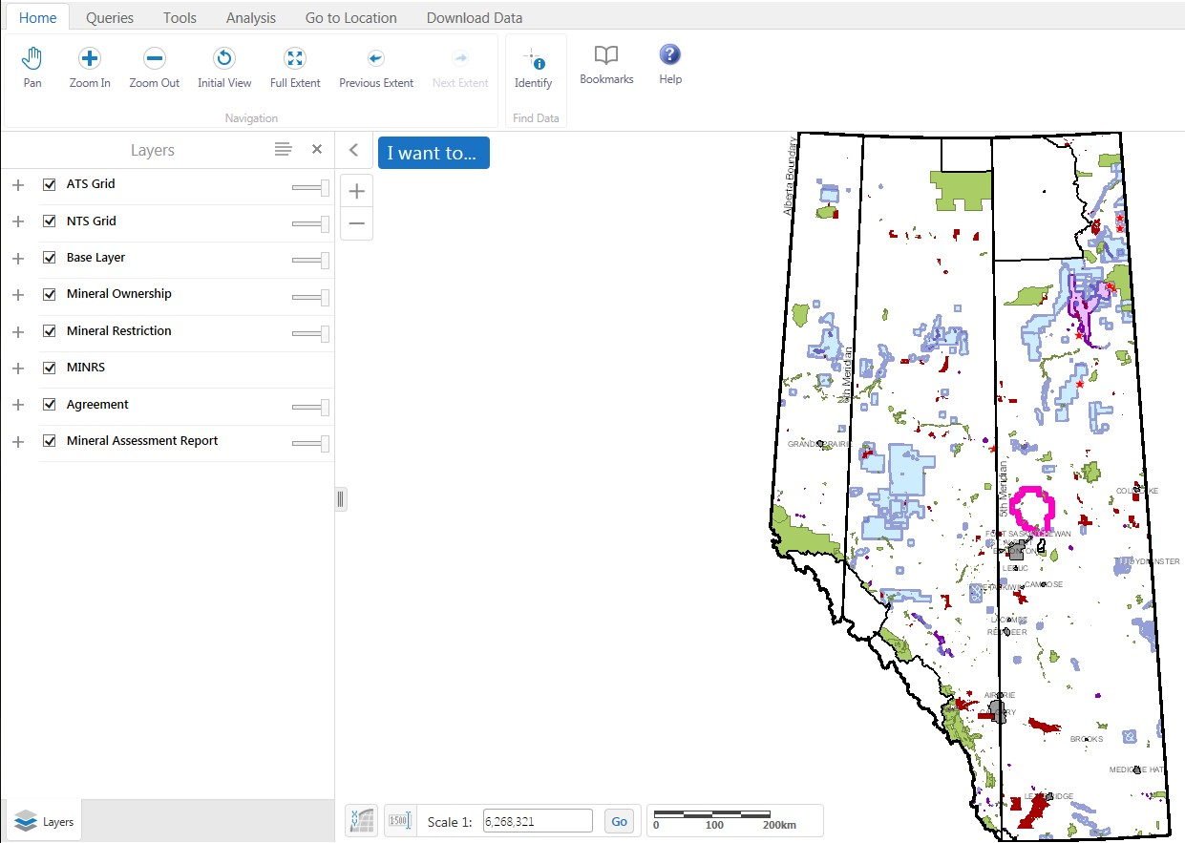
INTRODUCTION
In this module you will learn about Geoview’s:
Screen layout
Information panel and map layers
Toolbar
  Home
  Queries
  Tools
  Analysis
  Go to Location
  Download Data
How to navigate the map
How to use queries
How to use identify
How to use annotations
How to create a printable map
How to export a map
Note: As this course demonstrates the use of the GeoView tool, the data in some instances may not portray the actual Crown or Freehold ownership and is not specific to a particular mineral type map.

Slide 4
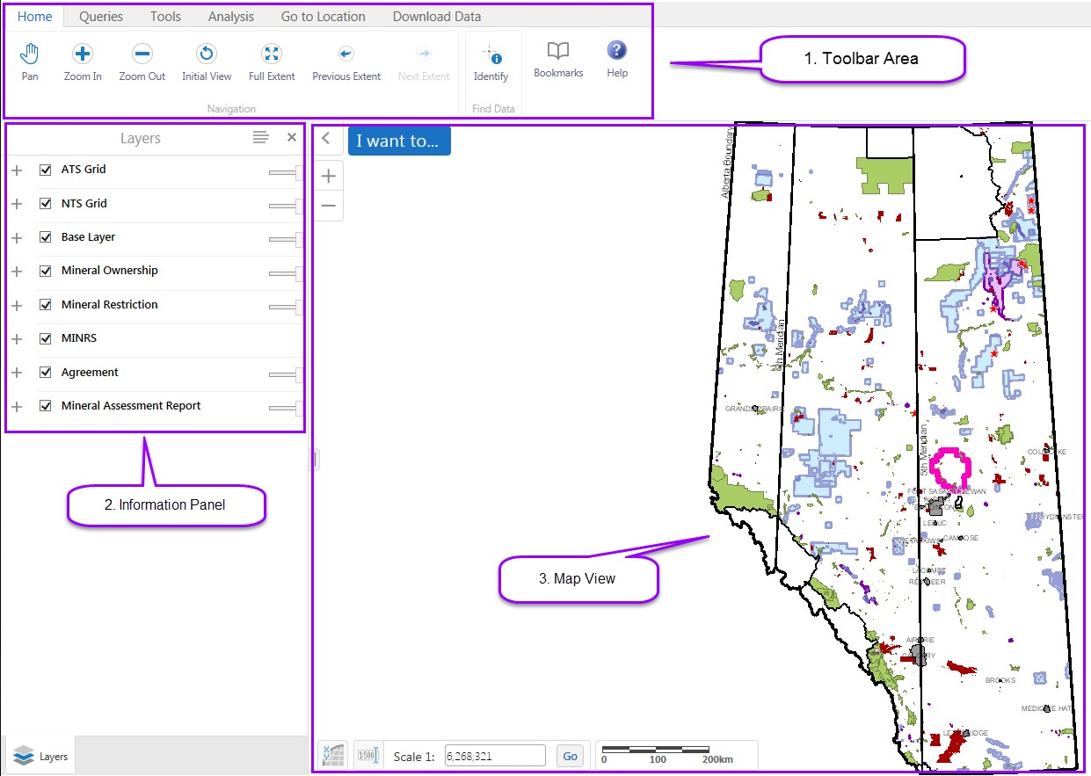
SCREEN LAYOUT
The GeoView screen display has three mains sections:
TOOLBAR AREA | INFORMATION PANEL | MAP VIEW
Contains numerous tools that are used to move around the map, find or search information on the map, print the map etc. These tools are categorized into high-level groups: Home, Queries, Analysis, Go to Location and Download Data | Shows different kinds of information/results when you interact with the map. For example, this panel displays the Map Layers where you can select different layers to hide or show on the map. | Shows the map window where you can interact with the map by zooming, panning, annotating.

Slide 5
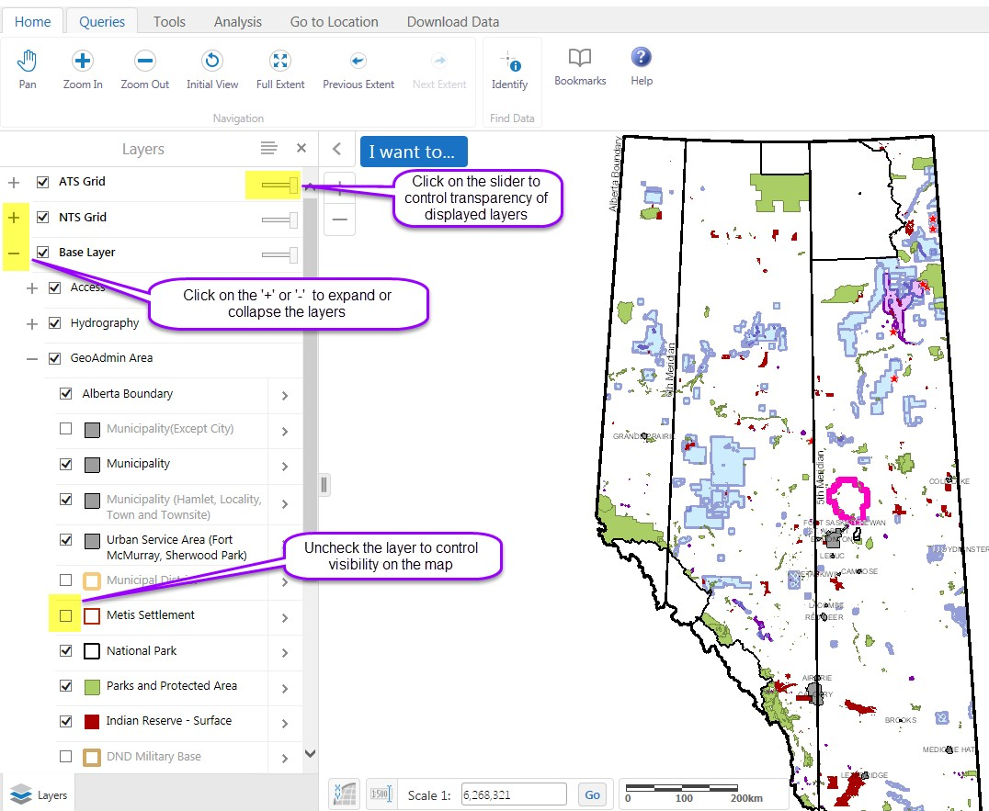
INFORMATION PANEL AND MAP LAYERS
Map layers control the display of the map layers list. You can check or uncheck the map layers according to your requirement. You can also control the visibility and transparency of the map using the sliders.

Slide 6
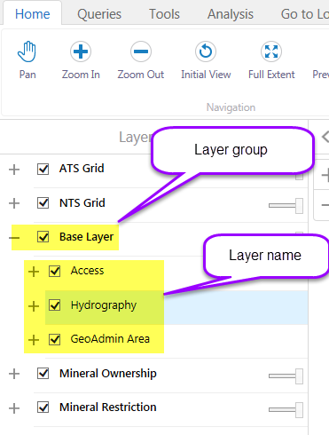
INFORMATION PANEL AND MAP LAYERS – LAYER GROUP AND LAYER NAME
The Information Panel display consists of a Layer Group and Layer Names. When the Layer Group is expanded, the Layer Names will be visible. Y ou can check/uncheck the Layer Group and Layer Names to control visibility in the map. The display of the Layer Group will override the display of the Layer Names.

Slide 7
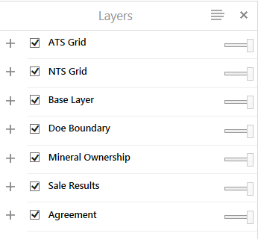
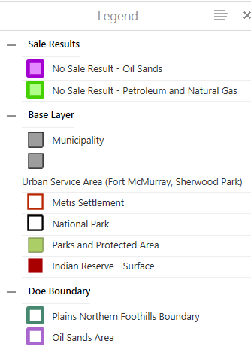
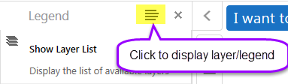
INFORMATION PANEL – MAP LEGEND
The Map legend shows the corresponding legend for the layers used in map. You can toggle between Show Legend and Show Layer.

Slide 8
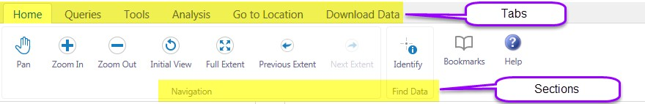
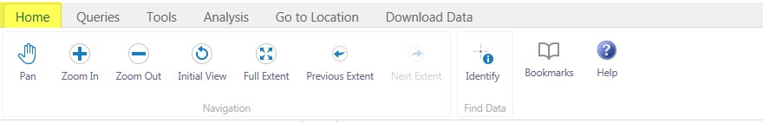





TOOLBAR
The toolbar contains many of the tools you use to pan (move around), zoom in and out, as well as to find and manipulate the information that is stored in the map.
The toolbar is divided into Tabs that group tools into high-level functions for example; Home, Queries, Tools, Analysis, Go to Location and Download Data. Each tab is divided into Sections by function for example, for the Home Tab; there are Navigation Tools and Find Data sections.
TOOLBAR TAB - HOME
Use these tools: | To:
 | Pan (move) the map in any direction. To pan the map, click on it and drag in any direction. Use the Pan tool to return to panning when you have used other tools.
 | Zoom in click and drag an area on the map or use your roller on your mouse.
 | Zoom out click and drag an area on the map or use your roller on your mouse.
 | Return to the extent (scale) that the map was at when it opened.
 | Return to the extent (scale) that the map was at when it opened.

Slide 9





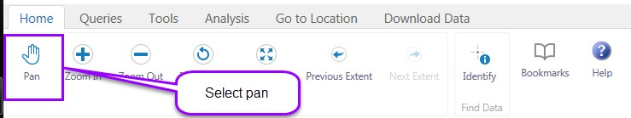
 | The map is zoomed backward to the previous extent (previous view of the map).
 | If you have zoomed forward and back the map will zoom forward to the next extent.
 | Identify information at the point on the map that is clicked is available at the section level scale.
 | Create and navigate to a previously created bookmark. To add a bookmark for the current extent, click the plus +, enter a name, and then click OK.
 | Opens page that lists the Geoview Training Manuals related to the specific mineral map accessed.
How to navigate the map – Pan

Slide 10
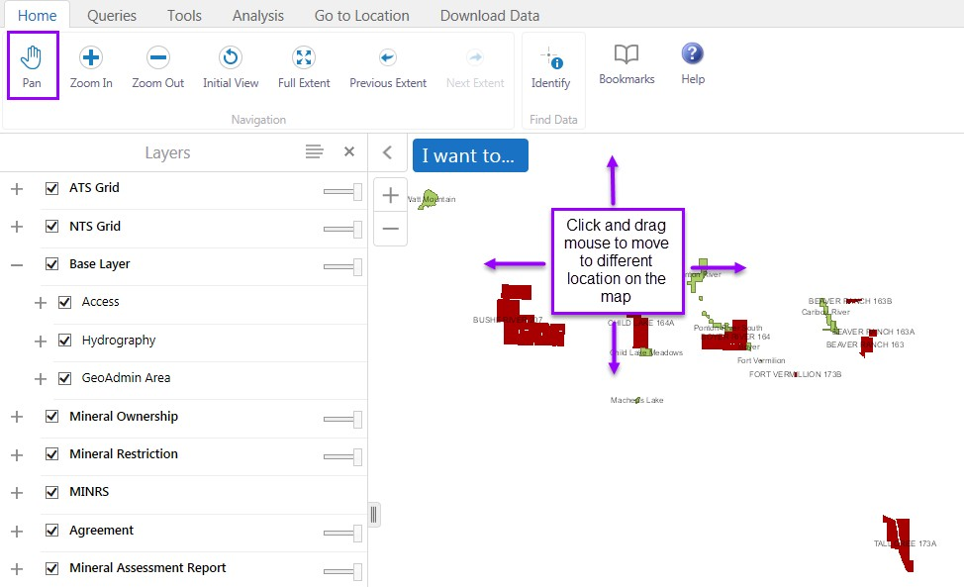
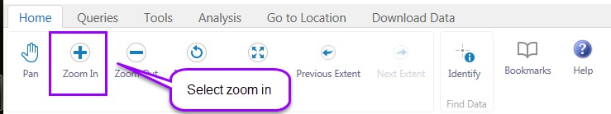

How to navigate the map – Zoom In / Zoom Out
Zoom In and Zoom out allows user to view selected areas at different viewing scales.
Page 10 of 57

Slide 11
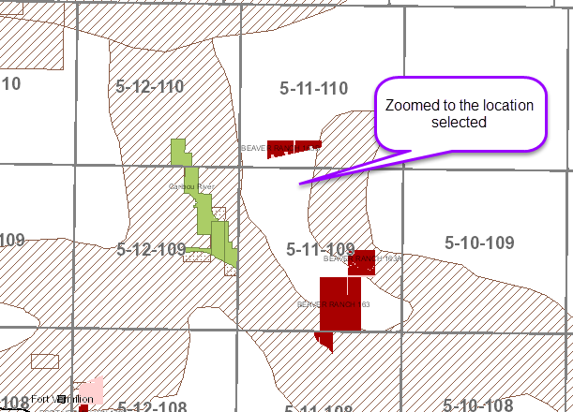
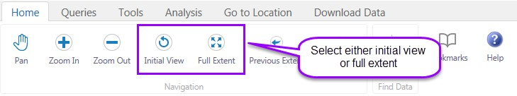
Selecting the ‘zoom out’ function works opposite of the ‘zoom in’ function.
Note: Once you are in the zoom mode you can also use the wheel on your mouse to zoom in and out.
How to navigate the map – Initial View / Full Extent
Initial View and Full Extent returns the map to the extent (scale) that the map was at when it opened.

Slide 12
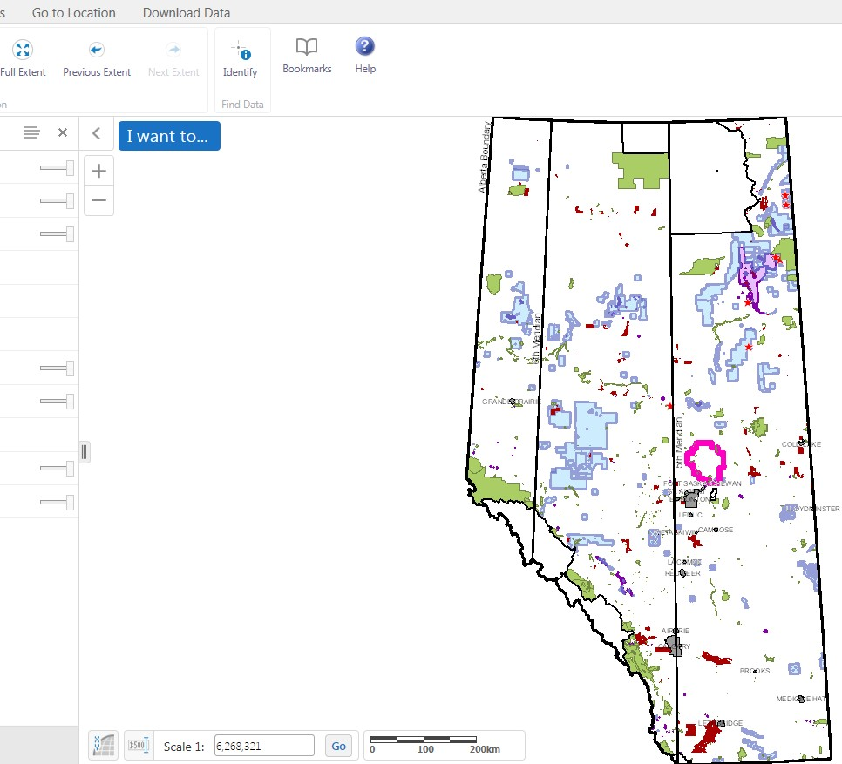
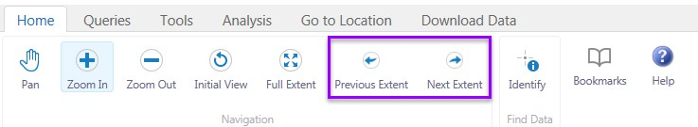
How to navigate the map – Previous Extent/Next Extent
This allows user to navigate to go back to a previous extent the user has viewed and then the next extent will go forward.

Slide 13
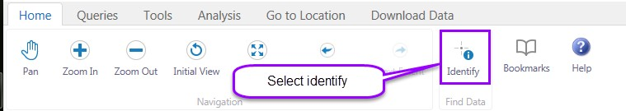
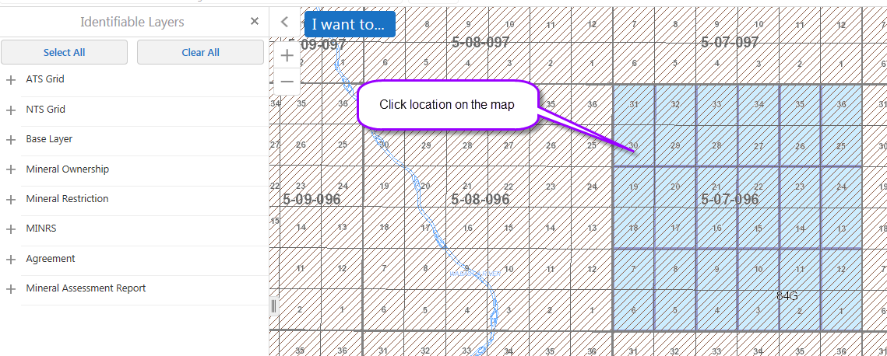
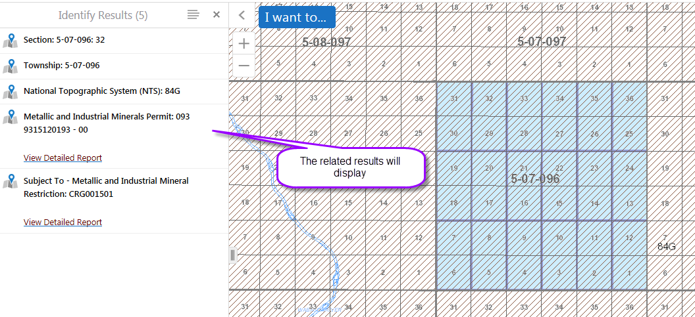
How to use – Identify
Note: When using the identify function you need to have the section scale visible.

Slide 14
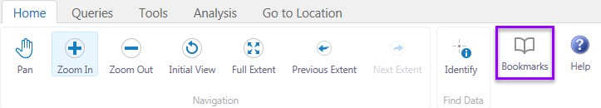
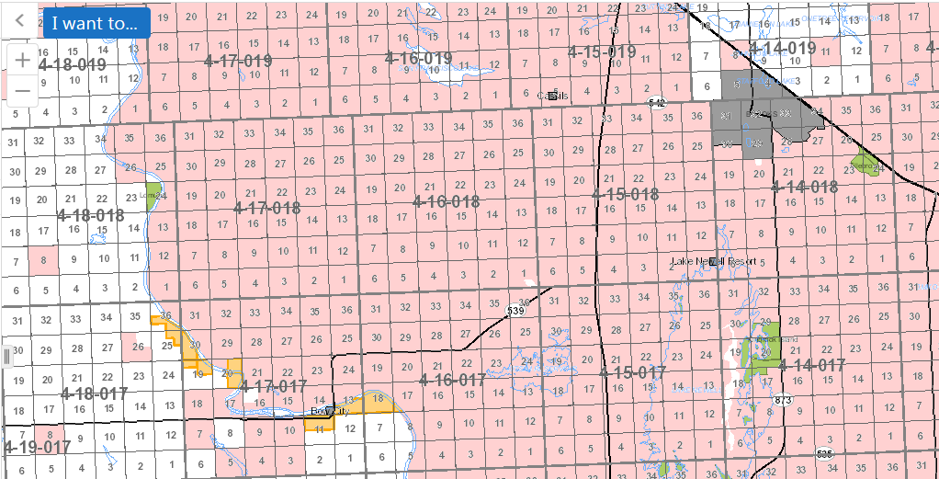
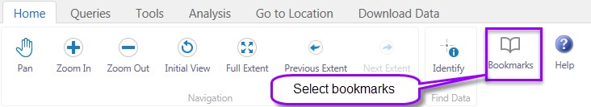
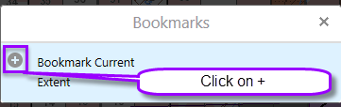
How to use – Bookmarks
Open map
Find area of interest

Slide 15
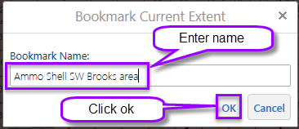
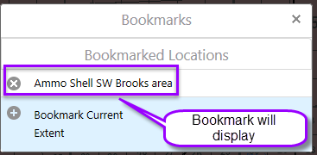
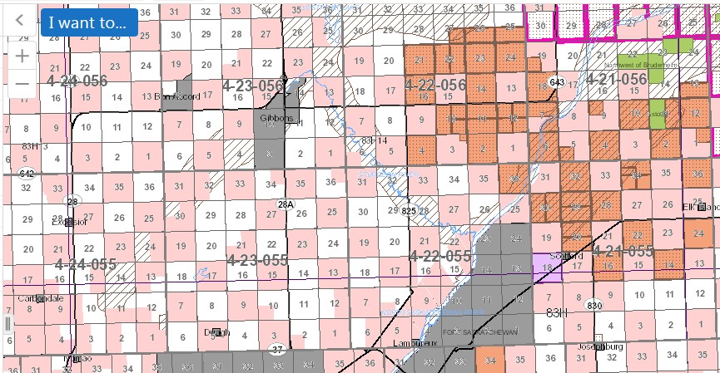
Open Metallic and Industrial map Find area of interest
Repeat bookmark process.

Slide 16
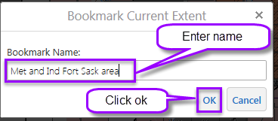
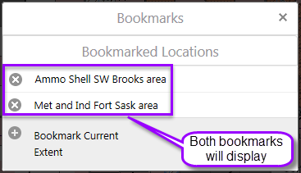
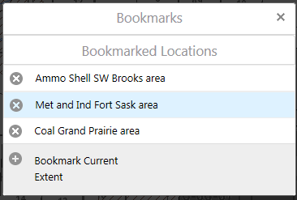
Note: Bookmarks are based on the user not on the different mineral type maps.
If you are in the Coal map and click on bookmarks and select the Metallic & Industrial bookmark it will display the Met & Ind bookmark area on the Coal map.

Slide 17
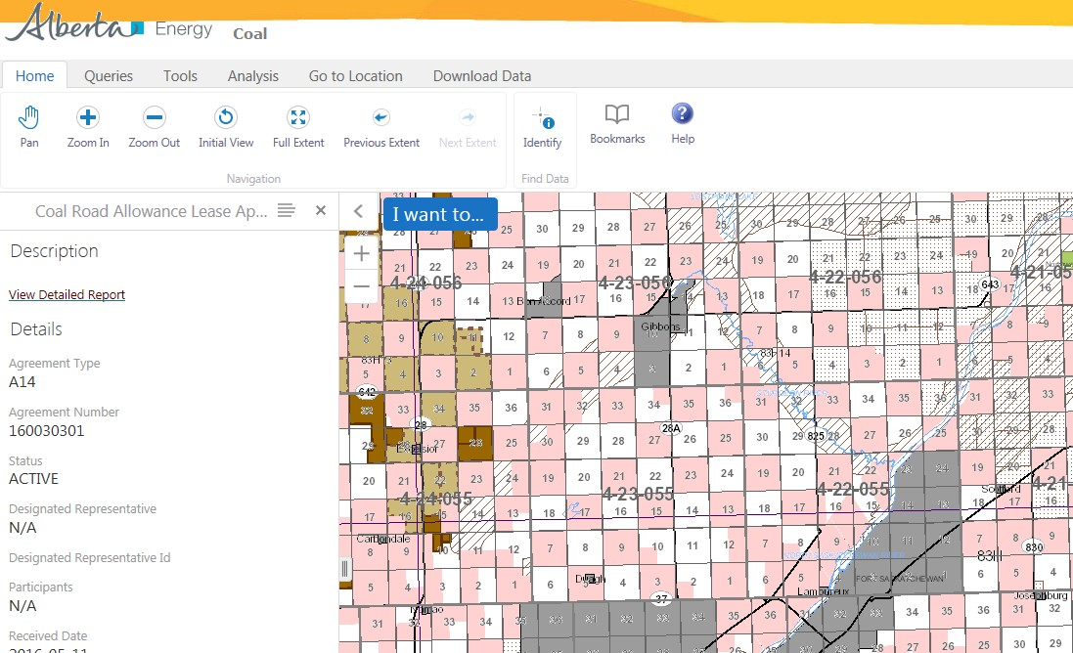
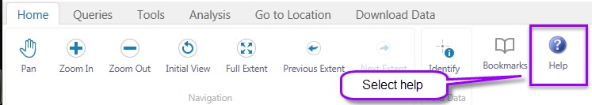
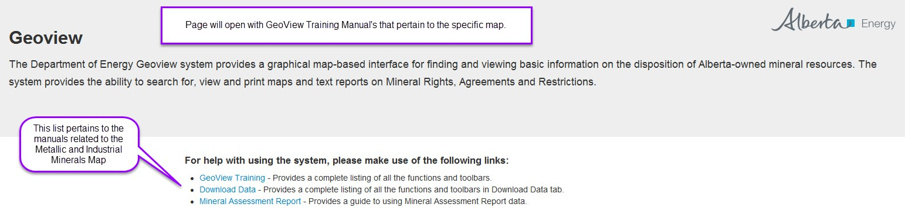
How to access manual - Help

Slide 18
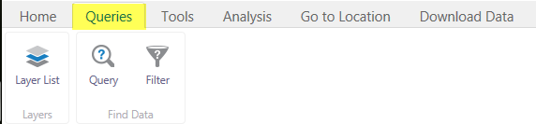



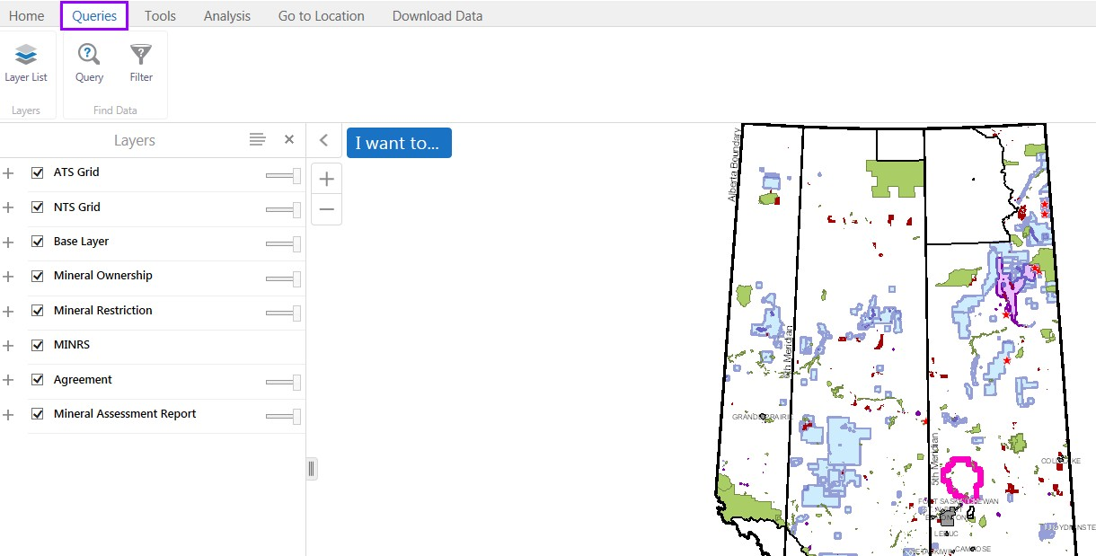
TOOLBAR TAB – QUERIES
Use these | To:
 | Show the layer list in the Map Layers panel.
 | Open the Query in the Information Pane. The Query makes it possible to specify a search by layer, field, and values. It is also possible to add multiple conditions to a search. Results will be returned.
 | Open Filter in the Information Pane. The Filter Builder enables end users to filter the features that show on the map. The Filter makes it possible to specify a definition expression to apply for a certain layer using its fields and specific values. The layer will be filtered to show only the results of the definition expression. Multiple conditions can be used to filter a certain layer.

Slide 19
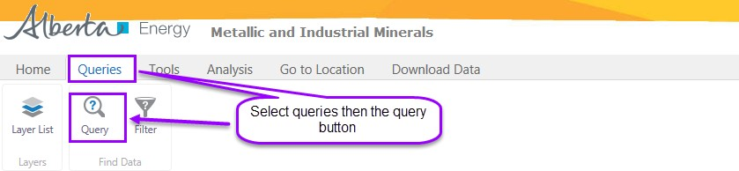
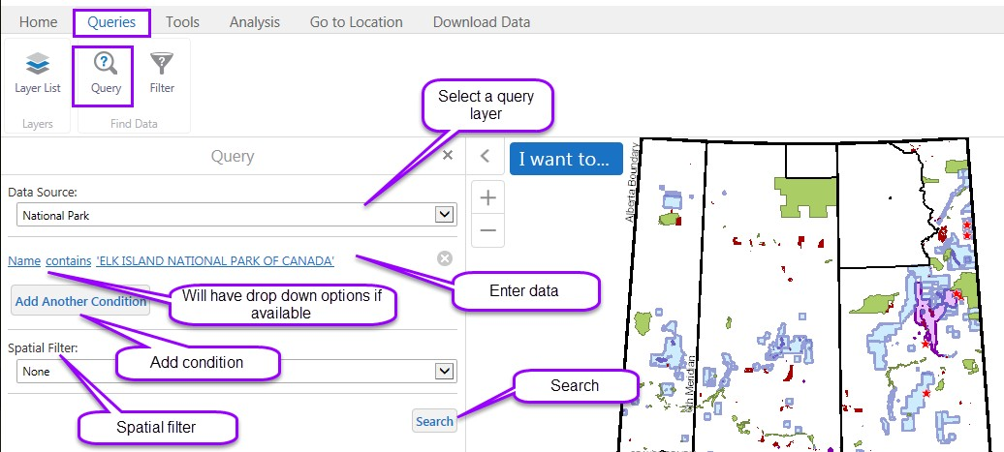
Note: The different mineral maps display different layer information.
How to use Queries – Steps
Select a query layer, layers available will display in a drop down
Enter data e.g. land key
Add another condition as required
Add spatial filters
Click search
When search is executed you may end up with more than one result, select the one that you require.

Slide 20
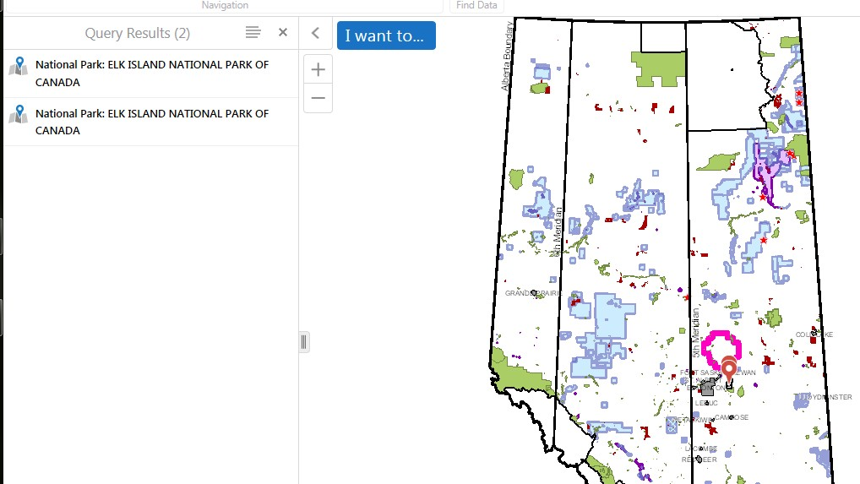
Page 20 of 57

Slide 21
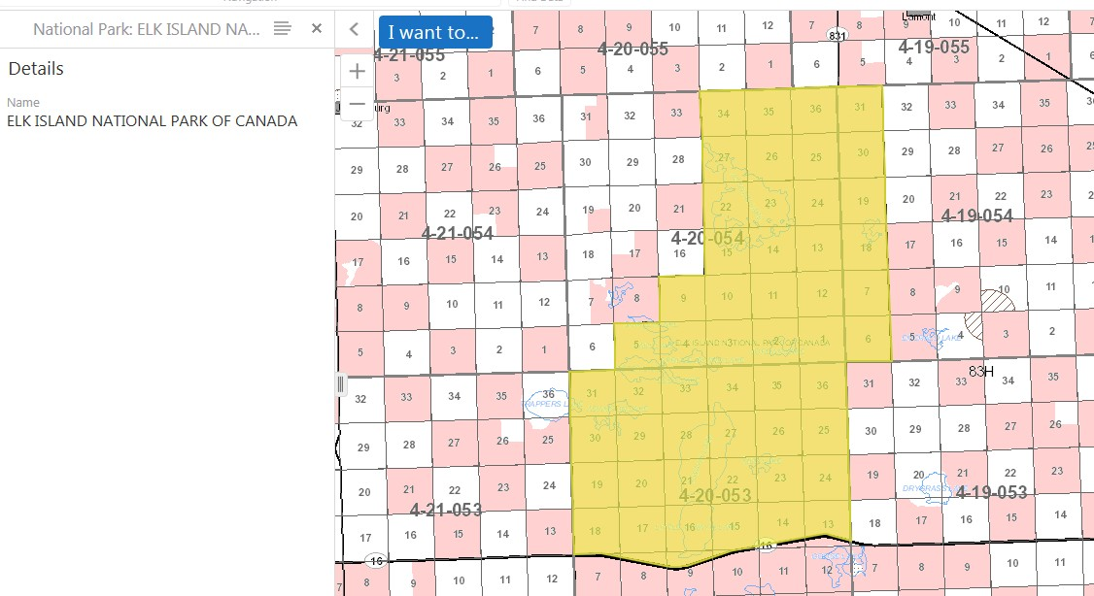
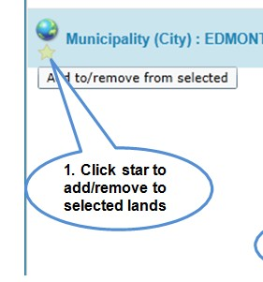
The result of the query is displayed.
This is sample from prod I think issue has been raised with geocortex, waiting for this required function.

Slide 22
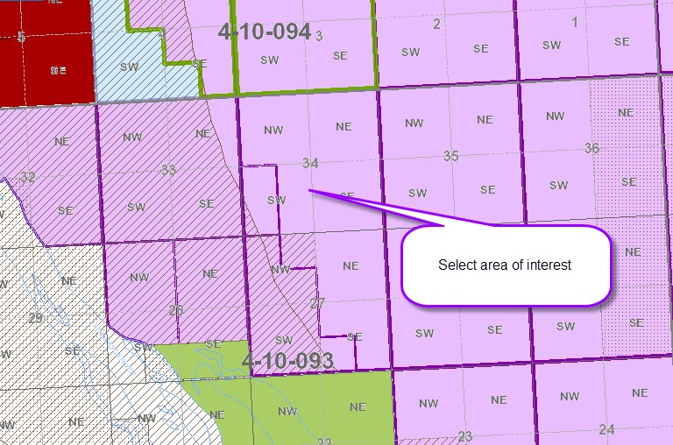
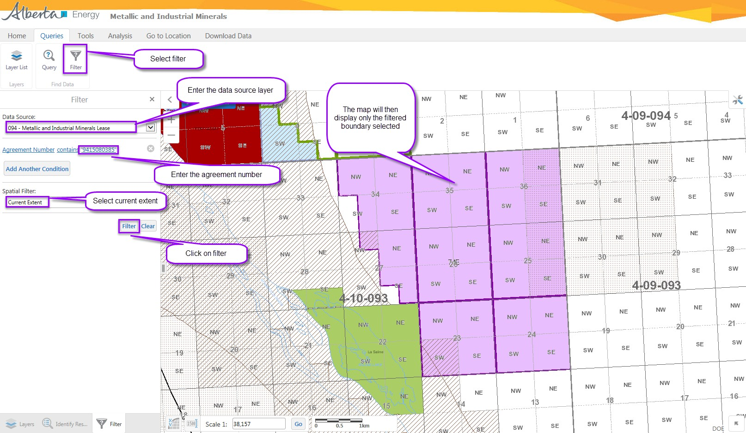
How to use - Filter

Slide 23
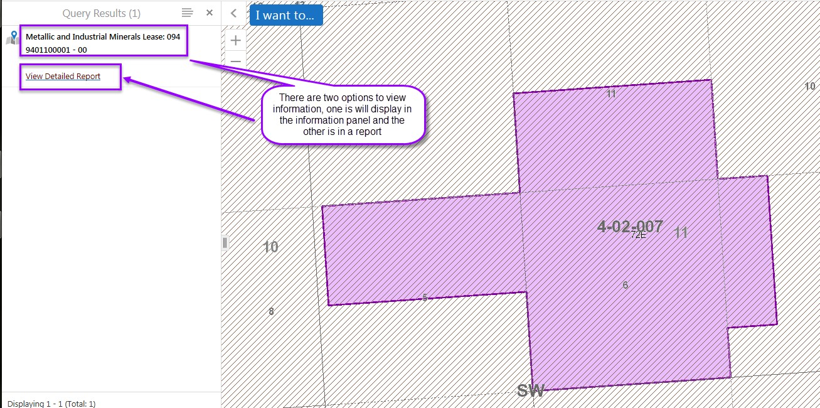
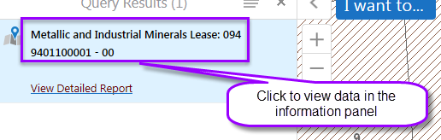
How to use Queries - Results - View Detailed Report
The first one displays data in the information panel and only limited data.

Slide 24
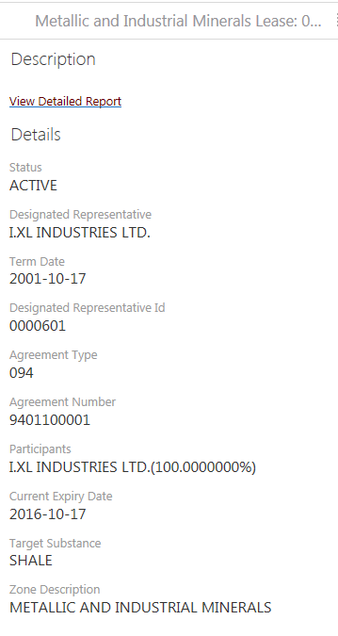

The second one, view detailed report, provides all public data in a report format.

Slide 25
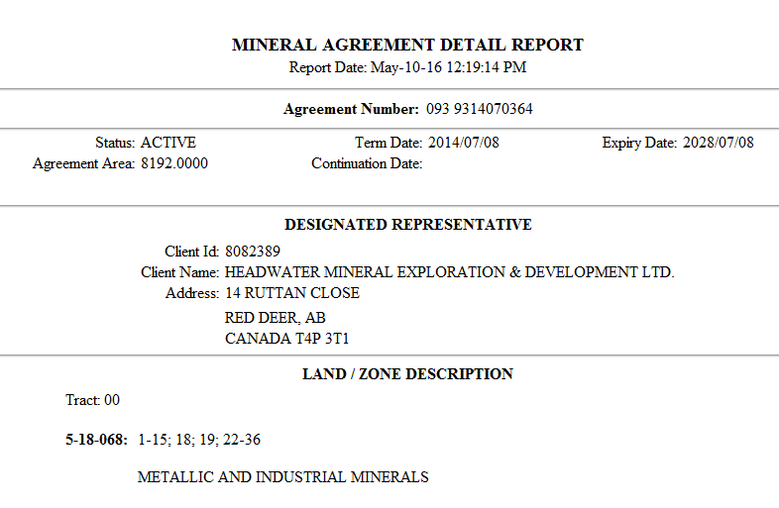

Slide 26
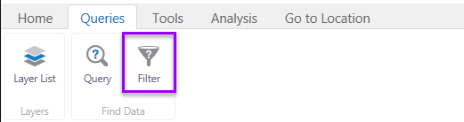
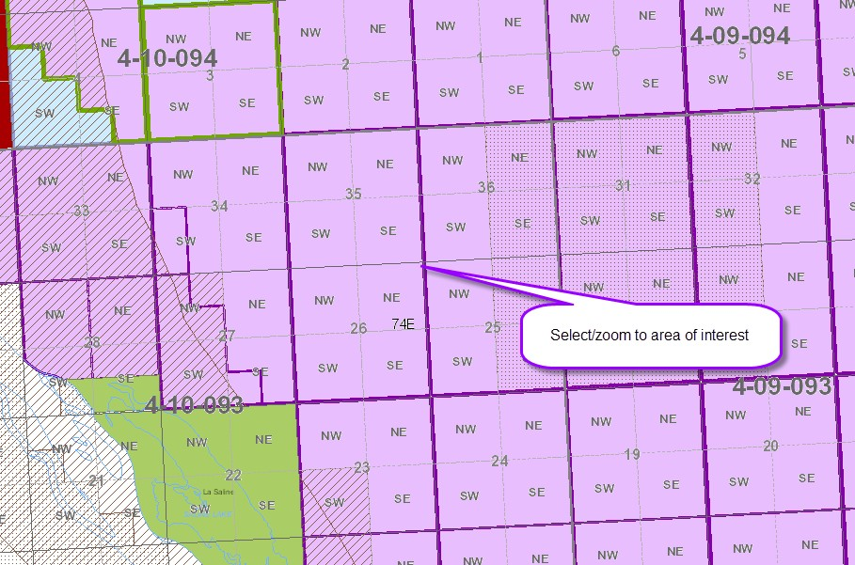
How to use – Filter

Slide 27
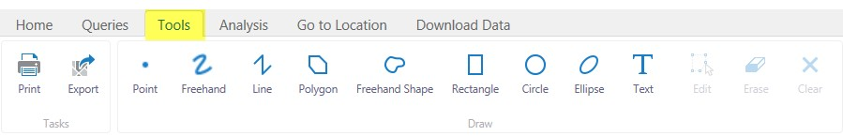




TOOLBAR TAB – TOOLS
Use these | To:
 | Open the Create a Printable Map dialog box where you can select the Layout, Output Format, Resolution, and Scale to print the map.
 | Open the Export a Map Image dialog box and select the image format that you want to export the map into. You can export to BMP, JPEG, PNG, TIFF, GeoTiff and PDF Image formats.
 | Draw a point on the map. The shape, size, colour and transparency of the point can be set using tools that appear on the toolbar when you select one of the drawing tools.
 | Draw freely on the map in any direction. The style, thickness, colour, and transparency of the line can be set.

Slide 28












 | Draw a straight line or click to change the line and draw in a new direction. The style, thickness, colour, and transparency of the line can be set.
 | Draw a polygon on the map, clicking to change direction. Double-click to stop drawing. You can set the thickness, colour, and transparency of the border and the colour and transparency of the fill.
 | Drawing freely on the map for irregular shapes for such as portions of land. The style, thickness, colour, and transparency of the line can be set.
 | Draw a rectangle on the map. Click and drag across the map. You can set the thickness, colour, and transparency of the border and the colour and transparency of the fill.
 | Draw a circle on the map. Drag into the center or outwards to change the size of the circle. You can set the thickness, colour, and transparency of the border and the colour and transparency of the fill.
 | Draw an ellipse on the map. Drag in different directions to change the shape and size of the ellipse. You can set the thickness, colour, and transparency of the border and the colour and transparency of the fill.
 | Add text to the map. When text is selected the snapping and style buttons will display. Click on the map and type the text. You can change the font, size, colour, transparency and angle of the text. You can add multiple lines of text and select layer and field information to add to the label.
 | Snapping tools are enabled when text button is selected. The user may enable or disable snapping by clicking the Enable Snapping button.
 | The user may choose which layers are affected by snapping by clicking the Select Snapping Layers button. When enabled, snapping allows the user to precisely draw shapes on the map by snapping to the nearest point, vertex or edge of an existing shape within a configurable radius around the mouse pointer
 | You can change the font, size, transparency. You can add multiple lines of text and select layer and field information to add to the label.
 | Edit the points of a drawing on the map. When you click on the drawing you want to edit, the points activate and you can then drag any of the points in any direction to change the shape of your drawing. You can also rotate the drawing by clicking and dragging the square above the marquee in the middle of the graphic.
 | Remove drawings from the map one at a time by clicking on each one.

Slide 29

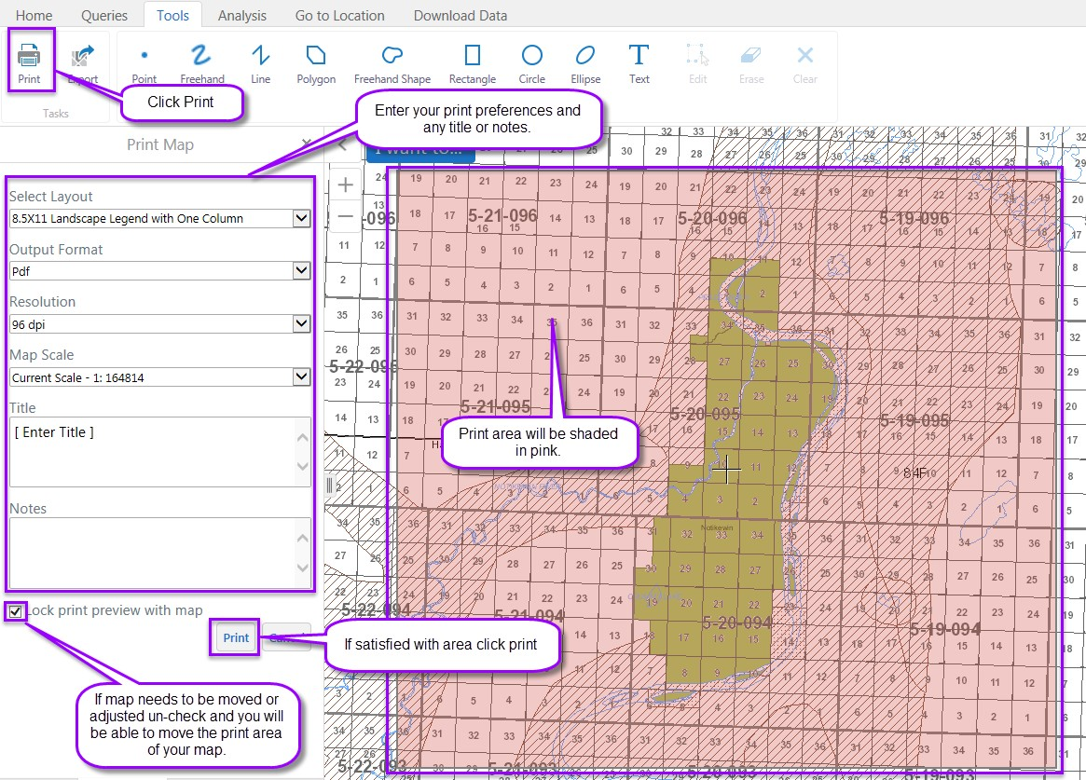
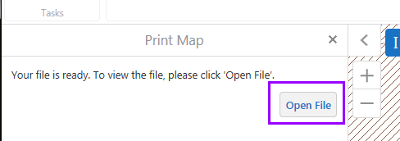
Clear all the drawings on the map at the same time.
How to create a printable map – map in formatted style
You can change the title and add notes on the map. All the changes to the map can be printed to PDF. The visible area of the map is the area which will appear in the created PDF map.
Your map will run in the background and notify you in the information panel that it is ready for viewing, then open file for viewing and select print option (file on the toolbar).

Slide 30


How to export a map – map in non-formatted style
Export a map image pop up will display.
Page 30 of 57

Slide 31





Slide 32



You can then print or save image.
How to use draw tools – drawing and Text
Different shapes and text can be added to the map but these are temporary. Leaving or refreshing the session will clear. These tools are used on the map for the purpose of printing.
Based on the draw tool selected you can also select a style.
Enable Snapping
Snapping is useful when you are drawing a polygon and want it to follow the lines in another graphic, displays a point indicator.

Slide 33




Select Snapping Layers
Styles
User must select the type of drawing tool for the style options to display. Example if draw tool selected is freehand the style options are.
Example if draw tool selected is rectangle the style options are.

Slide 34



Using the line
Using the circle

Slide 35



If text is selected you can select a font style.
Note: There is no option currently that will allow the user to select font style size or colour.

Slide 36


Slide 37



Text will display.
User can also enlarge the text or move.
To edit/remove any drawing or text data put on the map you can use the edit, erase or clear functions.

Slide 38











TOOLBAR TAB – ANALYSIS
Use these | To:
 | Identify data at a particular point anywhere on the map. All the features beneath the point you click are listed in the Results List.
 | Identify features by drawing a line in any direction on the map. All the features that intersect with the line you draw are listed in the Results List.
 | Identify features by dragging a line in any direction on the map. All the features that intersect with the line you draw are listed in the Results List.
 | Identify features by drawing a segmented shape over an area on the map. All the features beneath the shape you draw are listed in the Results List.
 | Identify features by drawing a rectangle over an area on the map. All the features beneath the shape you draw are listed in the Results List.
 | Measure distances on the map by drawing a segmented line.
 | Measure an area of the map by drawing a shape.
 | When distance/area is selected the units and snapping buttons will display. Change the unit of measurement on a drawing to other options like Kilometers, Hectares, Acres, etc.
 | The user may enable or disable snapping by clicking the Enable Snapping button.
 | The user may choose which layers are affected by snapping by clicking the Select Snapping Layers button. When enabled, snapping allows the user to precisely draw shapes on the map by snapping to the nearest point, vertex or edge of an existing shape within a configurable radius around the mouse pointer.

Slide 39






 | Add the distance or area measurement to the map as a drawing.
 | Erase a drawing by clicking it.
 | Clear all the drawings on the current map.
Note: In order to enable the Drawing tools, a drawing must first be created.
How to use identify tools – Drawing
Note: When specific draw/identify button selected, addition options will display.

Slide 40


Using the point
Using the rectangle
Page 40 of 57

Slide 41




Using the enable buffering and identifiable layers
How to use – Distance and Area

Slide 42




Change the unit of measurement on a drawing to other options like Kilometers, Hectares, Acres, etc.
Options of measure

Slide 43


To edit/remove any drawing or text data put on the map you can use the edit, erase or clear functions.

Slide 44


How to use – Buffering
TOOLBAR TAB – GO TO LOCATION

Slide 45




Use these | To:
 | The Go to ATS (Alberta Township Survey) makes it possible to search by a specific land location (M/R/T: Sec, Qtr Sec)
 | The Go to NTS (National Topographic System) makes it possible to search by a map sheet (e.g. 84F10)
How to use Go to Location – Go to ATS
User can do an Alberta Township Survey (ATS) search based on m/twp/rge, m/twp/rge/sec or m/twp/rge/sec/qtr sec only.

Slide 46


Clear does not just clear the fields returns user to the layers info????

Slide 47



How to use Go to Location – Go to NTS
User can do a National Topographic System (NTS) search based on the NTS system used by Natural Resources Canada for providing general purpose topographic maps of the country.

Slide 48


Slide 49




TOOLBAR TAB – DOWNLOAD DATA
Note: Download Data – currently only applies to Coal and Metallic and Industrial Minerals Maps.
Use these | To:
 | Download the zip file containing the Coal or Metallic and Industrial Minerals Agreement data in SHAPE file format.
 | Download the zip file containing the Coal or Metallic and Industrial Minerals Agreement data in DXF file format.
How to download shape file data

Slide 50



Page 50 of 57

Slide 51


Slide 52


How to download DXF file data

Slide 53




Note: The dated link is 24 hours behind live data. Upon clicking on the dated link, a zip file is provided to open or save.

Slide 54


How to use info

Slide 55

Note: Road Allowance info sample is missing.
Road Allowance Land Key Table for Metes and Bounds and Land Description Samples
Lands must be only North (2 miles) or South (1 mile) of a section as per valid land descriptions for Road Allowance.
This information describes the related metes and bounds based on the road allowance orientation as shown on the Township overlay.
Landkey | Road Allowance Orientation | Appendix | Description
4-27-027:11 | RS | 4-27-027:11RS | Road Allowance lying to the South.
4-27-027:11 | RW | 4-27-027:11RW | Road Allowance lying to the West.
4-27-027:11 | RI | 4-27-027:11RI | Road Allowance being the South West intersection.

Slide 56


Slide 57

Congratulations!
You have completed the GeoView System Overview online Training Course.
If you have any comments or questions on this training course, please forward them to the following e-mail address:
GIS SOLUTIONS SUPPORT: ENERGY-MOGISSupport@gov.ab.ca

