Slide 1
Welcome!
To the ETS – Agreement Management
Rental and Royalty Default
Online Training Course
Agreement Administration Management – Rental and Royalty Defaults: This process allows clients the ability to view notification and cancellation letters through the Request Status screen.

Slide 2
Revisions Table
Date | Revisions Type | Page Number
March 10, 2017 | Initial Creation | All
June 2020 | Update Banner and Add Resource page | All
October 2020 | Updated | Various
January 2022 | Updated | Slide 4 and 9-11

Slide 3
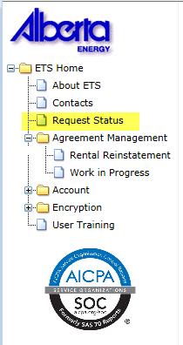
In this module, you will learn how to:
View a response document(s)
Course Pre-requisites:
Training System Overview
ETS Account Setup and Preferences (For Site Administrators)

Slide 4
You will receive an Email Notification from ETS, when either a: Rental Default Cancellation Letter; Royalty Default Notification Letter; or a Royalty Default Cancellation Letter is sent to your ETS account.
EXTERNAL SENDER. Do not open links or attachments that are unexpected. Do not give out User IDs or Passwords.
You have received a Rental Default cancellation document-Request Number XXXXXX for account ENXXXXX. This request can be found under Request Status-Rental Defaults.
To review your request sign on to the Electronic Transfer System (ETS) website, available through Alberta.ca.
Do not reply to this EMail. If you have questions or concerns please contact Energy.Rentals@gov.ab.ca.

Slide 5
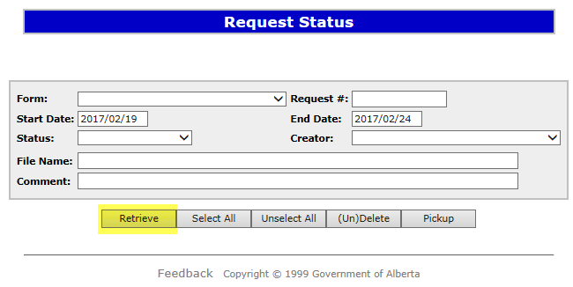
Request Status
After you receive an Email Notification from ETS, you would access the Request Status screen. Choose your Search Parameters (Start Date / End date, From, or Request Number) and select Retrieve.
1. Select Request Status
2. Choose your Search Parameters
3. Select Retrieve

Slide 6
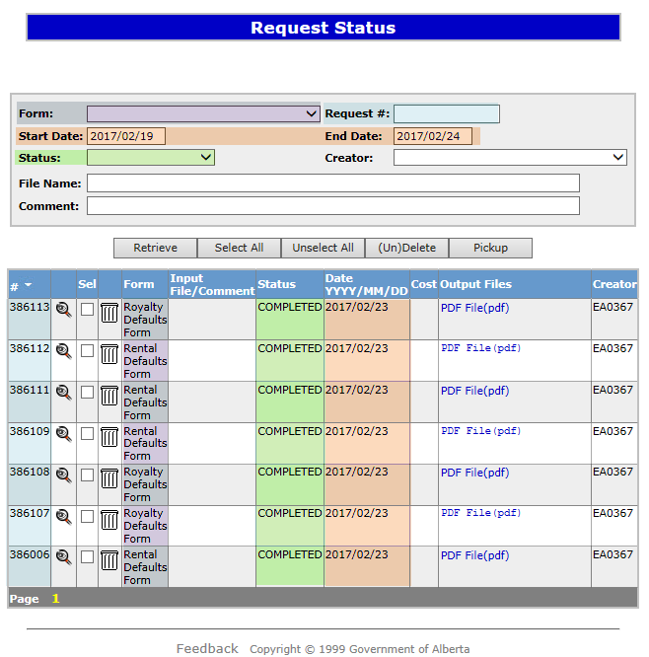
Request Status – Search Parameters and Result
Parameter Field | Result Column
Type | Form Type
Request Number | ETS #
Start/End Date | Last Updated
Status | Status
File Name | (not shown as a result column)
Comment | (not shown as a result column)
You can utilize the search parameter fields to filter search results.
The table on the right shows the correlation between the parameter fields and each corresponding result column.
Below is a color-highlighted illustration of the Work in Progress search screen to further demonstrate the relationship between the data.

Slide 7
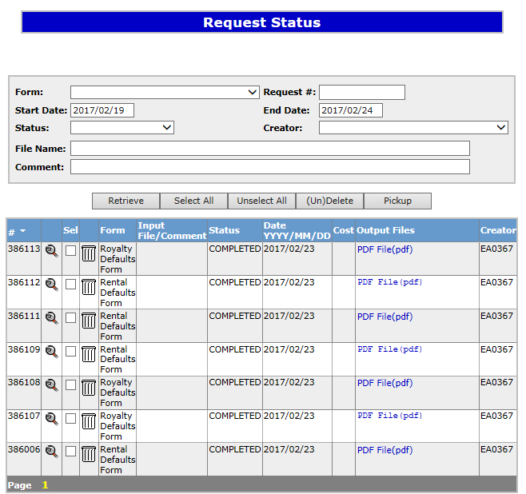
Request Status – Search Results
Search Results
To open a document click on the report Pdf link.
Navigate with this page numbers, if there are multiple pages of search results.

Slide 8
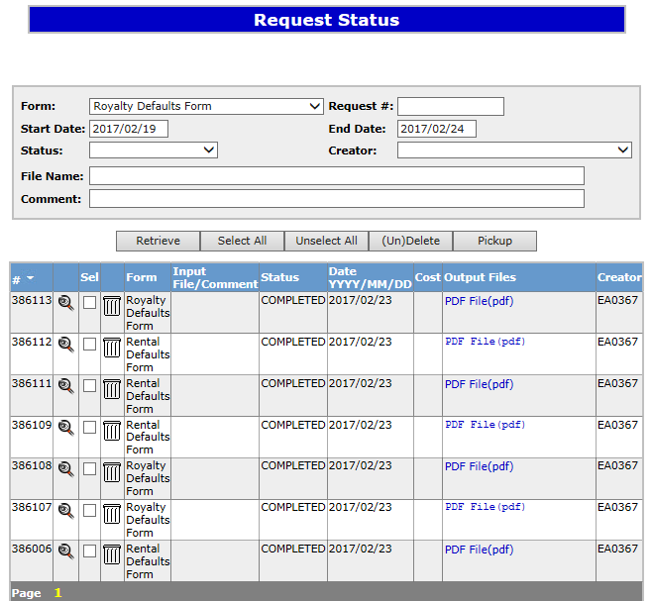
Request Status
The Request Status screen will populate all Completed requests. Select the PDF relating to the Reference Number detailed in the Email Notification. The corresponding letter will populate.
1. Reference Number
2. Select PDF

Slide 9
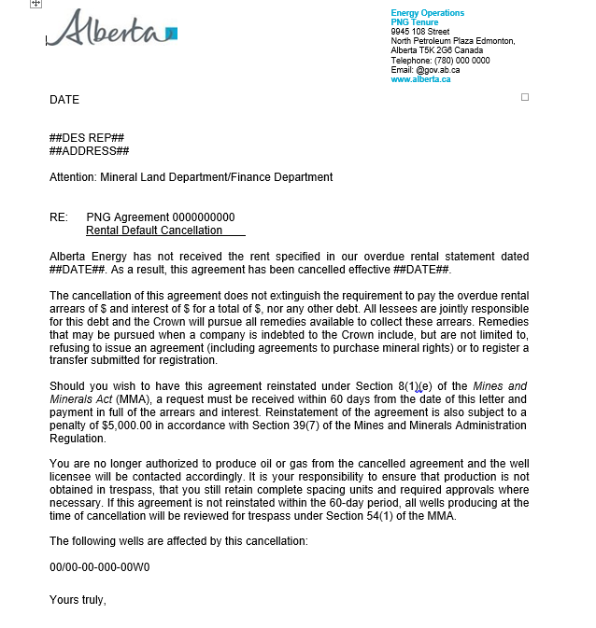
Rental Default Cancellation Letter

Slide 10
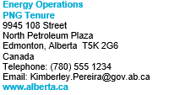
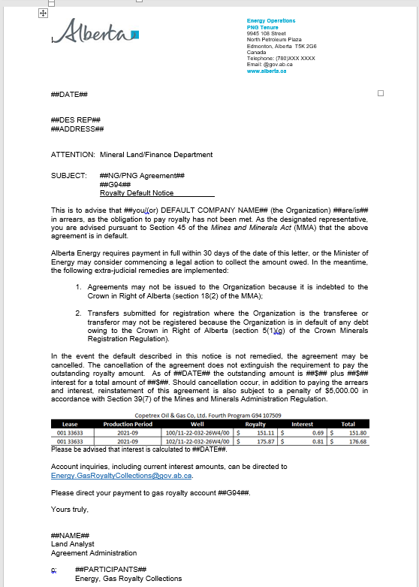
Royalty Default Notification Letter

Slide 11
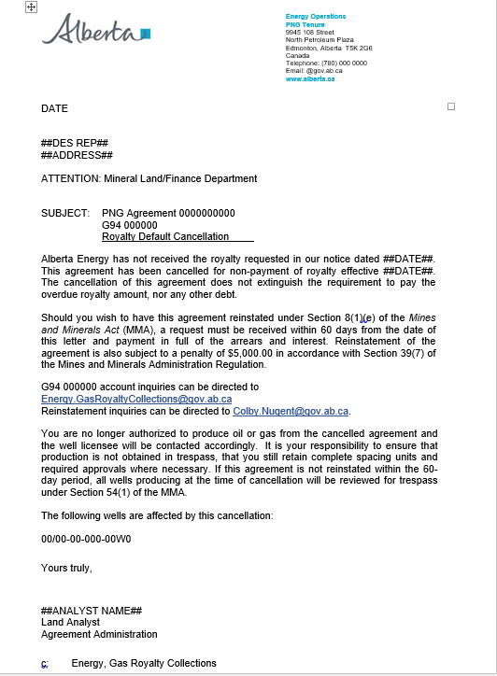
Royalty Default Cancellation Letter

Slide 12
RESOURCES
ETS Support and Online Learning provides access to relevant guides, courses and other information.
If you have questions, please contact Energy.Rentals@gov.ab.ca
or the PNG Tenure Help desk at 780-644-2300 and by selecting option #3.

Slide 13
Congratulations!
You have completed the ETS
Agreement Management
Rental & Royalty Default
Online Training Course
To access Courses, Guides and Forms for all your ETS Business please see ETS Support and Online Learning.
If you have any comments or questions on this training course,
please contact:
Crown Agreement Management
Helpdesk: (780) 644-2300
Email inquires: ENERGY.Rentals@gov.ab.ca

