Slide 1
Welcome
Welcome!
The Work In Progress functionality of Transfers enables you to retrieve a transfer request, view/change the request status depending on your role, delete a transfer request and create a new request by copying an existing one.
In addition, it allows you to view the electronic copy of the Memorandum of Registration if the transfer request was approved by Alberta Energy.
To the ETS – Work in Progress
Online Training Course

Slide 2
Revisions
Date | Revisions Type | Page Number
August 31, 2012 | Conversion | All
April 2020 | Cosmetic Updated | All

Slide 3

Introduction
In this module, you will learn how to:
Request Reviewer Approval of Transfer
Approve Transfer or Set to Concurrence
Concur/Reject Transfer
View Memorandum of Registration
Delete Transfer
Copy Transfer

Slide 4
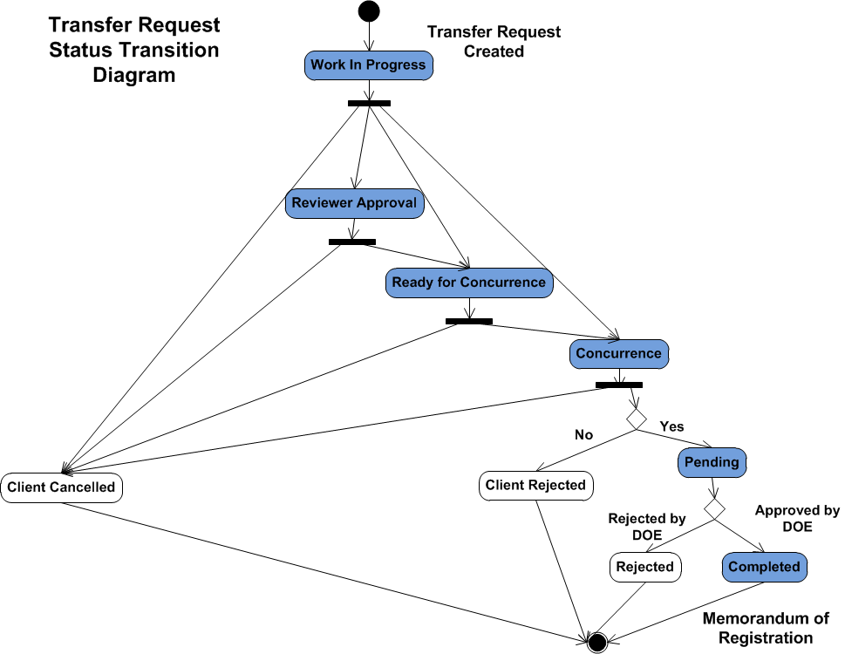
Transfer Request Status Change
The figure on the left hand shows how the status of a transfer request changes from one state to another. The statuses are set by the client(s) depending on the role(s) assigned by the Site Administrator within the company.

Slide 5
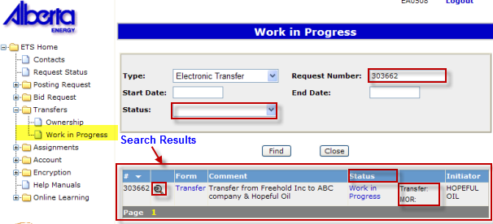
Work in Progress – Find Transfer Request
More Information (Pages 6 to 11)
Request Number - You may insert a Transfer Request number if you know it (provided in e-mail notification), or, you may leave it blank and all documents within the Type indicated will be listed.
Status - You can filter your search by selecting a specific status (i.e., Work In Progress, Reviewer Approval, Ready for Concurrence, Concurrence, Pending, Approved, Client Rejected, Client Cancelled, Rejected).
Search Results - The results of your Work In Progress search is displayed on the window below the query option. You may re-sort the results of your query by transfer # or status.
Transfer Request Details - Clicking on the magnifying glass icon will display the Transfer Request Details.
Status – Displays the status of the request. If the status is Concurrence and you have a Concurrence role, you can click on this link to open the Concurrence screen. Clicking on the column header will re-sort the results in status order.
Formats - If PDF, XML or TIF appear next to “Transfer” or “MOR”, you may view these documents in these formats by the clicking on any of these links. You may then save it to your local drive

Slide 6
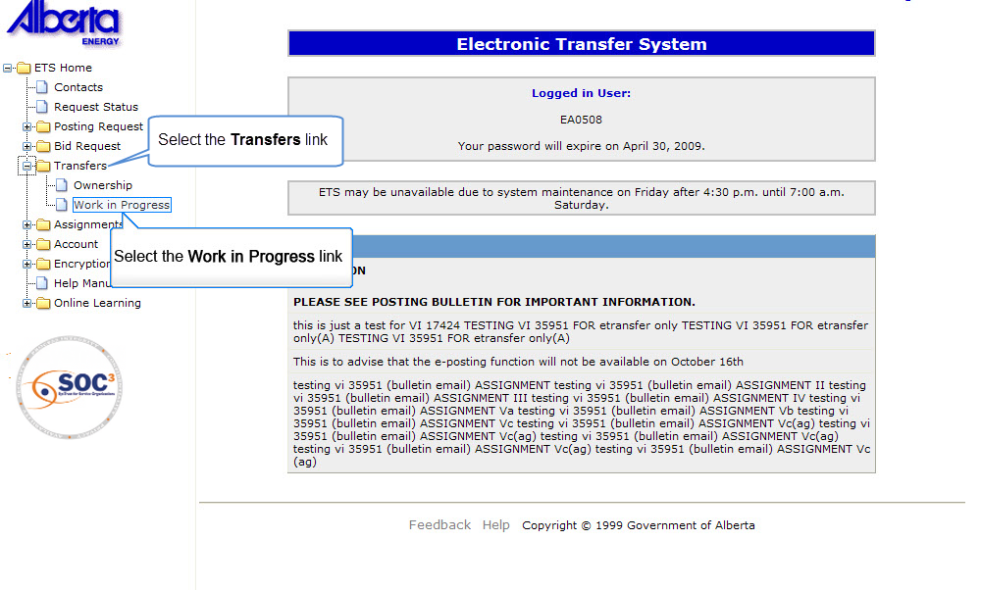

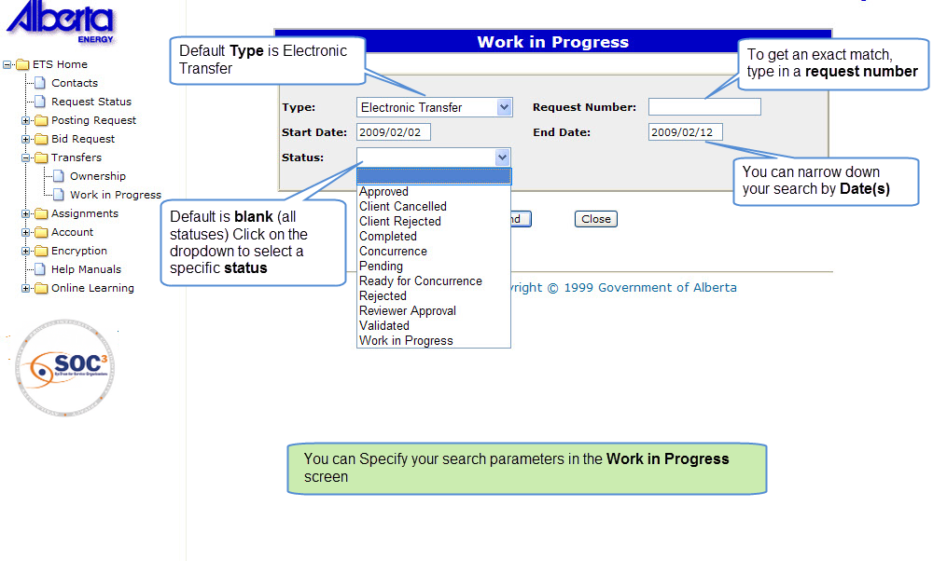
Back to Find Transfer Request

Slide 7
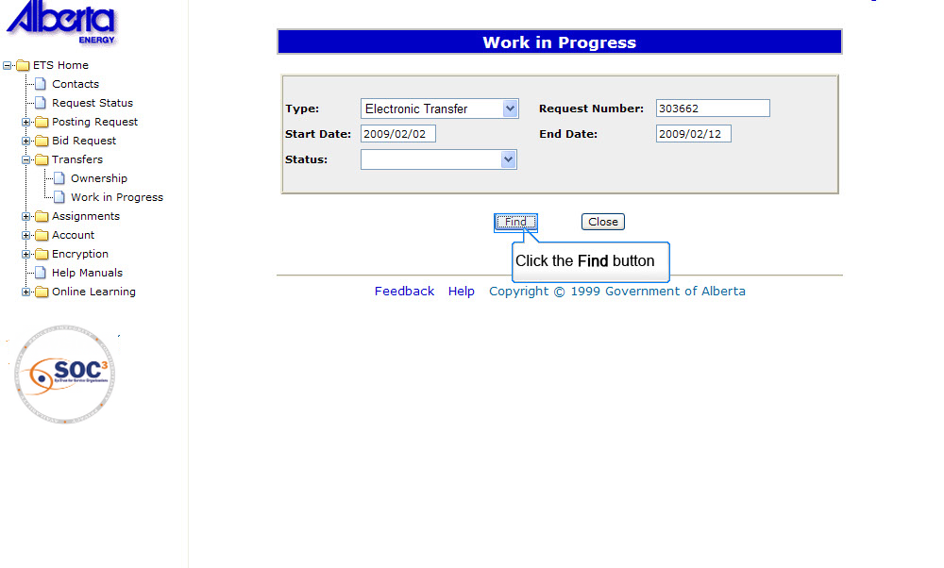
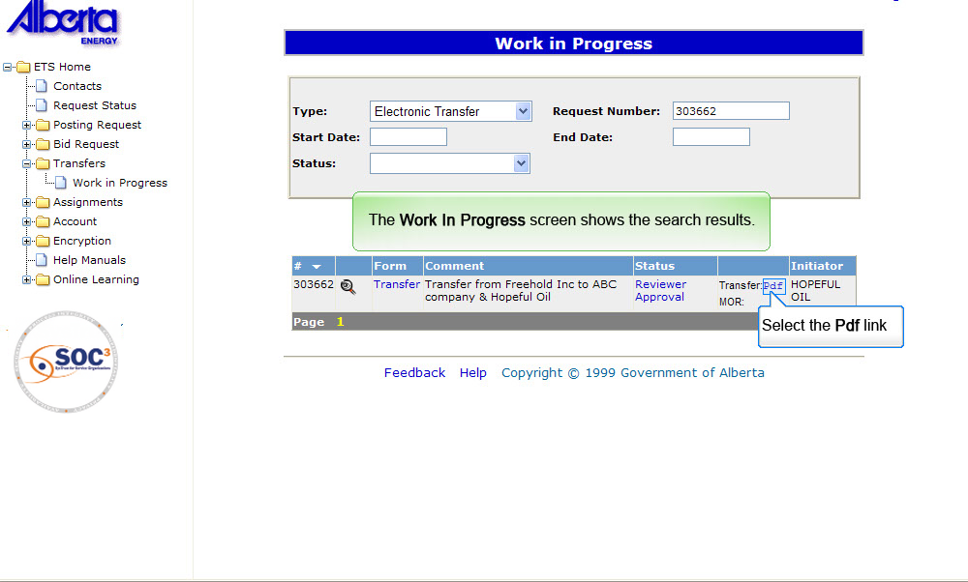
Back to Find Transfer Request

Slide 8
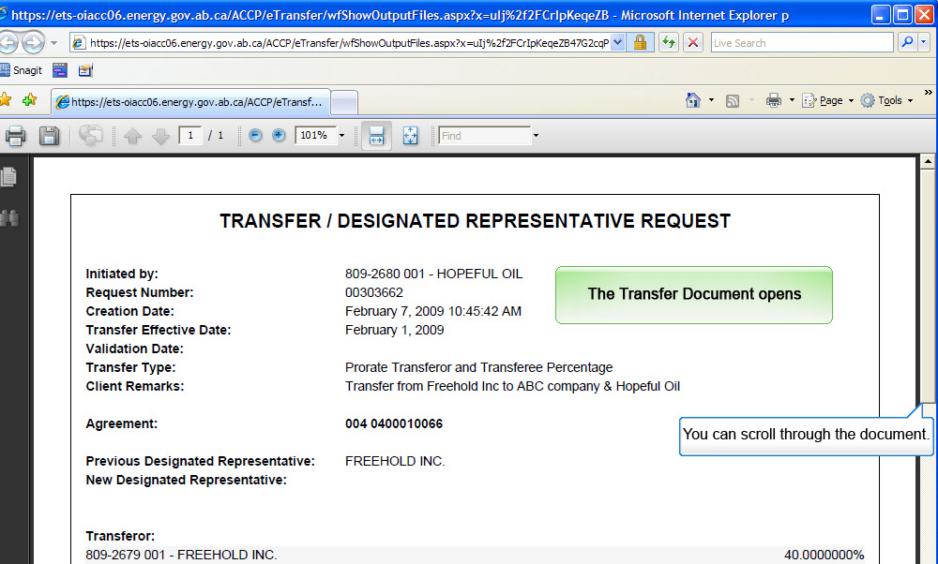
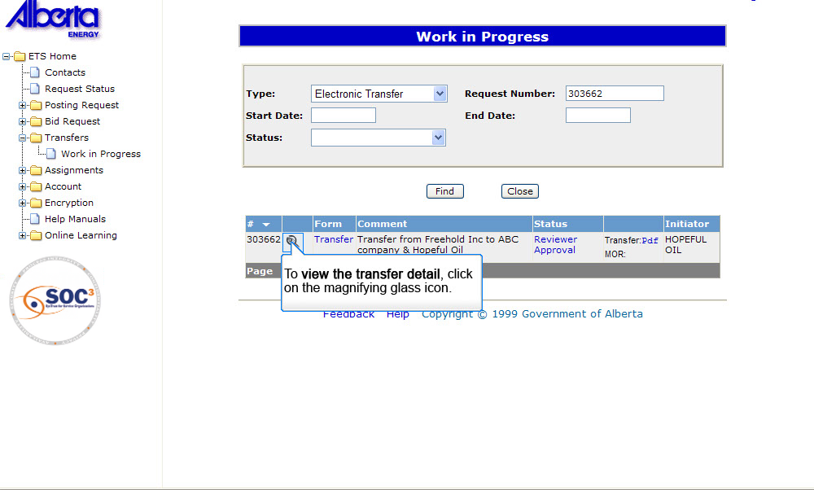
Back to Find Transfer Request

Slide 9
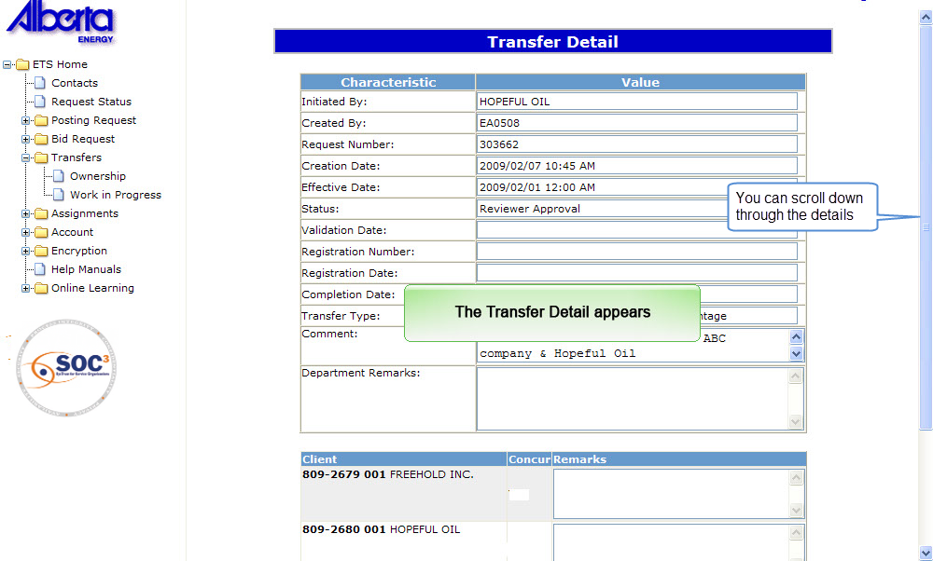
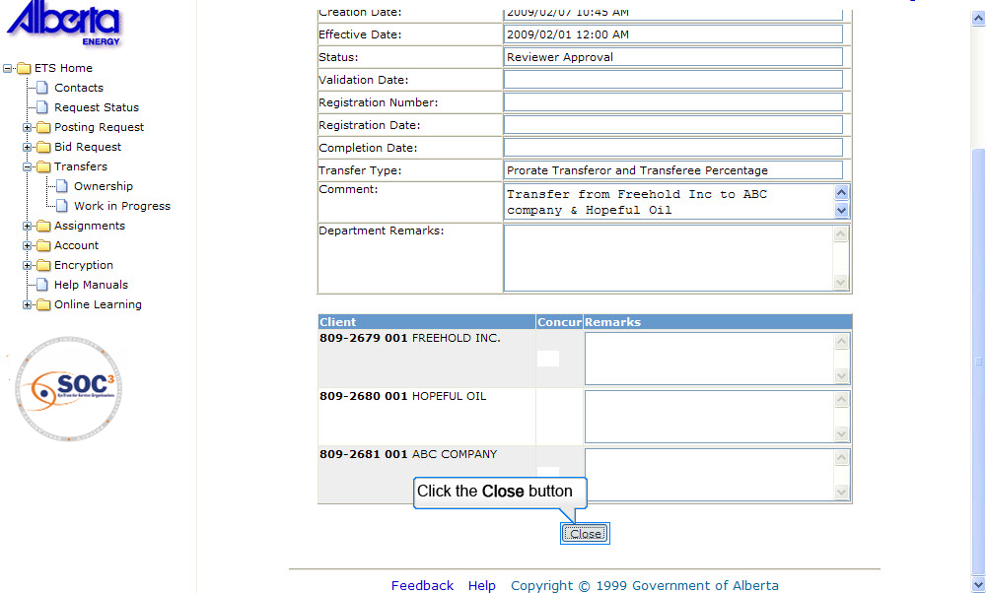
Back to Find Transfer Request

Slide 10
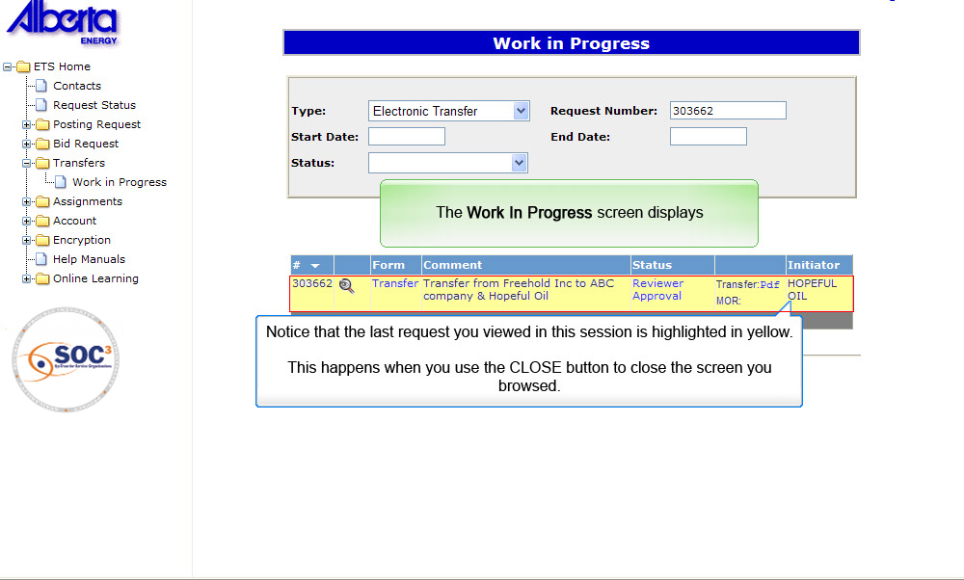
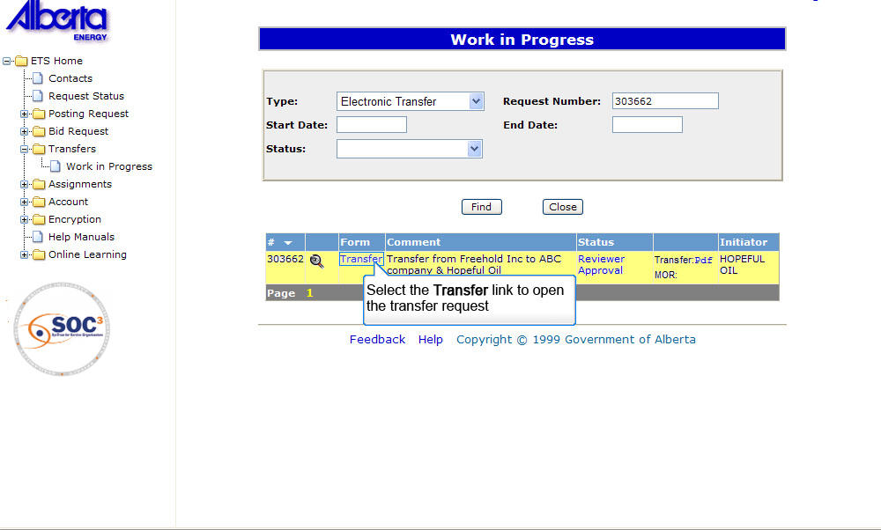
Back to Find Transfer Request

Slide 11
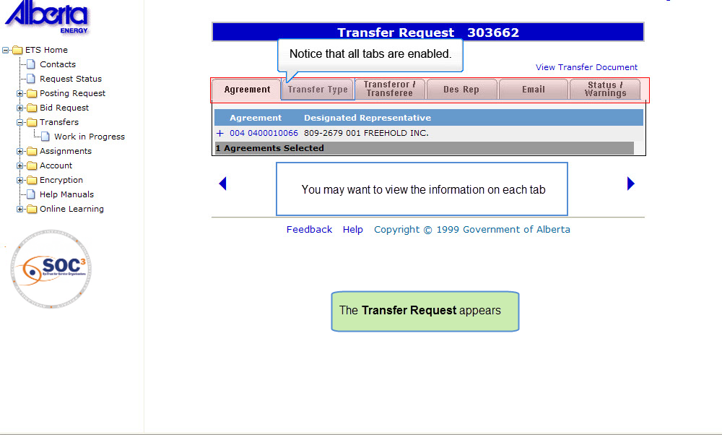
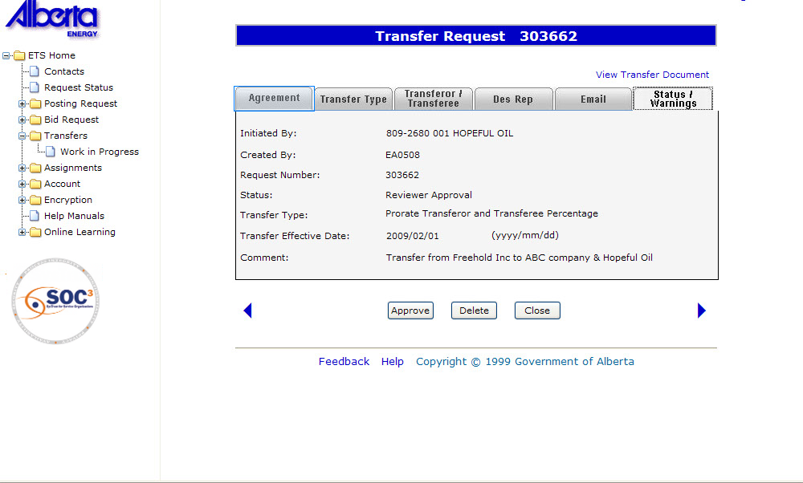
Back to Find Transfer Request

Slide 12
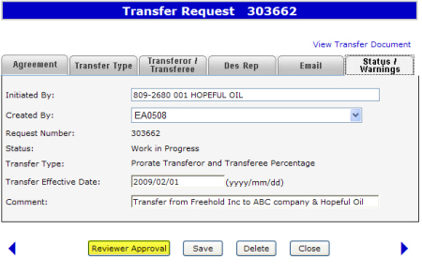
Reviewer Approval
More Information (Pages 13 to 20)
When a new transfer request is created and saved into the database, a request number will be generated and the status of the transfer will be set to Work in Progress. The transfer request is only visible to the Creator role. Once satisfied, the Creator can proceed to request for reviewer approval. The program validates the request and if there are no client errors, the status is changed to Reviewer Approval. The Reviewer can then access the transfer.
Click on More Information to view how to request for reviewer approval.

Slide 13
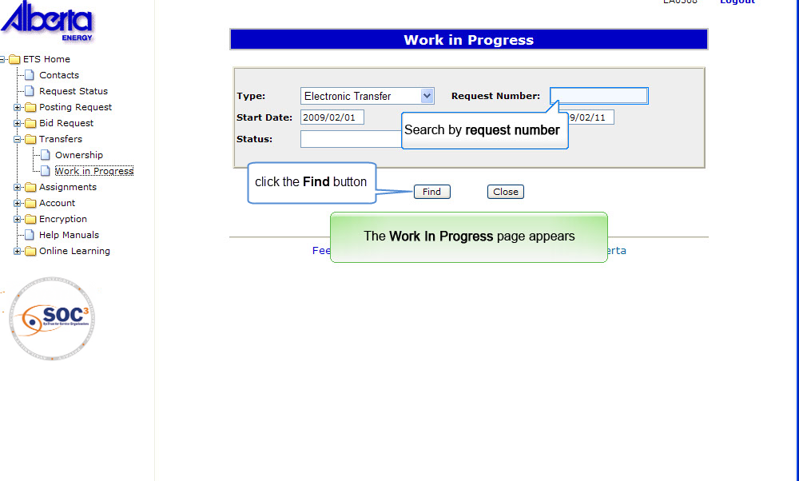
Back to Reviewer Approval

Slide 14
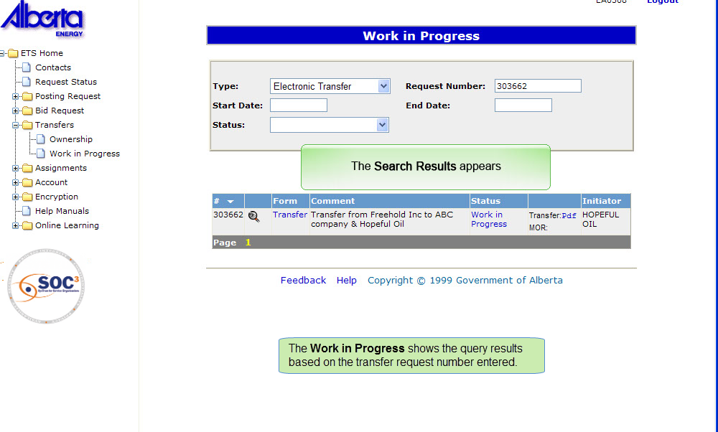
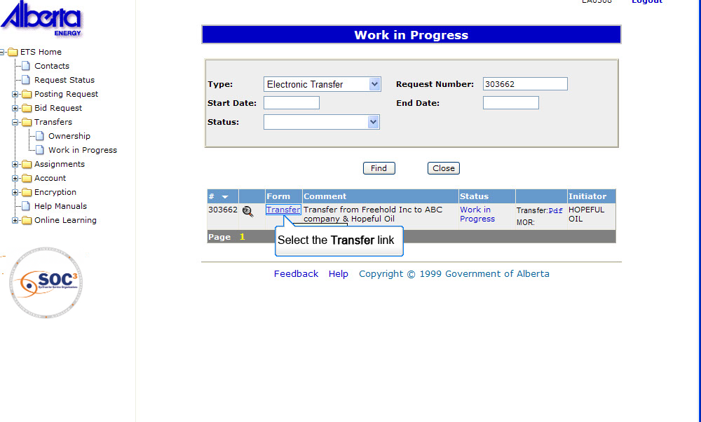
Back to Reviewer Approval

Slide 15
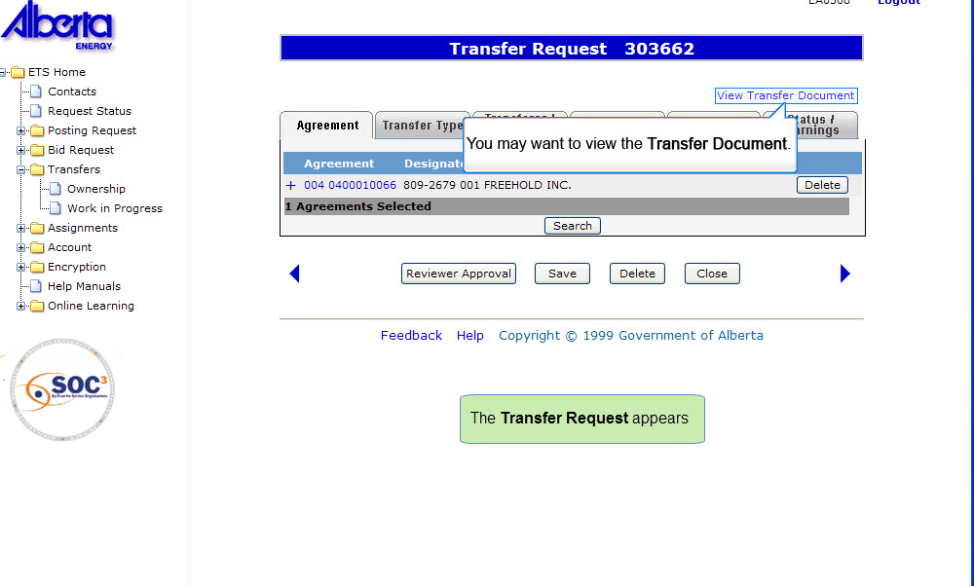
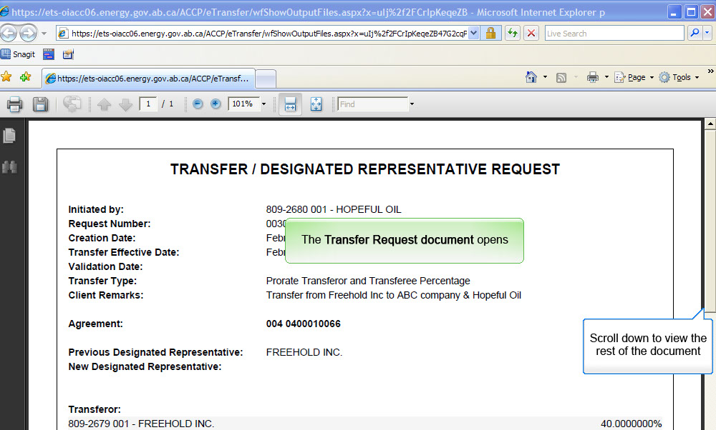
Back to Reviewer Approval

Slide 16
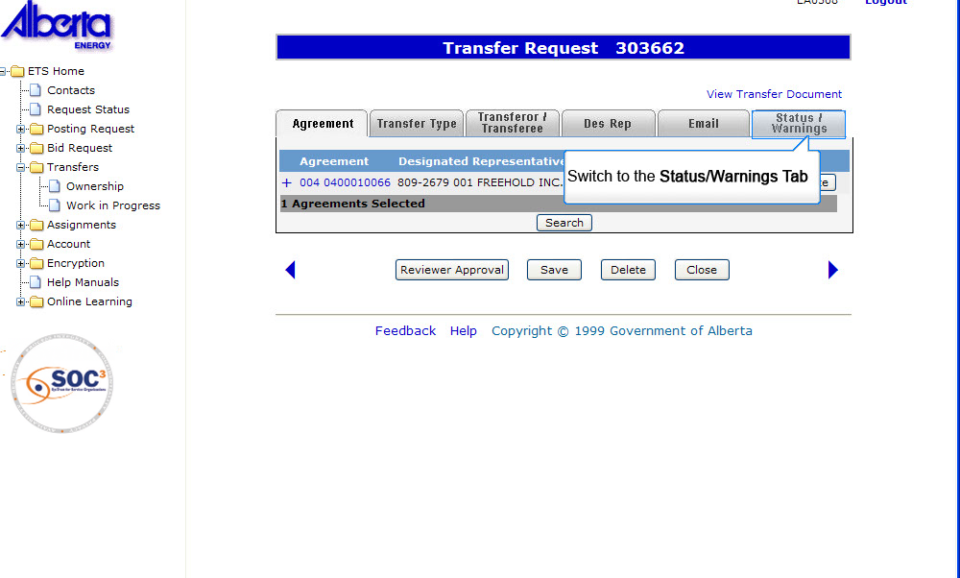
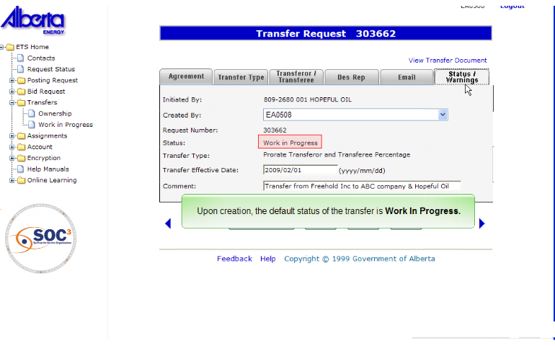
Back to Reviewer Approval

Slide 17
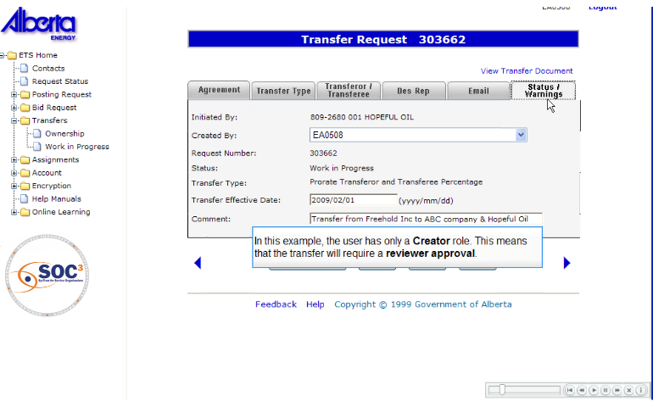
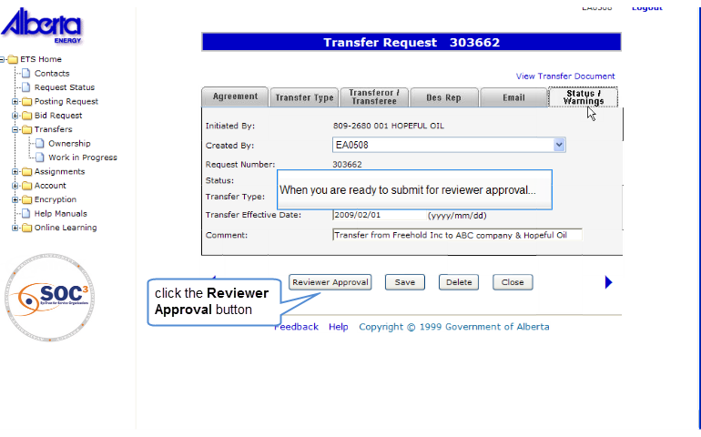
Back to Reviewer Approval

Slide 18
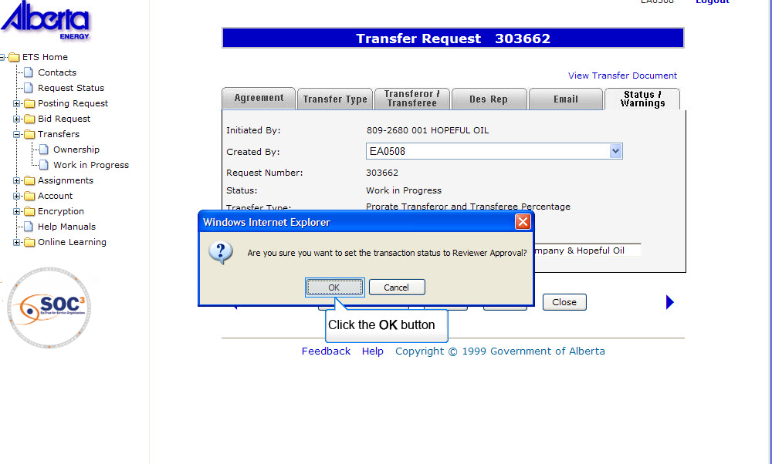
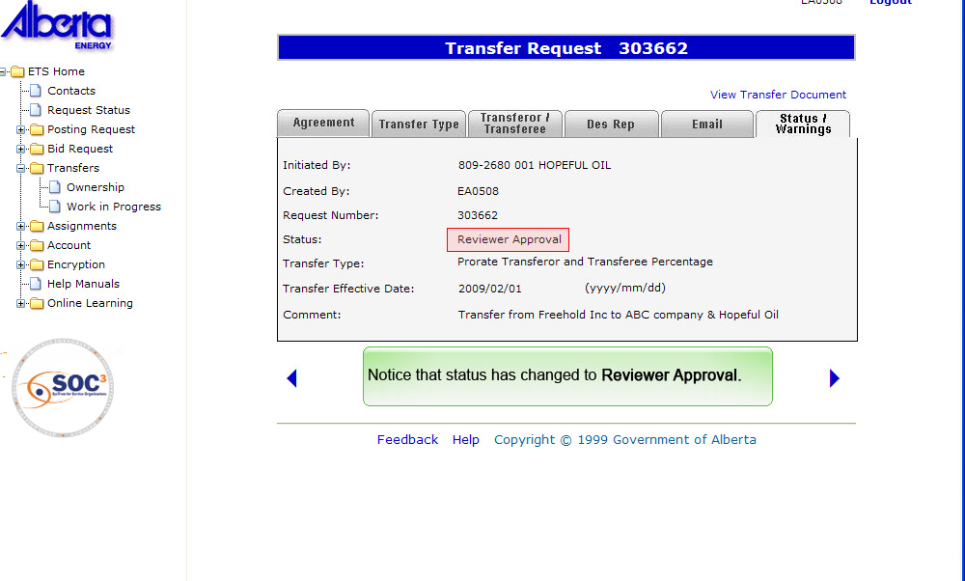
Back to Reviewer Approval

Slide 19
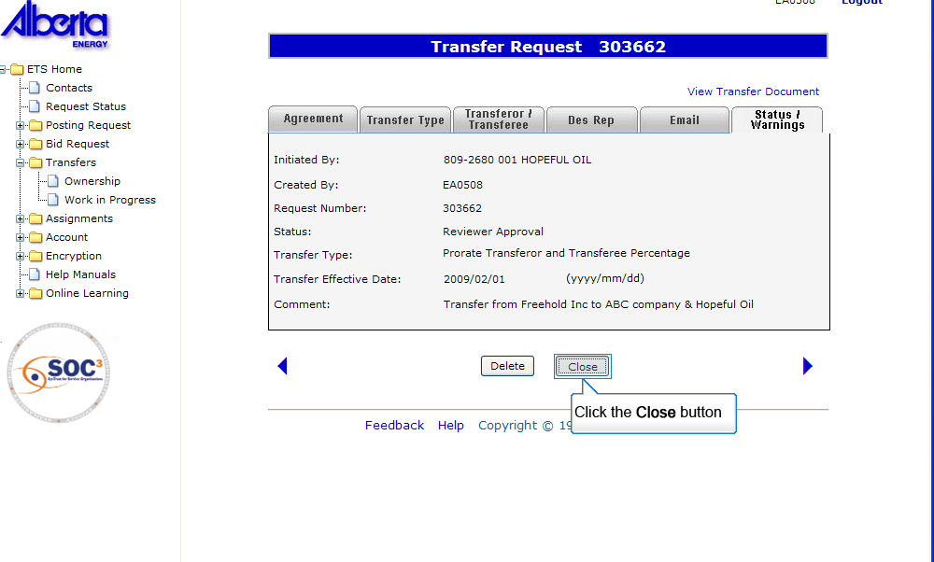
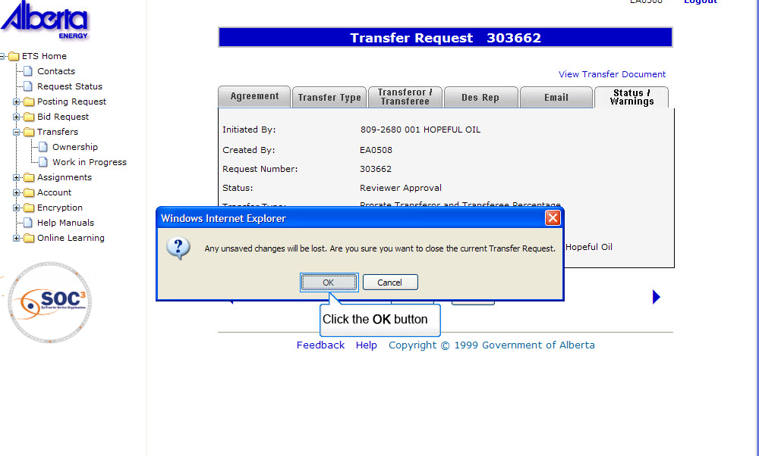
Back to Reviewer Approval

Slide 20
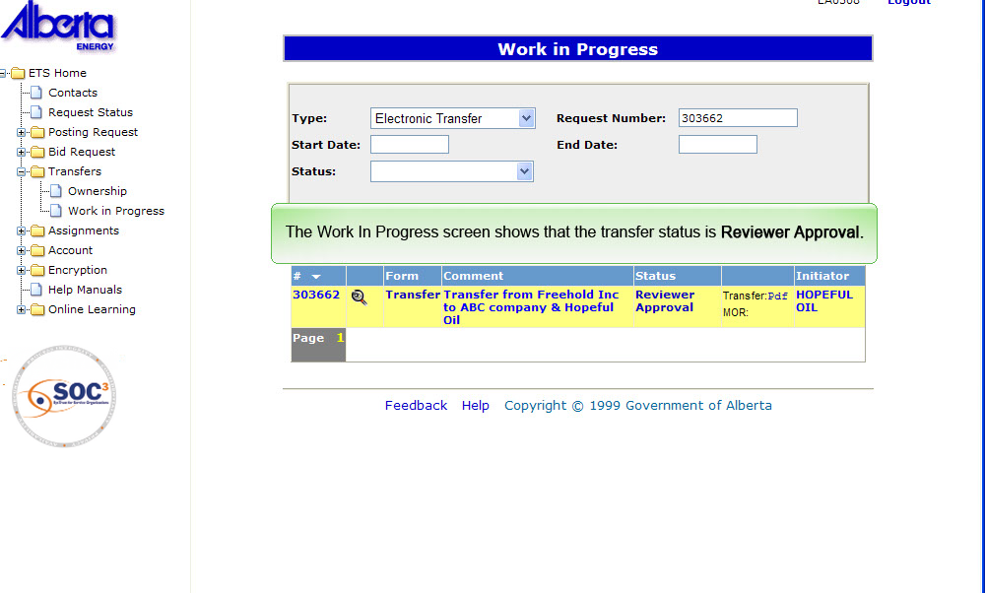
Back to Reviewer Approval

Slide 21
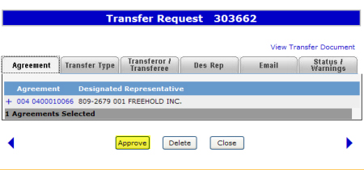
Ready for Concurrence
More Information (Pages 22 to 33)
When a transfer request requires a reviewer approval, the Reviewer will retrieve and approve the request. The program validates the request and if there are no client errors, the status is changed to Ready for Concurrence.
In some instances when a Reviewer is also a Concurrer, the status will change to Concurrence. When the status is changed to Concurrence; ETS will automatically send an e-mail to the external Concurrer (transferee) indicating the request number of the transfer and concurrence is required. Interest will be locked at this point.
Click on More Information to view how to approve request or set status to concurrence.
Note: When the status is changed to Concurrence, e-mails will not be generated to internal Concurrer(s).

Slide 22
To Approve Transfer Request (Note: User should have a reviewer role)
Back to Ready for Concurrence

Slide 23
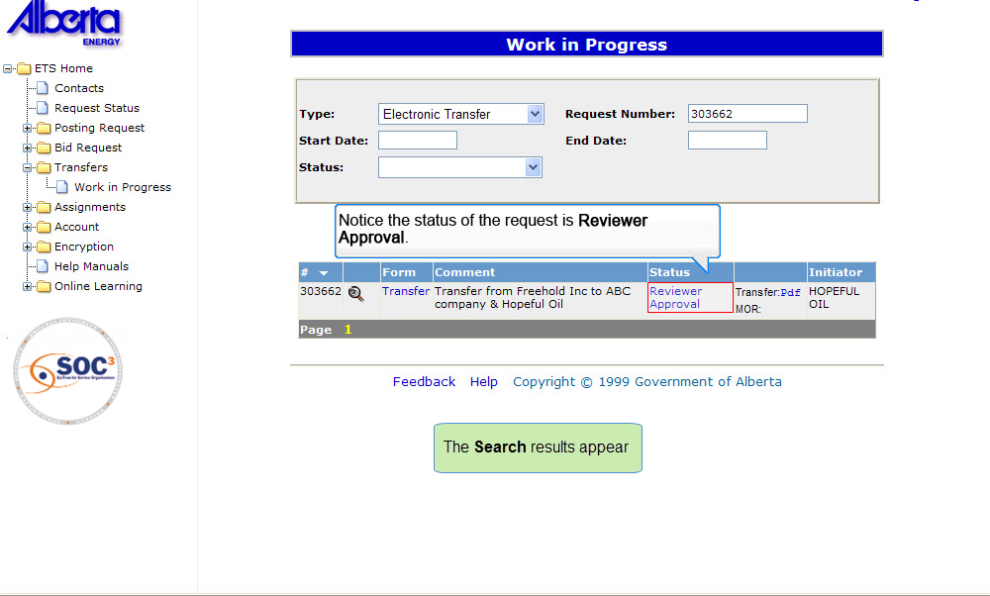
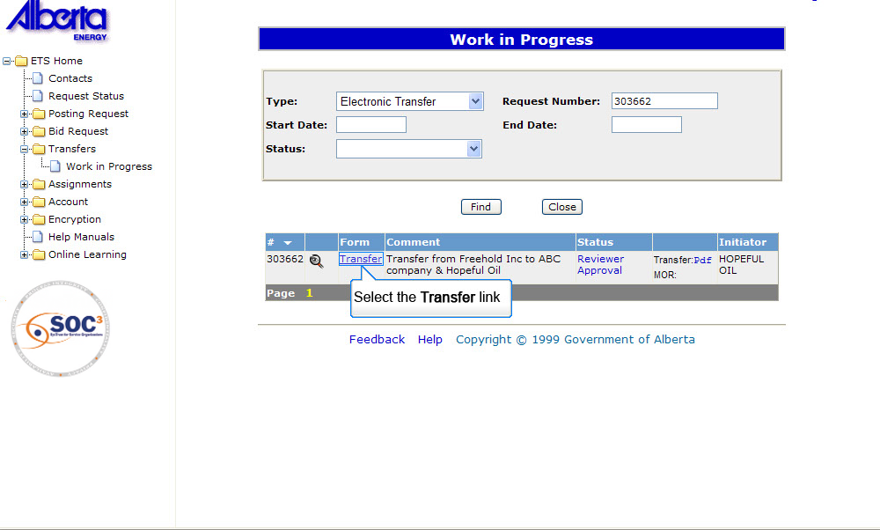
Back to Ready for Concurrence

Slide 24
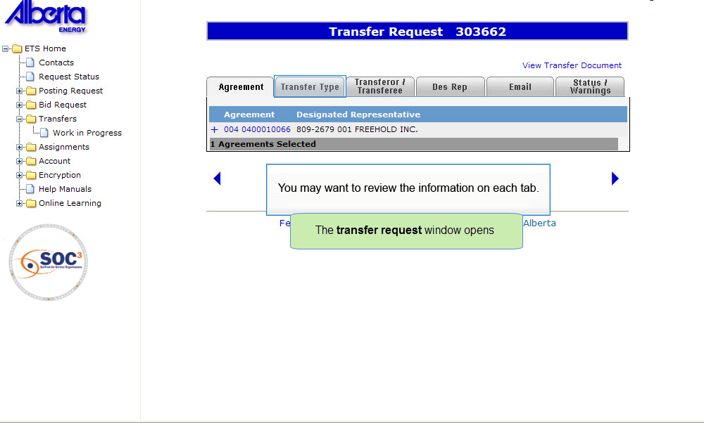
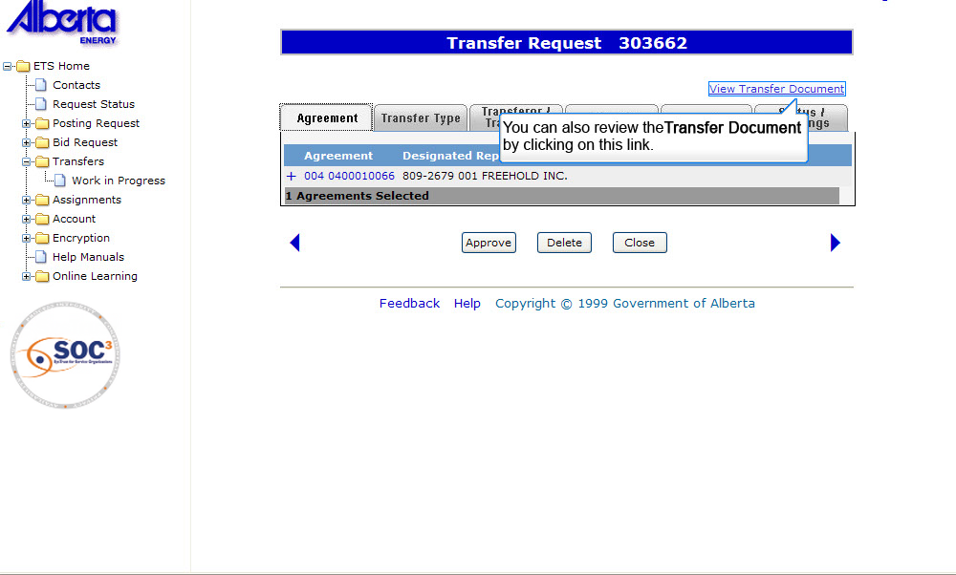
Back to Ready for Concurrence

Slide 25
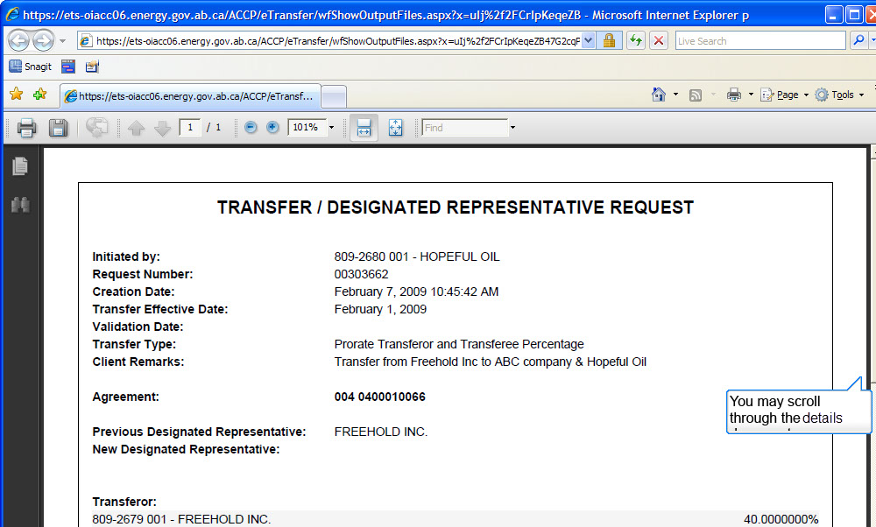
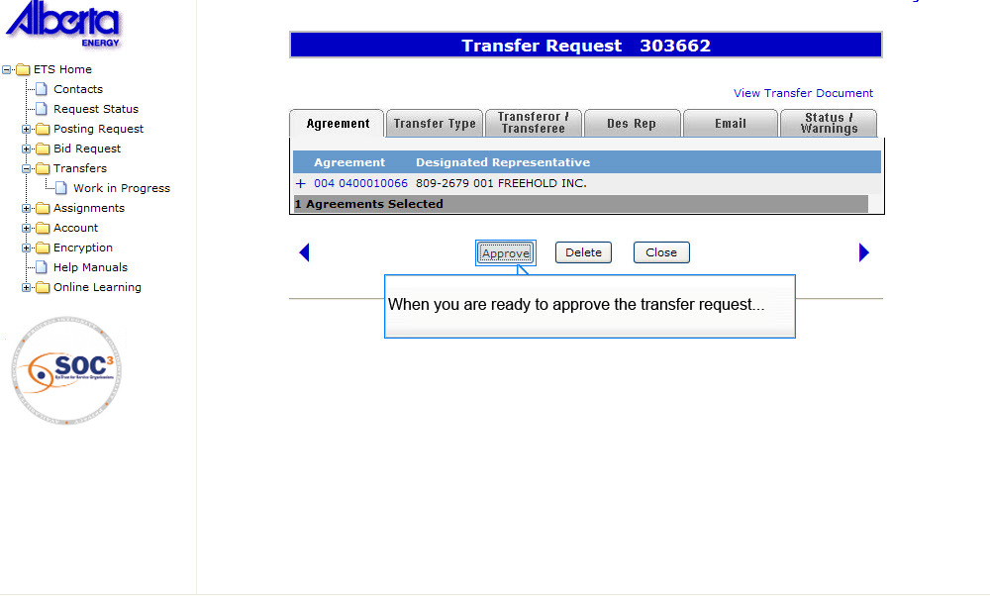
Back to Ready for Concurrence

Slide 26
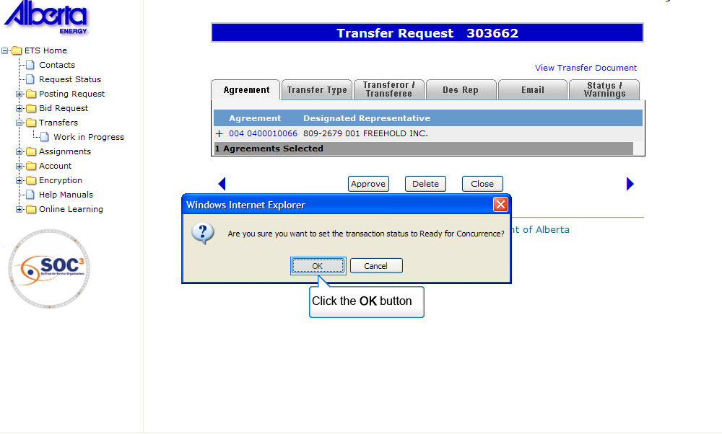
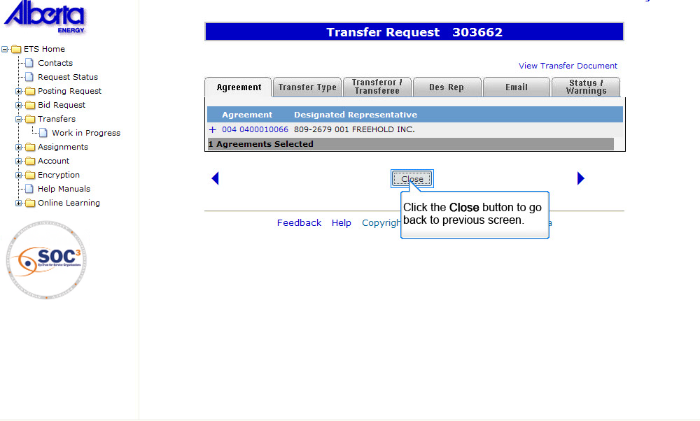
Back to Ready for Concurrence

Slide 27
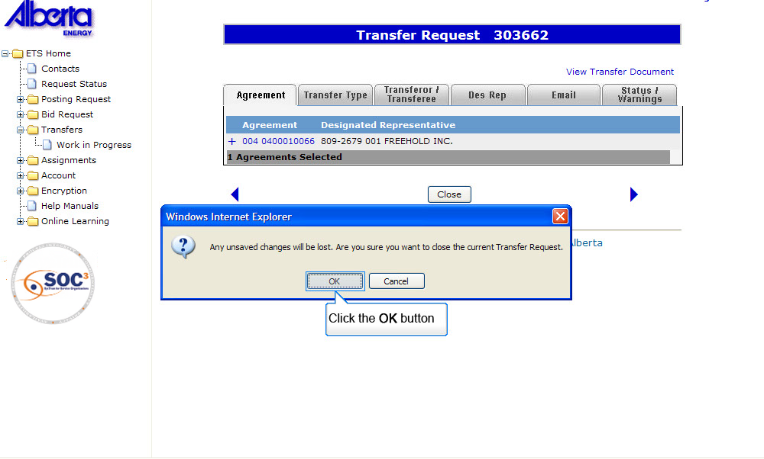
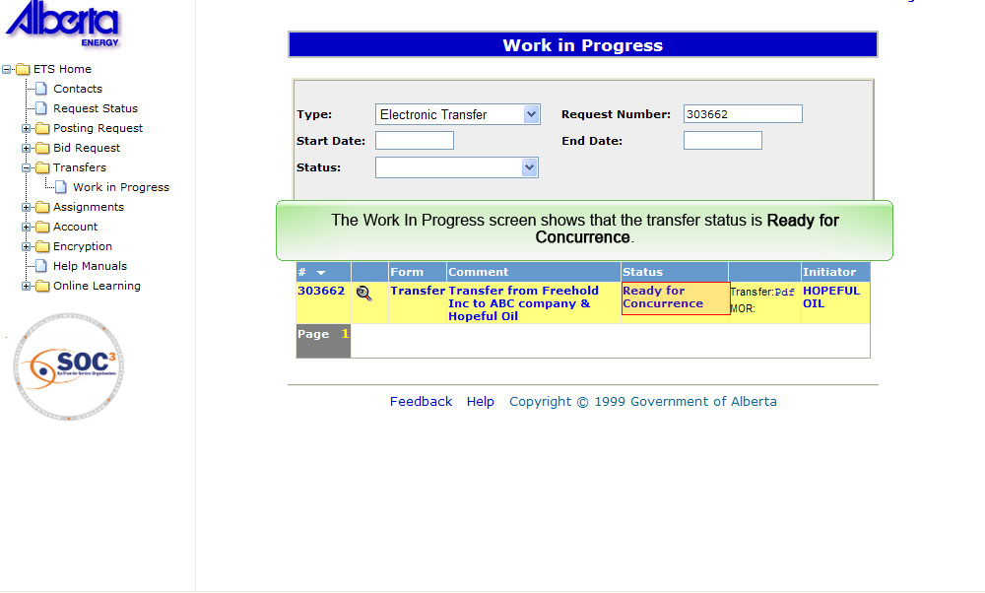
Back to Ready for Concurrence

Slide 28
To Submit Transfer for Concurrence (Note: User should have a Concurrer role)
Back to Ready for Concurrence

Slide 29
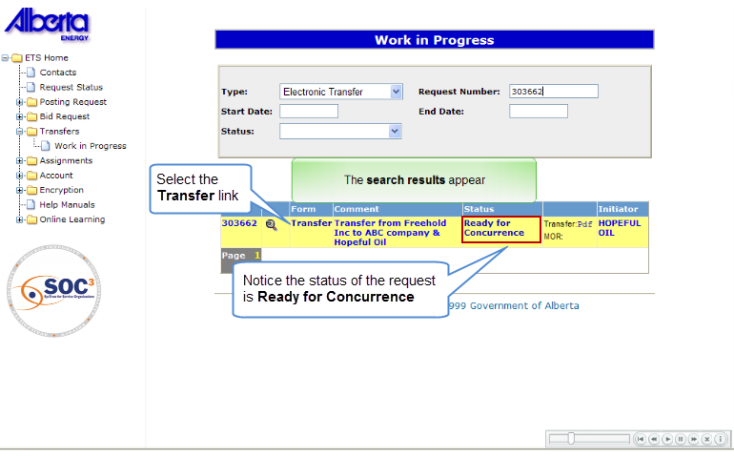
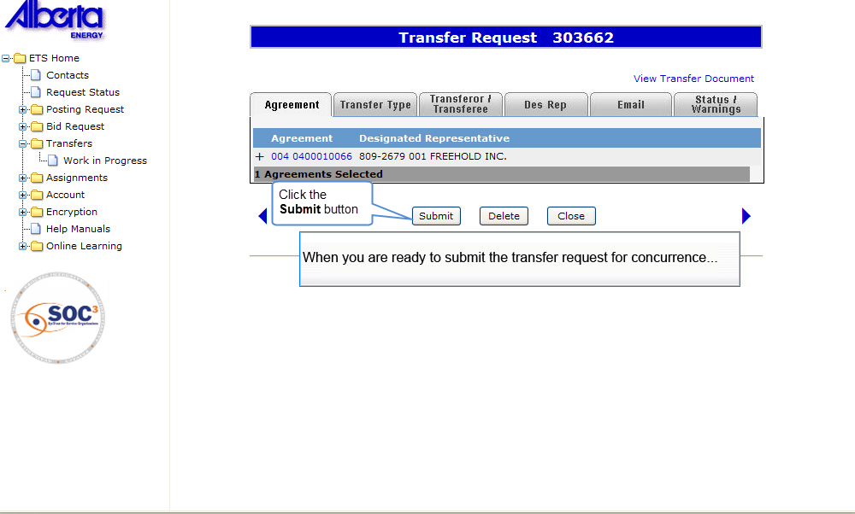
Back to Ready for Concurrence

Slide 30

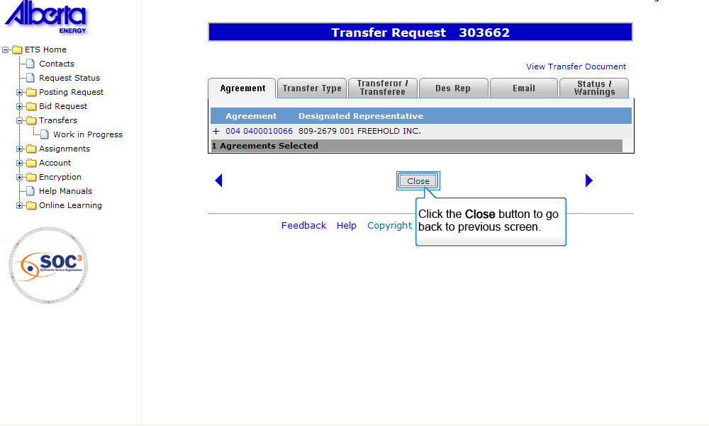
Back to Ready for Concurrence

Slide 31

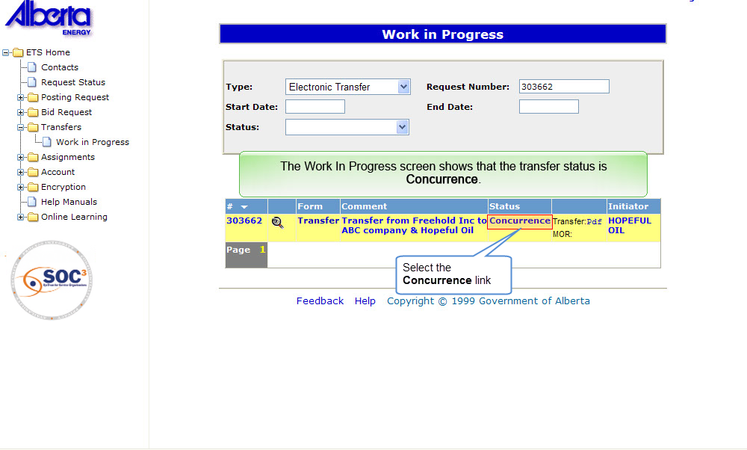
Back to Ready for Concurrence

Slide 32
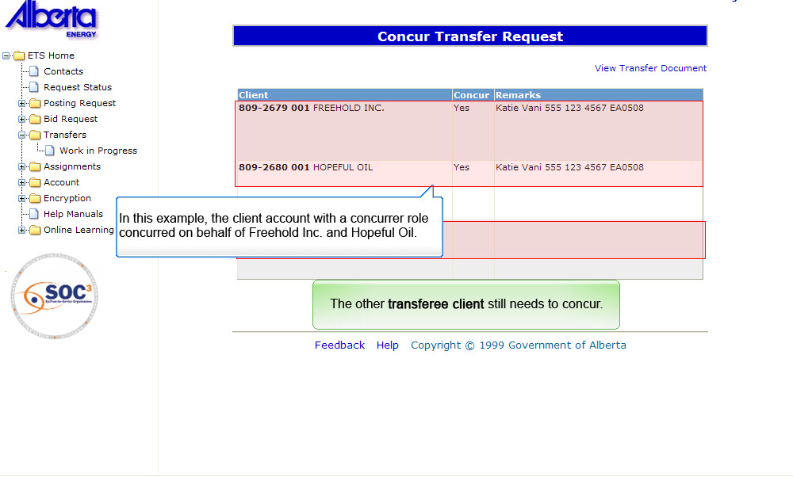
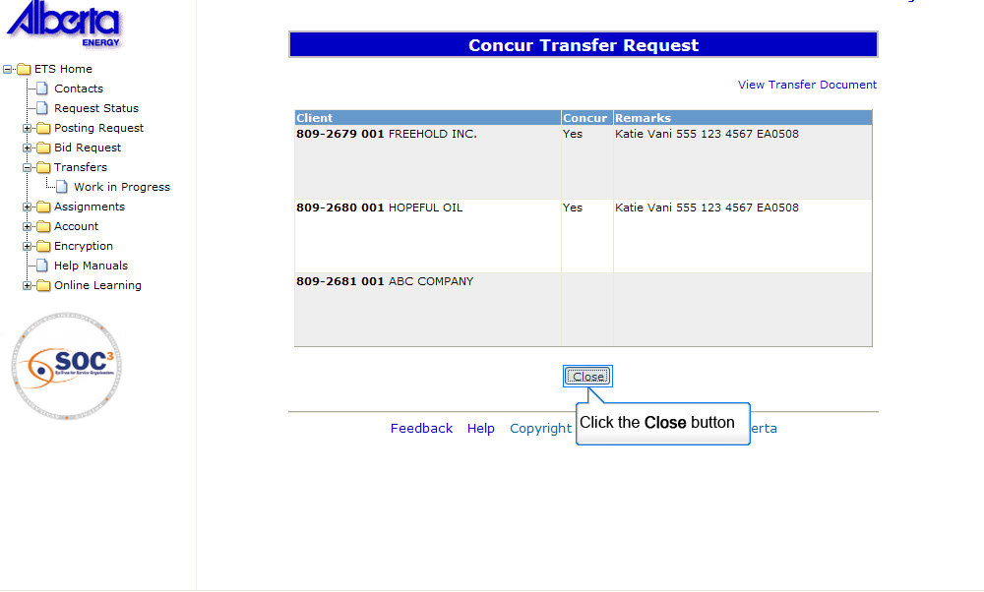
Back to Ready for Concurrence

Slide 33
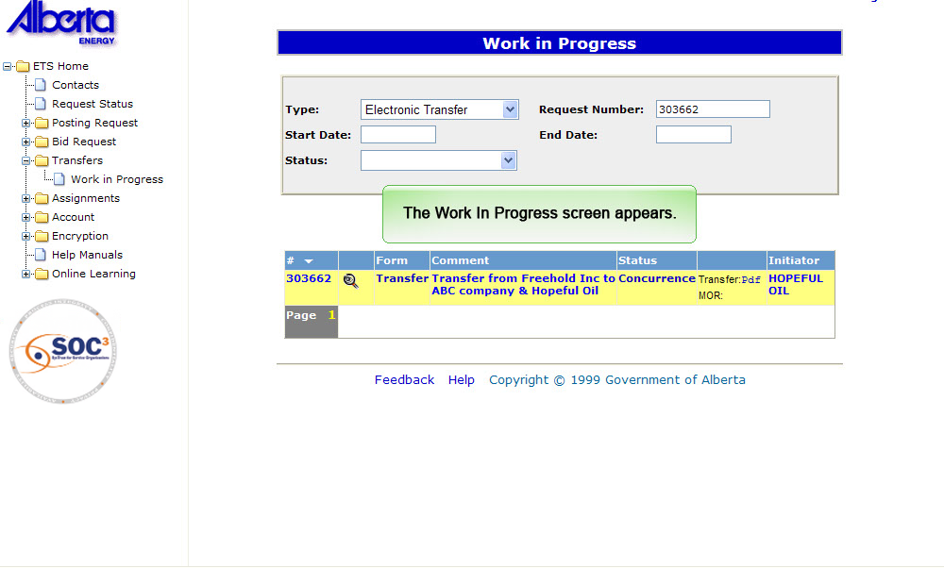
Back to Ready for Concurrence

Slide 34
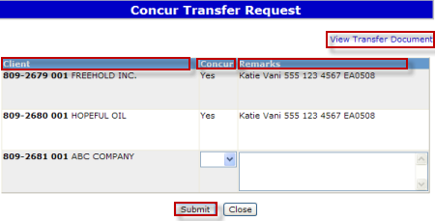
Concurrence
More Information (Pages 35 to 41)
When a transfer request requires concurrence, the individual with Concurrer role will be able to concur to the transfer request. The Concurrer has the option to select YES or NO.
If the transfer is set to NO at this point, the transfer status will automatically be set to Client Rejected and no further processing can be done on this transfer. The transfer request can be copied by the creator at this time.
If the transfer is set to YES by all parties involved in the transfer, the status will then change to Pending.
Click on More Information to view how to concur/ reject transfer request.
View Transfer Document - Link to the Original Transfer Document in PDF format. Allows the concurrer to review request before deciding to concur or not.
Clients - Lists all companies that are required to concur to the request to transfer ownership of registered interest. Displays the Client ID and Company Name.
Concur - Defaults to Blank. Client with the Concurrer role can choose YES or NO.
Remarks - is optional. Client may insert additional information in the remarks field.
Submit - Clicking on the Submit button will submit the client's response to request for concurrence. After the response is submitted, the client will be unable to change the response.

Slide 35
Transferee Client – To Concur/Reject Transfer (Note: User should have Concurrer role)
Back to Concurrence

Slide 36
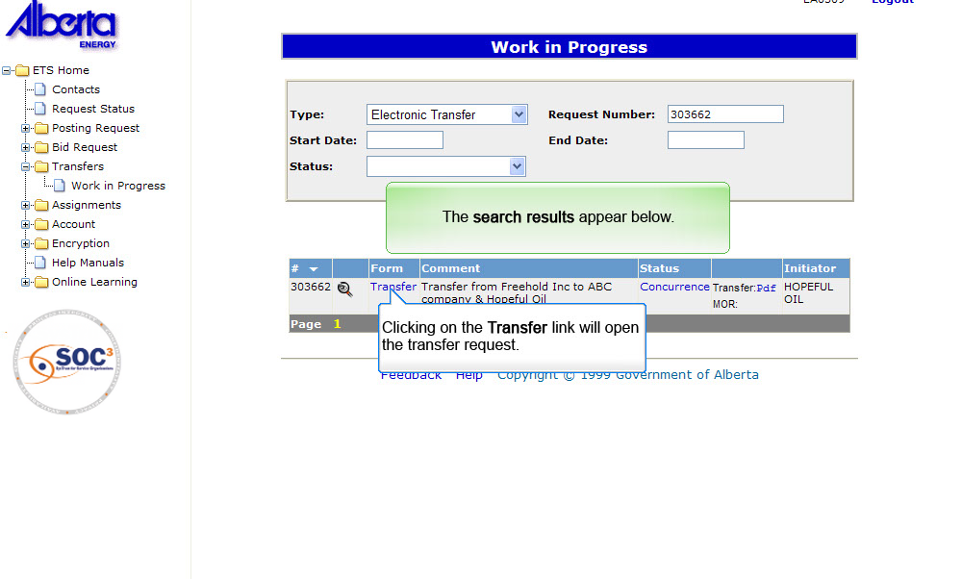
Back to Concurrence

Slide 37
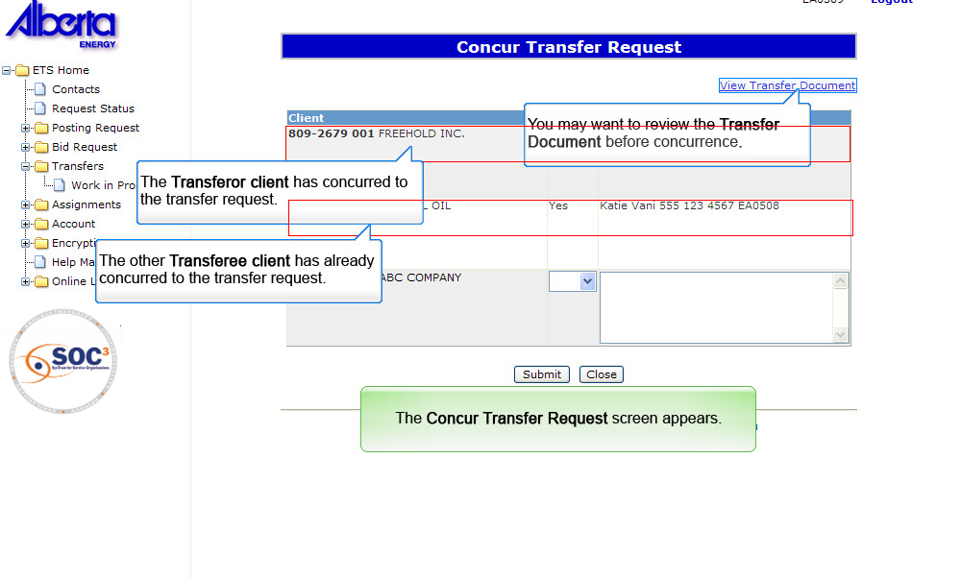

Back to Concurrence

Slide 38


Click the close button
Back to Concurrence

Slide 39


Back to Concurrence

Slide 40


Back to Concurrence

Slide 41

Back to Concurrence

Slide 42

Memorandum of Understanding
When a transfer request has been approved by Alberta Energy, a Memorandum of Registration (MOR) is created and is made available to the client(s) involved. The MOR document is generated in both PDF and XML formats. You may want to save a copy of the PDF or XML file to your local hard drive.
Once approved, the status of a transfer request will show Completed. Otherwise, the status will indicate that the request is Rejected.

Slide 43

Delete Transfer
More Information (Pages 44 to 47)
When a transfer request is deleted, the status is changed to Client Cancelled. Use the Copy Transfer option if you want to copy the information in the cancelled request to create a new transfer request.
Only a Creator can delete a transfer.
Click on More Information to view how to delete transfer request.

Slide 44

Back to Delete Transfer

Slide 45


Back to Delete Transfer

Slide 46


Back to Delete Transfer

Slide 47


Back to Delete Transfer

Slide 48

Copy Transfer
More Information (Pages 49 to 52)
When a transfer request is rejected by the transferee client or cancelled by the transferor client, the status of the request is Client Rejected or Client Cancelled, respectively. The rejected/cancelled request can be copied to create a new one. A new request number is assigned and the transfer status is set to Work In Progress.
Only a Creator role can copy a transfer.
Click on More Information to view how to copy transfer request.

Slide 49

Back to Copy Transfer

Slide 50


Back to Copy Transfer

Slide 51


Back to Copy Transfer

Slide 52


Back to Copy Transfer

Slide 53
Resources
ETS Support and Online Learning provides access to relevant guides, course and other information
If you have questions, please contact Transfers.Energy@gov.ab.ca or the Transfer Helpdesk at (780)644-2300

Slide 54

Conclusion
Congratulations!
You have completed the ETS – Work in Progress
Online Training Course
Please proceed to review other training modules detailing other functionality of Transfers.
If you have any comments or questions on this training module, please forward them to the following email address:
Transfers.Energy@gov.ab.ca

