Slide 1
Welcome
Welcome!
A transfer request is initiated by a transferor client. The types of transfer request include prorate transferor and transferee percentage, set transferor and transferee percentage, variable transferor and transferee percentage, or a request to change the designated representative only.
To begin the electronic transfer, a valid agreement is selected by the transferor. A transfer request should indicate the transferor/transferee, designated representative and email address (if other than the default).
The request may or may not require reviewer approval within the company depending on the role(s) assigned to the individual creating the request. This means that the individual may be assigned multiple roles: Creator, Reviewer and Concurrer at the same time.
To the ETS – Initiate a Transfer
Online Training Course

Slide 2
Revisions
Date | Revisions Type | Page Number
August 31, 2012 | Conversion | All
April 2020 | Cosmetic Updates | All
November 2022 | Updated | Including Geothermal Agreements

Slide 3

Introduction
In this module, you will learn about the:
Six logical tabs that comprise a Transfer Request:
  Agreement
  Transfer Type
  Transferor/Transferee
  Designated Representative
  Email
  Status/Warnings
Transfer Type: Prorate Transferor Transferee Percentage
Transfer Type: Set Transferor and Transferee Percentage
Transfer Type: Variable Transferor and Transferee Percentage

Slide 4
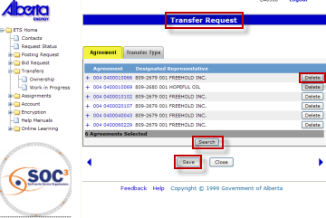

Agreement Tab
The Agreement tab displays the agreements that are being transferred. The agreements shown are the ones selected from the Agreements Found screen. You can delete or add new agreement(s) to include in this transfer request. Agreements include PNG, Oil Sands, Coal and Mineral Development as well as Geothermal Agreements.
A Transfer Request Number will be assigned by ETS when a transfer is saved. Make sure you note this number, as you will need it to access the transfer request through the Work In Progress (WIP) screen.
Transfer Request Number - The Transfer Request Number will show on the header if the request is successfully saved.
Delete - Clicking on the Delete button will delete the agreement displayed on that line.
Search - Clicking on the Search button will open the Search Agreements screen, to add another agreement to the Transfer screen.
Save - Save the transfer request. A Transfer Type MUST be specified before saving.

Slide 5
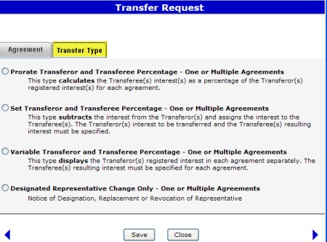
Transfer Type Tab
Once you have selected the agreements to be transferred, you must identify the type of transfer you are preparing. There are four(4) types of request to select from as indicated on the image on the left.
You cannot change a transfer type once it is selected and saved. If the incorrect type is chosen, you will need to delete the transfer in order to change the request status to “Client Cancelled” and start a new transfer.

Slide 6
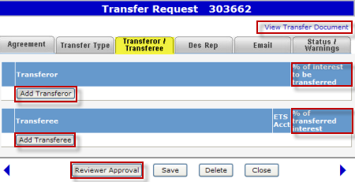
Transferor/Transferee Tab
The Transferor/Transferee tab allows you to add the transferor(s), transferee(s) and their interest in the agreement depending upon the selected type of transfer. A change in designated representative type of transfer will not require any information on this tab.
The Add Transferor button opens the Select Transferor screen. The Select Transferor screen will display a list of common Transferor(s) for the selected Agreement(s). You may select a single or multiple client(s) as transferor(s).
The Add Transferee button will open the Find Client screen, which enables you to select the Transferee(s). For more details about the Find Client Screen, refer to Search Agreements training module.
View Transfer Document - The Transfer Document hyperlink opens the Original Transfer Document (PDF). It is available on all tabs.
Add Transferor - The Add Transferor button opens the Select Transferor screen. This screen will display a list of possible Transferor(s) for the selected agreement(s).
% - Depending on the type of transfer, this could be the Percentage of Interest to be transferred, Undivided Interest or the Current Registered Interest.
Add Transferee - The Add Transferee button will open the Find Client screen, which enables you to select the Transferee(s).
% - Depending on the type of transfer, this could be the Percentage of Transferred Interest, Undivided Interest or the Resulting Registered Percent.
Reviewer Approval - Depending on your role(s), the action button could change to Reviewer, Approve or Submit. This button is available on all tabs.

Slide 7
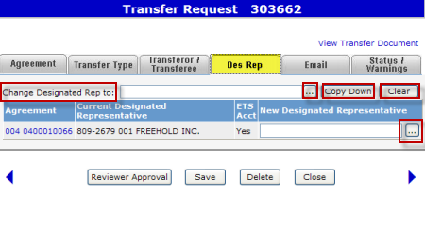
Designated Representative Tab
More Information (Pages 8 to 19)
A Designated Representative change may be submitted for an agreement, without a transfer. Follow the same process as any of the transfer types, except select the Designated Representative change only option from the list of Transfer Types.
The current Designated Representative for each Agreement will be displayed under the Designated Representative column.
You may change the designated representative for a specific agreement or you may also complete a global replacement if ALL Designated Representatives are the same for ALL the agreements being transferred.
Click on More Information to view how to change designated representative(s).
Change Des Rep - Global Change - You can replace ALL designated representatives with the same new name. The new designated representative is populated with the name that you select from the Find Client screen.
Find (….)- Click on the Find Client button to select and populate a new Designated Representative.
Copy Down - Use the Copy Down button to copy the new Designated Representative for ALL agreements.
Clear - Use the Clear button to clear the Designated Representative fields to “blank”. To remove the New Designated Representative name, go to Find Client screen and select the Blank Field.
Individual Change - Click on the Find (….) Client button to select and populate a new Designated Representative for a specific agreement.

Slide 8
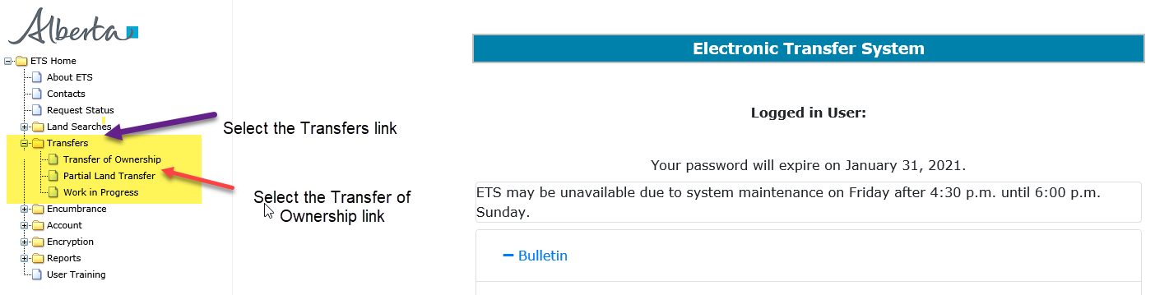
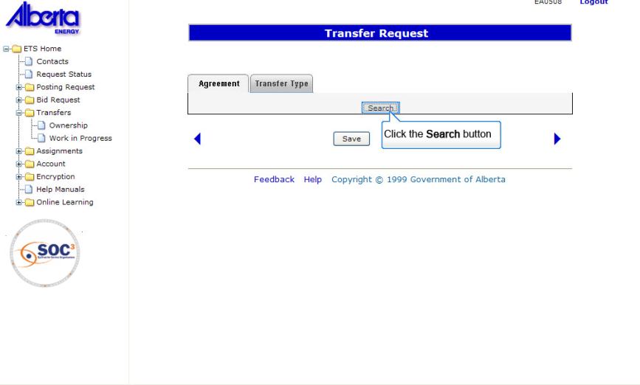
Back to Designated Representative Tab

Slide 9
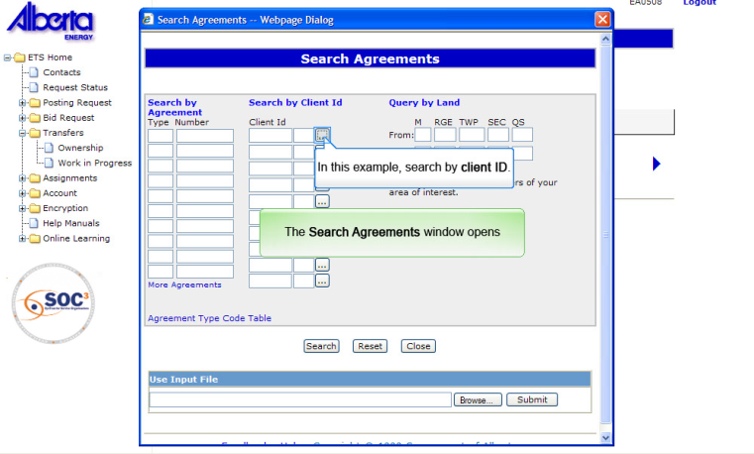
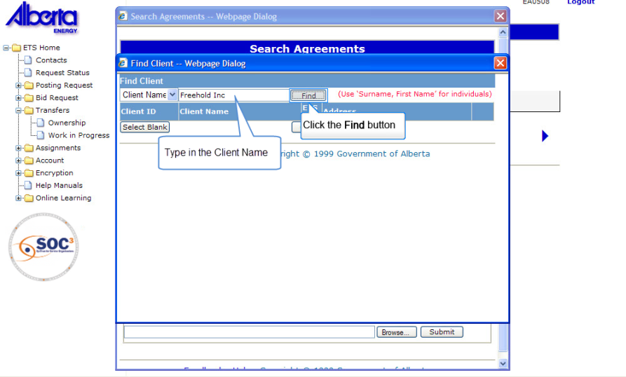
The Find Client Window Opens up
Back to Designated Representative Tab

Slide 10
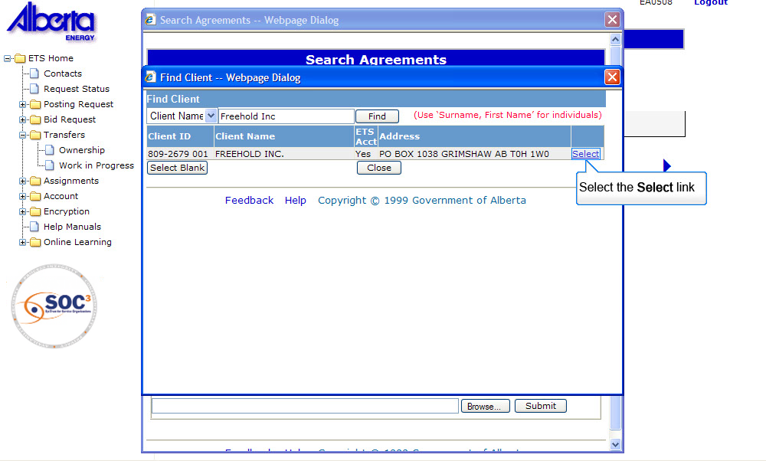
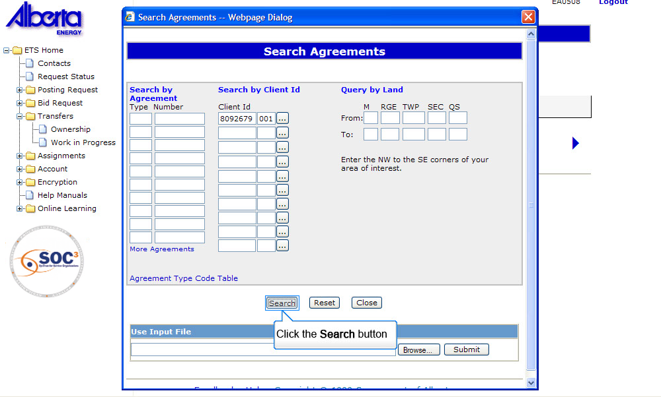
Back to Designated Representative Tab

Slide 11
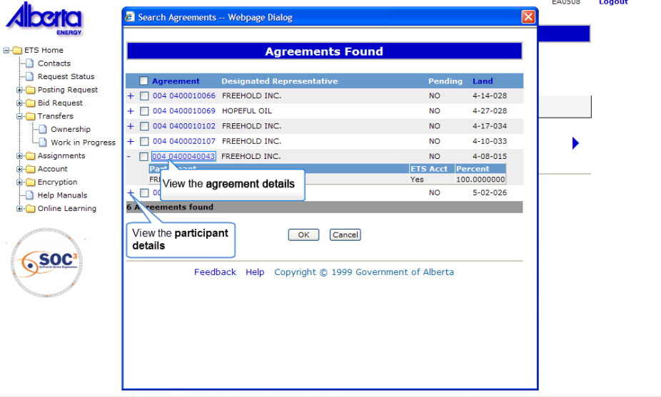
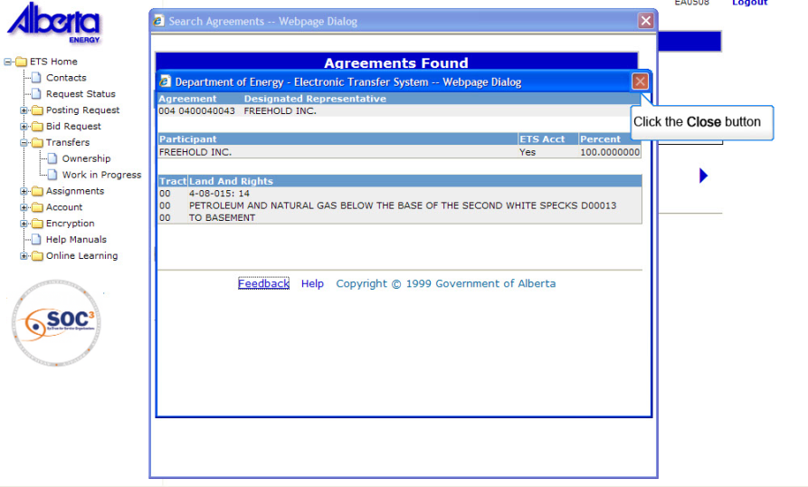
Back to Designated Representative Tab

Slide 12
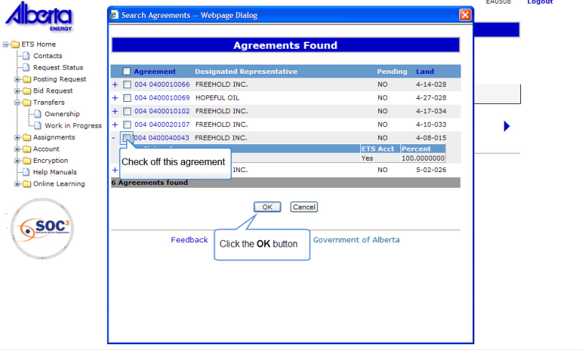
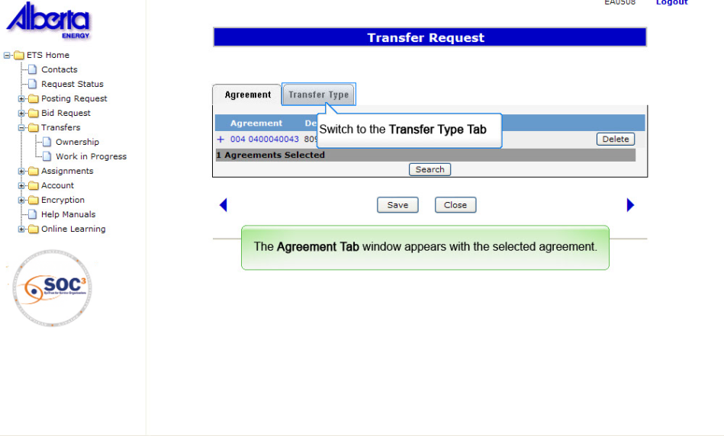
Back to Designated Representative Tab

Slide 13
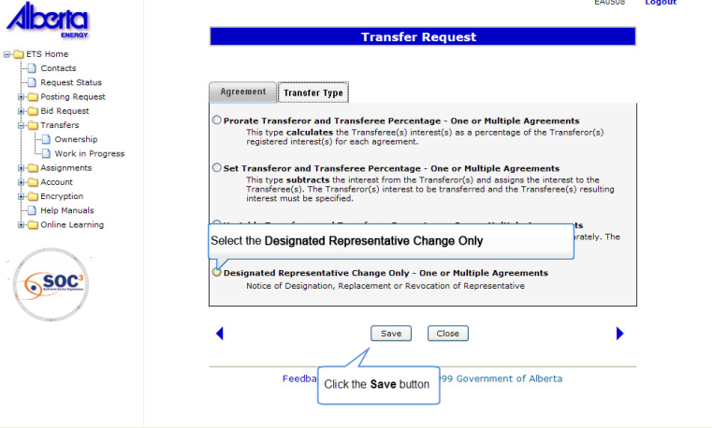
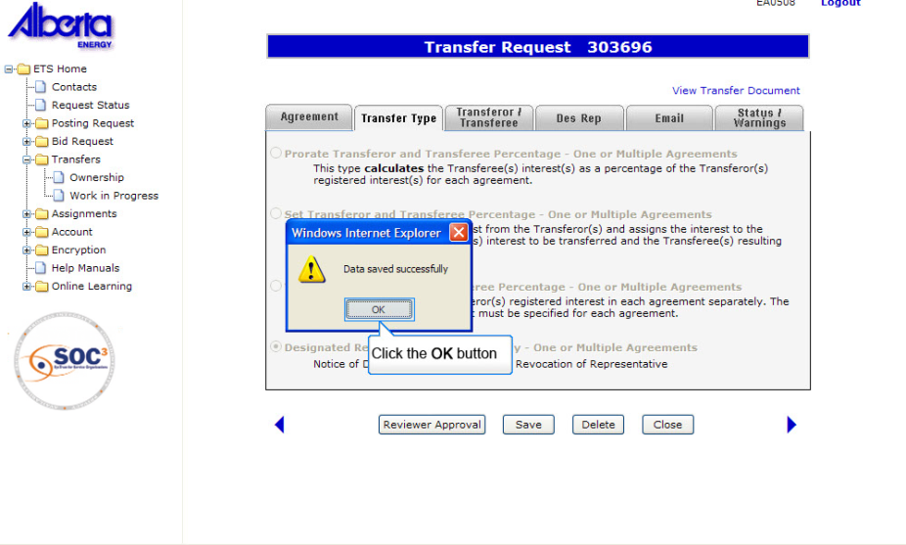
Back to Designated Representative Tab

Slide 14
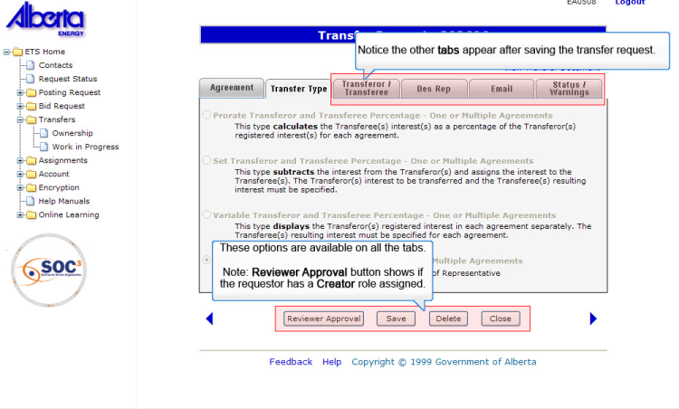
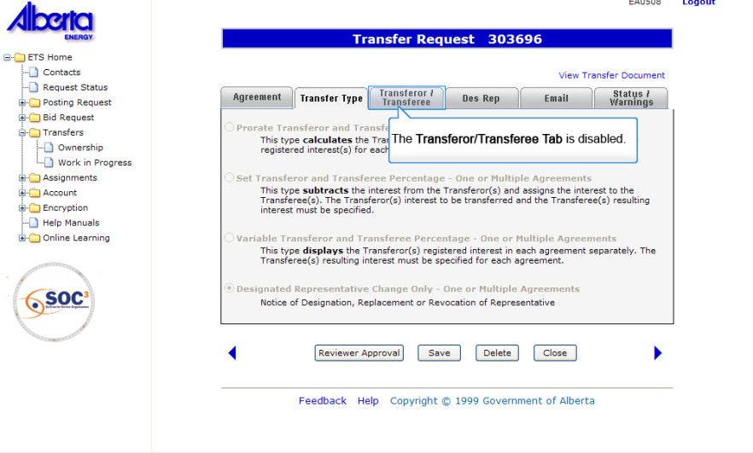
Back to Designated Representative Tab

Slide 15
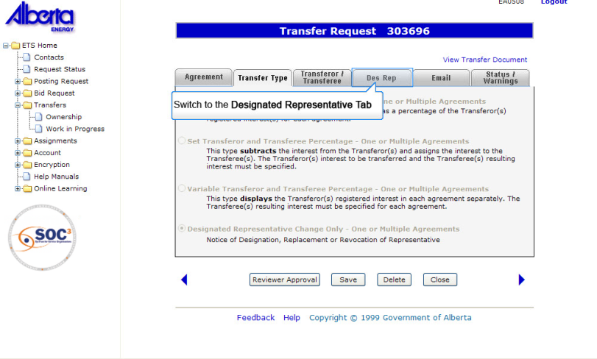
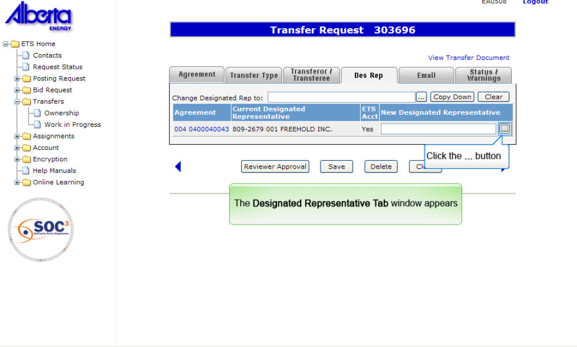
Back to Designated Representative Tab

Slide 16
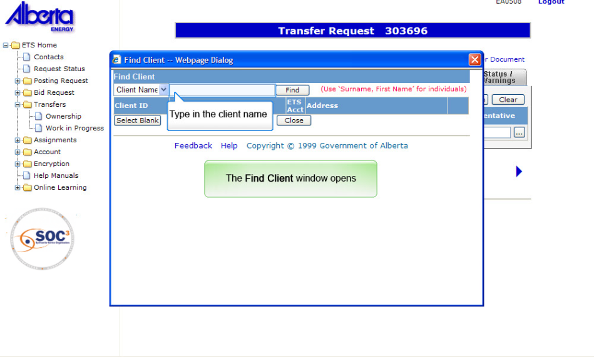
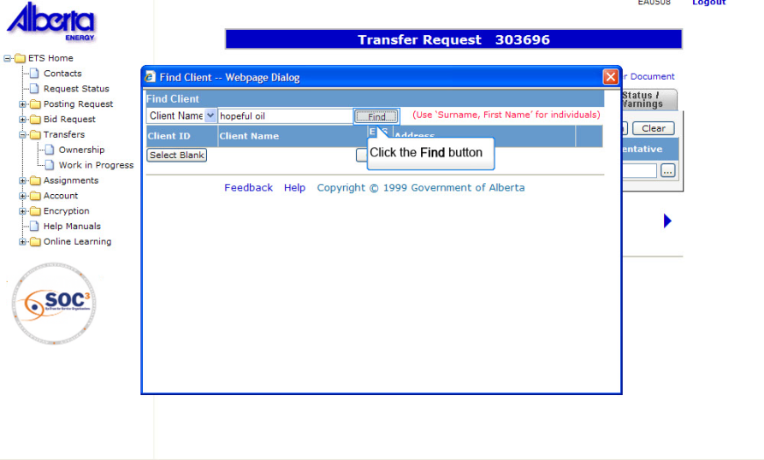
Back to Designated Representative Tab

Slide 17
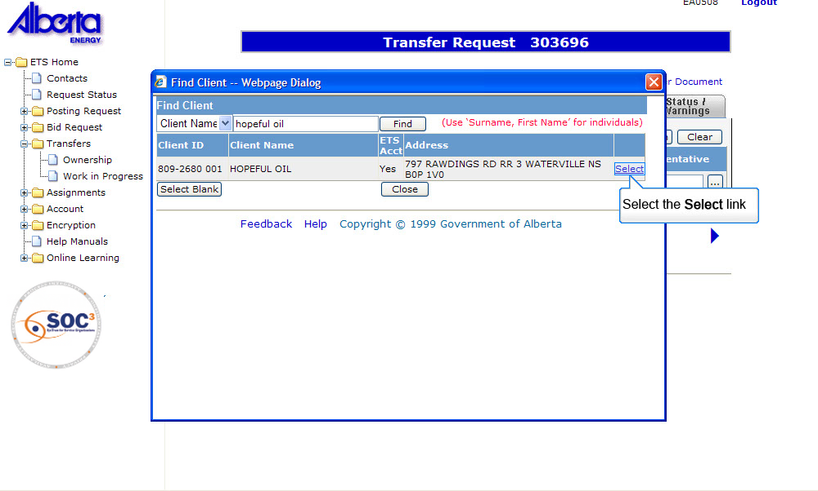
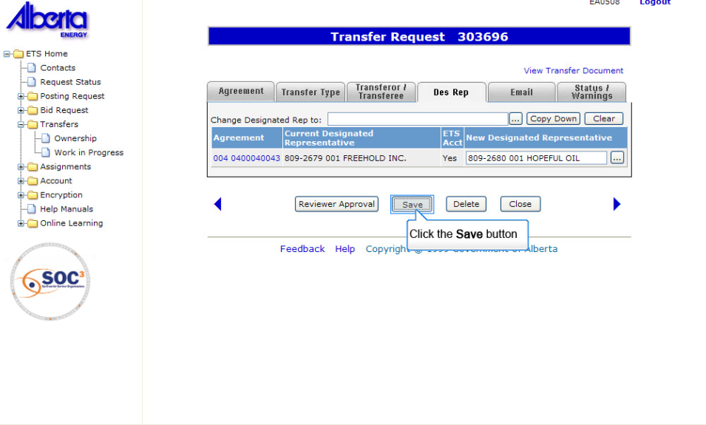
Back to Designated Representative Tab

Slide 18
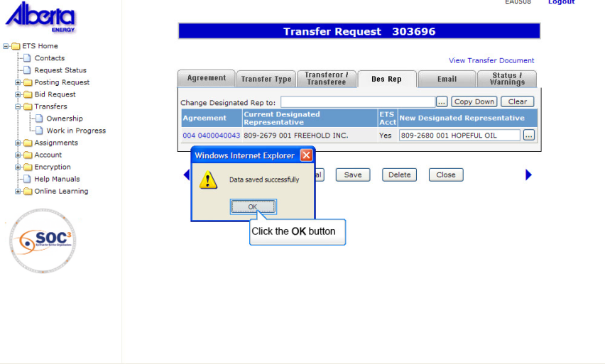
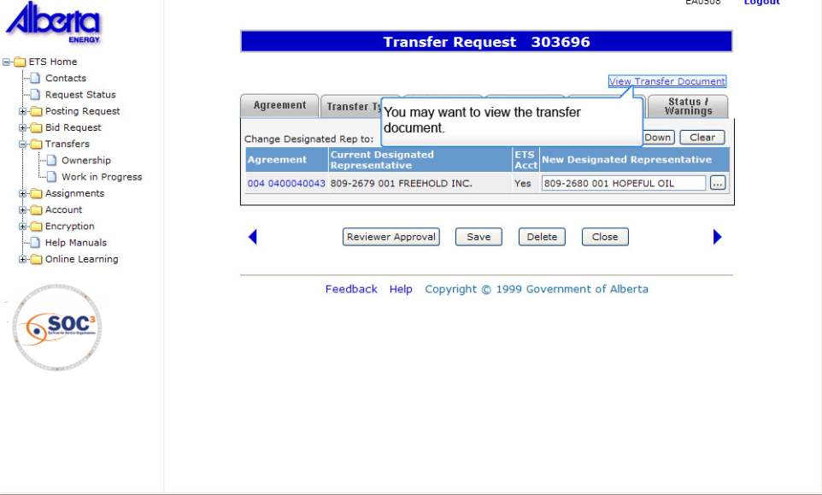
Back to Designated Representative Tab

Slide 19
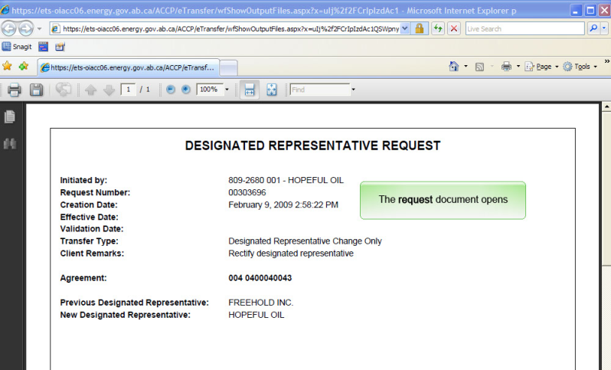
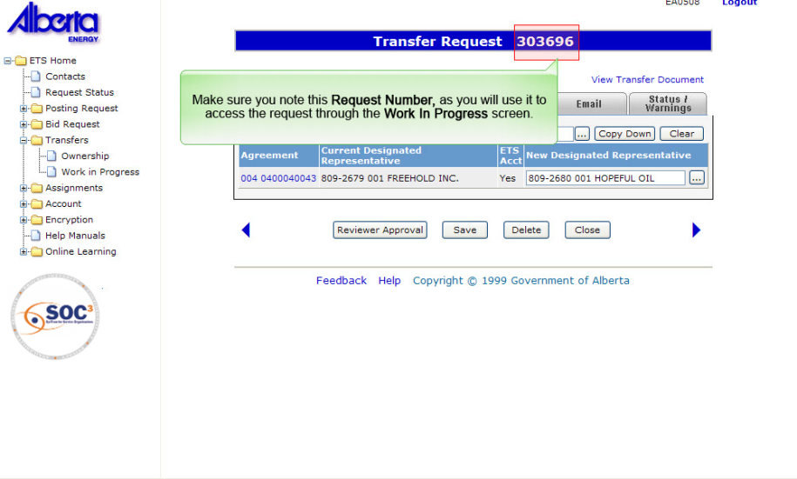
Back to Designated Representative Tab

Slide 20
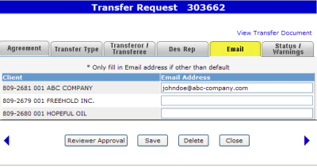
Email Tab
The Email tab allows you to insert a specific email address that should receive the email requesting concurrence to a transfer request. If an email address is not specified then an email message will be sent to clients with the concurrence role who are part of this transfer. The default email address is associated with the individual/client account that the Site Administrator had set up.
The email recipients can then access the transfer request using the Work In Progress (WIP) screen.
Tip: The email address should be left blank if the Concurrer’s default email address is in effect.
Click here for more details about Email Notification

Slide 21
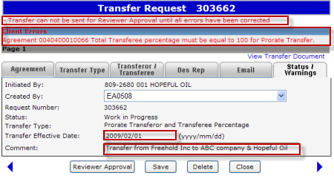
Status/Warnings Tab
The Status/Warnings Tab displays the status information and allows you to enter comments about the transfer request. Any applicable Client Errors/Warnings will also be displayed on this tab as well as on the other tabs.
Client Errors will be displayed when a status change (e.g. Reviewer Approval, Ready for Concurrence, Concurrence) is applied to the transfer request and is not valid. Errors will stop you from proceeding further until all errors are corrected.
Client Warnings will also be displayed when a status change is not valid. However, warnings will not stop you from proceeding further.
Client Warning - Client Warnings will be displayed after the request is validated. In this example, an attempt was made to submit the request for reviewer approval.
Client Errors - Client Errors will be displayed after the request is validated. Errors will need to be corrected in order to proceed.
Date - Transfer Effective Date is optional.
Comment - Comment field allows the Creator to enter brief information about the transfer. This field is limited to 60 characters.

Slide 22
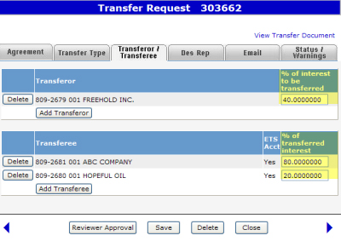
Prorate Transferor & Transferee %
More Information (Pages 23 to 41)
A Prorate Transfer of one or multiple agreements should be used when you require the system to calculate automatically the Transferee(s) interest(s) as a percentage of the Transferor(s) registered interest(s) for each agreement. The system will automatically calculate the actual interest being transferred and acquired for each agreement. Note that the actual interest is not displayed on this screen.
Specifications:
The Transferor(s) and Transferee(s) must be common in all agreements.
You may transfer all or a percent of the Transferor(s) registered interest.
Click on More Information to view how to initiate this type of transfer.
Note: Do Not Insert the Actual Registered Interest.

Slide 23
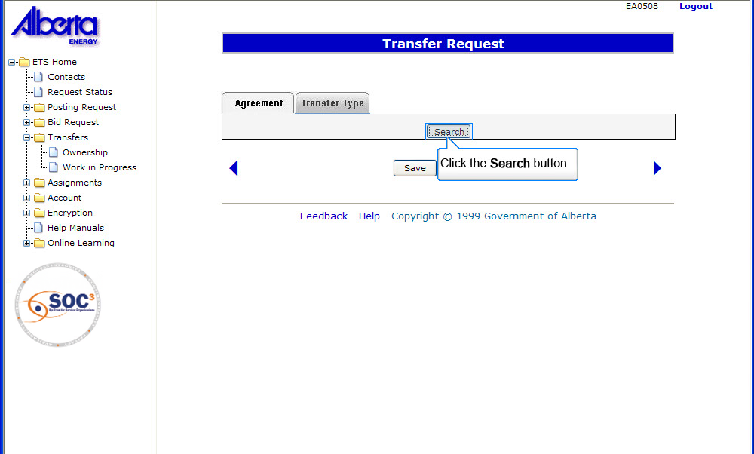
Back to Prorate Transferor and Transferee %

Slide 24
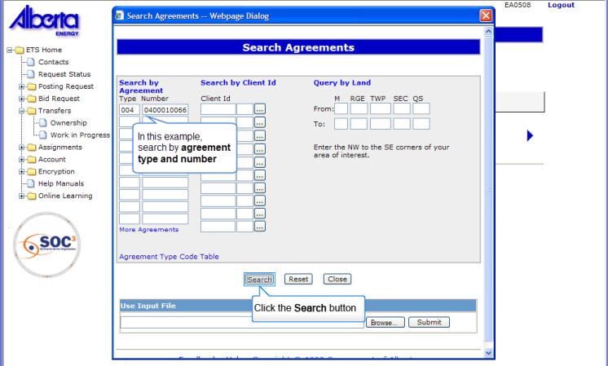
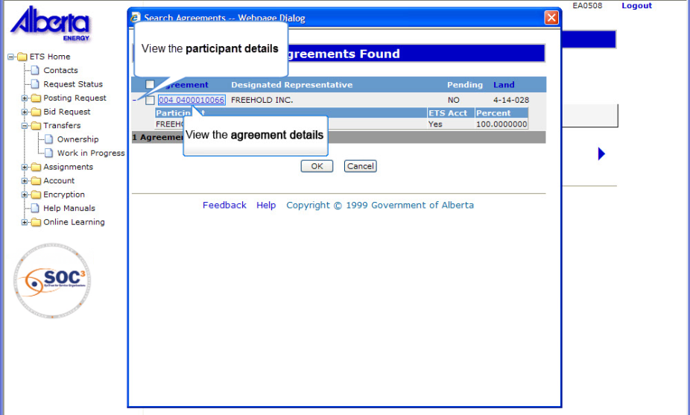
The Search Agreements window opens
Back to Prorate Transferor and Transferee %

Slide 25
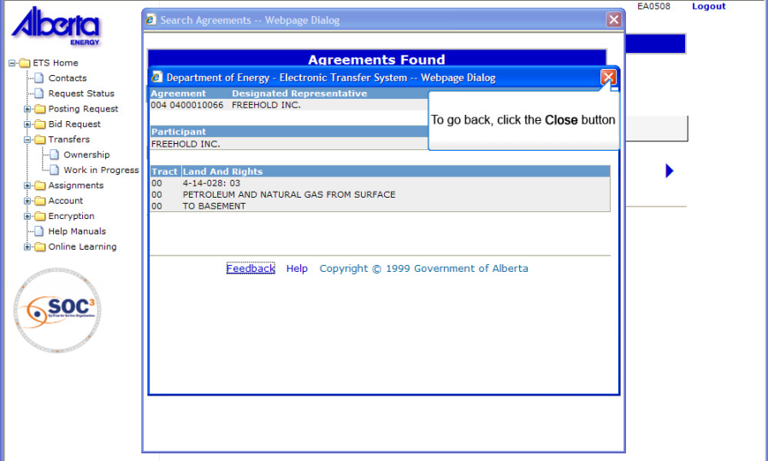
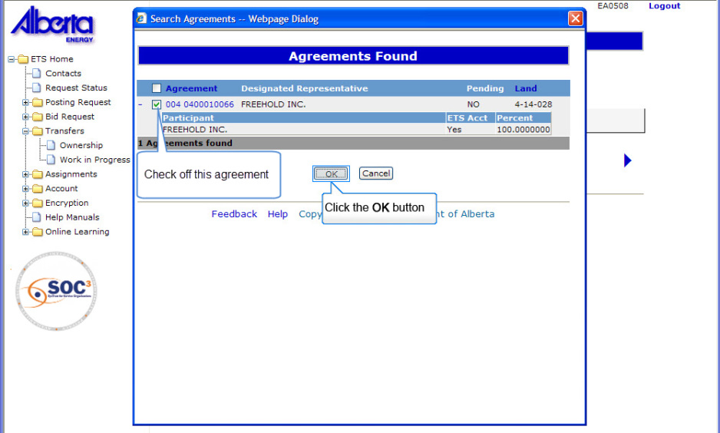
Back to Prorate Transferor and Transferee %

Slide 26
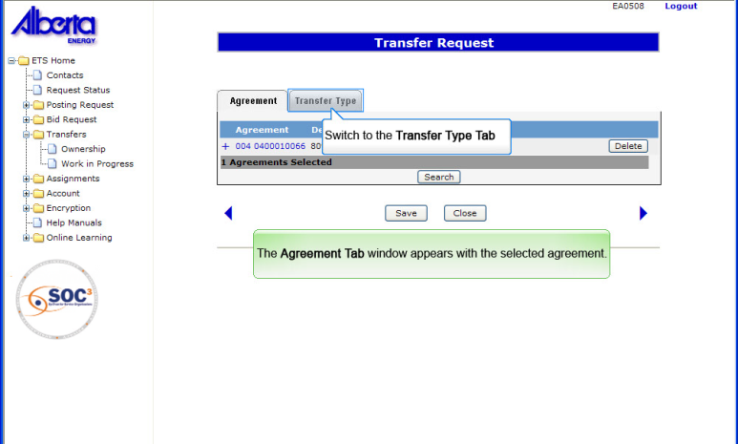
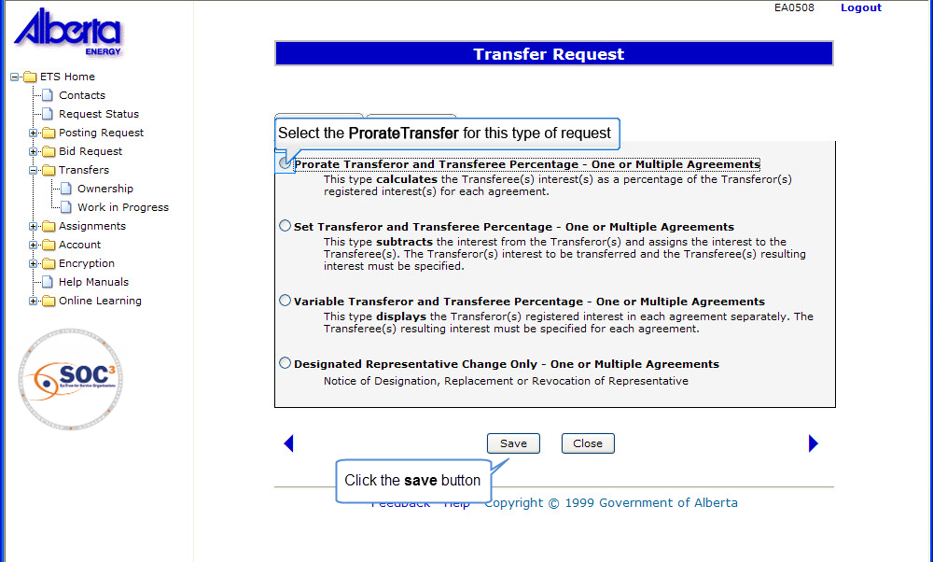
Back to Prorate Transferor and Transferee %

Slide 27
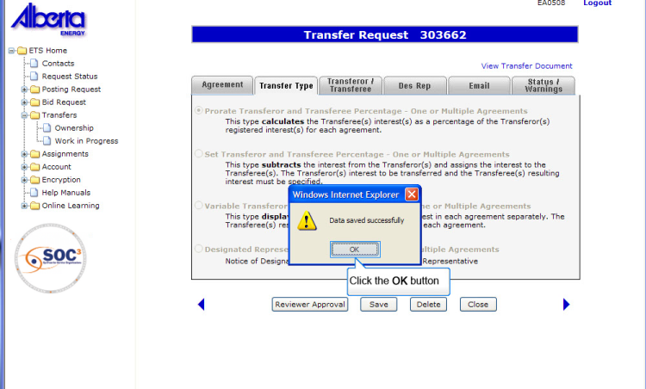
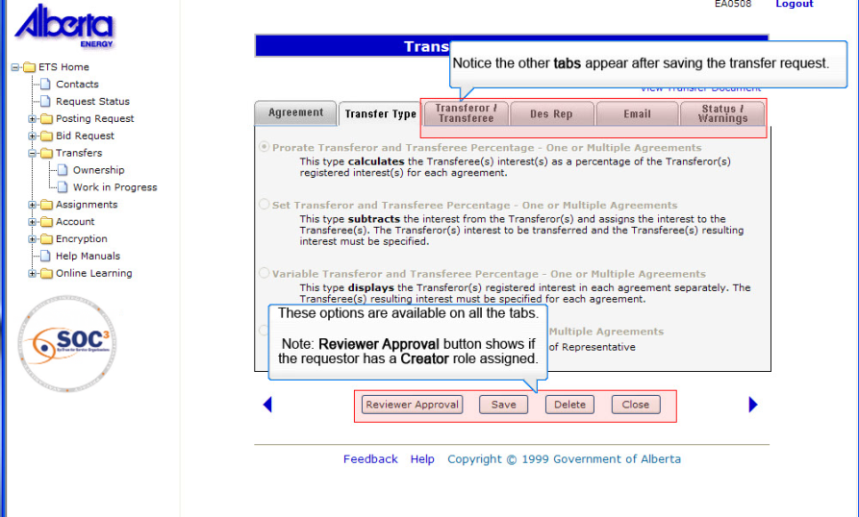
Back to Prorate Transferor and Transferee %

Slide 28
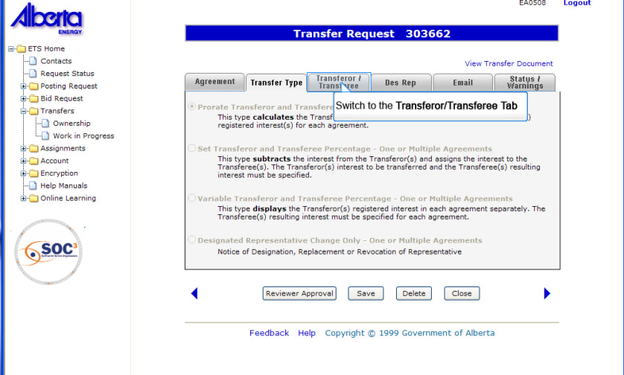
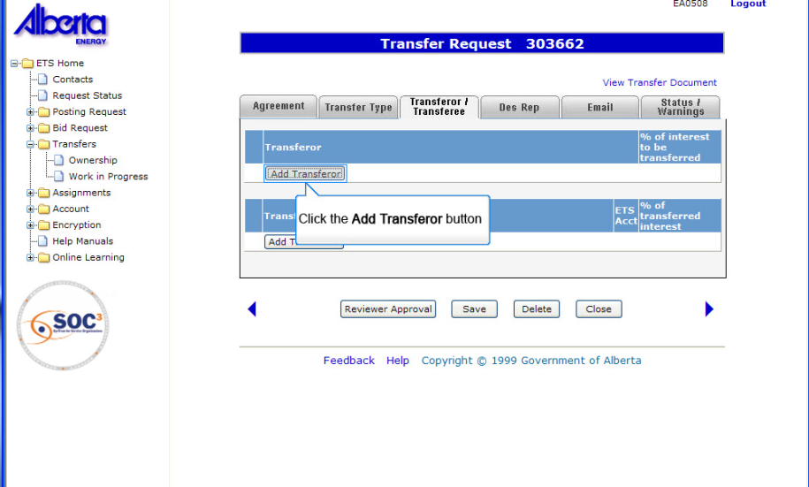
Back to Prorate Transferor and Transferee %

Slide 29
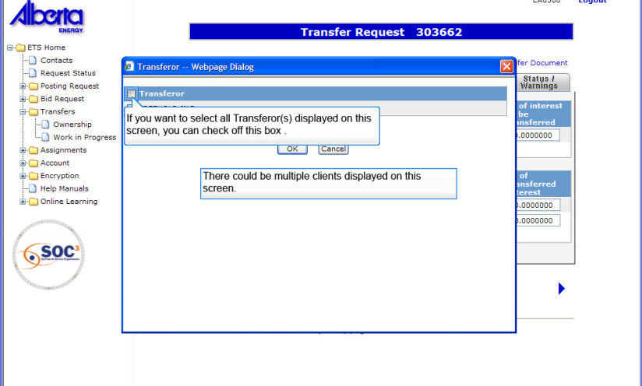
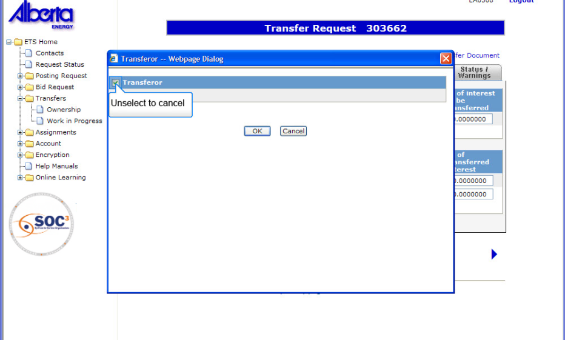
Back to Prorate Transferor and Transferee %

Slide 30
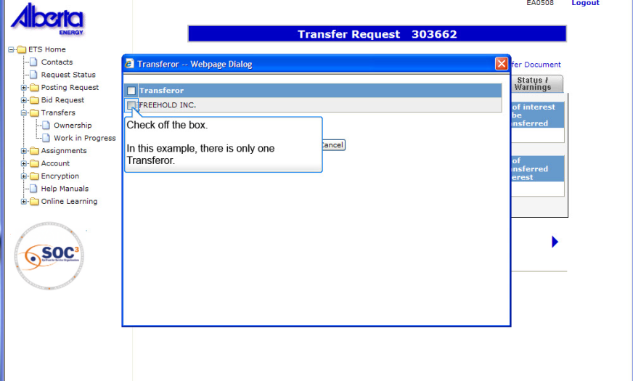
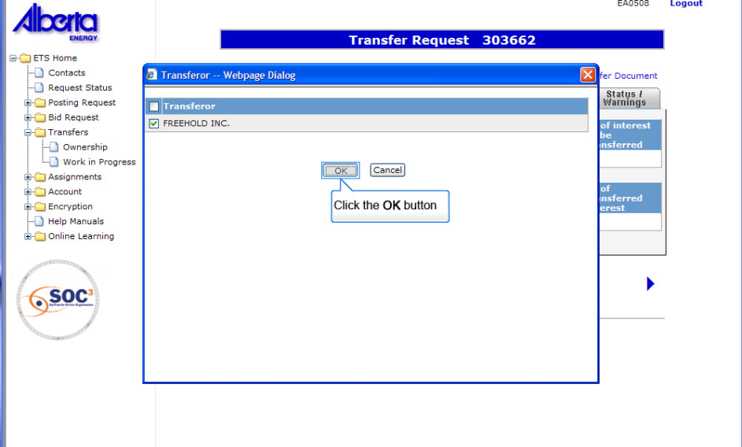
Back to Prorate Transferor and Transferee %

Slide 31
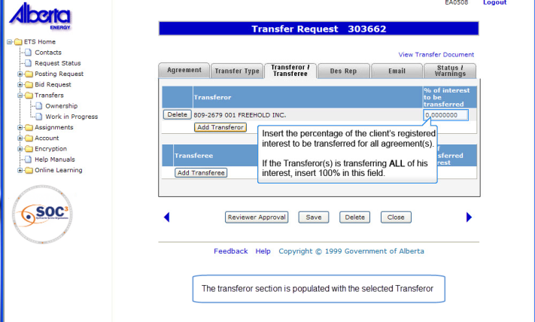
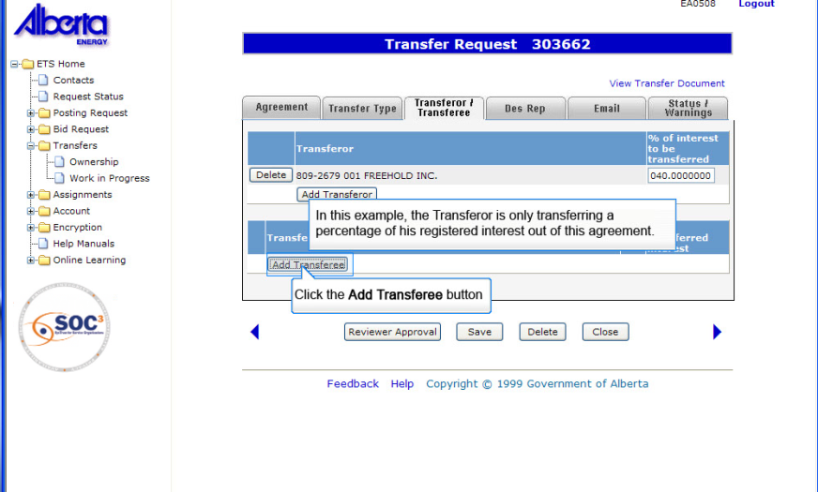
Back to Prorate Transferor and Transferee %

Slide 32
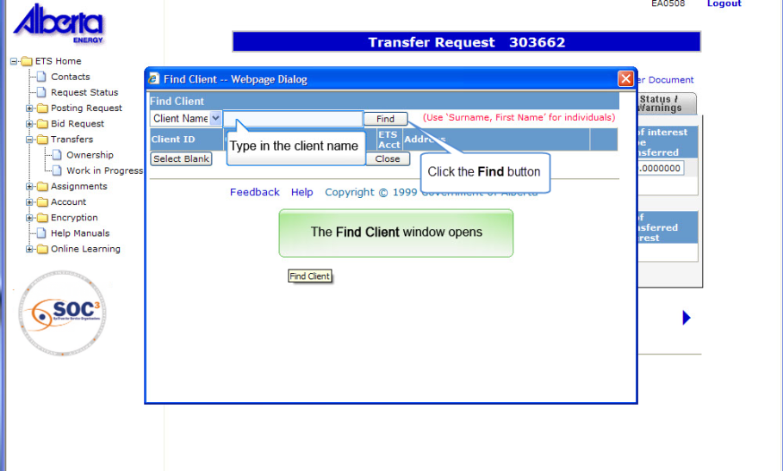
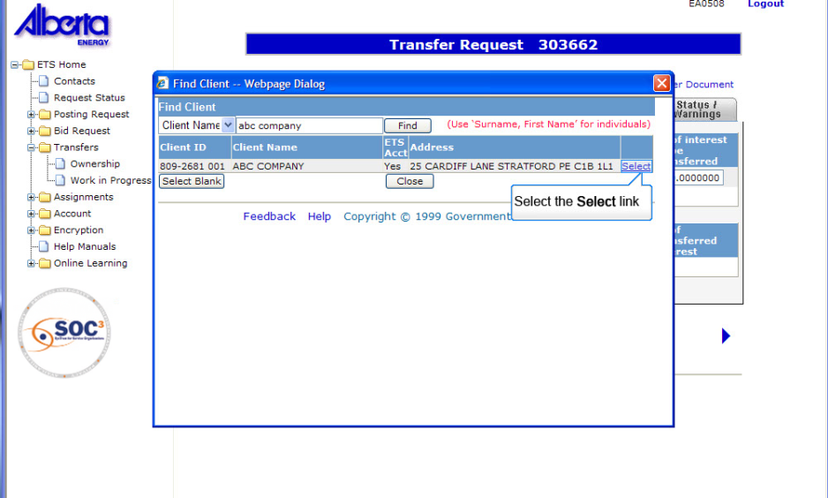
Back to Prorate Transferor and Transferee %

Slide 33


Back to Prorate Transferor and Transferee %

Slide 34


Back to Prorate Transferor and Transferee %

Slide 35


Back to Prorate Transferor and Transferee %

Slide 36


Back to Prorate Transferor and Transferee %

Slide 37


Back to Prorate Transferor and Transferee %

Slide 38


You will see the comments displayed on the Work in Progress screen
Back to Prorate Transferor and Transferee %

Slide 39


Back to Prorate Transferor and Transferee %

Slide 40


Back to Prorate Transferor and Transferee %

Slide 41


Back to Prorate Transferor and Transferee %

Slide 42

Set Transferor & Transferee %
More Information (Pages 43 to 63)
The "Set Transferor and Transferee Percentage" Transfer is used when transferring 100% interest or less in one or more agreements.
Specifications:
The Transferees(s) interest must be equal to the Transferor(s) interest.
The Transferor(s) and Transferee must be common to all agreements if there is more than one agreement.
Click on More Information to view how to initiate this type of transfer.
Tip: This type relates to the manual transfers submitted with a schedule.

Slide 43

Back to Set Transferor and Transferee %

Slide 44


Back to Set Transferor and Transferee %

Slide 45


Back to Set Transferor and Transferee %

Slide 46


Back to Set Transferor and Transferee %

Slide 47


Back to Set Transferor and Transferee %

Slide 48


Back to Set Transferor and Transferee %

Slide 49


Back to Set Transferor and Transferee %

Slide 50


Back to Set Transferor and Transferee %

Slide 51


Back to Set Transferor and Transferee %

Slide 52


Back to Set Transferor and Transferee %

Slide 53


Back to Set Transferor and Transferee %

Slide 54


Back to Set Transferor and Transferee %

Slide 55


Back to Set Transferor and Transferee %

Slide 56


Back to Set Transferor and Transferee %

Slide 57


Back to Set Transferor and Transferee %

Slide 58


Back to Set Transferor and Transferee %

Slide 59


Back to Set Transferor and Transferee %

Slide 60


TIP: note that if you enter an email address and then want to change it you have to type over it. You can’t just delete it
Back to Set Transferor and Transferee %

Slide 61


You will see the comments displayed on the Work in Progress screen
Back to Set Transferor and Transferee %

Slide 62


Back to Set Transferor and Transferee %

Slide 63


Back to Set Transferor and Transferee %

Slide 64

Variable Transferor & Transferee %
More Information (Pages 65 to 84)
A "Variable Transferor and Transferee Percentage" Transfer should be used when transferring all of the Transferor(s) registered interest in all agreements listed in this transfer.
Specifications:
The Transferor(s) MUST transfer out all of his registered interest in the agreements listed.
The Transferee(s) interest does not have to be the same for each agreement. You will be able to specify different percentage of interest for each agreement.
Click on More Information to view how to initiate this type of transfer.
Tip: This type of transfer is useful for re-distributing interests amongst the current participants in an agreement.

Slide 65
Back to Variable Transferor and Transferee %

Slide 66

The Find Client Window Opens up
Back to Variable Transferor and Transferee %

Slide 67


Back to Variable Transferor and Transferee %

Slide 68


Back to Variable Transferor and Transferee %

Slide 69



Back to Variable Transferor and Transferee %

Slide 70


Back to Variable Transferor and Transferee %

Slide 71


Back to Variable Transferor and Transferee %

Slide 72


Back to Variable Transferor and Transferee %

Slide 73


Back to Variable Transferor and Transferee %

Slide 74

Back to Variable Transferor and Transferee %

Slide 75


Back to Variable Transferor and Transferee %

Slide 76


Back to Variable Transferor and Transferee %

Slide 77


Back to Variable Transferor and Transferee %

Slide 78


Back to Variable Transferor and Transferee %

Slide 79


Back to Variable Transferor and Transferee %

Slide 80


Back to Variable Transferor and Transferee %

Slide 81


You will see the comments displayed on the Work in Progress screen
Back to Variable Transferor and Transferee %

Slide 82


Back to Variable Transferor and Transferee %

Slide 83


Back to Variable Transferor and Transferee %

Slide 84


Back to Variable Transferor and Transferee %

Slide 85
Resources
ETS Support and Online Learning provides access to relevant guides, course and other information
If you have questions, please contact Transfers.Energy@gov.ab.ca or the Transfer Helpdesk at (780)644-2300

Slide 86

Conclusion
Congratulations!
You have completed the ETS – Initiate a Transfer
Online Training Course
Please proceed to the Work in Progress module detailing other functionality of Transfers.
If you have any comments or questions on this training module, please forward them to the following email address:
Transfers.Energy@gov.ab.ca

