Slide 1
Welcome
PNG Continuation – Continuation: This is the process to complete and submit an Online Continuation Application via ETS. The process begins with the creation of a new application through to submission. The application progresses through various stages (statuses) until completion.
To the ETS – PNG Continuation: Continuation
Online Training Course

Slide 2
Revisions
Revisions Table
Date | Revisions Type | Page Number
November 17, 2014 | Initial Creation | All
September 2015 | Updated | All
March 2016 | Updated | Various
September 2020 | Updated | Various
January 2022 | Updated | Various

Slide 3
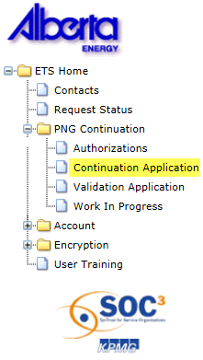
Introduction
In this module you will learn how to:
Create and submit an Online Continuation Application.
Cancel or withdraw an Online Continuation Application.
Review and respond to an offer.
Amend a submitted (Processing) application where the agreement has expired.
View a final document.

Slide 4
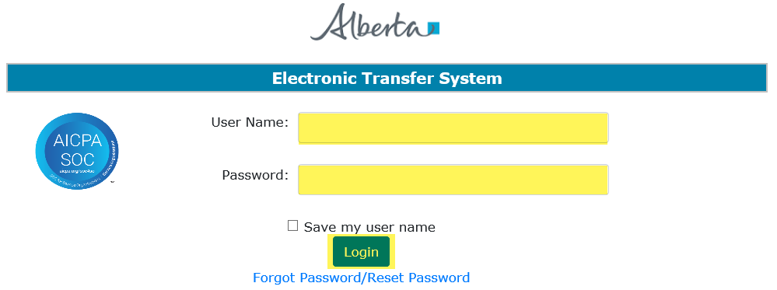
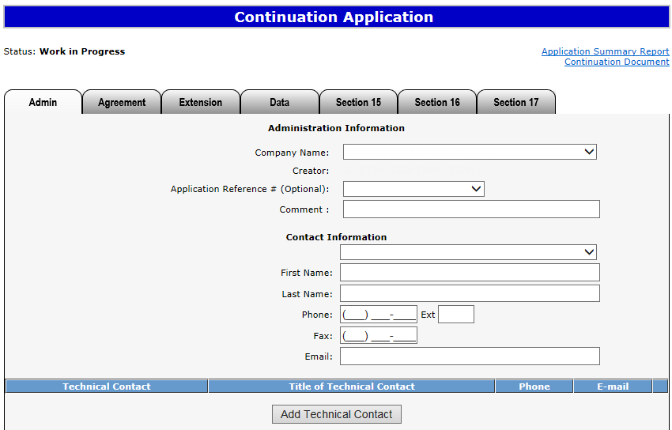
Login to ETS
1. Login to ETS with your user name and password
2. Expand PNG Continuation
3. Select Continuation Application

Slide 5
Create and Submit a Continuation Application
You must have the Creator role to create or amend an application and the Submitter role to submit an application.
All the lands (or a portion of lands) within your application must be associated with an extension or continuation.
If any part of your application includes lands where the balance of the spacing unit is freehold, you may be required to provide proof you have the right to drill for and recover petroleum or natural gas or both with respect to that spacing unit. Please refer to Section 25 of the PNG Tenure Regulation. Note – this information can accompany your application, or be dropped off at our office.

Slide 6
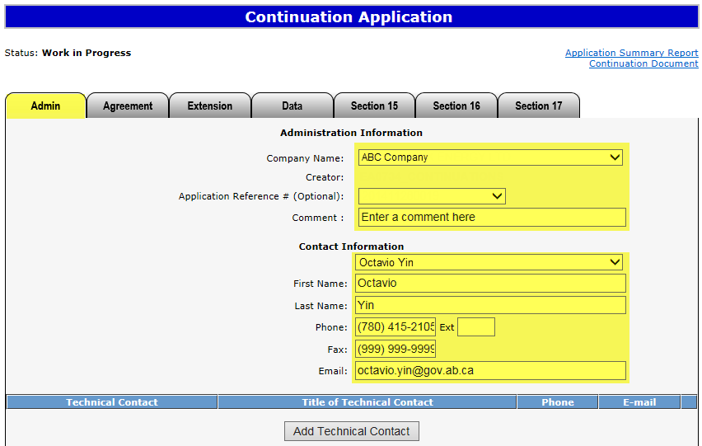
Create Continuation Application – Administration Information
1. Select Company Name and optionally enter Comment
When an application is created, its status is “Work in Progress.”
2. Select Contact Information and edit if required
An Application Reference Number is not necessary for creating a new application. You may add an agreement to an existing application already submitted to Alberta Energy by using the Application Reference Number in the Administrative Tab in ETS. This is also referred to as the Application Number on your Continuation Document PDF. For example, a qualifying well has already been used and you want to add an agreement to the submitted application.
Contact Information can be updated at anytime.

Slide 7
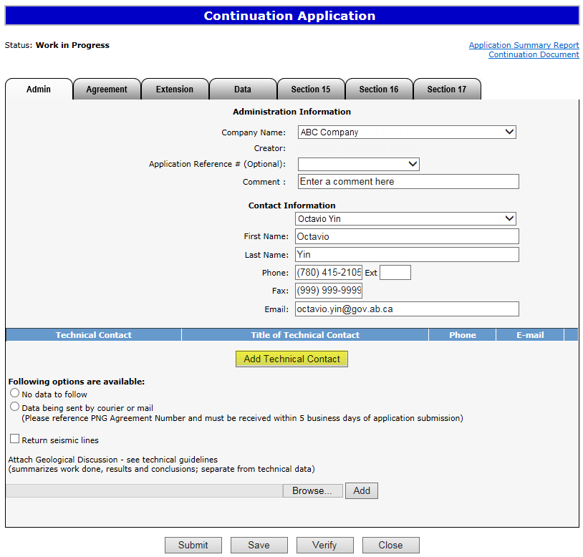
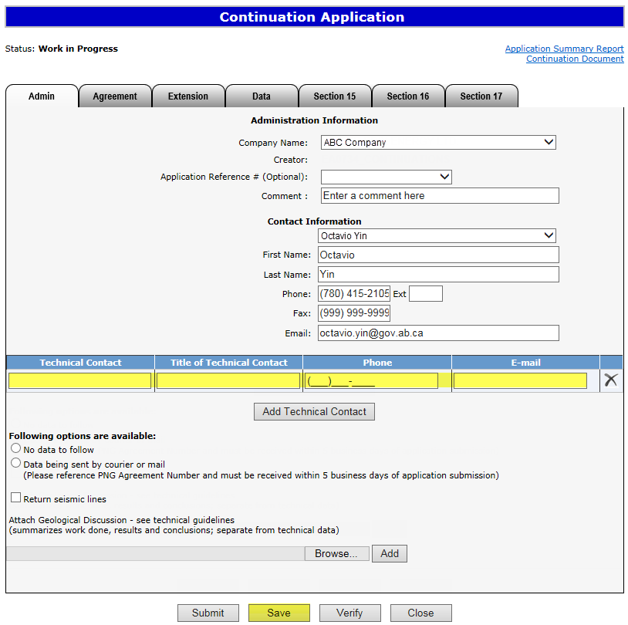
Create Continuation Application – Administration Information – Add Technical Contact (optional)
4. Enter Technical Contact (all fields are required)
3. Click on Add Technical Contact
5. Click Save
Use the Save button after completing information on each tab.

Slide 8
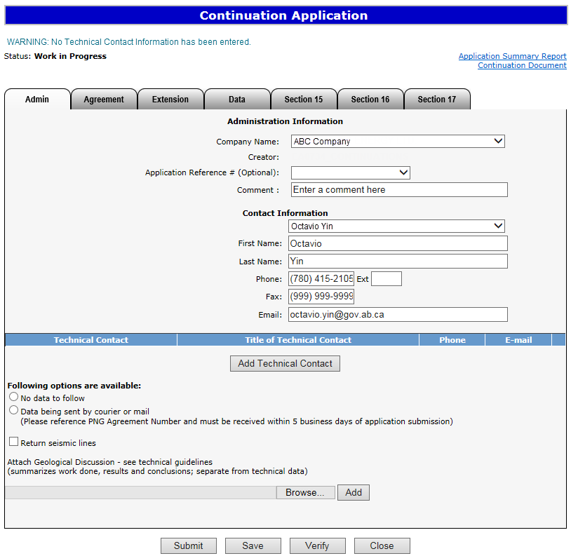
If information in not entered into an optional field, the screen may display a blue/green warning message. However, warning messages do not prevent you from saving the application data.
Warning Message

Slide 9
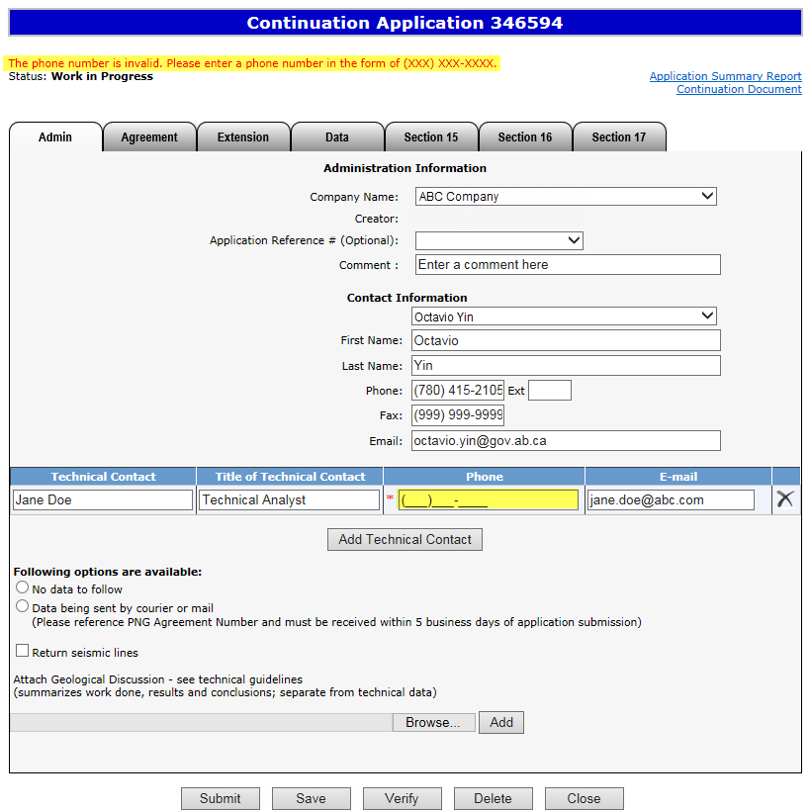
If information in not entered into a mandatory field, or the application validation fails, the screen will display a red error message. The application must be corrected and then you can try to save again.
Error
Message

Slide 10
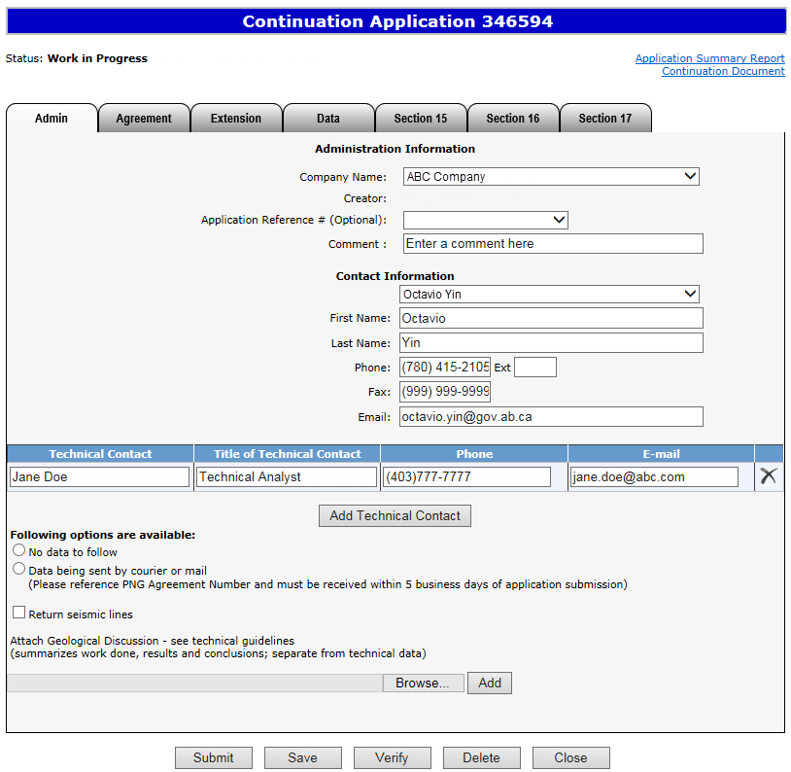
ETS request number for the application is generated and displayed upon successful save.
At this time, the application can be retrieved and opened from your Work In Progress list.

Slide 11
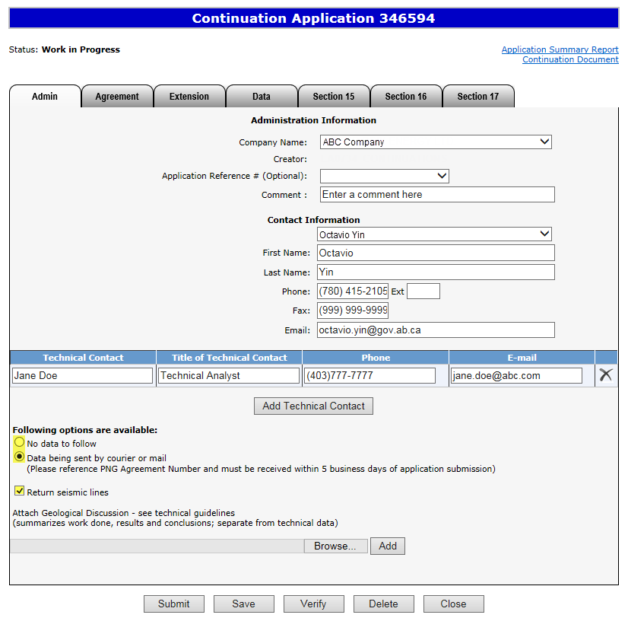
Create Continuation Application – Administration Information – Data Options
6. Choose option
7. Click on checkbox if applicable

Slide 12
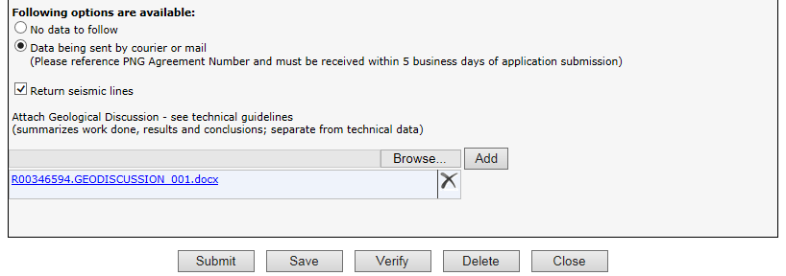
Create Continuation Application – Administration Information – Attach Geological Discussion
9. Click Add
If needed, use this button to remove the attached document.
8. Click Browse
To view the document already attached click on this link.
Geological Discussion should always be attached and submitted with an application. It needs to be text only and must not include any maps or diagrams. Technical Data cannot be submitted through ETS.

Slide 13
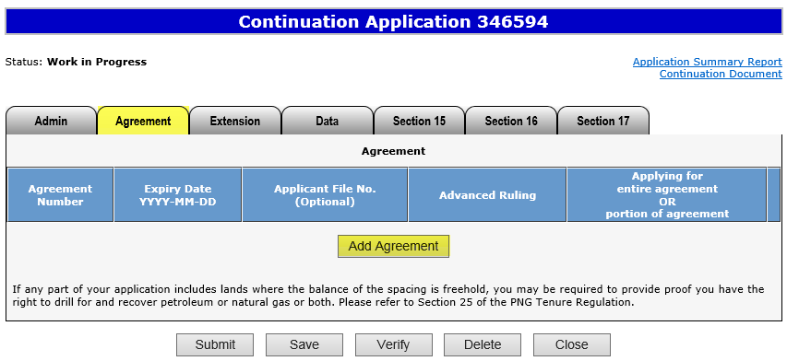
Create Continuation Application – Agreement Information – Add Agreement
1. Click on Agreement tab
2. Click on Add Agreement

Slide 14
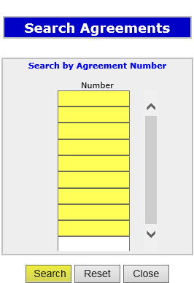
Create Continuation Application – Agreement Information – Add Agreement (continued)
3. Enter Number(s)
5. Click on Checkbox to select all agreements or each individual agreement
6. Click OK
4. Click Search

Slide 15
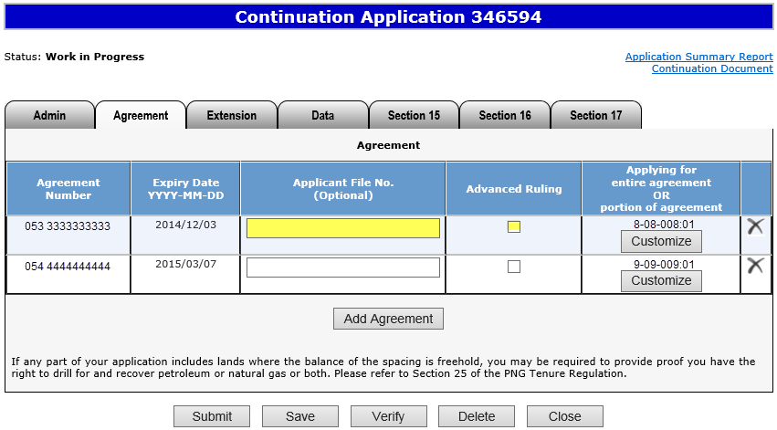
Create Continuation Application – Agreement Information – Add Agreement (continued)
7. Optionally enter Application File Number
8. Click on checkbox if applicable
After an agreement is added, the Expiry Date is automatically populated.
An application for advanced ruling must be received by Alberta Energy 2 months prior to expiry.

Slide 16
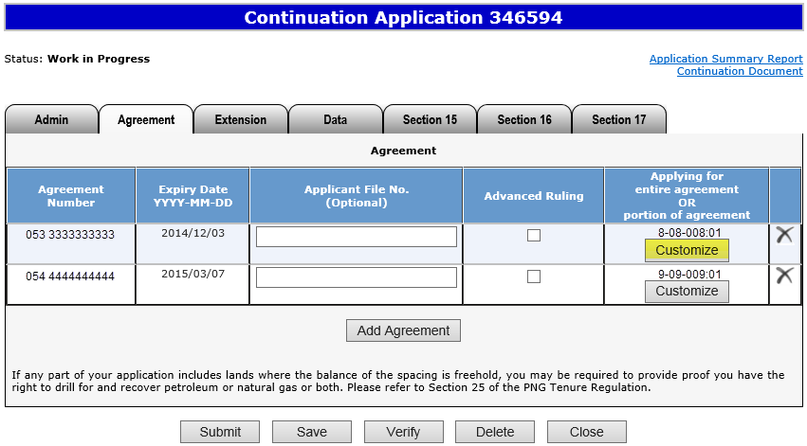
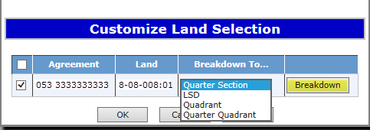
Create Continuation Application – Agreement Information – Customize/Breakdown Land
If land needs to be broken down, it must be done at this point. You may wish to breakdown land if applying for a portion of the agreement expiry or if you wish to select a portion of a land in the Section 16 and Section 17 tabs.
1. Click Customize
2. Select “Breakdown To” if applicable.
3. Click Breakdown if applicable

Slide 17
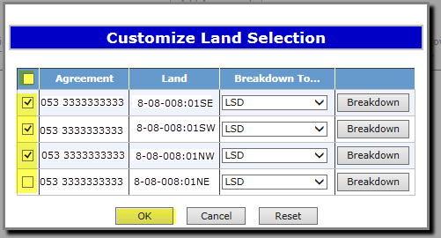
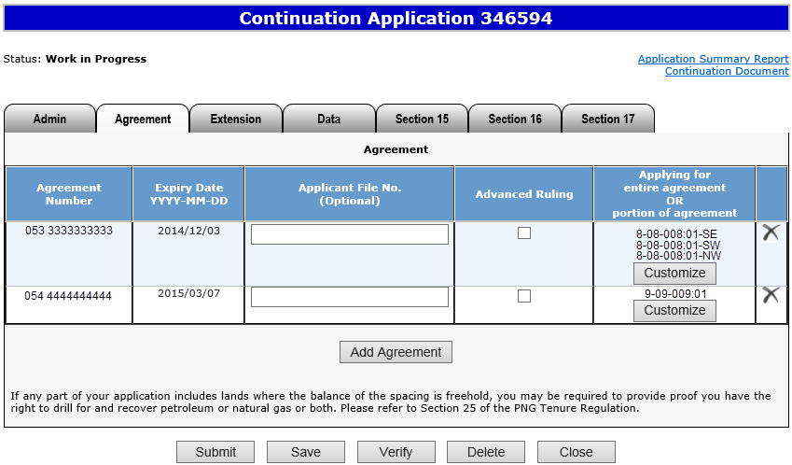
Create Continuation Application – Agreement Information – Customize/Breakdown Land (continued)
4. Click on the checkbox to select lands you want to use for agreement expiry
Result of customization/breakdown is displayed.
5. Click OK
Use the Reset button to clear the screen.

Slide 18
Create Continuation Application – Agreement Information – Remove Agreement
If needed, use this button to remove the added agreement.

Slide 19
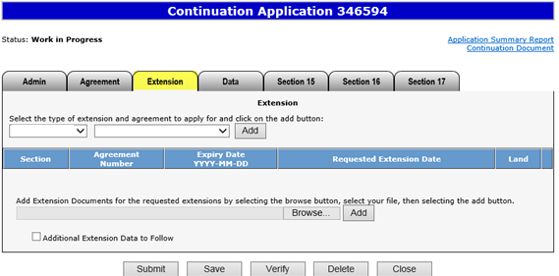
Create Continuation Application – Extension Information
1. Click on Extension tab
This table shows the extensions that can be applied for:
Extension | Description
Section 16(6) | Request an extension under Section 16(6) (Must be under Section 16 continuation at Expiry)
Section 18(6) | Request an extension under Section 18(6) (Must be under Section 18 continuation at Expiry)
Section 8(1)(h) | Request an extension under Section 8(1)(h) of the Mines and Mineral Act
Section 8(1)(g) | Request an extension under Section 8(1)(g) of the Mines and Mineral Act
Section 26 | Request an extension under Section 26 of the PNG Tenure Regulation
8(1)(g) extends the period of time you can submit your application and it must be requested with another type of continuation.
You may apply for an extension on one or multiple agreements.

Slide 20
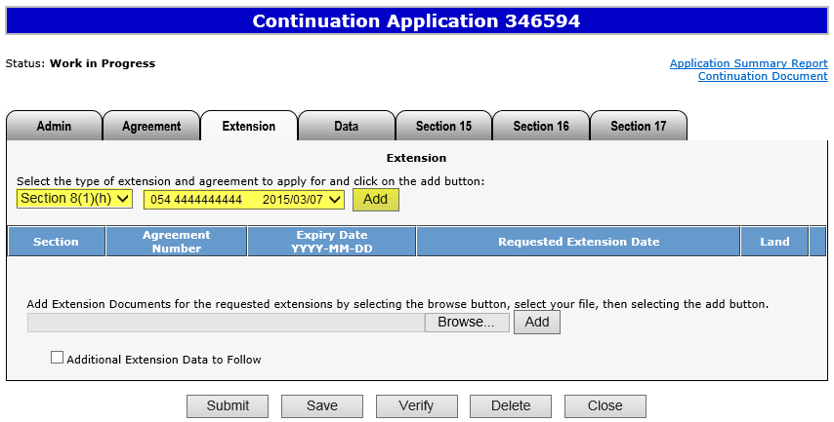
Create Continuation Application – Extension Information – Add Extension
2. Select extension
3. Select agreement
4. Click Add
Select land sections if the extension applied for is Section 8(1)(g), 16(6), 18(6), or 26.

Slide 21
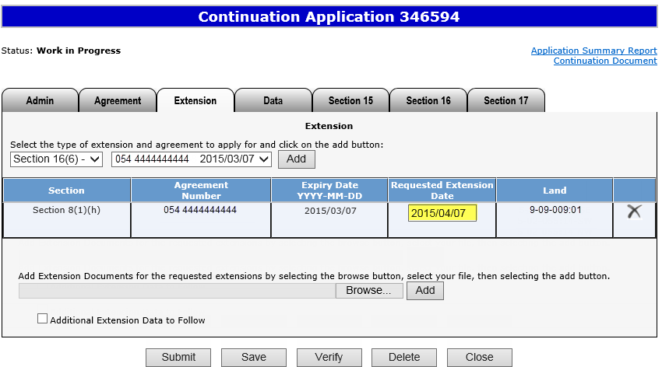
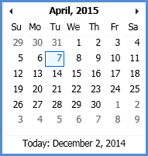
Create Continuation Application – Extension Information – Add Extension (continued)
5. Select Requested Extension Date
If needed, use this button to remove the added extension.
The extension date is the date you wish to have the agreement term date extended to. It cannot be the current
date or a past date.

Slide 22
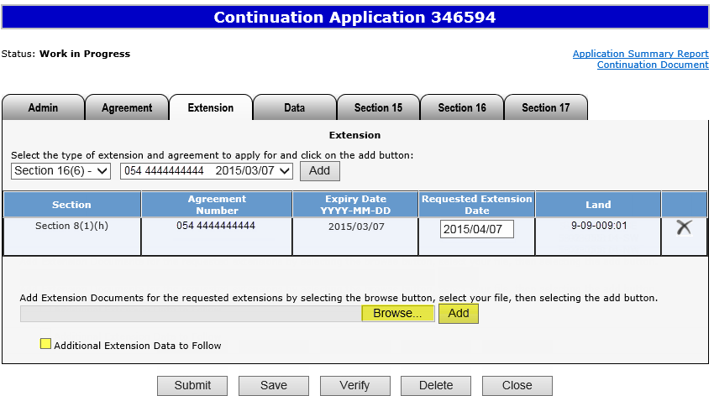
Create Continuation Application – Extension Information – Add Extension Document
1. Click Browse
2. Click Add
3. Optionally click checkbox
Extension Document, which contains the reason for needing the extension, must be attached and be in either Word or
PDF format. No technical data can be attached.

Slide 23
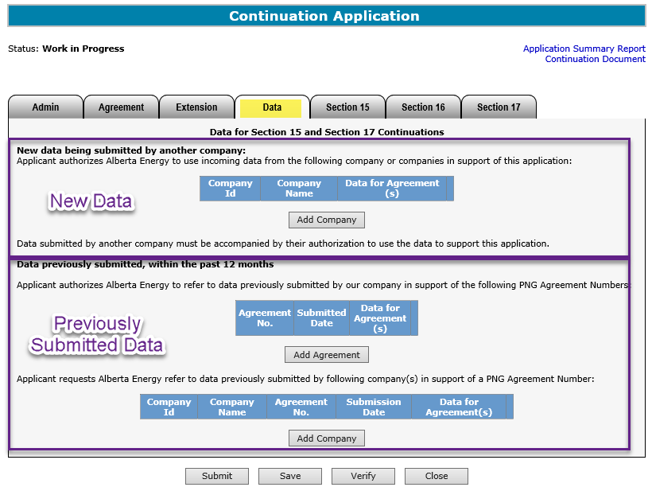
Create Continuation Application – Data Tab
Click on Data tab
This tab is required only if the data is going to be submitted by another company or the data is already provided for an existing PNG agreement.
An authorization request is also required (see Request Authorization for Data in PNG Continuation: Authorization online training course).
If your application is for more than one agreement but this data is only to be use for one of the agreements you can enter that in under “Data for Agreement” If it is left blank the data will be used for all the agreements in the application.
If the data will be coming from other companies, complete the New Data section.
If the data is already with Alberta Energy, complete the Previously Submitted Data section.

Slide 24
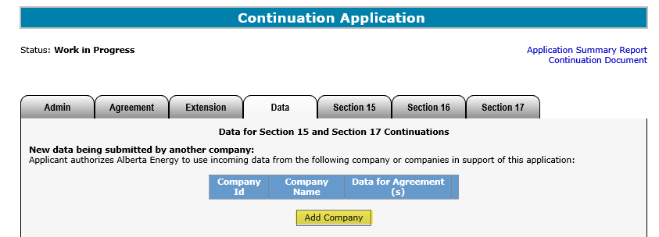
Create Continuation Application – Data Tab – Add Company
2. Choose and enter search parameters and click Find
3. Click Select
1. Click Add Company

Slide 25
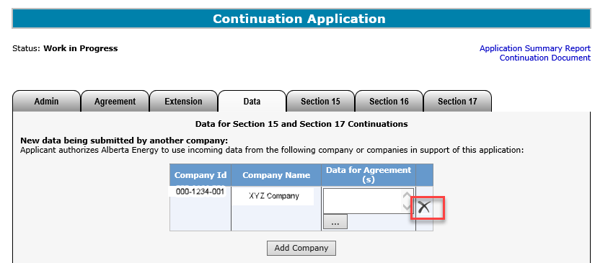
Create Continuation Application – Data Tab – Remove Company
If needed, use this button to remove the added company.

Slide 26
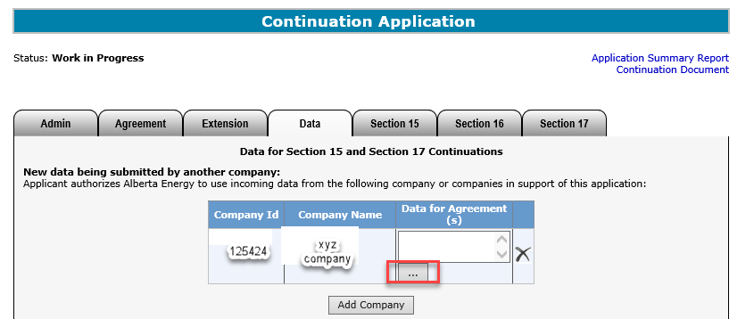
Create Continuation Application – Data Tab – Add Data for Agreement
If the data submitted is not to be used for all the agreements. Click the … to add which agreement(s) you want us to use the data for.

Slide 27
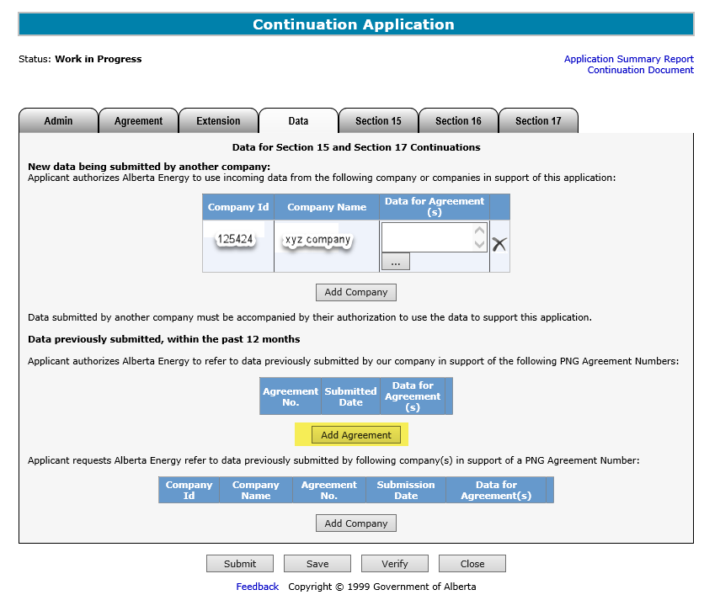
Create Continuation Application – Data Tab – Add Agreement for Previously Submitted Data
1. Click Add Agreement

Slide 28
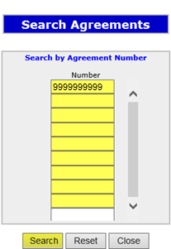
Create Continuation Application – Data Tab – Add Agreement for Previously Submitted Data (continued)
2. Enter Number(s)
4. Click on Checkbox
5. Click OK
3. Click Search

Slide 29
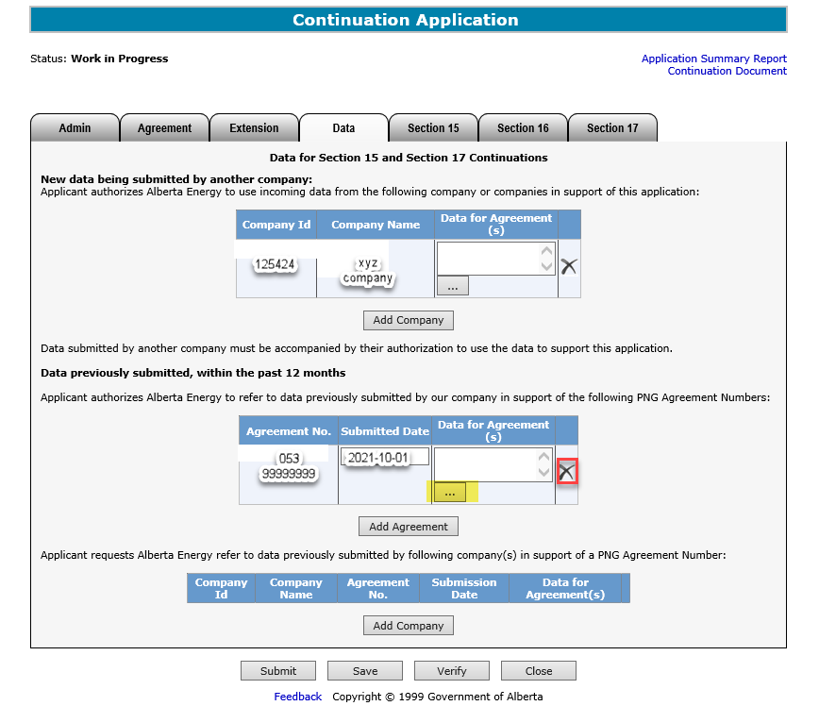
Create Continuation Application – Data Tab – Add Agreement for Previously Submitted Data (continued)
6. Select Submitted Date
As required, use this button to remove the added agreement.
As required, use this button to indicate which agreement you want us to use the data for.
The Submitted Date is the date when the data was previously submitted to Alberta Energy. The bottom portion of the screen is for data previously submitted by another company. The company’s name must be provided.

Slide 30
Create Continuation Application – Section 15 Information
Click on Section 15 tab
This table shows the Section 15 continuations that can be applied for:
Continuation | Description
Section 15(1)(a) | Well data
Section 15(1)(b) | Unit Agreement OR Production Allocation Unit Agreement
Section 15(1)(c) | Obligation to pay offset compensation
Section 15(1)(d) | Gas Storage Agreement
Section 15(1)(e) | Mapping

Slide 31
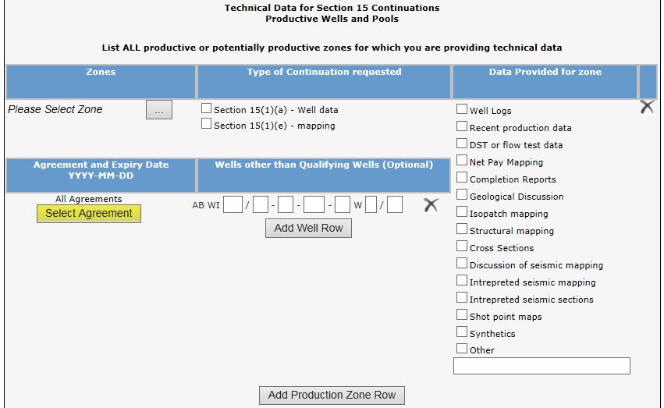
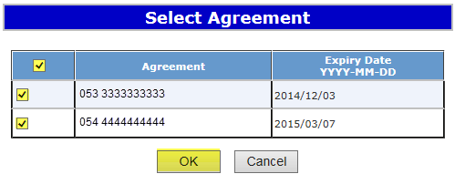
Create Continuation Application – Section 15 Information – Select Agreement
By default all agreements of the application are selected for Section 15.
1. Click on Select Agreement
2. Click on Checkbox to select all agreements or each individual agreement
3. Click OK

Slide 32
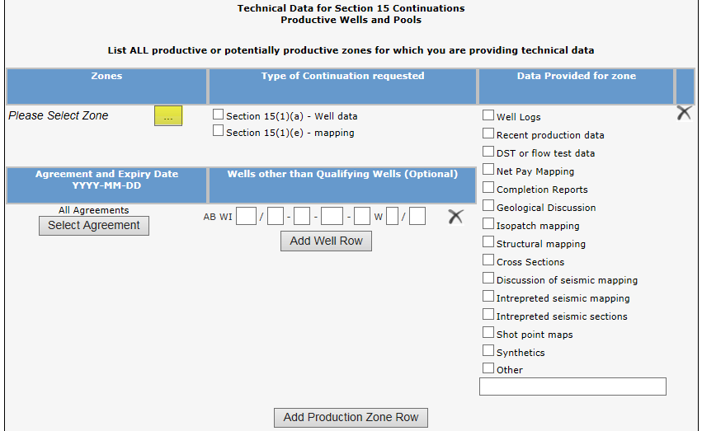
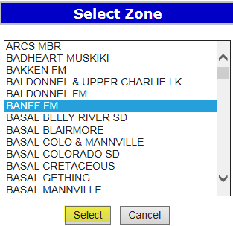
Create Continuation Application – Section 15 Information – Select Zone
2. Select Zone
1. Click on Ellipsis
3. Click Select
In the Select Zone list, first click on any zone and type the first letter of the zone you are searching for. The system will navigate alphabetically.

Slide 33
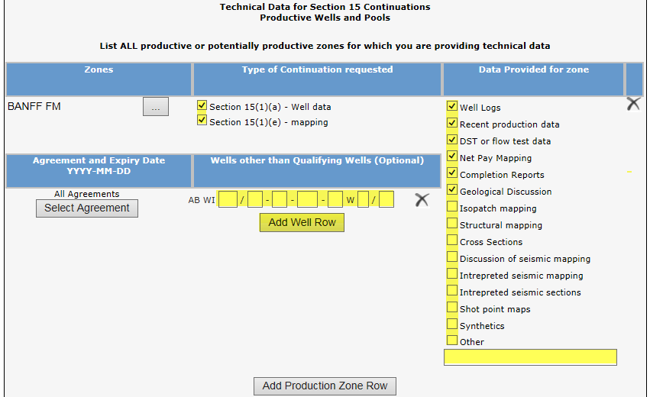
Create Continuation Application – Section 15 Information – Request Continuation for 15(1)(a) and 15(1)(e)
1. Click on checkbox if applicable
2. Click on checkbox if applicable
To apply for a different zone, add a new production zone row.
3. Optionally enter well. Click Add Well Row to add another well.
If the Geological Discussion option is checked, you must attach the related document in the Admin tab.

Slide 34
Create Continuation Application – Section 15 Information – Request Continuation for 15(1)(b), 15(1)(c), and 15(1)(d)
2. Select agreement
3. Click Add
1. Select option
5. Enter information
4. Select Zone

Slide 35
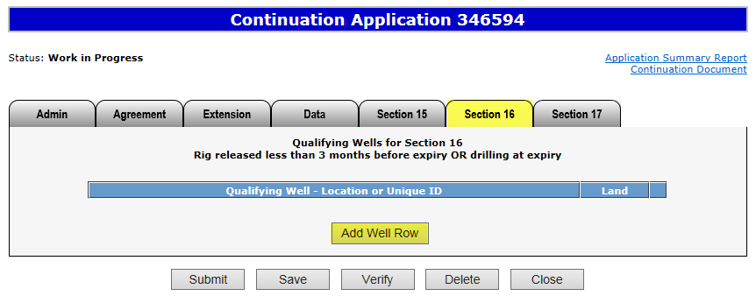
Create Continuation Application – Section 16
1. Click Section 16 tab
2. Click on Add Well Row
More than one qualifying well may be added for Section 16.

Slide 36
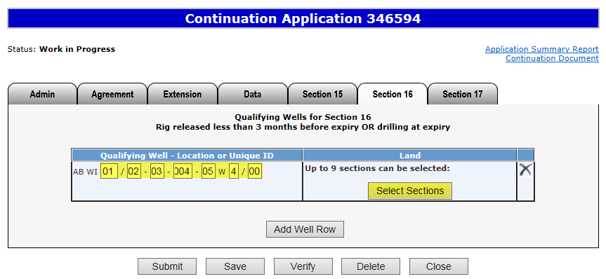
Create Continuation Application – Section 16 (continued)
3. Enter well
As required, use this button to remove the added well.
4. Click on Select Sections

Slide 37
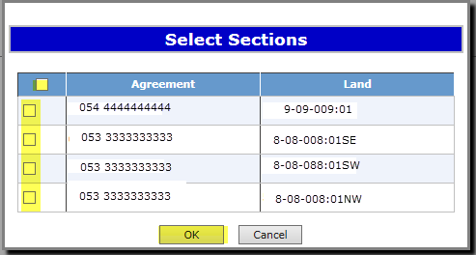
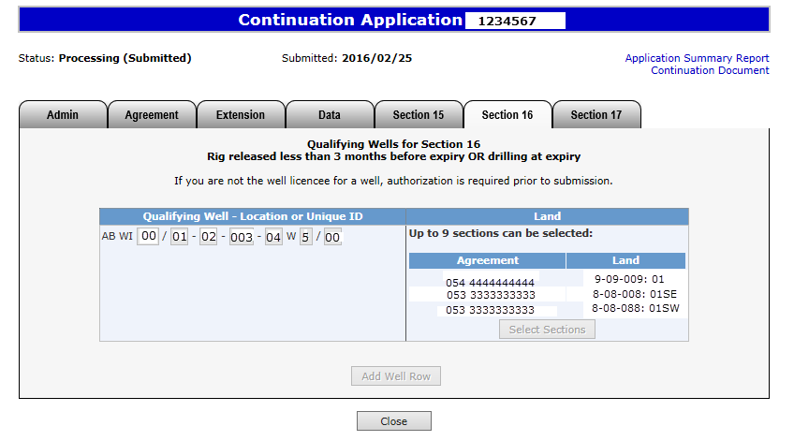
Create Continuation Application – Section 16 (continued)
6. Click OK
5. Click on the top Checkbox to select all land sections or each individual land selection box

Slide 38
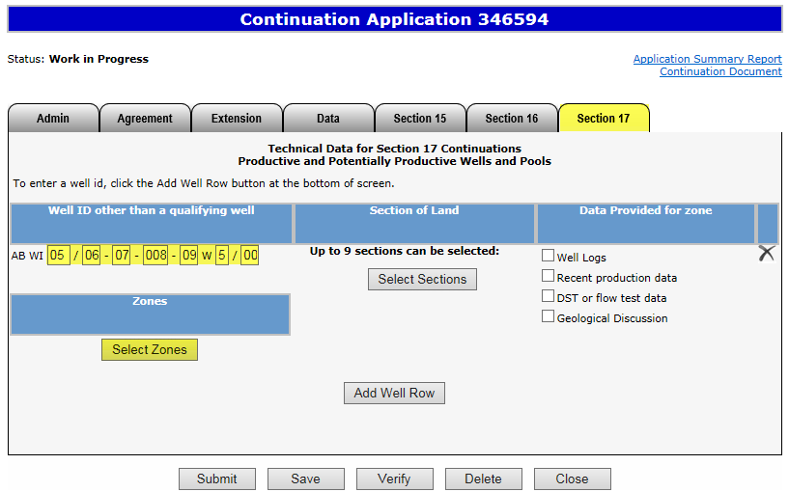
Create Continuation Application – Section 17
1. Click Section 17 tab
2. Enter well
3. Click Select Zones

Slide 39
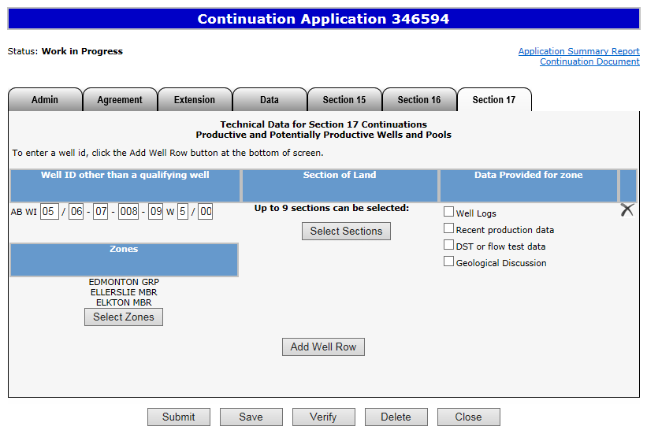
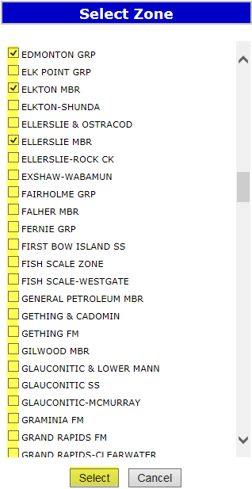
Create Continuation Application – Section 17 (continued)
4. Select zone(s)
5. Click Select
When selecting a zone from the list, first click on any zone and type the first letter of the zone you are searching for. The system will navigate alphabetically.

Slide 40
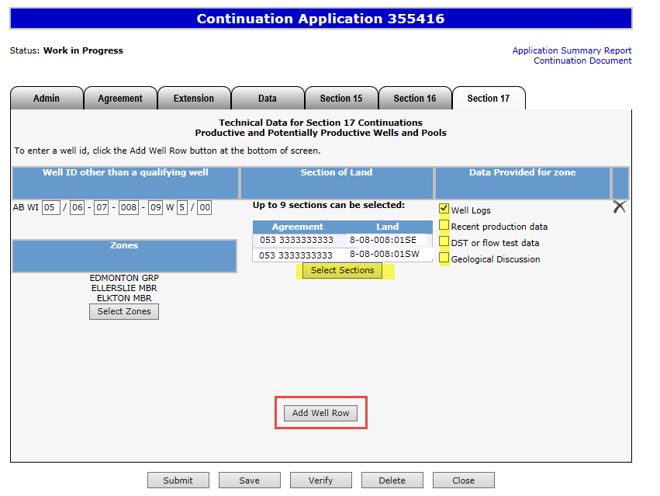
Create Continuation Application – Section 17 (continued)
7. Click on checkbox if applicable
6. Click on Select Sections
To apply using an additional well, add a well row.
If the Geological Discussion option is checked, you must attach the related document in the Admin tab.

Slide 41
View Continuation Document
The Continuation Document is a PDF document which details the information in your application.
If an application contains multiple agreements, before it is submitted, all the agreements will show on this document. Once the application has been submitted, ETS separates the agreements and each agreement will show on a separate Continuation Document.
Please do not mail a printed application to Alberta Energy.
To view the document click on this link.
The Continuation Document can be viewed at any time after the application has been saved.

Slide 42
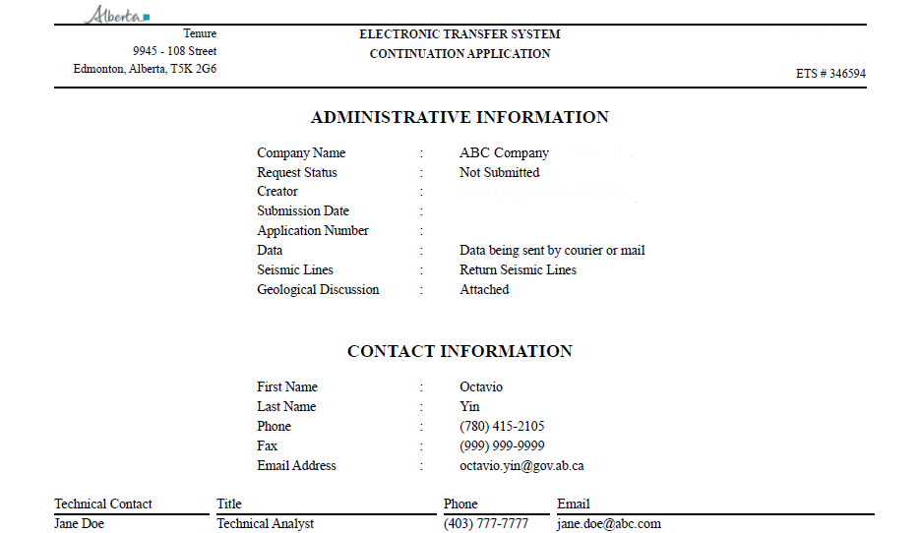
View Continuation Document (continued)
After the application has been submitted, you should open the document and print a copy for your records.
Please note the document will reflect any amended information if the application has been amended.

Slide 43
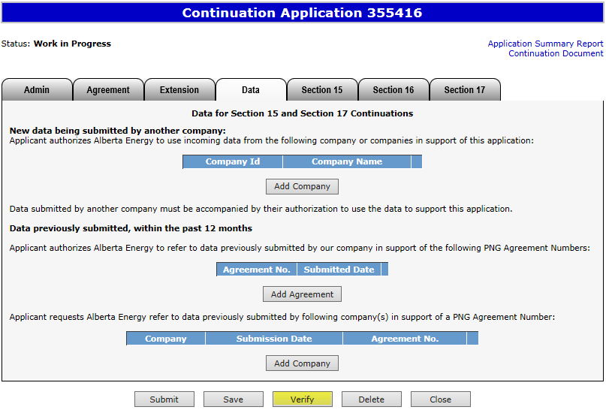
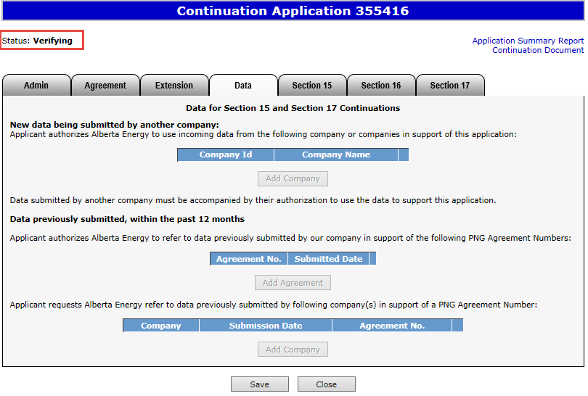
Verify Continuation Application
This process verifies information within the application using internal validations to ensure data is correct. Any errors or warnings will be displayed on the screen. You may use the Verify button after completing the application.
Click Verify
Status becomes Verifying.
Once the verification process is complete, load the application again from your Work In Progress list, and the status should return to “Work in Progress.”
At this stage, you may continue working on your application.

Slide 44
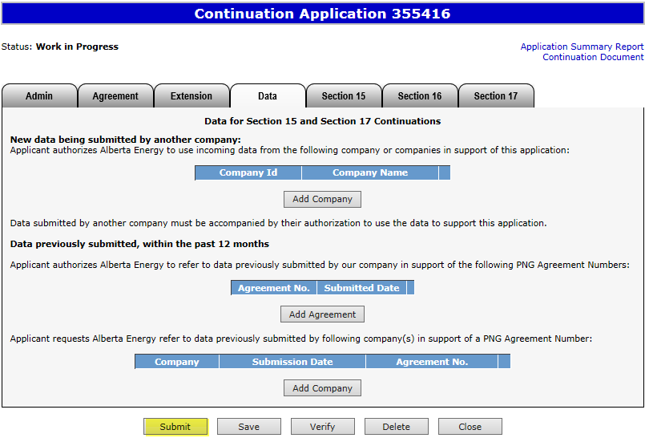
Submit Continuation Application
You must have the Submitter role to submit an application.
Verifying your application at various steps when completing can be a useful tool; however, verification is not required prior to submission.
When the application is complete, click the submit button. The application will go through the verification process and if no errors are identified, the application will automatically be submitted.
If there are errors, the application goes back into work in progress so it can be corrected and resubmitted. The contact person identified on the application will also receive an email indicating that action is required.
1. Click Submit

Slide 45
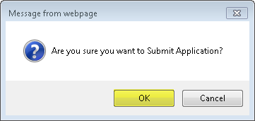
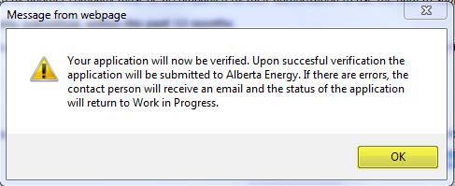
Submit Continuation Application (continued)
2. Click OK
3. Click OK

Slide 46
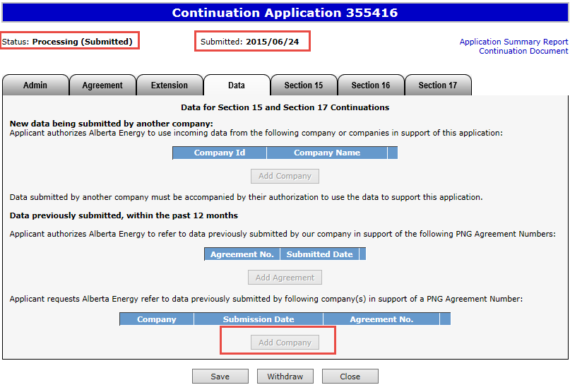
Submit Continuation Application (continued)
Alberta Energy has received the application when the status becomes Processing (Submitted). The application remains in this status until the application is reviewed.
Submission Date is now displayed.
At this stage the application cannot be edited (except Contact Information).

Slide 47
View Application Summary Report
The Application Summary Report is a PDF document which details the information contained within your application and whether it is was received by the internal system. The Application Summary Report displays all agreements that are applied for together and which share an Application Reference Number. Please note that the continuation document only displays one agreement.
Please do not send a printed application to Alberta Energy.
To view the document click on this link.

Slide 48
Work In Progress
You can use the Work In Progress screen to retrieve all active applications submitted by your company.
Please note that certain applications may have been archived and will no longer be in your Work in Progress list.

Slide 49
Work In Progress
2. Optionally choose your search parameters
1. Select Work In Progress
3. Click Find
Remove the default date search parameters if you wish to retrieve all active Continuation applications.

Slide 50
Work In Progress – Search Parameters and Result
Parameter Field | Result Column
Type | Application Type
Request Number | ETS #
Start/End Date | Last Updated
Application # | Application #
Agreement # | Agreement #
Status | Status
Comment | (not shown as a result column)
You can utilize the search parameter fields to filter search results.
The table on the right shows the correlation between the parameter fields and each corresponding result column.
Below is a highlighted colour illustration of the Work in Progress search screen to further demonstrate the relationship between the data.

Slide 51
Work In Progress – Search Result
To load an application or view an offer click on the ETS request number link.
Search Result
To open a document click on the report Pdf link.
Navigate with these page numbers if there are multiple pages of search result.

Slide 52
Cancel or Withdraw an Application
You can:
Cancel an application in Work in Progress status.
Withdraw a previously submitted application prior to expiry. Please note that withdrawing an application will remove it from Alberta Energy’s records.
You must have the Submitter role to cancel or withdraw an application.

Slide 53
Cancel an Application
1. Click Delete
2. Click OK

Slide 54
Cancel an Application (continued)
Status becomes Client Cancelled.
At this stage, the application is no longer editable.

Slide 55
Withdraw an Application
When an application is withdrawn, it is removed from Alberta Energy’s records. Any offers made by Alberta Energy on the agreement are also rescinded. When submitting a new application for the agreement, you must apply for all lands and/or zones that you want Alberta Energy to review.
Please refer to any previously submitted data in your new application if applicable.
2. Click OK
1. Click Withdraw

Slide 56
Withdraw an Application (continued)
Status becomes Client Withdrawn.
At this stage, the application cannot be edited.

Slide 57
Copy an Application
The copy functionality assists you in creating a new application by copying information from a cancelled, withdrawn or rejected application. Once OK is clicked the new application is created and all data is copied over.
1. Click Copy
2. Click OK
Please note that if an application was withdrawn, any offers by Alberta Energy are also rescinded. All lands and zones must be re-applied for. Please refer to any previously submitted data in your new application if applicable.

Slide 58
Offer
If an offer is received by ETS, the application status becomes Offer.
An email may be sent from ETS informing your company’s contact that an offer is available for review and response. These email notifications are considered a courtesy and should not be relied on to track PNG Continuation Applications in ETS.
When submitting an application through ETS, it is your responsibility to continually check your Work in Progress to determine if an offer has been sent.
The offer can have one or more options for you to choose from.
You have until the Offer Expiry Date to respond to the offer.
If the Offer Expiry Date has passed without a response, the application will be sent back to the internal system, and the status will become “Processing (No Response).” The agreement expiry will be processed as set out in the offer letter.

Slide 59
Review Offer
Status has become Offer.
Access the Offer in this tab.
Click this link to view the offer letter.
The Date the Offer expires.

Slide 60
Review Offer (continued)
Offer land option #1
Offer land option #2
Early Response checkbox for authorizing Alberta Energy to review your Offer Response prior to the Offer Expiry Date. Once checked your decision CANNOT be changed unless it is prior to agreement expiry.

Slide 61
Respond to Offer
For each offer option, you can choose one of these responses:
Accept
Decline
Additional Data (before expiry) / Request for Review (after expiry)
Customize
1. Choose option

Slide 62
Respond to Offer – Add Document
Add a supporting document if your choice is
Additional Data (before expiry) or Request for Review (after expiry)
2. Click Browse
1. Select Additional Data (or Request for Review)
4. Click checkbox if applicable
3. Click Add
Only one document is required for multiple Additional Data (or Request for Review) options. However, you may add as many documents as needed.

Slide 63
Respond to Offer – Customize
1. Select Customize
2 Optionally click Breakdown
3. Choose Section
4. Choose Decision
If “Additional Data” or “Request for Review” is selected as the decision, you must add at least one supporting document.

Slide 64
View Offer Response Document
Once your offer response is completed you can review it with the Offer Response Document.
The Offer Response Document is a PDF file that shows your offer response.

Slide 65
View Offer Response Document (continued)

Slide 66
Respond to Offer – Early Response Checkbox
If the early offer response box is unchecked, changes can be made to the offer response, up to and including, the Offer Expiry Date. The Status will become “Offer Response Pending.” Once the Offer Expiry Date passes, the offer response is sent to the internal system and the status will become “Processing (Offer Response Submitted).”
If the early offer response box is checked, NO changes can be made to the offer response unless it is prior to expiry as the offer response has been submitted to the internal system. Once the internal system has received the offer response, the status will become “Processing (Offer Response Submitted).” At this point Alberta Energy may finalize the agreement at any point after agreement expiry.
If you are submitting additional data or a request for review, it is advantageous to check the Early Response box because this ensures that your response is sent right away. If you do not check the early response box, the response is not sent until after the offer expiry date.
Note: Authorizing Alberta Energy to finalize the agreement before the Offer Expiry Date does not flag the agreement as a rush. It simply means that the agreement is placed into the offer response work list sooner. Alberta Energy has one month from the Offer Response received date to process and this may fluctuate.

Slide 67
You must have the Submitter role to submit an offer response.
Submit once the offer response is complete.
If you only save your offer response it will not come to Alberta Energy. After the offer expiry date the status will become processing (no response)
1. Click Submit
3. Click OK
2. Click OK

Slide 68
Final
If a final document is received by ETS, the application status becomes Completed.
An email may be sent from ETS informing your company, and the applicant if applicable, that a final document is available for viewing. These email notifications are considered a courtesy and should not be relied on to track PNG Continuation Applications in ETS.
Where the Designated Representative and the Authorized Applicant are the same, the email goes to the company’s contact person for the request.
Where the Designated Representative and the Authorized Applicant are different, the Designated Representative email goes to whomever has PNG Continuation Documents form type (assigned by the Site Admin) and the Authorized Applicant email goes to the company’s contact person for the request.
A final document contains a final letter and if applicable, an amended appendix.

Slide 69
View Final (as Applicant)
To view the final document click on either link.

Slide 70
View Final (as Designated Representative)
1. Select Request Status
2. Choose your search parameters
Search Result
3. Click Retrieve
To view the final document click on this link.
In order to view documents in Request Status you must have PNG Continuation Documents form type assigned.

Slide 71
Offer Withdrawn
If an offer is withdrawn, Alberta Energy will contact the company. ETS will not send an email notification.
Once the offer is withdrawn, it is removed and is no longer accessible (cannot be seen in the Offer tab).
Offer Withdrawn Applications will return to Processing (Submitted) status.
“No Application” or Correction Application with the offer withdrawn will become Offer Withdrawn status.

Slide 72
Amend a Continuation Application
You can only amend a submitted (Processing) application and only if the agreement has not expired.
You must have the Creator role to amend an application and the Submitter role to submit it.
Extensions, zones, land and wells can be added as amendments to the request; however, they are considered a late amendment. Existing data cannot be removed.
The request will not continue until the amendment is submitted.

Slide 73
Amend Continuation Application
2. Click OK
1. Click Amend

Slide 74
Amend Continuation Application (continued)
Status becomes Amendment in Progress.
When amending an application, the following information can be edited:
Zones, land and wells to the existing agreement(s)
Attach Geological Discussion documents
The Data tab
Information under Extension, Section 15, and Section 16 tabs
Once the amendment is completed, click Submit to send the application back to the internal system.
Status will become Processing (Amended).

Slide 75
No Application
If you fail to apply for continuation and we determine there is an obligation to offer continuation under the PNG Tenure Regulation, Alberta Energy will initiate the process by creating an application, offer or final through our internal system. The system generated application will have a request number assigned and the Designated Representative name populated.
If there is an offer it will be available in the Work in Progress, if only a final is sent, it will display in Request Status.
ETS will send an email informing your company’s site administrator that an application has been created and action is required.
If an offer is sent you may review the offer and if satisfactory, accept or decline by completing the offer response and submitting. If no response is submitted by the Offer Expiry date, the agreement will be continued as outlined in the Offer. A Request for Review is not available on a no application offer.
Contact Information must be provided in order to submit No Application Offers.
If there is no obligation to offer continuation, a cancellation letter is sent and it will be available in the Request Status. Some of the agreements that you receive a final cancellation letter for may also appear on the monthly Agreement Cancellation Report.

Slide 76
Correction Application
At times Alberta Energy may create a correction application on your company’s behalf to send you an offer or final. This will occur when an agreement was previously finalized by Alberta Energy and a correction is required.
An email will be sent from ETS informing your company that an offer or a final is available for your review and/or action.
If an offer is sent, it will be available in your Work In Progress list. The process to respond to the offer remains the same. If a final is sent, you must retrieve it from the Request Status page.
Contact Information must be provided in order to submit Correction Task Offers.

Slide 77
Designated Representatives can find Completed (Finals) ETS Requests submitted by an Authorized Applicant under “Request Status”
Designated Representatives can find Completed (Finals) ETS Requests for applications that have expired without submission under “Request Status”
Designated Representatives can find all other ETS Requests under “Work in Progress”
Authorized Applicants can find all ETS Requests under “Work in Progress”

Slide 78
List of ETS Statuses (continued)
Status Group | Status Name | Description | Party | Location
Creating an Application | Work in Progress | Application has yet to be submitted to the internal system. | Designated Representative Authorized Applicant | Work in Progress
 | Verifying | Application is being verified by the internal system. | Designated Representative Authorized Applicant | Work in Progress
 | Submitted | Application has been submitted but not yet received by the internal system. | Designated Representative Authorized Applicant | Work in Progress
 | Processing (Submitted) | Application has been received by the internal system. | Designated Representative Authorized Applicant | Work in Progress
Cancelling/ Withdrawing an Application | Client Cancelled | Application has been cancelled from your Work In Progress list by you. | Designated Representative Authorized Applicant | Work in Progress
 | Client Withdrawn | An already submitted application has been withdrawn by you prior to expiry. | Designated Representative Authorized Applicant | Work in Progress

Slide 79
List of ETS Statuses (continued)
Status Group | Status Name | Description | Party | Location
Offer | Offer | Offer has been received by ETS and is available for your action. This includes a correction offer or a “no app offer” | Designated Representative Authorized Applicant | Work in Progress
 | Offer Response Pending | Offer response has been submitted, however it will not be with the internal system as the early response is not selected. Offer Expiry Date has not passed. | Designated Representative Authorized Applicant | Work in Progress
 | Offer Response Submitted | Offer response has been submitted. Early response is selected or Offer Expiry Date has passed and has not been received by the internal system. | Designated Representative Authorized Applicant | Work in Progress
 | Processing (Offer Response Submitted) | Offer response has been received by the internal system. Early response selected or Offer Expiry Date has passed. | Designated Representative Authorized Applicant | Work in Progress
 | No Response | Offer Expiry Date has passed without your response. This has not yet been received by the internal system. | Designated Representative Authorized Applicant | Work in Progress
 | Processing (No Response) | Offer Expiry Date has passed without your response. This has been received by the internal system. | Designated Representative Authorized Applicant | Work in Progress

Slide 80
List of ETS Statuses (continued)
Status Group | Status Name | Description | Party | Location
Department Withdrawn | Processing (Submitted) | Offer for an application has been withdrawn by Alberta Energy. | Designated Representative Authorized Applicant | Work in Progress
 | Offer Withdrawn | Offer for a “no application” or correction application has been withdrawn by Alberta Energy. | Designated Representative Authorized Applicant | Work in Progress
Rejected | Department Rejected | Application has been rejected by Alberta Energy. | Designated Representative Authorized Applicant | Work in Progress
Amendment | Amendment in Progress | Amendment has been activated and is work in progress. | Designated Representative Authorized Applicant | Work in Progress
 | Amended | Amendment has been submitted but not yet received by the internal system. | Designated Representative Authorized Applicant | Work in Progress
 | Processing (Amended) | Amendment has been received by the internal system. | Designated Representative Authorized Applicant | Work in Progress

Slide 81
List of ETS Statuses (continued)
Status Group | Status Name | Description | Party | Location
Final | Completed | Application is now completed and the final document is available for your retrieval. Application was made by the Authorized Applicant, not the Designated Representative Application is now completed and the final document is available for your retrieval. Application was made by the Authorized Applicant. Application is now completed and the final document is available for your retrieval. Application was made by the Designated Representative. Application was not made and the agreement or a portion of the agreement has expired. This includes Cancellation letters from no application files. A correction final is sent. | Designated Representative Authorized Applicant Designated Representative Designated Representative Designated Representative Authorized Applicant | Request Status Work in Progress Work in Progress Request Status Request Status Request Status

Slide 82
Resources
ETS Support and Online Learning provides access to relevant guides, courses and other information.
If you have questions, please contact PNGContinuations.Energy@gov.ab.ca
or the PNG Tenure Help Line at (780) 644-2300.

Slide 83
Congratulations!
Congratulations!
You have completed the ETS – PNG Continuation: Continuation
Online Training Course
To access Courses, Guides and Forms for all your ETS Business please see ETS Support and Online Learning.
If you have any comments or questions on this training course,
please contact:
Crown Agreement Management
Helpdesk: (780) 644-2300
Email inquires: PNGContinuations.Energy@gov.ab.ca

