Slide 1
Welcome
PNG Continuation – Expiry Reinstatement:
This is the process to complete and submit an Online Expiry Reinstatement request via ETS for a PNG Agreement. The process begins with the creation of a new request through to submission. The request progresses through various stages (statuses) until completion.
To the ETS – PNG Continuation:
Expiry Reinstatement
Online Training Course

Slide 2
Revisions
Revisions Table
Date | Revisions Type | Page Number
March 10, 2017 | Initial Creation | All
June 2020 | Update Banner and Resource Page | All
September 2020 | Updated | Various

Slide 3
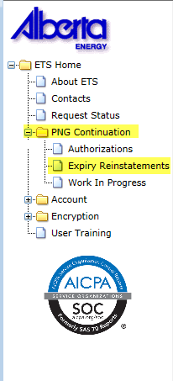
Expiry Reinstatement - Introduction
In this module, you will learn how to:
Create and submit an Online Expiry Reinstatement request
Cancel or withdraw an Online Expiry Reinstatement request
View response document(s)
Course Pre-requisites:
Training System Overview
ETS Account Setup and Preferences (For Site Administrators)
You must have the Creator role to create or withdraw a request and the Submitter role to submit a request.

Slide 4
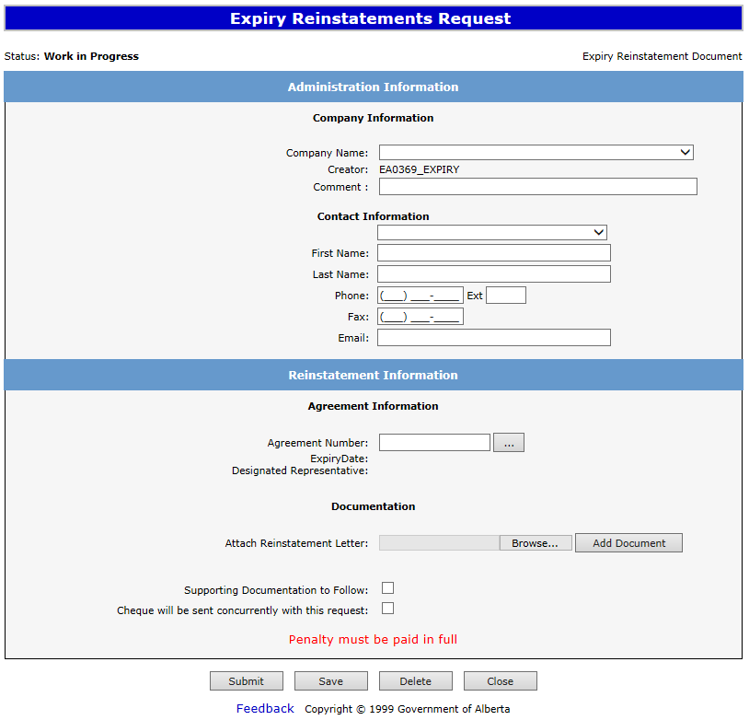
Create – Expiry Reinstatement
Select the Expiry Reinstatements node under PNG Continuation. Complete the Company Information, then under the Agreement Information select the dotted box to enter your agreement number.
1. Complete Company and Contact Information
2. Select for Agreement Number

Slide 5
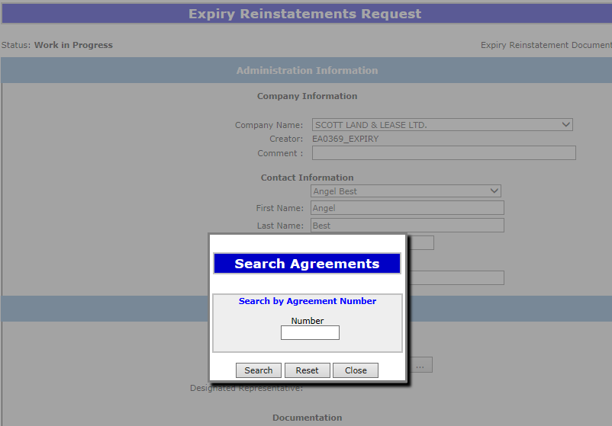
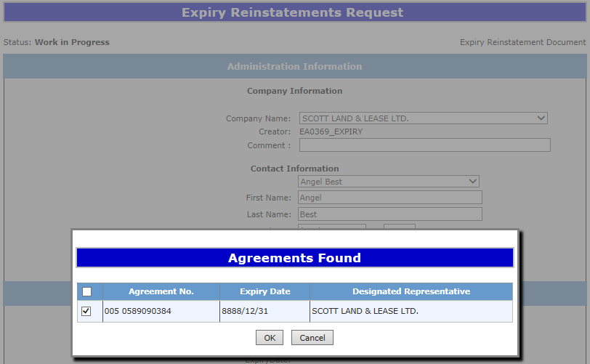
Type in the PNG Agreement Number in the Search Agreements screen, select Search. The Agreements Found screen will populate the Agreement Number. Select the Agreements Found number Check Box, then select OK.
2. Check Box
ABC Company
1. Enter Agreement Number
ABC Company
005 5555555555
3. Select OK

Slide 6
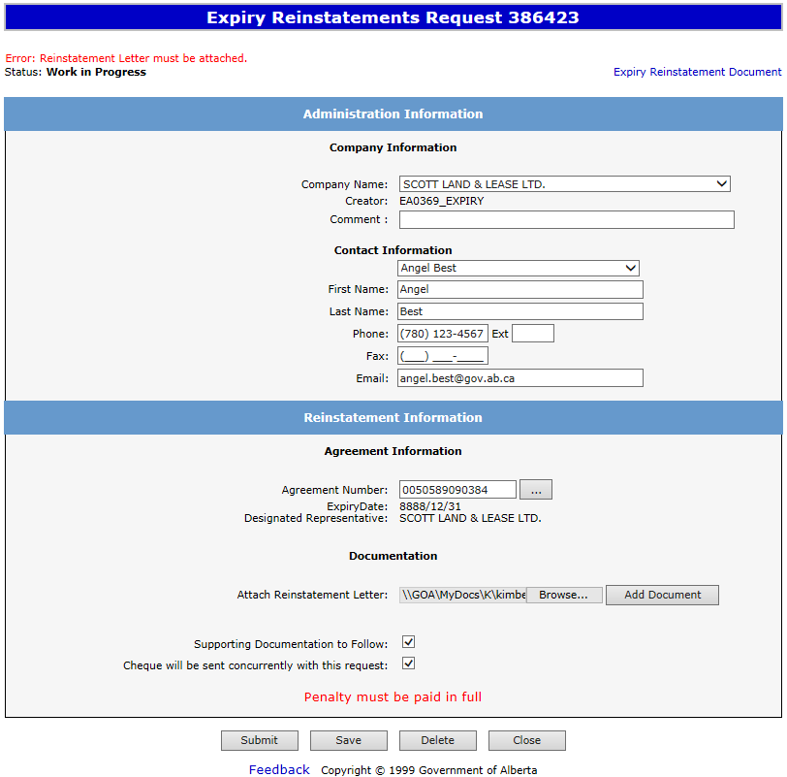
After selecting Ok you will be taken back to the Expiry Reinstatement - Administration Information screen. The screen status will be updated to Work in Progress with a ETS Reference Number. Select the Browse button to attach your Reinstatement Letter, which outlines your rational for requesting a reinstatement. Then select Add Document, to upload your document.
ABC Company
Our File M1234
1. Select Browse
0055555555555
2. Select Add Document
ABC Company
Ensure you select Add Document, or you will receive the Error above: “Reinstatement Letter must be attached”.

Slide 7
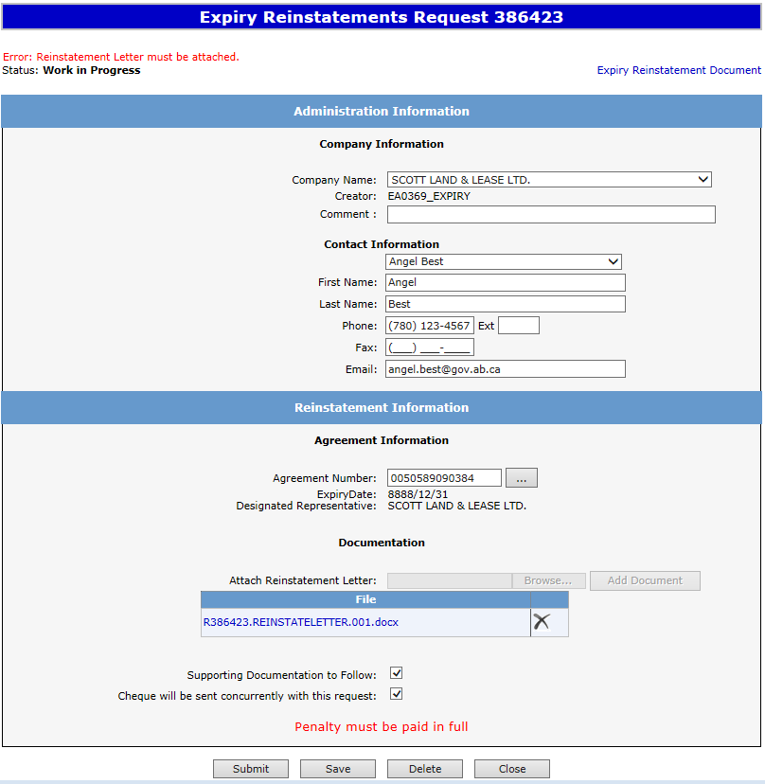
After your letter uploads, check off Supporting Documentation to Follow if you are submitting information or data. You will then check off Cheque will be sent concurrently with this request. Select Save and then Submit.
2. Select Cheque will be sent concurrently with request
Select Supporting Documentation if you are sending information or data.
ABC Company
Our File M1234
3. Select Save
4. Select Submit
0055555555555
ABC Company
Ensure you check off “Cheque will be sent concurrently with this request”. If this is not checked you will not be able to submit your request.

Slide 8
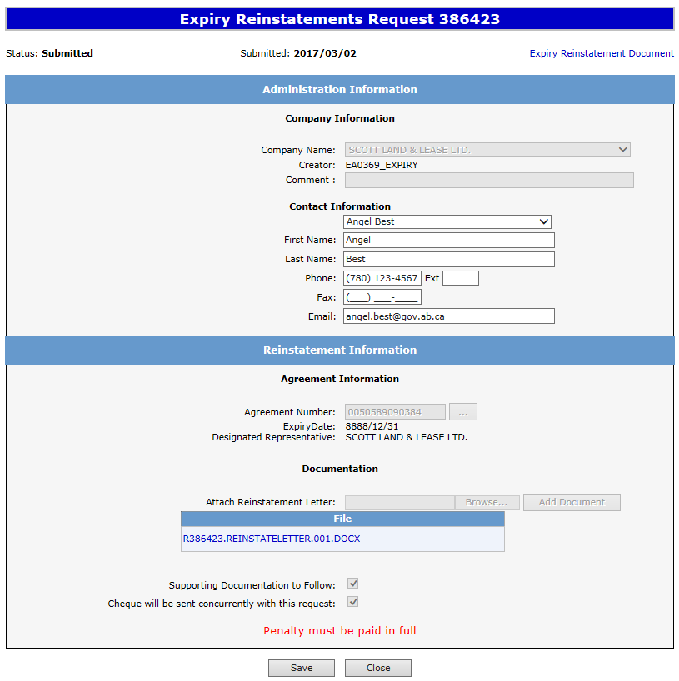
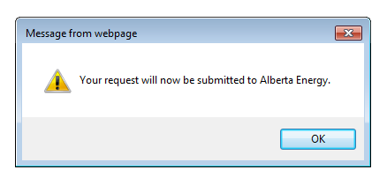
A Message Box will populate stating your request will be submitted to Alberta Energy. Select Ok. Your Expiry Reinstatement status will now be Submitted.
ABC Company
0055555555555
1. Select OK
ABC Company
Please note: If you wish to print out or save an electronic copy of your request, please select the “Expiry Reinstatement Document” on the top right hand of the screen.

Slide 9
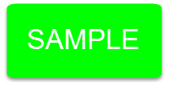
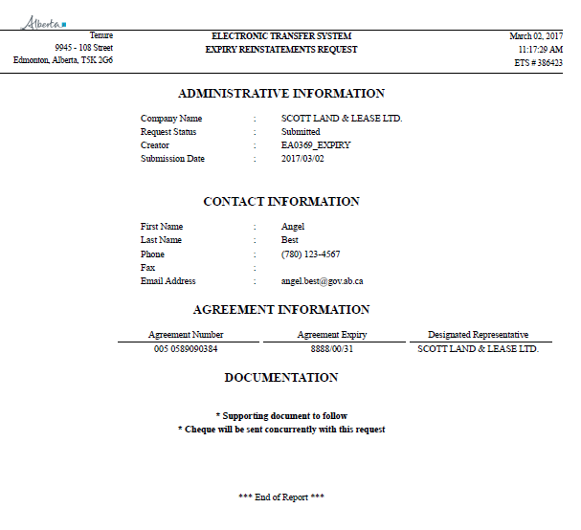
By selecting Expiry Reinstatement Document on the Administration Information screen, the following PDF document will populate for your records.
ABC Company
ABC Company
005 5555555555
ABC Company

Slide 10
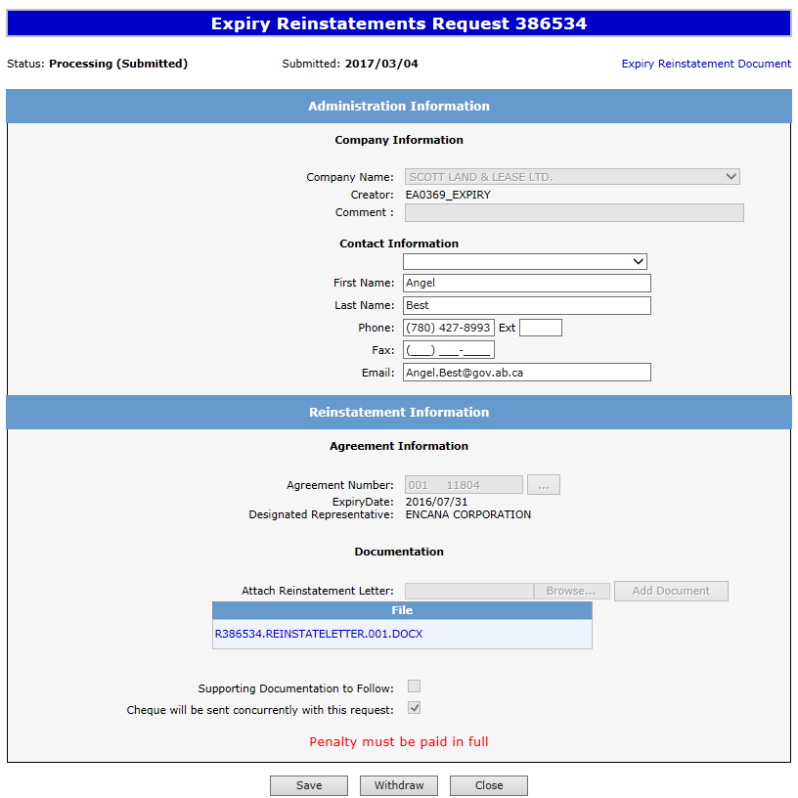
After submitting your request the Status will change to Processing (Submitted). At the bottom of the screen you must select either Save, Close or Withdraw Button.
Please note: By selecting the Reinstatement Document a PDF electronic version of your form will populate.
ABC Company
Our File M1234
055 5555555555
ABC Company

Slide 11
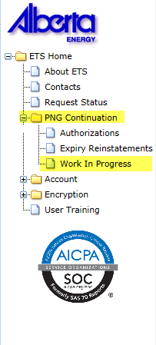
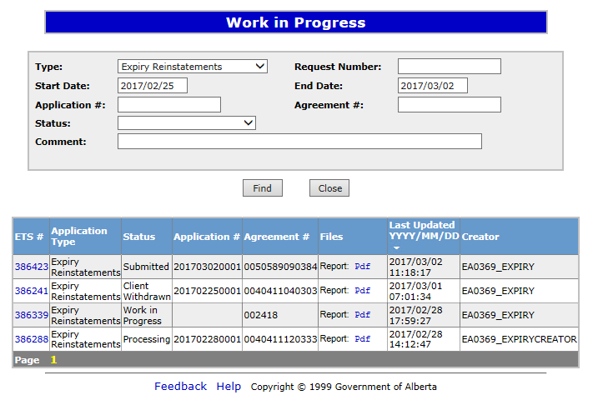
Work in Progress
The Work in Progress screen will populate, select Find and all your reinstatements currently in ETS will generate. By changing the parameters on the Work in Progress screen varying results will populate. You can also search by the Request Number.
1. Select Find
386534
005 5555555555
054 5555555555
001 5555555555
004 5555555555

Slide 12
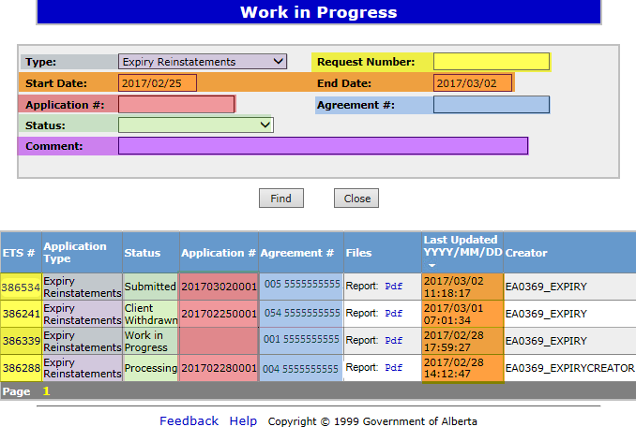
Request Status – Search Parameters and Result
Parameter Field | Result Column
Type | Application Type
Request Number | ETS #
Start/End Date | Last Updated
Application | Application #
Agreement # | Agreement#
Status | Status
Comment | (not shown as a result column)
You can utilize the search parameter fields to filter search results.
The table on the right shows the correlation between the parameter fields and each corresponding result column.
Below is a color-highlighted illustration of the Work in Progress search screen to further demonstrate the relationship between the data.
Our File 1234

Slide 13
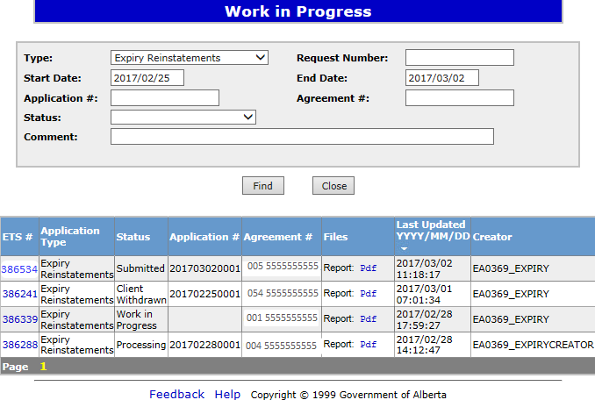
Request Status – Search Result
To load a request, click on the ETS Request number link.
To open a document click on the report Pdf link.
Search Results
Navigate with this page number, if there are multiple pages of search results.

Slide 14
Reinstatement Completed
If a decision is received by ETS, the request status becomes Completed.
An email may be sent from ETS informing your company’s contact that an offer is available for review and response. These email notifications are considered a courtesy and should not be relied on to track PNG Continuation requests in ETS.
When submitting a request through ETS, it is your responsibility to continually check your Work in Progress to determine if any decisions have been sent.

Slide 15
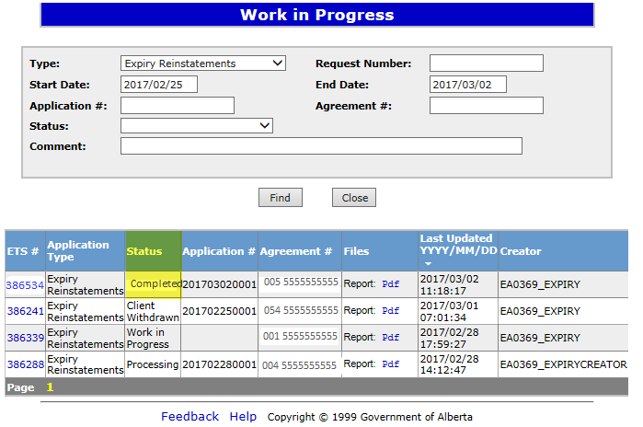
Select Work in Progress under the PNG Continuation node, the Work In Progress screen will populate. Select Find, and all of your Reinstatements currently in ETS will generate. You may also search your request using the Request Number provided to you with your original submission.
1. Select Find

Slide 16
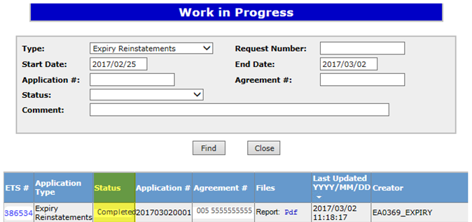
Rental Reinstatement Letter
Select Final Pdf and the Reinstatement Letter will populate.
1. Select PFD

Slide 17
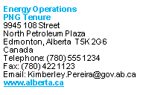
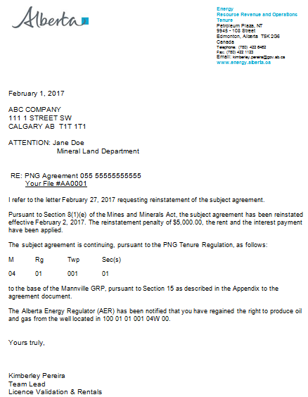
Expiry Reinstatement Letter
February 28, 2017

Slide 18
Expiry Reinstatement - Withdraw
By selecting either the Expiry Reinstatement Type or by entering the Request Number you may access your submission and Withdraw your request.
To Withdraw your Expiry Reinstatement request, the Status will need to be Submitted. At this point you will access the Work in Progress screen and click on the ETS Request Number. You may Withdraw your Expiry Reinstatement at anytime while the Status is Submitted or Processing (Submitted).
1. Select Request Number

Slide 19
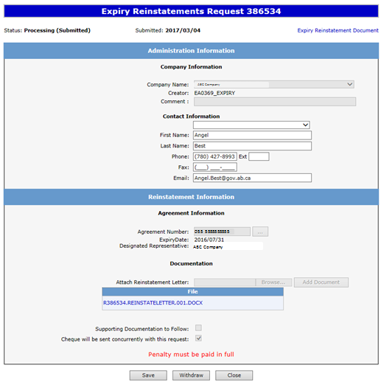
The Administration Information screen will populate displaying the Company Information and the Agreement Information to Reinstate. Click on the Withdraw button at the bottom of the screen.
386423
005
1. Click Withdraw

Slide 20
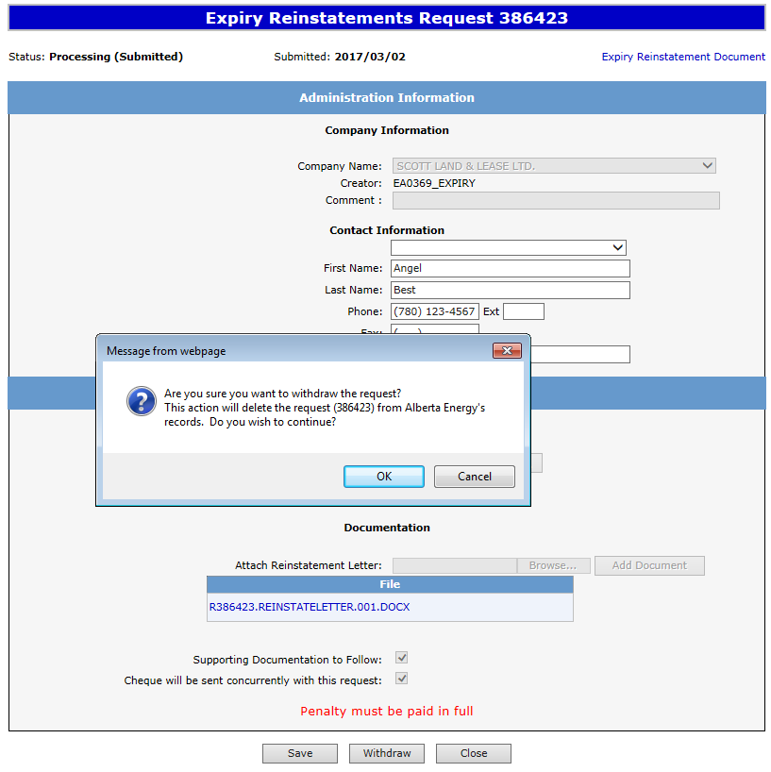
A Message box will populate confirming the Withdrawal of your Expiry Reinstatement application. To proceed click the Ok button.
ABC Company
2. Click OK

Slide 21
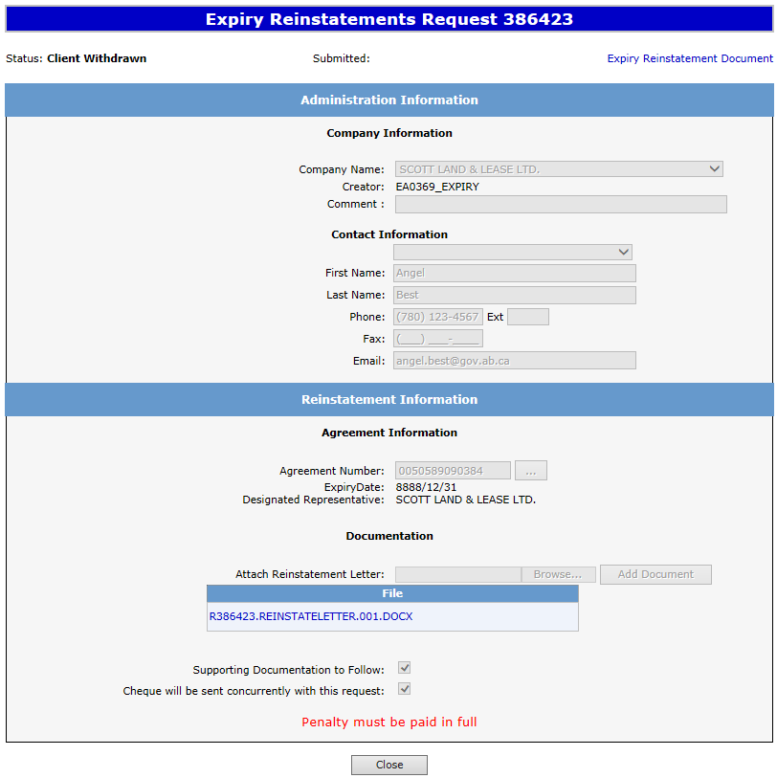
Once you select Ok, the Administration Information screen will populate with the Status of Client Withdrawn. All information has been deleted from Alberta Energy’s records. Select Close, you will be taken back to Work In Progress.
Please note: By selecting the Reinstatement Document a PDF electronic version of your form will populate.
ABC Company
005 5555555555
ABC Company
1. Select Close

Slide 22
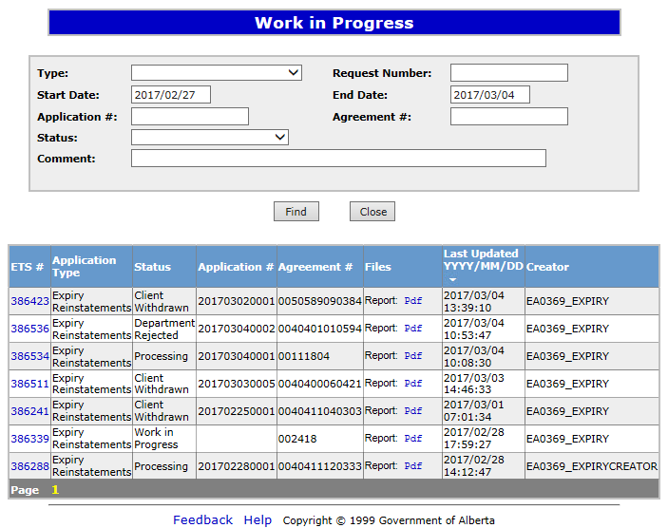
The Work in Progress screen will confirm the Expiry Reinstatement has been Client Withdrawn.
Expiry Reinstatement
005 5555555555
055 5555555555
054 5555555555
001 5555555555
004 5555555555
005 4444444444
004 4444444444

Slide 23
Resources
ETS Support and Online Learning provides access to relevant guides, courses and other information.
If you have questions, please contact PNGContinuations.Energy@gov.ab.ca
or the PNG Tenure Help Line at (780) 644-2300.

Slide 24
Congratulations!
Congratulations!
You have completed the ETS – PNG Continuation: Expiry Reinstatement
Online Training Course
To access Courses, Guides and Forms for all your ETS Business please see ETS Support and Online Learning.
If you have any comments or questions on this training course,
please contact:
Crown Agreement Management
Helpdesk: (780) 644-2300
Email inquires: PNGContinuations.Energy@gov.ab.ca

