Slide 1
Welcome!
To the ETS – Encumbrance
Registration of Security Notice, Assignment of Security Interest and Discharge of Security Interest (Full or Partial)
Online Training Course
This is the process of submitting a Security Notice upon interest in Crown minerals, Assignment of Security Interest and discharge of Security Interest for registration.

Slide 2

Encumbrance
Government of Alberta
Revision Page
Revisions Table
Date | Revisions Type | Page Number
May 3, 2018 | Initial Creation | All
April 2020 | Updates to Headings | All
November 2022 | Updated | Includes Geothermal Agreements
February 2023 | Updated treenode screenshots | 4, 12-13, 19, 32, 35

Slide 3
Encumbrance
Government of Alberta
Introduction
In this module, you will learn how to:
Register a Security Notice
Register an Assignment of Security Notice
Register a Full/Partial Discharge of a Security Notice
Use Query by Land
View Work in Progress
View ETS Encumbrance Request Status
Retrieve Final Document(s)
Click on any of the above to be directed to the corresponding instructions in the module.
Prerequisite Learning Module
Prior to proceeding we recommend you review the Encumbrance Roles Module located on the Online Learning portal.

Slide 4
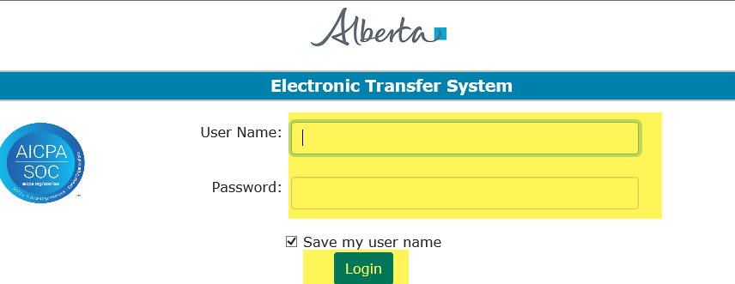
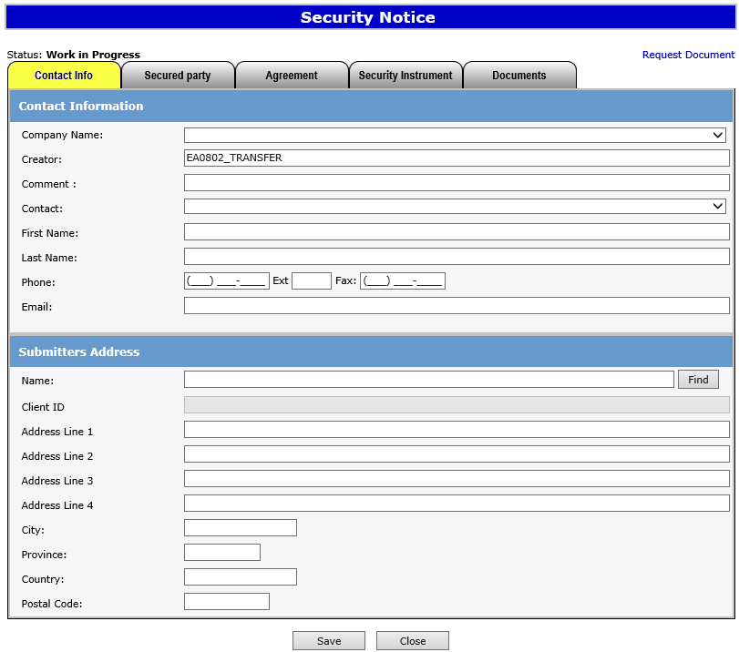
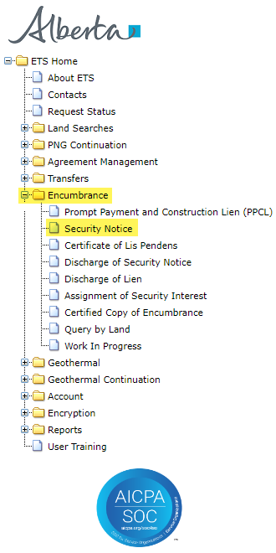
SECURITY NOTICE
1. Login to ETS with your user name and password.
2. Click Encumbrance.
3. Click Security Notice.

Slide 5
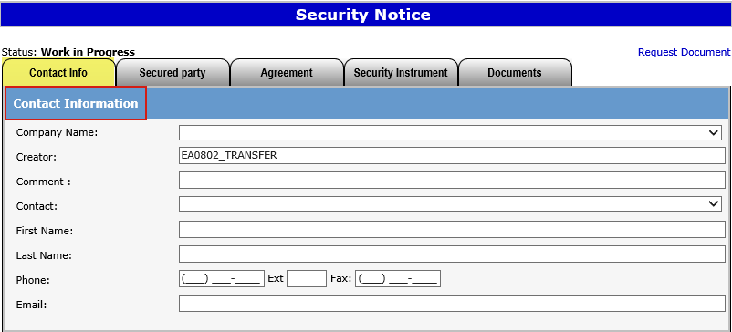

Enter Contact Information
1. Select Company Name from drop down menu.
2. Select Contact from drop down list. This will auto generate the information below.
Users can also manually enter in Contact Information by typing into the fields above.
Status will remain Work in Progress until user completes all tabs and submits request.

Slide 6
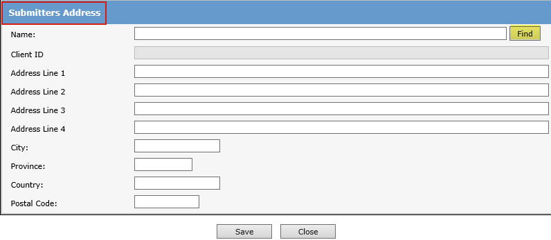
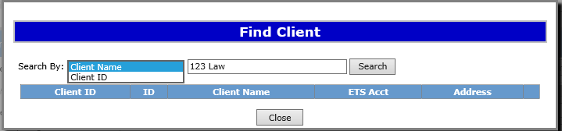
Enter Submitters Address
1. Type in Company Name and hit Enter or click Find to search for the applicable Client Name.
User can Search Submitter info by Client Name or Client ID.
2. Type in Client Name or DOE Client ID.
3. Click Search.
If mandatory fields are not entered (displayed with a red asterisk *) or validation fails, a red error message will appear at the top of the page. Input must be corrected in order to save Contact and Submitter Information.

Slide 7
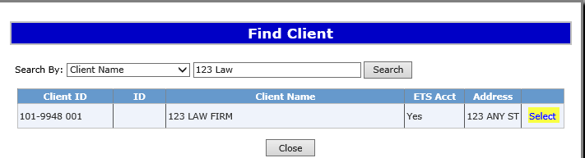
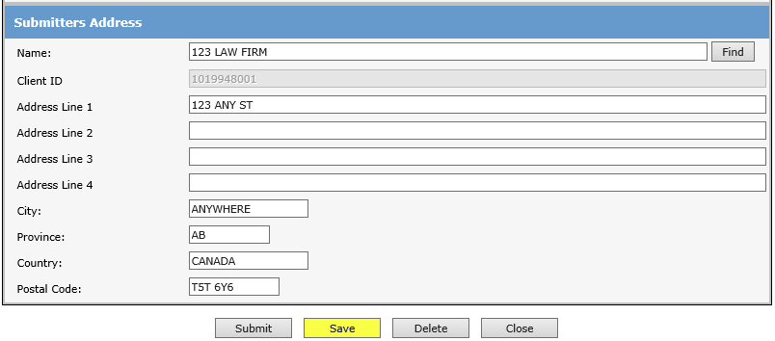
Enter Submitter Address (Cont’d.)
A pop up window will generate a list of Client Names and addresses. Scroll to find the relevant client and address.
1. Click on Select to continue.
The submitters address of the selected Client will auto generate. Verify the address is correct.
2. Click Save to proceed.
User can manually enter Submitters Address, if the correct address is not displayed in the search.
Saving periodically is recommended as the screen will timeout after 15 minutes of inactivity.

Slide 8
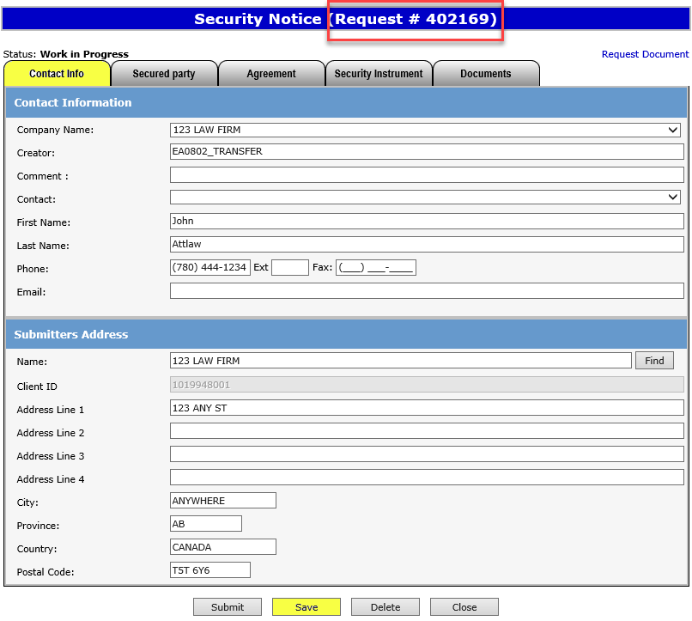
ETS Request Number
Ensure the contact information and submitters address are correct. The company name MUST be the same as the submitters Address Name.
Click Save.
An ETS request number will be displayed at the top of the screen.
The ETS request Number will be used to track your request in the Work in Progress node (slide 27).

Slide 9
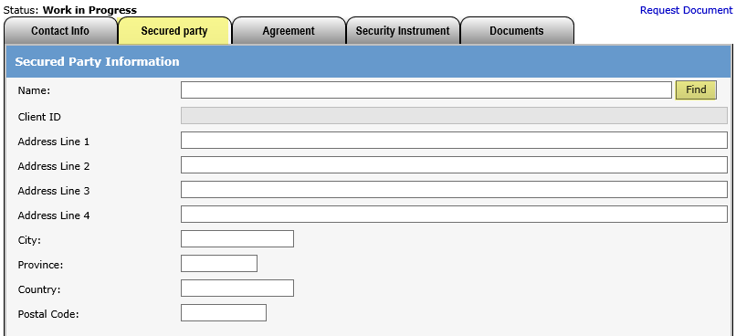
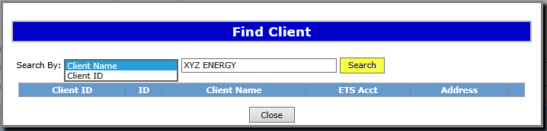
Enter Secured Party
Click on the Secured party tab to enter the Secured Party contact information.
By clicking Find users can search by Secured Party name, or if client is not found, user can enter the Secured Party name and address manually.
1. Click Find to search by Client Name, or Client ID.
2. Type in Client Name or Client ID and click Search.

Slide 10
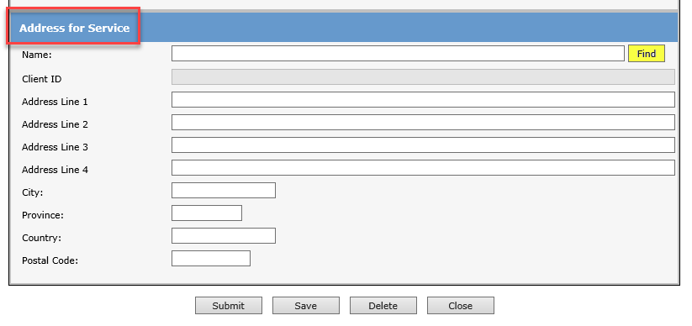
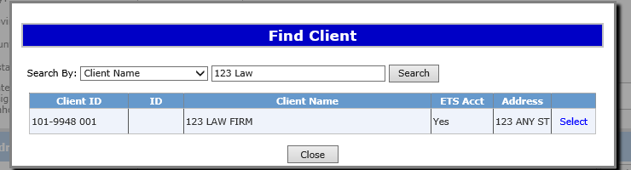
Secured Party Address for Service
1.Type in Company Name and hit Enter or Click Find to search for Client Name.
Users will enter the Secured Party Address for Service.
If clients address cannot be found, user can manually type in the address.
Click Save at the bottom of the screen.
2. A list with client name and address will appear. Click on Select to choose which address to use.

Slide 11
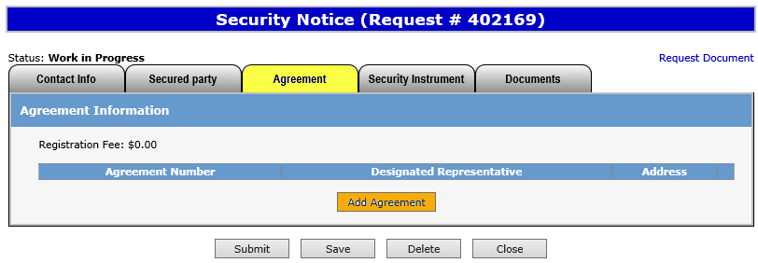

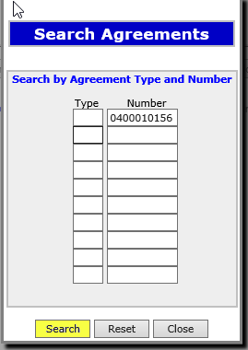
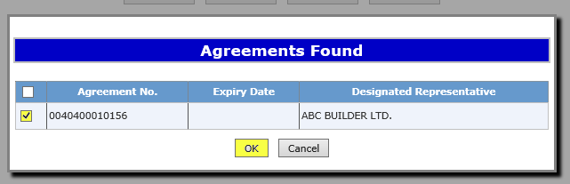
Enter Agreement Information
1. Click on Add Agreement to search the agreement(s) which the security notice will be registered against.
2. Enter the Agreement number(s) in the Search Agreement box, when done entering all agreements click Search.
3. Select the relevant agreements using the check box and click OK.
If unable to locate the agreement number a Query by Land search can be done.
Please see slides 12 - 13 for guide. Agreement numbers including Geothermal, Oil Sands, Coal and Mineral Development and PNG.

Slide 12
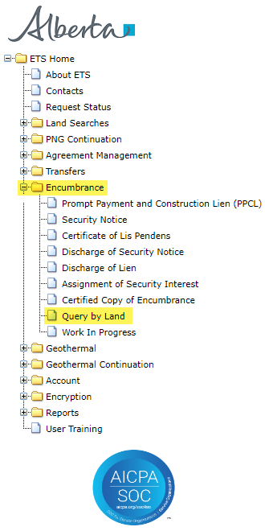
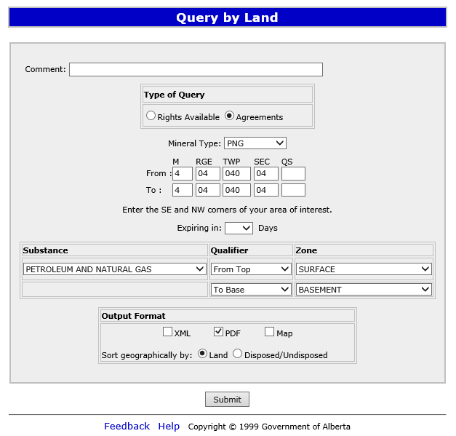
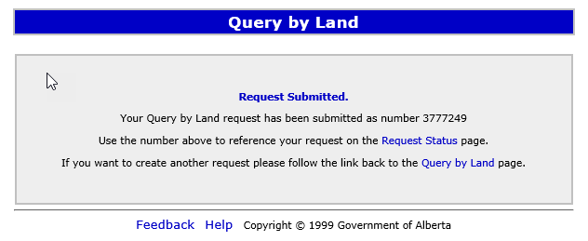
Encumbrance
Government of Alberta
QUERY BY LAND
1. Click on Agreements.
2. Choose mineral type.
3. Enter land description.
4. Click on PDF.
5. Click Submit.
A request number will display on the screen. Keep this request number to locate your search on the Request Status screen.
12

Slide 13
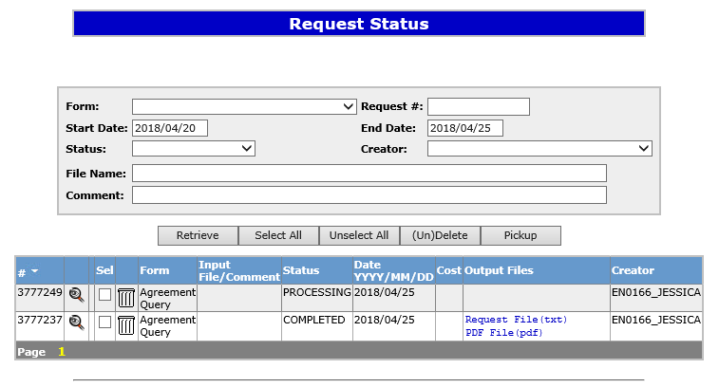
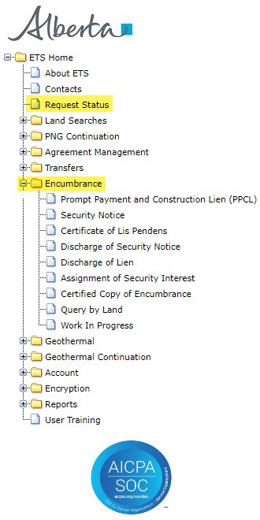
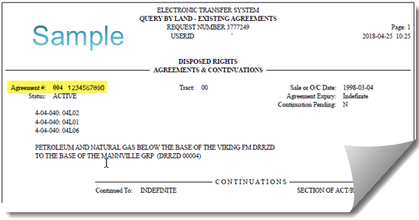
Encumbrance
Government of Alberta
1. Enter request number, or click Retrieve to display all requests.
2. Click on PDF File (pdf) to display results
Active agreement numbers on the lands requested will be displayed.
13

Slide 14
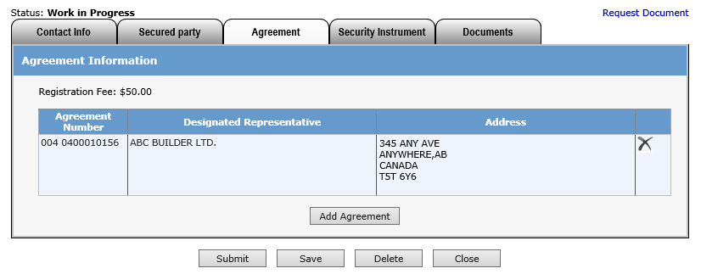
Enter Agreement Information (Cont’d.)
Agreement information (Agreement Number, Designated Representative and Address will be displayed.
Click on the “X” icon to delete the agreement.
4. Click Save to update the information entered.
The fee for registration is $50.00 per agreement. Invoices for registrations will be mailed out monthly to the submitter of the request.
14

Slide 15
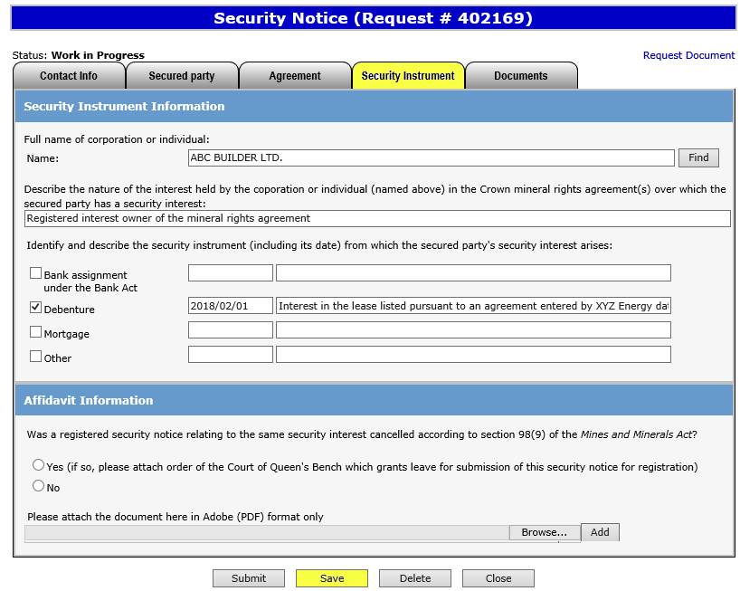
Security Instrument
1. Click Find to search for client name, or manually enter clients name and address if not found.
2. Describe nature of interest held by corporation above.
3. Identify security instrument (including date).
4. Verify information and click Save.

Slide 16
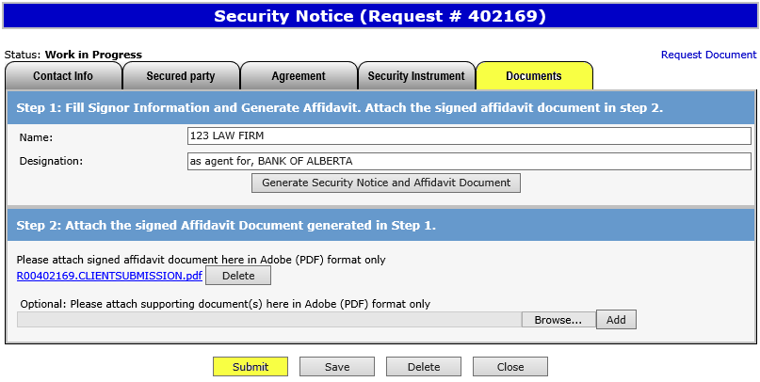
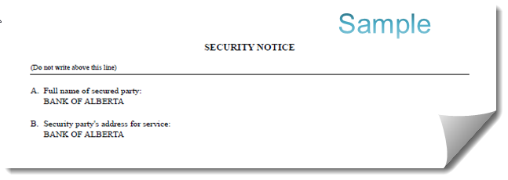
Generate and Sign Security Notice
Click on the Documents tab to generate the Security Notice.
The request will be validated to make sure all necessary information has been entered. If all required information is not entered, an error will appear on the top of the screen.
Review and print the Security Notice and Affidavit form.
1. Enter name and capacity of signor.
2. Click on Generate Security Notice and Affidavit Document.

Slide 17
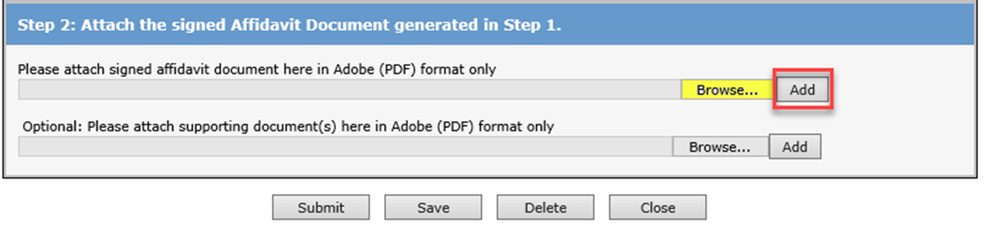
Encumbrance
Government of Alberta
Uploading Documents
1. Select browse to upload the signed security notice and affidavit form.
(Must be PDF formatting)
2. Click Add.
3. Click Save and Submit.
If you would like to add additional documents, you may attach cover letters, etc. in the optional supporting documents line prior to submitting by following the same process above. Please ensure that the documents you are adding are not password protected.
17

Slide 18
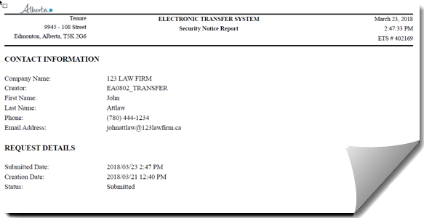
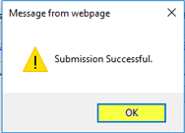
Encumbrance
Government of Alberta
Request Document
The Request Document link will show the date and time your request was submitted, which will become the registration date if approved. Please retain a copy for your records.
The request status will show the date and time the request was submitted.
Sample
If are you unable to submit a request, please ensure you have the proper ETS roles assigned to you by your ETS site administrator.

Slide 19
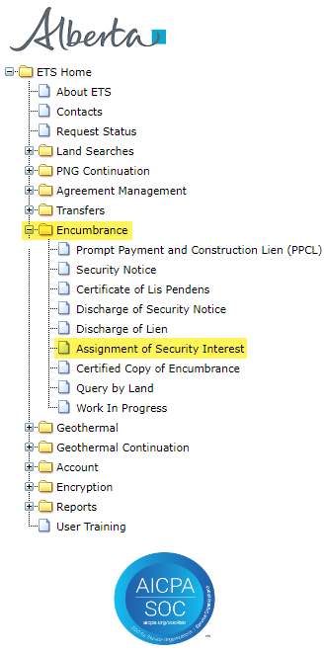
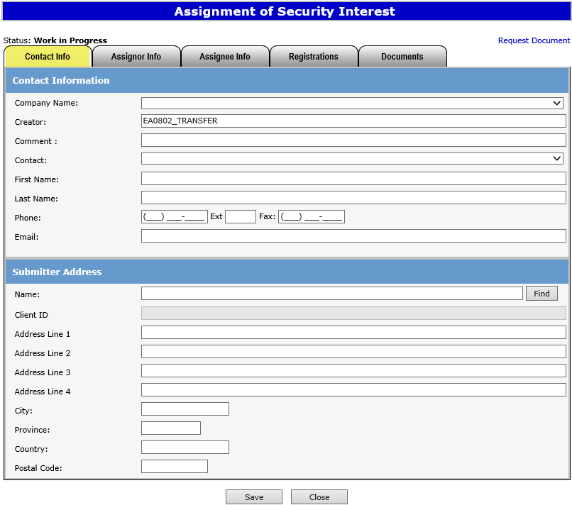
Encumbrance
Government of Alberta
ASSIGNMENT OF SECURITY INTEREST
1. Click on Encumbrance.
2. Click on Assignment of Security Interest.
19

Slide 20
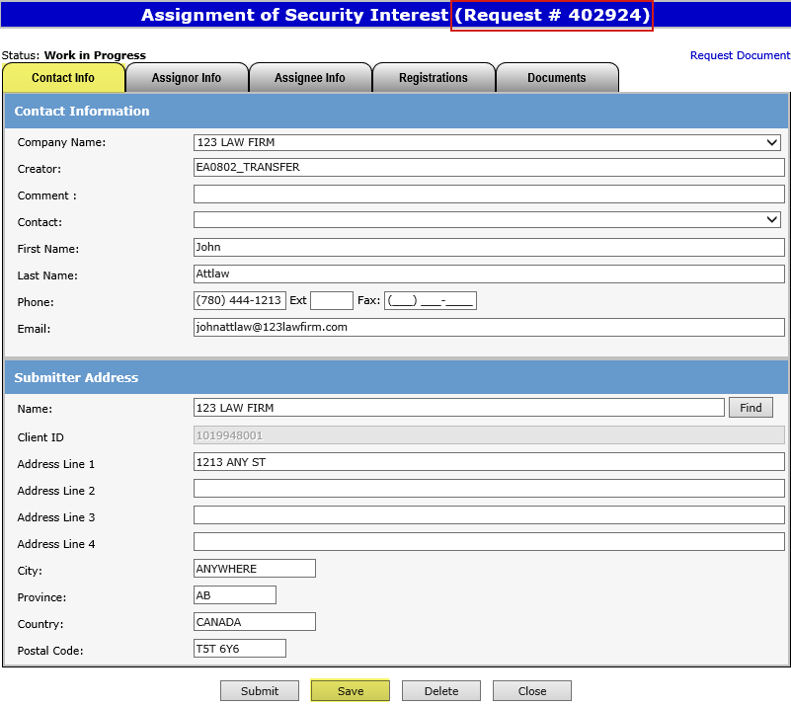
Encumbrance
Government of Alberta
ETS Request Number
Ensure the contact information and submitters address are correct. Also ensure that both the Company name and the Submitters address name are the same.
Click Save.
An ETS request number will be displayed at the top of the screen.
The ETS request Number will be used to track your request in the Work in Progress node.
(Slide 27)
20

Slide 21
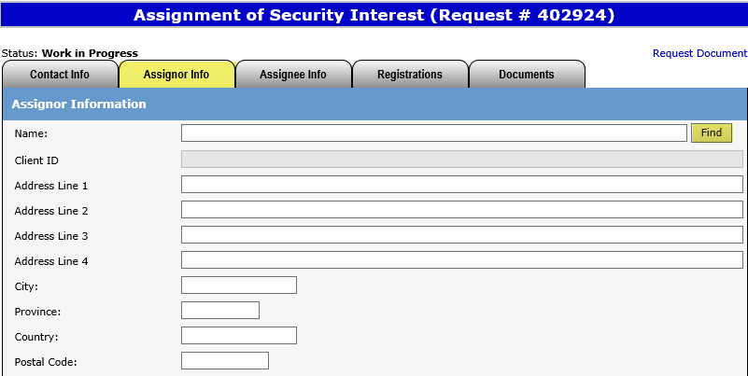
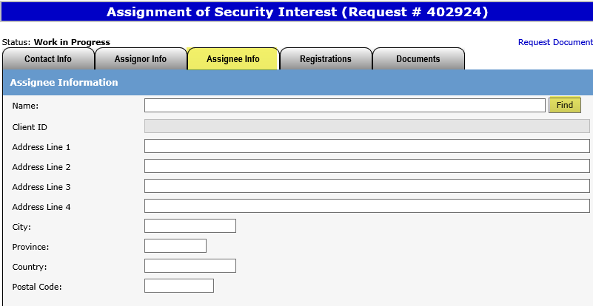
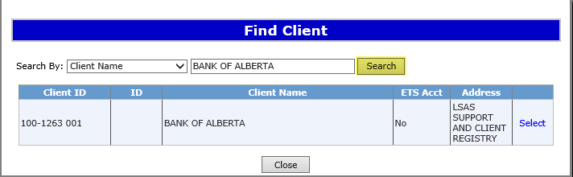
Encumbrance
Government of Alberta
Enter Assignor & Assignee Info
1. Click Find to search by Client Name, or Client ID.
Click on the tabs to enter the Assignor and Assignee information.
By clicking Find users can search by Assignor or Assignee name, or user can enter the Assignor and Assignee name and address manually, if client is not found.
2. Type in Client Name or Client ID and click Search.

Slide 22
Encumbrance
Government of Alberta
Assignee Address for Service (Cont’d.)
Users will enter the Assignees Address for Service.
If the relevant client address cannot be found, user can manually type in the address.
Click Save at the bottom of the screen.
3.Type in Company Name and hit Enter or Click Find button to search for Client Name.
4. Select the applicable Company Name by clicking on Select.
22

Slide 23
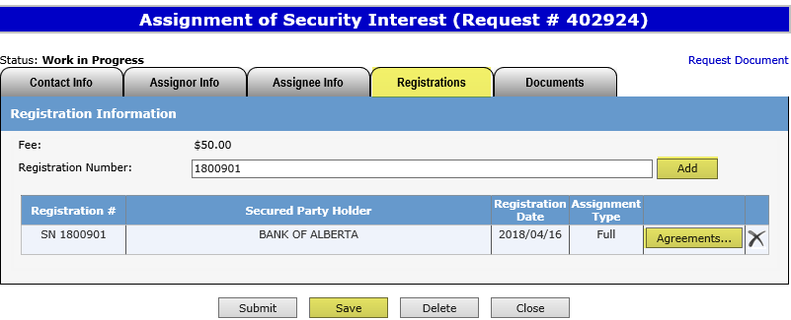
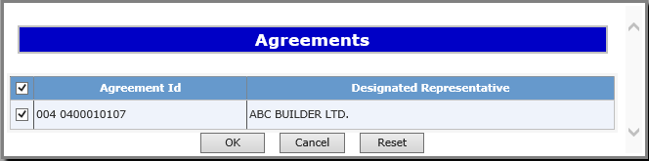
Encumbrance
Government of Alberta
Enter Registration Number
1. Enter the Registration number which the Assignment of Security Interest will be registered against.
2. Click Add.
3. To view all agreements on the Security Notice, or to partially assign the security interest, click Agreements.
4. Click Save once completed.
4. Deselect the agreement(s) that are not being assigned for a Partial Assignment of Security Interest.
The fee for registration is $50.00 per agreement. Invoices for registrations will be mailed out monthly to the submitter of the request.
23

Slide 24
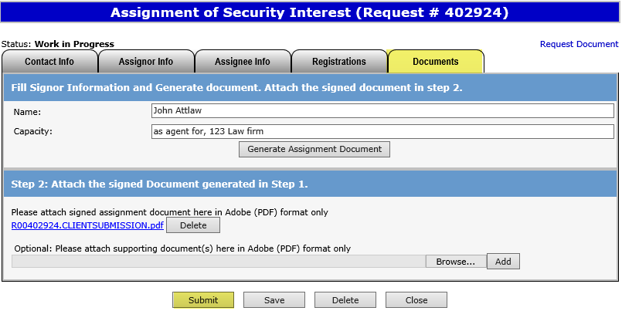
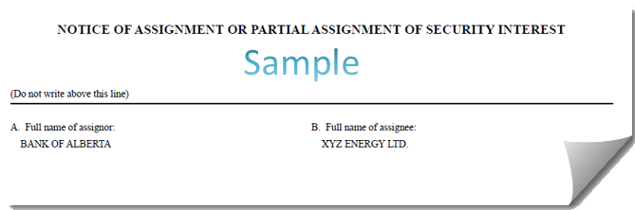
Encumbrance
Government of Alberta
Generate and Sign Assignment Document
Click on the Documents Tab to generate the Assignment Document.
The request will be validated to verify all required fields have been entered. If information is missing, an error will appear on the top of the screen.
Review and print the Assignment Document for your records.
1. Enter name and capacity of signor.
2. Click on
Generate Assignment Document.
24

Slide 25
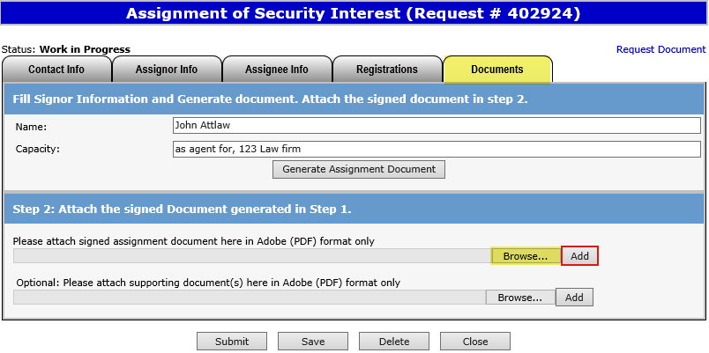
Encumbrance
Government of Alberta
Upload Document
1. Click Browse to upload the signed security notice and affidavit form.
(Must be PDF)
2. Click Add.
3. Save and Submit.
If you would like to add additional documents, you may attach cover letters, etc. in the optional supporting documents line. Do not attach documents that are password protected.
25
25

Slide 26
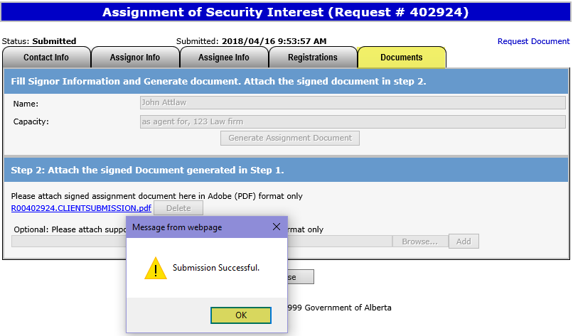
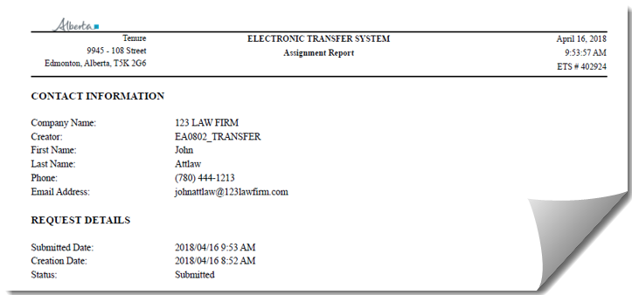
Encumbrance
Government of Alberta
Request Document
The request status will show “Submitted” and the date and time. This date will be the registration date if approved.
Sample
If are you unable to submit a request, please ensure you have the proper ETS roles assigned to you by your ETS Site Administrator.

Slide 27

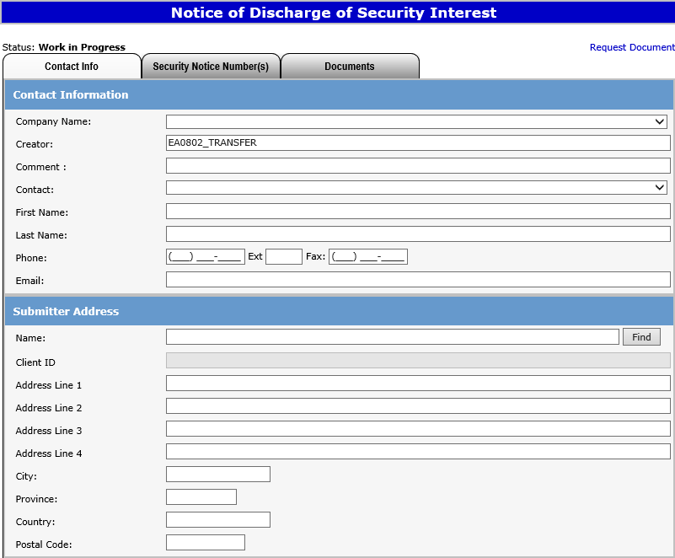
Encumbrance
Government of Alberta
DISCHARGE OF SECURITY INTEREST
1. Click on Encumbrance.
2. Click on Discharge of Security Notice.

Slide 28
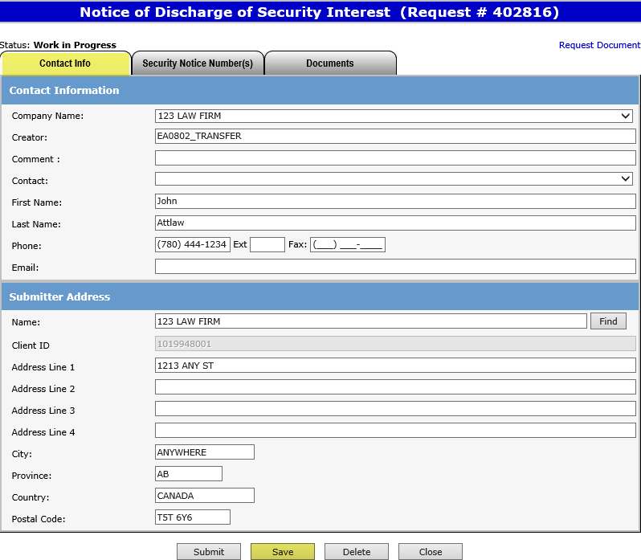
Encumbrance
Government of Alberta
ETS Request Number
Ensure the contact information and submitters address are correct. Also ensure that the Company name and the Submitter address name is the same.
Click Save.
An ETS request number will be displayed at the top of the screen.
The ETS request Number will be used to track your request in the Work in Progress node
(Slide 27)

Slide 29
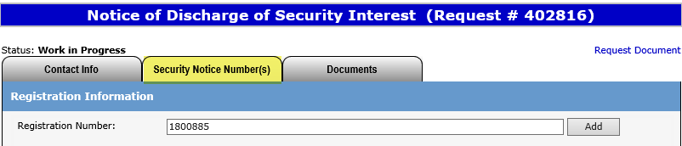
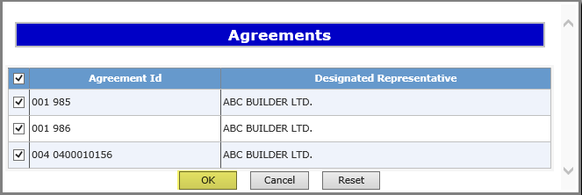
Encumbrance
Government of Alberta
Enter Registration Number
1. Enter the relevant Registration Number to be discharged and click Add.
2. Click Agreements to view all agreements listed under the Security Notice.
3. For partial discharges, agreements can be deselected and click OK.

Slide 30
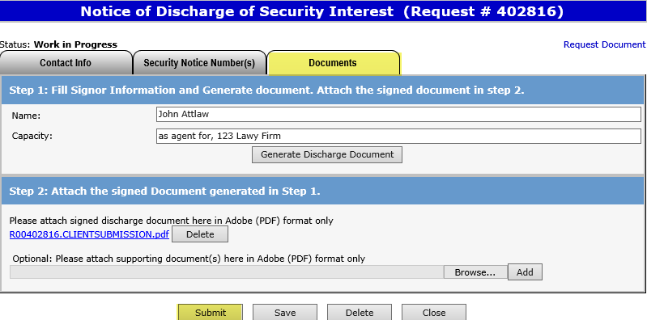
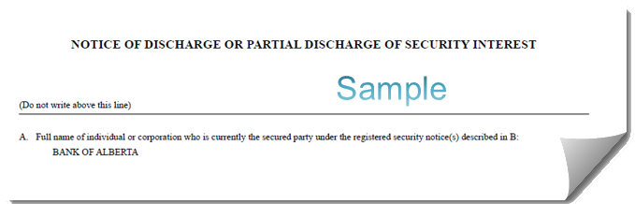
Encumbrance
Government of Alberta
Generate and Sign Discharge Document
Click on the Documents Tab to generate the Discharge Document.
1. Enter name and capacity of signor.
The request will be validated to make sure all necessary information has been entered. If not all required information is entered, an error will appear on the top of the screen.
Review and print the Discharge Document for your records. Please attached the document, ensure that it is not password protected.
2. Click on Generate Discharge Document.

Slide 31
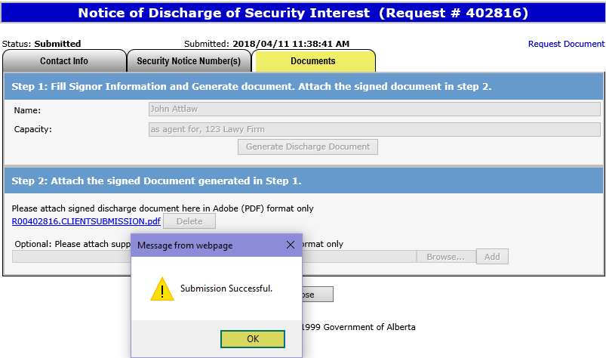
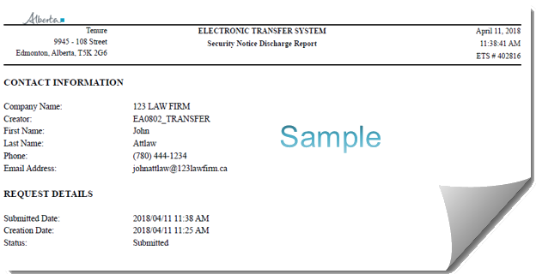
Encumbrance
Government of Alberta
Request Document
The request status will show “Submitted” and the date and time. This date will be the registration date if approved.
If are you unable to submit a request, please ensure you have the proper ETS roles assigned by your ETS Site Administrator.

Slide 32



Encumbrance
Government of Alberta
WORK IN PROGRESS
1. Enter your ETS request Number and click Find.
2. Click on the ETS # Link to retrieve the Security Notice.
Users can retrieve saved encumbrance requests by clicking on Work in Progress (WIP) in the side menu.
32

Slide 33

Encumbrance
Government of Alberta
ETS ENCUMBRANCE REQUEST STATUS
The status of an encumbrance is also available when searching an ETS request number.
There are 5 types of statuses:
Work in Progress (WIP) – request is created but not submitted.
Submitted – request is submitted. (Submitted date & time will be the registration date).
Processing – request is received and being processed by Alberta Energy.
Completed – request has been registered and documents are available to be viewed/printed.
Department Rejected – request has been rejected by Alberta Energy and documents are available to be viewed/printed.
Client Cancelled – request has been cancelled by client.
The WIP screen will show the ETS Request Number, Application Type, Status, Comments, files, when the request was last updated and the Creator.
33

Slide 34

Encumbrance
Government of Alberta
RETRIEVING FINAL DOCUMENTS
Sample
An email notification (sample above) will be sent to notify users that the encumbrance request has either been completed or department rejected.
The user will be able to access the registration advice and registered documents by signing into their ETS account.

Slide 35


Encumbrance
Government of Alberta
Retrieving Final Documents (Cont’d.)
1. After Logging onto ETS Select Encumbrance.
3. Enter in your Request Number and click Find.
4. Click on Final PDF link.
2. Click on Work In Progress.
Final documents will also be available to view inside the ETS request screen.

Slide 36


Encumbrance
Government of Alberta
Retrieving Final Documents (Cont’d.)
Sample
Sample
The documents returned will include a Registration Advice Letter and a registered copy of the encumbrance form that was submitted. Please print these documents for your records as they will be removed from ETS after 90 days.
36

Slide 37
Encumbrance
Government of Alberta
Resources
ETS Support and Online Learning provides access to relevant guides, course and other information
If you have questions, please contact Transfers.Energy@gov.ab.ca or the Transfer Helpdesk at (780)644-2300
Page 37 of 38

Slide 38

Encumbrance
Government of Alberta
Congratulations!
You have completed the ETS – Encumbrance
Registration of Security Notice, Assignment of Security Interest and Discharge of Security Interest (Full or Partial)
Online Training Course
If you have any comments or questions on this training course,
please forward them to the following email address:
Transfers.Energy@gov.ab.ca
38
38

