Slide 1
Welcome!
Agreement Management – Surrenders: This is the process to complete and submit an Online Surrender request via ETS. The process begins with the creation of a new request through to submission. The request progresses through various stages (statuses) until its completion.
To the ETS – Agreement Management
Surrenders
Online Training Course

Slide 2
Revisions Page
Revisions Table
Date | Revisions Type | Page Number
March 10, 2017 | Initial Creation | All
June 2020 | Update Banner and add Resource page | All
October 2020 | Updated | Various
January 2022 | Updated | Slides 12, 15, 16, 22 and 25

Slide 3
Surrender - Introduction
In this module, you will learn how to:
Create and submit an Online Surrender request
Cancel or withdraw an Online Surrender request
View a response document(s)
Course Pre-requisites:
Training System Overview
ETS Account Setup and Preferences (For Site Administrators)
You must have the Creator role to create or withdraw a request and the Submitter role to submit a request.

Slide 4
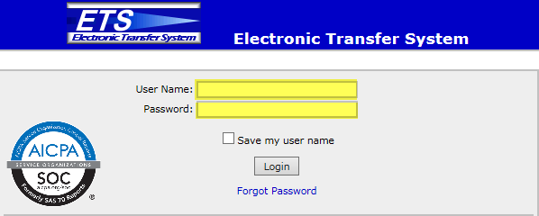
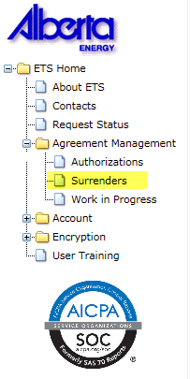
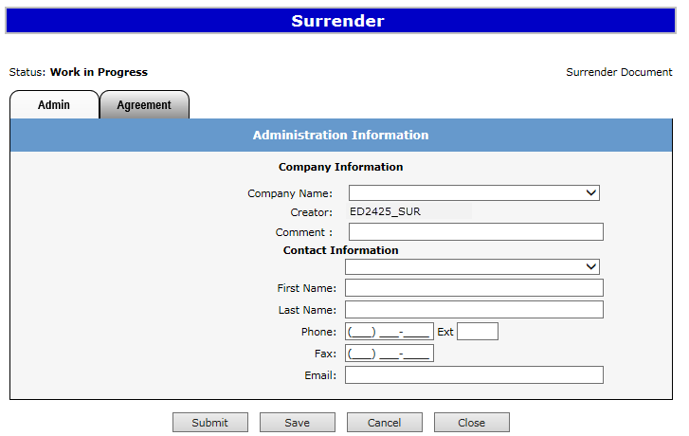
Login to ETS
1. Login to ETS with your User Name and Password
2. Expand
Agreement Management
3. Select Surrenders

Slide 5
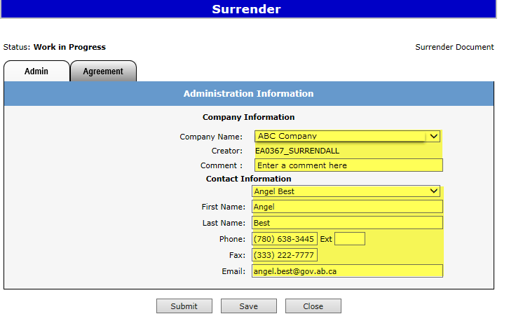
Create Surrender Request – Administration Information
When a request is created, its status is “Work in Progress”.
2. Select Company Name and optionally enter Comment
1. Select Admin tab.
3. Select Contact Information and edit if required
Use the Save button after completing information.

Slide 6
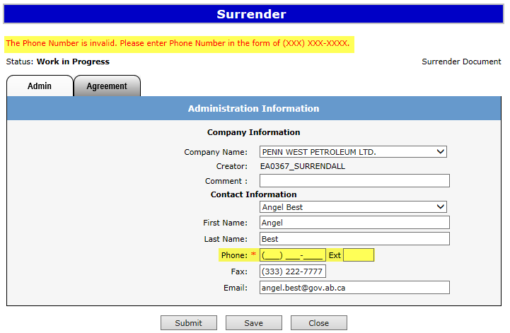
If information is not entered into a mandatory field, or the request validation fails, the screen will display a red error message. The request must be corrected and then you can try to save again.
Error
Message
ABC Company

Slide 7
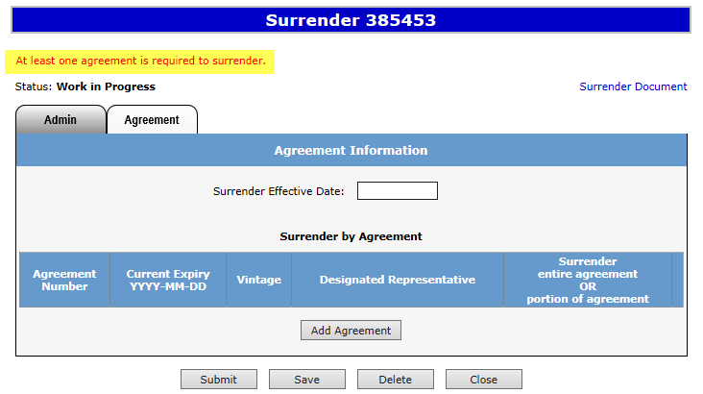
The ETS request number for the surrender is generated and displayed once the Admin tab is completed. At this time, the request can be retrieved and opened from your Work In Progress list.
1. Select Agreement tab.

Slide 8
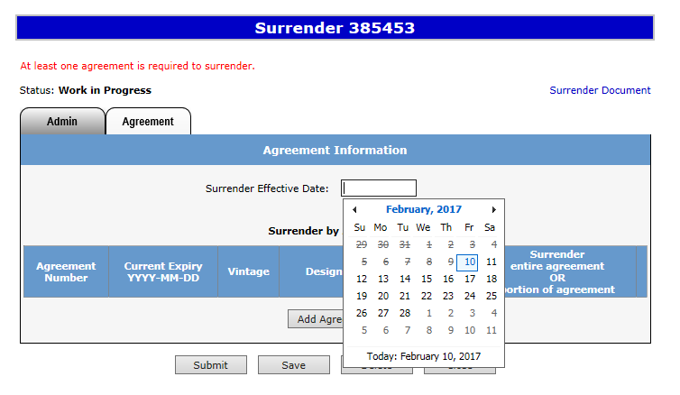
1. Select Surrender Effective Date.

Slide 9
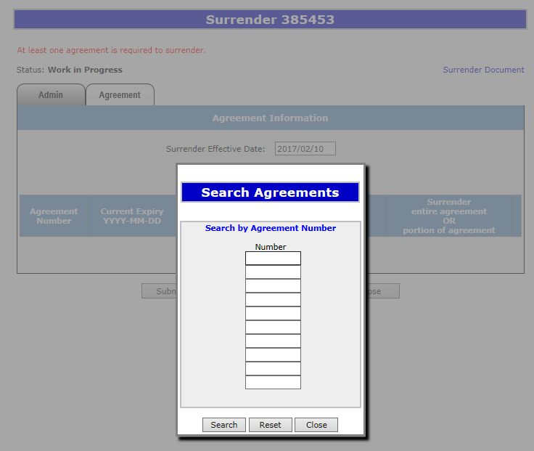
After selecting the Surrender Effective Date, click on the Add Agreement button. The Search Agreements screen will populate, enter the agreement number(s) and click Search.
1. Insert Agreement Number(s)
2. Click Search

Slide 10
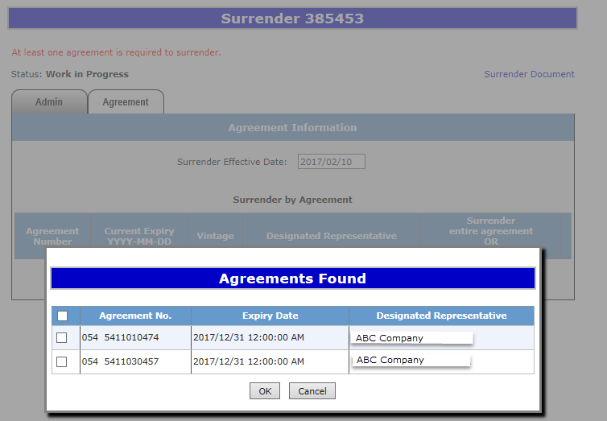
Once the Search button has been selected the Agreement Found screen will populate with all agreement(s) entered.
054 5400000001
ABC Company
001 1000
ABC Company

Slide 11
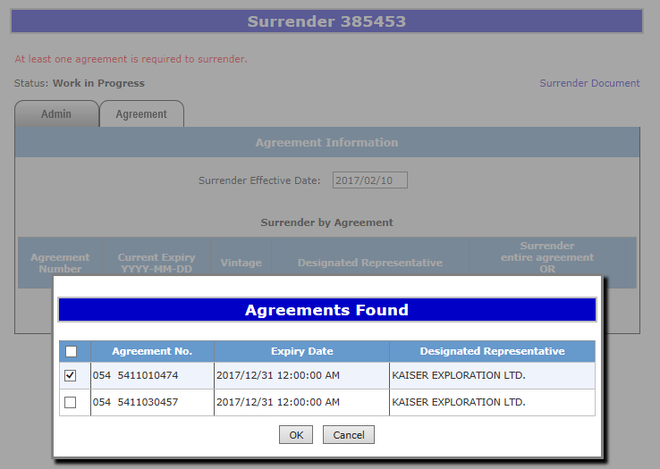
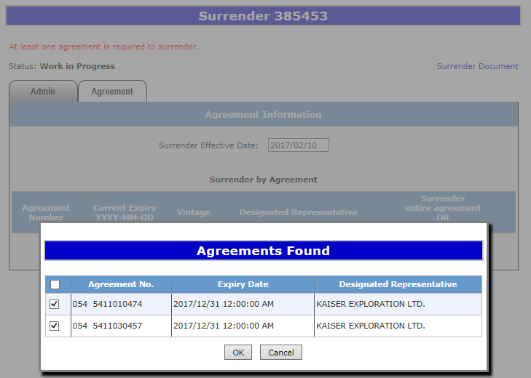
On the Agreements Found screen, select the agreement(s) you would like to fully or partially surrender by ticking off the check box and clicking Ok.
Selecting one agreement
054 00000001
ABC Company
Selecting two agreements
001 1000
ABC Company
054 00000001
ABC Company
001 1000
ABC Company

Slide 12
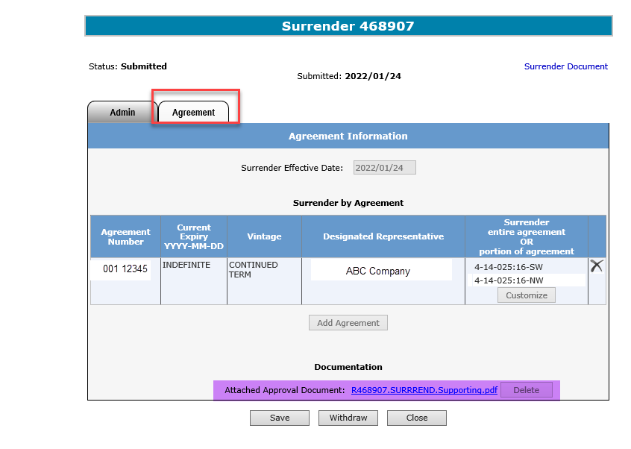
The Agreement Information Screen is updated with the Current Expiry; Vintage; and Land. You have the opportunity to Surrender the entire agreement or portion of the agreement by selecting the Customize button. You may also delete an agreement from the surrender request by selecting the . In the event that the surrender involves a bankrupt company, applicants must attach a written approval from the receiver. Please note that this must be in a PDF format.
Click the X to Delete the agreement from the Surrender request
Optional add document: First save the agreement number. Browse and add your document and press save.

Slide 13
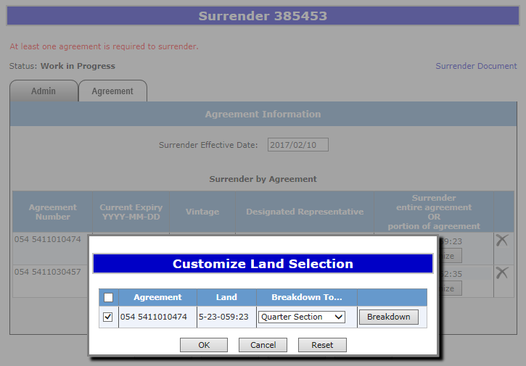
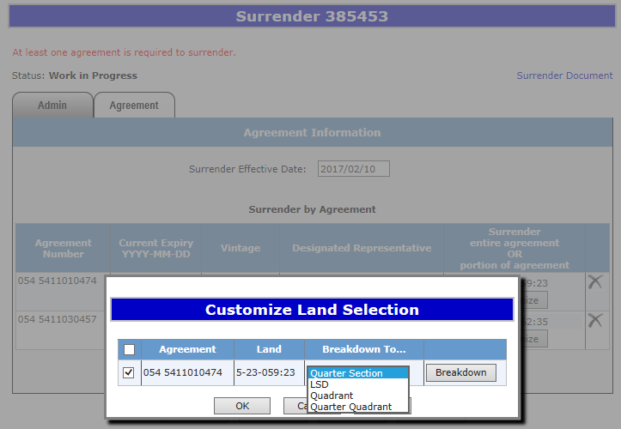
When you select the Customize button the Customize Land Selection screen will populate. You now can elect to Breakdown the land by toggling the arrow. The following options LSD; Quadrant; and Quarter Quadrant appear.
054 5400000001
054 5400000001
For an Initial Term, you cannot breakdown a portion of the land from how it was originally purchased. Example: If the original purchase was one section you cannot surrender a half section on an Initial Term.

Slide 14
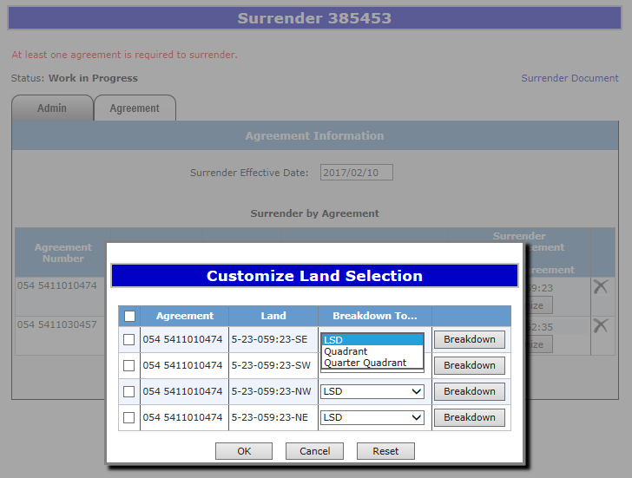
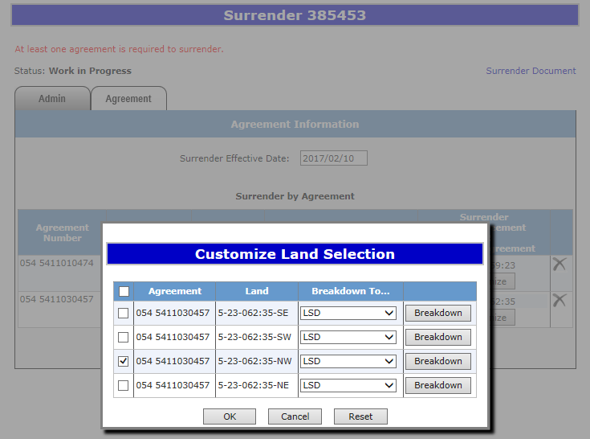
On the Customize Land Selection screen when LSD has been selected, another Customize Land Selection screen will populate on this screen select the LSD you want to surrender. Then click Ok.
001 1000
001 1000
001 1000
001 1000
001 1000
001 1000
001 1000
001 1000
Click OK
Click OK

Slide 15
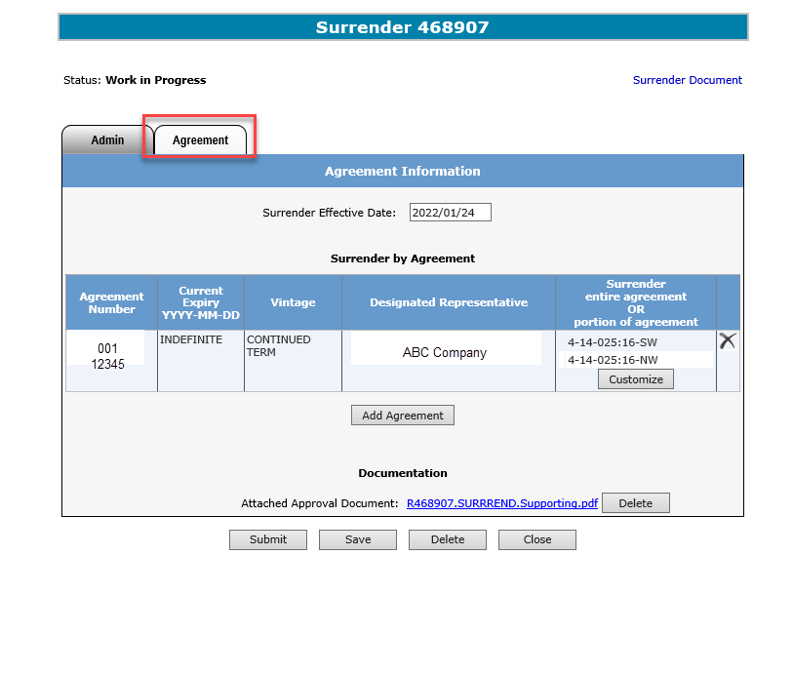
After you click Ok on the Customize Land Selection Screen, you will be taken back to the Agreement Information Screen. You will click Save and then Submit, a message will populate Are you sure you want to Submit Application? Click Ok and your request will be submitted, the agreement will move to Submitted status.
2. Click Submit
1. Click Save
Use the Save button after completing information.

Slide 16
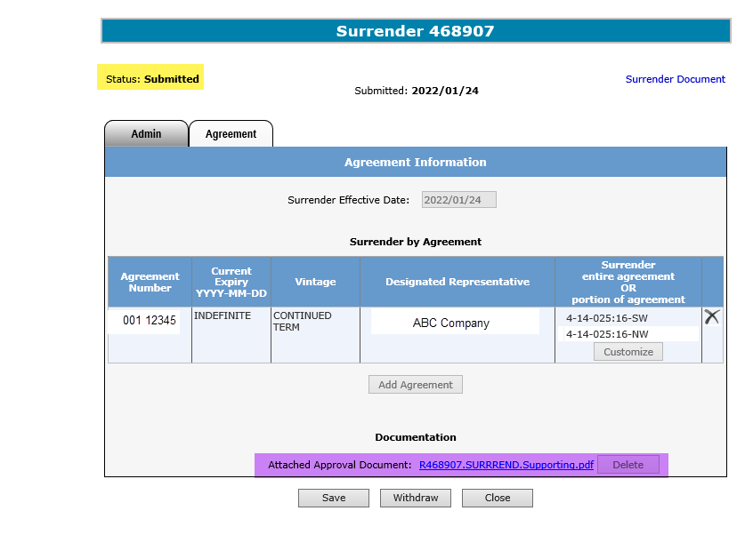
Once you have submitted your surrender request, ETS will update to Submitted. You can locate your agreement under the Work in Progress screen.
To view the document click on this link
Surrender successfully submitted. Processing will begin

Slide 17
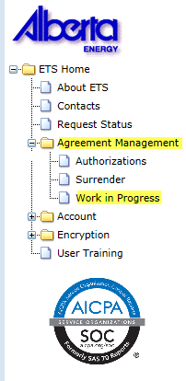
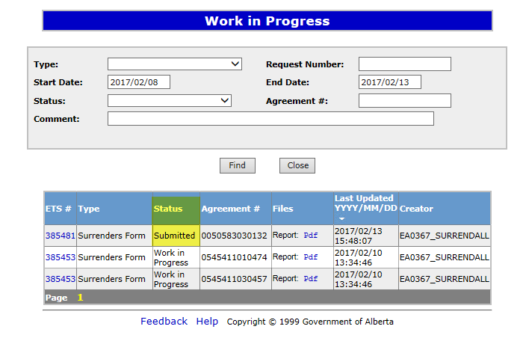
After your Surrender has been Submitted, the surrender request will move to the Work in Progress folder and the status will update to Submitted.

Slide 18
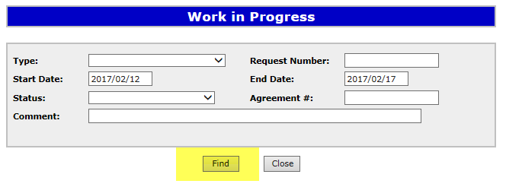
Work in Progress
2. Optionally choose your
Search Parameters
1. Select Work In Progress
3. Select Find
Remove the default date search parameters if you wish to retrieve all active items.

Slide 19
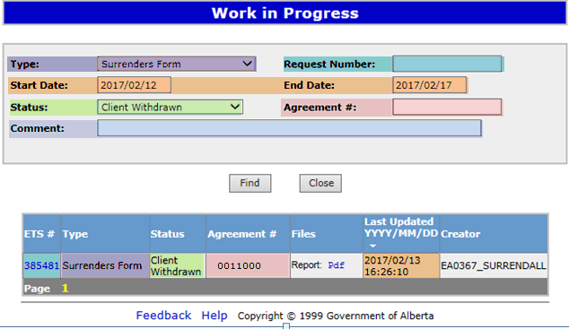
Parameter Field | Result Column
Type | Form Type
Request Number | ETS #
Start/End Date | Last Updated
Agreement # | Agreement #
Status | Status
Comment | (not shown as a result column)
Work In Progress – Search Parameters and Result
You can utilize the search parameter fields to filter search results.
The table on the right shows the correlation between the parameter fields and each corresponding result column.
Below is a colour-highlighted illustration of the Work in Progress search screen to further demonstrate the relationship between the data.

Slide 20
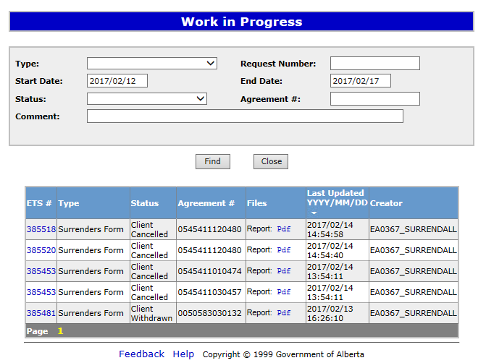
Work In progress – Search Result
To load a request click on the ETS request number link.
Search Results
To open a document click on the report Pdf link.
001 1000
001 2000
Navigate with this page numbers, if there are multiple pages of search results.
054 1000000000
004 1000000000
005 1000000000

Slide 21
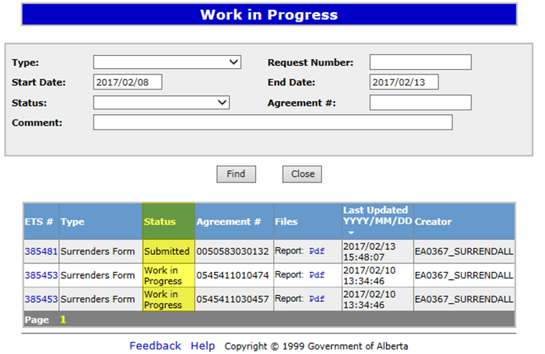
Work in Process
To check the status of your agreement, select the Work in Progress screen. On the lower portion of the screen under Status it will list the current status. Example: Submitted, Work in Progress, Completed, Processing; Client Withdrawn; and Client Cancelled.
001 1000
004 1000000000
054 1000000000

Slide 22
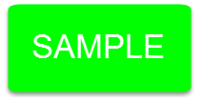
Upon completion of the Surrender request, a notification email will be sent to the site Administrator/Contact.
EXTERNAL SENDER. Do not open links or attachments that are unexpected. Do not give out User IDs or Passwords. Your Surrender Request Number XXXXXX for account ENXXXXX has been Completed. This request can be found under Agreement Management-Work in Progress. To review your request sign on to the Electronic Transfer System (ETS) website, available through Alberta.ca. Do not reply to this EMail. If you have questions or concerns please contact Energy.Rentals@gov.ab.ca.

Slide 23
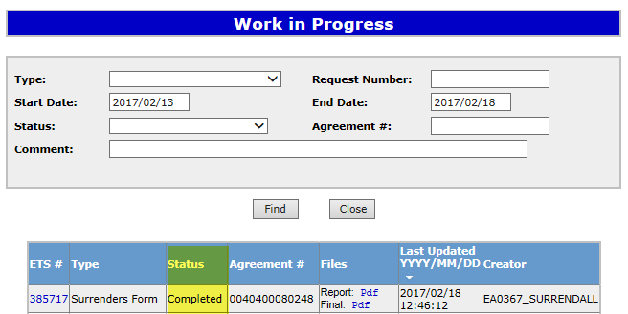
When your Surrender has been processed the Status on the Work in Progress screen will change to Completed. You can view your documents by selecting the Pdf under Files.
001 1000
1. Select Pdf

Slide 24
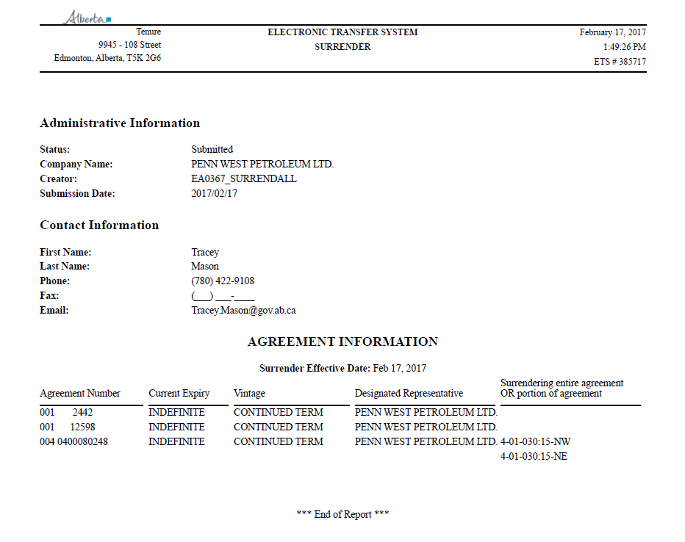
1. Select Pdf
When Report Pdf is selected, the following document will populate.
ABC Company
001 1000
004 1000000000
054 1000000000
ABC Company
ABC Company
ABC Company

Slide 25
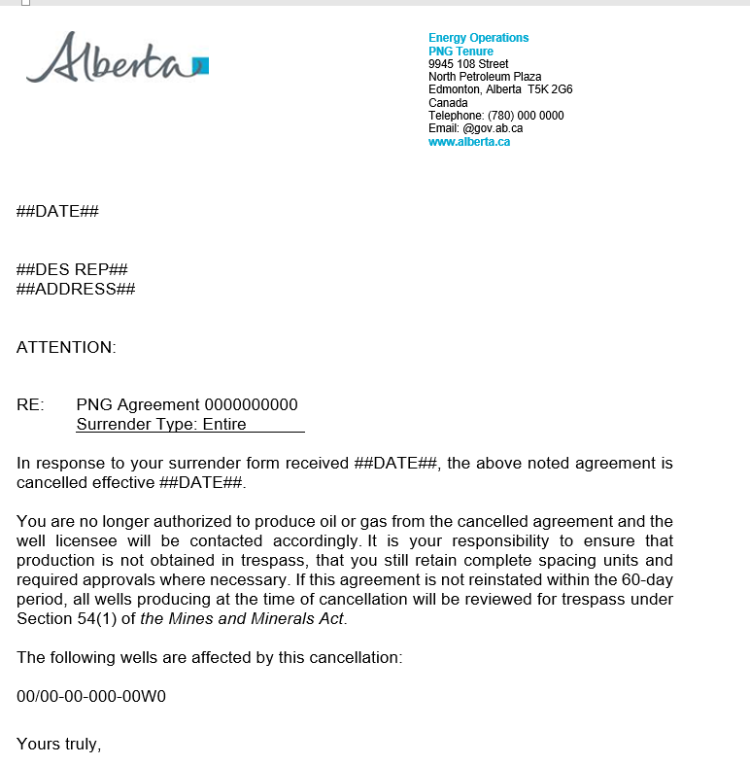
Select Final Pdf and the following document will populate.
1. Select Pdf
001 1000

Slide 26
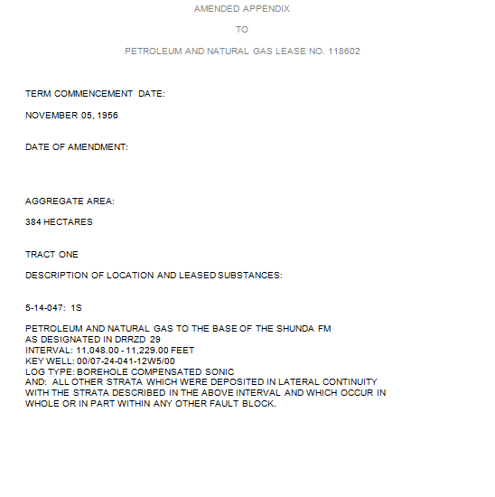
After completion of a Partial Surrender, an Amended Appendix will populate with the Final Surrender letter.
001 0000100001
February 1, 2017
1-01-001:
KEY WELL:00/01-01-001-01W5/00

Slide 27
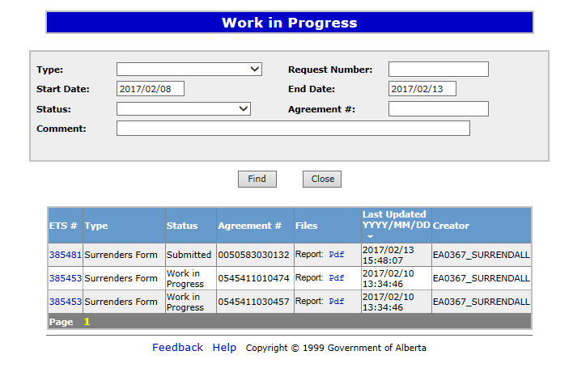
Withdraw Request
To Withdraw your Surrender request, the Status will need to be Submitted. At this point you will access the Work in Progress screen and click on the ETS Request Number. You may Withdraw your Surrender Request at anytime while the Status is Submitted or Processing.
1. Click ETS Request Number
0010000100001
0010000100002
0010000100003

Slide 28
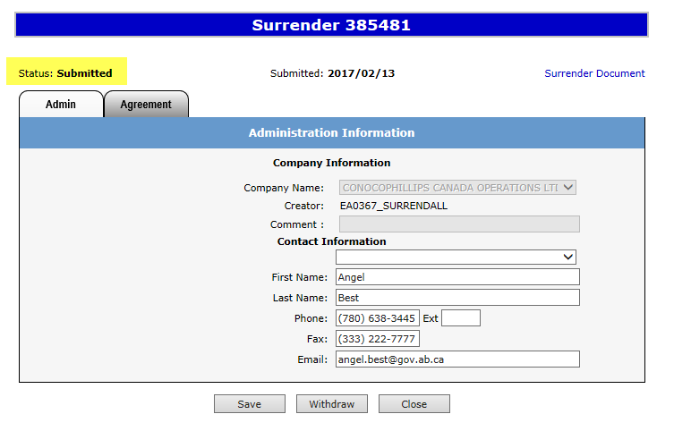
Withdraw Request Continued
The Admin screen will populate displaying the Company Information and the Status will show Submitted. Click on the Withdraw button at the bottom of the screen.
ABC Company
1. Click Withdraw

Slide 29
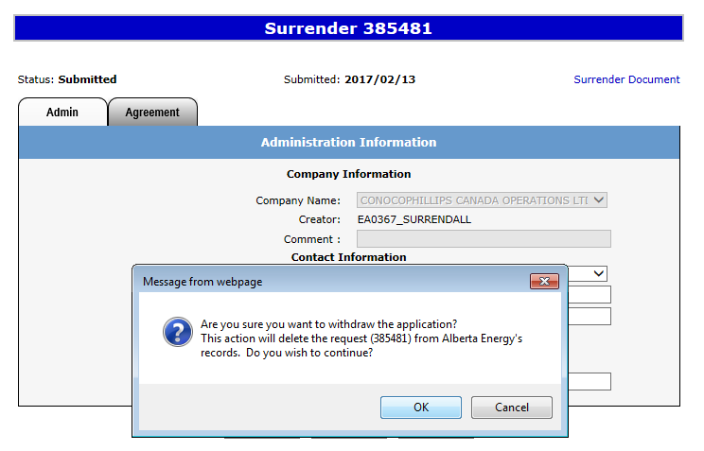
Withdraw Request Continued
A Message box will populate confirming the Withdrawal of your Surrender application. To proceed click the Ok button.
ABC Company
1. Click Ok

Slide 30
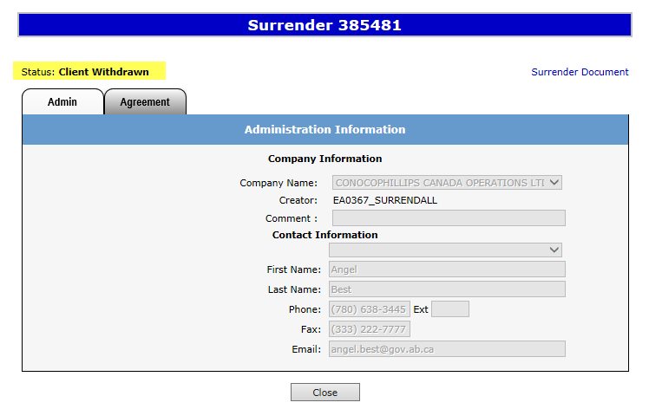
Withdraw Request Continued
ETS will update the Status to Client Withdrawn, the Surrender application has been deleted from Alberta Energy’s records and the request will no longer be retrievable through a search.
ABC Company
1. Click Close

Slide 31
RESOURCES
ETS Support and Online Learning provides access to relevant guides, courses and other information.
If you have questions, please contact Energy.Rentals@gov.ab.ca
or the PNG Tenure Help Desk at 780-644-2300 and by selecting option #3.

Slide 32
Congratulations!
You have completed the Agreement Management
Surrenders
Online Training Course
To access Courses, Guides and Forms for all your ETS Business please see ETS Support and Online Learning.
If you have any comments or questions on this training course,
please contact:
Crown Agreement Management
Helpdesk: (780) 644-2300
Email inquires: ENERGY.Rentals@gov.ab.ca

