Slide 1
Airshed Data Administration Module Training Course
This offers an overview on how to use Air Data Administration in ETS.
Government of Alberta
November 15, 2019

Slide 2
Table of Contents
Airshed Administration Roles
Airshed Administration Forms
Airshed Administration for Coordinator
Airshed Administration for Station Managers

Slide 3
Airshed Administration Roles

Slide 4
ETS Role Management
Each Client Account must be assigned a role or roles which defines the functionality that this account can access while on the ETS air data module. This is designed to allow organizations to delegate specific functionality to certain accounts for different forms in order to maximize the visibility of secure information to those authorized to view that information. Multiple roles can be assigned to each Client Account.
The roles available in ETS are:
Site Administrator
Create accounts and assign Coordinator role for the area operator in ETS account node
Coordinator*
Can create stations and assign roles by station within the assigned “area operator” in admin module
Station Manager*
Can modify ambient station details and assign reference data. Role can be assigned by station.
Reviewer
Can review Pending Review submissions of others and pass or fail them, progressing them to Submitted or Review Failed status. Can view and edit the submissions of others. Role can be assigned by station.
Submitter
Can create requests and begin the submission process; data will be validated and submission will progress to Pending Review but not to Submitted. Cannot view submissions of others. Role can be assigned by station.
Viewer
Can view the submissions of other users and view station information. Role can be assigned by station.
* Functions of these roles will be discussed in this manual

Slide 5
ETS Role Assignment
Roles | Role Assignment by Station | Create Station | Update Ambient Station info (includes assigning VVC, equipment) | See Stations (read-only) | Submit (create a submission) | Review (sign off on a submission) | View Submissions (work in progress)
Coordinator* | Yes | Yes | No | Yes | No | No | Yes
Station Manager* | No | No | Yes | Yes | No | No | No
Reviewer | No | No | No | Yes | No | Yes | Yes
Submitter | No | No | No | Yes | Yes | No | No
Viewer | No | No | No | Yes | No | No | Yes
* Functions of these roles will be discussed in this manual

Slide 6
Airshed Administration Form Types

Slide 7
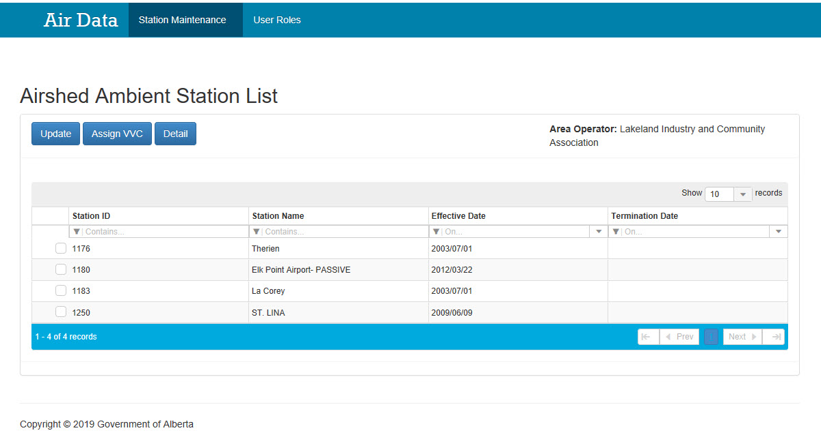
Airshed Administration Processing Form
Select Option
Area Operator
Form Title
This is a typical form used for updating, assigning VVCs, and getting detailed information on stations when the “Station Maintenance” option is selected.
The contents in the form will change depending on the selection made and will be identified throughout this document.
Processing buttons
Records display options
Headers with search filters
Data
Number of records information
Page Navigation

Slide 8
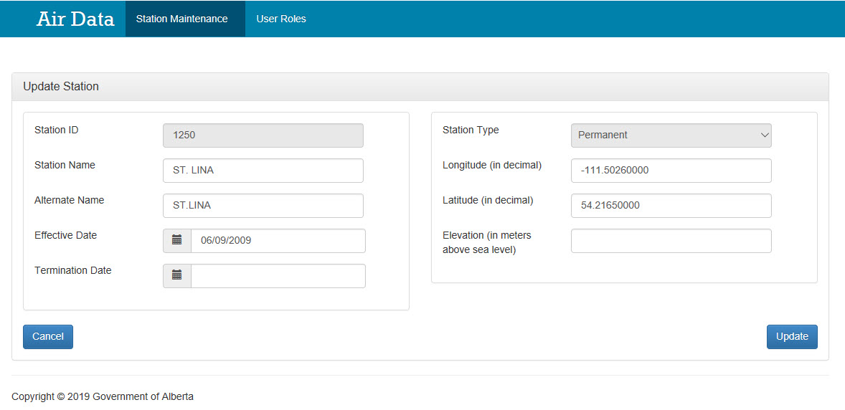
Airshed Administration Create/Update Form
This is a typical form used to create, update, and provide details for existing stations when the “Station Maintenance” option is selected.
The contents in the form will change depending on the selection made and will be identified throughout this document.
Form Title
Selection Options
Filled in area
Greyed-out fields (cannot be modified). Note: there are other field that are not greyed-out and cannot be modified
Filled in area
Screen Button
Screen Button

Slide 9
Airshed Administration for Coordinator

Slide 10
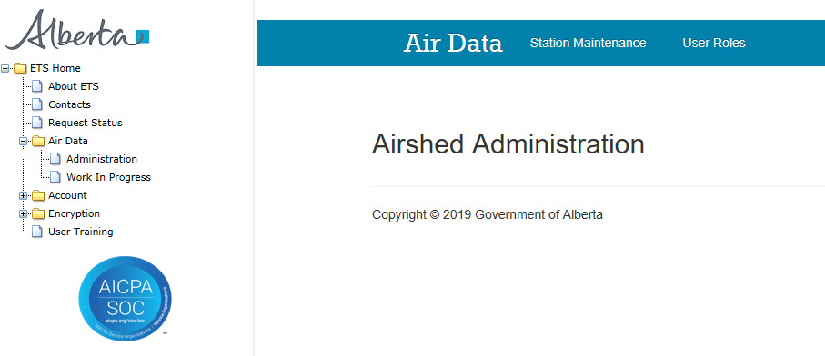
Airshed Administration Screen Coordinator
This is the “Airshed Administration” Screen for the Coordinator. At the top of the screen in the blue band are 2 choices:
“Station Maintenance” - the Station Manager maintain information on the stations, and
“User Roles” - the Station Manager assign various roles and stations to user(s).
To access the “Airshed Administration” screen, the Coordinator signs on to ETS, clicks “Air Data” node and clicks the “Administration” sub-node.
The Coordinator:
signs on to ETS,
clicks “Air Data” node,
clicks “Administration” sub-node,
to get the “Airshed Administration” screen shown on above.

Slide 11
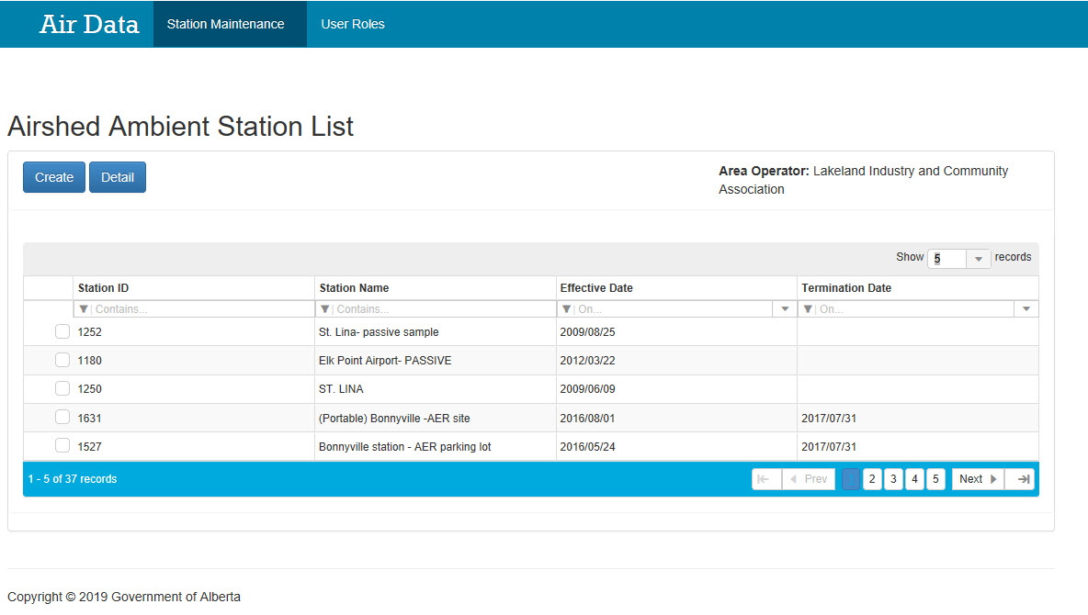
Airshed Ambient Station List Screen Coordinator
Clicking the “Station Maintenance” Option brings to you to this Screen
1
A
B
C
D
“Create” and “Detail” buttons for processing.
This is the “Airshed Ambient Station List” form for a particular Airshed having:
“Create” and “Detail” buttons for creating new stations, and providing detailed data on existing stations;
A list of stations with detailed information based on the following headers:
Station ID,
Station Name,
Effective Date, and
Termination Date
2
1
2
A
B
C
D

Slide 12
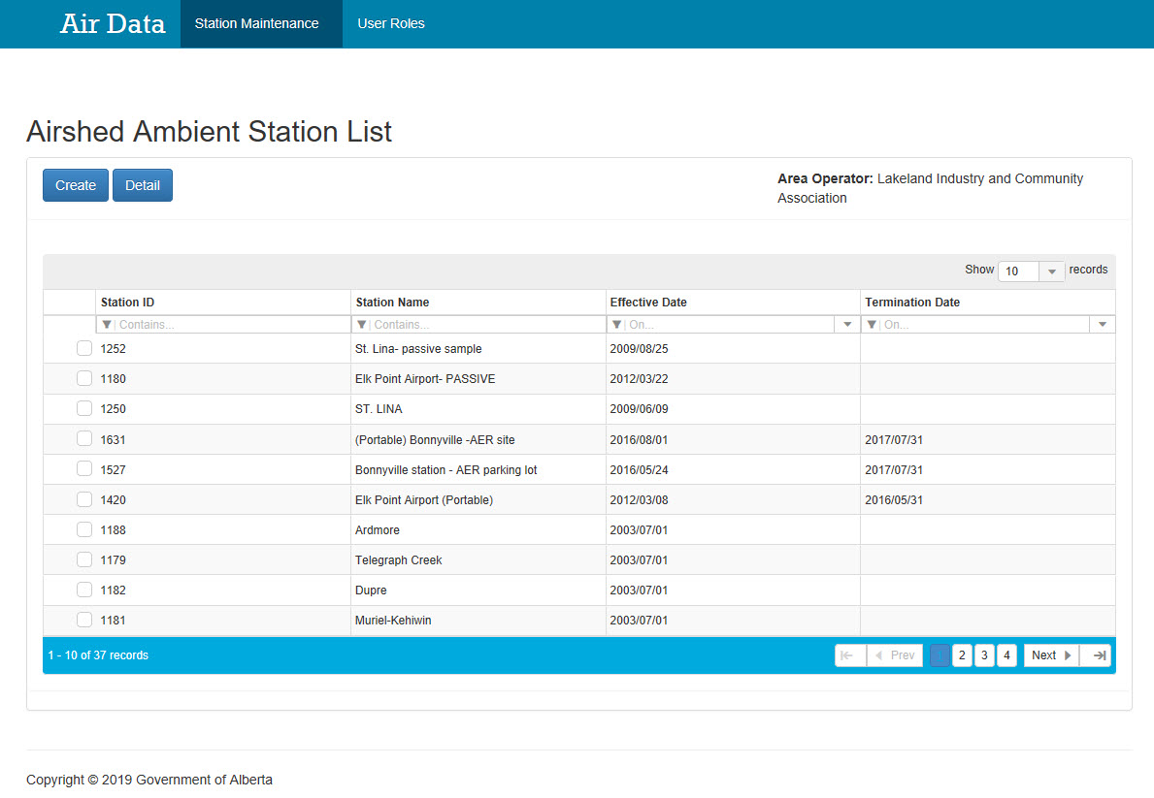
Airshed Ambient Station List: Create Coordinator
If the Coordinator is interested in creating a station, the Coordinator clicks the:
“Create” button at the top left.
1
“Create” button to create a station.

Slide 13
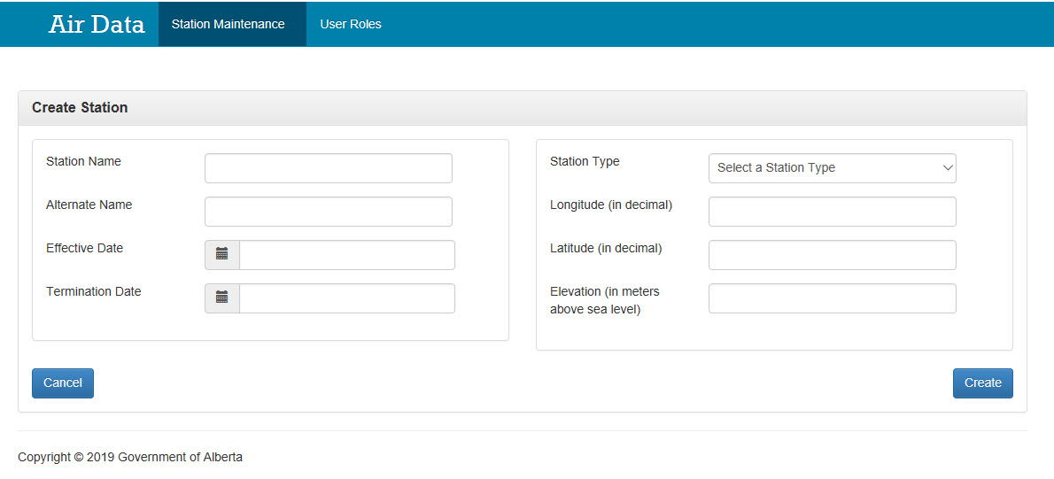
Create Station Screen Coordinator
This is the “Create Station” screen where the Coordinator creates the station by filling in the following fields:
Station Name,
Alternate Name,
Effective Date,
Termination Date,
Station Type (i.e. Permanent, Portable, or Mobile),
Longitude (in decimal),
Latitude (in decimal),
Elevation (in meters above sea level).
Note: If the Station Type is “Mobile” then the Longitude and Latitude fields will be greyed out and cannot be filled in. However if the station type is “Permanent” or “Portable” then the Longitude and Latitude fields must be filled in.
The “Create” button proceeds creating the station, where the “Cancel” button cancel the changes take you back to the previous screen.
Use the dropdown list to search and select the station type to be either “Permanent”, “Portable”, or “Mobile”.
The “Cancel” button cancels the changes and takes you back to the “Airshed Ambient Station List” screen.
The Coordinator clicks “Create” button to proceed creating the station.

Slide 14
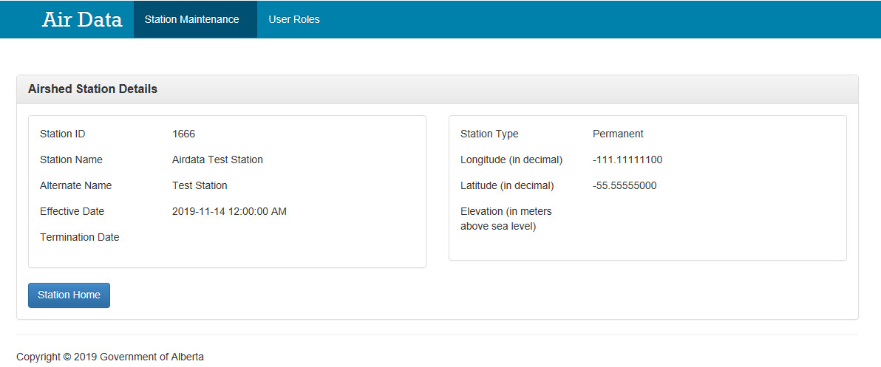
Create Station Screen: Success Coordinator
Once the data is all filled in and the “Create” button clicked, the Airshed Station Details is created.
Note the Station ID number is generated and the station data that is entered cannot be amended.
To get back to the previous screen, click the “Station Home” button.
The “Station ID” is generated.
The Coordinator clicks “Station Home” to get back to the “Airshed Ambient Station List” screen.

Slide 15
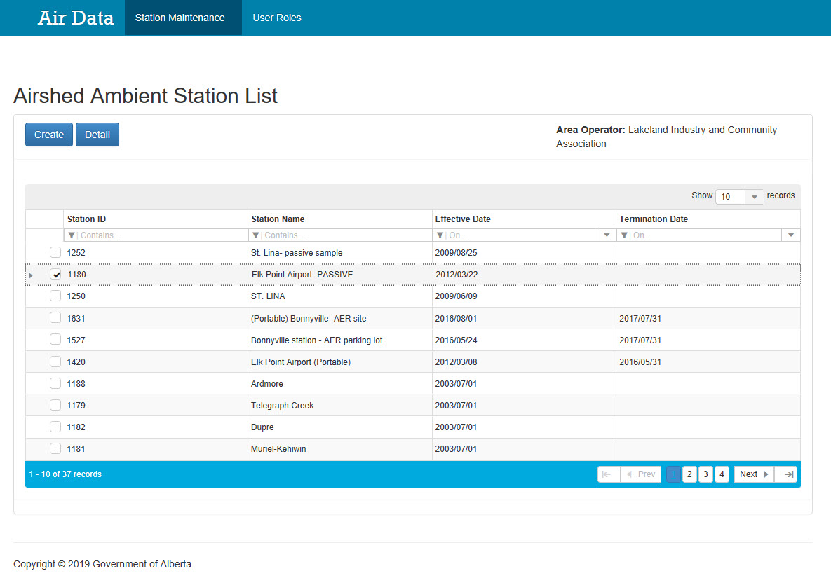
Airshed Ambient Station List: Detail Coordinator
2
Click the “Detail” button to get more details on the chosen station.
If the Coordinator is interested in getting more information on a particular station, the Coordinator clicks the:
Tick box beside the desired Station ID (the entire row will be highlighted in blue) and
“Detail” button at the top left.
Note: To unselect the station row, click the tick box again.
1
Click the tick in box beside the desired Station ID. Click the tick box again to deselect.

Slide 16
Airshed Station Details Coordinator
This is the “Airshed Station Details” form where detailed information on a particular station can be derived. The information here cannot be modified.
The information provided include:
Station ID
Station Name
Alternate Name
Effective Date
Termination Date
Station Type
Longitude (in decimal)
Latitude (in decimal)
Elevation (in meters above sea level)
“Station Home” button takes you back to the previous screen
The Coordinator clicks “Station Home” to get back to the “Airshed Ambient Station List” screen.

Slide 17
Airshed Administration for Station Managers

Slide 18
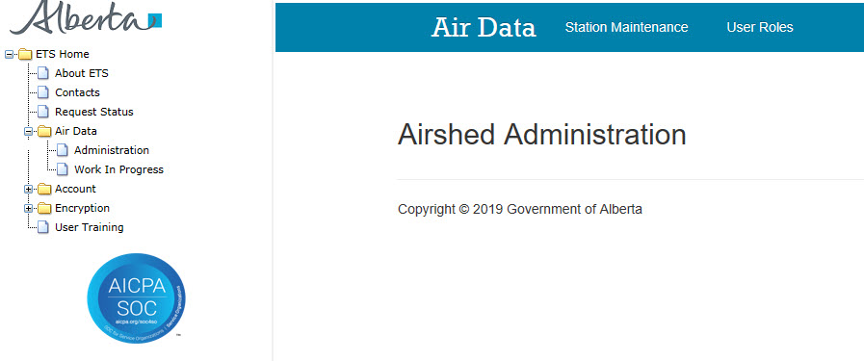
Airshed Administration Screen Station Manager
This is the “Airshed Administration” Screen for the Station Manager. At the top of the screen in the blue band are 2 choices:
“Station Maintenance” - the Station Manager maintain information on the stations;
“User Roles” - the Station Manager may view the roles and stations assigned to them by the Coordinator.
To access the “Airshed Administration” screen, the Station Manager signs on to ETS, clicks “Air Data” node and clicks the “Administration” sub-node.
The Station Manager:
signs on to ETS,
clicks “Air Data” node,
clicks “Administration” sub-node,
to get the “Airshed Administration” screen shown on above.

Slide 19
Airshed Ambient Station List Station Manager
Click the “Station Maintenance” Option to display this form
The “Airshed Ambient Station List” form for a particular Area Operator with:
“Update”, “Assign VVC”, and “Detail” buttons, for updating station details, assigning VVCs and viewing detailed data on stations;
A list of stations with information on based on the following headers:
Station ID,
Station Name,
Effective Date, and
Termination Date
1
A
B
C
D
2
2
A
B
C
D
1
“Update”, “Assign VVC”, and “Detail” buttons for processing.

Slide 20
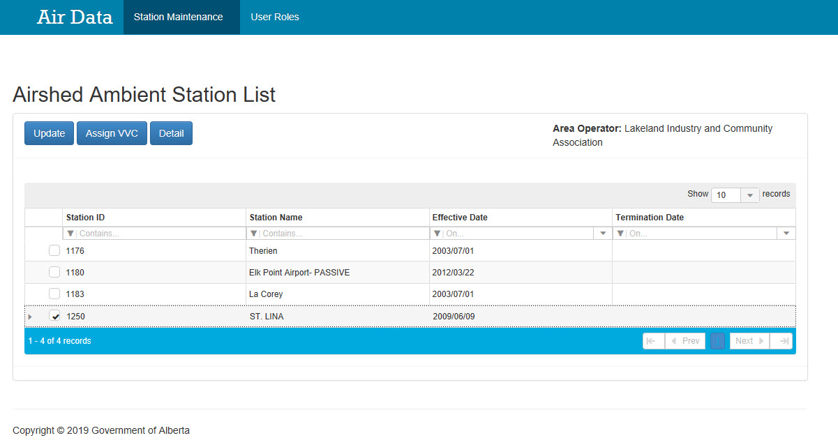
Airshed Ambient Station List: Update Station Manager
If the Station Manager is interested in updating information on a particular
station, the Station Manager clicks the:
Tick box beside the station (the entire row will be highlighted in blue) and
“Update” button at the top left.
2
Click the “Update” button to update the chosen Station ID
1
Click the tick in box beside the desired Station ID. Click the tick box again to deselect.

Slide 21
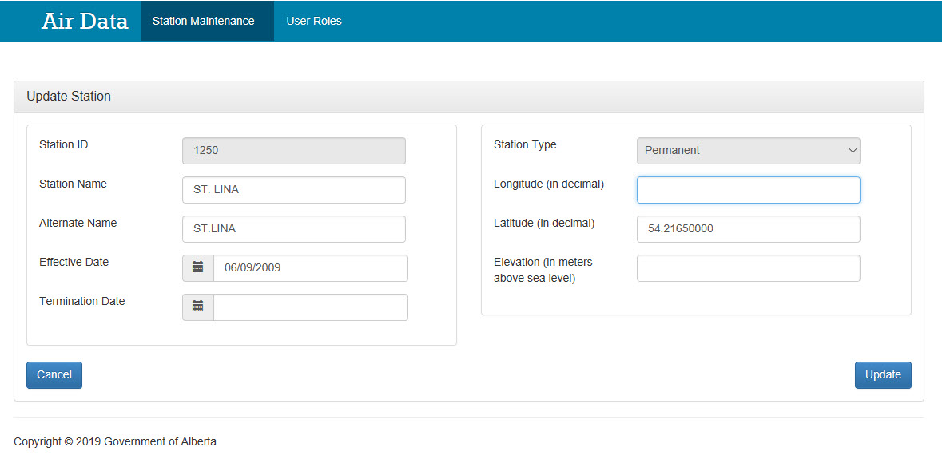
Airshed Ambient Station: Update Station Station Manager
This is the “Update Station” form where Station Manager can amend/update information on the station.
The following fields can be updated:
Station Name;
Alternate Name;
Effective Date;
Termination Date;
Longitude (in decimal);
Latitude (in decimal);
Elevation (in meters above sea level).
The following fields are greyed-out and cannot be updated:
Station ID;
Station Type
The “Update” button confirms the amendment where the “Cancel” button cancel the changes
take you back to the previous screen.
Greyed-out fields (cannot be modified)
The “Cancel” button cancels the changes and takes you back to the “Airshed Ambient Station List” screen.
The Station Manager clicks “Update” to confirm the changes.

Slide 22
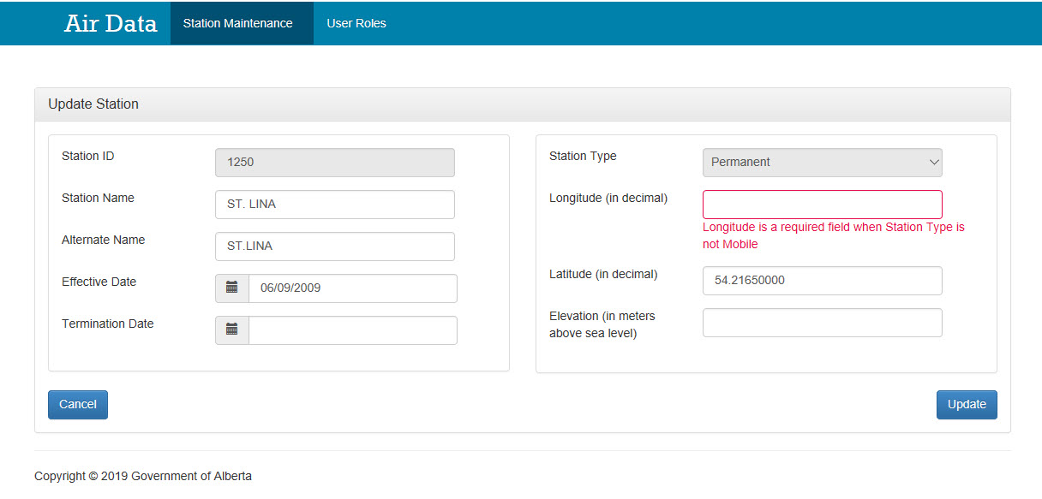
Update Station: Error Station Manager
This is typical error message. In this case, the Longitude field was not filled in resulting in the message “Longitude is a required field when Station Type is not Mobile”.
Note: Whenever the Station Type is “Mobile”, the Longitude and Latitude fields will be greyed out and cannot be filled in. For “Permanent” and “Portable” station types, the Longitude and Latitude fields must be filled in or the error will occur. When filling in the Longitude and Latitude data, please ensure the information goes to at least 5 decimal places.
Clicking the “Update” button creates an error where Longitude data must be filled in for “Permanent” and “Portable” station types.

Slide 23
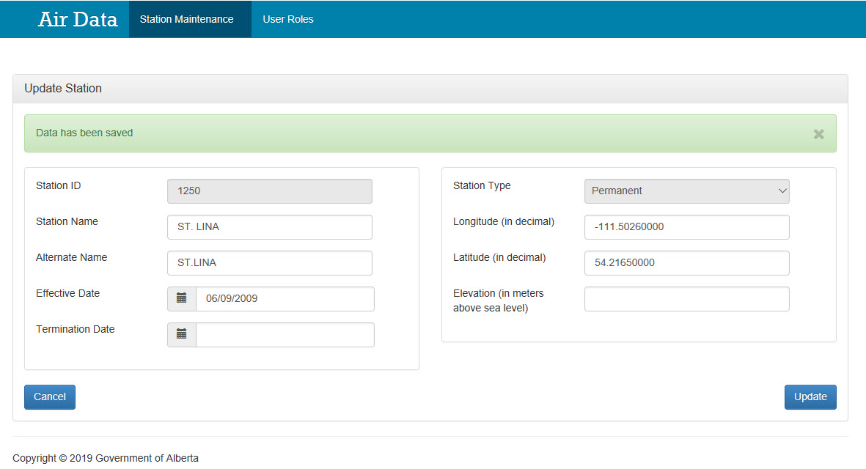
Update Station: Success Station Manager
The green bar with the message, “Data has been saved” indicates success in updating the station information after the “Update” button is clicked.
Once the data is all filled in, the “Update” button clicked, and the green bar with the message, “Data has been saved” appears, it indicates success in updating the station information.
To get back to the previous screen, click the “Cancel” button.
The “Cancel” button sends you back to the previous screen
The “Update” button confirms the changes added.

Slide 24
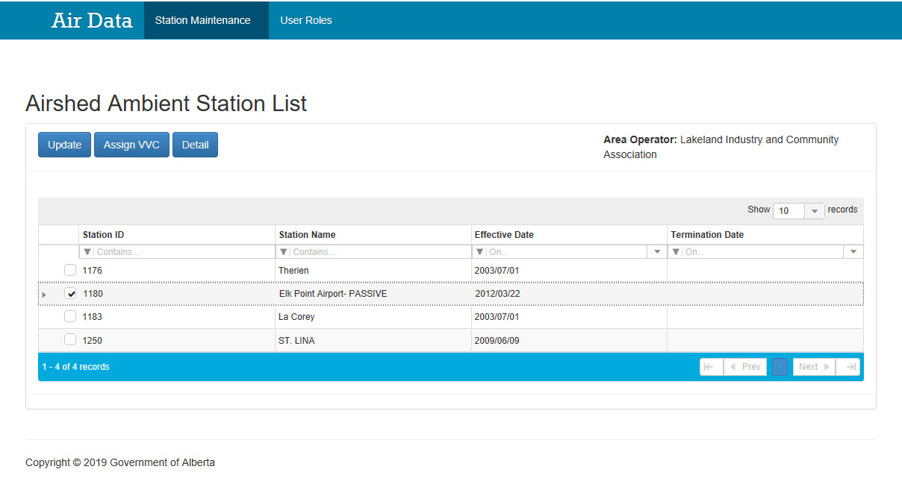
Airshed Ambient Station List: Assign VVC Station Manager
If the Station Manager is interested in assigning VVCs to a particular station, the Station Manager, clicks the:
Tick box beside the station (the entire row will be highlighted in blue) and
“Assign VVC” button at the top left.
Note: Only one station at a time can be assigned VVCs.
To unselect the station row, click the tick box a second time.
2
Click the “Assign VVC” button to assign VVCs to the selected station
1
Click the tick in the box beside the desired Station ID. Click the tick box again to deselect.
Note: Only one station at a time can be assigned VVCs

Slide 25
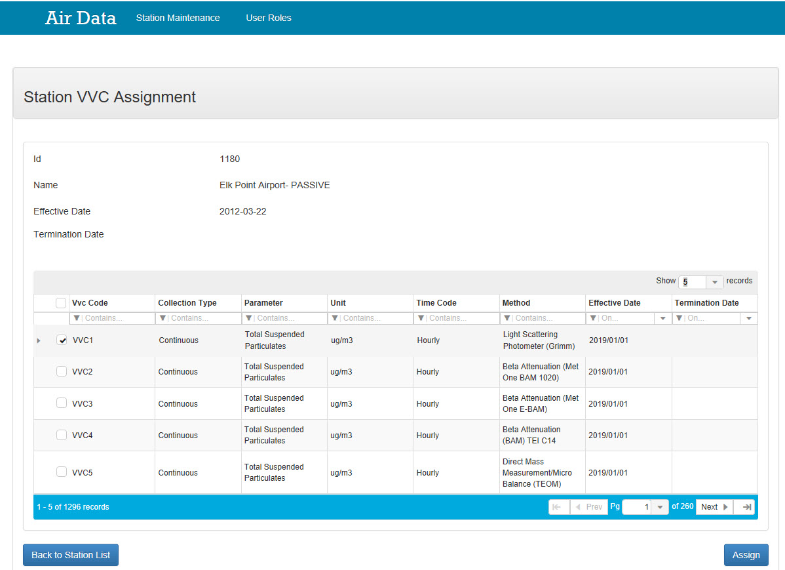
Airshed Ambient Station: VVC Assignment Screen Station Manager
This is the “Station VVC Assignment” form for a particular Station ID having information on the:
Station ID;
Name of the Station;
Station Effective Date;
Station Termination Date.
A list of Station VVCs with detailed information based on the following headers:
VVC Code;
Collection Type;
Parameter;
Unit;
Time Code;
Method;
VVC Effective Date;
VVC Termination Date.
The “Assign” button assigns VVCs to the selected station and the “Back to Station List” button takes you to the previous screen.
Tip: Use the search bar to help you search through the VVCs.
1
2
1
3
2
4
3
5
4
A
B
C
D
E
F
G
H
A
B
C
5
D
E
F
G
H
The “Back to Station List” button takes you to the previous screen
The “Assign” button assigns VVCs to the selected station

Slide 26
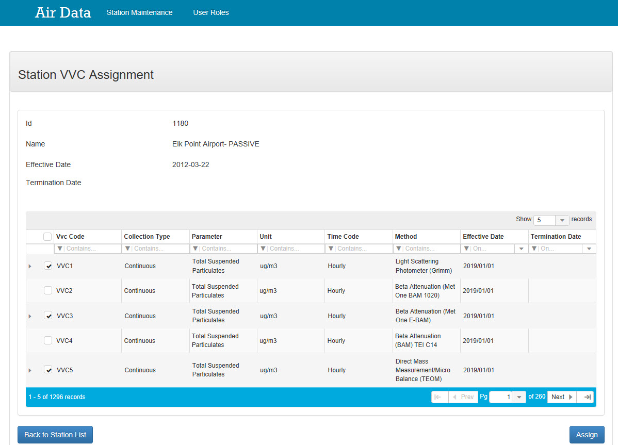
VVC Assignment Station Manager
1
Click the tick in the box beside the desired VVC Code(s).
Note: Click the tick box again to deselect.
To assign VVC(s), the Station Manager clicks :
The tick box beside the desired VVC code(s);
The “Assign” button
Note: To unselect the station row, click the tick box twice
2
Click the “Assign VVC” button to assign VVCs to the selected station

Slide 27
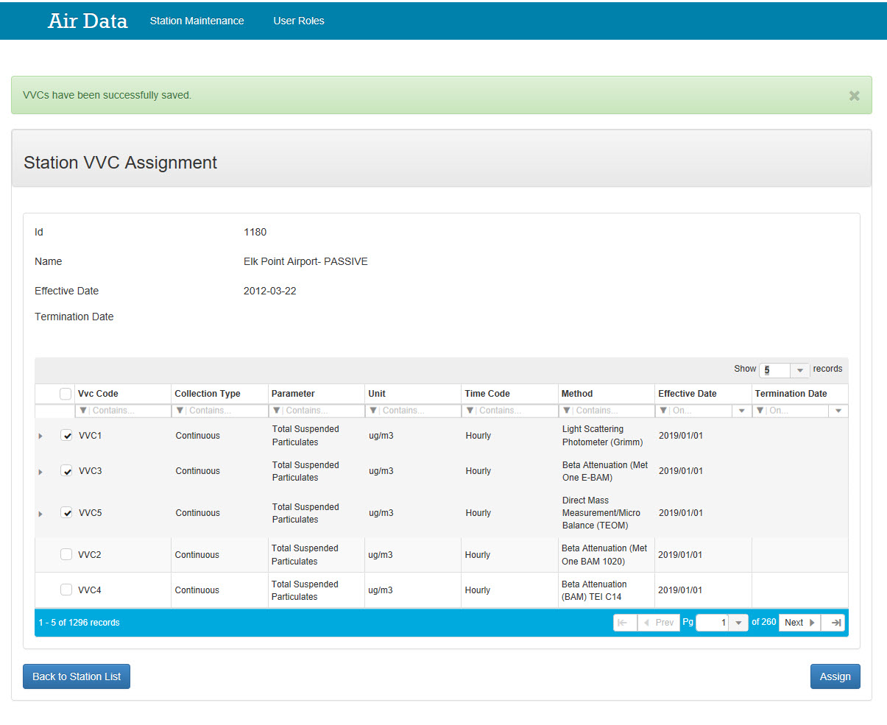
VVC Assignment: Success Station Manager
The green bar with the message, “VVCs have been successfully saved” indicates success in assigning VVC(s) after the “Assign” button is clicked.
The “Back to Station List” button takes you to the previous screen
Note the selected VVCs are at the top of the list.
Once the “Assign” button is clicked, the green message bar displays the “VVCs have been successfully saved.” indicates success in assign VVCs to the station. Additional VVCs can be assigned by checking them off and clicking “Assign” again. Click “Back to Station List” to go to the previous screen.

Slide 28
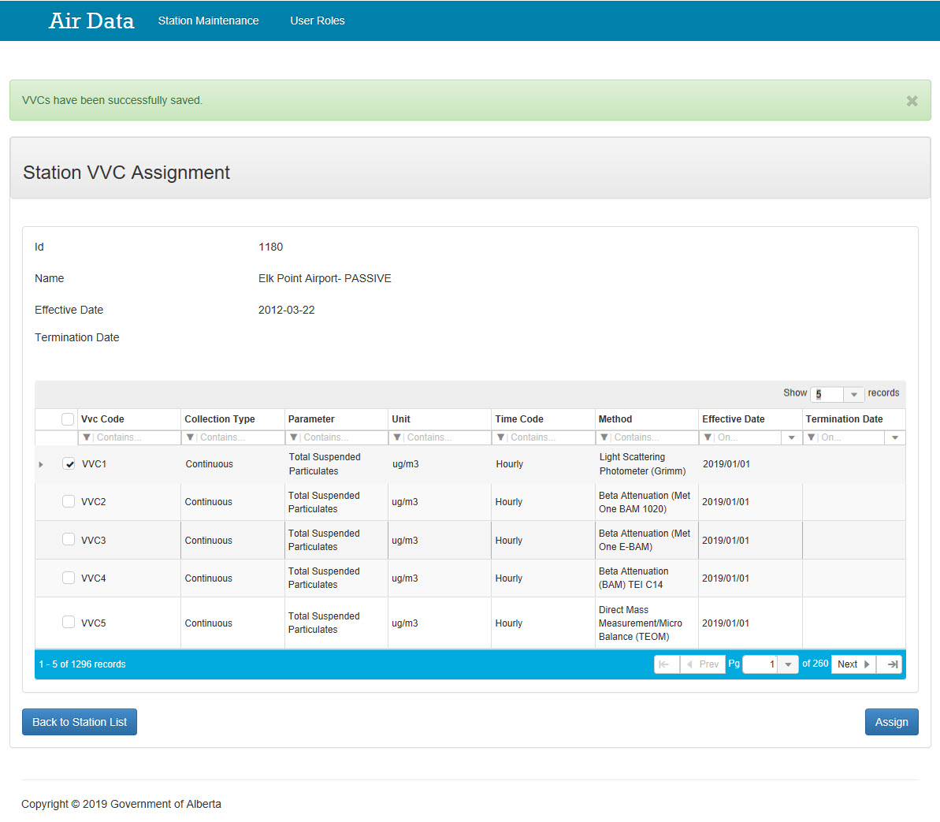
Unassigning VVCs Station Manager
The green bar with the message, “VVCs have been successfully saved” indicates success in unassigning previously selected VVC(s) after the “Assign” button is clicked.
The “Back to Station List” button takes you to the previous screen
Note the previously selected VVCs (i.e. VVC3 and VVC5) no longer have ticks.
The above screenshot shows success in unassigning VVCs to a particular station. This is done by deselecting previously selected rows (i.e. ensuring the ticks are removed) and clicking the “Assign” button. More than one VVCs can be unassigned by deselecting them all at once and click the “Assign” button. Clicking the “Back to Station List” button takes you back to the previous screen.

Slide 29
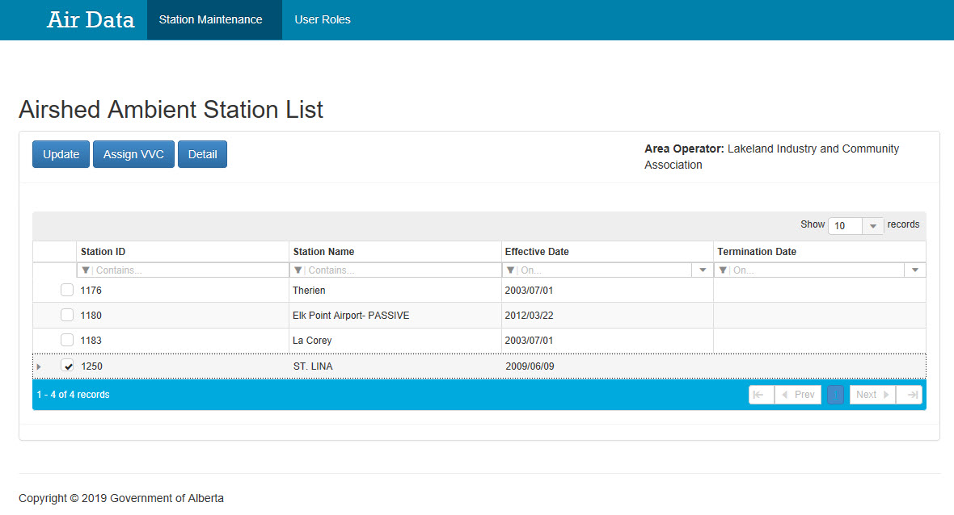
Airshed Ambient Station List: Detail Station Manager
2
Click the “Detail” button to get more details on the station
If the Station Manager is interested in getting more information on a particular station, the Station Manager clicks the:
Tick box beside the desired Station ID (the entire row will be highlighted in blue) and
“Detail” button at the top left.
Note: To unselect the station row, click the tick box a second time.
1
Click the tick in the box beside the desired Station ID. Click the tick box again to deselect.

Slide 30
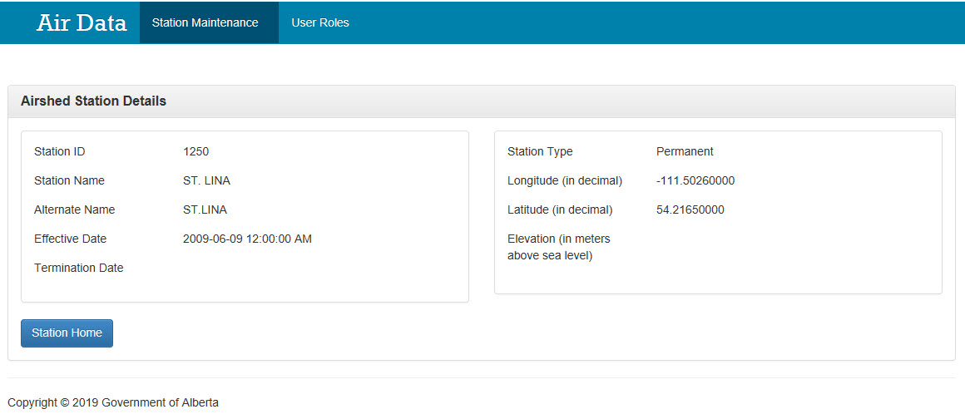
Station Details Station Manager
This is the “Airshed Station Details” form where detailed information on a particular station can be derived. The information here cannot be modified.
The information provided include:
Station ID
Station Name
Alternate Name
Effective Date
Termination Date
Station Type
Longitude (in decimal)
Latitude (in decimal)
Elevation (in meters above sea level)
“Station Home” button takes you back to the previous screen
The Station Manager clicks “Station Home” to get back to the previous screen.

Slide 31
Congratulations!
You have completed the ETS – Airshed Data Administration Module Training Course
Please proceed to the subsequent modules detailing the functionality contained within each module of the application.
For information or help with the different Form Types,
please see the Contacts page in the ETS menu. For information on your ETS account, please contact:
ETS Account Setup and Account Support: ETSAccountSetup@gov.ab.ca or 780-644-2300, option 4
ETS Technical Support (XML error questions, admin module issues, etc.): ETS@gov.ab.ca

