Slide 1
ETS - Airshed Data Submission Online Training Course
This offers an overview on how to submit Airshed data in ETS
Government of Alberta
November 15, 2019

Slide 2
Table of Contents
Introduction
Airshed Submissions
ETS and Role Management
Data Submission
Error Types
How to determine your assigned Role?

Slide 3
Airshed submissions
NOTE: Beginning November 15, 2019 at 5:00 pm MST, airsheds will submit all air reports and data to ETS and NOT to the airdata warehouse.
Airshed submissions to ETS include:
Ambient air data, including continuous and non-continuous (passive, canister, PUF, etc.) data (XML file), accompanied by (as applicable):
PDF calibration report (for continuous ambient data)
PDF certified laboratory analysis report (for non-continuous ambient data)
PDF reports:
monthly and annual airshed air monitoring reports
monitoring plan
site documentation
airshed ambient monitoring notifications (as per AMD Notification Template)
Airsheds must use the file naming conventions provided in the EPEA Approval Industrial Monitoring Documentation Submission Naming Guideline

Slide 4
Airshed Submissions- Ambient XML Schema
Effective November 15, 2019 after 5 p.m. MST, Version 2.0 of the ambient XML schema must be used in the submission of ambient data to be accepted by ETS:
This means:
The new ambient XML schema must be used from that date going forward for new data sets and for the resubmission of historic data;
The new ambient XML schema is for use by all ambient data submitters (industrial and airshed);
Submitting ambient data using the V1.9 schema will NOT be accepted by ETS going forward;
Version 2.0 of the Reference Tables must be used in conjunction with Version 2.0 of the ambient XML schema. A new version of the Ambient Schema Guidance document will be added in the near future.
More information on Version 2.0 of the ambient XML Schema can found at Alberta Online Learning website: https://training.energy.gov.ab.ca/Pages/Air.aspx#Ambient

Slide 5
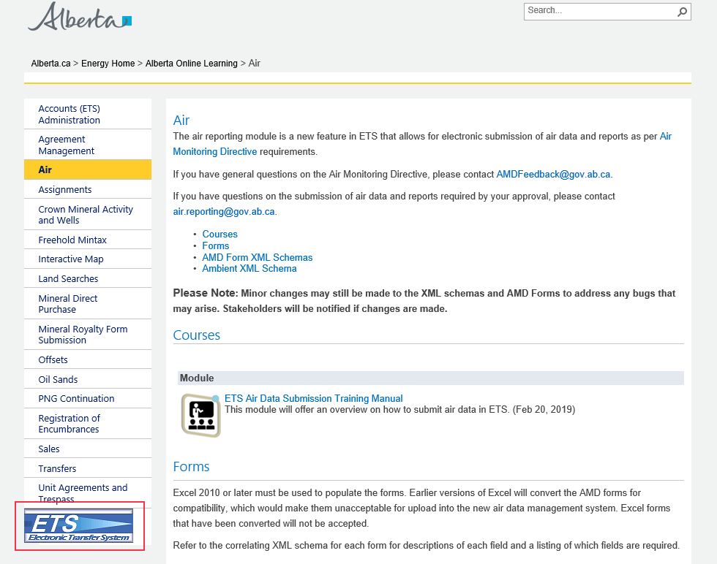
Signing in to ETS
Or you can use the link
www.alberta.ca/ets

Slide 6
Technical Requirements
Ensure you have access to the Internet and a Computer that meets the Minimum Technical Requirements.
The ETS website is a secure environment protected by 128-bit encryption via SSL, identified by a certificate of authentication.
To use the secure ETS website properly, stakeholders must ensure they (or their service provider) have access to a computer with Internet access. Those who do not have their own computer can use any computer with internet access (e.g. local library).
Software
Microsoft Internet Explorer Recommended Version 11.0 or higher;
Web browser must support Secure Sockets Layer (SSL) 3.0 with Cipher strength of 128 bits;
Windows Vista or higher;
Adobe Reader version 8.0 or later;
JavaScript on the browser must be enabled;
System allows browser cookies.

Slide 7
Submission Failure or ETS Outage
It is recommended that airsheds submit their data, forms and reports well before the due date to ensure adequate time for submission, should a submission failure occur. If there is a submission failure, time would be required to correct the errors identified in the error report and resubmit.
Planned ETS maintenance or outages will be posted on the ETS site and communicated to ETS users. If unable to meet reporting timelines due to an ETS outage, airsheds should:
Provide notification to Air.Data@gov.ab.ca of inability to submit due to outage; and
Complete the air submission within 24 hours of being notified that the website is operational.

Slide 8
ETS Support
Support: Report problems or questions to Crown Land Data at (780) 644-2300
ETS may be unavailable due to system maintenance on Friday after 4:30 p.m. until 6:00 pm Sunday
If you require support with existing ETS accounts or setting up a new account, please contact ETSAccountSetup@gov.ab.ca.
If you require technical support with ETS, please contact ETS@gov.ab.ca or 780-908-4969.
Note that technical support will only be available during business hours, so it is important to ensure the data is submitted within the business hours timeframe: 8:15 AM - 4:30 PM Monday to Friday.

Slide 9
Introduction: ETS
The Electronic Transfer System (ETS) provides secure access to do business electronically with the Government of Alberta. Holders of an authorized Account may access the services available through ETS.
To have access to ETS, you will need to apply for access. More information can be found at: https://www.alberta.ca/Electronic-transfer-system.aspx
Once the application is successful, the role of the Site Administrator will be created by the Government of Alberta. The Site Administrator is responsible for creating and maintaining Client Accounts and assigns the role for Coordinator. Individual accounts (called a Client Account) are subsets of the Site Administrator Account.
Each Client Account is assigned a role that defines the required functionality. The Coordinator is responsible for assigning the levels of access to ETS based on the role an individual has within the company.
Once the Client Account is created, the individual can logon to the secure ETS web site using this new Client Account login Id and password.

Slide 10
ETS Role Management
Each Client Account must be assigned a role which defines the functionality that this account can access while on the web site. This is designed to allow organizations to delegate specific functionality to certain accounts for different forms in order to maximize the visibility of secure information to those authorized to view that information.
The roles available in ETS are:
Site Administrator*
Create accounts and assign Coordinator role for the area operator in ETS account node
Coordinator*
Can create stations and assign roles by station within the assigned “area operator” in admin module
Station Manager
Can modify ambient station details and assign reference data. Role can be assigned by station.
Reviewer*
Can review Pending Review submissions of others and pass or fail them, progressing them to Submitted or Review Failed status. Can view and edit the submissions of others. Role can be assigned by station.
Submitter*
Can create requests and begin the submission process; data will be validated and submission will progress to Pending Review but not to Submitted. Cannot view submissions of others. Role can be assigned by station.
Viewer*
Can view the submissions of other users and view station information. Role can be assigned by station.
* These roles will be discussed in this manual

Slide 11
ETS Role Assignment
Roles | Role Assignment by Station | Create Station | Update Ambient Station info (includes assigning VVC, equipment) | See Stations (read-only) | Submit (create a submission) | Review (sign off on a submission) | View Submissions (work in progress)
Coordinator | Yes | Yes | No | Yes | No | No | Yes
Station Manager | No | No | Yes | Yes | No | No | No
Reviewer | No | No | No | Yes | No | Yes | Yes
Submitter | No | No | No | Yes | Yes | No | No
Viewer | No | No | No | Yes | No | No | Yes

Slide 12
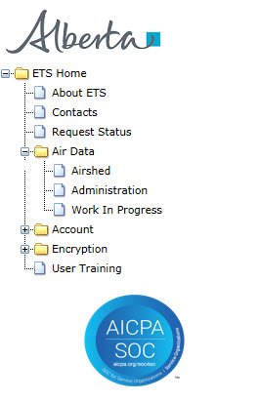
ETS Role Management
Once you signed in to ETS, the “Air Data” tree node will appear on the left of the screen. The “Air Data” node has 3 sub-nodes (all circled in red). The “Air Data” sub-nodes are:
“Airshed” – for the Submitter to make data submissions, manage warnings/errors, data resubmissions;
“Administration” – for the Coordinator to assign roles (i.e. Submitter, Reviewer, Viewer, and Station Manager) to users. Also, users can identify the roles assigned to them;
“Work In Progress” – for Submitter, Reviewer, and Viewer to see the status of the data submission. The Reviewer accesses this node to review submissions requiring accept or reject.
To access any one of the sub-nodes, click on the “Air Data” node.
NOTE: For you to see the “Airshed” sub-node, you must be assigned the Submitter role. If you are not assigned that role, the “Airshed” sub-node will not appear.

Slide 13
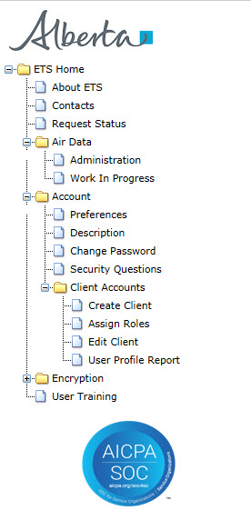
Creating Users Site Administrator
Before roles can be assigned, users must be created and this is done by the Site Administrator only.
To create the users, the Site Administrator signs in to ETS. When this screen at left is appears, the Site Administrator clicks on the on the “Create Client” sub-node (circled in red).
To get to “Create Client” node the Site Administrator clicks on:
“Accounts” node and ;
“Client Accounts” sub-node.
Once, the Site Administrator coordinator clicks on “Create Client” sub-node, the process of creating users will start.
For more information on:
Creating users, refer to “ETS Client Account Setup and Maintenance” at https://training.energy.gov.ab.ca/Courses/ETS_client_account_setup_and_maintenance.pdf
Site Administrator, refer to “ETS Account Setup and Preferences” at https://training.energy.gov.ab.ca/Courses/ETS_account_setup_and_preferences.pdf
The Site Administrator creates client accounts

Slide 14
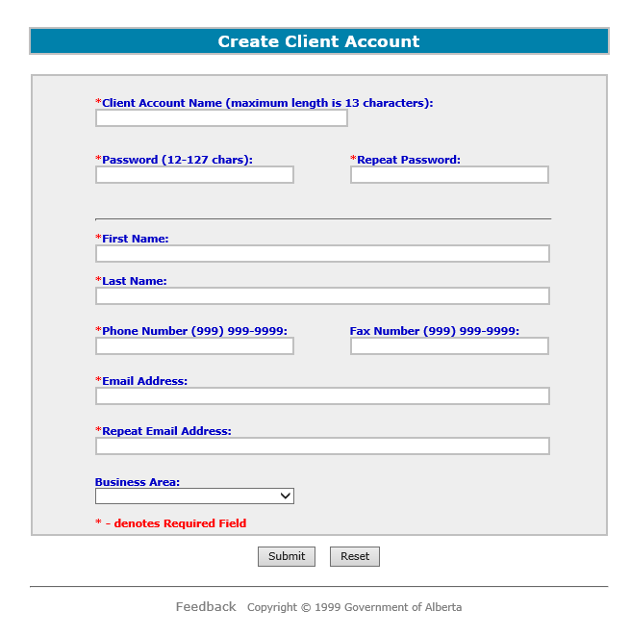
Creating Users Site Administrator
Once, the Site Administrator coordinator clicks on “Create Client” sub-node, the “Create Client Account” form appears (on left) where the following mandatory information is filled in:
Client Account Name;
Password – twice (Password and Repeat Password);
First Name;
Last Name;
Phone Number; and
Email address – twice.
The Fax Number and Business Area are optional.
The Site Administrator then clicks the “Submit” button to create the account.
For more information on:
Creating users, refer to “ETS Client Account Setup and Maintenance” at https://training.energy.gov.ab.ca/Courses/ETS_client_account_setup_and_maintenance.pdf
Site Administrator, refer to “ETS Account Setup and Preferences” at https://training.energy.gov.ab.ca/Courses/ETS_account_setup_and_preferences.pdf
The Site Administrator fills in the “Create Client Account” form

Slide 15
Assigning a User Coordinator Role Site Administrator
After the users are created, the Site Administrator assigns the Coordinator role. Only the Site Administrator can assign the Coordinator role.
To assign the Coordinator role, the Site Administrator signs in to ETS. When this screen at left is appears, the Site Administrator clicks on the on the “Assign Roles” sub-node (circled in red).
Once, the Site Administrator coordinator clicks on “Assign Roles” sub-node, the process of assigning the coordinator role will start.
For more information on:
Creating users, refer to “ETS Client Account Setup and Maintenance” at https://training.energy.gov.ab.ca/Courses/ETS_client_account_setup_and_maintenance.pdf
Site Administrator, refer to “ETS Account Setup and Preferences” at https://training.energy.gov.ab.ca/Courses/ETS_account_setup_and_preferences.pdf
The Site Administrator assigns Coordinator role

Slide 16
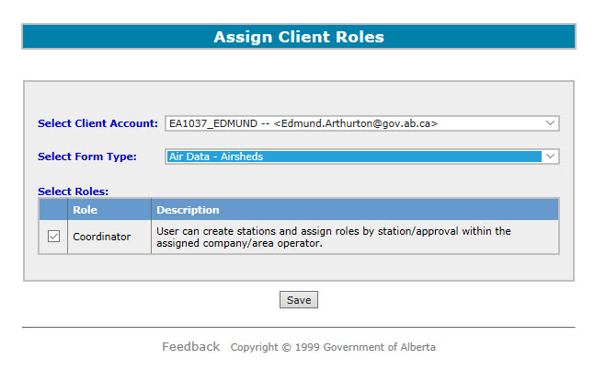
Assigning a User Coordinator Role Site Administrator
Once, the Site Administrator coordinator clicks on “Assign Roles” sub-node, the “Assign Client Roles” form appear.
To assign the Coordinator role to the desired user, the Site Administrator will select from the dropdown list the:
“Select Client Account”: the user created previously to be assigned to be Coordinator;
“Select Form Type”: Air Data – Airsheds;
Once these fields are filled in, the Site Administrator next create a tick in the box (circled in red) to assign the role of coordinator and click the “Save” button confirming the assignment. (The Site Administrator has the option of removing the assignment by clicking the tick in the box to remove it).
For more information on:
Creating users, refer to “ETS Client Account Setup and Maintenance” at https://training.energy.gov.ab.ca/Courses/ETS_client_account_setup_and_maintenance.pdf
Site Administrator, refer to “ETS Account Setup and Preferences” at https://training.energy.gov.ab.ca/Courses/ETS_account_setup_and_preferences.pdf
The Site Administrator assigns the Coordinator role to the user by clicking the check box here.

Slide 17
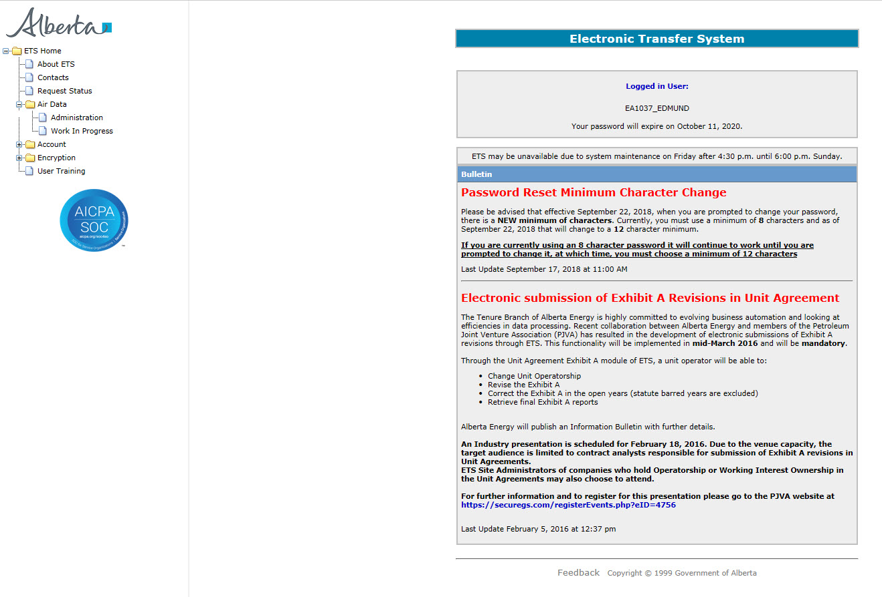
Assigning Roles Coordinator
Once the Coordinator is assigned, the Coordinator now has responsibility to assign the roles of Submitter, Reviewer, Viewer, and Station Manager to users who were created by the Site Administrator.
To assign roles, the Coordinator signs in to ETS. When this screen at left is appears, the Coordinator clicks on the on the “Administration” sub-node (circled in red).
This can be done by clicking on:
“Air Data” node then ;
“Administration” sub-node
Once, the Site Administrator coordinator clicks on “Administration” sub-node, the assigning roles will start.
Note the Coordinator can only see the “Administration” and “Working In Progress” nodes.
The Coordinator assign roles through the “Administration” sub-node.
Note: The Airshed node will not be visible to the Coordinator.

Slide 18
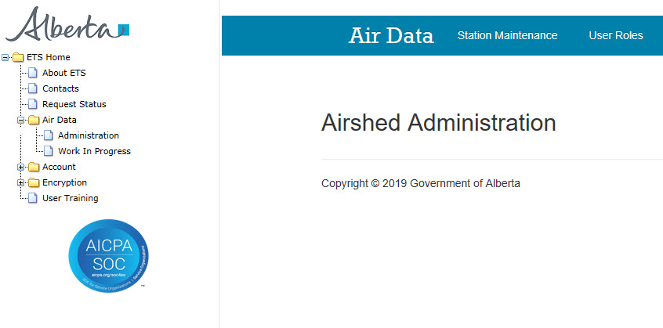
Assigning Roles Coordinator
Once the Coordinator clicks on the “Administration” sub-node, the “Airshed Administration” screen appears.
At the top of the screen (blue band) there are 2 choices:
“Station Maintenance” - the coordinator maintain information on the stations
“User Roles” - the coordinator assign various roles and stations to user(s).
To assign role(s) to user, the Coordinator clicks “User Roles”;
The Coordinator clicks on this selection (“User Roles”) to assign role(s) to user(s)
The Coordinator assign roles through the “Administration” sub-node.
Note: The Airshed node will not be visible to the Coordinator.

Slide 19
Assigning Roles Coordinator
Once the Roles Maintenance screen appears, the Coordinator can now assign role(s) to the user with the following steps:
Identify and select the user from the “User” dropdown list;
Select the role for the user in the “Roles” list;
Select stations from the “Stations” list that will be assigned to the user;
Click the “Assign” button;
Once the transaction is successful, a green “Data has been saved” bar will appear (Not shown here).
1
2
1
3
2
3
4
5
4

Slide 20
Assigning Roles – Example Coordinator
5. The message, “Data has been saved” indicates success
5
1. Select User from dropdown list
1
2
2. Check role(s) to be assigned to user;
3. Check station(s) to be assigned to user.
Note: the stations can be searched/filtered
3
4. Click “Assign” Button
4
This is an example of a user that has Submitter role assigned.

Slide 21
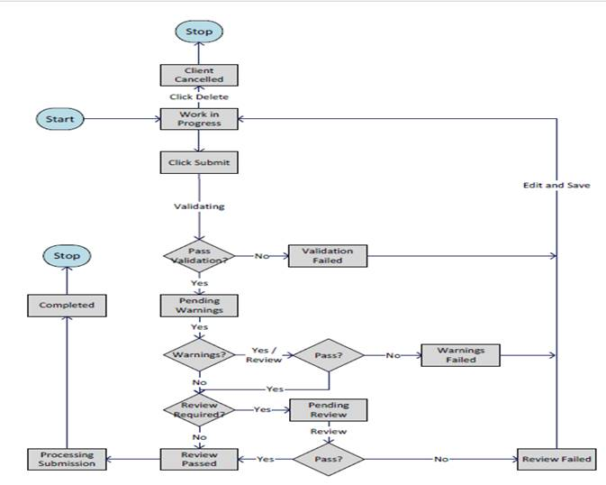
Data Submission: Overview
The data submission process comprises of the following stages or status types :
Work in Progress – new, un-submitted requests;
Click Submit – the request is submitted for validation;
Client Cancelled – the client cancels the request by clicking on the delete button preventing further processing;
Validating – the request is validated after file submission;
Validation Failed – the request has validation errors;
Pending Warnings – the request has passed validation but has warning errors;
Warning Failed – the request cannot proceed due to being rejected at the Pending Warnings stage;
Pending Review – the request passed warning process and is reviewed by the Reviewer;
Review Failed – the request has been rejected by the reviewer;
Review Passed – the request has been approved by the reviewer;
Processing – the request has been submitted to the department;
Completed – the request has been accepted by the department;
3
1
2
4
5
12
6
7
8
11
10
9

Slide 22
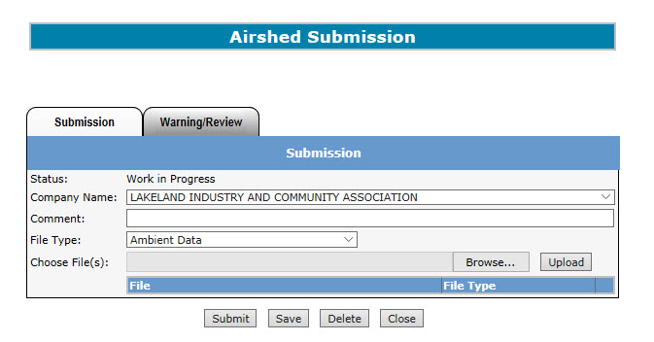
Signing In Submitter
The Submitter clicks on the “Airshed” sub-node for the
To get to the “Airshed” Submission” screen shown on the right.
Note: The “Airshed” sub-node is only viewable to the Submitter.
Only the Submitter makes submissions.
To access the Data Submission form, the Submitter will:
Sign in (where the above screen appears);
Click on the “Air Data” node. This will expand to the sub-nodes;
Click on the “Airshed” sub-node;
The “Airshed Submission” form appears (right).

Slide 23
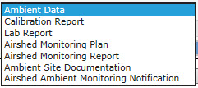
Airshed Submission Form
The Status - “Work in Progress” at the start of process
This is the Airshed Submission form used only by the Submitter.
The following information must be to be filled before the files can be uploaded and submitted:
“Company Name” (selected from dropdown list);
“Comment” (optional);
“File Type” (selected from dropdown list);
“Choose File(s)” (selected using the “Browse” button and uploaded clicking the “Upload” button).
“Browse” button searches for the file(s) to be uploaded
1
*This is the list of Airshed file types:
2
3
1
4
“Upload” button uploads the file(s)
2
3
4
“Submit” button is to submit the file for validation.
“Close” button is to go back to the sign in page without saving data
“Save” button is to save the data to ETS where it is stored until it is submitted for review.
“Delete” button cancels the submission request.
REMINDER: You must be assigned the role of submitter in order to upload and submit data.

Slide 24
Airshed Submission Form: File Types
Airshed File Types
On the left is the list of Airshed file types mentioned from the previous slide. The files selected for uploading must be in the file type format or an error will result.
The formats for the listed file types are:
Ambient data – ambient schema submissions (XML)
Calibration report – continuous ambient monitoring, submitted along with ambient XML (PDF)
Lab Report – passive ambient data report from laboratory, submitted along with ambient XML (PDF)
Airshed Monitoring Plan – as per AMD Chapter 2 (no longer required; voluntary submission only) (PDF)
Airshed Monitoring Report – monthly and annual submissions (PDF)
Ambient Site Documentation – as per AMD Chapter 3 (PDF)
Airshed Ambient Monitoring Notification– as per AMD Chapter 9 and AMD Notification template (PDF)
Submitters, for more information see, “Acceptable Formats for EPEA Approval and Code of Practice Records and Submission Coordinates” at https://www.alberta.ca/assets/documents/ep-epea-approval-acceptable-formats.pdf
Please check the description for all these reports

Slide 25
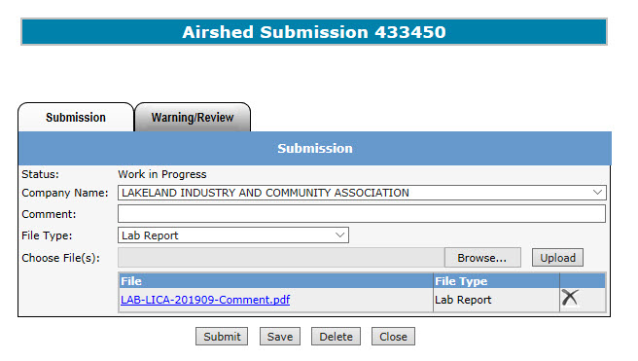
Airshed Submission Form: Naming Guidelines
When uploading files for submission, note the file naming convention. For example when the Airshed Lab Report is submitted, the supporting file uploaded (highlighted with the red box on the left) is named “LAB-LICA-201909-Comment.pdf” in the format of “LAB-XXXXXX-YYYYMM-Comments.pdf”, where:
“########” - is the Airshed acronym;
“YYYY” – monitoring year;
“MM” – monitoring month;
“Comments” – additional descriptor (optional).
Each file type has its own naming convention and to get more information on the matter see, “EPEA Approval Industrial Monitoring Documentation Submission Naming Guideline”, at https://www.alberta.ca/assets/documents/ep-epea-approval-industrial-monitoring-documentation-submission-naming-guideline.pdf
Submitters: To avoid errors when uploading, please ensure the proper naming convention is adhered to.
The naming convention for submitting Airshed Lab Report Data is “LAB-XXXXXXXX-YYYYMM-Comments.pdf”. More information: https://www.alberta.ca/assets/documents/ep-epea-approval-industrial-monitoring-documentation-submission-naming-guideline.pdf

Slide 26
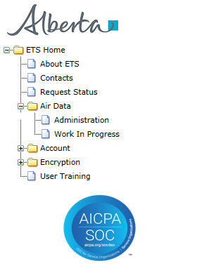
Work in Progress Form
The Work In Progress form is used to find the status of requests submitted.
To access the Work In Progress form, the Submitter, Reviewer, and Viewer can:
Sign in;
Click on the “Air Data” node to expand it;
Click on “Work In Progress” sub- node ;
The “Work in Progress” form appears (below)
1
Sign on and click on “Air Data” node to expand to the sub-nodes
2
Click on this sub-node to get the “Work in Progress” form

Slide 27
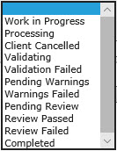
Work in Progress Form
A. Search Requests
1
To Search and retrieve requests, fill in the “Work in Progress” form using one or more of the following search criteria:
Status* (drop down list);
Request #;
Start Date;
End Date;
Comment entered;
NOTE: if no criteria is entered, the result will return all requests under the account.
2
Click on the “Find” Button to get the search results.
*This is the list of Status types:
* The types of status was discussed in the Data Submission Overview.

Slide 28
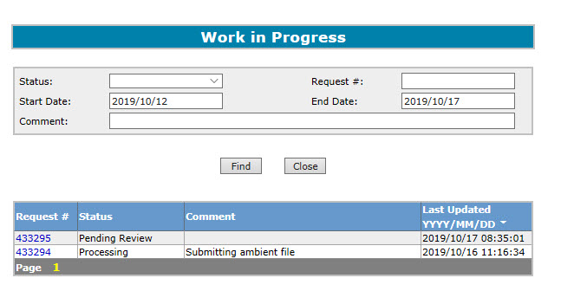
Work In Progress Form: Example
B. Search Results
This is an example showing the results returned from applying the search criteria in the “Work In Progress” form. In this example, no criteria was applied which resulted in the results box (red box circled) showing the entire list of requests by:
Request #;
Status;
Comment;
Last Updated (“YYYY/MM/DD”).
For the desired request to be processed or viewed, the user can click on the desired request number.
NOTE: To shorten the list of results, re-do the search by filling in one or more of the search criteria elements.
1
Click on the request number to process the request

Slide 29
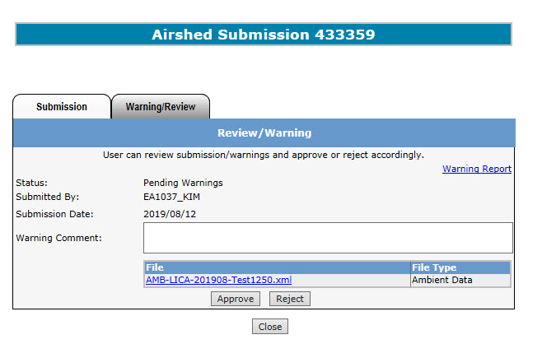
Warning Form
This is the Warning form that the Submitter receives whenever there is a data validation failure. The Submitter selects the request number from the “Work in Progress” form.
The information the Submitter will see are:
“Pending Warnings” Status;
Warning Report link. Click on the link will bring up a report detailing the data validation errors;
Submitter’s Name;
Submission Date;
To approve or reject the request, the Submitter will:
Fill in any comments required in the “Review Comment” box (Mandatory);
Click the “Approve” for “Reject” button;
Clicking the “Close” button will return the Submitter to the previous screen.
The link to the Warning Report
The Submitter fills in the Warning Comments (Mandatory)
The Submitter clicks the “Approve” or “Reject” Button to process the request.

Slide 30
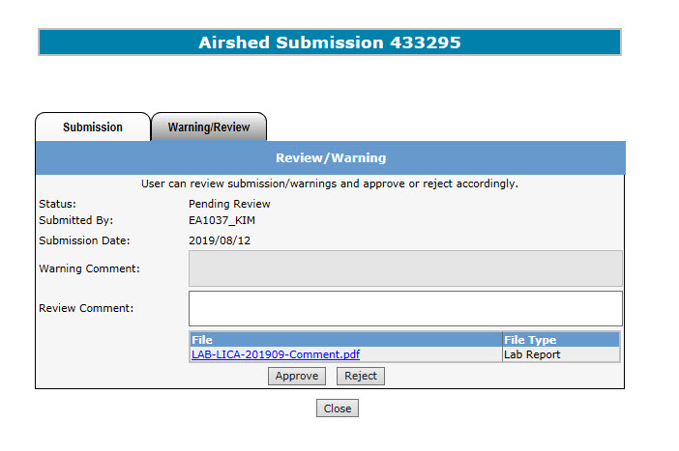
Review Form
This is the Review form where the Reviewer/Viewer can review the request.
The request is selected from the “Work In Progress” form. The information provided to the are:
“Pending Review” Status;
Submitter’s Name;
Submission Date;
Warning Comment (by the Submitter);
File to be uploaded.
Clicking the “Close” button will return the Reviewer/Viewer to the previous screen.
NOTE: the “Approve” and “Reject” buttons shown here are available to the Reviewer only.
The “Approve” and “Reject” buttons are only viewable to the Reviewer.

Slide 31
Data Submission: Upload & Submit Submitter
A. Upload & Submit Example
Once the file(s) is/are uploaded successfully, a request number is generated. This request number will now be used to track the submission.
1. Select Company Name from the dropdown list.
Note: The company name cannot be left blank (if only 1 company exists, it is defaulted by the system).
2. Add Comments - max length 60 characters (Optional Field).
1
2
3
4
4. Click the “Browse” button to select the file corresponding to the file type.
5
3. Select File Type from the dropdown list.
5. Click the “Upload” button to upload the file. Repeat steps 3-5 as needed to upload multiple files in one submission.
6
6
6. Click the “Submit” button to submit the file(s) for validation or “Delete” button to cancel the request.
This is an example of a completed “Submission” form with an uploaded file (Submitters only). More than one files can be uploaded for each submission.

Slide 32
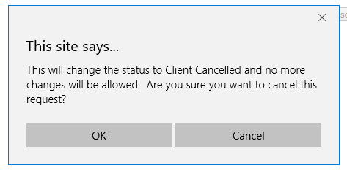
Data Submission: Client Cancelled Submitter
A. Cancel Request (Example)
The above message appears informing the Submitter that the status will change to “Client Cancelled” and no further processing will take place. Clicking “OK” button will change the status to “Client Cancelled”. Clicking “Cancel” button will cancel that request
If the Submitter choose to cancel the request and to ensure no further processing takes place, click the “Delete” button. The screen on the right appears.,

Slide 33
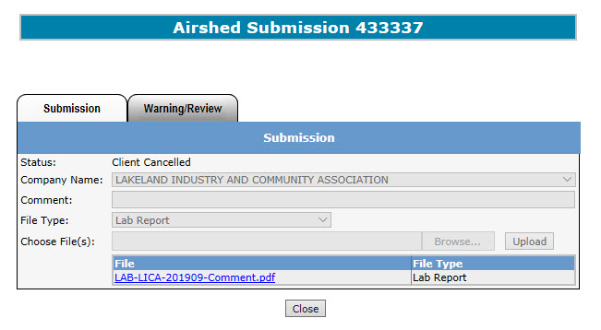
Data Submission: Client Cancelled Submitter
1
Note the status has changed to “Client Cancelled”.
2
The submission request cannot be modified at this time as indicated by the greyed-out areas.
3
Clicking the “Close” button will take you back to the Sign-in screen.
Once the Submitter confirms cancelling the request, the status changes to “Client Cancelled”.

Slide 34
Data Submission: Upload & Submit Submitter
A. Upload & Submit Example
If the Submitter choses to submit the file for validation, click the “Submit” button.

Slide 35
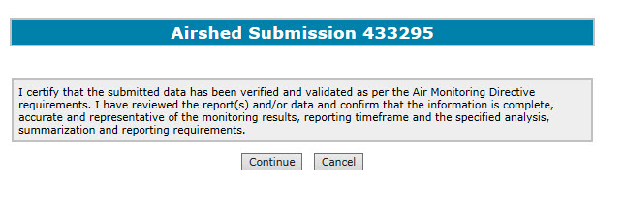
Data Submission: Processing Submitter
B. Certification
Once Data Submission is successful, this screen appears. Clicking the “Continue” button will proceed to the Validating step. Clicking the “Cancel” button will return you to the Sign in page.

Slide 36
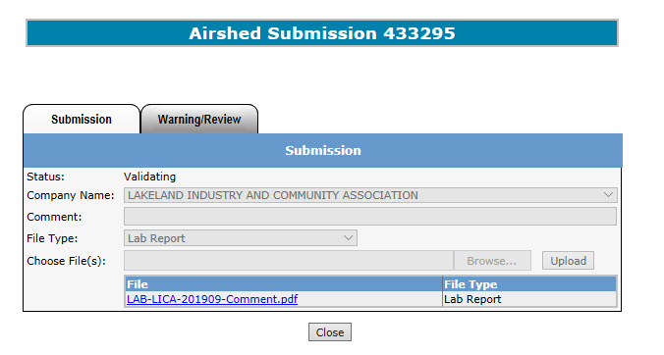
Data Submission: Validating Submitter
A. Validating
Once the Submitter clicks the “Continue” button on the certification message, the status on the submission form changes to “Validating”.
Note: the submission request form is greyed-out, meaning it cannot be modified.
1
Note the status has changed to “Validating”.
2
The submission request cannot be modified at this time as indicated by the greyed-out areas.
3
Clicking the “Close” button will proceed to the “Work in Progress” screen.

Slide 37
Data Submission: Validation Failed Submitter
Lakeland Industry and Community Association
433315
NOTE: When the request fails the validation process, ETS will send an email informing the Submitter that the request sent is rejected due to validation error(s) and the Submitter is to sign on to ETS, correct the error(s), and resubmit.

Slide 38
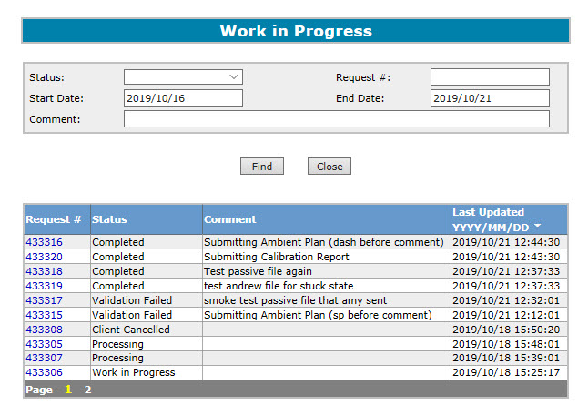
Data Submission: Validation Failed Submitter
To get further information on why the validation failed for a particular request, the Submitter will:
Sign on to ETS;
Click on “Airshed” node on the left of the screen;
Click on “Work in Progress” sub-node;
Enter the criteria to search for the results;
Click “Find” button and get the results;
Click on the desired request number with the “Validation Failed” status.
Enter the Search Criteria
Click the “Find” button
Click on the desired Request # with the “Validation Failed” status

Slide 39
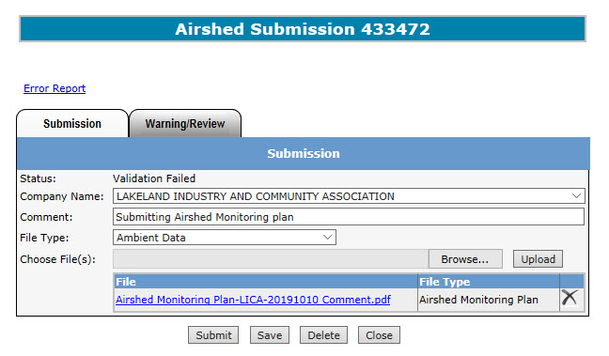
Data Submission: Validation Failed Submitter
Once the Submitter clicks on the desired request number in the “Work In Progress” form, the “Airshed Submission” form appears showing:
The Status is now “Validation Failed”; and
In the top left area an “Error Report” link appears.
The Submitter clicks on the “Error Report” link to get more information from the Error Report.
NOTE: if you click the “Save” button the error report will disappear.
2
1

Slide 40
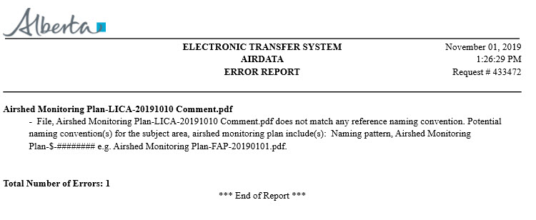
Data Submission: Validation Failed Submitter
1
2
This is the Submission Report. The information in the report include:
Date and time of report;
Request number;
File Description;
Error Details;
Total number of files submitted.
3
4
5
Note: As described in the message, this submission generated a error indicating an incorrect file naming convention. Optional comments added to the file name should be preceded by a dash(i.e. “Airshed Monitoring Plan-LICA-20190101-Comment.pdf”)

Slide 41
Data Submission: Validation Passed with Warnings Identified
Lakeland Industry and Community Association
If the request passes validation processing and warnings have been identified, an email is sent to the Submitter indicating there are warnings in the file that need to be verified. The Submitter will have the option to approve the request for it to go to the validation stage, or to reject the request for it to be resubmitted.
This next step in the process is Pending Warnings. If there are no warning errors, then the next step is Pending Review.

Slide 42
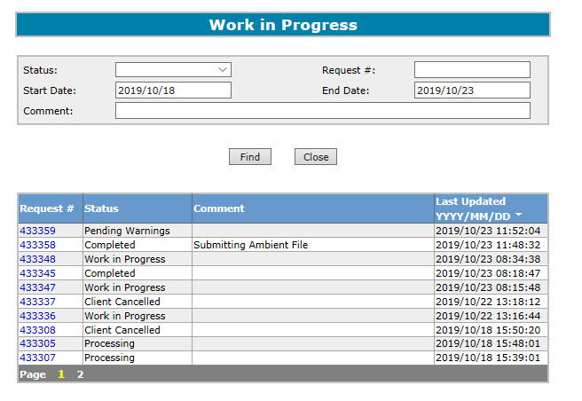
Data Submission: Warnings Submitter
Steps in determining the requests that have “Pending Warnings” status:
Sign on to ETS;
Click on “Air Data” node on the left of the screen;
Click on “Work in Progress” sub-node;
Enter the criteria to search for the results;
“Pending Warnings” can be selected from the Status menu
Click “Find” button and get the results;
Click on the desired request number with the “Pending Warnings” status.
Enter the Search Criteria
Click the “Find” button
Click on the desired Request # with the “Pending Warnings” status

Slide 43
Data Submission: Warnings Submitter
Once the Submitter clicks on the desired request number with the “Pending Warnings” status, The “Review/Warning” form appears where:
The Status is now “Pending Warnings”; and
The “Warning Report” link is found on the right of the Review/Warning forms.
To access the warning report the Submitter clicks on the “Warning Report” link.
To approve the request, the Submitter fills in the “Warning Comment” box and clicks the “Approve” button indicating the Submitter has received the Warning Report and confirmed the data is correct.
To reject the request, the Submitter fills in the “Warning Comment” box and clicks the “Reject” button.
1
2
The Submitter must fill in the Warnings Comment box whenever the request is being approved or rejected.
REMINDER: You must be assigned the role of Submitter to approve or reject the request.

Slide 44
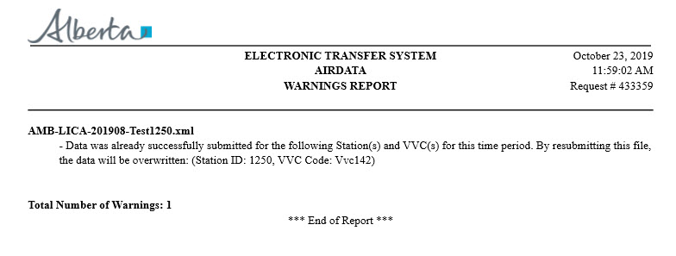
Data Submission: Warnings Report Submitter
This is the Warnings Report providing details why the request has warning errors. The information in the report include:
Date and time of report;
Request number;
File Name(s);
Error Details;
Total number of warnings raised.
NOTE: Once the report is access, the “Warning Report” link disappears from the Review/Warnings form.
1
2
3
4
5
Note: As described in the message, this submission generated a warning as it is a second submission for the same time period at the same station.

Slide 45
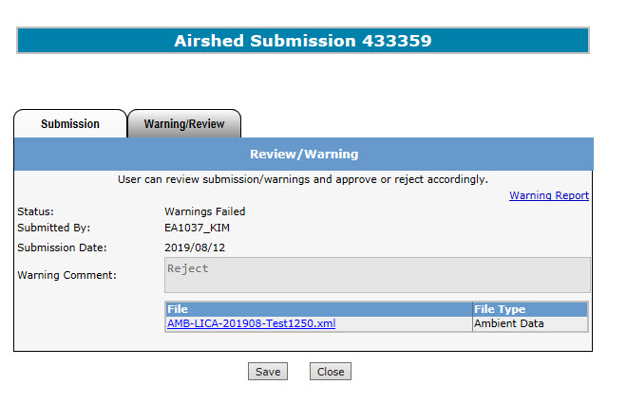
Data Submission: Warnings Failed Submitter
If the Submitter rejects the request, the status changes to “Warnings Failed” and the request is sent back to the “Work in Progress” stage for the Submitter to delete, or amend and resubmit the request.

Slide 46
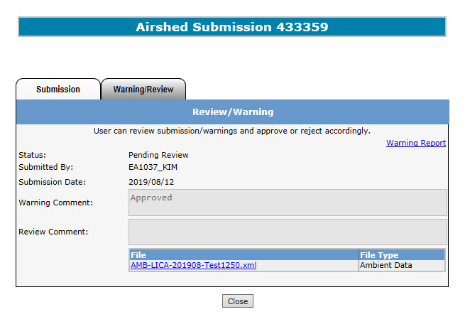
Data Submission: Warnings Pass Submitter
Resubmission of PM2.5 Mass to add Act of Nature flag on data affected by wildfire smoke
If the Submitter approves the request, that action:
Confirms the Warning Report is reviewed and the data is correct,
Changes the status to “Pending Review” and
Causes the request to go to the “Review” step.

Slide 47
Data Submission: Email for Review Submitter
B. Validation Passed
Lakeland Industry and Community Association
NOTE: After the warning is approved, or if there were no warnings identified, an email from ETS is sent to the Submitter informing that the request needs attention and a Reviewer is required to sign off the submission. That next step is Pending Review.

Slide 48
Data Submission: Pending Review Reviewer
The Reviewer, will review all submissions made by the Submitter including those with warnings. To start the review process the Reviewer will:
Sign in;
Click on the Air Data node to expand it;
Click on Work In Progress sub- node ;
The “Work in Progress” form appears (below)
NOTE: If the Submitter is also assigned as the Reviewer and have made submissions, if they have passed the validation and warnings processes, they go straight to the completion stage skipping the review stage.
1
The Reviewer signs on and click on “Air Data” node to expand to the sub-nodes
2
The Reviewer clicks the “Work In Progress” sub-node to get the “Work in Progress” form
REMINDER: You must assigned the role of Reviewer to approve or reject the request.

Slide 49
Data Submission: Process Review Reviewer
B. Search Results
The Reviewer will identify the requests with the “Pending Review” status by applying the search criteria filling in either:
Request #;
Status;
Comment;
Last Updated (“YYYY/MM/DD”).
And clicking the “Find” Button.
The result box will show all files and the Reviewer clicks on the desired request number with the “Pending Review” status to review and process request;
1
Click on the request number to process the request

Slide 50
Data Submission: Review Processing Reviewer
C. Reviewer Processing
This is the Review/Warning form where the Reviewer will approve the request. The request number selected for processing can be found in the “Airshed Submission” header. Information also provided are:
Request Status;
Submitter’s Name;
Submission Date;
Warning Comment (previously entered by the submitter - Optional);
Which are all greyed-out (cannot be modified).
To approve the request, the Reviewer will:
Fill in any comments required in the “Review Comment” box (mandatory if approving a resubmission);
Click the “Approve” or “Reject” button;
Clicking the “Close” button will return the Reviewer to the previous screen.
1
The Reviewer fills in Comments (mandatory if approving a resubmission)
2
The Reviewer clicks “Approve” or “Reject” Button
Note: The “Approve” and “Reject” buttons are not available to the Viewer or any user without a Reviewer role.

Slide 51
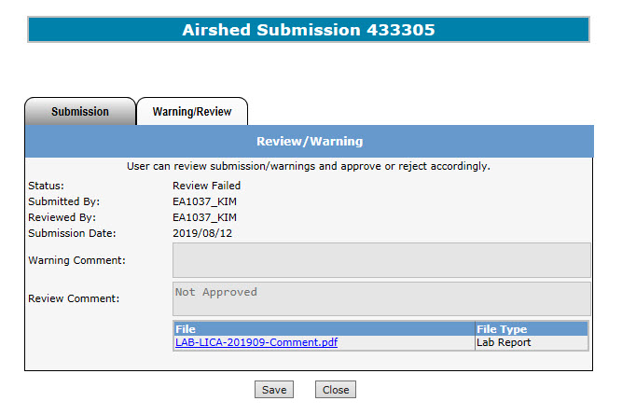
Data Submission: Review Failed Reviewer
D. Approved Status: Reject
Once the Reviewer rejects the request, the “Warning/Review“ form appears once again showing the Status changed to “Review Failed”.
If request is to be resubmitted, the Reviewer clicks the “Save” button which sends the file back to “Work In Progress” stage for the Submitter to correct and resubmit.
If the Reviewer clicks the “Close” button the form closes and returns to the “Work in Progress” form.

Slide 52
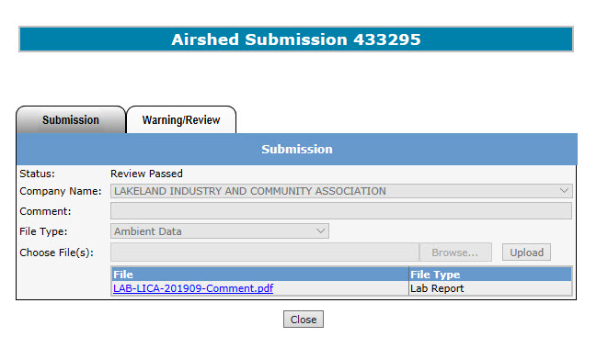
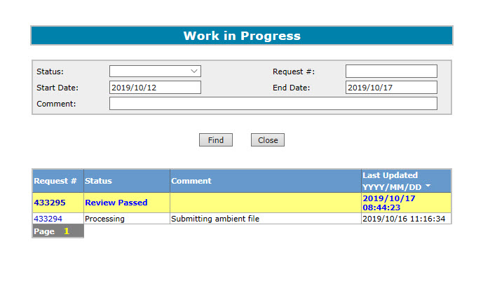
Data Submission: Review Passed Reviewer
D. Approved Status: Passed
If the Reviewer approves the request, the “Warning/Review “form appears, showing the Status changed to “Review Passed” (shown on left). When the Reviewer clicks the “Close” button, the form closes and the “Work in Progress” form appears showing the processed request highlighted in yellow (shown on right).

Slide 53
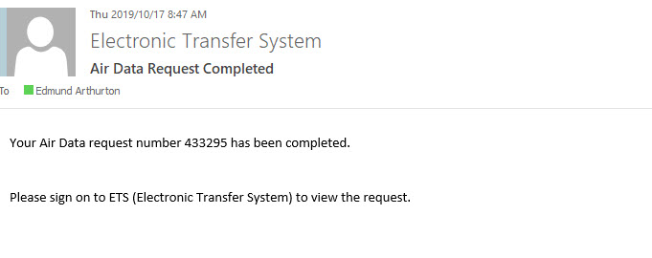
Data Submission: Processing Completed
A. Processing Completed – email notification received
Lakeland Industry and Community Association
Once the request is processed, ETS will send an email notification informing the Submitter that the request has been completed and is able to sign on to ETS to view the request.

Slide 54
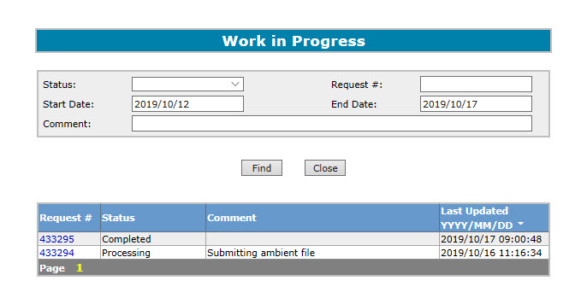
Data Submission: Completion Review
B. Completion Review
1
Enter the Search Criteria
When the Submitter/ Reviewer/Viewer wants to identify the requests with “Completed” status, they would:
Sign on to ETS;
Click on “Air Data” node on the left of the screen;
Click on “Work in Progress” sub-node to get the form;
Enter the criteria to search for the results;
Click “Find” and get the results;
Click on the desired Request number with the “Completed” status;
2
Click the “Find” Button
3
Click on the desired Request # with the “Complete” Status

Slide 55
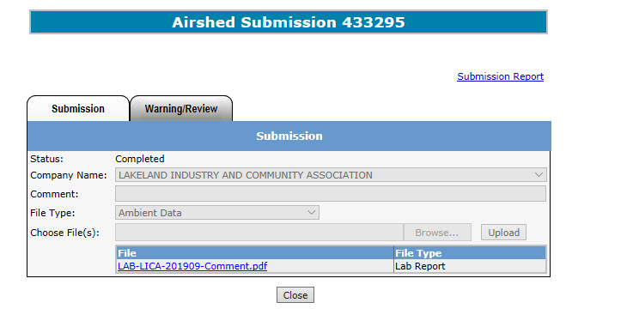
Data Submission: Completion Status
C. Completion Submission
Once again, the Airshed Submission form appears showing:
The Status is changed to “Completed”; and
In the top right area, the “Submission Report” link appears.
Note the other information is greyed-out (no modifications).
To get more information from the Submission Report, click on the “Submission Report” link;
2
1

Slide 56
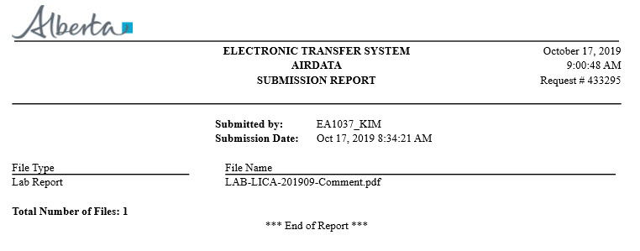
Data Submission: Completion Report
D. Submission Report
This is the Submission Report. The information in the report include:
Date and time of report;
Request number;
Submitter’s Username;
Submission Date;
File Type(s);
File Name(s);
Total number of files submitted.
1
2
3
4
5
6
7

Slide 57
Your report/data is not considered accepted by the department (Regulator) until status is completed.

Slide 58
Data Submission
Please Note:
The Submission report is only available for 90 days following data submission, therefore you should download the report immediately.
If you are unable to download the report within that 90-day period, you can email ETS@gov.ab.ca within one (1) year of the submission to request the report, otherwise the report will not be available.

Slide 59
Data Resubmission
If multiple files are submitted under one Request Number and one of those files fails:
Delete the file with errors
Correct errors in the file
Re-upload the file
Re-submit entire request
Note: When correcting file errors, a new request number is not required in order to re-submit. The corrected file should be re-uploaded to the same request number.

Slide 60
Amended Documents
If amended documents are required, note that the naming convention must still be followed. Examples:
Original LAB report (pdf): LAB-LICA-201901
Amended LAB report (pdf): LAB-LICA-201901-V01
Original Ambient Schema (xml): AMB-LICA-201901
Amended Ambient Schema (xml): AMB-LICA-201901-V01

Slide 61
Error Types
During the submission process, the Submitter will encounter two (2) types of errors:
File Validation Errors, and
Data Validation Errors
File validation errors are encountered when the file(s), that are have been uploaded for submission fails the file validation rules before being processed for review. These errors must be corrected or no further processing can take place. Some examples of this type of error include missing company name, invalid file type, wrong naming convention, etc.
Data validation errors are encountered when the file(s) have been loaded for processing but fails the data validation rules before being reviewed by the Reviewer. The Submitter has the options of approving or rejecting the submission. Some examples of this type of error include invalid VVC code, approval ID does not match submitted approval ID, Resubmission for station ID and VVC Code, etc.
Examples of both type of errors are shown below.
For more information on the types of errors encountered, please see “Air Data errors” at,…

Slide 62
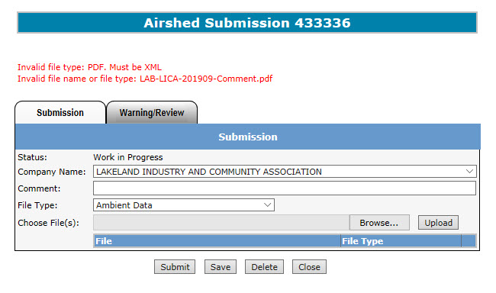
Error Types: File Validation Error
Here is an example of a file validation error. There are two (2) error messages printed in red at the top.
The errors are caused by the Submitter trying to upload a file of the wrong file type. For instance, the file, “LAB-LICA-201909-Comment.pdf,” is being uploaded as an Ambient Data file type which must be a .xml file. To resolve this, the Submitter either upload the file in the Ambient Data file type (.xml), or choose the Lab Report file type (from the dropdown list) to upload the “.pdf” file format.
For more information regarding file formatting error, please see….

Slide 63
Error Types: Data Validation Error
Here is an example of the Data Validation Error telling the Submitter that the Submission Form (left) is showing the status is now “Validation Failed”. Clicking on the Error Report link brings up the Error Report (right) describing the file naming convention for the file uploaded were not adhered to and should be corrected. Note: This submission failed the validation as a dash is required before the comment in the filename, “Airshed Monitoring Plan-LICA-20191010 Comment.pdf”.
For more information regarding file naming conventions, please see: EPEA Approval Industrial Monitoring Documentation Submission Naming Guideline: https://www.alberta.ca/assets/documents/ep-epea-approval-industrial-monitoring-documentation-submission-naming-guideline.pdf

Slide 64
Error Types: Data Validation Error
This is another example of a data validation error. This time the Submitter received a Warning Error indicating the data submitted needs to be reviewed before proceeding to the Reviewer. The Review/Warning form (left) has the status “Pending Warnings” and the Warning Report link. Clicking on the Warning Report link generates the Warning Report which indicates the file has been already submitted and resubmitting this file will overwrite previous data.

Slide 65
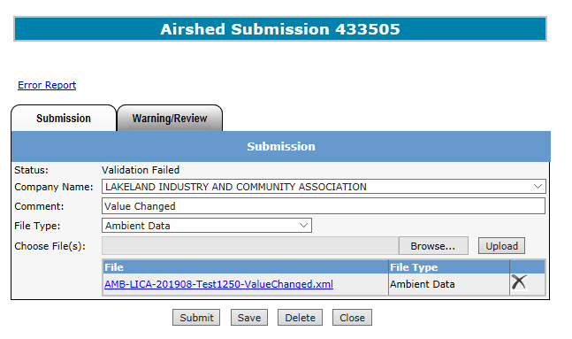
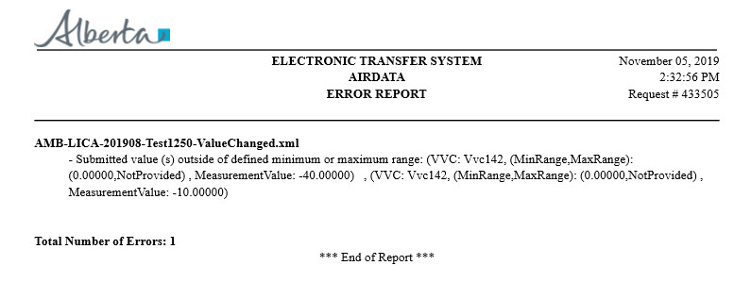
Error Types: Data Validation Error
This is another example of a data validation error. The Submission form (left) has the status “Validation Failed” and the Error Report link. Clicking on the Error Report link generates the Error Report which indicates the value submitted are outside of the defined maximum or minimum range and provides details on the VVC ID, and the value submitted in the report.

Slide 66
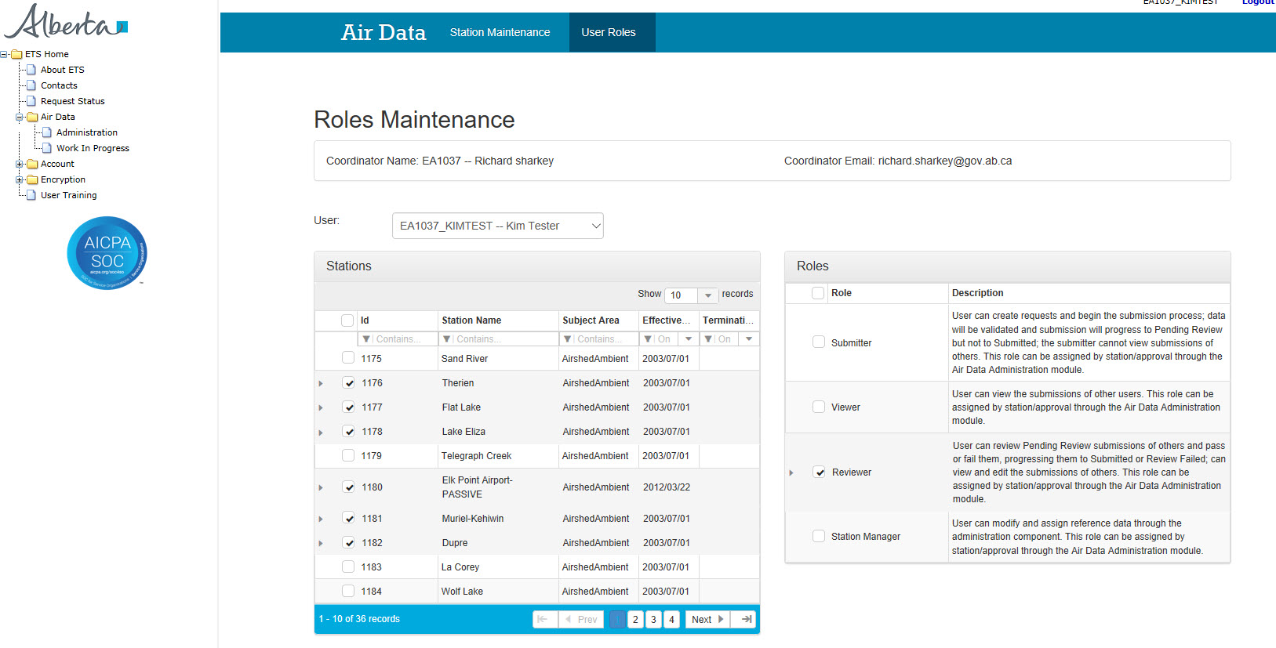
How to determine your assigned role?
To determine the role assigned to you:
Sign in to ETS;
Click “Air Data” node;
Click “Administration” sub-node (this will take you to the Administration screen);
Click “User Roles” (Blue band at top);
The User Roles screen appears showing:
Coordinator’s name - the one who assigned you the role;
Your name (select from the dropdown list;
List of station(s) assigned to you;
The role(s) assigned to you;
A
B
D
C

Slide 67
References

Slide 68
References
GoA website: www.alberta.ca
Electronic Transfer System website: https://www.alberta.ca/Electronic-transfer-system.aspx
Electronic Transfer System Login: alberta.ca/ets
Air Monitoring Directive Chapter 9 submissions: https://www.alberta.ca/amd-chapter-9-submissions.aspx)
Acceptable Formats for EPEA Approval and Code of Practice Records and Submission Coordinates: https://www.alberta.ca/assets/documents/ep-epea-approval-acceptable-formats.pdf
EPEA Approval Industrial Monitoring Documentation Submission Naming Guideline: https://www.alberta.ca/assets/documents/ep-epea-approval-industrial-monitoring-documentation-submission-naming-guideline.pdf
ETS Support and Online Learning: https://training.energy.gov.ab.ca/Pages/default.aspx
Alberta Online Learning – Air Page: https://training.energy.gov.ab.ca/Pages/Air.aspx

Slide 69
References
ETS Client Account Setup and Maintenance: https://training.energy.gov.ab.ca/Courses/ETS_client_account_setup_and_maintenance.pdf
Password Reset: https://training.energy.gov.ab.ca/Courses/ETS_password_reset.pdf
ETS Account Setup and Preferences: https://training.energy.gov.ab.ca/Courses/ETS_account_setup_and_preferences.pdf
XML Schema for Ambient Data Submission: https://training.energy.gov.ab.ca/Pages/Air.aspx#Ambient
Examples for XML Schema: https://training.energy.gov.ab.ca/Pages/Air.aspx#Ambient
Reference Tables: https://training.energy.gov.ab.ca/Pages/Air.aspx#Ambient

Slide 70
Congratulations!
You have completed the ETS – Airshed Data Submission Online Training Course
Please proceed to the subsequent modules detailing the functionality contained within each module of the application.
For information or help with the different Form Types,
please see the Contacts page in the ETS menu. For information on your ETS account, please contact:
ETS Account Setup and Account Support: ETSAccountSetup@gov.ab.ca or 780-644-2300, option 4
ETS Technical Support (XML error questions, admin module issues, etc.): ETS@gov.ab.ca

