Slide 1
ETS – Industrial Data Submission Training Manual
This offers an overview on how to submit Air Regulatory (Industrial) data via ETS
Government of Alberta
November 15, 2019

Slide 2
Table of Contents
Introduction (1-9)
ETS Role Management (10-14)
Creating Client Accounts (15-16)
Assigning a Coordinator Role (17)
Assigning User Role(s) (18-20)
Data Submission Overview (21)
Regulatory Submission Form (22-25)
Work in Progress Form (26-28)
Warning Form (29)
Review Form (30)
11. Data Submission Process
Upload and Submit Request (31-32)
Cancel Request (33-34)
Data Certification (35)
Data Validation (36)
Validation Passed (37)
Warnings (38-41)
Warnings Approved (42)
Pending Data Review (43-44)
Reviewer Processing (45)
Review Passed (46)
Completed (47-48)
Completed Submission Report (49-50)
Validation Failed (52-55)
Warnings Failed (56)
Review Failed (57)
Correcting Failed Submissions
Amended Documents
Error Types (60)
File Validation (61-62)
Ambient XML/AMD Forms Schema Validations (63)
Data Validations (Hard Stops) (64)
Possible Data Validation (Warnings) (65)
Determining your assigned role (66)
Contacts (67)
References (68-69)
Notes:
EDS - Remove airshed throughout presentation – replace with ‘Industrial’. EA - done EDS - Update with all links once slides complete

Slide 3
Introduction
Overview of Changes
All changes take effect on November 15th, 2019 at 5:00 pm MST
New Version 2.0 ambient XML schema for submission of ambient data
ETS Administration Module*
Roles Management – different authorizations by user and approval
Station Maintenance – including emission sources and industrial ambient
Equipment Assignment – industrial ambient
Allows upkeep of metadata
Additional automatic validations have been put in place for ambient data and AMD forms
* Not covered in this manual. Please see Industrial Data Administration Module Training Course
Notes:
EDS – should have a link to your admin training manual here (once created)
Move this slide to beginning of presentation (slide 3)
EA – moved.

Slide 4
Introduction
Ambient XML Schema 2.0
The new schema must be used from that date going forward for new data sets and the resubmission of historic data for successful submission of ambient air data.
Reference tables for data codes are posted online
VVCs: Valid Variable Combination codes combine method, time, unit, parameter and collection codes into a single code
Refer to the correlating XML schema “Data Dictionary” for descriptions of each field and a listing of which fields are required
Note: For more information on Ambient XML Schema 2.0 please see: https://training.energy.gov.ab.ca/Pages/Air.aspx
Notes:
EDS – also move this slide to the beginning (keep it after the ‘overview of changes’ slide); EA – done;
- add ‘see references slide at end of presentation’ for the second point; EA

Slide 5
Introduction
ETS Air Data Background
As of January 1, 2019, as per Air Monitoring Directive, 2019 air reporting is being submitted via ETS (the Electronic Transfer System). Submissions to ETS include:
12 AMD reporting forms (Excel forms or XML files)
Ambient air data, including continuous, passive, intermittent and dustfall (XML file), accompanied by (as applicable):
PDF calibration report (for continuous ambient data)
PDF certified laboratory analysis report (for non-continuous ambient data)
PDF air reports:
Monthly, quarterly and annual Industrial Air Monitoring (IAM) reports
Combined monthly, quarterly and annual reports (if air component required)
SES, RATA, SES/RATA, and CGA reports
For more information, see: “Air Monitoring Directive Chapter 9 Submissions – Information on electronic submission of air data and reports as per Air Monitoring Directive (AMD) requirements” at: https://www.alberta.ca/amd-chapter-9-submissions.aspx
Note: Air reports that are not listed above (ex. Special Air Reports, Start Up/Shutdown Notifications) should still be sent via e-mail to Air.Reporting@gov.ab.ca or EPEA.Reports@AER.ca
Notes:
EDS - See change to first paragraph
EA - accepted

Slide 6
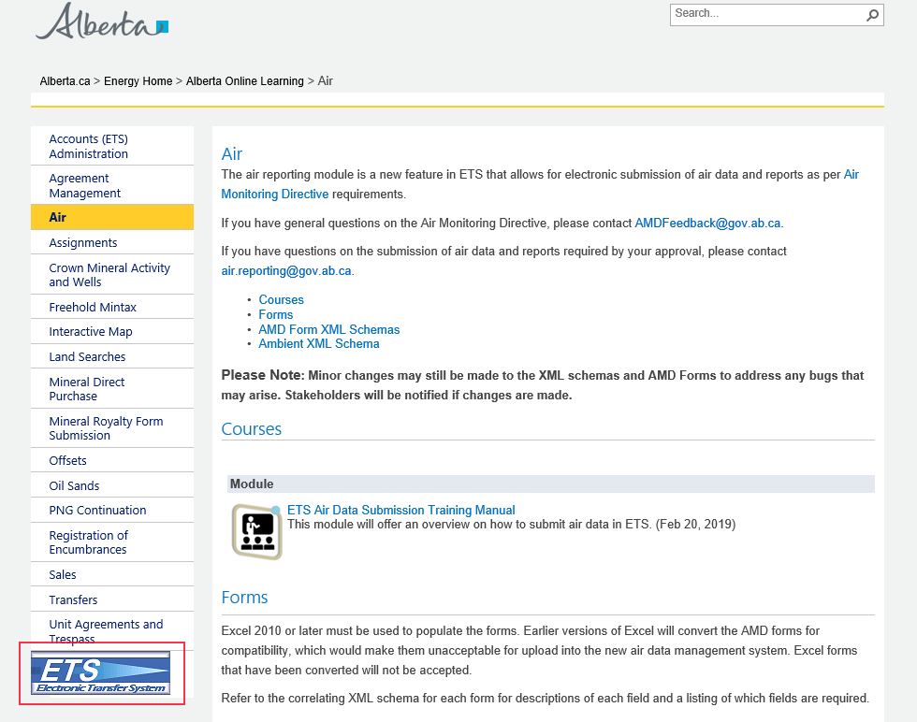
Introduction
Accessing ETS
https://training.energy.gov.ab.ca/Pages/Air.aspx
Or you can use the link
www.alberta.ca/ets

Slide 7
Introduction
ETS Support and Web Browser Compatibility
ETS supports Chrome, Microsoft Edge, Internet Explorer 11.0 or higher, and Firefox 50.0 or higher
Pop-ups must be enabled in your web browser to access reports (i.e. submission or error reports)
If you require support with existing ETS accounts or setting up a new account, please contact ETSAccountSetup@gov.ab.ca or 780-644-2300
If you require technical support with ETS, please contact ETS@gov.ab.ca or 780-908-4969
Technical support will only be available during business hours: 8:15 AM – 4:30 PM Monday to Friday
Note: If experiencing issues when using Internet Explorer, please switch to Chrome and report your issues to ETS@gov.ab.ca

Slide 8
Introduction
Submission Failure or ETS Outage
It is recommended that industrial operations submit their data, forms and reports, well before the due date to ensure adequate time for submission, should a submission failure occur. If there is a submission failure, time would be required to correct the errors identified in the error report and resubmit.
Planned ETS maintenance or outages will be posted on the ETS site and communicated to ETS users. ETS may be unavailable due to system maintenance on Friday after 4:30 p.m. until 6:00 pm Sunday
If an industrial operation is unable to meet reporting timelines due to an ETS outage, the industrial operation would not be penalized for late submission if:
Air.Reporting@gov.ab.ca (for AEP-regulated facilities) or EPEA.Reports@aer.ca (for AER-regulated facilities) has been notified of your inability to submit air data, forms or reports due to ETS / the website being down
Your air submission is completed within 24 hours of being notified that the website is operational.
Note: During weekends there may be a delay in receiving e-mail notifications from ETS

Slide 9
Introduction
ETS Account Set-Up
Once the ETS Account Set Up/Change Form is submitted and completed, an EN account number is created and a Site Administrator is assigned.
Site Administrator, refer to “ETS Account Setup and Preferences” at https://training.energy.gov.ab.ca/Courses/ETS_account_setup_and_preferences.pdf
The Site Administrator is responsible for creating and maintaining Client Accounts and assigning a Coordinator.
Client Accounts are subsets of the Site Administrator Account. Each Client Account is given access to air regulatory forms based on their assigned User Role(s)
The Coordinator is responsible for assigning User Roles to Client Accounts based on the required functionality of an individual under a specified approval

Slide 10
ETS Role Management
Each Client Account must be assigned role(s).
One or any combination of User Roles can be assigned to each client account.
User Roles are described on the slides 12-13
Please note:
For existing users the administration module will be pre-assigned on November 15, 2019 with:
Submitter and Reviewer roles for all current approvals that are linked to the legal company name, this will include Reclamation and Decommissioning status approvals as they are still active.
Site Administrator needs to assign coordinator role(s)
Coordinator needs to go though each user and assign or remove roles, as needed for each approval
If an EPEA Approval number is not showing up on the list, please contact air.reporting@gov.ab.ca to have it assigned
Notes:
EDS - lets make this two slides, keep the first paragraph here and move the ETS roles to another
EDS – Please add the message from ‘Industry ETS Training Oct 30 2019_V2’ slide 8 on pre-assigned roles
EA – slides split and message added.

Slide 11
ETS Role Management
Contractors may submit data or reports on behalf of a company for an EPEA regulated facility
The contractor requires an ETS User Account under the companies ETS Account in order to submit on their behalf
Contractors require a separate user account for each company they submit on behalf of
Facilities should be aware that when the Reviewer User role is assigned, it allows that User to see everything that is submitted for that approval
If you would like cover off for a time period, the Coordinator would need to assign a Client User Role(s) required during that time. Afterwards the Coordinator would need to remove the Client User Role(s) they no longer want the Client to have.
This is the same with Contractors. Should a facility no longer work with a contractor, the User Role(s) would need to be removed at time of separation

Slide 12
ETS Role Management
Site Administrator
Create accounts and assign Coordinator role in ETS account node
Must assign at least one User Coordinator role
Coordinator
Can assign all roles below, by approval, to all active users in admin module (see slide 18)
Station Manager**
Can modify source and ambient stations details and assign reference data for station/approvals to which they are assigned.
Reviewer*
Can review ‘Pending Review’ submissions and pass or fail them, progressing them to Submitted or Review Failed status. Can view and edit the submissions of others. Role is assigned by approval
Submitter*
Can create requests and begin the submission process; data will be validated and submission will progress to Pending Review but not to Submitted (unless user also has Reviewer role). Cannot view submissions of others. Role is assigned by approval
Viewer*
Can view, but not modify the submissions and station reference data of other users, as assigned by approval
* These roles will be discussed in this manual
** Station Manager will be covered in the Industrial Data Administration Module Training Course
Note: Reviewer, Submitter and Viewer roles are assigned based on approval. A User may have different roles for different approvals
Note: If you do not know who your Site Administrator is, please contact ETSAccountSetup@gov.ab.ca
Notes:
EDS - lets make this two slides, keep the first paragraph here and move the ETS roles to another
EDS – Please add the message from ‘Industry ETS Training Oct 30 2019_V2’ slide 8 on pre-assigned roles
EA split done

Slide 13
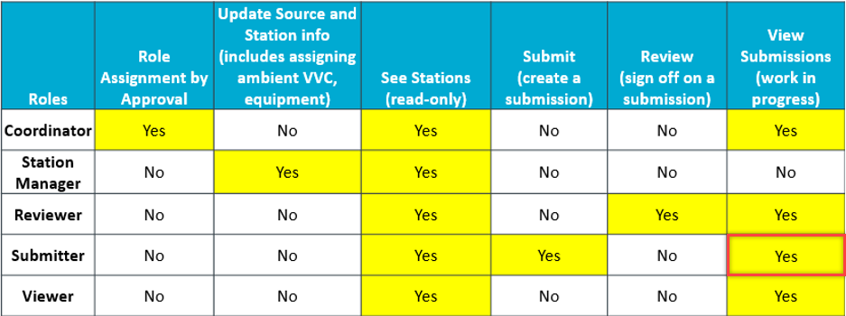
ETS Role Management
Note: A Submitter can only view submissions that they have submitted (i.e. Won’t necessarily see all submissions for that approval, if there is more than one Submitter)
Notes:
EDS – please title this slide ‘ETS Role Management’ like previous slide
EA - done

Slide 14
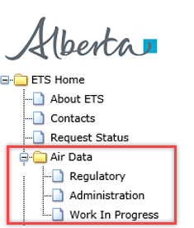
ETS Role Management
Once signed in to ETS, the “Air Data” tree node will appear on the left of the screen. The “Air Data” node has 3 sub-nodes:
“Regulatory” – for the Submitter to make data and report submissions, and manage warnings/errors
“Administration” – for the Coordinator to assign User roles and the Station Manager to update Source and Station information
Also, Users can identify the roles assigned to them
“Work In Progress” – for Submitter, Reviewer, and Viewer to see the status of the data submission. The Reviewer accesses this node to review submissions requiring accept or reject
Note: To see the “Regulatory” sub-node, you must be assigned the Submitter role
Note: If the “Air Data” node is not visible, contact your Coordinator (or Site Administrator if no Coordinator present) to assign your user account at least one role
Notes:
EDS – what you can see based on your roles. Ex. If you’re a submitter you will see regulatory air node. If you don’t, the regulatory node will not appear.

Slide 15
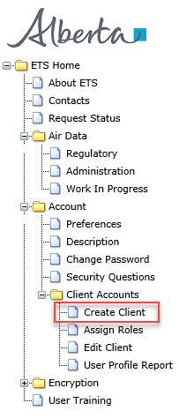
Creating Client Accounts
Before roles can be assigned, Client Account(s) must be created by the Site Administrator
To get to “Create Client” node the Site Administrator clicks on:
“Accounts”
“Client Accounts”
Once the Site Administrator clicks on “Create Client”, the process of creating users will start.
For more information refer to ETS Client Account Setup and Maintenance: https://training.energy.gov.ab.ca/Courses/ETS_client_account_setup_and_maintenance.pdf
Note: ‘Client’ is equivalent to ‘User’
Notes:
EDS – please add Katelyn’s slides here (refer to email from Oct 22, refer to comments on slide 8/9 with screenshots)
EA - added

Slide 16
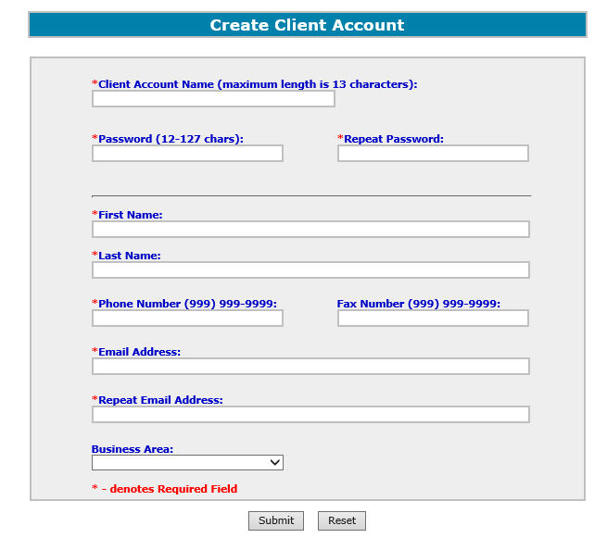
Creating Client Accounts
Once, the Site Administrator clicks on “Create Client” sub-node, the “Create Client Account” form appears where the following mandatory information is filled in:
Client Account Name
Password – twice (Password and Repeat Password)
First Name
Last Name
Phone Number
Email address
The Fax Number and Business Area are optional.
Click “Submit” button to create the account
The account creation will need to be confirmed in a pop-up
Note to Site Administrator: Write down the Client Account username and password, and forward to the Client as it is not retrievable
Notes:
EDS – please add Katelyn’s slides here (refer to email from Oct 22, refer to comments on slide 8/9 with screenshots)
EA - added

Slide 17
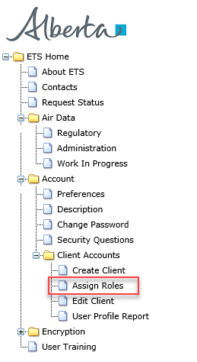
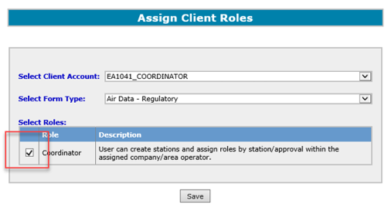
Assigning a Coordinator Role
After the users are created, the Site Administrator assigns the Coordinator role. Only the Site Administrator can assign the Coordinator role.
To assign the Coordinator role, the Site Administrator clicks “Assign Roles”
Next, the Site Administrator checks off role of coordinator and clicks “Save”
Notes:
EDS – please add Katelyn’s slides here (refer to email from Oct 22, refer to comments on slide 8/9 with screenshots)
EA - added

Slide 18
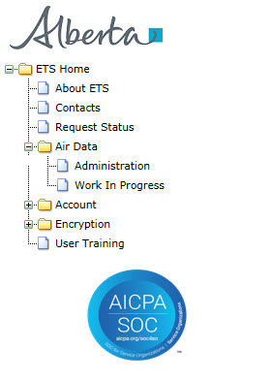
Assigning User Role(s)
Once the Coordinator is assigned they are responsible for assigning the user role(s) to Client Accounts
To assign roles, the Coordinator clicks on
“Air Data” node
“Administration” sub-node
Note: Coordinator can only see the “Administration” and “Work In Progress” nodes unless they have Submitter role assigned
Note: Coordinator can assign user roles to themselves
Notes:
EDS – please add Katelyn’s slides here (refer to email from Oct 22, refer to comments on slide 8/9 with screenshots)
EDS – redundant info on left and right, remove middle image and edit blue box as per Katelyn’s email
EA – Katelyn’s slide added (above)

Slide 19
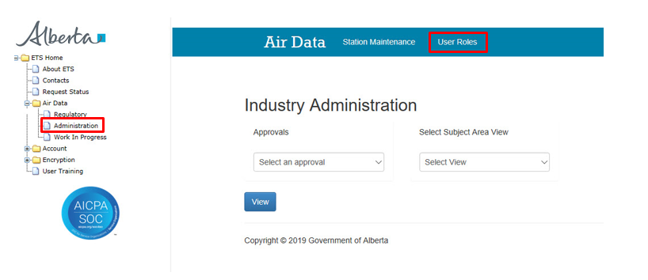
Assigning User Role(s)
Once the Coordinator clicks on the “Administration” sub-node, the “Industry Administration” screen appears.
To assign role(s) to user, the Coordinator clicks “User Roles”

Slide 20
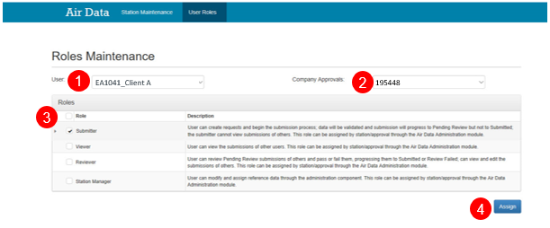
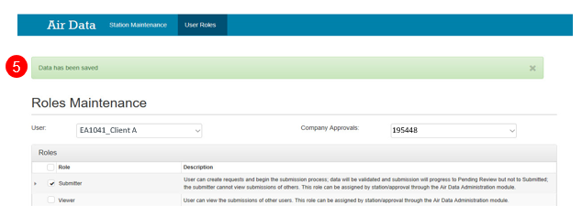
Assigning User Role(s)
Using the Roles Maintenance screen, the Coordinator can now assign role(s) to the User with the following steps:
Identify and select the user from the “User” dropdown list
Select the approval for the user
Select the role(s) for the user in the “Roles” list
Multiple (or all) roles can be assigned to any user
Click the “Assign” button
Once the transaction is successful, a green “Data has been saved” bar should appear
Notes:
EA-Change remember to change the approval number to 195448!
EDS – let’s remove the arrows to make this less busy
EA – Arrows removed

Slide 21
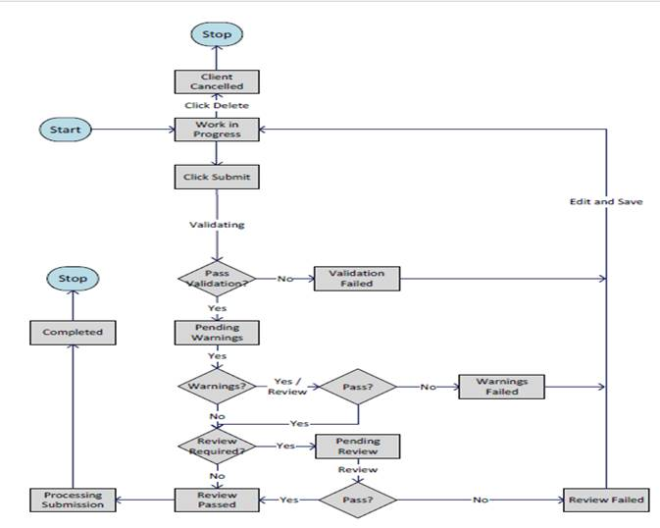
Data Submission Overview
3
The data submission will proceed through the following stages or status types:
Work in Progress – new, un-submitted requests
Processing – request is submitted for validation
Client Cancelled –request is cancelled by clicking delete
Validating – request is validated after file submission
Validation Failed – request has data validation errors
Pending Warnings – request has passed validation, but has warning message(s)
Warning Failed – warnings were rejected by client
Pending Review – request passed warning process and requires review by the Reviewer
Review Failed – request has been rejected by the Reviewer
Review Passed – request has been approved by the Reviewer
Processing – request has been submitted to the department
Completed – request has been accepted by the department
The status types are found in the “Work in Progress” form.
1
2
4
5
12
6
7
8
11
10
9
Note: You will need to refresh the page to see the status changes. If a file is stuck at Processing or Validating for an extended period of time, please contact ETS Support at ETS@gov.ab.ca
Notes:
EDS – move this slide up, before slide 22
EA done! This is now slide 22

Slide 22
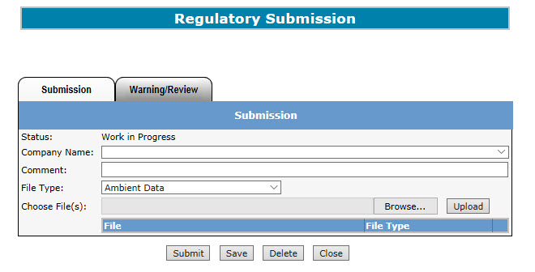
Regulatory Submission Form
To access the Regulatory Submission form, the Submitter will:
Click on the “Air Data” node to expand sub-nodes
Click on the “Regulatory” sub-node
The “Regulatory Submission” form appears (left)
Note: The “Regulatory” sub-node can only be accessed by the Submitter and the Submitter role must be assigned in order to submit a file
Notes:
EDS – remove the grey block here, but keep all of the nodes
EA - Done

Slide 23
Regulatory Submission Form
The Status - Work in Progress at the start of the process.
The Regulatory Submission form is used only by Users with Submitter role assigned
The following information is filled before the files can be uploaded and submitted:
“Company Name” (selected from dropdown list)
“Comment” (optional)
“File Type” (selected from dropdown list)
“Choose File(s)” (selected using the “Browse” button and uploaded clicking the “Upload” button)
“Browse” button searches for the file(s) to be uploaded
1
2
3
4
This is the list of Regulatory file types (discussed later):
“Upload” button uploads the file(s)
“Close” button is to go back to the sign in page without saving data
“Submit” button is to submit the file for validation.
“Delete” button cancels the submission request.
“Save” button is to save the data to ETS where it is stored until it is submitted for review.
Notes:
EDS - “Upload and submit form”, but this is an ambient XML schema submission (not a form)
EA- Amended

Slide 24
Regulatory Submission Form
Industrial File Types
The formats for the listed file types are:
Ambient data: (XML) ambient schema submissions
Calibration report: (PDF) continuous ambient analyzer calibration report
Lab Report: (PDF) Certificate of Analysis report for ambient data analyzed at a laboratory
Industrial Monitoring Report: (PDF) Industrial Air Monitoring, IAM or Combined, CMB reports
Source Emission Survey report: (PDF)
Relative Accuracy Test Audit report: (PDF)
SES and RATA Combined report: (PDF)
Cylinder Gas Audit Report: (PDF)
AMD Form: (Excel or XML) AMD1 -12 form submissions
For more information see “Acceptable Formats for EPEA Approval and Code of Practice Records and Submission Coordinates” at https://www.alberta.ca/assets/documents/ep-epea-approval-acceptable-formats.pdf
Note: The file-type selected will be validated against the uploaded file. If filling out a AMD form in XML still choose the AMD Form option
Notes:
EA – added file types

Slide 25
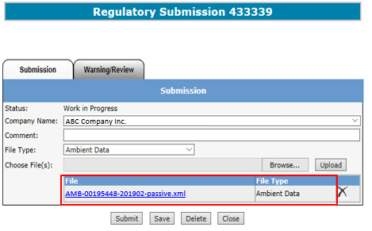
Regulatory Submission Form
Naming Guidelines
When uploading files for submission, note the file naming convention.
For example when Ambient Data is submitted, the file uploaded is named “AMB-00195448-201902-passive.xml” in the format of “AMB-########-YYYYMM-Comments.xml”, where:
“########” - is 8-digit approval number;
“YYYY” – monitoring year;
“MM” – monitoring month;
“Comments” – additional descriptor (optional).
For more information on naming convention see “EPEA Approval Industrial Monitoring Documentation Submission Naming Guideline” at https://www.alberta.ca/assets/documents/ep-epea-approval-industrial-monitoring-documentation-submission-naming-guideline.pdf
Note to Submitters: To avoid errors when uploading, please ensure the proper naming convention is adhered to

Slide 26
Work in Progress Form
The “Work In Progress” form is used to find the status of file submissions
To access the “Work In Progress” form, clients with Submitter*, Viewer or Reviewer roles can:
Click on “Air Data” node
Click on “Work In Progress” sub- node
The “Work in Progress” form appears (below)
This form can be refreshed to see updated statuses, for example to see if a Processing status has changed to Completed
* Remember, if a User only has the Submitter role, they will only view their own submissions

Slide 27
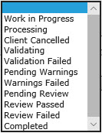
Work in Progress Form
Search Requests
To search for and retrieve requests, fill in the “Work in Progress” form using one or more of the following search criteria:
Status (drop down list)
Request #
Start Date
End Date
Comment entered
List of Status types:
Note: If no criteria is entered, the result will return all requests under the account

Slide 28
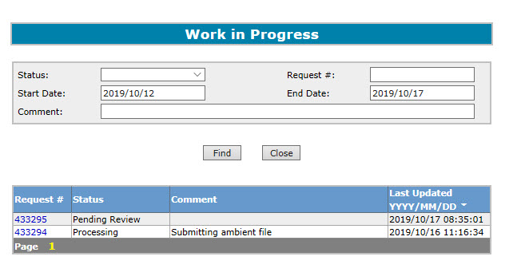
Work In Progress Form
Search Results
This is an example showing the results returned from applying the search criteria in the “Work In Progress” form.
In this example, no criteria was applied which resulted in the results box showing the entire list of requests by:
Request #
Status
Comment
Last Updated (“YYYY/MM/DD”)
For a request to be viewed, the user can click on the desired request number.
Click on the request number to process the request
Note: To shorten the list of results, re-do the search by filling in one or more of the search criteria elements

Slide 29
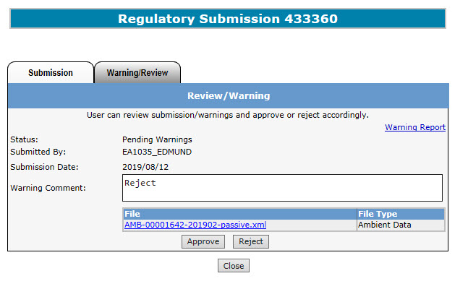
Warning Form
This is the “Warning” form that Users with the Submitter role can see when file status is Pending Warnings. The Submitter selects the request number from the “Work in Progress” form.
The information the Submitter will see are:
Pending Warnings Status
Warning Report – Report detailing the data validation warnings
Submitter’s Username
Submission Date
To approve or reject the request, the Submitter will:
Fill in any comments required in the “Warning Comment” box (Mandatory)
Limit of 200 characters
Click the “Approve” or “Reject” button
Clicking the “Close” button will return the Submitter to the previous screen.
EA1035_Client A
AMB-00195448-201902-passive.xml
The Submitter fills in the Warning Comments (Mandatory)
Note: If a warning is rejected, file returns to Work in Progress status; if warning is accepted, file proceeds to Review

Slide 30
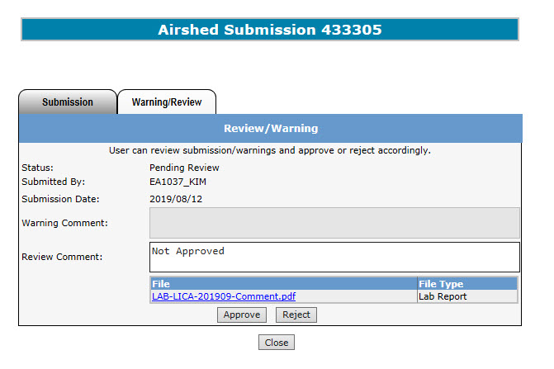
Review Form
This is the “Review” form that Users with Viewer and/or Reviewer roles can see when file status is Pending Review. The request is selected from the “Work In Progress” form.
The Reviewer is able to see the Warning Report (if any warnings were approved)
The information the Viewer/Reviewer will see are:
Pending Review Status
Submitter’s Username
Submission Date
Warning Comment (by the Submitter)
Limit of 200 characters
File to be uploaded
Clicking the “Close” button will return the Reviewer/Viewer to the previous screen.
EA1035_Client A
LAB-00195448-201902-Comment.pdf
Note: The “Approve” and “Reject” buttons are only seen when User has the Reviewer role

Slide 31
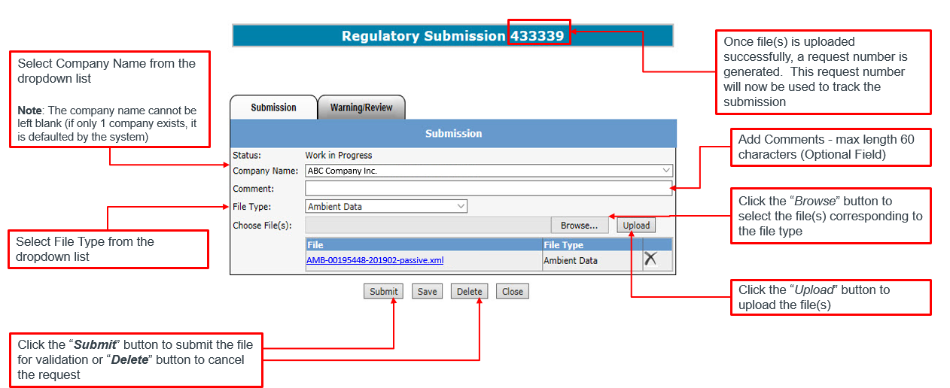
Data Submission Process
Upload & Submit Request
Note: More than one file can be uploaded for each submission

Slide 32
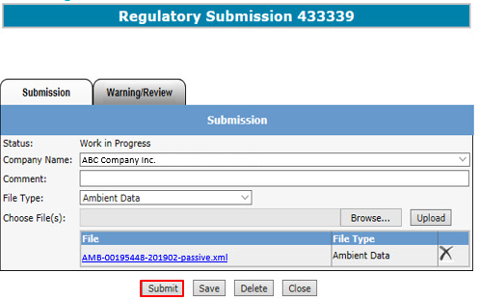
Data Submission Process
Upload & Submit Request
If the Submitter chooses to submit the file for validation, click the “Submit” button.
Multiple files can be uploaded under one request. For example, one request should represent the complete monthly submission: AMD1, AMD5, IAM, LAB, CAL, Ambient XML, etc.

Slide 33
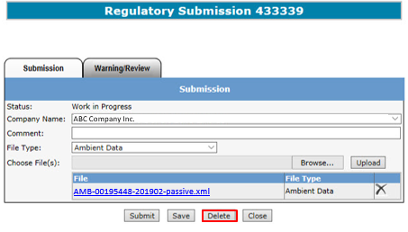
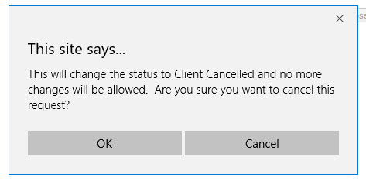
Data Submission Process
Cancel Request
If the Submitter does not intend to proceed with a submission, they can click the “Delete” button.
The message on the bottom left of this slide will appear, informing the Submitter that the status will change to Client Cancelled and no further processing will take place
Clicking “OK” will change the status to Client Cancelled
Clicking “Cancel” will keep submission status as its previous status

Slide 34
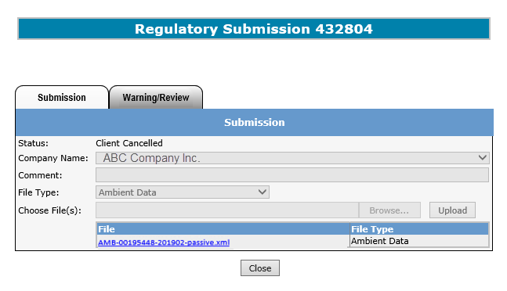
Data Submission Process
Cancel Request
Note the status has changed to Client Cancelled
The submission request cannot be modified at this time as indicated by the greyed out areas.
Clicking the “Close” button will take you back to the sign in screen
Note: Once the Submitter confirms cancelling the request, the status changes to Client Cancelled

Slide 35
Data Submission Process
Data Certification
Once the Data Submission is processing, the screen to the left will appear
Clicking “Continue” will proceed to the Validating step
Clicking “Cancel” will return you to the previous page (Work in Progress)

Slide 36
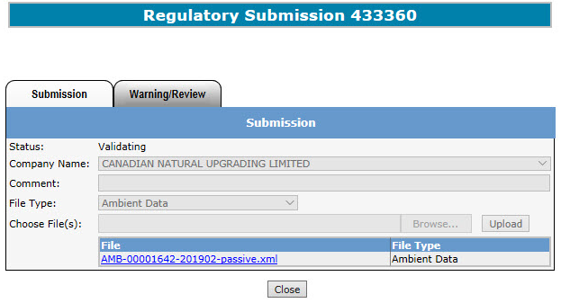
Data Submission Process
Data Validation
Once the Submitter clicks the “Continue” button on the certification message, the status on the submission form changes to Validating
Clicking the “Close” button on this form will return you to the “Work in Progress” list of all requests
ABC Company Inc.
AMB-00195448-201902-passive.xml
Note: Now the submission request form is greyed, therefore cannot be modified

Slide 37
Data Submission Process
Validation Passed
If the request passes the validation process, an email informing the Submitter that a Reviewer is required to sign off the submission will be sent (below).
The next step in the process is Pending Warnings. If you have no warning errors, then the next step is Pending Review.
If a User has Submitter and Reviewer roles assigned, the status will not go to Pending Review, it will go straight to Processing and next to Completed

Slide 38
Data Submission Process
Warnings
If the request passes validation processing and warnings have been identified, an email is sent to the Submitter indicating there are warnings in the file that need to be either approved or rejected.
The Submitter will have the option to approve the request to go to the review stage, or reject the request for submission

Slide 39
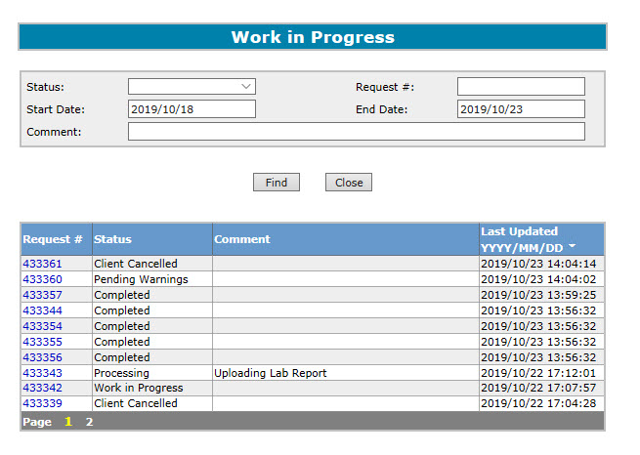
Data Submission Process
Warnings
The request with Pending Warnings status is retrieved by:
Entering search criteria for the request in the “Work in Progress” form
Click on the desired request number with the Pending Warnings status

Slide 40
Data Submission Process
Warnings
Once the Submitter clicks on the request number with the Pending Warnings status, the “Review/Warning” form appears:
The Status is now Pending Warnings
The Warning Report link is found on the top right of the Review/Warning forms
To access the warning report, the Submitter clicks on the Warning Report link.
To APPROVE the request, the Submitter fills in the “Warning Comment” box and clicks the “Approve” button indicating the Submitter has received the Warning Report and confirmed the data is correct.
To REJECT the request, the Submitter fills in the “Warning Comment” box and clicks “Reject”
EA1035_Client A
AMB-00195448-201902-passive.xml
AMB-00195448-201902-passive.xml
Note: The Submitter must fill in the Warnings Comment box whenever the request is being approved or rejected. There is a 200 character limit for Warning Comments

Slide 41
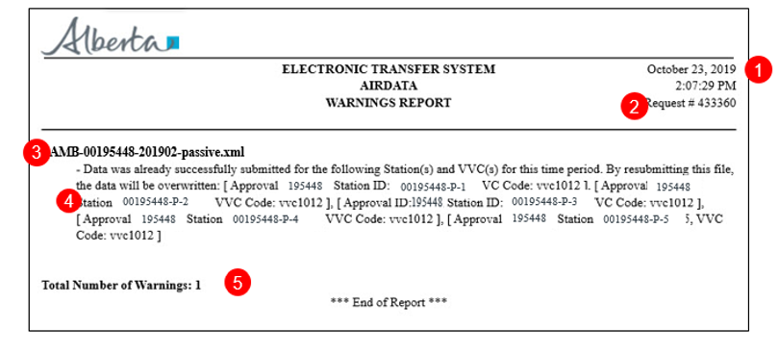
Data Submission Process
Warnings
This is the Warnings Report providing details why the request has warning errors.
The information in the report includes:
Date and time of report
Request number
File Name(s)
Error Details
Total number of warnings raised

Slide 42
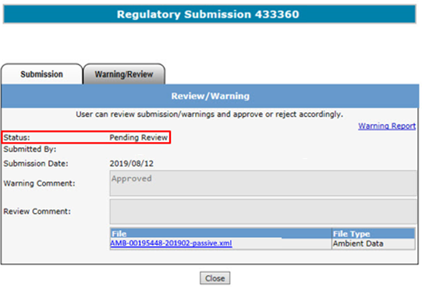
Data Submission Process
Warnings - Approved
If the Submitter approves the request:
They have confirmed the Warning Report has been reviewed and the data is correct
The status changes to Pending Review
EA1035_Client A
Note: If a User has both Submitter and Reviewer roles, the request will go past the Pending Review status to Processing and Completed

Slide 43
Data Submission Process
Pending Review
Clients with the Reviewer role can review all submissions made by the Submitter, including those with warnings.
To start the review process, the Reviewer will:
Click on “Air Data” node
Click on “Work In Progress” sub- node
The “Work in Progress” form appears (below)
Note: If the Submitter is also assigned the Reviewer role, and the submission has passed the validation and warning processes, that submission will go straight to the processing/completion stage (skipping the review stage)

Slide 44
Data Submission Process
Pending Review
The Reviewer will identify the requests with the Pending Review status by applying the search criteria filling in either:
Request #
Status
Comment
Last Updated (“YYYY/MM/DD”)
And clicking the “Find” Button.
Reviewer clicks on the desired request number with the Pending Review status to review and process request

Slide 45
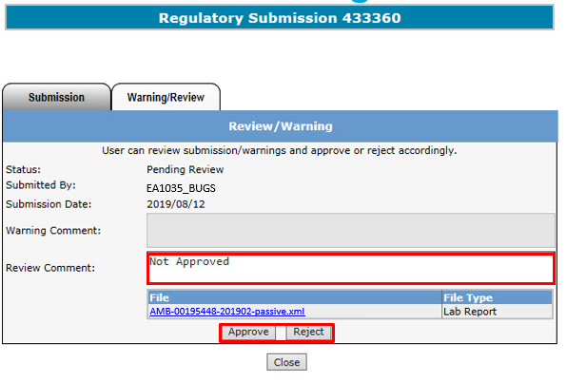
Data Submission Process
Reviewer Processing
This is the Review/Warning form where the Reviewer will approve or reject the submission.
Information also provided are:
Request Status
Submitter’s Name
Submission Date
Warning Comment
To approve or reject the request, the Reviewer:
Fills in any comments required in the “Review Comment” box
Clicks the “Approve” or “Reject” button
Clicking the “Close” button will return the Reviewer to the previous screen
EA1035_Client A
Note: The “Approve” and “Reject” buttons are not available to the Viewer

Slide 46
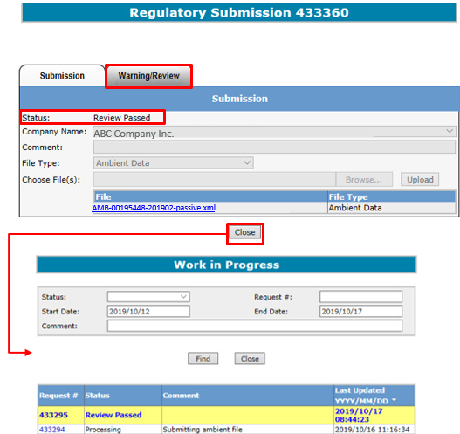
Data Submission Process
Review Passed
If the Reviewer approves the request, the “Warning/Review” form appears, showing the Status changed to Review Passed (shown on top left)
When the Reviewer clicks the “Close” button, the “Warning/Review” form closes and the “Work in Progress” form appears showing the request highlighted in yellow (shown on bottom left)

Slide 47
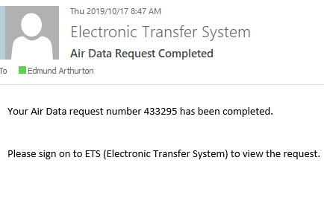
Data Submission Process
Completed
Once the request is processed, ETS will send an automated email notification informing the Submitter that the request has been completed, and is available for viewing.
ABC Company Inc.

Slide 48
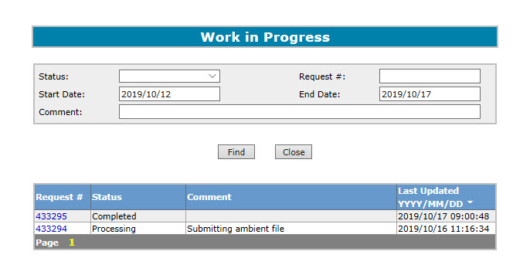
Data Submission Process
Completed
If the Reviewer/Viewer wants to view the requests with Completed status, they would:
Select the request number from the “Work in Progress”
Click on the desired Request number with the Completed status

Slide 49
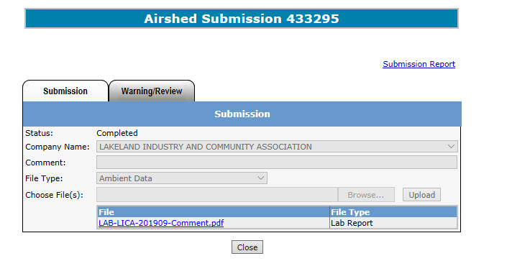
Data Submission Process
Completed Submission Report
Once again, the Regulatory Submission form appears showing:
The status has changed to Completed
The Submission Report link appears
The other information is greyed-out, therefore can not be modified
To get more information from the Submission Report, click on the Submission Report link
ABC Company Inc.
AMB-00195448-201902-passive.xml

Slide 50
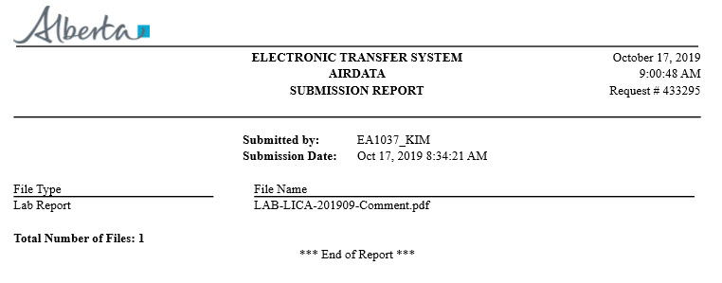
Data Submission Process
Completed Submission Report
The Submission Report includes the following information:
Date and time of report
Request number
Submitter’s Username
Submission Date
File Type(s)
File Name(s)
Total number of files submitted
1
2
3
EA1035_Client A
4
5
6
LAB-ABC Company-201902-Comment.pdf
7

Slide 51
Data Submission Process
Please Note:
The Submission Report is only available for 90 days following data submission, therefore you should download the report immediately
If you are unable to download the report within that 90-day period, you can email ETS@gov.ab.ca within one (1) year of the submission to request the report, otherwise the report will not be available
Your data is not considered submitted to the department (Regulator) until status is ‘Completed’

Slide 52
Data Submission Process
Validation Failed
If the request fails the Validation process, an email informing the Submitter that the request is rejected due to validation error(s) and the Submitter must sign on to ETS to correct the error(s) and resubmit
ABC Company Inc.
433315

Slide 53
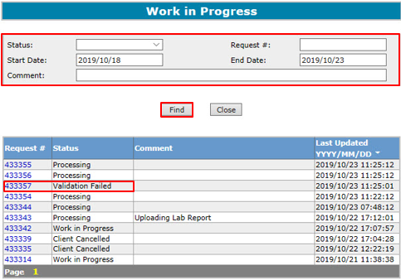
Data Submission Process
Validation Failed
To get further information on why the validation failed for a particular request, the Submitter will:
Enter search criteria for the request in the ‘Work in Progress’ form
Click on the desired request number with the Validation Failed status
This form can be refreshed to see updated statuses, for example to see if a Processing status has changed to Completed
Note: When a file fails validation and requires you to edit and re-submit, you don’t need to create a new request number. You can go back into your original request number, remove the file with the error, correct that file, re-upload and re-submit

Slide 54
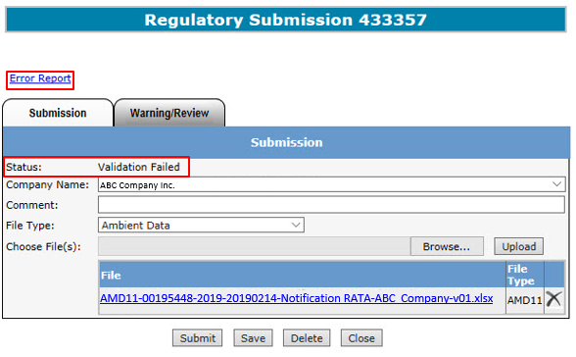
Data Submission Process
Validation Failed
Once the Submitter clicks on the request number in the “Work In Progress” form, the “Regulatory Submission” form appears showing:
The Status is now Validation Failed
In the top left area an Error Report link appears
The Submitter clicks on the Error Report link to get more information
Note: If you click the “Save” button the Error Report will disappear. To generate the error report again, hit “Submit”.
Notes:
EDS – add note here stating that if you hit save the error report will disappear.
EA – done!

Slide 55
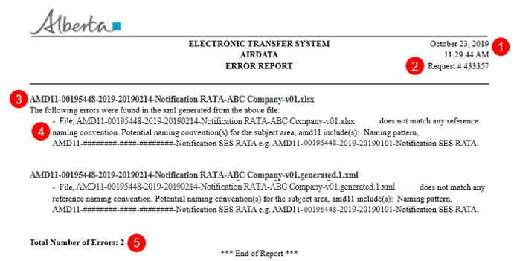
Data Submission Process
Validation Failed
This is the Error Report providing detail on why the file failed the validation process.
The information in the Error Report includes:
Date and time of report
Request number
File Name(s)
Error Details
Total number of errors identified in the submitted files
The Error Report will list all errors that apply to all files in the request number. If the file is not listed in the Error Report, it means that there are no errors associated with that file.

Slide 56
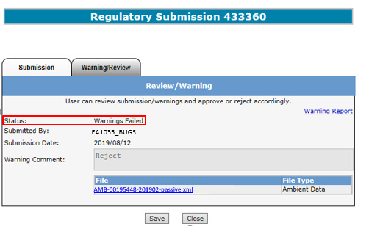
Data Submission Process
Warnings - Failed
If the Submitter rejects the request:
The status changes to Warnings Failed
Request is sent back to the “Work in Progress” stage for the Submitter to delete or correct and re-submit
EA1035_Client A

Slide 57
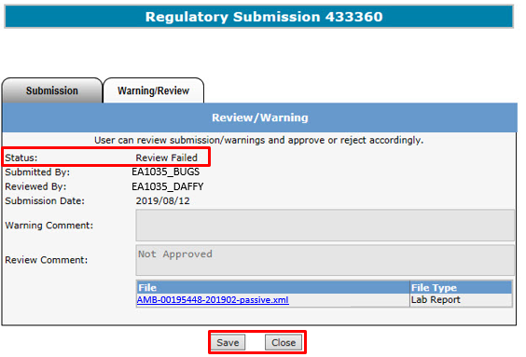
Data Submission Process
Review - Failed
If the Reviewer rejects the request, the “Warning/Review“ form appears once again, showing the Status changed to Review Failed
If the intent is to correct and resubmit the request, the Reviewer clicks the “Save” button which sends the file back to “Work In Progress” status
If the Reviewer clicks the “Close” button the form closes and returns to the “Work in Progress” form
EA1035_Client A
EA1035_Client B

Slide 58
Correcting Failed Submissions
If multiple files are submitted under one Request Number, and one or more of those files fail:
Delete the file(s) with errors
Correct errors in the file
Re-upload the file
Re-submit the request
Note: When correcting file errors, a new request number is not required in order to re-submit. The corrected file should be re-uploaded to the same request number

Slide 59
Amended Documents
If amended documents are required, note that the naming convention must still be followed.
Examples:
Original IAM report (pdf): IAM-00195448-201901
Amended IAM report (pdf): IAM-00195448-201901-V01
Original AMD7 form (excel): AMD7-00195448-2019-20190122-Stack A
Amended AMD7 form (excel): AMD7-00195448-2019-20190122-Stack A-V01
Original Ambient Schema (xml): AMB-00195448-201901
Amended Ambient Schema (xml): AMB-00195448-201901-V01

Slide 60
Error Types
During the submission process, the Submitter may encounter errors at different levels of validation:
File Validation
Encountered when the file(s), that have been uploaded for submission fails the file formatting rules before being processed for review. These errors must be corrected or no further processing can take place.
Ex. Missing company name, invalid file type, invalid file name, etc.
Ambient XML/AMD Forms Schema Validations
Encountered when the file(s), that have been uploaded for submission fails the xml validation rules before being processed for review. These errors must be corrected or no further processing can take place.
Ex. Missing required fields, wrong schema version, wrong xml formatting etc.
Data Validation (Hard Stops)
Encountered when the file(s) have been loaded for processing but fails the data validation rules before being reviewed by the Reviewer. The Submitter has to correct the file and resubmit.
Ex. invalid VVC code, approval ID in filename does not match submitted approval ID in form, wrong naming convention.
Possible Data Validation (Warnings)
Encountered when the file(s) have been loaded for processing but fails the data validation rules (warning) before being reviewed by the Reviewer. The Submitter has the options of approving or rejecting the submission.
Ex. Resubmission for station ID and VVC Code, etc.
Examples of the types of errors are shown in the following slides
For more information on the types of errors encountered, please see “Submission guidance document”

Slide 61
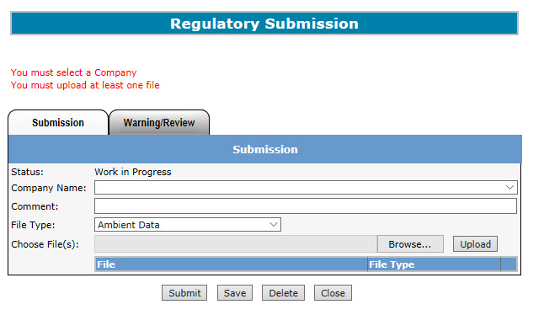
Error Types
File Validation Error
There are two (2) error messages printed in red
The errors are caused by the Submitter clicking the “Submit” button without:
Selecting the Company Name
Uploading the file(s)

Slide 62
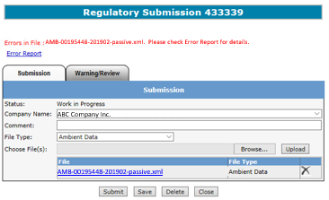
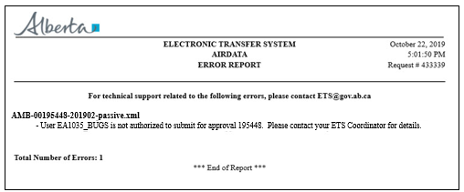
Error Types
File Validation Error
On the top left is the Submission form with the error message (red font) and an Error Report link that the Submitter clicks in order to get more details.
On the bottom left is the Error Report which indicates the User is not authorized to submit for approval 195448 (see slide 22, step 2)
The Coordinator should be contacted to address this error
EA1035_Client A

Slide 63
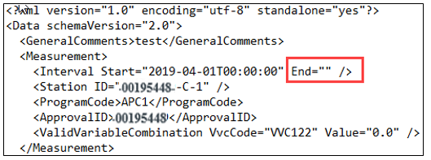
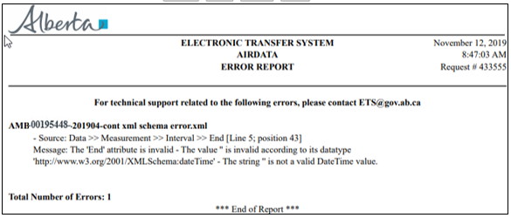
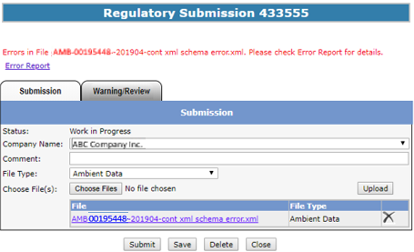
Error Types
Ambient XML/AMD Forms Schema Validations
The Error Report states the interval End date and time is missing
As seen in the XML, there is no data in this position (top left, red box)

Slide 64
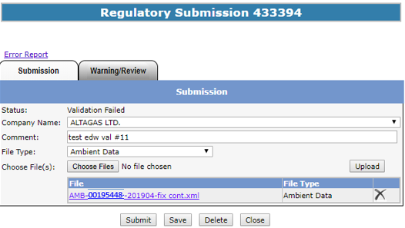
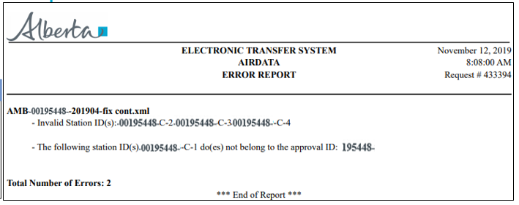
Error Types
Data Validation (Hard Stop) Error Example
ABC Company
Here is an example of the Data Validation Error telling the Submitter that the Submission Form (top left) is showing the status Validation Failed.
Clicking on the Error Report link brings up the Error Report (right) showing two error descriptions. The descriptions for these errors indicate there was an incorrect station submission for the approval.
Note: For more information regarding file naming conventions, please see: EPEA Approval Industrial Monitoring Documentation Submission Naming Guideline at https://www.alberta.ca/assets/documents/ep-epea-approval-industrial-monitoring-documentation-submission-naming-guideline.pdf

Slide 65
Error Types
Possible Data Validation Errors (Warnings)
EA1035_Client A
This is another example of a data validation error.
The Submitter received a Warning Error indicating the data submitted needs to be reviewed before proceeding to the Reviewer.
The Review/Warning form (left) has the status Pending Warnings and the Warning Report link.
Clicking on the Warning Report link generates the Warning Report which indicates the file has been already submitted and resubmitting this file will overwrite previous data.

Slide 66
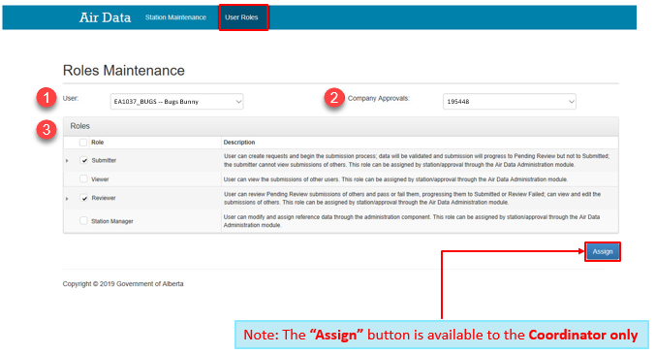
How to Determine Your Assigned Role(s)
To determine the role assigned to you:
Click “Air Data” node
Click “Administration” sub-node (this will take you to the Administration screen)
Click “User Roles” (Blue band at top)
The User Roles screen appears showing:
Your Name (select from the dropdown list)
List of approval(s) under the company
The role(s) assigned to you per approval
EA1035_Client A
Note: the “Assign’ button is available to the Coordinator only

Slide 67
Contacts
ETS Account Setup and Support: ETSAccountSetup@gov.ab.ca or 780-422-1395
ETS Technical Support (XML error questions, admin module issues, etc.): ETS@gov.ab.ca
Validation error questions/addition of sources or ambient stations/admin module content: Air.Reporting@gov.ab.ca
AMD General Reporting Questions/VVS creation requests: AMDFeedback@gov.ab.ca
For questions relating to individual facility reporting requirements, please contact your approval coordinator

Slide 68
References
GoA website: www.alberta.ca
ETS: www.alberta.ca/ets
Electronic Transfer System: https://www.alberta.ca/Electronic-transfer-system.aspx
Air Monitoring Directive Chapter 9 submissions: https://www.alberta.ca/amd-chapter-9-submissions.aspx)
Acceptable Formats for EPEA Approval and Code of Practice Records and Submission Coordinates: https://www.alberta.ca/assets/documents/ep-epea-approval-acceptable-formats.pdf
EPEA Approval Industrial Monitoring Documentation Submission Naming Guideline: https://www.alberta.ca/assets/documents/ep-epea-approval-industrial-monitoring-documentation-submission-naming-guideline.pdf
ETS Support and Online Learning (including training manuals, XML schema, AMD forms, reference tables, submission guidance document, etc.): https://training.energy.gov.ab.ca/Pages/default.aspx

Slide 69
References
ETS Client Account Setup and Maintenance: https://training.energy.gov.ab.ca/Courses/ETS_client_account_setup_and_maintenance.pdf
Password Reset: https://training.energy.gov.ab.ca/Courses/ETS_password_reset.pdf
ETS Account Setup and Preferences: https://training.energy.gov.ab.ca/Courses/ETS_account_setup_and_preferences.pdf
XML Schema for Ambient Data Submission V2.0 (Aug 2, 2019): https://training.energy.gov.ab.ca/Forms/PR_Ambient_Data_Submission.docx
Examples for XML Schema V2.0 (Aug 2, 2019): https://training.energy.gov.ab.ca/Forms/PR_Examples_for_XML_Schema.pdf
Reference Tables V2.0 (Aug 2, 2019): https://training.energy.gov.ab.ca/Forms/PR_Reference_Tables.xlsx

Slide 70
Congratulations!
You have completed the ETS – Industrial Data Submission Training Manual
Please proceed to the subsequent modules detailing the functionality contained within each module of the application.

