Slide 1
Welcome
Welcome!
This training module provides the procedures for using Query by Map for a Bid Request.
To the ETS – Bidding Query by Map
Online Training Course

Slide 2
Revisions
Date | Revisions Type | Page Number
October 31, 2012 | Conversion | All
May 10, 2013 | Updated Query by Map | 4 – 8
June 2016 | Updated Query by Map | 4-16
April 2020 | Updates | All
December 2020 | Update the ETS login page | Various

Slide 3

Query by Map - Introduction
In this module, you will learn how to:
Select Parcel(s) for a Sale Date
Load the Selected Parcel(s) into the Bid Request screen
You must complete the GeoView Overview module before proceeding with this module.
Note: As this course demonstrates the use of the GeoView tool, the data in some instances may not portray the actual Crown or Freehold ownership and is not specific to a particular mineral type map.

Slide 4
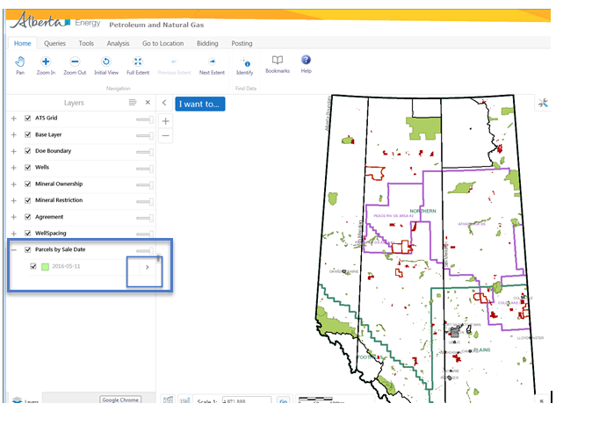
Query by Map – Parcels by Sale Date
There are separate parcel layers for each sale that are available. Sale dates are sorted chronologically and the next available sale date is turned on. The parcels for a sale are available for bidding 8 weeks prior to the sale date and are not available after the sale has closed.
Before using the map to search for parcels, set the Select Active Layer drop down list to the sale date required.
For more information about all the mapping tools please see the GeoView System Overview module

Slide 5
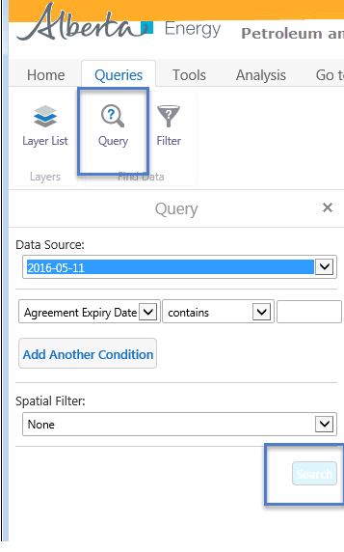
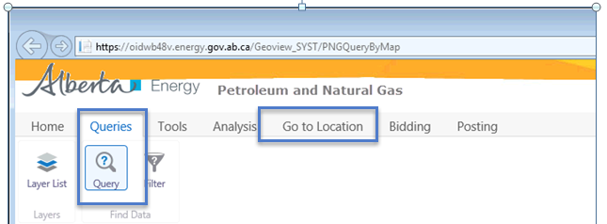
Query by Map – Simple Query Builder
The Query tool allows you to query an area of interest to determine if there are postings for a particular sale date.
You can query an area of interest by choosing the posting date under Query Layer. Alternatively, you may select Go to Location and enter the Meridian-Range-Township (M-RR-TTT) to find records in the Township layer.
Tip: A query can be made on the active layer available.
Tip: The logical operator "=" is used for exact matches. Use "contain" to perform a partial match.

Slide 6
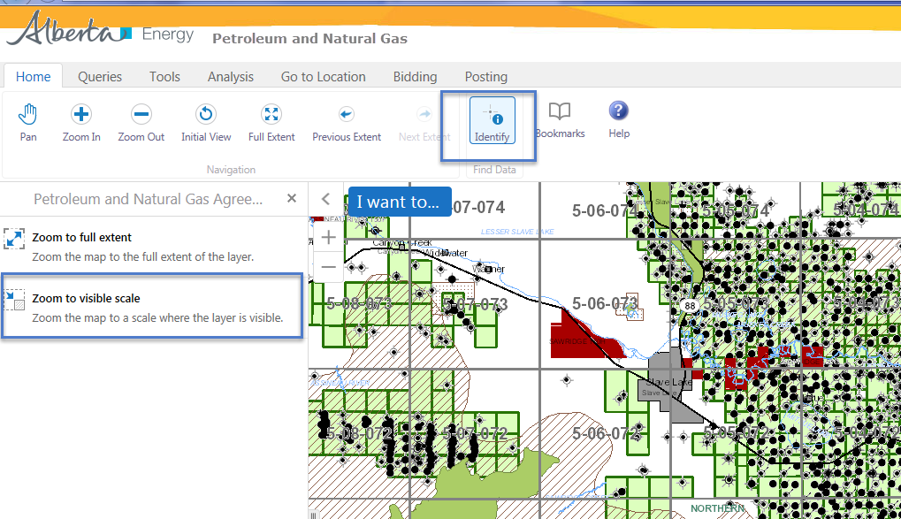
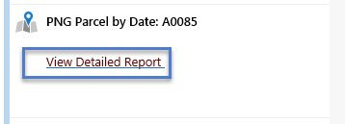
Query by Map – Point Identify
The Identify tool displays information about the land. You first need to zoom to visible scale so that the proper scale displays.
To identify a posting or agreement you need to click and drag on the land you want to view.
Clicking on View Detailed Report opens the Mineral Agreement Detail Report.
If there are restrictions, clicking on View Detail Report under the Restrictions section shows the restrictions pertaining to the same area. Restrictions do not appear on all sale parcels.

Slide 7
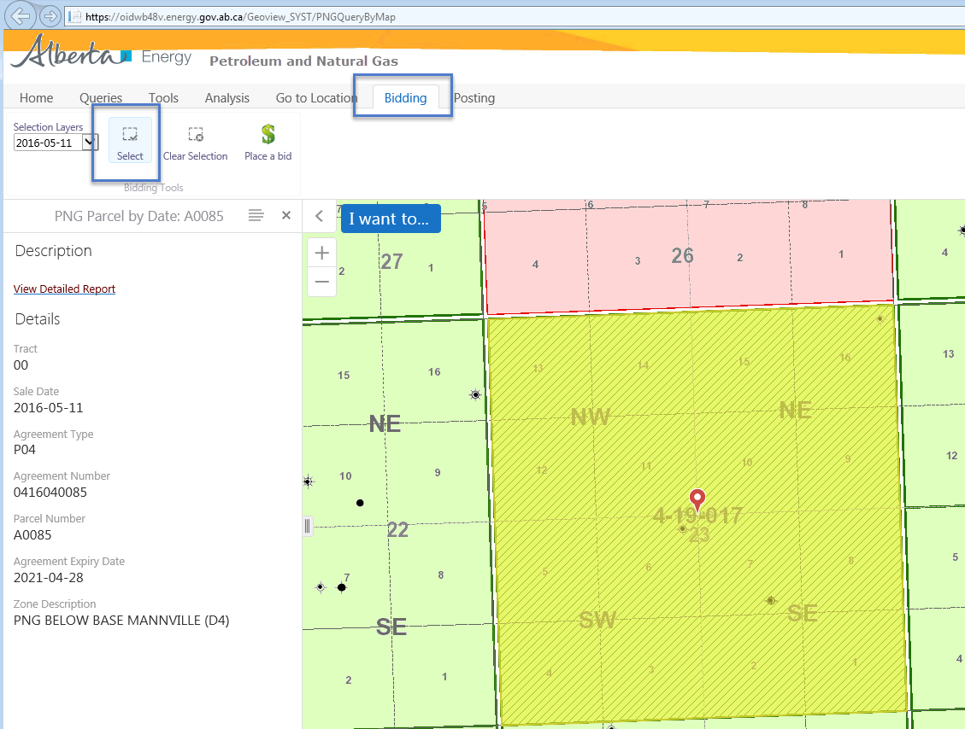
Query by Map – Bidding
The Bidding Tab allows you to select parcels to initiate the bidding process. The active layer must be set to the correct sale date.
Click on Select to initiate the bid. You need to click and drag on the land you want to select.
To learn more about the Bid Request screens, refer back to Initiate Bid Request training module.

Slide 8
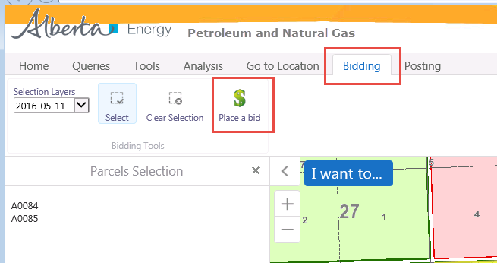
Query by Map – Place a Bid
Click on Place a bid to initiate the bid.
To learn more about the Bid Request screens, refer back to Initiate Bid Request training module.

Slide 9
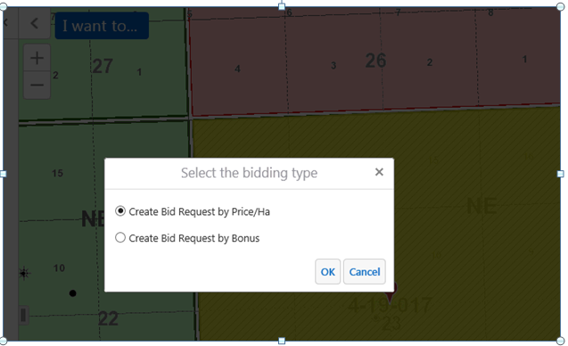
Query by Map – Select Bidding Type
You now have the option to create a bid request by PRICE/HA or BONUS. Choosing either of the calculation methods will open the Bid Request screens. Based on your selection from the map interface, the following fields will have default values:
Sale Date
Calculate Bid By
Selected Parcels on the Parcel Tab
To learn more about the Bid Request screens, refer back to Initiate Bid Request training module.
More Information (Pages 9 to 42)

Slide 10
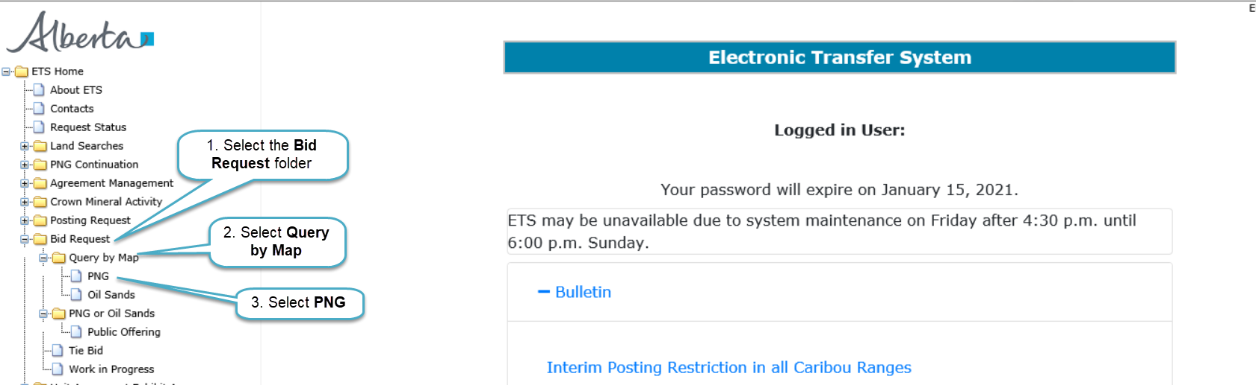
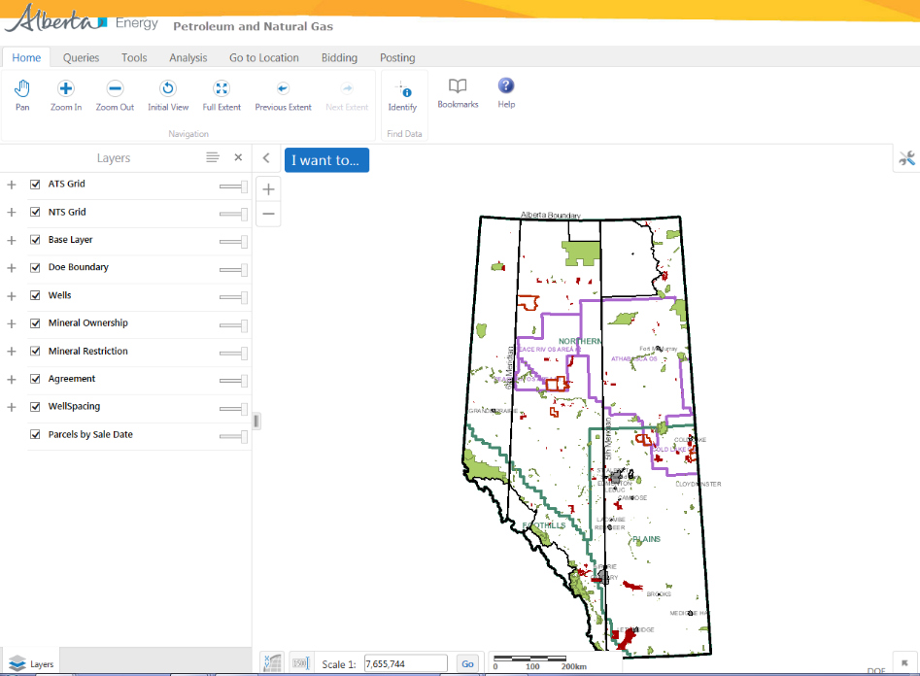
Map of Alberta is displayed
Back to Query by Map

Slide 11
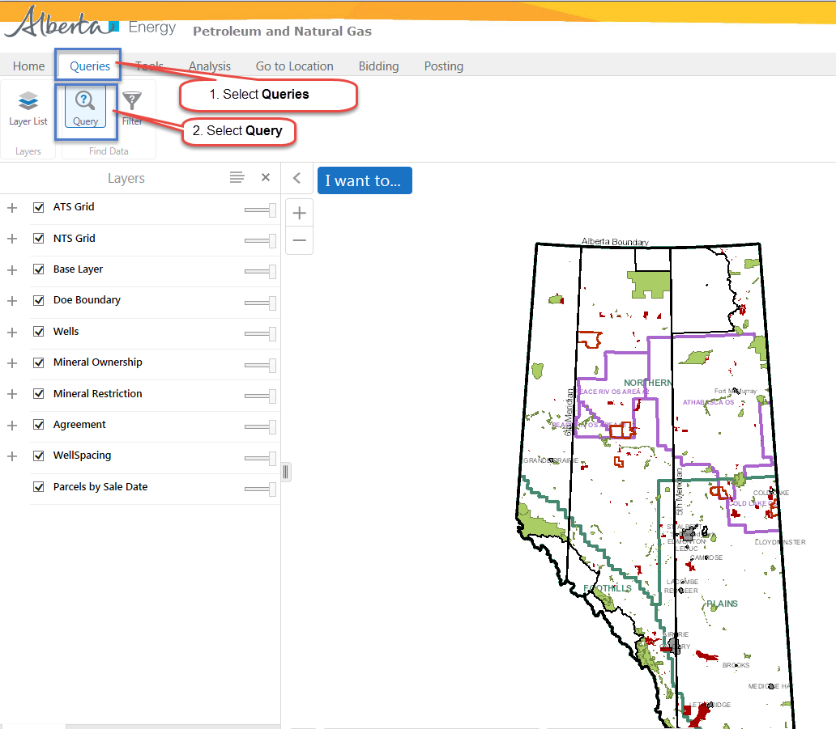
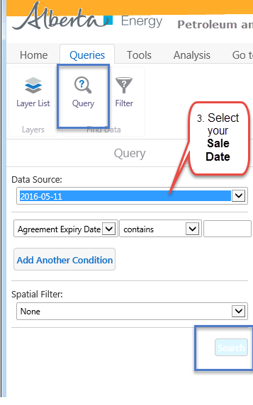
Back to Query by Map

Slide 12
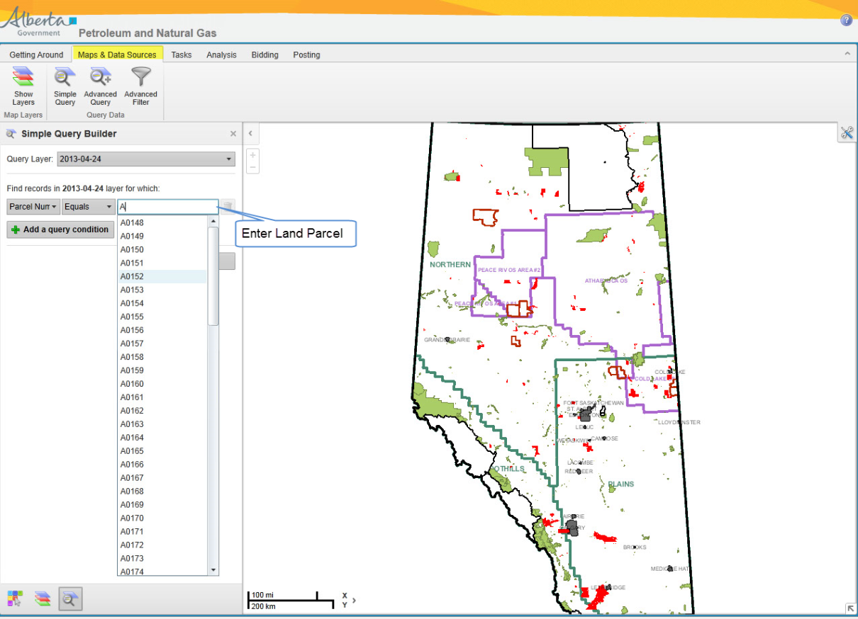
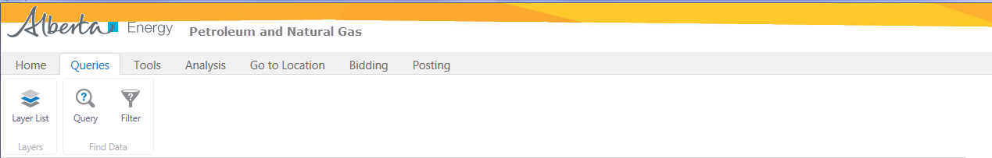
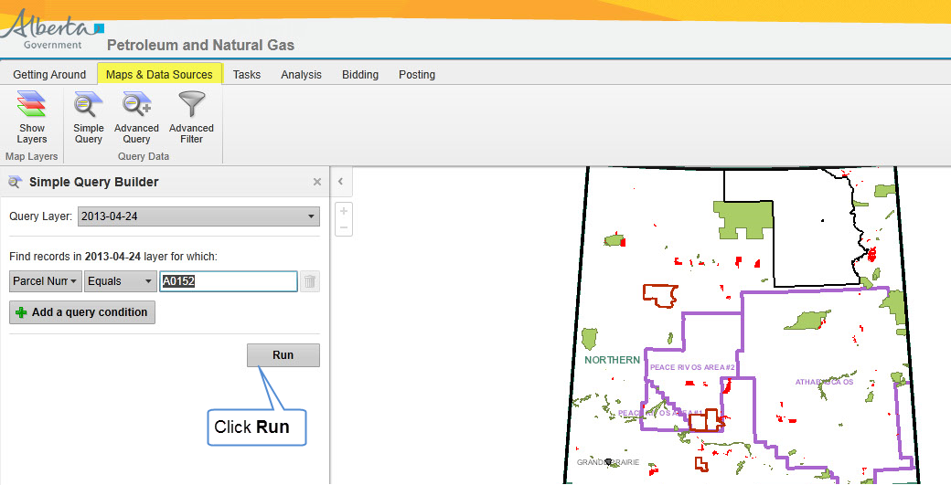
Back to Query by Map

Slide 13
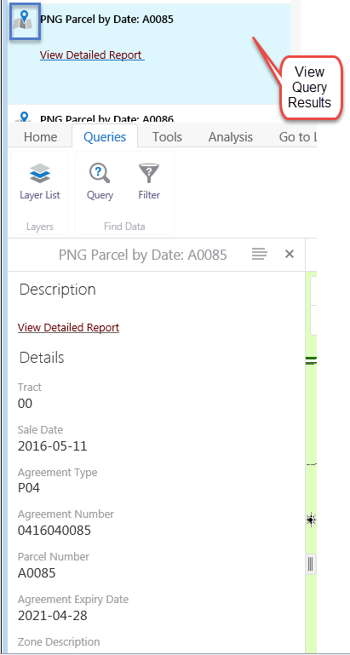
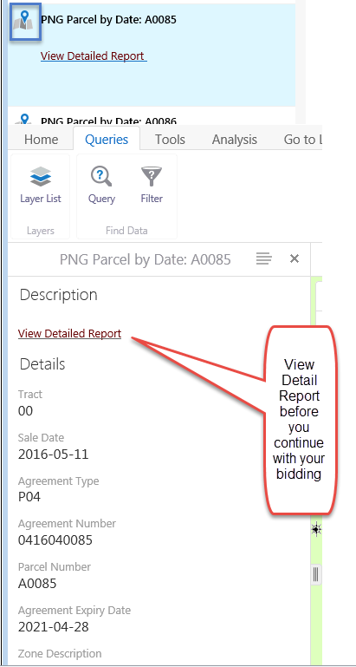
Back to Query by Map

Slide 14
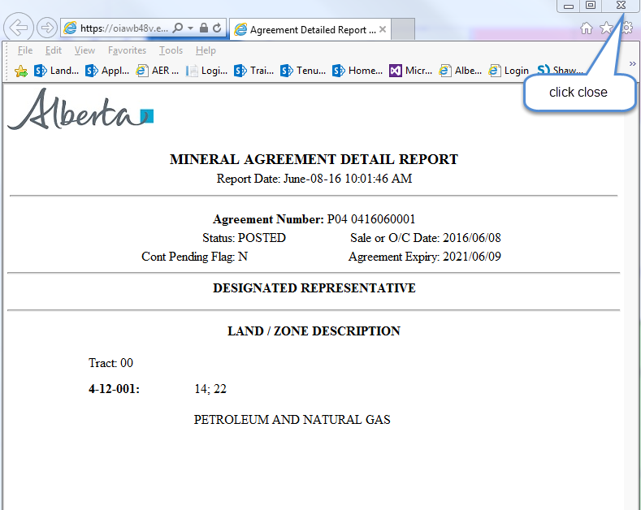
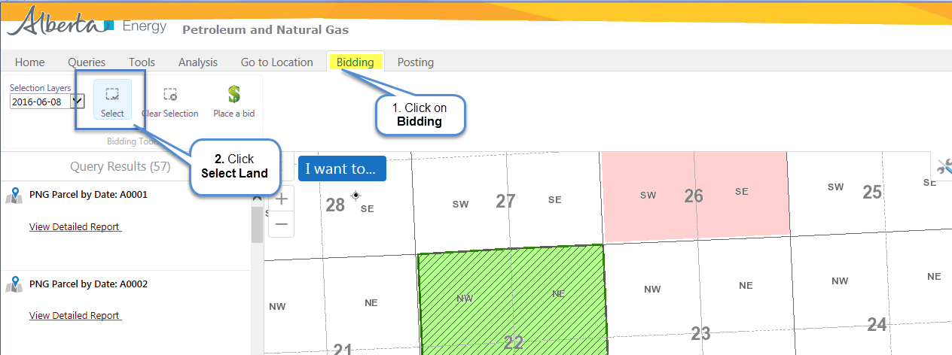
Detailed Report is displayed
Back to Query by Map

Slide 15
You will need to click and drag on the map to highlight your land
Back to Query by Map

Slide 16

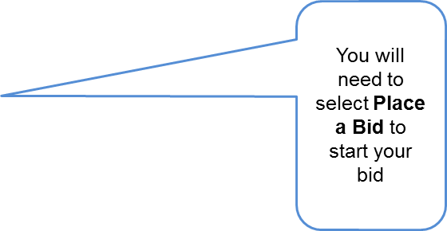


Back to Query by Map

Slide 17
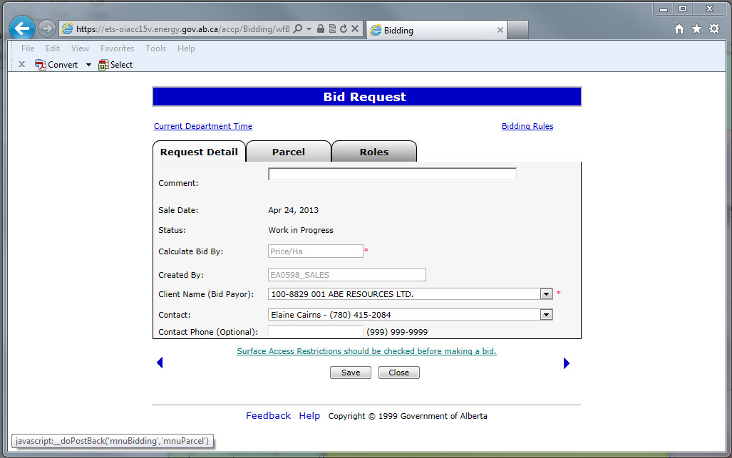
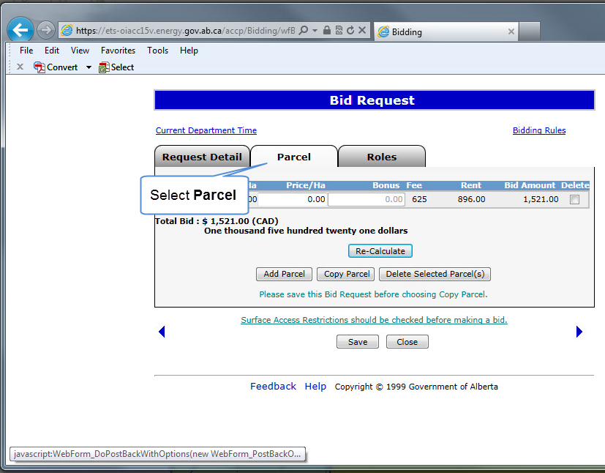
Bid Request Window opens up
Back to Query by Map

Slide 18
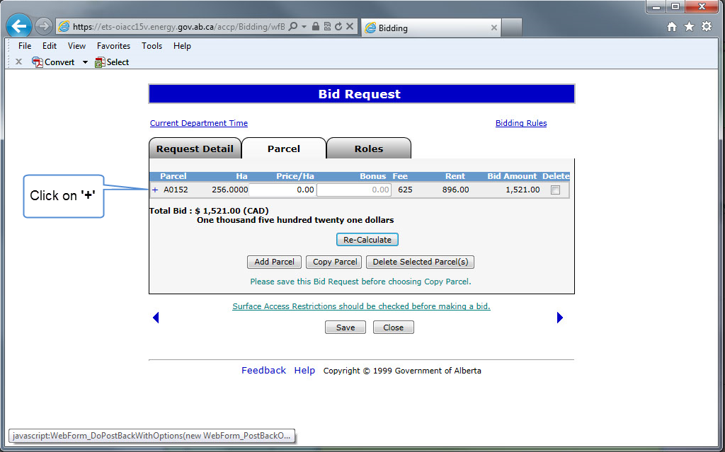
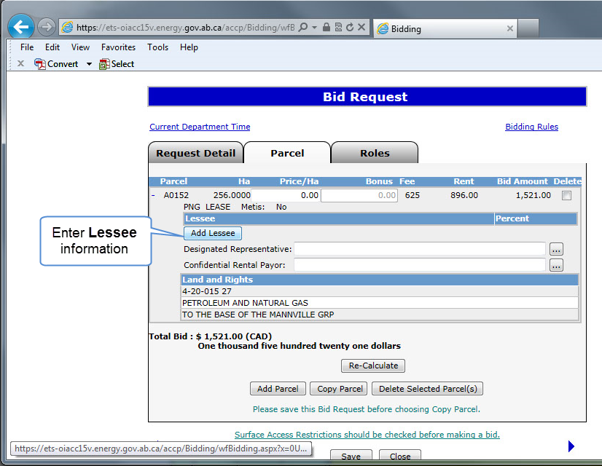
Back to Query by Map

Slide 19
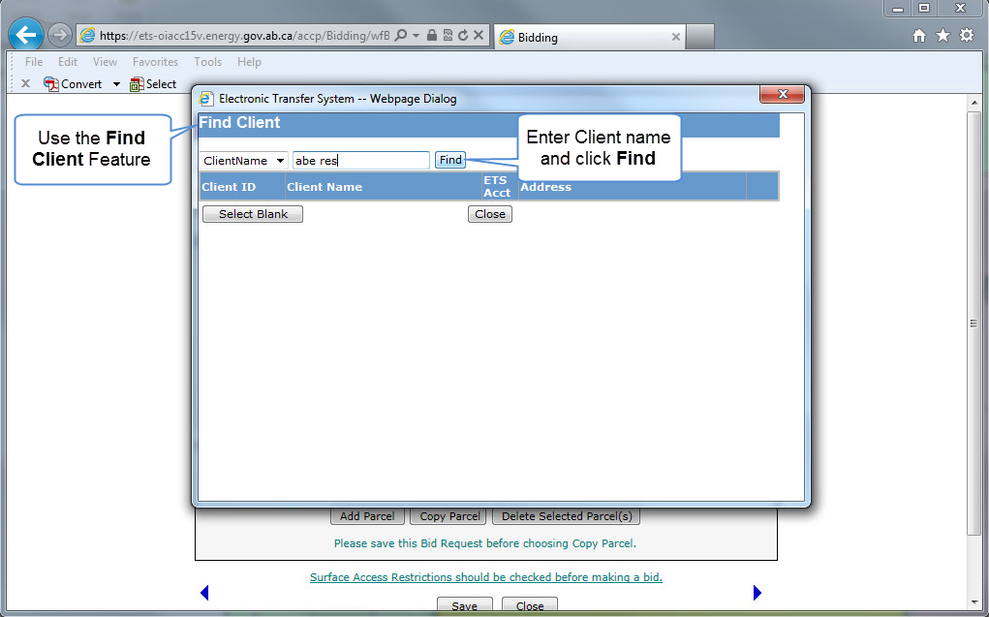
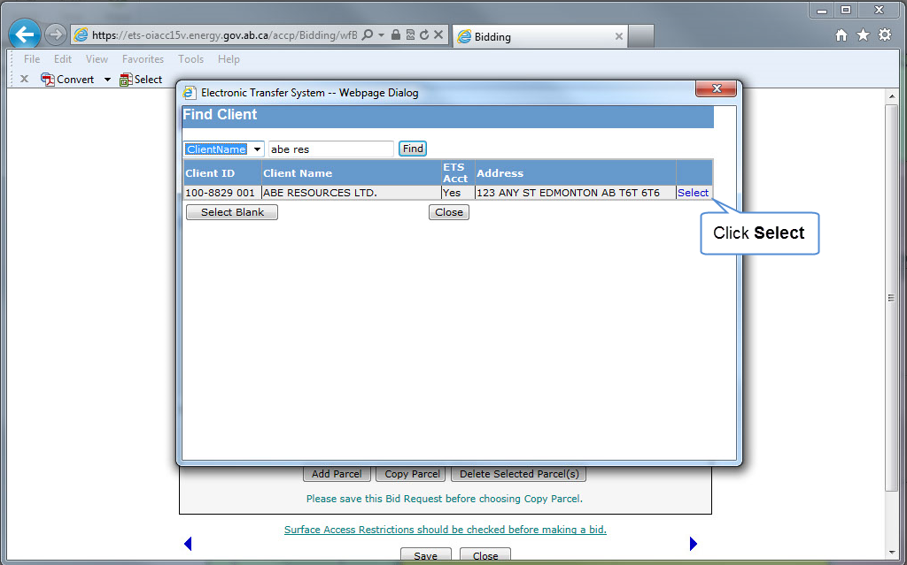
Back to Query by Map

Slide 20
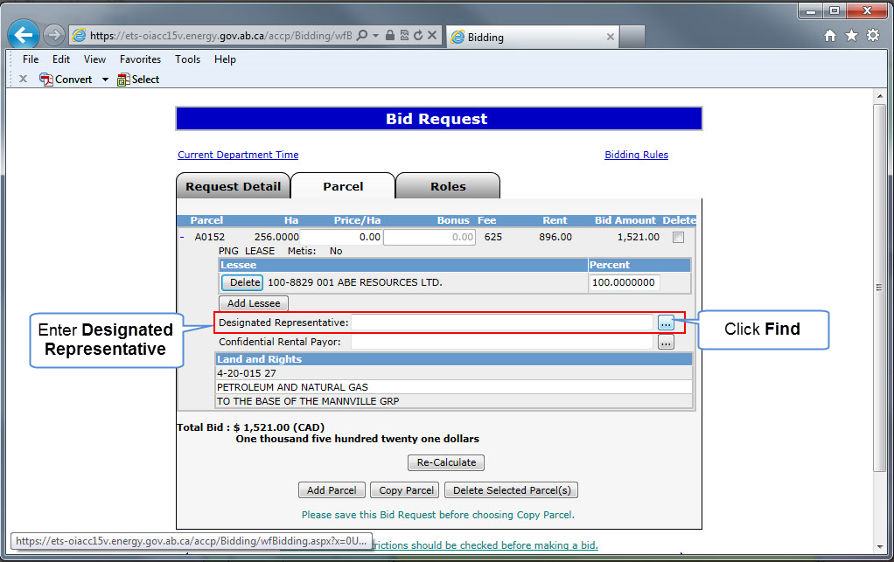
Back to Query by Map

Slide 21
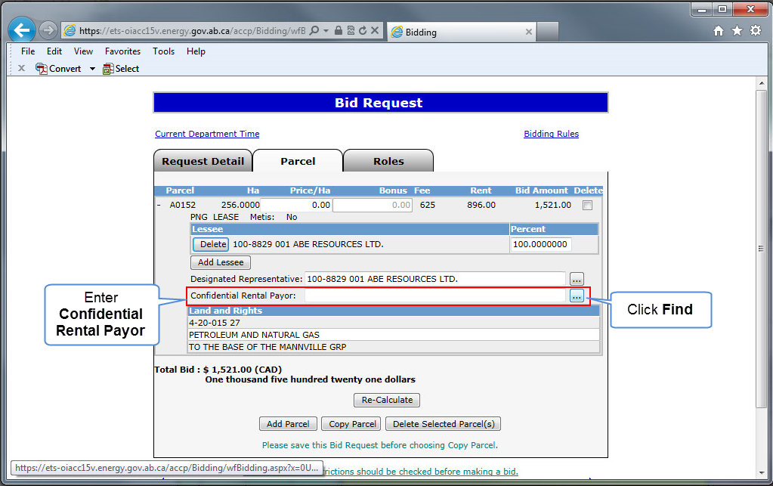
Back to Query by Map

Slide 22
Back to Query by Map

Slide 23
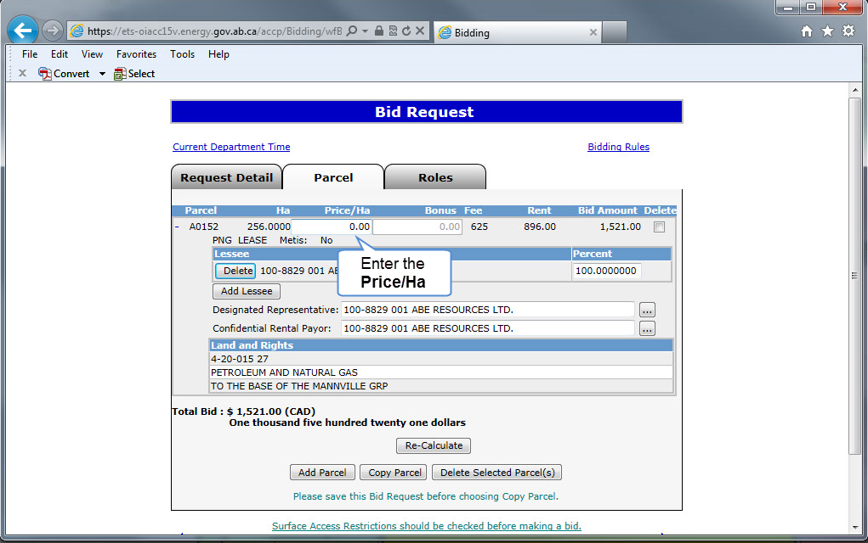
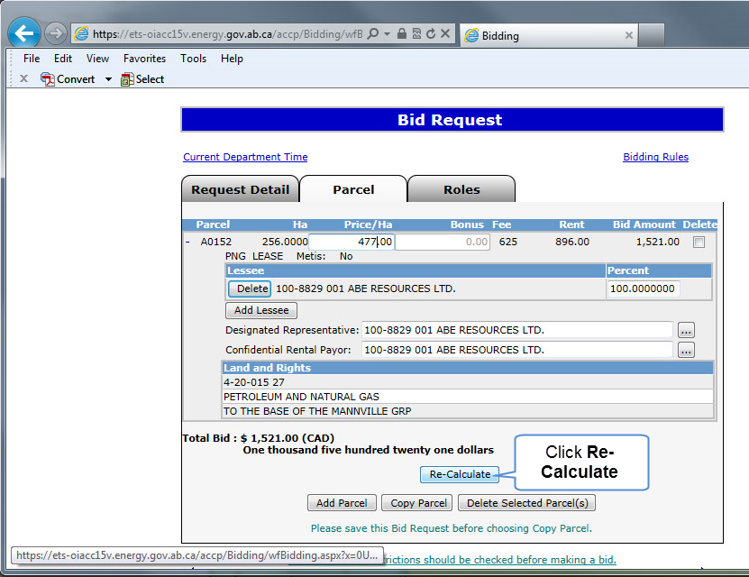
Back to Query by Map

Slide 24
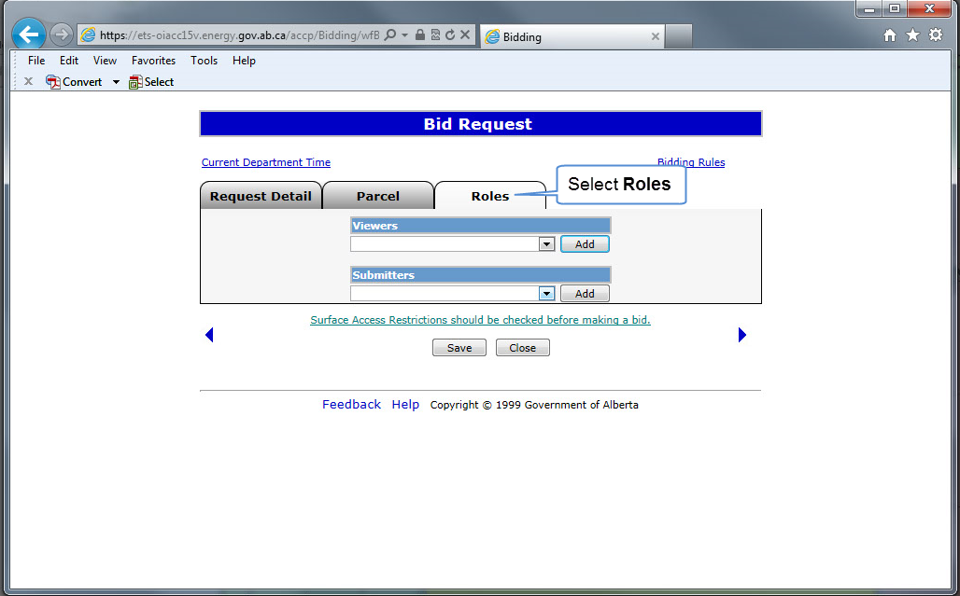
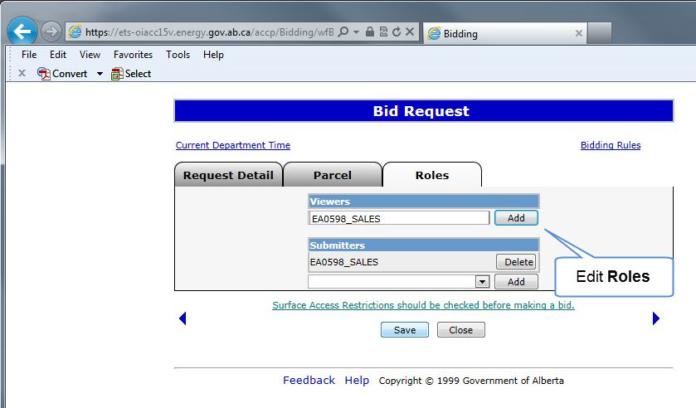
Back to Query by Map

Slide 25
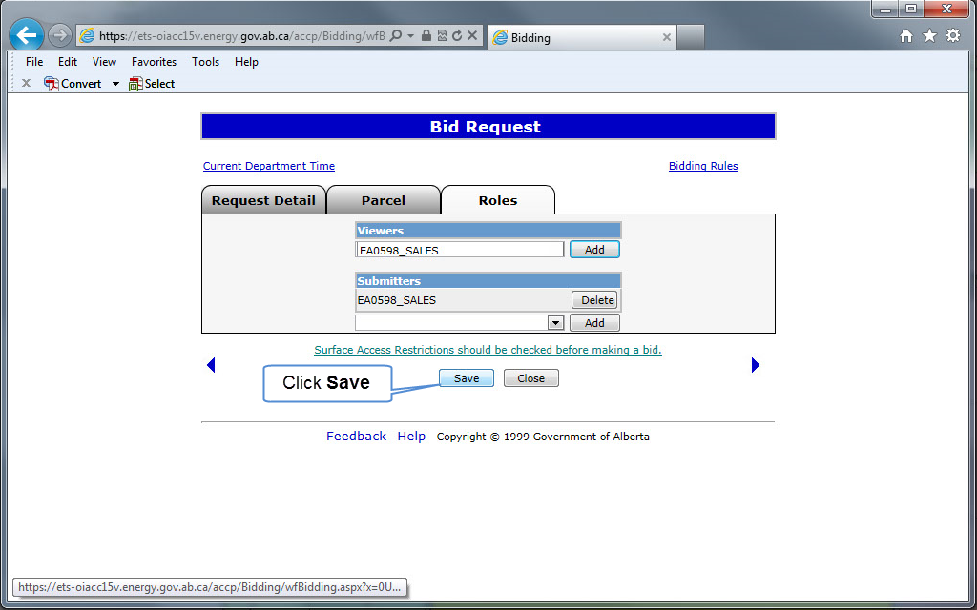
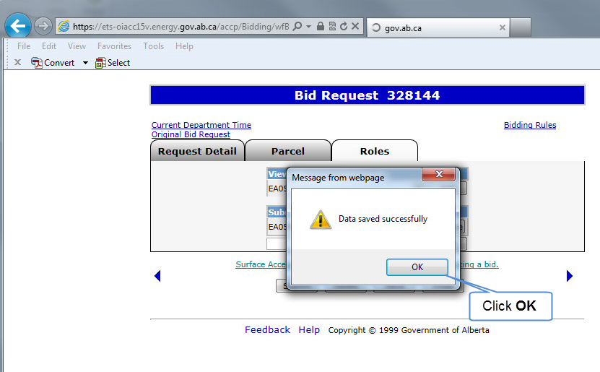
Back to Query by Map

Slide 26
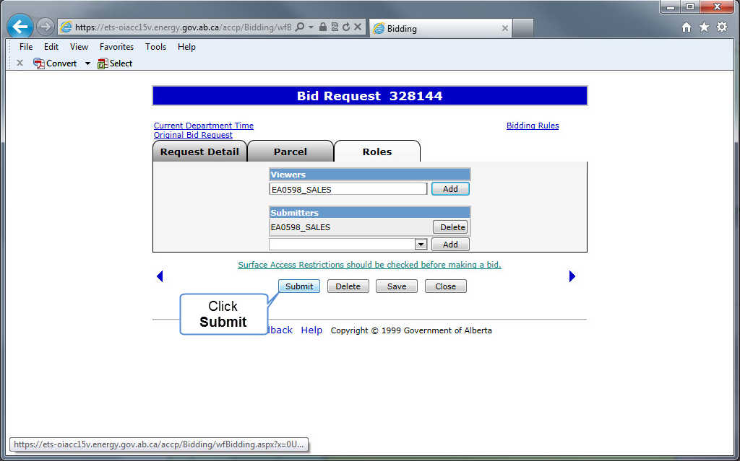
Back to Query by Map

Slide 27
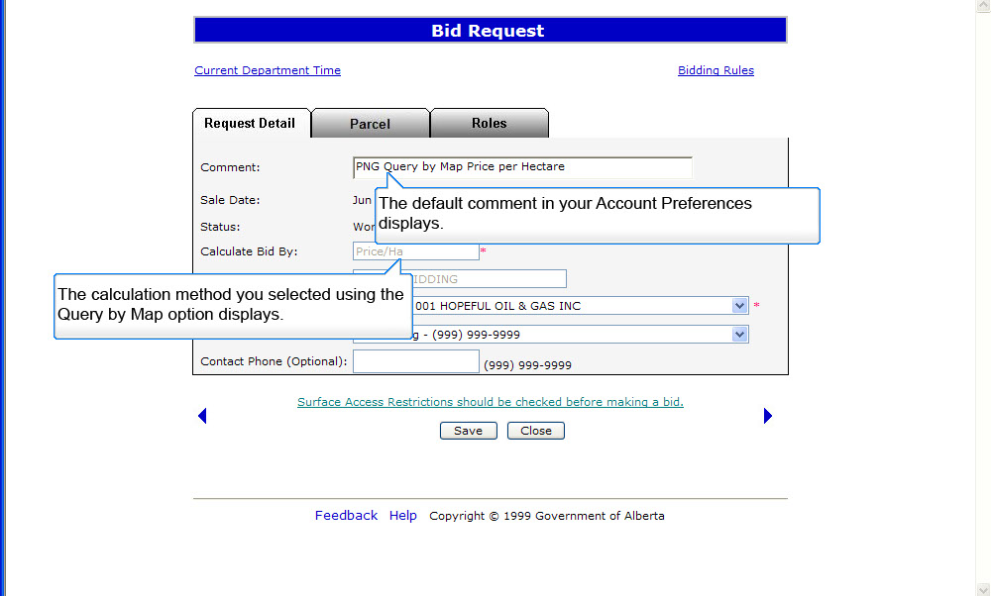
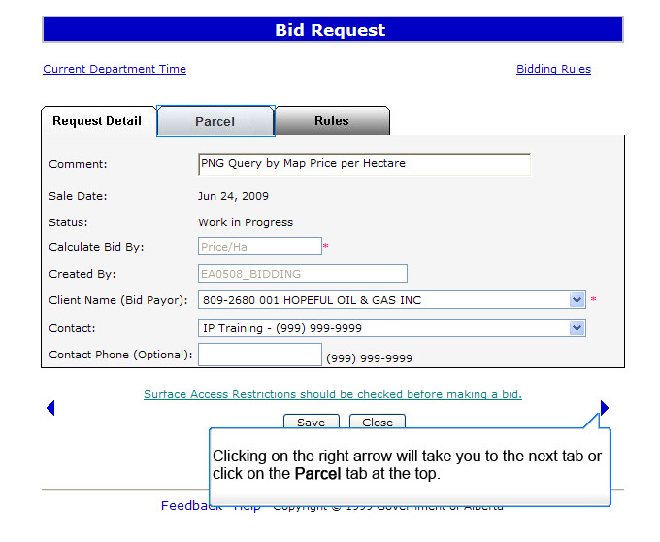
Back to Query by Map

Slide 28
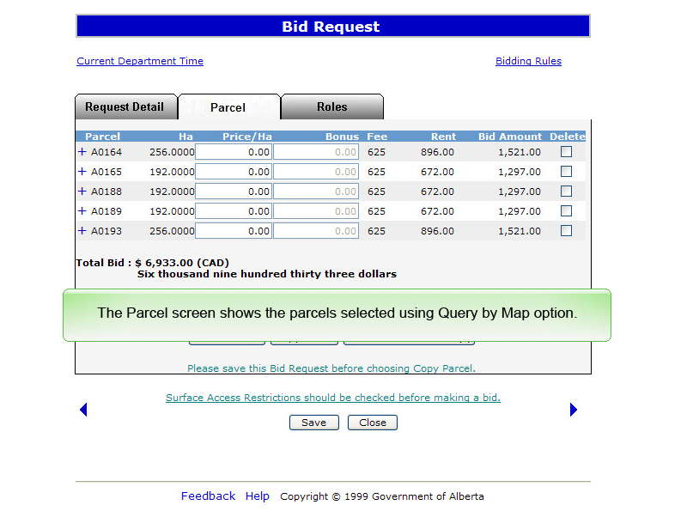
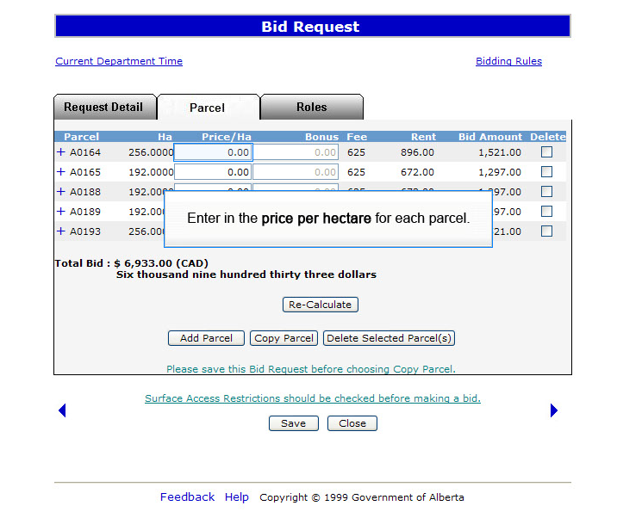
Back to Query by Map

Slide 29
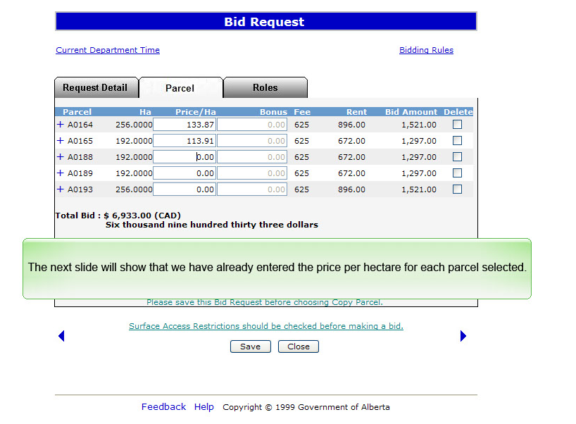
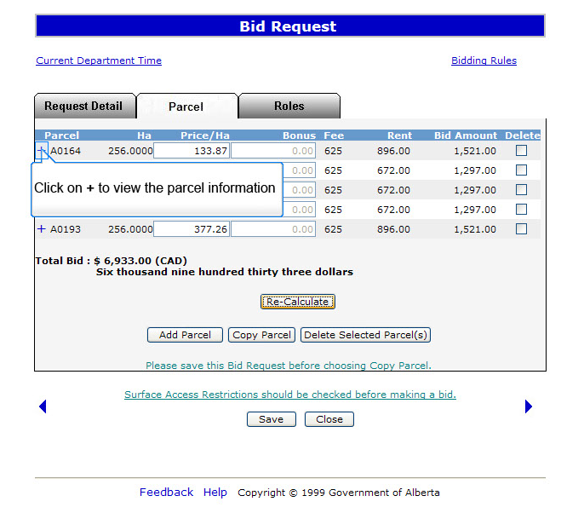
Back to Query by Map

Slide 30
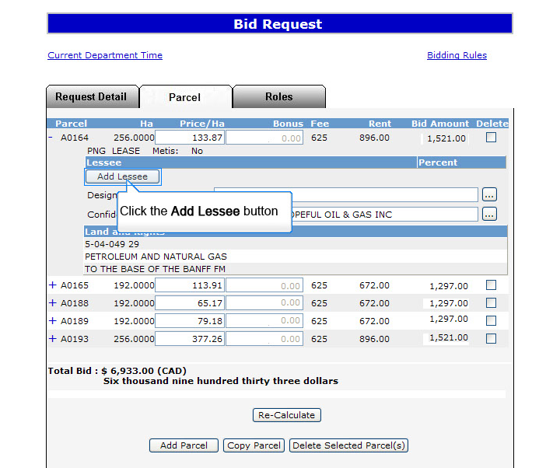
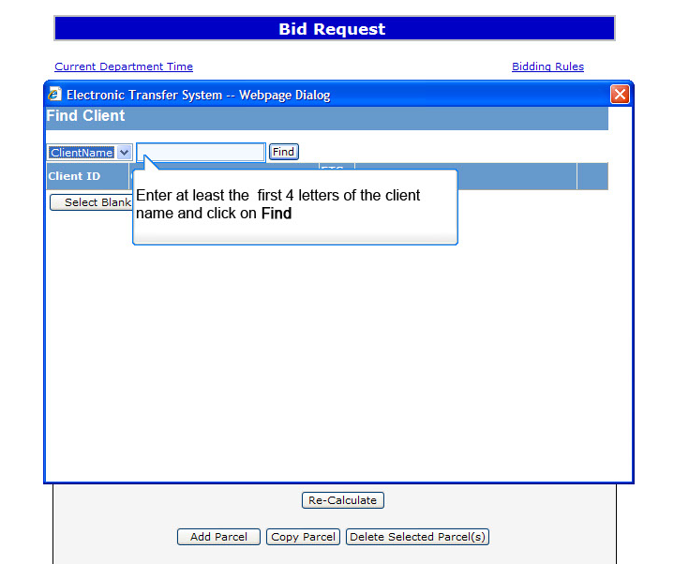
Back to Query by Map

Slide 31
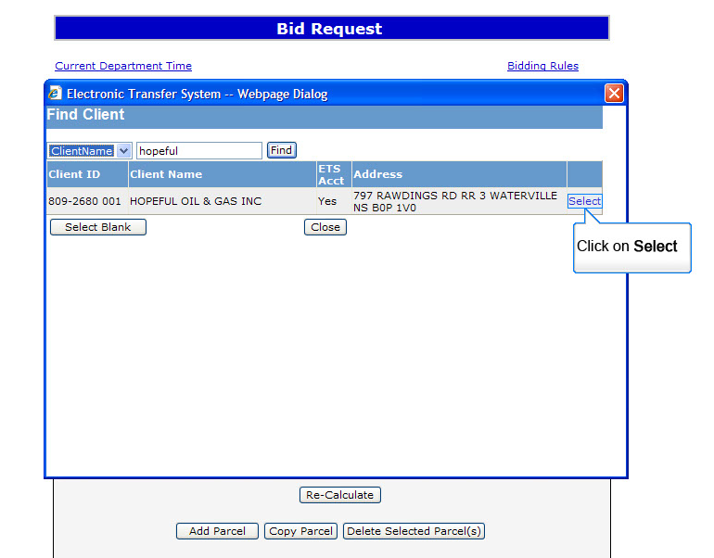
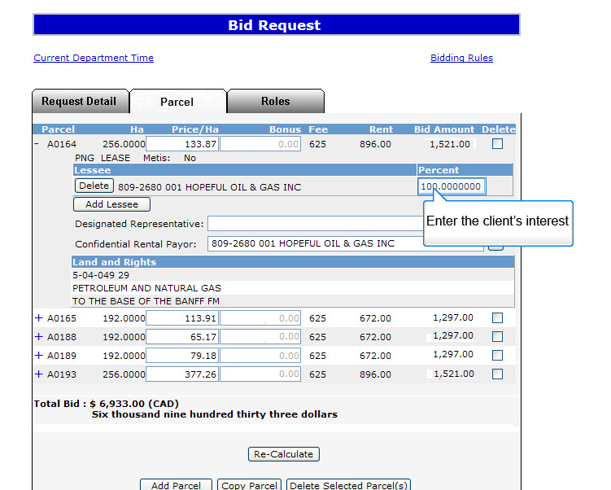
Back to Query by Map

Slide 32
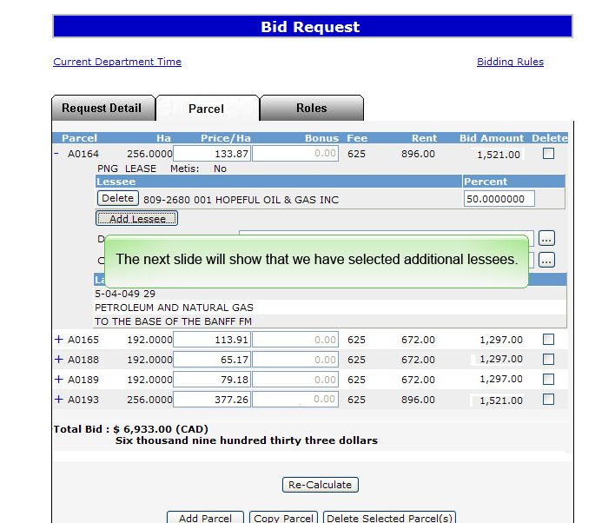
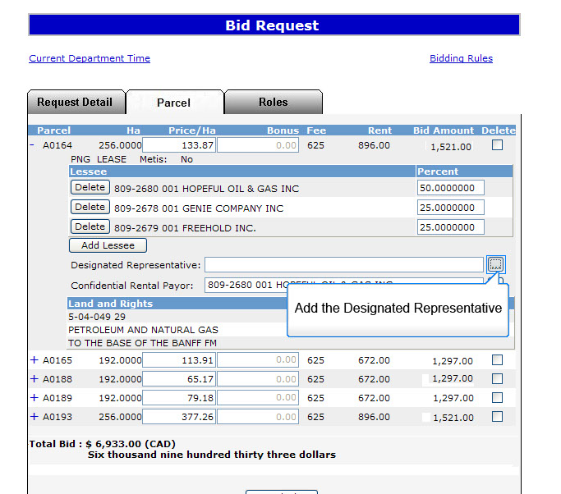
Back to Query by Map

Slide 33
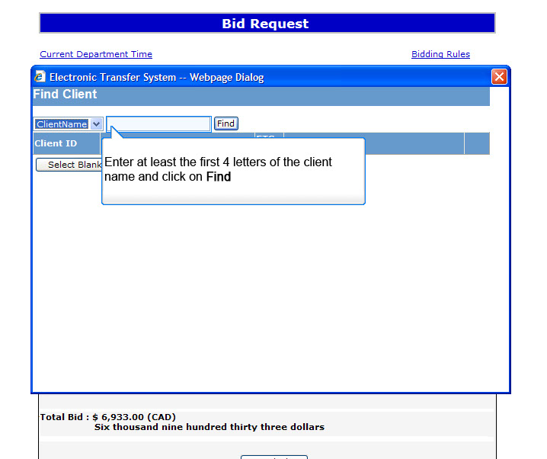
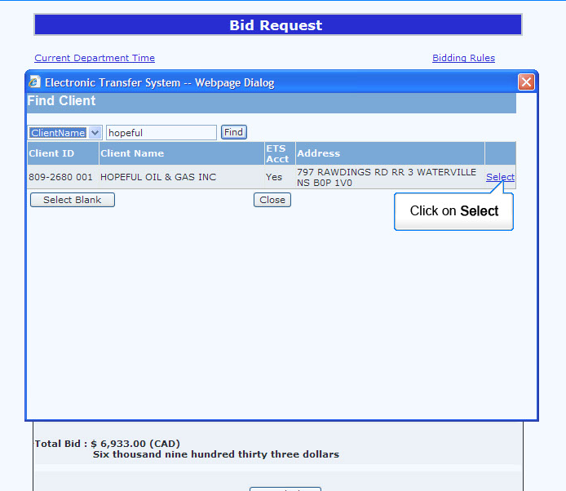
Back to Query by Map

Slide 34
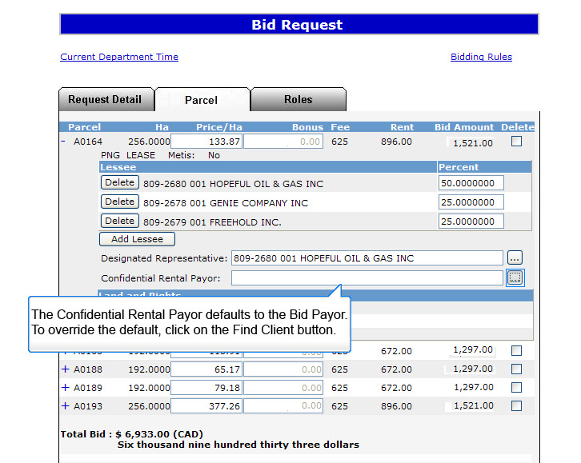

Back to Query by Map

Slide 35


Back to Query by Map

Slide 36


Back to Query by Map

Slide 37


Back to Query by Map

Slide 38


Back to Query by Map

Slide 39


Back to Query by Map

Slide 40


Back to Query by Map

Slide 41


Back to Query by Map

Slide 42


Back to Query by Map

Slide 43


Back to Query by Map

Slide 44
Resources
ETS Support and Online Learning provides access to relevant guides, course and other information
If you have questions, please contact
for PNG: Bidding.Energy@gov.ab.ca or the Sales Helpdesk at (780)644-2300 or
for Oil Sands: OSTenure@gov.ab.ca

Slide 45

Conclusion
Congratulations!
You have completed the ETS – Bidding Query by Map
Online Training Course
Please refer back to Initiate Bid Request module to continue learning about creating a bid request.
If you have any comments or questions on this training module, please forward them to the following email address:
Bidding.Energy@gov.ab.ca

