Slide 1
Welcome
Welcome!
The Public Offering functionality in Posting allows users to submit requests for public offerings of Petroleum and Natural Gas(PNG) and Oil Sands(OS) rights.
The public offering process is often referred to as a "land sale" however, the mineral rights are not sold but leased.
To the ETS – Public Offering
Online Training Course

Slide 2
Revisions
Date | Revisions Type | Page Number
August 31, 2012 | Conversion | All
April 2020 | Updated | All
December 2020 | Updated the ETS login page | Various

Slide 3

Introduction
In this module, you will learn how to:
Add/Change Public Offering Request Detail
Add Parcel of Land using any of the following options:
  Enter Land
  Load from File
  Load from Rights Available
Delete/Change Parcel of Land
Request Advance Booking or Drilling to Sale
Add Roles (Viewer/Submitter)

Slide 4
Initiate Requests
More Information (Pages 5 to 22)
The two options to request PNG and OS rights are Public Offering and Direct Purchase.
POSTING - PUBLIC OFFERING
The Public Offering option allows you to enter a Posting request for a specific sale date. If Alberta Energy approves the request, the lands will be posted in a sale. Each request allows for a maximum of 10 parcels of land and each request must be within a 3X3 township and range grid.

Slide 5
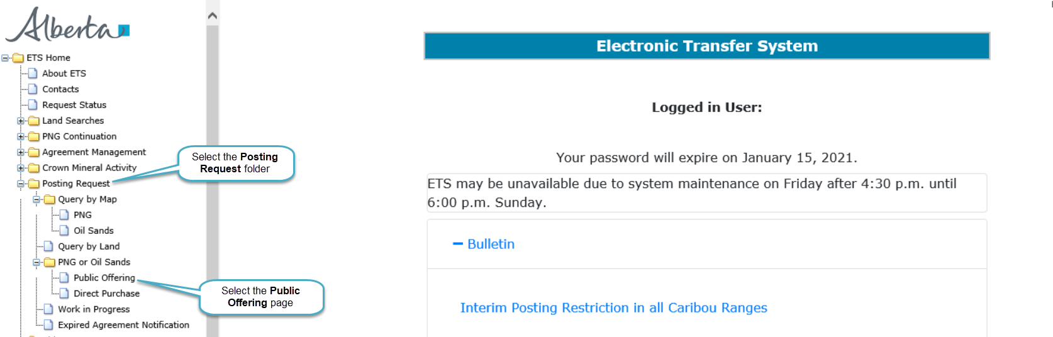
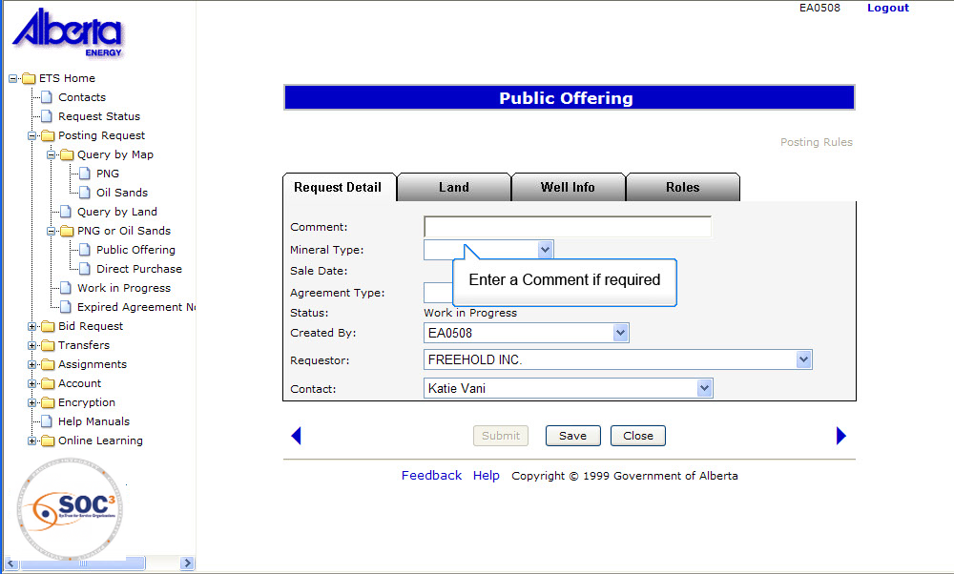

Back to Initiate Requests

Slide 6
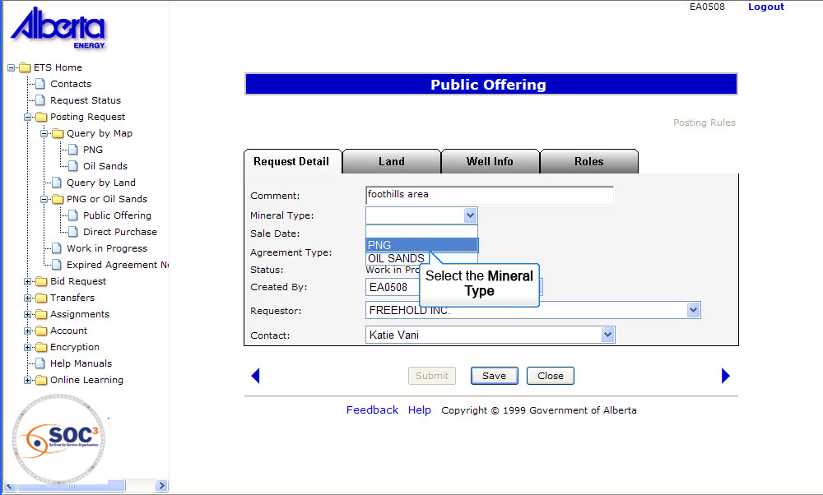
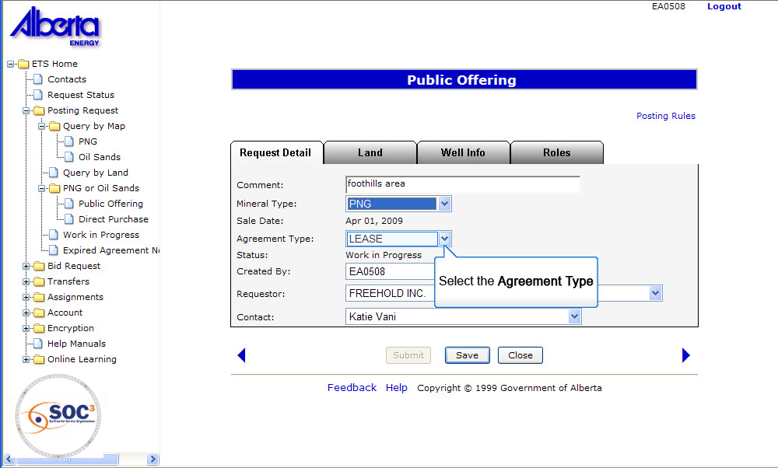
Change Request 120279:
Back to Initiate Requests

Slide 7
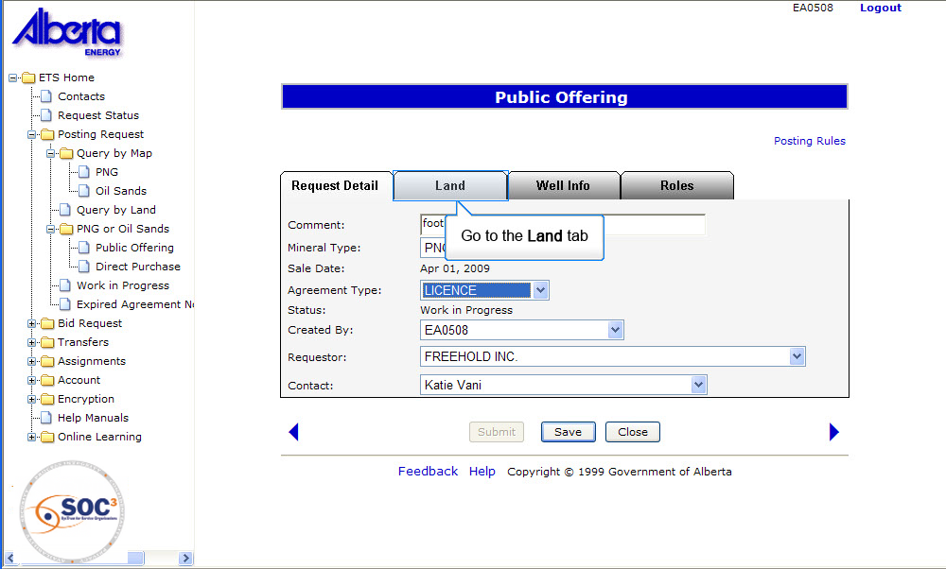
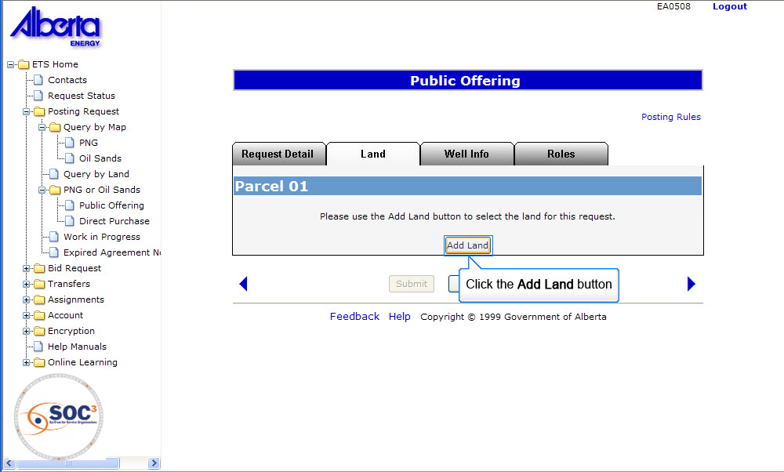
Back to Initiate Requests

Slide 8
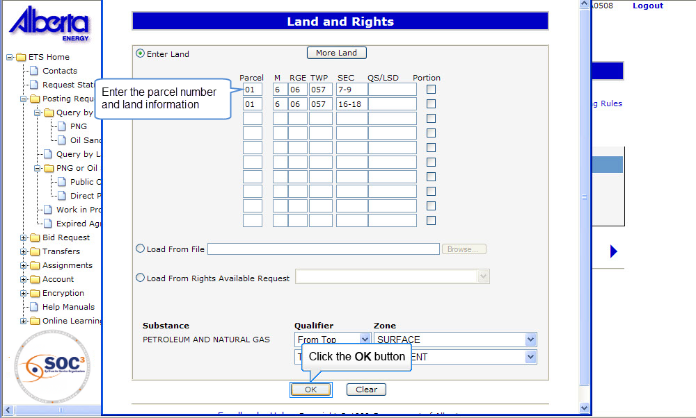
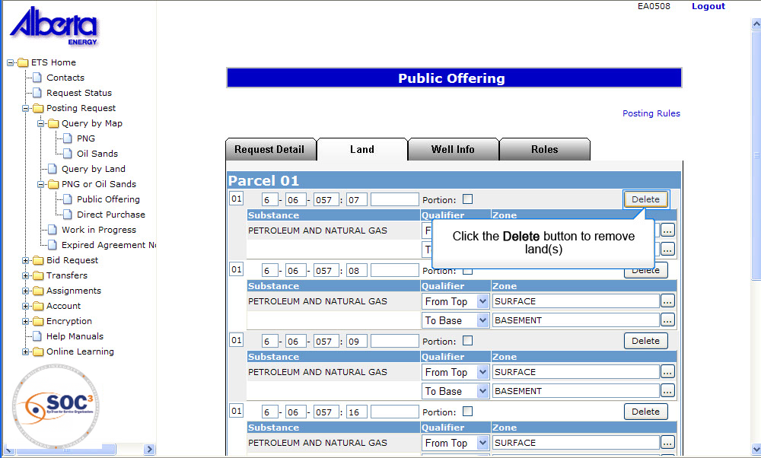
Back to Initiate Requests

Slide 9
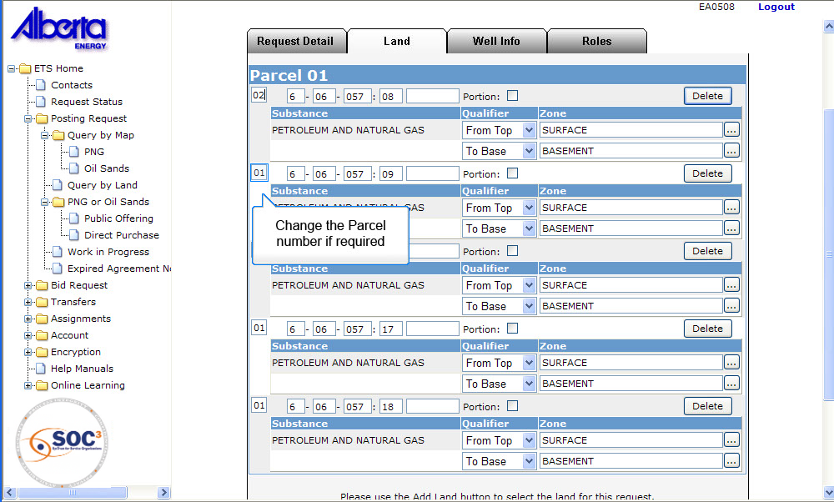
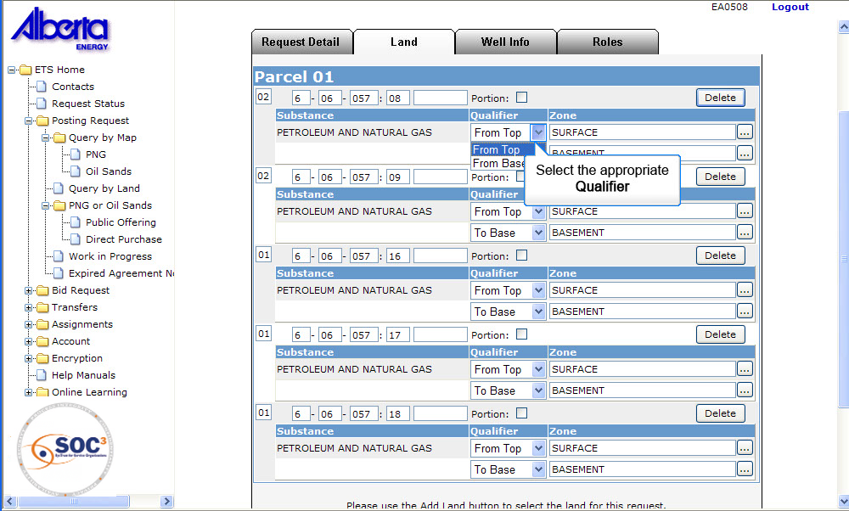
Back to Initiate Requests

Slide 10
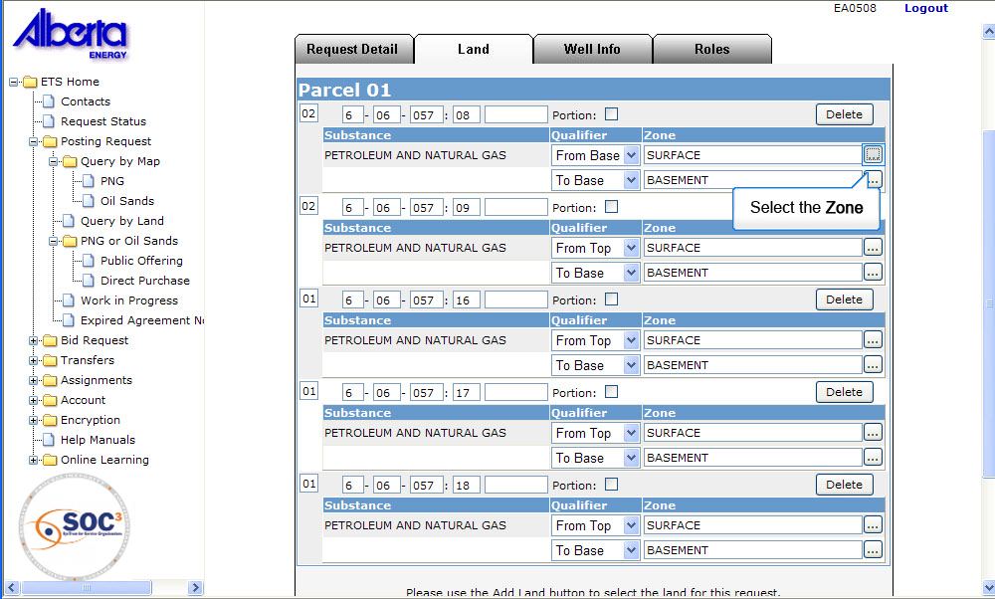
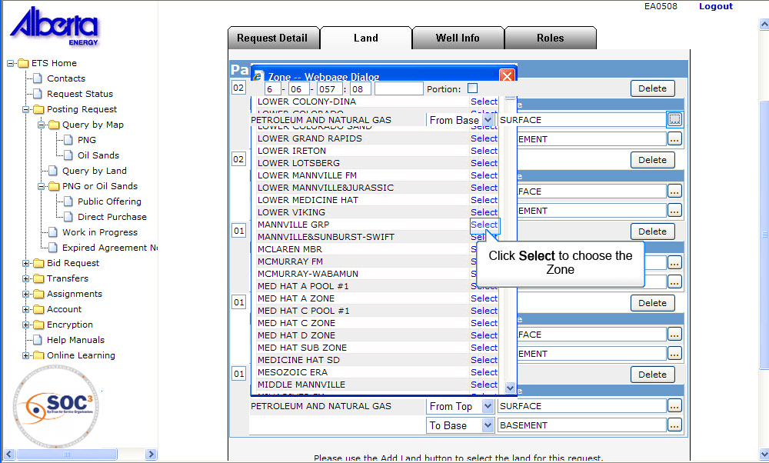
Back to Initiate Requests

Slide 11
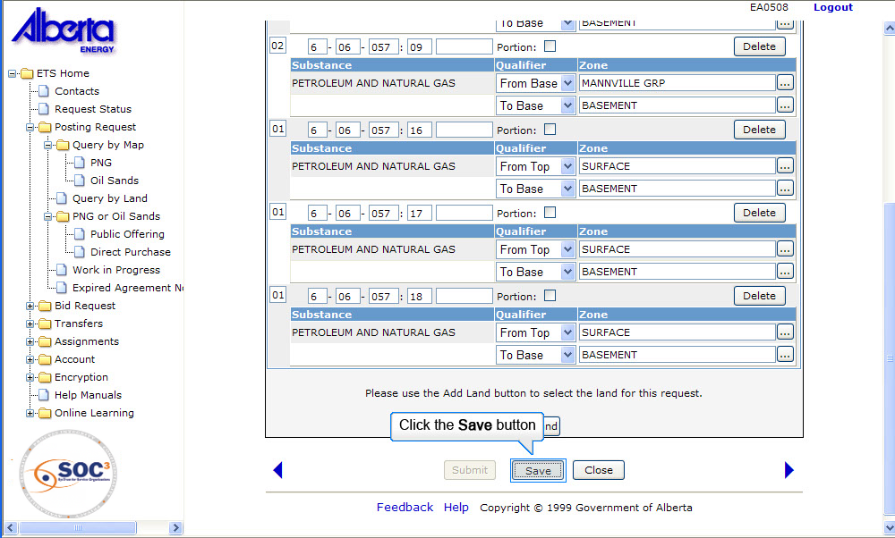
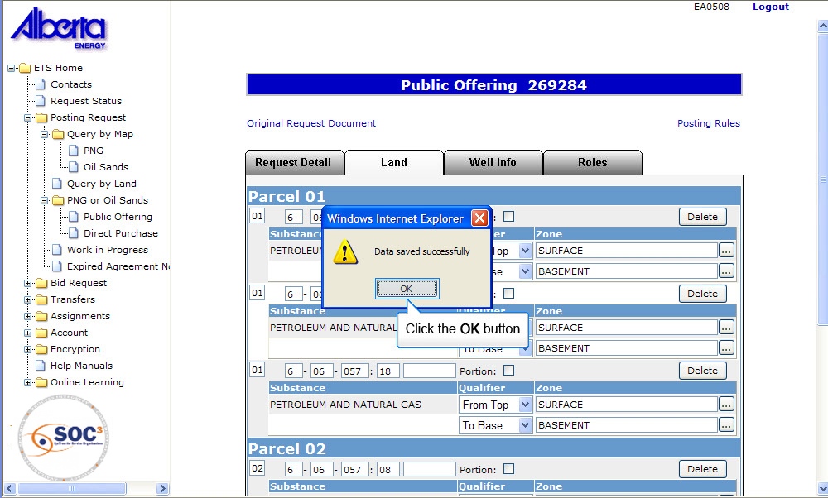
Back to Initiate Requests

Slide 12
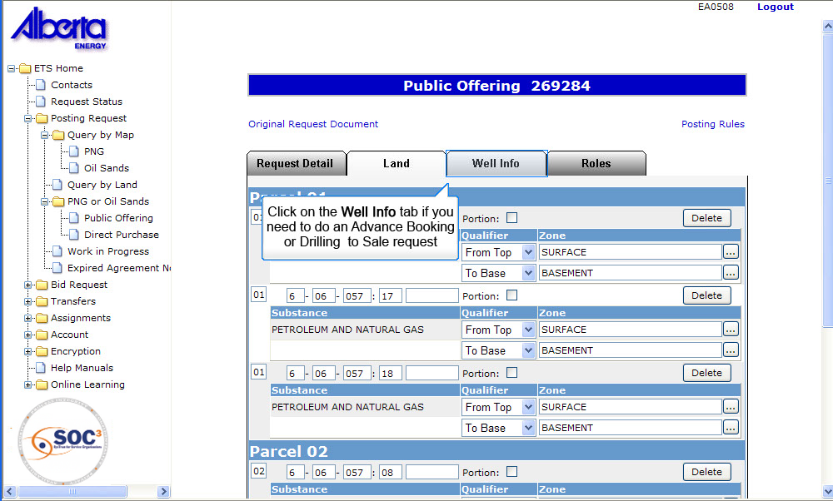
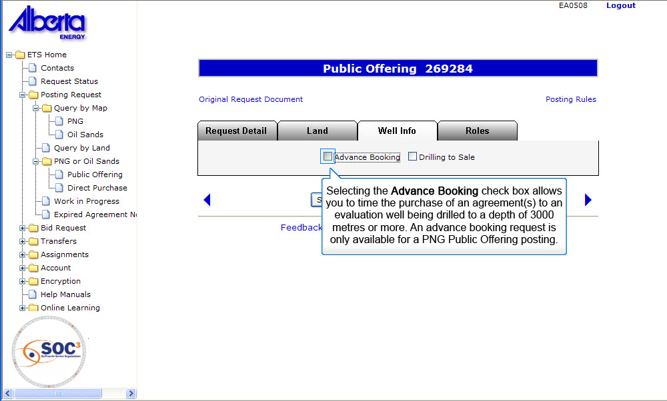
Back to Initiate Requests

Slide 13
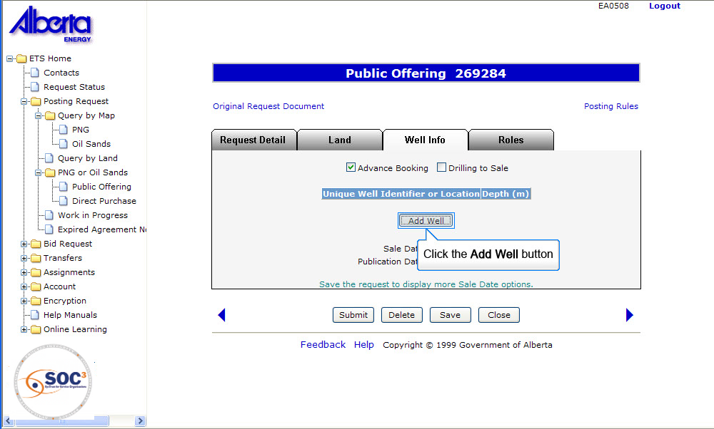
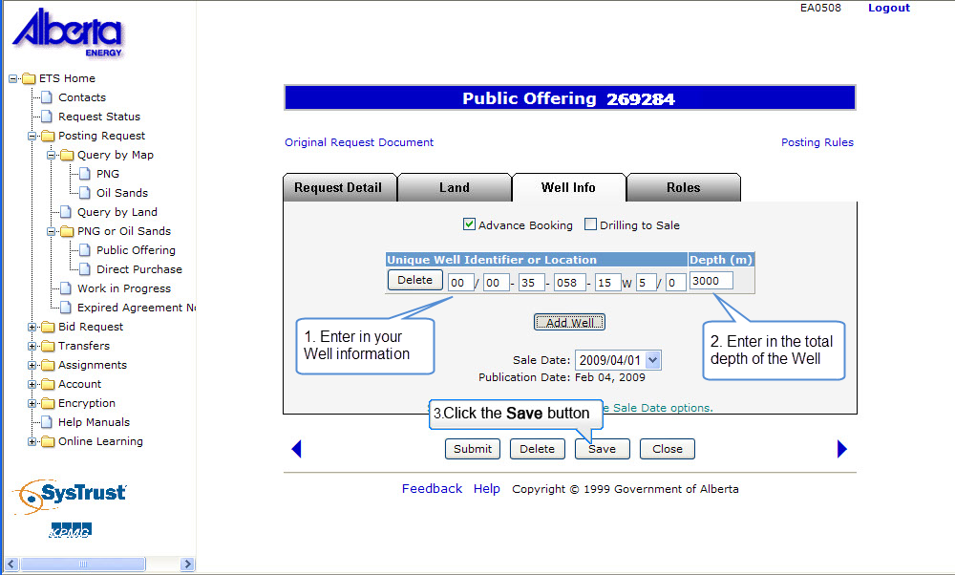
Back to Initiate Requests

Slide 14
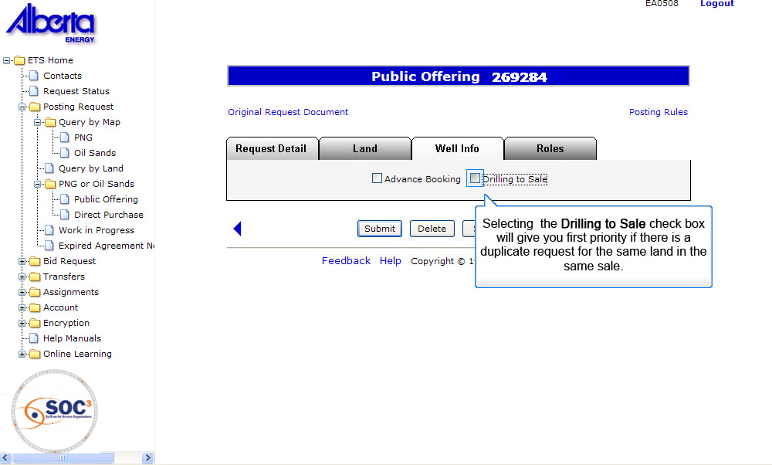
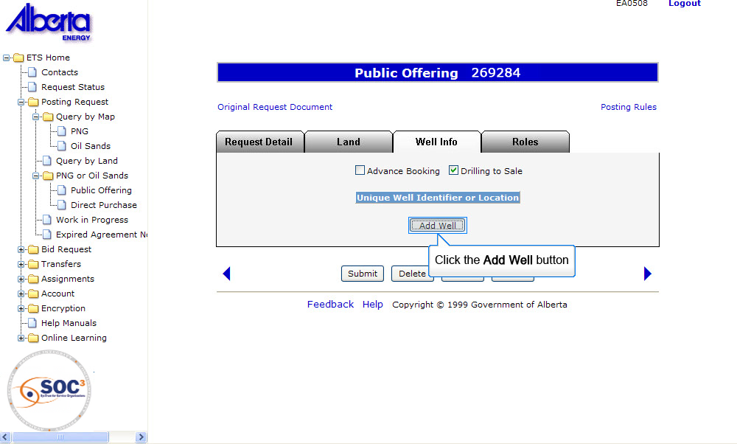
Back to Initiate Requests

Slide 15
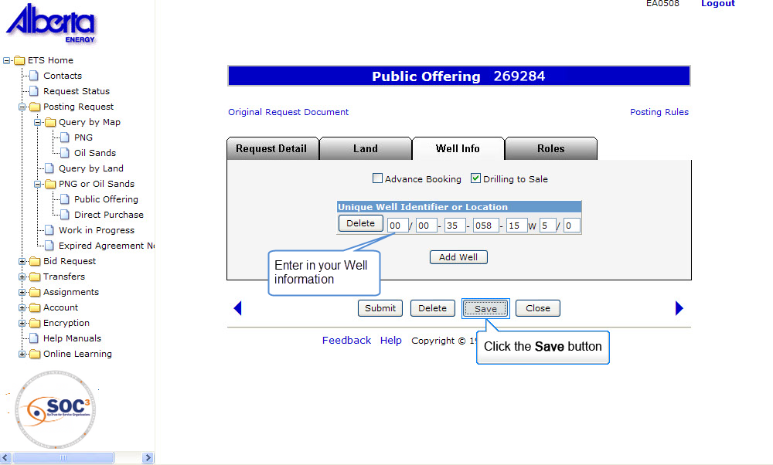
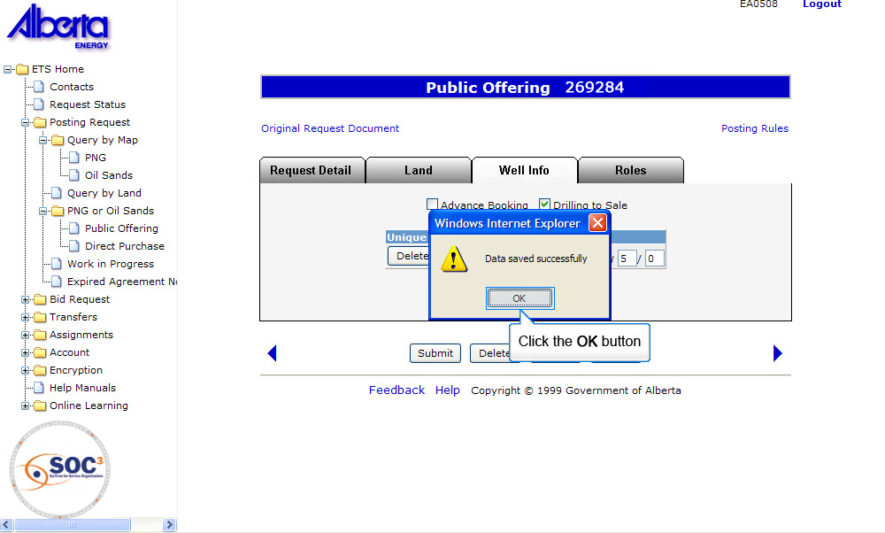
Back to Initiate Requests

Slide 16
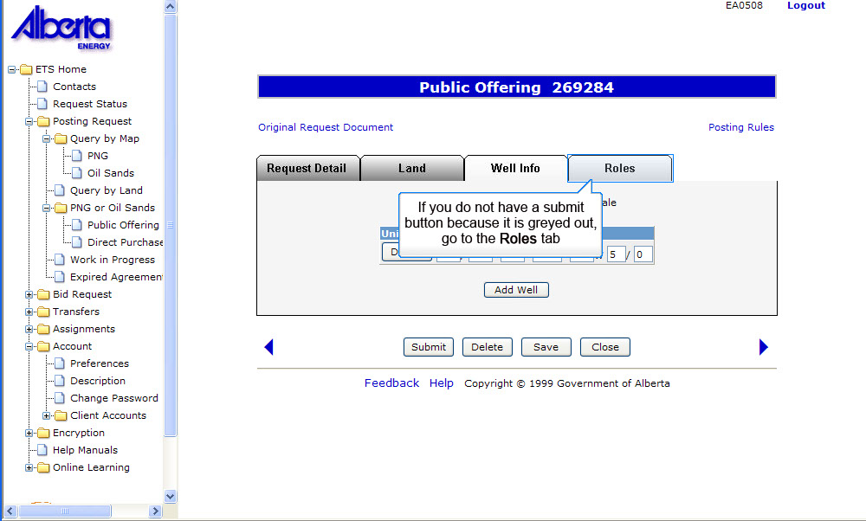
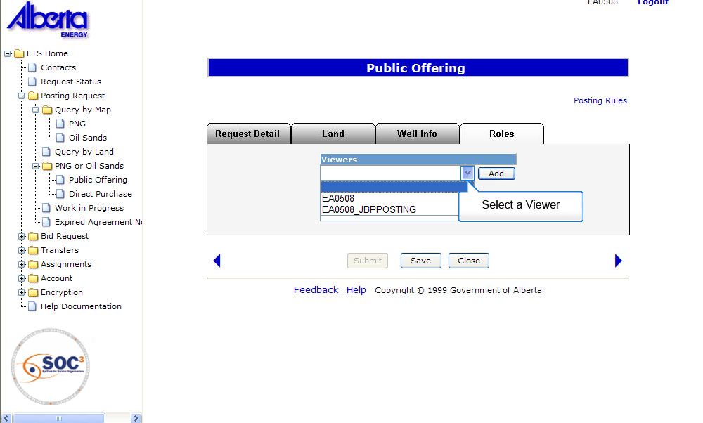
Back to Initiate Requests

Slide 17
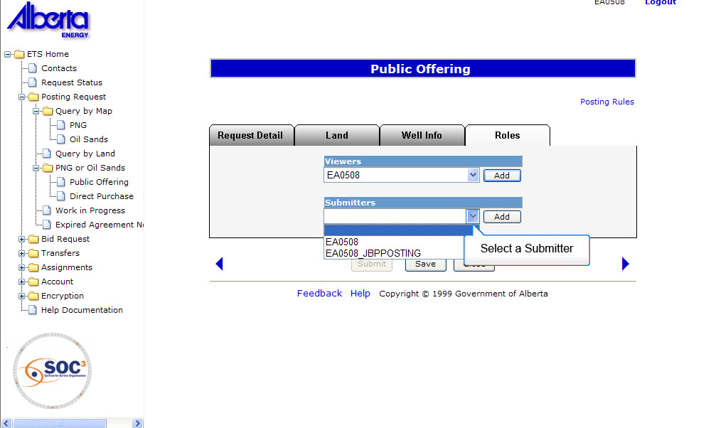
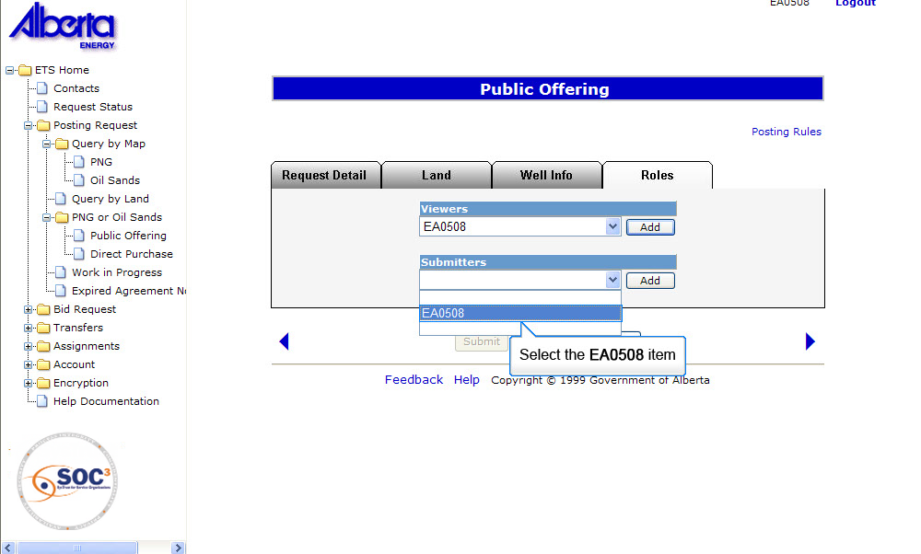
Back to Initiate Requests

Slide 18
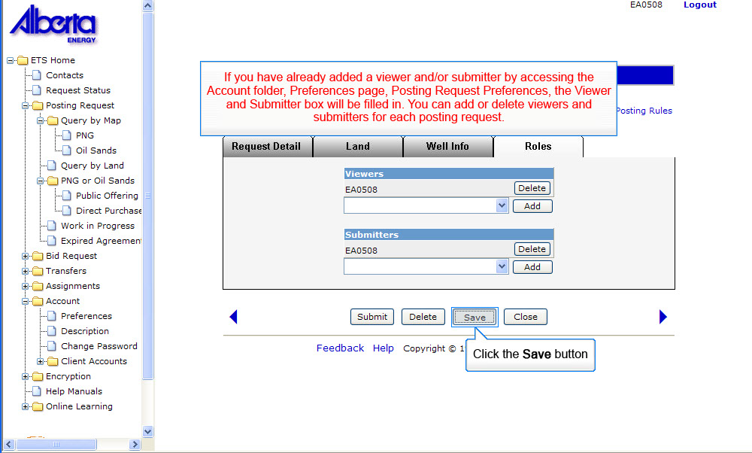
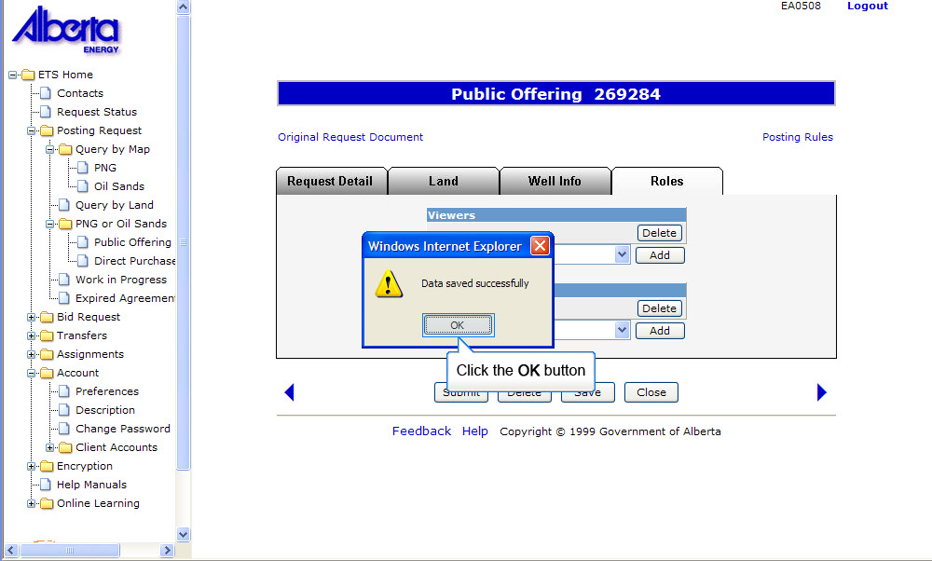
Back to Initiate Requests

Slide 19
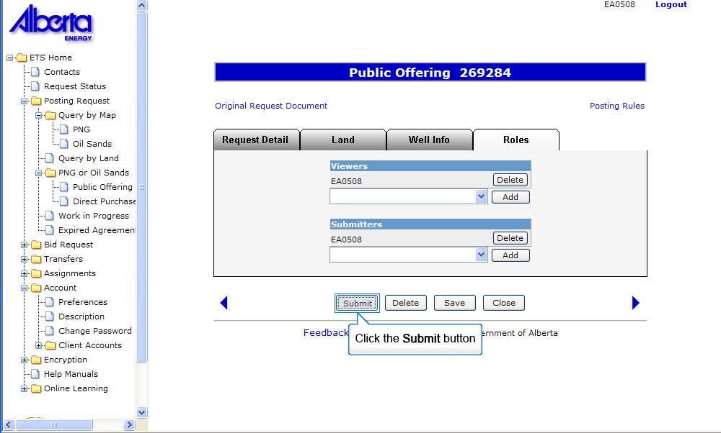
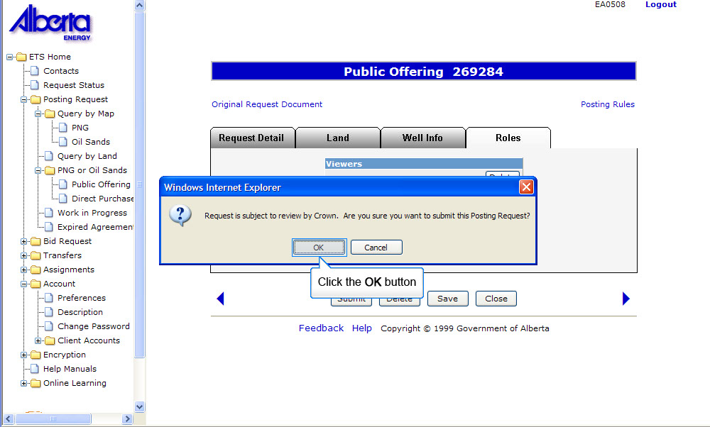
Back to Initiate Requests

Slide 20
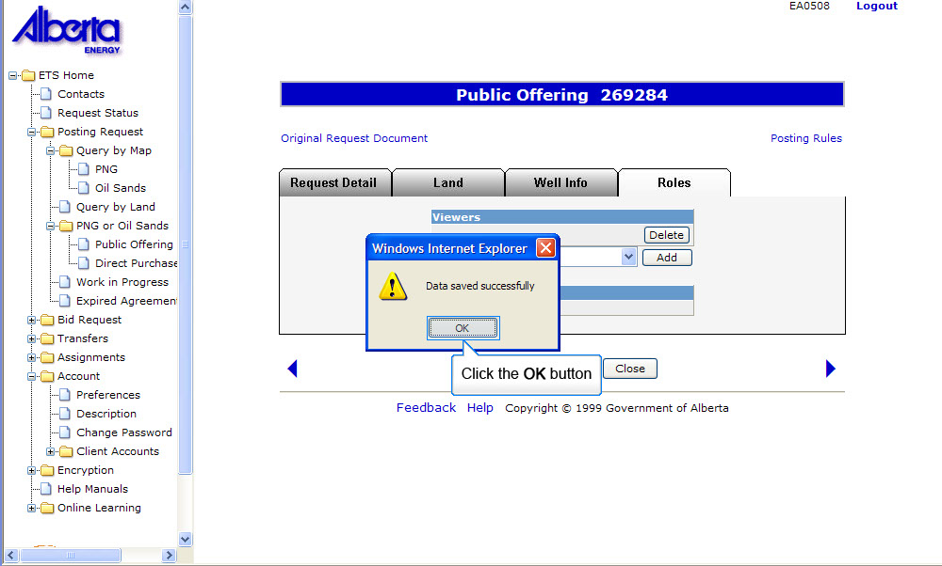
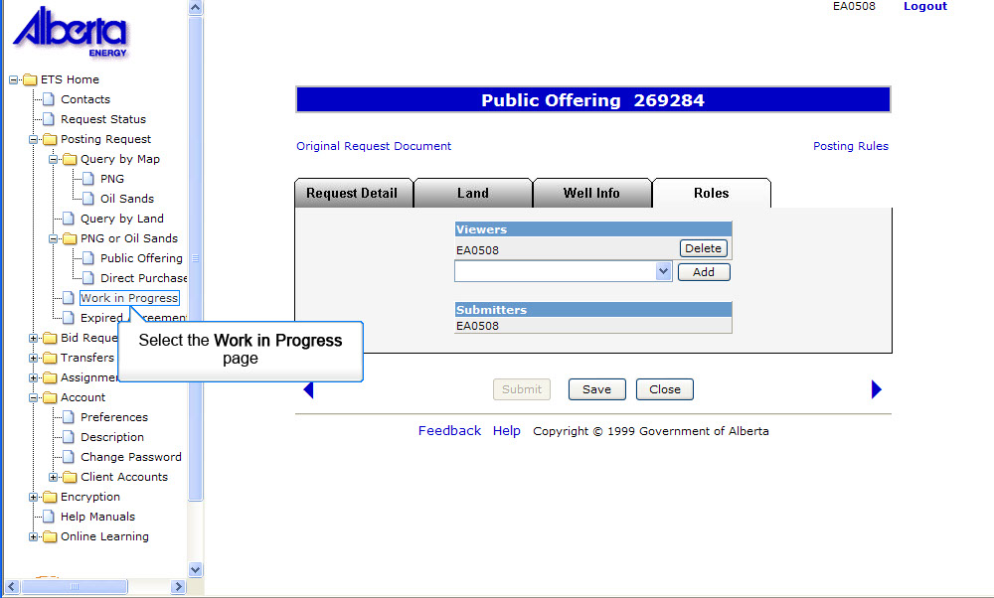
Back to Initiate Requests

Slide 21
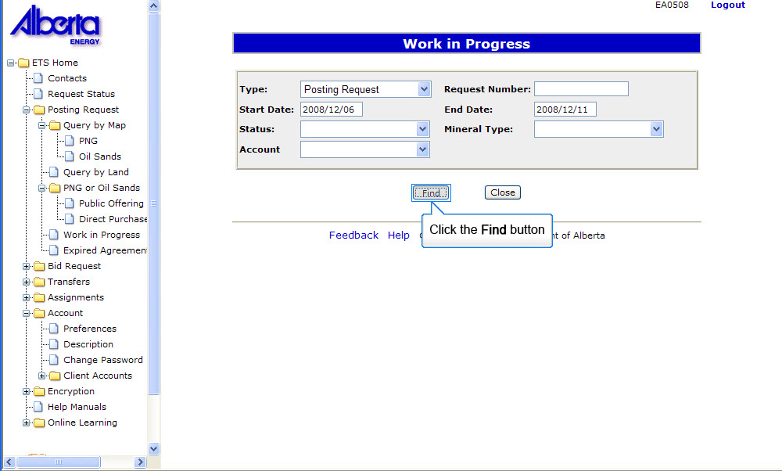
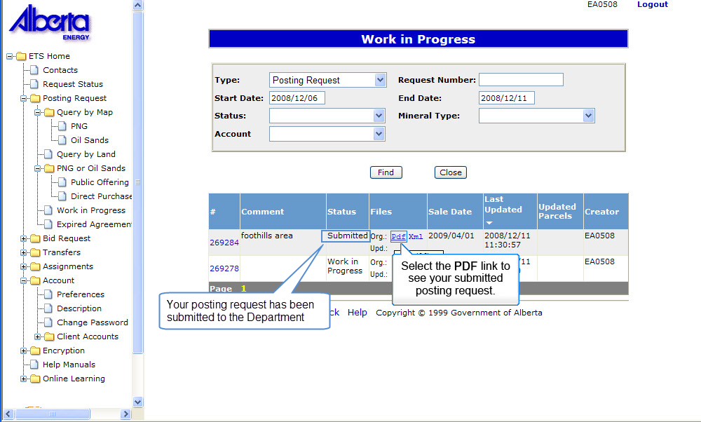
You must monitor the updated file to determine what has changed from your original request.
Back to Initiate Requests

Slide 22
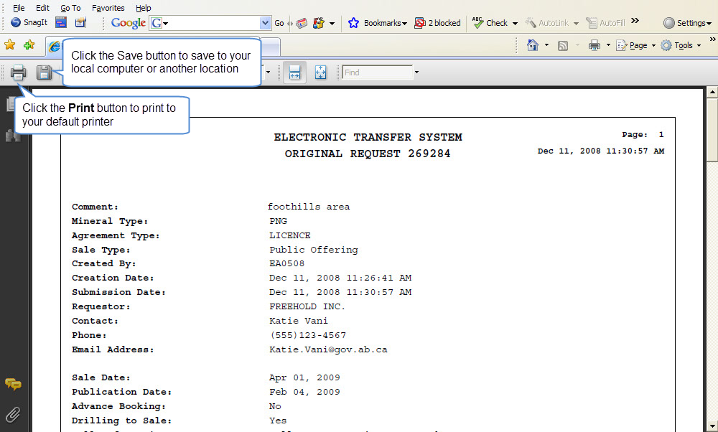
Back to Initiate Requests

Slide 23
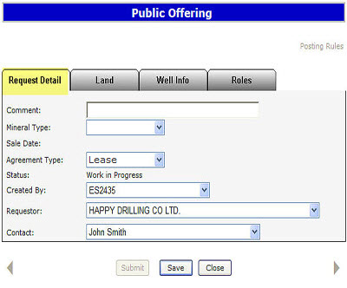
Request Detail Tab
The Request Detail tab allows you to enter or change information about your posting request.
Enter a comment to identify the request (optional field). If you entered a comment in your Account Preferences it will be shown here.
Select the Mineral Type (PNG or OS).
The sale date for the current acceptance period will be displayed. If the request is submitted in the next acceptance period the Sale Date will change.
Select the Agreement Type.

Slide 24
Request Detail Tab (Continued)
For PNG, the Agreement Type will default to Lease with the option of changing to a Licence. For OS, the Agreement Type will default to Lease with the option of changing to a Permit.
The status of the request will be displayed as work in progress until the request is submitted to Alberta Energy
The Created by and Contact fields will be defaulted to your user name and the Requestor field will indicate your company name. The contact will receive notification by email regarding updates to the posting request.
Tip: Only the Coordinator can use the drop-down arrow to select a different Creator.

Slide 25
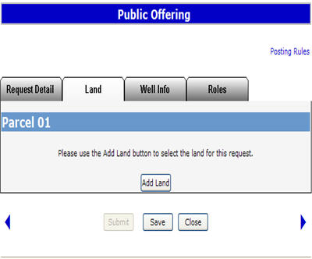
Land Tab
The Land tab allows you to add, change or delete the land, and change rights (PNG only).
.

Slide 26
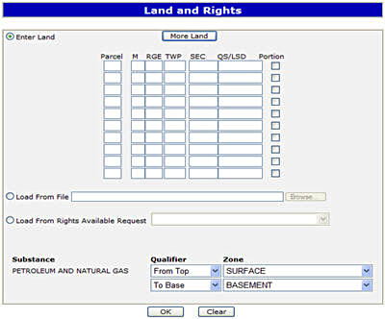
Enter Land and Rights
Method 1 – Enter Land and Rights
You can enter land and rights manually on the Land and Rights screen:
Enter the land description. Select the Portion check box if the land you are requesting has Crown and non-Crown mineral rights ownership.
Tip: If the Meridian, Range and Township are identical for the next section of land, you do not need to enter this information again.
The substance will be defaulted to Petroleum and Natural Gas for a PNG Request. This allows Alberta Energy to process the request for both substances.

Slide 27
Enter Land and Rights – Load from File
Method 2 – Load from File
You can load the Land and Rights from an XML or CSV file created using the Query by Land option. You can also produce the XML or CSV file using an in-house system.

Slide 28
Enter Land and Rights – Load from Rights Available Request
Method 3 – Load from Rights Available Request
You can load the requested land by selecting the Request that you have made in the past 60 days that have rights available.

Slide 29
Enter Land and Rights (Continued)
For PNG the Zones are defaulted to Surface to Basement with the option to change.
Tip: If the zones are different for each section of land, leave as Surface to Basement. This can be changed in the Land screen. If you are requesting all available rights leave the default as Surface to Basement.
For OS the zones are defaulted to Surface to Basement, no changes allowed. When processed by Alberta Energy, any available rights within the respective OS area may be granted.

Slide 30
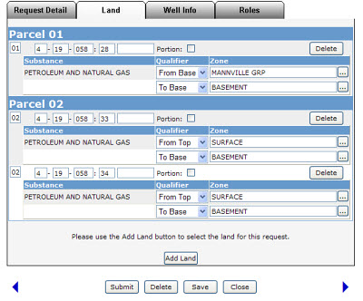
Land Tab
To delete a parcel, click on the Delete button.
To change the parcel number, click on the number you want to change and add the new parcel number.
Use the drop down arrow to select the Qualifier, either From Top, To Base, From Base and To Top.
To change the zones, click on the ellipsis (...) button to open the Zone table. You can sort the zones by Name or Depth. Click on the Select button to the right of the zone you want.
Tip: Saving a posting request does not submit it to Alberta Energy.

Slide 31
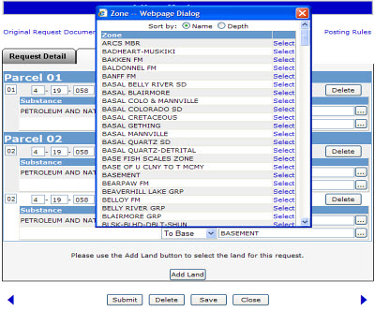
Land Tab - Zone Table
If the request has no errors, a posting request number will be indicated at the top of the screen and a link to the Original Request Document will be visible. This document details the information entered for the posting request. Click on the link to open the Original Request Document.
Once you have added the land and rights your request is ready to be submitted, except if you are drilling a well to the sale or would like the request submitted as an advance booking. If this is the case, you need to click on the Well Info tab.
Tip: Any changes to a request must be made before the request is submitted. Any future changes to a posting request can still be done up to one week (Wednesday) before the publication date of the sale by contacting the Sales group.

Slide 32
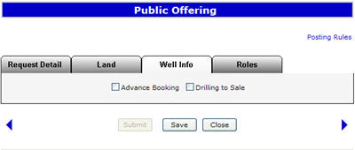
Well Info Tab
The Well Info tab allows you to enter information for an Advance Booking or Drilling to Sale.

Slide 33
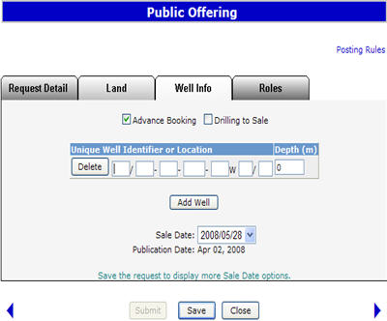
Well Info Tab Details
Advance Booking
An Advance Booking request is a posting request where the requestor wishes to time the purchase of an agreement(s) to an evaluation well being drilled to a depth of 3000 metres or more. An advance booking request is only available for a PNG Public Offering posting.

Slide 34
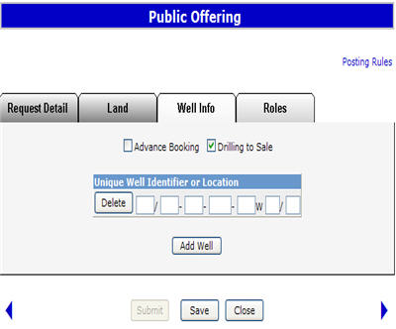
Well Info Tab Details (Continued)
Drilling to Sale
A requestor who is drilling a well timed to the sale date is given first priority if there is a duplicate request for the same land in the same sale.

Slide 35
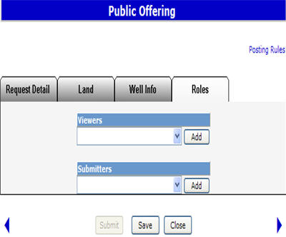
Roles Tab
The Roles tab is used to define who can view and submit your request. If you have already added a viewer and/or submitter by accessing the Account folder, Preferences page, Posting Request Preferences, the Viewer and Submitter box will be filled in. You can add or delete Viewers and Submitters for each posting request.
Tip: If the submitter and the creator of the posting request are different users, it is the responsibility of the creator to advise the submitter that the request is now available for submission to Alberta Energy

Slide 36
Resources
ETS Support and Online Learning provides access to relevant guides, course and other information
If you have questions, please contact
For PNG: Postings.Energy@gov.ab.ca or the Sales Helpdesk at (780)644-2300 or
for Oil Sands: OSTenure@gov.ab.ca

Slide 37

Conclusion
Congratulations!
You have completed the ETS – Public Offering
Online Training Course
Please proceed to the subsequent modules detailing other functionality of the Posting application.
If you have any comments or questions on this training module, please forward them to the following email address:
Postings.Energy@gov.ab.ca

