Slide 1
Welcome
Welcome!
Adding a lessee to a title is a declaration of a lessee’s interest in that Title Id.
A new lessee may be added by either:
A PE Administrator or
A new lessee
To the ETS – Add Lessee
Online Training Course

Slide 2
Revisions
Date | Revisions Type | Page Number
August 31, 2012 | Conversion | All

Slide 3

Introduction
In this module, you will learn how to add a new Lessee to a title,
if you are:
A Production Entity Administrator, or
A lessee wishing to declare your interest in the Title for a specific Production Entity.

Slide 4
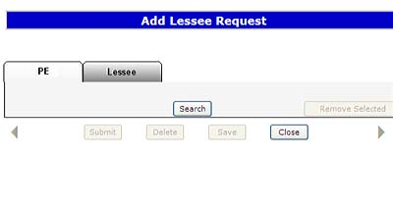
Search
PE Admin
  To begin the ‘Add Lessee’ process, do a search for the applicable Production Entity (PE) or Title. Refer to tip for details.
  To add a new lessee to the title(s), select either the titles or the FMT PE’s on the ‘Search Results’ screen
New Lessee
  must search by the Title Id
  must have a Client Id and a BA Id.
TIP: A PE Admin can search by multiple criteria. A New Lessee must search by the Title Id.

Slide 5
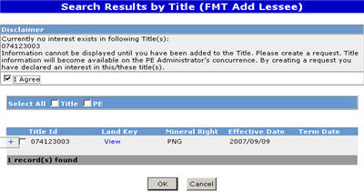
New Lessee Adds Self
New lessees have the ability to add themselves to a Title.
If a new lessee does not have an existing interest in the Title being searched, a Disclaimer will be displayed, which must be accepted in order to initiate this process.
Initial query requests made by the new lessee will not display the PE Administrator, Title Owner, Payor or Lessee information.
Tip: The PE Administrator must concur to this request before the new lessee can be added to the Title.

Slide 6
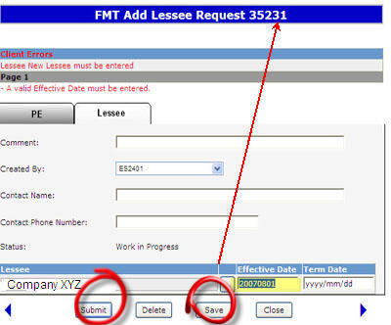
New Lessee Adds Self (Continued)
A new lessee must select the title(s) to which he wants to be added.
Saving the Search Query allocates a Request number and triggers a prompt to enter the new lessee. The signed on user will be defaulted to the client search screen when the client search button is used.
The Effective Date of the new lessee must be entered; the Term Date may be left blank.
The created ADD LESSEE document is not available to the new lessee for review while the request is in the Work-In-Progress (WIP) status.
The Submit button must be selected to change the request status from WIP to ‘Concurrence’. The Submit process also triggers an email notification to the PE Administrator for concurrence.

Slide 7
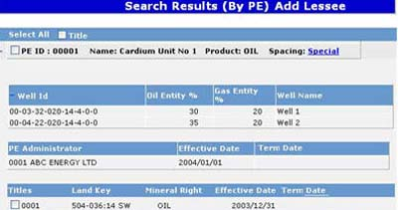
PE Administrator Initiate Request
More Information (Pages 8 to 23)
A PE Administrator has the ability to add a new lessee to any PE where he is listed as an administrator. The added lessee must concur with his/her addition to the lessee role before the transaction can be finalized.
Once the transaction has been sent for concurrence, refer to the WIP module for completing this transaction.
When conducting a search of a PE, the PE Administrator is able to view all roles associated with that production entity. Narrowing the search criteria by adding search parameters allows the viewer to work with just what is needed. This concurrence process also eliminates the need to submit a paper form.
TIP: A maximum of 5 lessees are allowed per title.
TIP: A new Effective Date cannot be less than current production year or more than the current date + 60 days.

Slide 8
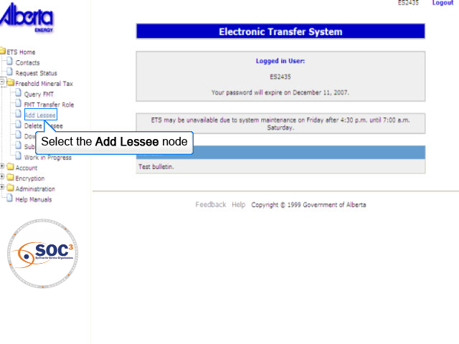
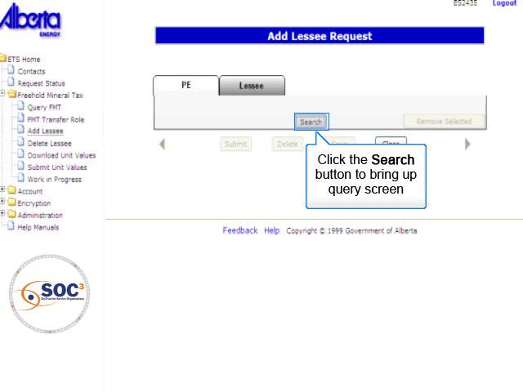
PEA1
Back to PE Administrator Initiate Request

Slide 9
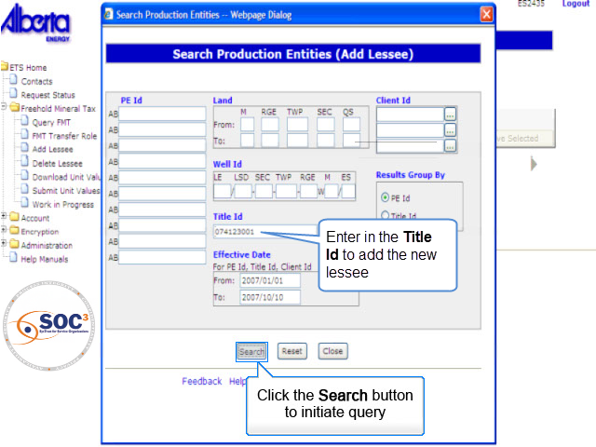
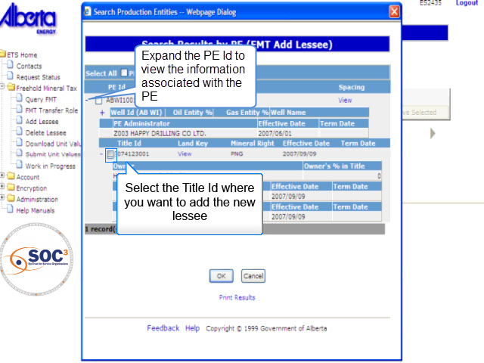
PEA2
Back to PE Administrator Initiate Request

Slide 10
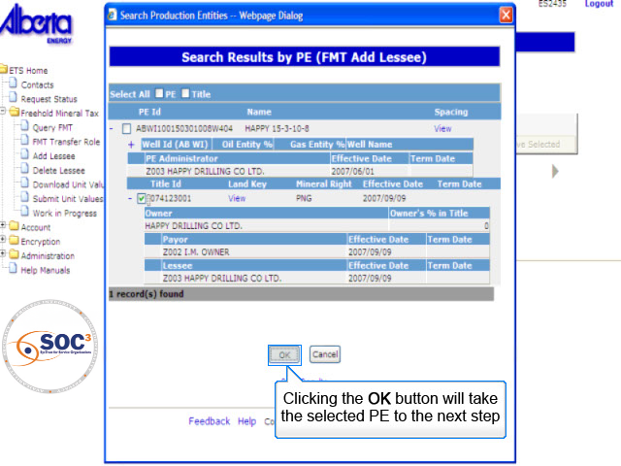
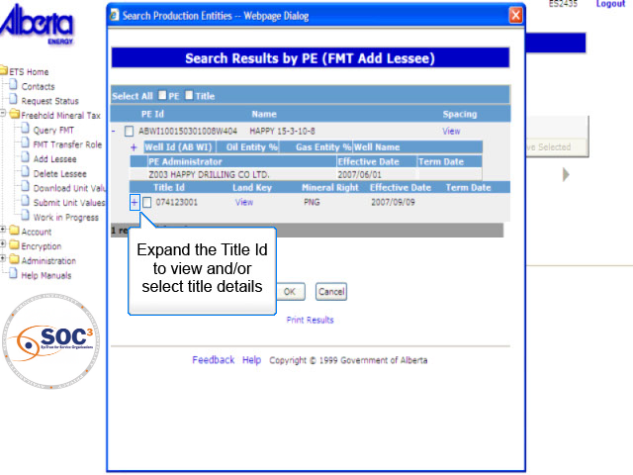
PEA3
Back to PE Administrator Initiate Request

Slide 11
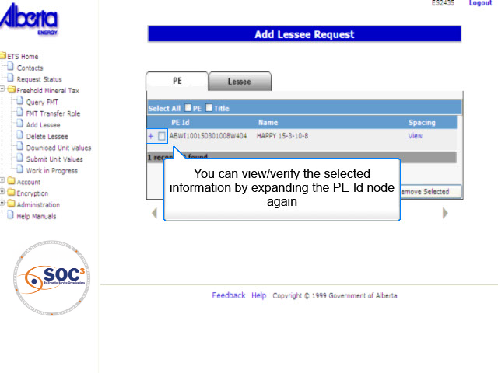
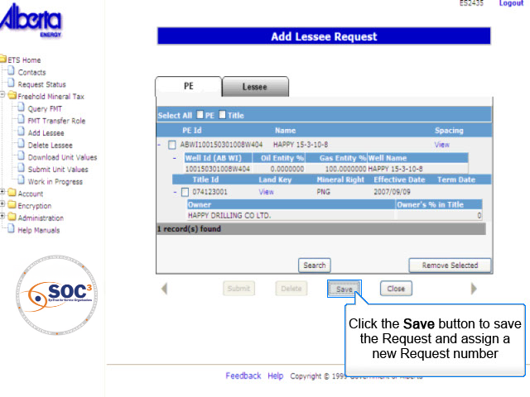
PEA4
Back to PE Administrator Initiate Request

Slide 12
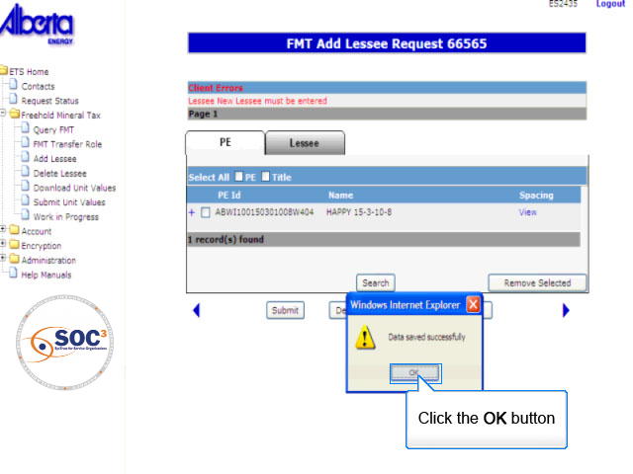
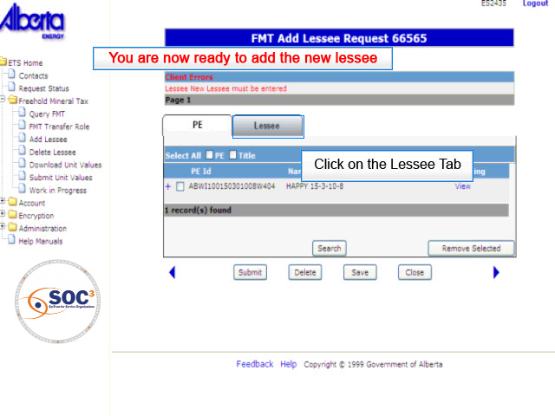
PEA5
Back to PE Administrator Initiate Request

Slide 13
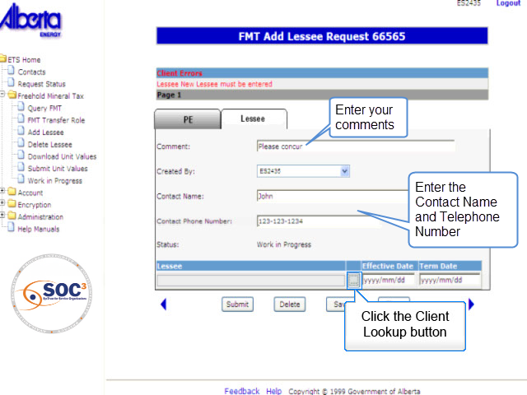
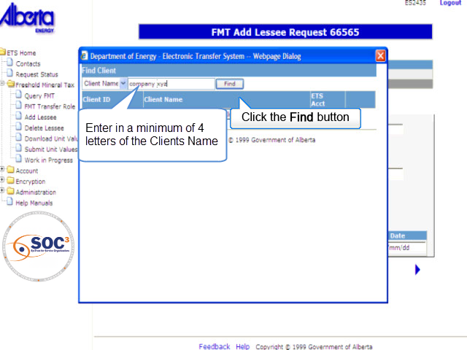
PEA6
Back to PE Administrator Initiate Request

Slide 14
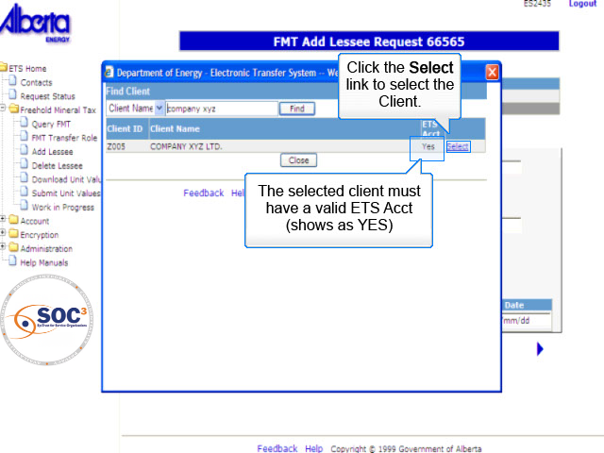
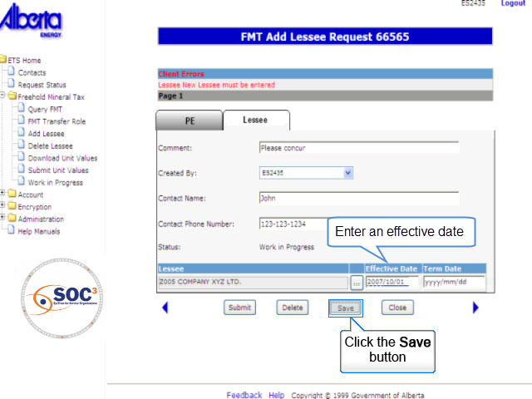
PEA7
Back to PE Administrator Initiate Request

Slide 15
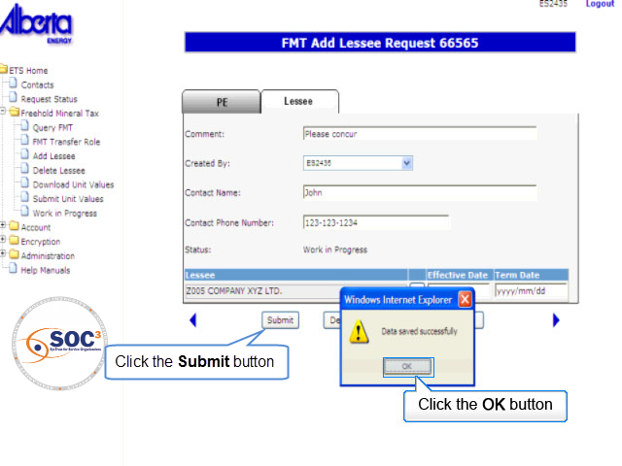
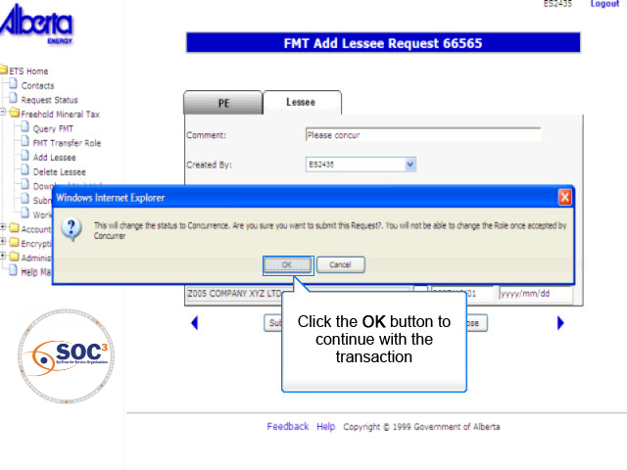
PEA8
Back to PE Administrator Initiate Request

Slide 16
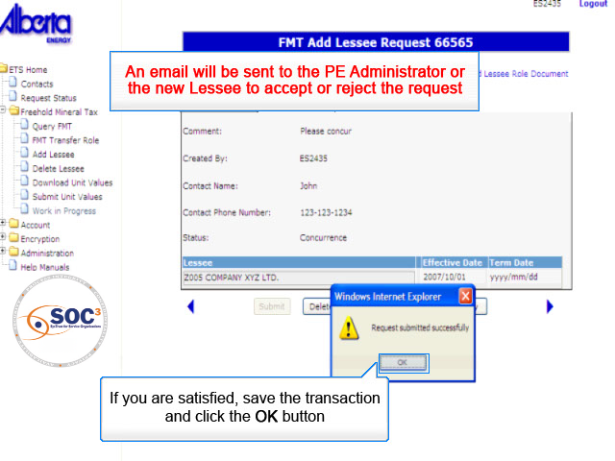
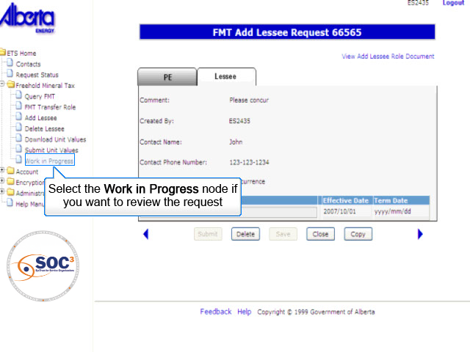
PEA9
Back to PE Administrator Initiate Request

Slide 17
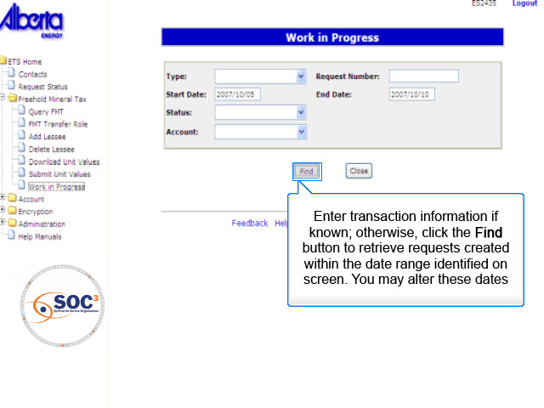
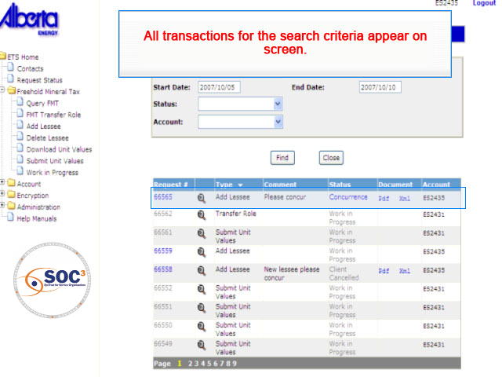
PEA10
Back to PE Administrator Initiate Request

Slide 18
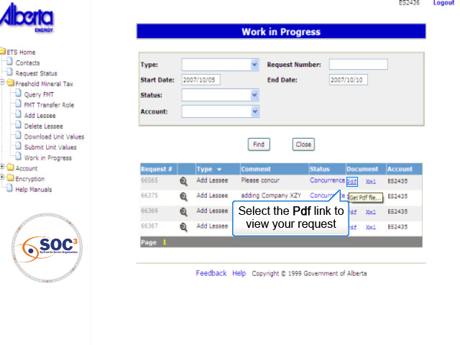
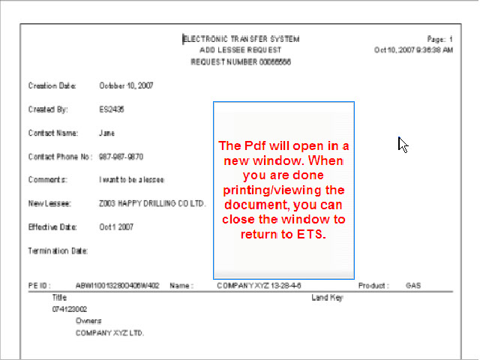
PEA11
Back to PE Administrator Initiate Request

Slide 19
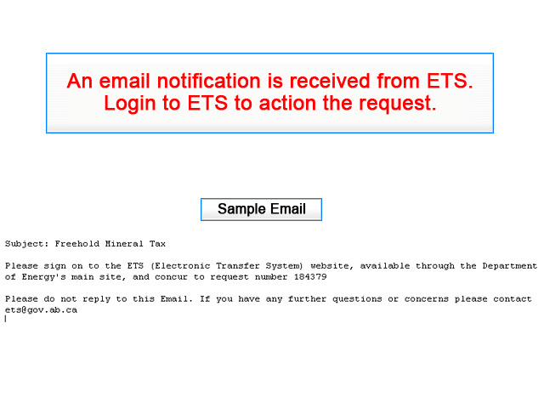
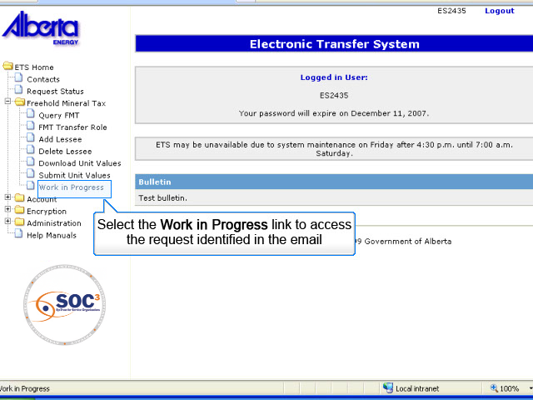
PEA12
Back to PE Administrator Initiate Request

Slide 20
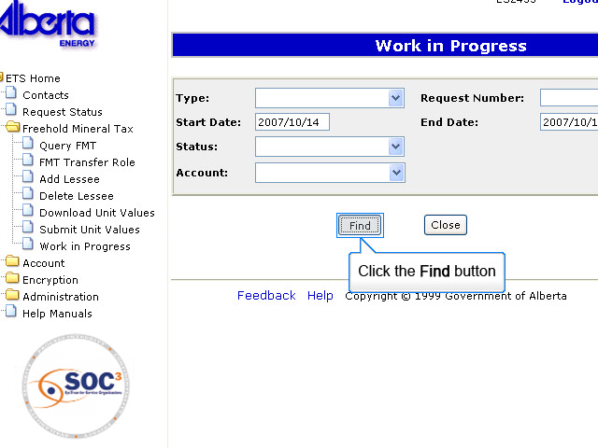
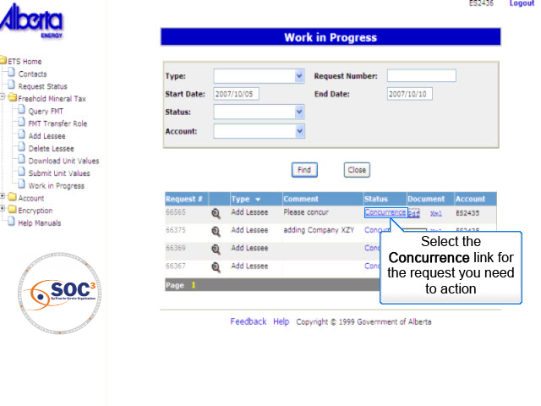
PEA13
Back to PE Administrator Initiate Request

Slide 21
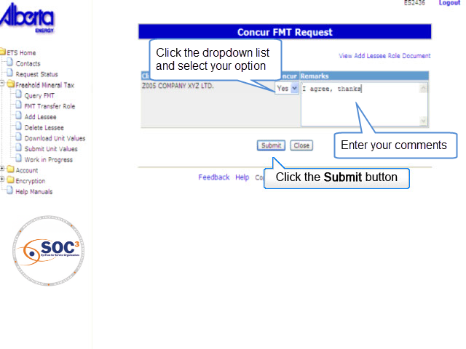
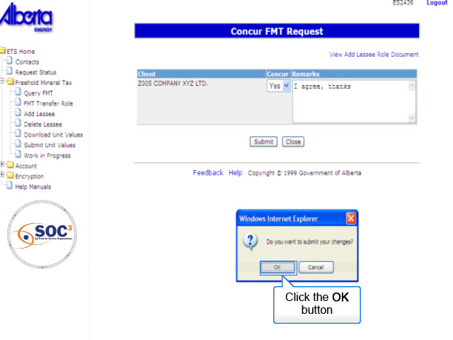
PEA14
Back to PE Administrator Initiate Request

Slide 22
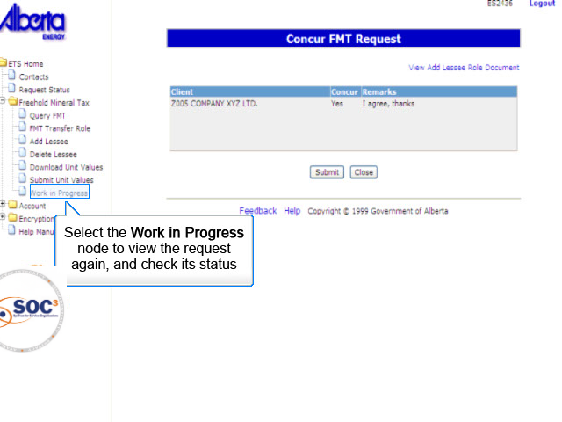
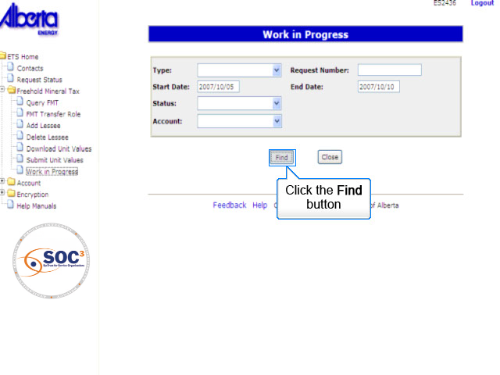
PEA15
Back to PE Administrator Initiate Request

Slide 23
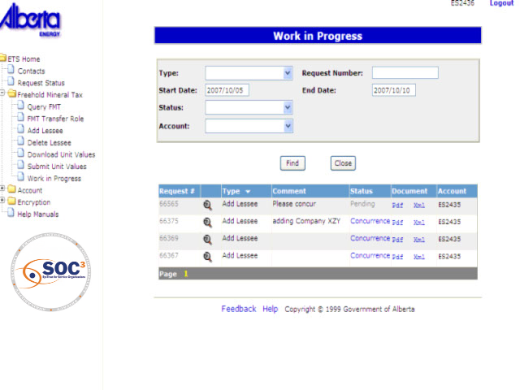
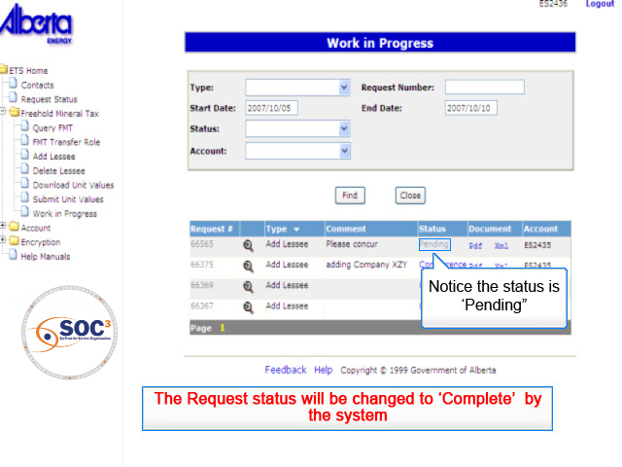
PEA16
Back to PE Administrator Initiate Request

Slide 24

Conclusion
Congratulations!
You have completed the ETS – Add Lessee Online Training Course
Please proceed to the subsequent courses detailing other functionality of the Freehold Mineral Tax application.
If you have any comments or questions on this training course, please forward them to the following email address:
Mintax.Energy@gov.ab.ca

