Slide 1
Welcome
Welcome!
All information gathering to perform the differing processes within this system may be initiated by using the Query FMT option.
A logged in user will be able to search for and retrieve information ONLY for your company ID(s) (Payor, Owner, PE Administrator or Lessee) associated with the item being queried.
The user will receive a message stating "No Records Found" when the users associated BA id's are not assigned as one or more of the roles for the criteria selected.
All Query results will be assigned a Request Number for tracking and will be produced in both a PDF format, and an XML format. The files will be retrieved from the Request Status Menu option of the Navigation Tree.
All Queries that exceed over 700 results will be processed over night. There will be a request number assigned to the query that you can check the next day.
To the ETS – Query FMT
Online Training Course

Slide 2
Revisions
Date | Revisions Type | Page Number
August 31, 2012 | Conversion | All

Slide 3

Introduction
In this module, you will learn how to search for Production Entities and their related Title and role associations, by querying:
  A Production Entity Id
  Land key
  Well Id
  Title Id
  A Client Id, or
  A combination of any of these ids
The more criteria fields entered, the narrower your search will be, retrieving only the necessary information needed to work with.
Date range will default to the current year.

Slide 4
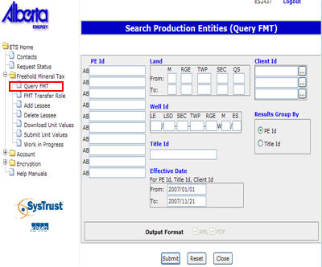

Menu
To access the QUERY FMT option, expand the tree node and click on Query FMT.
Note that while the Query screen looks the same for each process node, its functionality may differ slightly depending on the business rules for that process.

Slide 5
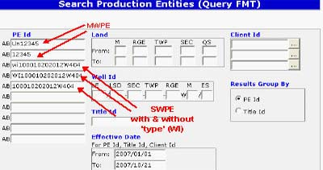
Query by Production Entity
Production Entities can be either a Multiple Well Production Entity (MWPE), or a Single Well Production Entity (SWPE).
A MWPE is created to allow for the grouping of wells used in a common purpose (i.e. a unit or a production allocation agreement).
A SWPE corresponds directly to an Active Well Event. A SWPE has one Well Event attached to it and has a Crown/Freehold percentage assigned to it.
Tip: Make sure the PE you are Searching has at least a portion of FH Land associated. Only FH particulars will be available to search. Searching Crown PEs will result in "No Records Found"

Slide 6
Production Entity Parameters
More Information (Pages 7 to 9)
To search by the MWPE, enter the 2 digit type (UN for Unit) and the 5 digit identifier number.
To search by the SWPE, enter the 2 digit Type (WI for Well Identifier, WG for Well Group and UN for Unit) and the well Identifier (16 digit number). You may also enter the UWI in the Well Id field.
The “type” in the PE Id field is an optional entry for either the SWPE or the MWPE.
An Effective date must be used for a PE Search. It's selection narrows your search results for a PE, Title and Client ID.
Tip: Using the Client ID Search criteria selection box to identify only those properties you may have in common with that corporate entity.
Tip: You must enter the "W" in the SWPE

Slide 7
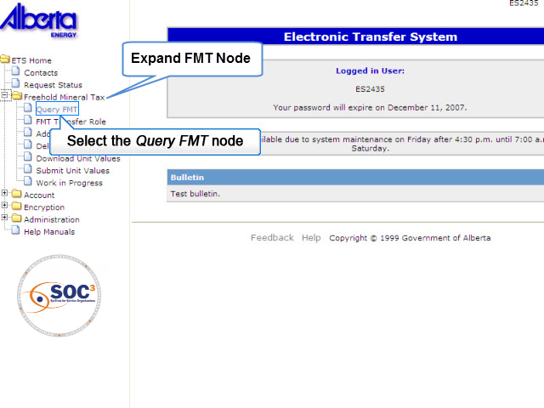
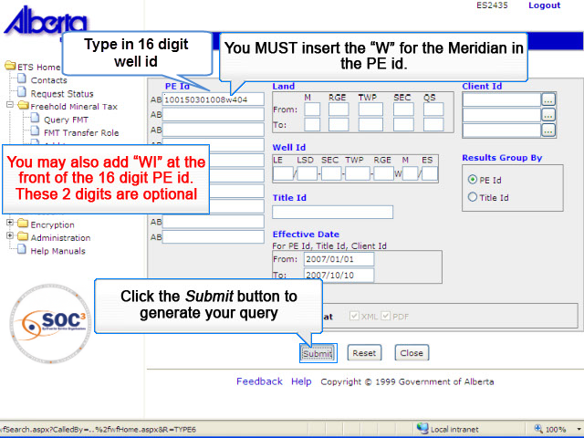
PE1
Back to Production Entity Parameters

Slide 8
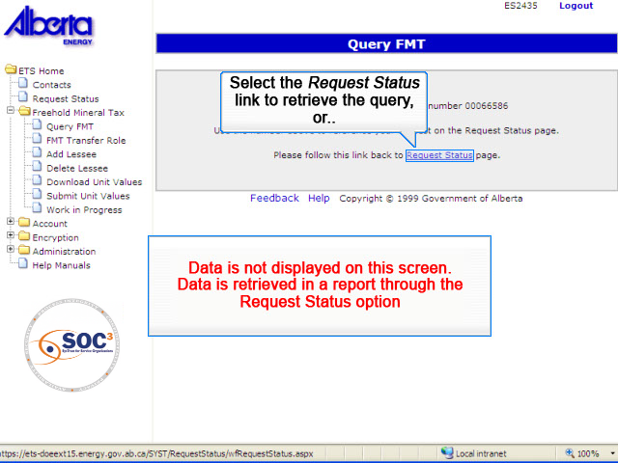
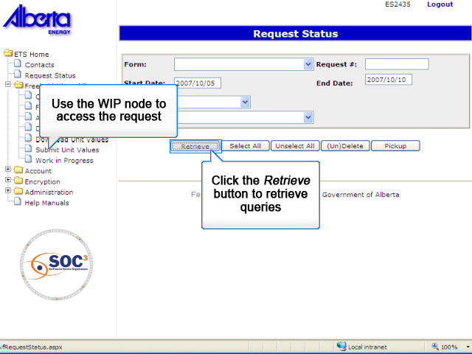
PE2
Back to Production Entity Parameters

Slide 9
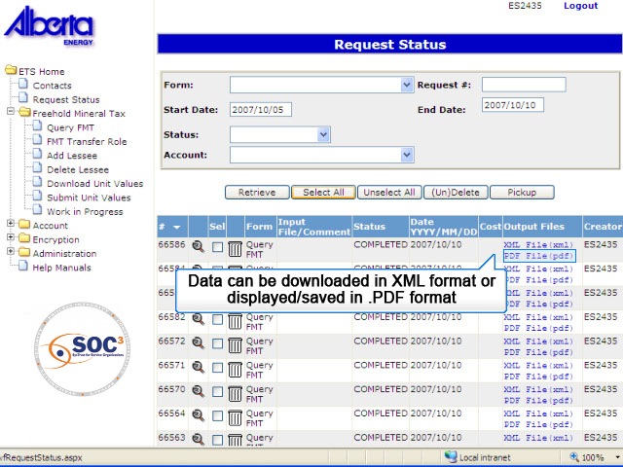
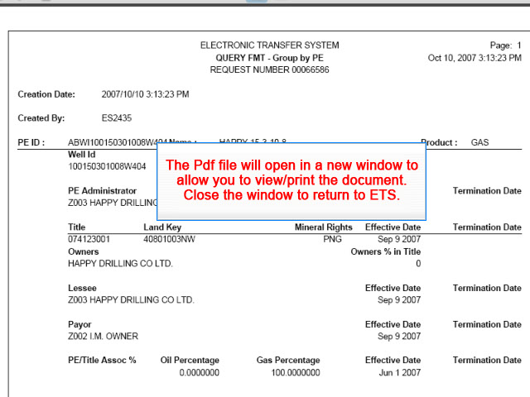
PE3
Back to Production Entity Parameters

Slide 10
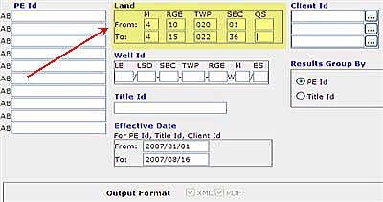
Query by Land ID
The Search by Land key searches from the North West coordinate to the South East coordinate of the land keys provided, and searches within the squared off boundaries of these land keys. This squared off boundary cannot exceed a 3X3 Township Grid.
You may search across multiple ranges, multiple townships or multiple sections, but you may NOT search across multiple Meridians.
All land description searches require you to enter the minimum of:
Meridian
Range
Township
Section for the "From" (NW Corner)
Section for the "To" (SE Corner)
Tip: Use this search to identify if you have an interest in an area. If you are not associated with the specified land keys as a Payor, Lessee, Owner or PE Administrator, the search will display "No Records Found".

Slide 11
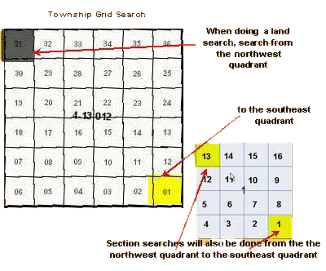
Land Grid
The search area is always defined from the northwest quadrant to the southeast quadrant.
If you are searching within a township, the northwest quadrant is section 31 and the southeast quadrant is section 1.
If you are searching within a section, the northwest quadrant is legal subdivision 13 and the south east quadrant is legal subdivision 1.
The same rule applies to a search within a quarter section; the northwest and southeast quadrants will vary, depending on the quarter section being searched.

Slide 12
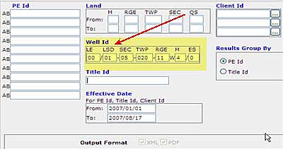
Search by Well ID
To search by the Well ID, enter the well Identifier (13 digit number).
Note that the event sequence indicator in this query option only requires a single digit (the second digit of two digits in the well event field) entry, whereas the PE field requires 2 digits.
Tip: This feature is similar to using the Search by PE option.
Tip: When searching by UWI, you do not need to enter in the first '1' in the Well Id number. This is auto-populated.

Slide 13
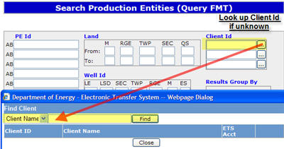
Query by Client ID
A Client is a user in the Payor, Owner, Lessee or PE Administrator role. This field only accepts a 4 digit BA ID.
When searching for PEs or Titles, a logged in user can be in any role. The logged in user can specify any other Client Id which is not associated with their ETS Account but must be either in a Payor, PE Admin, Lessee or Owner role.
To find a Client BA Id, click on the square in the Client Id field. This allows you to enter all or a portion of the client's name, in order to access the BA Id associated with that name. The Client name being searched must contain at least 4 characters.
An Effective date range must be used with search by a Client Id.If effective date range is unknown, set the range to "All non statute barred" (or 'Open') years.
Tip: When doing business and communicating with another business partner, the advantage of entering the partners id in the client id search criteria is that it will display only those items you have in common with that Client id.

Slide 14
Query by Client ID (Continued)
A Client may also search their own client ID to obtain a report of all the properties they have a role for on the FMT system.
Reports can be downloaded in either PDF or XML format.
Tip: If the client searched has less than 700 records then the results will be returned immediately. If there are more than 700 records the request will be processed over night and be available the following day.

Slide 15
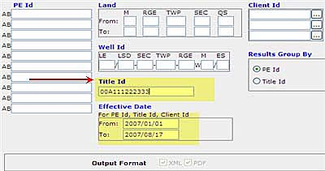
Query by Title ID
More Information (Pages 16 to 21)
Use this option if you know the fee simple Freehold Mineral Rights Certificate of Title number.
The system will search all titles where you (the logged in user) are listed as a Payor, Owner, PE Administrator or a Lessee.
If you know the UWI or PE, you may also choose a specific PE within a title to tie to.
There are no restrictions on the length of this field.
You must enter the effective date range of the title you are searching when using this search option.
If the date is unknown, enter Jan 1 of the first non-statute barred year in From and leave today default in the To.
Tip: Searching using two or more criteria will result in more specific results.
Following Slides will demonstrate a number of different query options

Slide 16
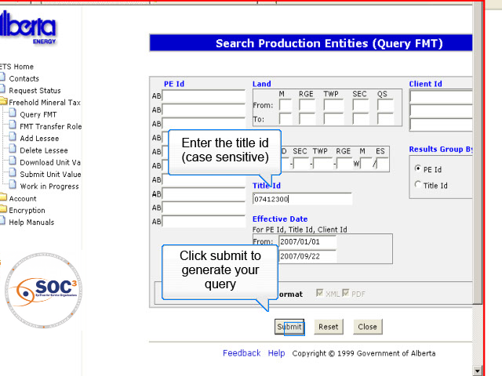
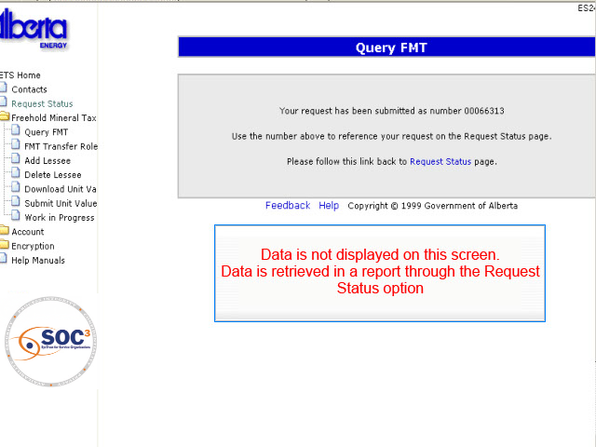
More Information1
Query By Title ID
Back to Query by Title ID

Slide 17
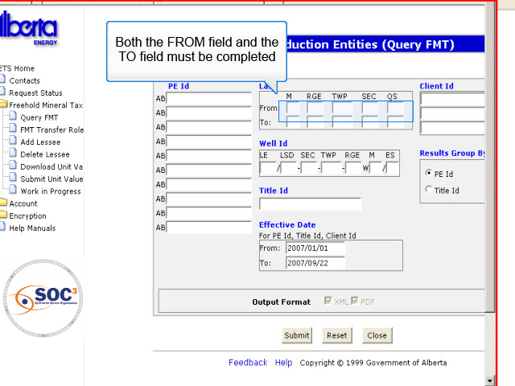
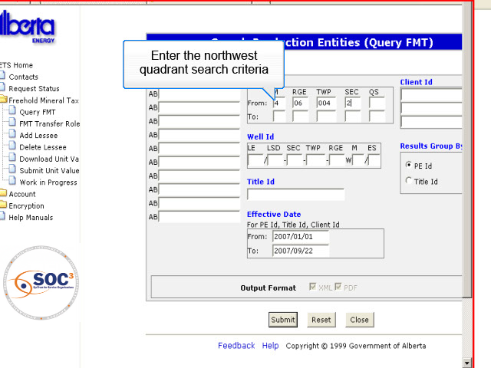
More Information2
Query By Land Keys
Back to Query by Title ID

Slide 18
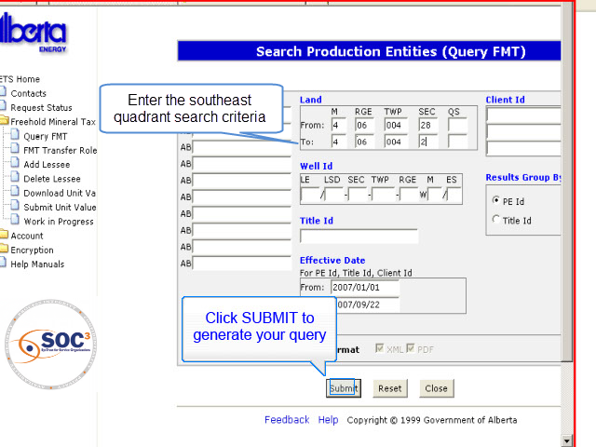

More Information3
Back to Query by Title ID

Slide 19
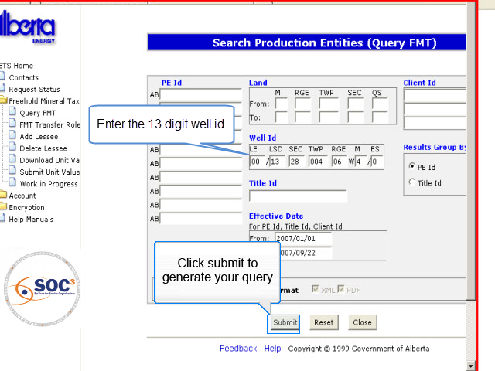

More Information4
Query By Well ID
Back to Query by Title ID

Slide 20
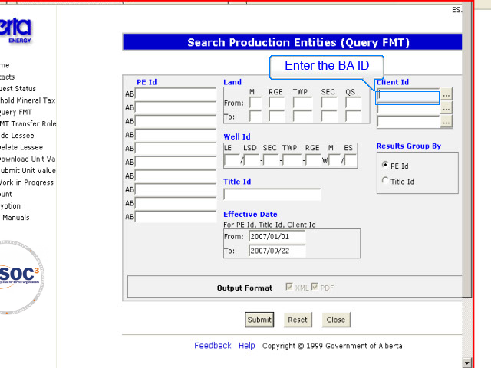
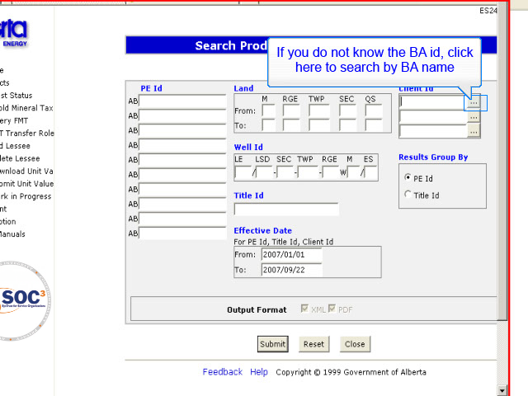
More Information5
Query By Client ID
Back to Query by Title ID

Slide 21
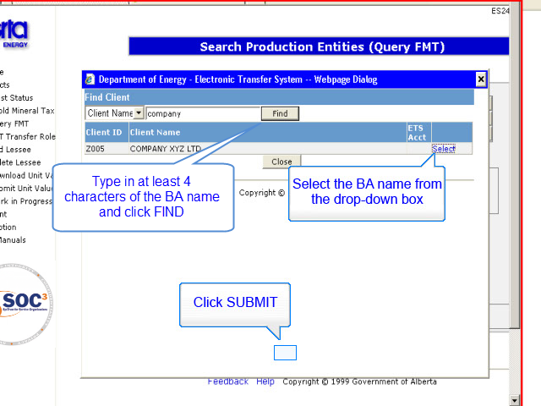
More Information6
Back to Query by Title ID

Slide 22
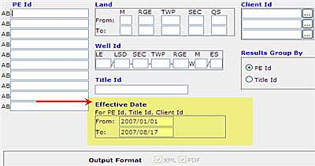
Query by Effective Date
The Effective Date is added to the assigned roles, and is the date when that role becomes effective for that client.
The “From Date” will be defaulted to Jan 1st of current year.
The “From Date” can be changed to Jan 1st of the current year minus 4 years or any date in between.
The “To Date” will be defaulted to Today’s date. This date may also be changed.
The Effective date will be required and cannot be left blank when searching by Title Id, PE Id, and Client Id.
The "To" date must always be equal or greater than the "From" date.
Tip: PEs, Titles and Clients that are active within any portion of the date range chosen (entered) will appear in results.
Tip: Most common reason for receiving the "No Records Found" message is that the incorrect "Effective Date" was used.

Slide 23
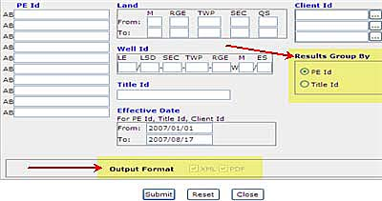
Results Grouped by PE ID or Title ID
This option will determine how the results are grouped on the Search Results screen.
Tip: Remember you have to be a specific role holder in order to see results related to that role.

Slide 24

Conclusion
Congratulations!
You have completed the ETS – Query FMT
Online Training Course
Please proceed to the subsequent courses detailing other functionality of the Freehold Mineral Tax application.
If you have any comments or questions on this module, please forward them to the following email address:
Mintax.Energy@gov.ab.ca

