Slide 1
Welcome
Welcome!
The Request Status function is used to retrieve any documents or reports generated either through the user's request, or generated by the Department and made available to the users via the ETS interface. The Request Status node is not tied to any specific application. It is used as a conveyance tool by all applications that the user has access to.
To the ETS – Request Status & Tax Statement Retrieval
Online Training Course

Slide 2
Revisions
Date | Revisions Type | Page Number
August 31, 2012 | Conversion | All

Slide 3

Introduction
In this module you will learn:
How to retrieve Query FMT requests
How to retrieve Download Unit Values requests
How to search for requests generated through FMT
How to retrieve your annual and revised Tax Statements, Annual Payor Summaries and Statement of Accounts.

Slide 4
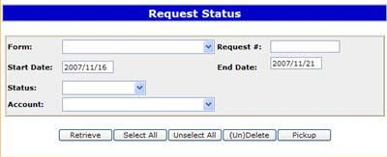
Request Status
More Information (Pages 5 to 13)
Users can search Request Status using the Request Number provided by the ETS system. There are a number of ways to search and display the results using Form, Request Number, Date Range, Status (Completed, Error, Pickup, Processing or Submitting), or Account.
The Start and End Dates on the Request Status search screen default to five days from the current date. You can manually change this by typing in the specific date you are looking for, or you can change this setting in your preferences to default to 30 or 60 days.
User information (documents) will be saved for users to access as output files in the Request Status node of ETS.

Slide 5
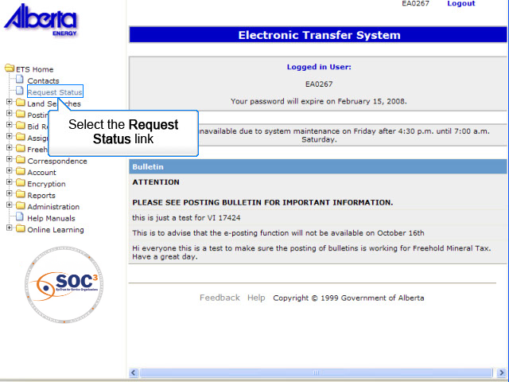
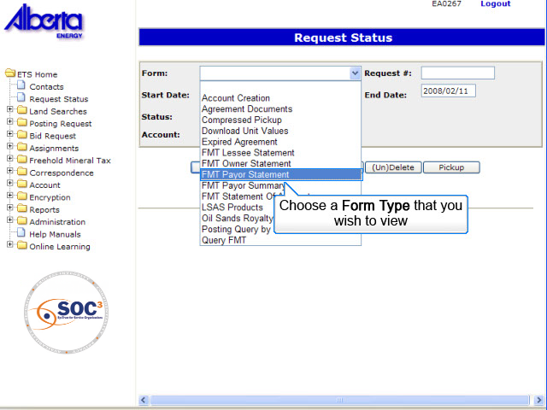
RS1
Back to Request Status

Slide 6
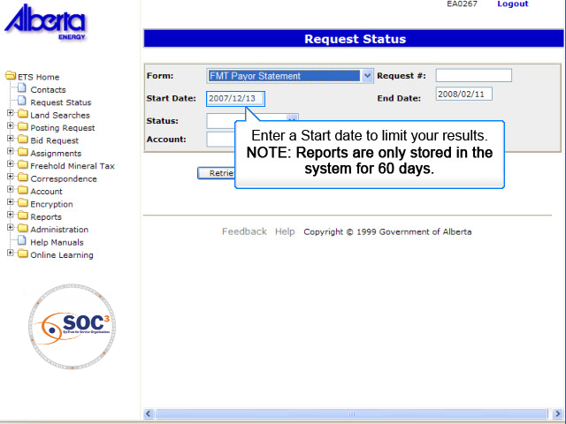
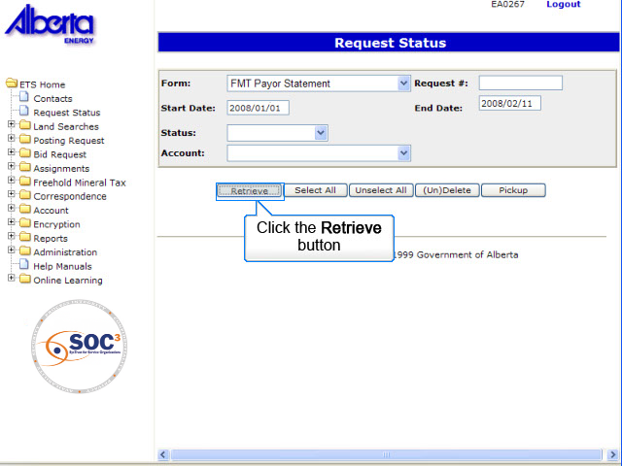
RS2
Back to Request Status

Slide 7
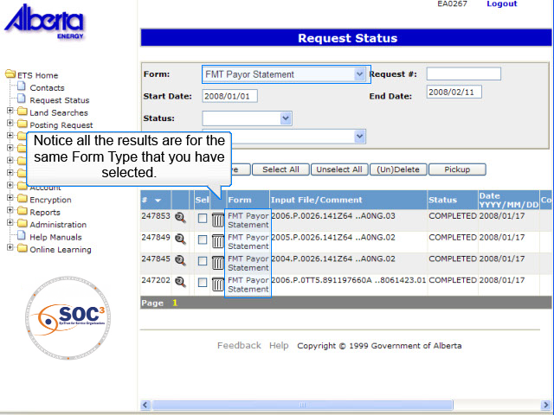
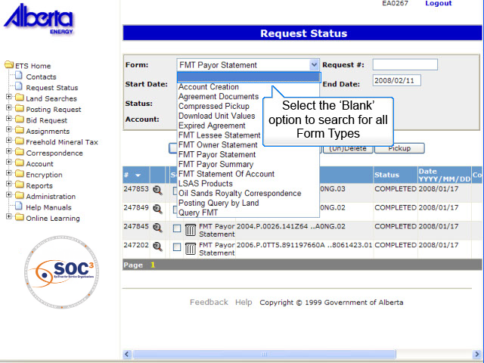
RS3
Back to Request Status

Slide 8
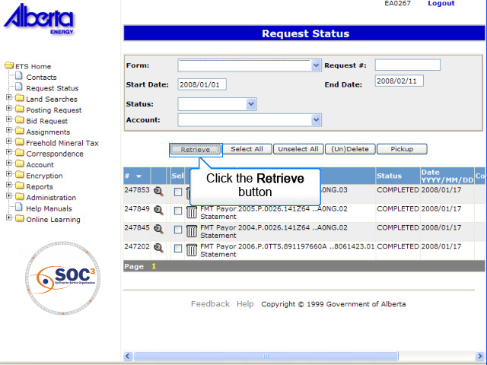
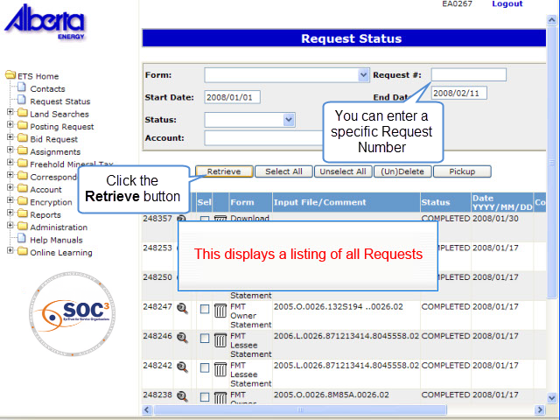
RS4
Back to Request Status

Slide 9
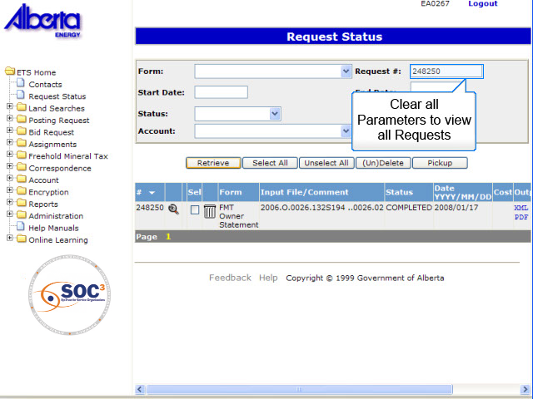
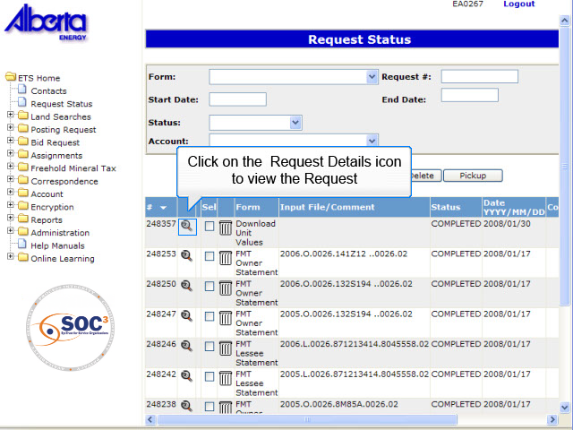
RS5
Back to Request Status

Slide 10
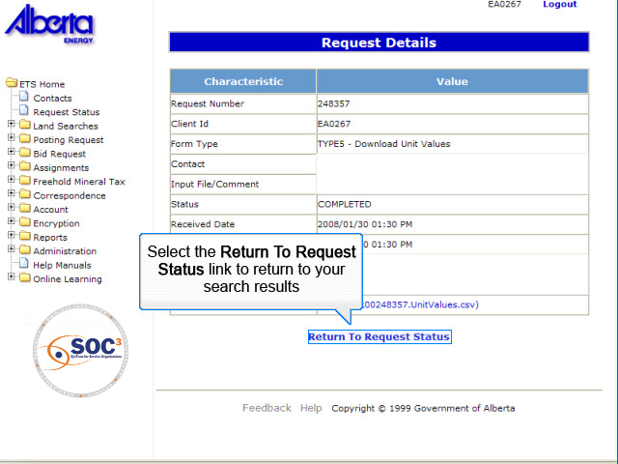
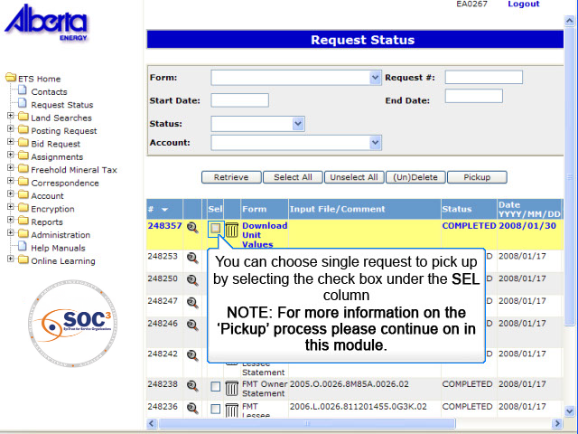
RS6
Back to Request Status

Slide 11
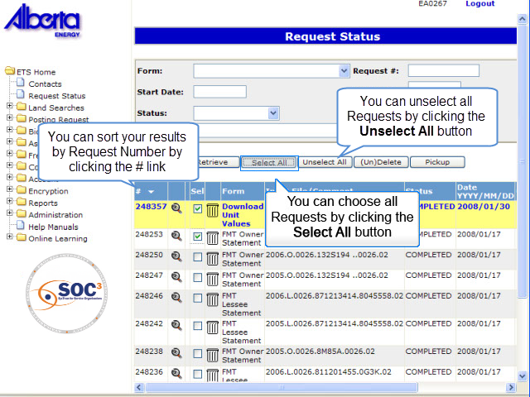
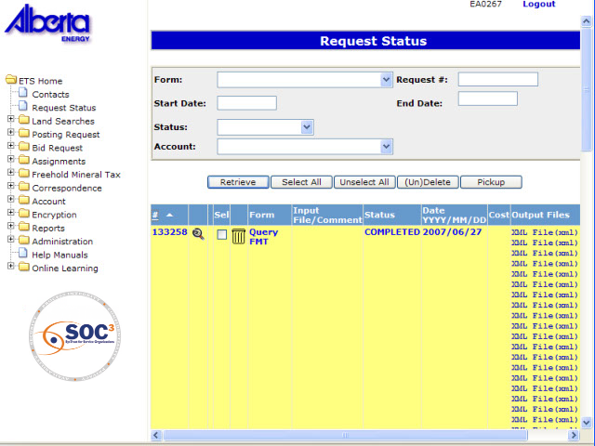
RS7
Back to Request Status

Slide 12
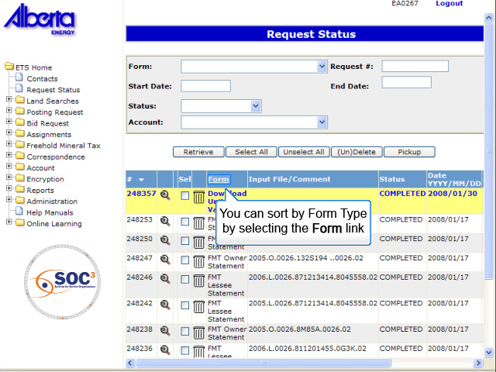
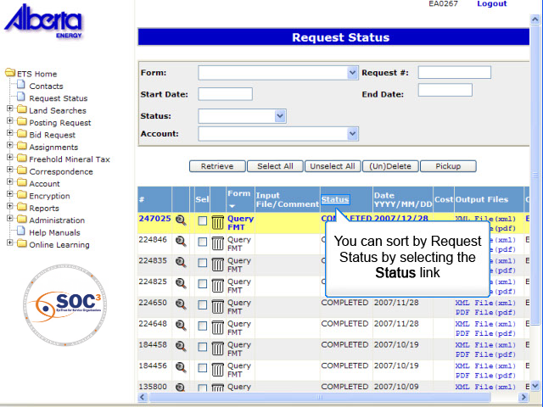
RS8
Back to Request Status

Slide 13
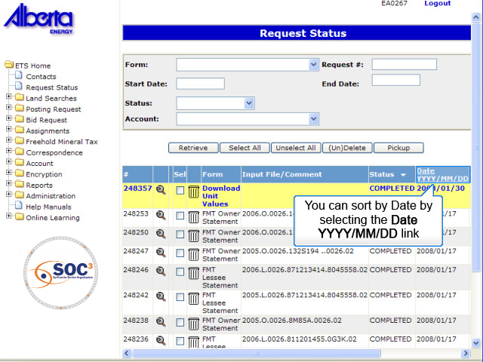
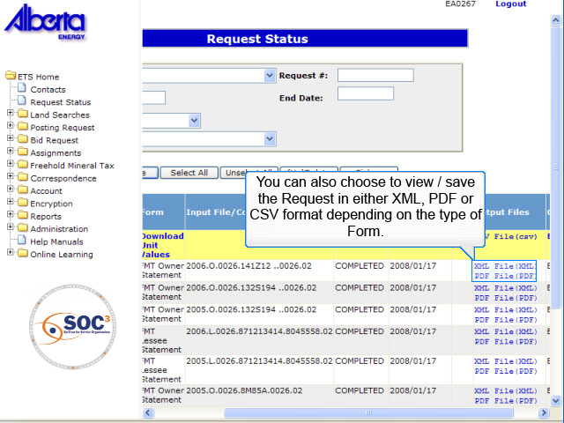
RS9
Back to Request Status

Slide 14
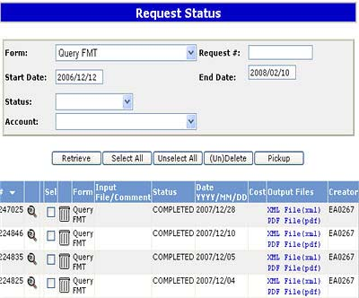
Query Form Type
Any queries generated through the Query FMT node of the Freehold Mineral Tax application will provide the user with a Request Number and create an output file which can be retrieved through the Request Status node.
These output files are available in XML and PDF formats.
These files can be picked up or deleted by selecting the form type 'Query FMT' in the Request Status screen.

Slide 15
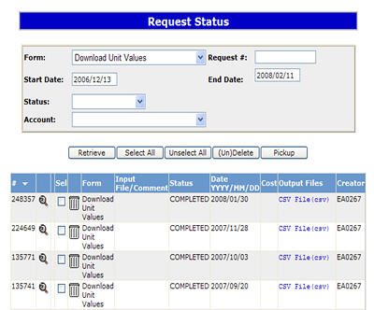
Download Unit Values Form Type
More Information (Pages 16 to 18)
The Download Unit Values report will be delivered as a csv file from the parameters selected on that node search screen.
The Download Unit Values report will display the existing PE's and Titles that you are a lessee on. You will calculate and insert your own values and upload to the Department if you choose not to accept the default value.
You may retrieve the results at anytime through the Request Status screen. The search results will not be displayed on screen.
You will download this file to your chosen network drive for the purpose of submitting Unit Values.
See the training Module - FMT Download Unit Values for more detailed information.

Slide 16
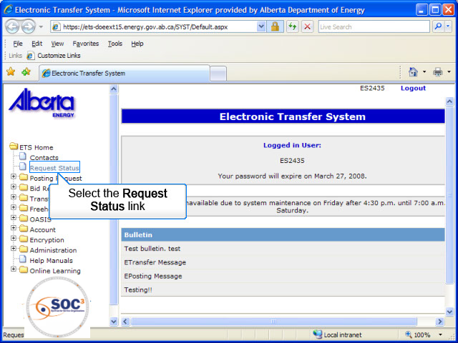
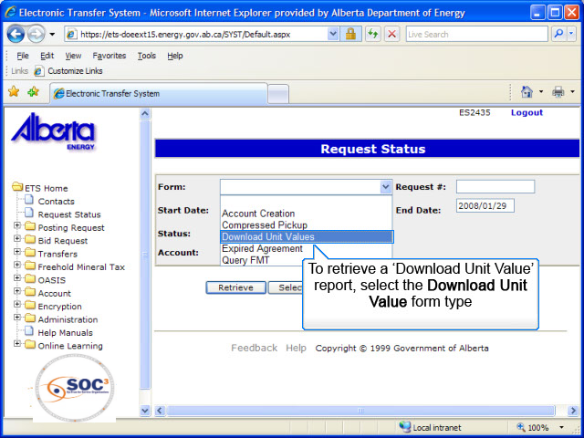
DU1
Back to Download Unit Values Form Type

Slide 17
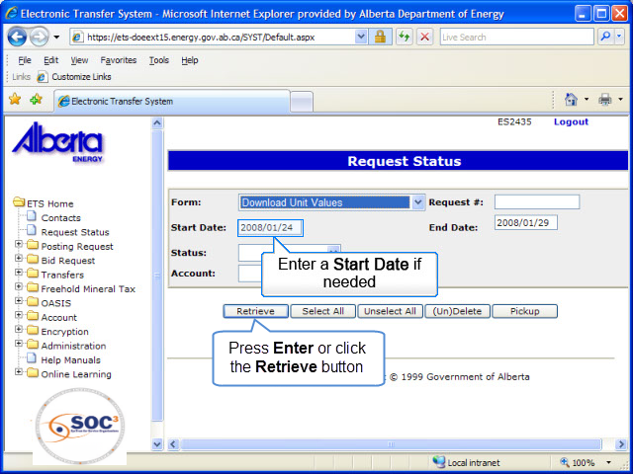
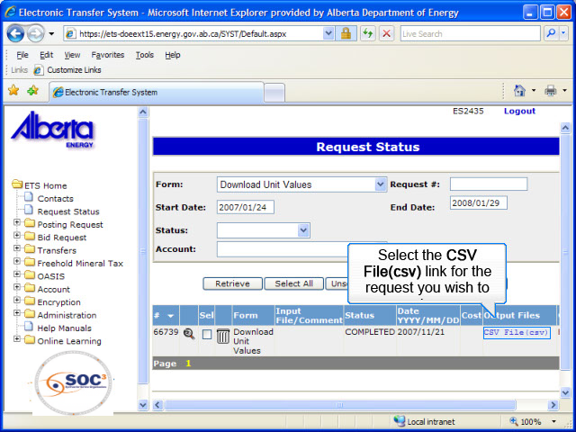
DU2
Back to Download Unit Values Form Type

Slide 18
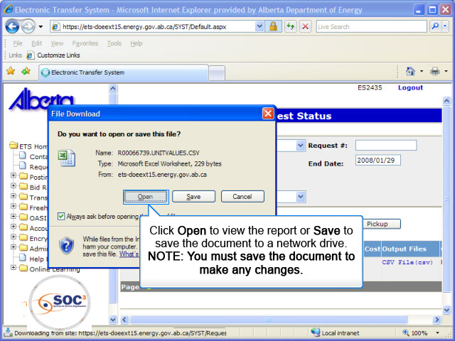
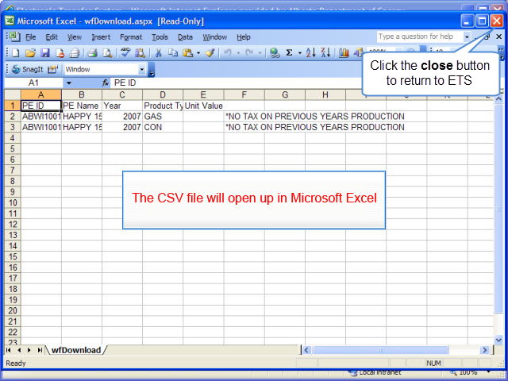
DU3
Back to Download Unit Values Form Type

Slide 19
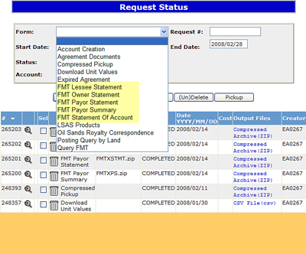
Tax Statement Retrieval
More Information (Pages 20 to 26)
Tax statements are generated annually, and an amended calculation may also occur on the last day of each month. Statements are produced for the Payor, Lessee, and Owner, as well as a Payor Summary for the annual assessment and Statement of Account report. The Statement of Account is produced on the 2nd or 3rd working day of each month.
Retrieving a Tax Statement follows the same process as looking up any other request that has been submitted through the Request Status node.
It is also highly recommended to save your documents locally as they will only be displayed by the system for up to 90 days.

Slide 20
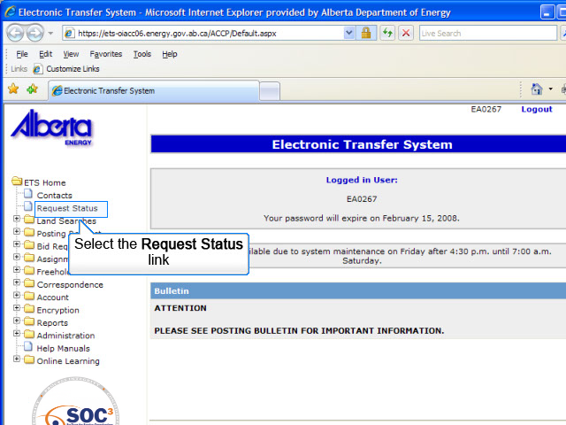
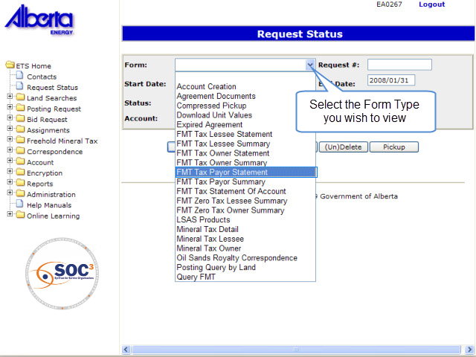
TSR1
Back to Tax Statement Retrieval

Slide 21
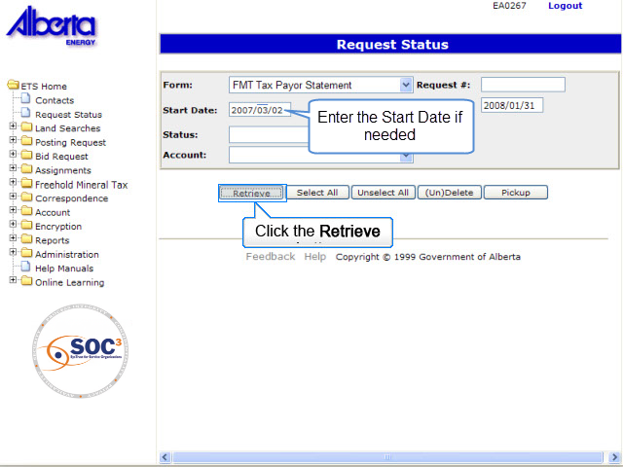
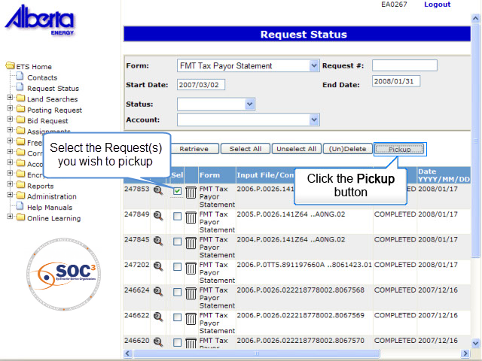
TSR2
Back to Tax Statement Retrieval

Slide 22
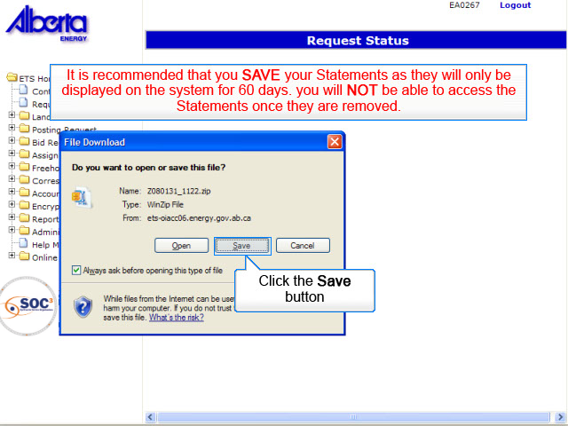
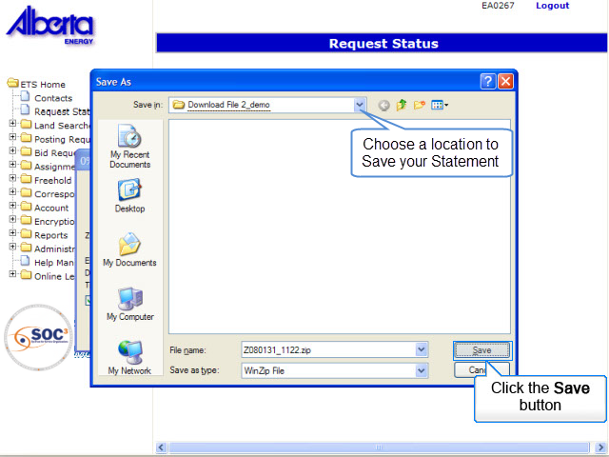
TSR3
Back to Tax Statement Retrieval

Slide 23
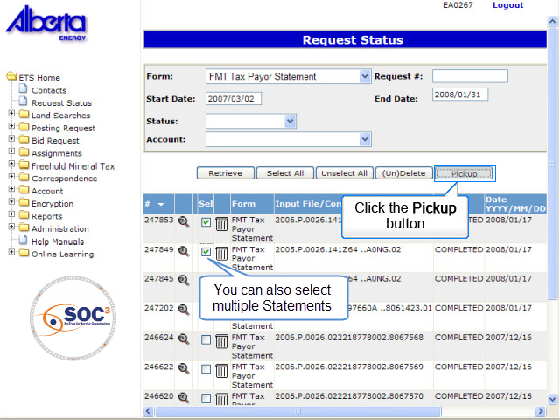
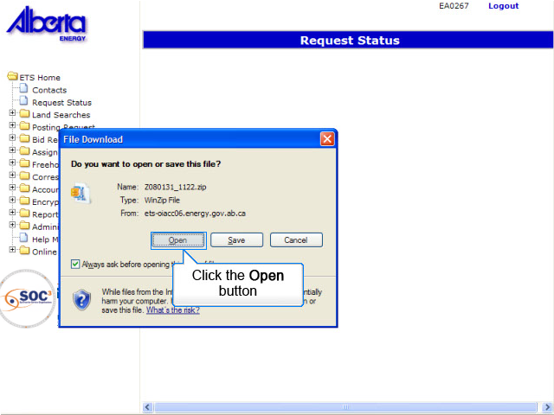
TSR4
Back to Tax Statement Retrieval

Slide 24
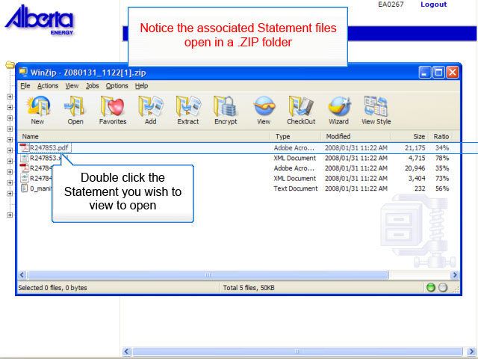
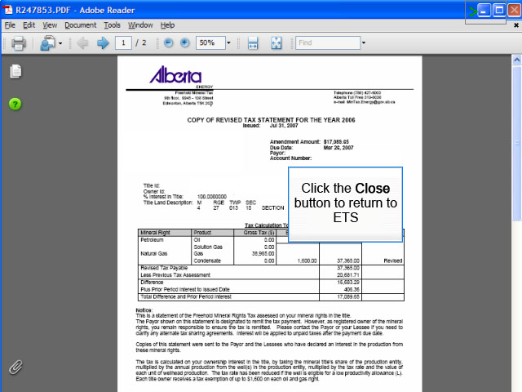
TSR5
Back to Tax Statement Retrieval

Slide 25
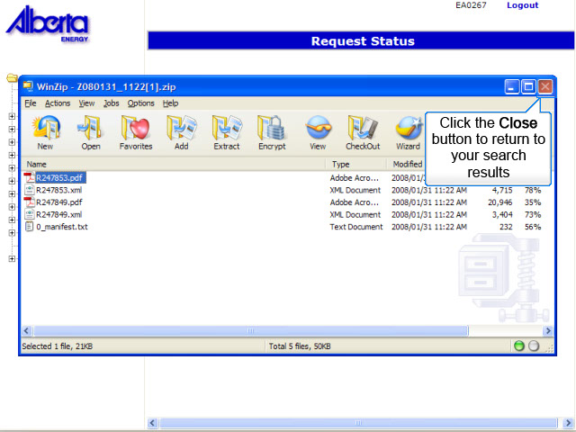
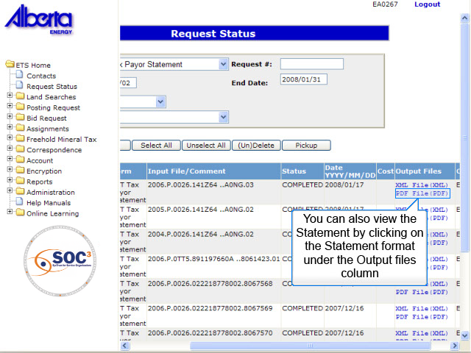
TSR6
Back to Tax Statement Retrieval

Slide 26
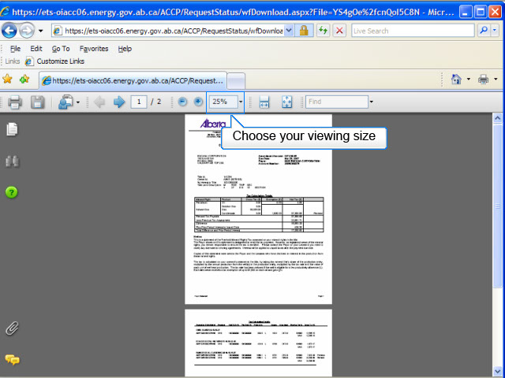
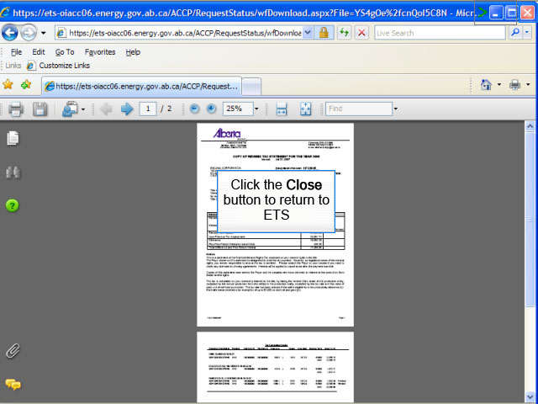
TSR7
Back to Tax Statement Retrieval

Slide 27
Tax Statements
This is a statement to the owner of the Freehold Mineral Rights Tax assessed on the mineral rights on the title. Copies of this statement are also produced for the Payor and the Lessees who have declared an interest in the production from these mineral rights.
The Payor shown on this statement is designated to remit the tax payment.
The Owner of the mineral rights, remains responsible to ensure the tax is remitted. Contact the Payor or the Lessee to clarify any alternate tax sharing agreements.
These statements are available in both PDF and XML formats. The following pages are an example of a Tax Statement.

Slide 28
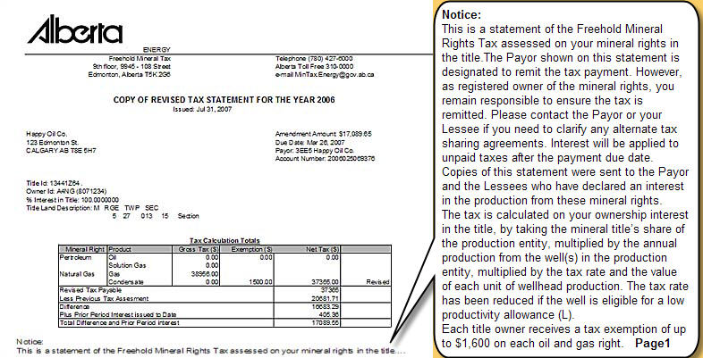
Tax Statement (Example)

Slide 29
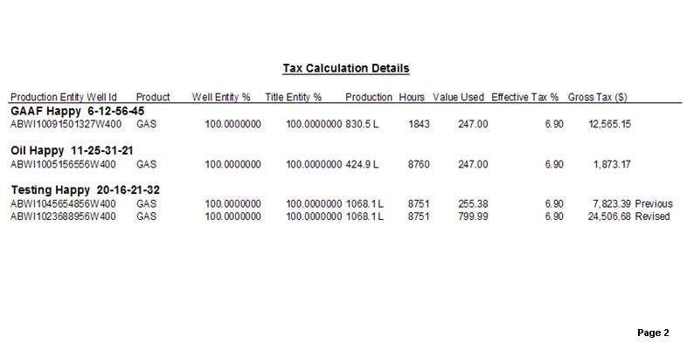
Tax Statement (Example)

Slide 30
Tax Statements Rules
The layout of the Lessee/Payor Statement is identical to the Owner Statement except:
  List of lessees will be printed only on Owner statement.
  Statement header for the Payor and Lessee will be “COPY OF TAX STATEMENT FOR THE YEAR YYYY” and the Statement header for the Owner will be “TAX STATEMENT FOR THE YEAR YYYY” for the Owner.
The exemption is grouped for SOL, CON and GAS. OIL has its own exemption.
Credit amounts are indicated in brackets.
If the statement contains amendment data, the following information will be displayed:
  Previous Tax Payable
  Revised Tax Payable
  Difference
  Prior Period Interest
  Total Difference and Prior Period Interest
If an adjustment (Tax Amendment) occurred, a new line will be printed with the word “Revised” to the right of it.

Slide 31
Payor Summary
The Payor Summary Statement displays all the titles where you are the designated Payor. This summary also displays the titles where there is no tax owing. The Payor Summary is available to the Payor only, and is available in XML and PDF format.
If you determine that you are no longer the Payor for a title, it is your responsibility to transfer the Payor Role to the new Payor. (See Module Freehold Mineral Tax - FMT Transfer Role). You MUST provide the new Payor with a copy of the current Tax Statement.
When remitting the Tax Payable, refer to the Statement of Account to submit the cover page with your payment.
The following page is an example for a Payor Summary.

Slide 32
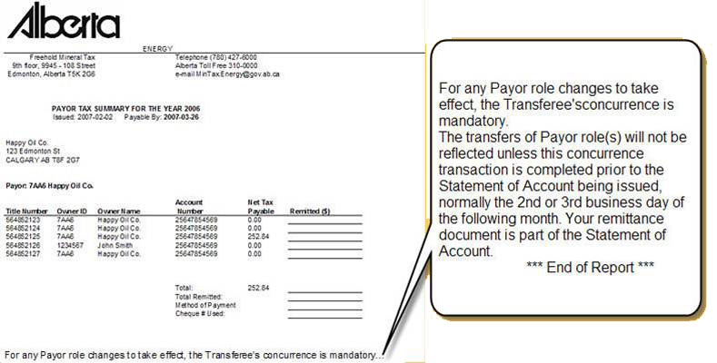
Payor Summary (Example)

Slide 33
Rules for Payor Summary Statements
Annual Tax Statements will be delivered in PDF and XML. The Payor Summary will report all zero tax calculated.
Note: Net Tax Payable amount = “Amount Payable” on the statement.
If a Client has Owner, Payor and Lessee roles, only the Owner Statement for that client will be generated.
If a Client has Payor and Lessee roles, only the Payor Statement for that client will be generated.
Clients with only Lessee roles will get Lessee statements.
Duplicate statements will not be generated.

Slide 34
Default Payor Rules
For newly associated titles: If a new FMT PE is linked to a Title where another FMT PE exists, the Payor will be carried forward from that FMT PE. For already active Freehold Titles, the Payor assigned remains assigned.
For corporate owned titles, that corporate entity's BA ID is assigned as Payor.
For Titles with more than one Corporate client as owner, the company with the greater percentage of ownership will be the defaulted Payor.
If there is more than one Corporate Owner and all have equal percentage of ownership, the FMT system will chose the payor.
If there are two Owners on a Title, one corporate and one non-corporate, then the corporate owner will be the Payor.
The PE Administrator will be the default Payor for all non-corporate-owned titles that do not already have a Payor assigned.
The Payor role may be transferred to a new Payor using the Transfer Role functionality and rules.

Slide 35
Tax Statement of Account
The Statement of Accounts gives a listing of all Tax Statements per account.
If the Net Tax Payable is zero, then no statement is sent.
If there is a balance owing there will be a monthly Statement of Account created.
The Projected Interest column is pre-calculated to the 25th of the Statement month.
You must include the cover page of this report in your remittance process.
The following pages are an example of a Statement of Accounts.

Slide 36
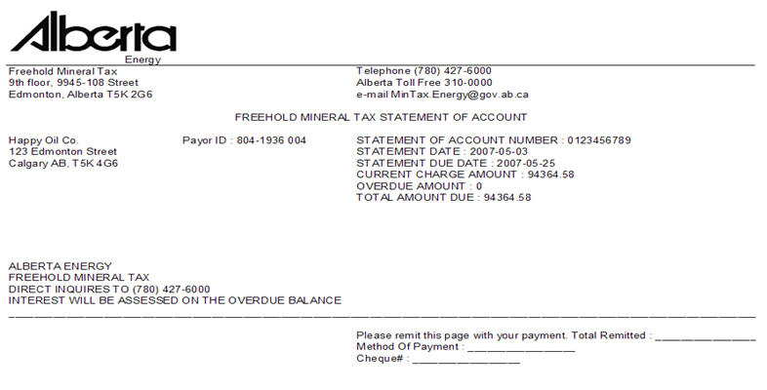
Statement of Account (Example)

Slide 37
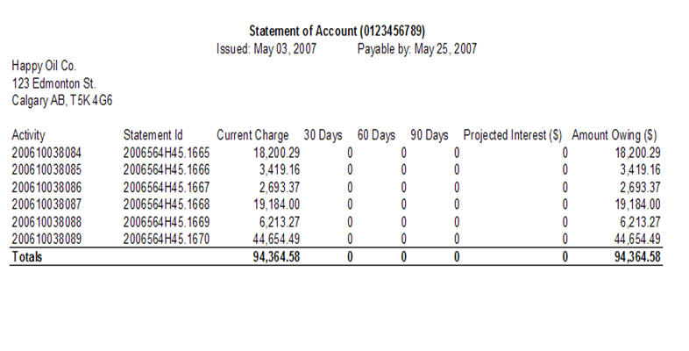
Statement of Account (Example)

Slide 38

Conclusion
Congratulations!
You have completed the ETS – Request Status & Tax Statement Retrieval Online Training Course
Please proceed to the subsequent courses detailing other functionality of the Freehold Mineral Tax application.
If you have any comments or questions on this training course, please forward them to the following email address:
Mintax.Energy@gov.ab.ca

