Slide 1
Welcome
Welcome!
The Work in Progress screen is accessed from the ETS main menu. The screen will be displayed when a user clicks on the ‘Work in Progress’ menu item.
This screen will display all requests assigned to the logged in user. It enables the user to search for, review and edit requests and to track their progress.
You may sort by any column on this screen to view information on FMT PE.
To the ETS – Work in Progress
Online Training Course

Slide 2
Revisions
Date | Revisions Type | Page Number
August 31, 2012 | Conversion | All

Slide 3

Introduction
In this module, you will learn how to:
Access the Work in Progress Screen
Retrieve files from the Work in Progress Screen
Concur, Reject, and Copy ETS files

Slide 4
Business Rules
Transfer requests will be visible to the Transferor and Transferee only.
Add Lessee Request Detail screen will be visible to the PE Administrator (Creator only).
Delete Lessee Request will be visible to the Creator only.
Unit Values requests will be visible to Lessee (Creator only).
Transferor clients in a Concurrence role can view the request when it is at ‘Concurrence’ status.
Transferee clients in a Concurrence role can view the requests at ‘Concurrence’, ‘Pending’, ‘Completed’ and ‘Rejected’ status.
Transferor clients in Creator role can view requests created by them regardless of the request status.
Transferor clients in Coordinator role can view requests created by the company regardless of the request status.
Transferor clients in Viewer role can view requests created by the company regardless of the request status.

Slide 5
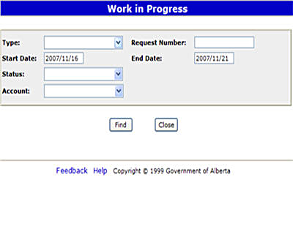
Accessing the WIP Screen
The WIP screen will display requests created in the last 6 months or based on user preferences.
You have selection options under the Type, Status and Account fields. Use the drop-down arrow to select the type of work to be viewed.
The Work in Progress results are listed in descending order from the most recent updated Request.
Requests with a WIP status of Pending will pick up and validate that request with Freehold Mineral Tax when the effective date equals current date.
Request with a WIP Status of Rejected are not updated and reasons are available by clicking on the request number.
Request with a WIP Status of Work in Progress are not complete or have not been submitted successfully.

Slide 6
Accessing the WIP Screen (Continued)
The REQUEST NUMBER (if known) is provided in the e-mail notification of a transaction, or on-screen when conducting a query.
A START and END date narrows the time frame during which the request was created. Dates defaulted depend on the Start and End dates in preferences screen. This is the only mandatory field.
The STATUS reflects the status of a WIP transaction. It can be left blank to select all Requests during the date range.
The Account can restrict the transaction to a particular creator, by selecting that ETS ID from the drop-down menu.
FIND retrieves the transactions identified.

Slide 7
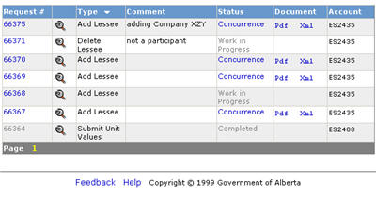
Review Search Results
The Work in Progress screen will provide active links for transactions i.e. role transfers or addition of a lessee that you are working on and have not been sent for concurrence, or transactions action.
Clicking on the Request Number will allow you to continue working on a transaction that has a status of Work In Progress.
Clicking on the magnifying glass will display a summary of that transaction.
If the status is Concurrence, click on the Pdf link to view the transaction, or the XML link to download the transaction.
Click on the Concurrence status to action the request.
TIP: Saving or Printing documents is useful for transactional backups.
TIP: Click on the Request Number to view reasons for rejection.

Slide 8
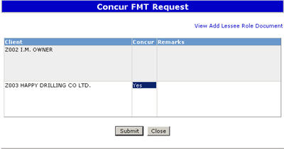
Concurrence
The Transferee or new lessee selects the Concurrence link to respond to the transaction request.
If you agree, select ‘YES’ from the ‘Concur’ dropdown on the ‘Concurrence’ screen to accept the transaction (i.e. Role Transfer), and click the Submit button.
The status of the Transfer is changed to ‘Pending’. If errors are found during validation then the request is set to ‘Rejected’.
The Pending status will be set to ‘Completed’ when an overnight job changes this status to ‘Completed’, and locks the Request (cannot be viewed).
The FMT system sends an email notification to the Transferor about the accepted transfer.
TIP: If no action is taken within 60 days, the system will reject the transfer.
TIP: The role remains with the Transferor until the status is completed.

Slide 9
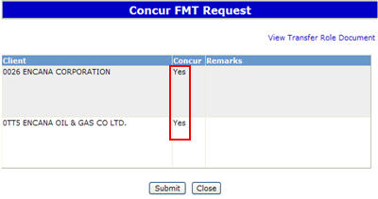
Reject Transition
A Transferee can select ‘NO’ from the ‘Concur’ dropdown on the ‘Concurrence’ screen to reject the transfer.
The request status is changed to ‘Client Rejected’, and an email notification is sent to the Transferor about the rejected transfer.
(Email: Your transfer request number 0001 has been rejected.)
If no action is taken by the Transferee, then the FMT system will change the request status to ‘Rejected’ after 60 days. An email notification will be sent to the Transferor.
A message box will appear when information/changes have been saved or submitted successfully.
TIP: Saving your file in a text format using Notepad will create the proper file format.

Slide 10
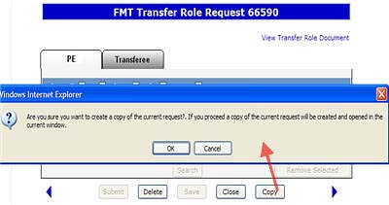
WIP Copy Transfer Request
More Information (Pages 11 to 15)
The logged in user finds a request to copy on ‘Work in Progress’ screen, and the system displays the requests.
Clicking on a Request Number opens up the Transfer Role request screen, with a COPY button option.
Selecting the Copy button creates a new request.
This is useful for creating a new transfer role transaction where the information is the same, but the dates may be different.
TIP: Saving your file in a text format using Notepad will create the proper file format.

Slide 11
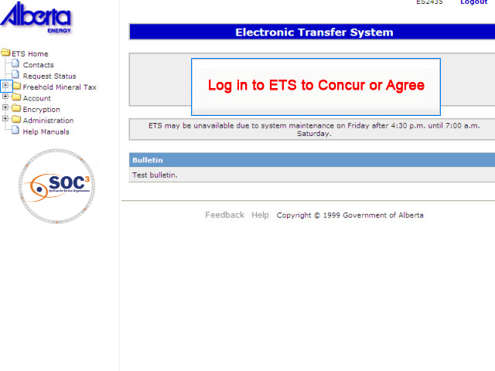
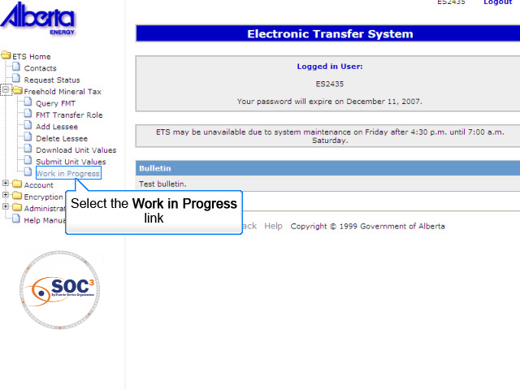
WIP 1 More Information
Back to WIP Copy Transfer Request

Slide 12
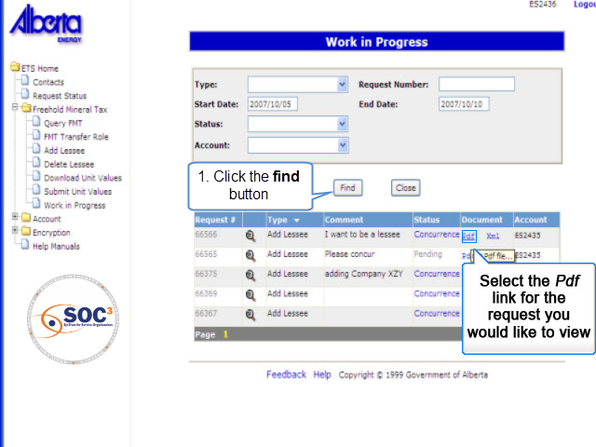
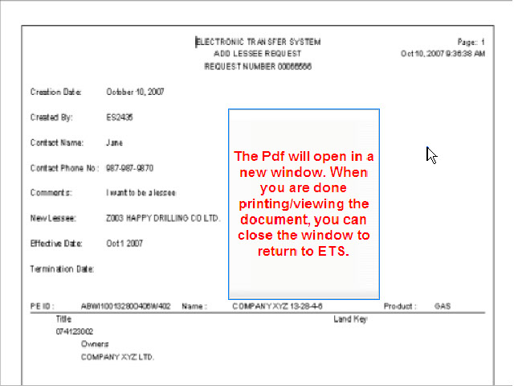
WIP 2 More Information
Back to WIP Copy Transfer Request

Slide 13
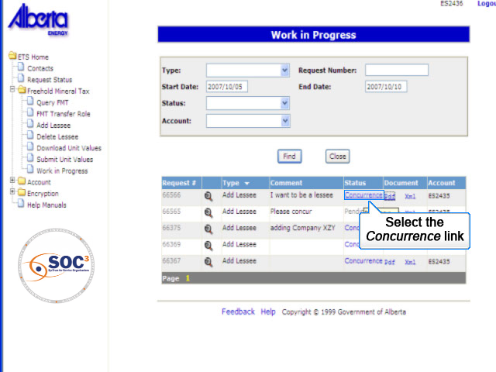
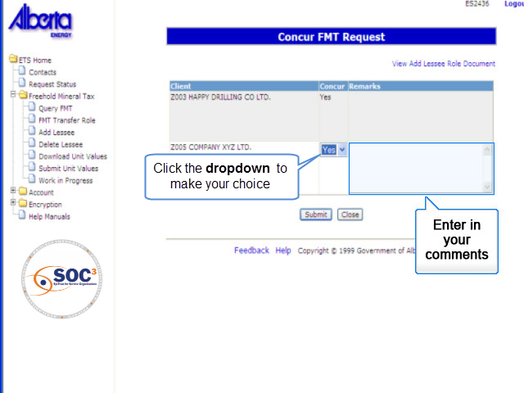
WIP 3 More Information
Back to WIP Copy Transfer Request

Slide 14
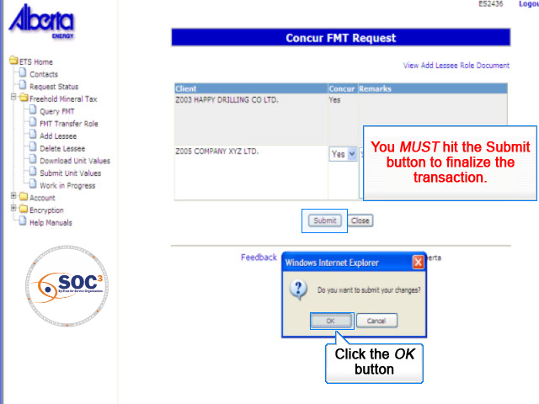
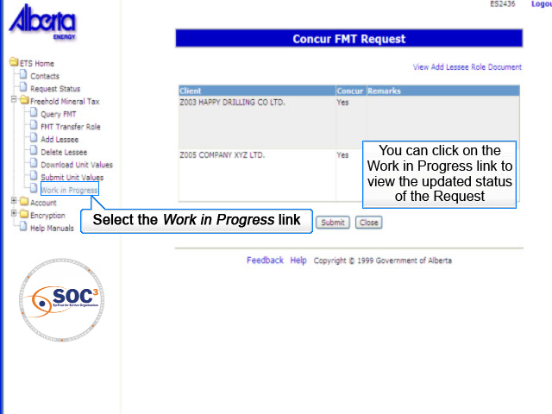
WIP 4 More Information
Back to WIP Copy Transfer Request

Slide 15
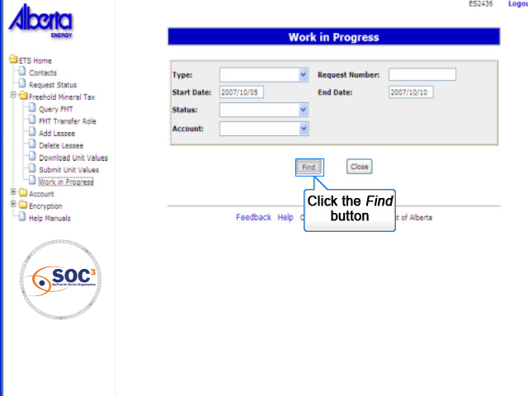
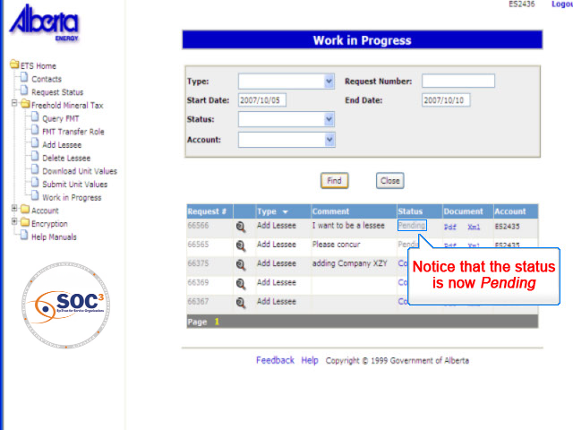
WIP 5 More Information
Back to WIP Copy Transfer Request

Slide 16

Conclusion
Congratulations!
You have completed the ETS – Work in Progress Online Training Course
Please proceed to the subsequent courses detailing other functionality of the Freehold Mineral Tax application.
If you have any comments or questions on this training course, please forward them to the following email address:
Mintax.Energy@gov.ab.ca

