Slide 1
Welcome
Welcome!
The Alberta Department of Energy provides Geoview as a mapping interface to enable users to locate geographic information in Alberta, as well as Edit land tools.
This module outlines the functionality of Edit lands for the purposes of adding lands or modifying lands in an OSR Application.
Prerequisite: Please refer to the Geoview Overview module for a full review of the mapping tools offered.
To the Geoview - Editing for OSR Applications
Online Training Course

Slide 2
Revision
Date | Revisions Type | Page Number
May 30, 2013 | Updates | All
July 17, 2016 | Updates | All

Slide 3
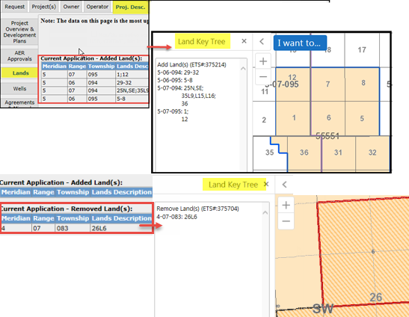
Introduction
In this module you will learn how adding Schemes affects the application lands, access and use the Edit land tools used to update the lands in the application.
The following are reviewed:
Map (Geoview)
  Scheme/Application Lands
  Launch Map
  Edit Tools
Editing Current Application Lands.
  Defaulted Lands
  Edit Tab
  How to Add Land(s)
  How to Remove Land(s)
  - from current application
  How to request lands for removal from an existing approved project
Reference the module “Geoview Syst.Overview” for Map tool options.
  Note: As this course demonstrates the use of the Geoview Edit tools, the data in some instances may not portray the actual Crown or Freehold ownership.

Slide 4
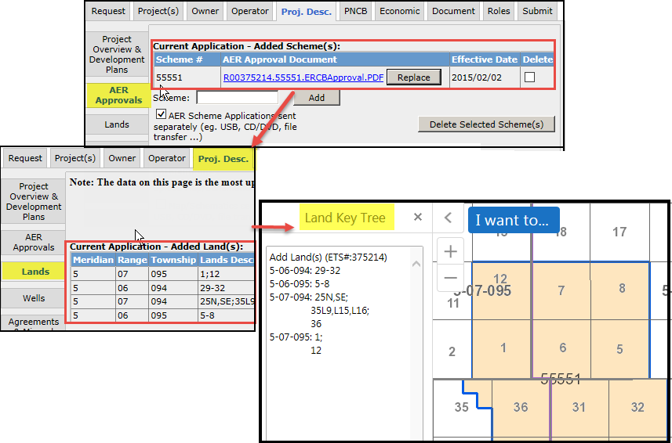

Current Application – Scheme/Land and Map (Geoview)
Schemes added to the current application will be used for determining the lands available.
By default, if a scheme is added which has available lands both the Land Tab, and the Map will be updated.
The defaulted lands are limited to the Development Area of the scheme record.
Lands are recorded in the current application as either;
Added lands, or Removed lands.
Added land(s) – these are lands treated as application lands.
Removed land(s) – these are lands which are part of an existing OSR Project, PILL, Pending Project, or Pending New Project which have been selected by the applicant for removal in the current application.
Application lands will be defaulted to those lands which are in the added Scheme(s) Development Area, and are not 100% freehold, or already in an OSR Project, Pending Application, or Pending New Project.

Slide 5
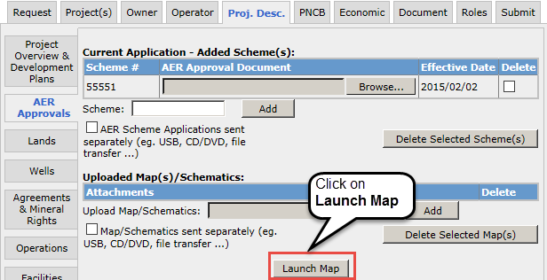

AER Approvals (Schemes) - Launch Map
The map can be launched from the Project Description tab / sub-tab AER Approval. The Launch Map function is located at the bottom of page.
The map will provide a graphical representation of the subject application by displaying all associated scheme land as well as the application ‘Added Lands’ (if applicable).
For Amendments or Amalgamations, additional information would be provided for the Approved Project(s), Pending Applications or Pending New Projects.
Use the map Edit tools to modify lands for the Current Application.
The following pages demonstrate how to edit the application lands.
Launch Map is only available to the user who represents the Primary Owner, and has the role of Creator or Delegate. For a Delegate to make edits, they must be assigned to the application.

Slide 6
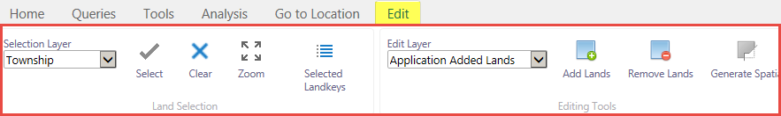
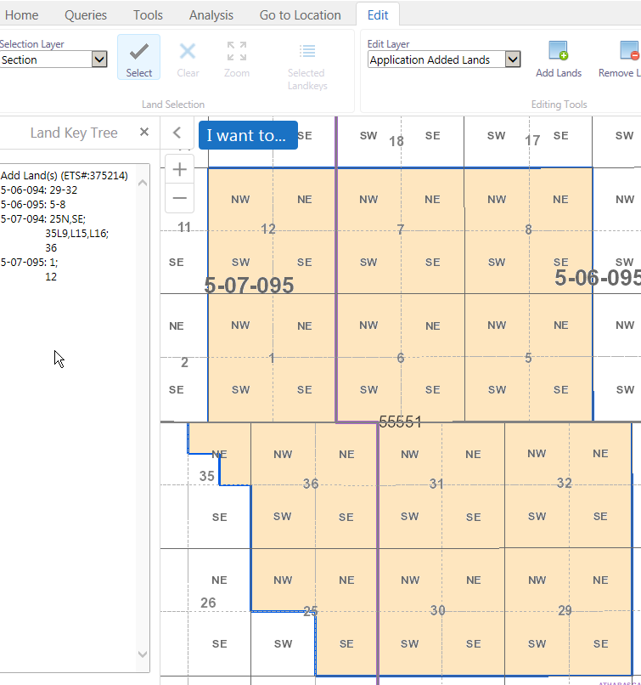
Map – Initial Map View
Edit tool function will be enabled if;
Application has Project, Potentially Includable lands & Leases (PILL), or available lands via the added Scheme,
User represents the Primary Owner,
And
c) User is the Creator, or assigned Creator/Delegate.
Left Panel of the map screen defaults to the
Land Keys in the application. If there are no lands added, the panel will be empty.
* details in Geoview Overview module

Slide 7
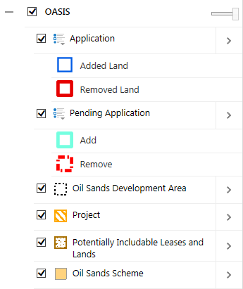
Geoview – Map Contents - Application Layer
The Map Contents panel will display layers specific to the current project application under the heading OASIS. Each layer can be turned On or Off.
The layers under OASIS are:
Application – represents the lands recorded for the Current Application.
Added Land – land added in the Current Application.
Removed Land - lands to be removed from an existing record; eg. Approved OSR Project, Approved PILL,
Pending New Project, or Pending Application.
Pending Application– displays those lands requested under a prior submitted application on the same project.
Project– displays the existing OSR Project.
Potentially Includable Leases and Lands – displays those lands approved as PILL lands under the existing OSR Project.
Oil Sands Scheme – displays the AER Approval lands
Oil Sands Development Area – displays the Development Area lands for the AER Approval.

Slide 8
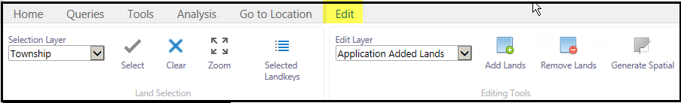
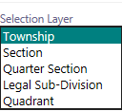


GeoView - Toolbar - Edit Tab
Use these tools: | To:
 | Defines at which level the lands can be selected. Eg. Section, ¼ section, LSD, or quadrant.
 | Activates the map selection tool. Upon activation, a R-mouse click will either select or unselect lands. (1st click is to select, 2nd click on same lands is to unselect).
 | Current selected lands are cleared.

Slide 9




GeoView - Toolbar - Edit Tab (Continued)
Use these tools: | To:
 | Edit Layer: Used to identify what land record is being modified. a) Application Added Lands – lands that are newly applied for lands. b) Application Remove Lands – lands being requested for removal from an existing record (eg. Project, Pending application, PILL)
 | Add Land(s) – Action to add the selected lands to the Edit Layer.
 | Remove Land(s) – Action to remove the selected lands from the Editing Layer
 | Displays the Selected Land keys in the Left panel. [ used when a previous instance was closed ]

Slide 10
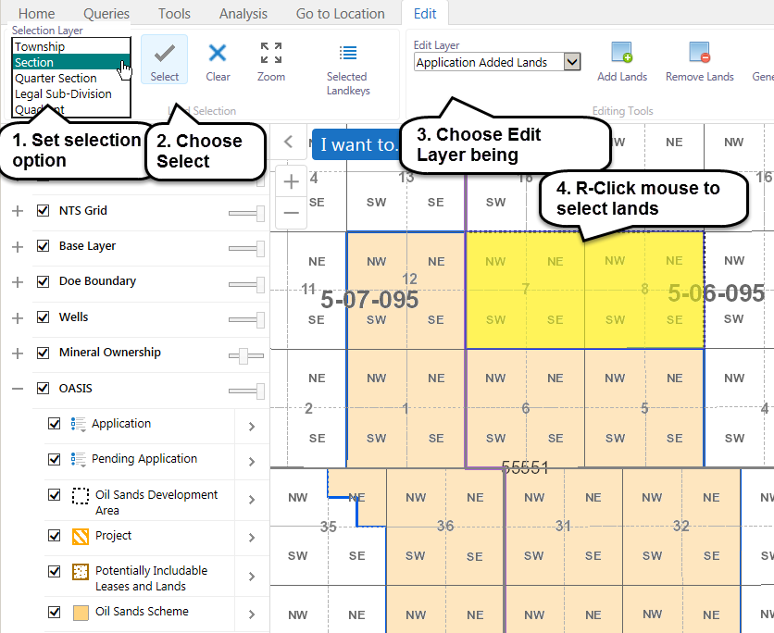
Map – Add Lands to the Current Application
Lands can be added to the application by way of the ‘Application Added Lands’ Edit Layer.
Steps:
Set Selection layer
Click on the Select tool
Choose Appl.Added Lands
[Edit Layer]
Click on the map to select Land(s)
Click Add Lands

Slide 11
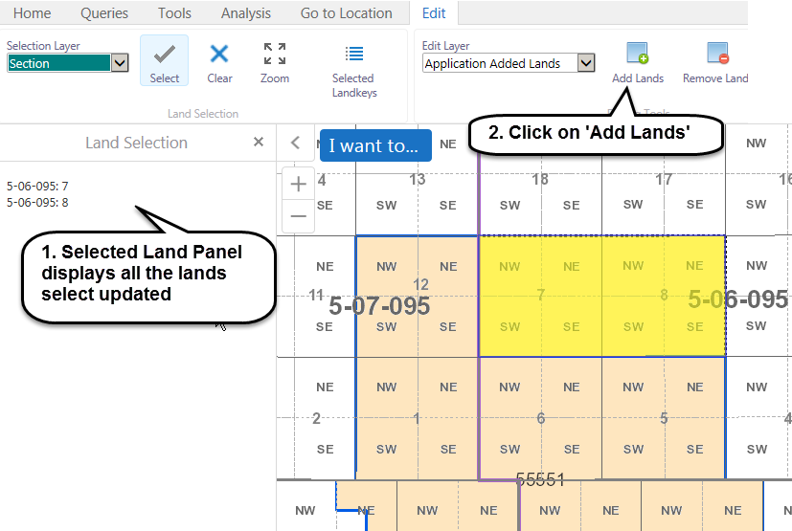
Map – Add Lands to the Current Application (...continued)
Selected Lands will be identified in Information Panel under
Land Selection
After Land has been selected, click on Add Land(s)

Slide 12
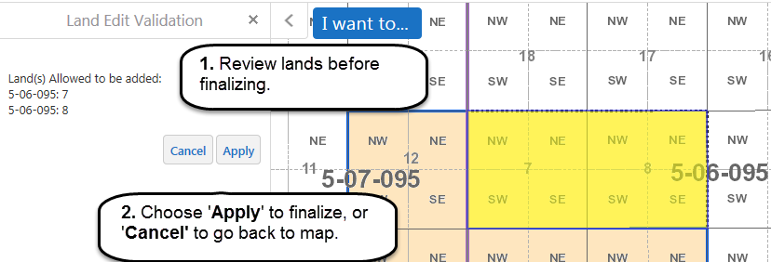
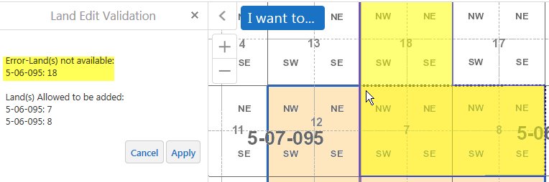
Map – Add Lands to the Current Application (...continued)
After clicking on Add Land(s), a validation screen is displayed.
Click on Apply to finalize the lands being added, or Cancel to return back to map.
Note: Validation will identify whether selected lands are allowed, if not an error message will appear.

Slide 13
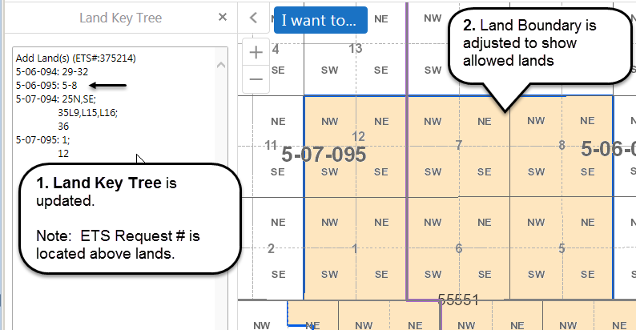
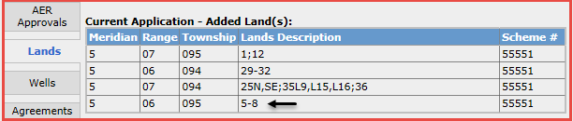
Map – Add Lands to the Current Application (...continued)
After Applying the land changes;
the Map information (Land key tree & Land boundary) is updated
and
b) the Lands tab in the application is updated.

Slide 14
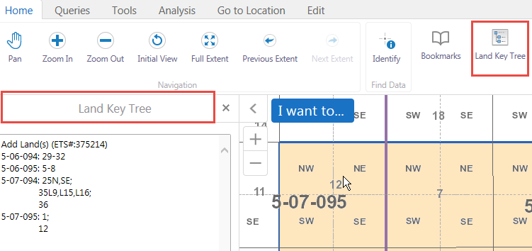
Map – Land Key Tree (sort order)
The Land Key Tree will display those lands which are in the application at the time of last saved action and land boundary will be adjusted accordingly.
Land Keys sort order are as follows:
Meridian
Range
Township
Sections
Quarter Sections
Legal Sub Divisions
Quadrants
The icon for the Land Key Tree may be selected to display the lands.

Slide 15
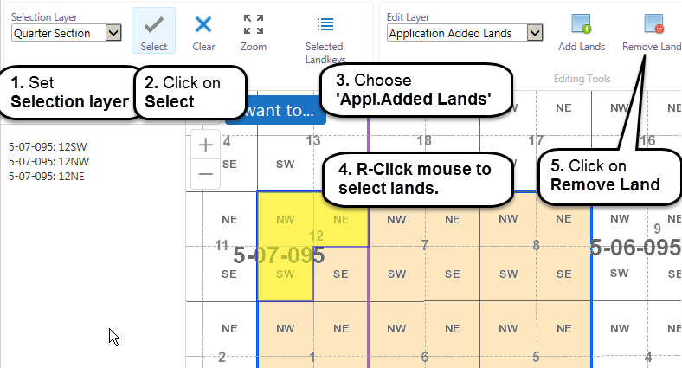
Map – Remove Lands from the Current Application record
Lands which are recorded in the application as Added Lands can be removed.
Steps:
Set Selection layer
Click on the Select tool
Choose Appl.Added Lands
[Edit Layer]
Click on the map to select Land(s)
Click Remove Land

Slide 16
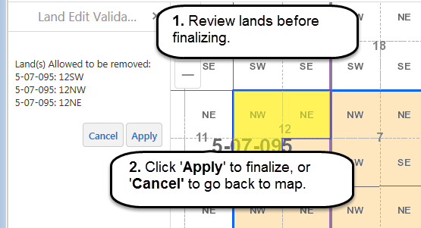
Map– Remove Lands from the Current Application record (...continued)
After clicking on Remove Land(s), a validation screen is displayed.
Click on Apply to finalize the lands being removed, or Cancel to return back to map.
Note: Validation will identify whether selected lands are allowed for removal, if not an error message will appear.
Cancel will close the popup window and return back to edit session.

Slide 17
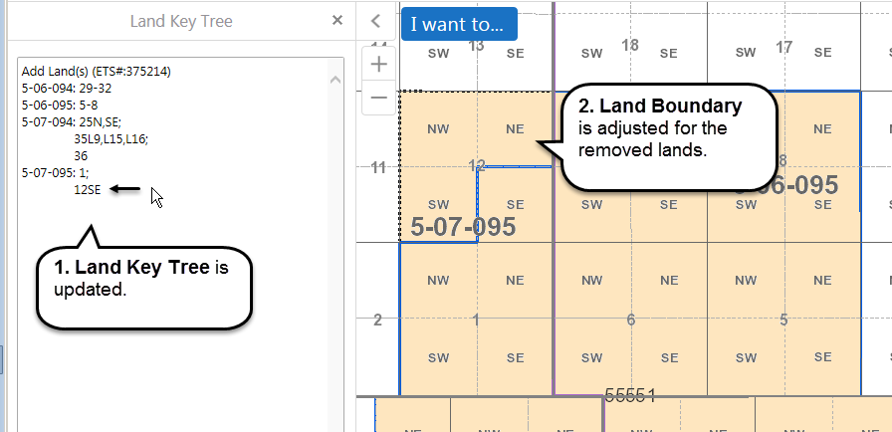
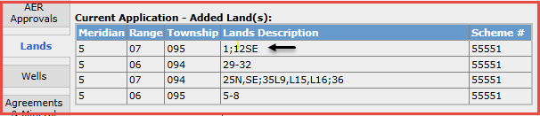
Map– Remove Lands from the Current Application record (...continued)
After Applying the land changes;
the Map information (Land key tree & Land boundary) is updated
and
b) the Lands tab in the application will is updated.

Slide 18
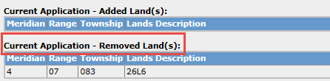
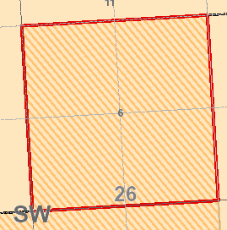
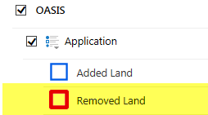
Map – Amendments – Existing Approval project lands requested for removal
Lands in an approved project may be requested for removal in an amendment application.
The lands requested for removal are recorded;
under the Lands Tab as Current Application – Removed Lands,
and
in the map as Removed Land; these lands with have a Red boundary.

Slide 19
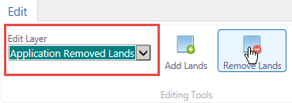
Map – Amendments – Existing Approval project lands requested for removal (Continued)
Land edits, for the purpose of removing lands from and an existing approved project need to be made using the Edit layer “Appl.Removed Lands”.
Since the ‘Appl.Removed Lands’ record represents lands to be removed from an existing approved project; your land selection on the map may be followed by the action;
- ‘Add lands’ to record additional lands to be removed from the existing project.
or
‘Remove lands’ to record less lands to be removed form the existing project.
Cancel will close the popup window and return back to edit session.

Slide 20
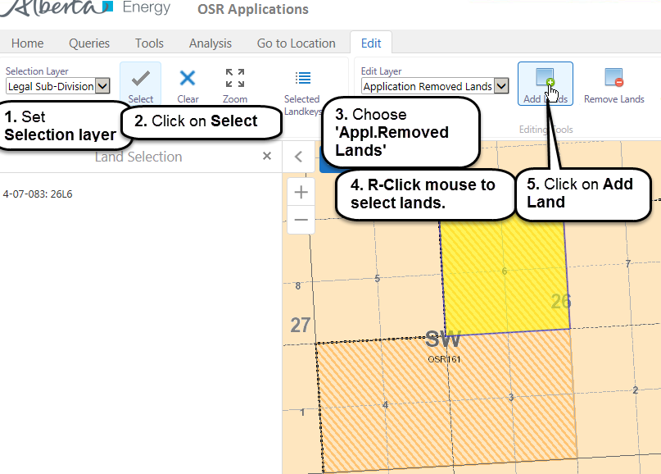
Map – Amendments – Existing Approval project lands requested for removal (Continued)
Land which are recorded in an approved project may requested for removal. These lands would be identified under the Edit Layer “Application Remove Lands’.
To add approved project lands to the Remove land record follow these steps.
Steps:
Set Selection layer
Click on the Select tool
Choose Appl.Removed Lands [Edit Layer]
Click on the map to select Land(s)
Click Add Land

Slide 21
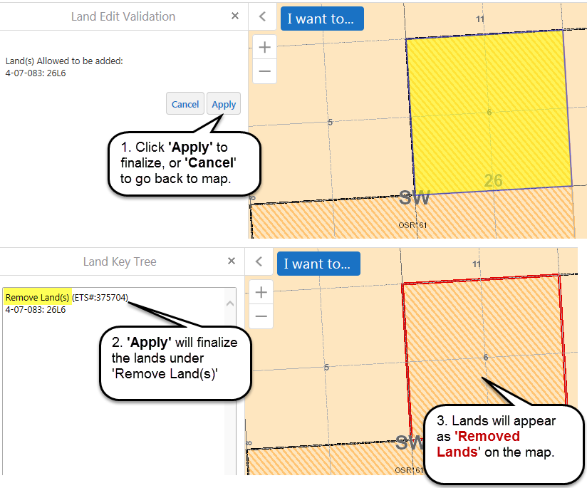
Map – Amendments – Existing Approval project lands requested for removal (Continued)
After clicking on Add (to the Removed Land record) a validation screen is displayed.
Click on Apply to finalize the lands being removed, or Cancel to return back to map.
Note: Validation will identify whether selected lands are allowed for removal, if not an error message will appear.
Cancel will close the popup window and return back to edit session.

Slide 22
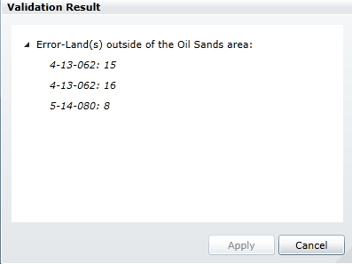
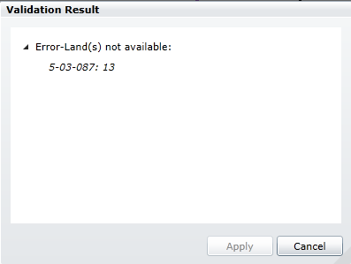
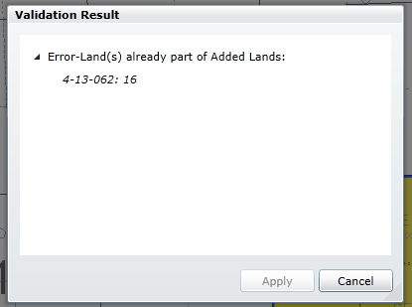
Validation Results - Errors
While editing, if an action is performed which is contrary to the Business Rules allowing the action, a warning window will appear. Here are some examples:

Slide 23
Conclusion
Congratulations!
You have completed the Geoview – Editing for OSR Applications Online Training Course
Supplemental training materials are available and can be accessed from the Alberta Energy Online Learning home page under:
Interactive Map – GeoView System Overview
Oil Sands – Create New OSR Project Application
Oil Sands – Create an Amendment OSR Project Application
If you have any comments or questions on this training course,
please forward them to the following email address:
ENERGY-MOGISSupport@gov.ab.ca

