Slide 1

Welcome
Geothermal Continuation – Continuation: This is the process to complete and submit an Online Continuation Application via ETS. The process begins with the creation of a new application through to submission. The application progresses through various stages (statuses) until completion.
To the ETS – Geothermal Continuation: Continuation
Online Training Course

Slide 2
Revisions
Revisions Table
Date | Revisions Type | Page Number
September 2025 | Initial Creation | All

Slide 3
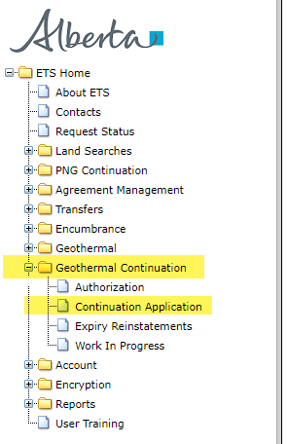
Introduction
In this module you will learn how to:
Create and submit an Online Continuation Application.
Cancel or withdraw an Online Continuation Application.
Review and respond to a notice.
View a final document.

Slide 4
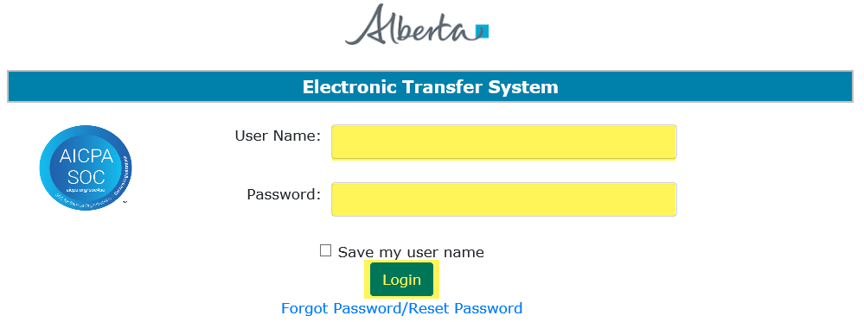
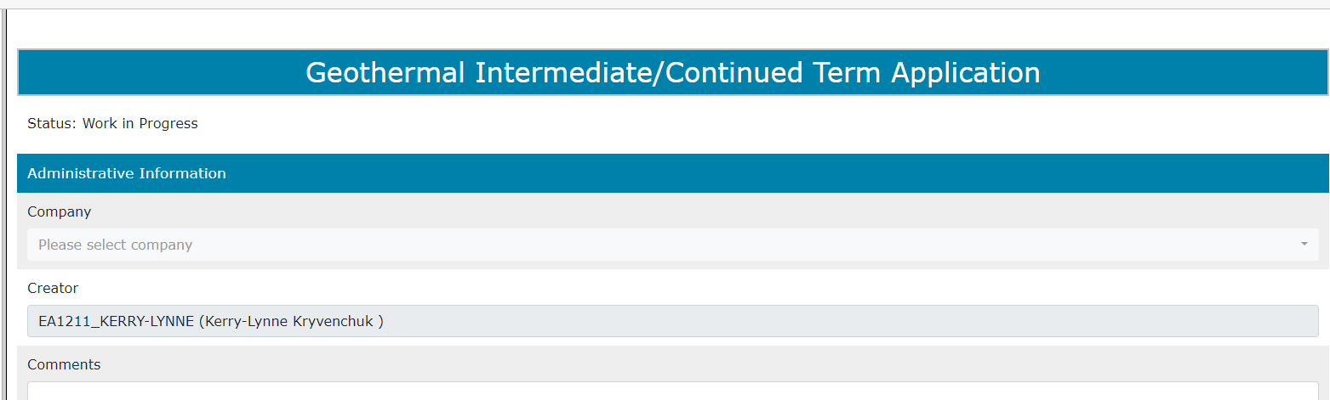
Login to ETS
1. Login to ETS with your user name and password
2. Expand Geothermal Continuation
3. Select Continuation Application

Slide 5
Create and Submit a Continuation Application
You must have the Creator role to create or amend an application and the Submitter role to submit an application.
All the lands (or a portion of lands) within your application must be associated with an extension or continuation.

Slide 6
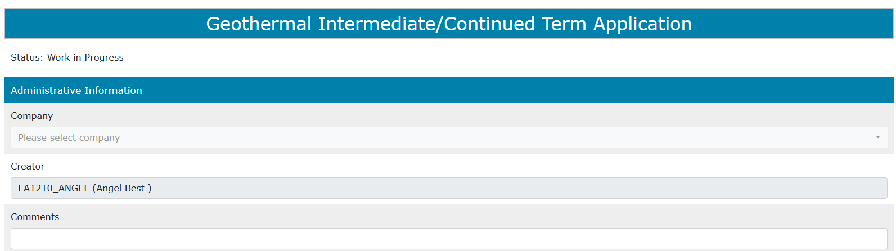
Create Continuation Application – Administrative Information
When an application is created, its status is “Work in Progress.”
1. Select Company Name and optionally enter Comment

Slide 7
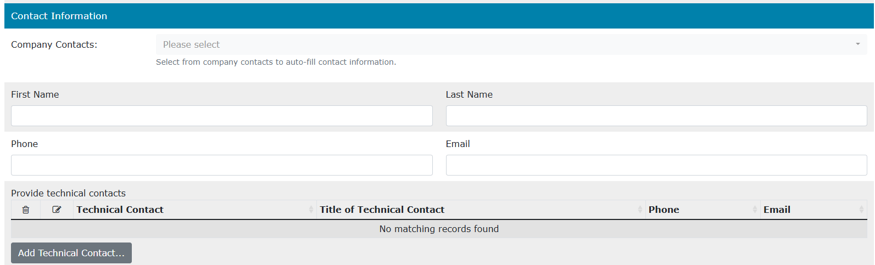

Create Continuation Application – Contact Information
2. Select Contact Information and edit if required
3. Click on Add Technical Contact (optional)
The contact information will auto-populate but you can change the information. Use the Save button after completing information in each section of the application.

Slide 8
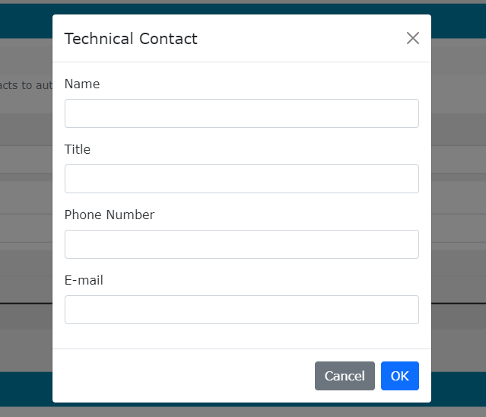
Create Continuation Application – Contact Information
– Add Technical Contact (optional)
4. Enter Technical Contact (all fields are required)
5. Click Ok

Slide 9
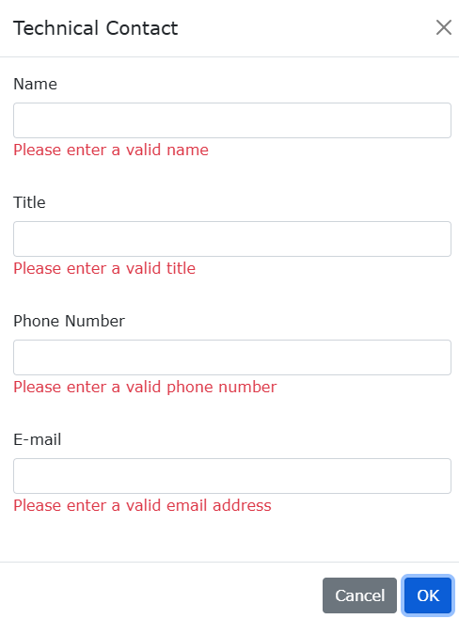
Create Continuation Application – Administrative Information
– Add Technical Contact
Error
Message if required information is missing
If information is not entered into a mandatory field, or the application validation fails, the screen will display a red error message. The application must be corrected and then you can try to save again.

Slide 10
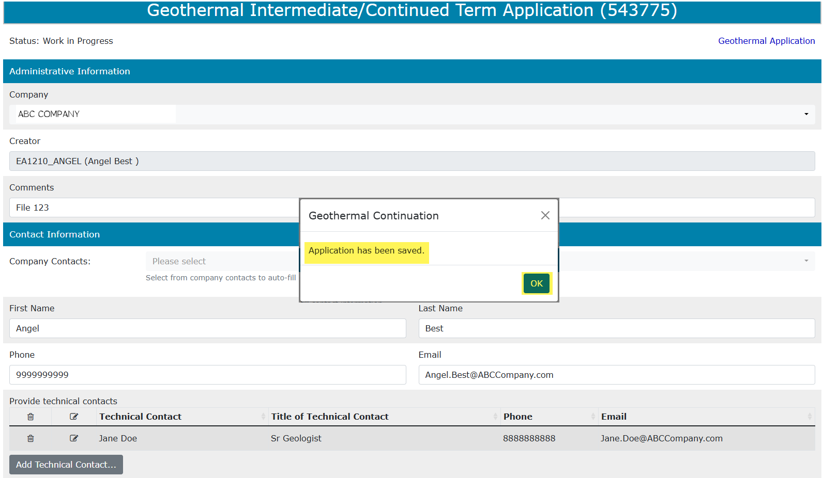
An ETS Request number for the application is generated and displayed upon successful Save.
At this time, the application can be retrieved and opened from your Work In Progress list.
5. Click Save

Slide 11
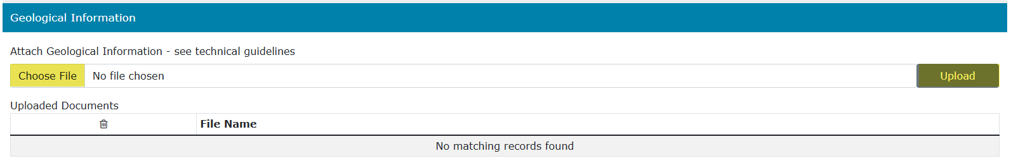
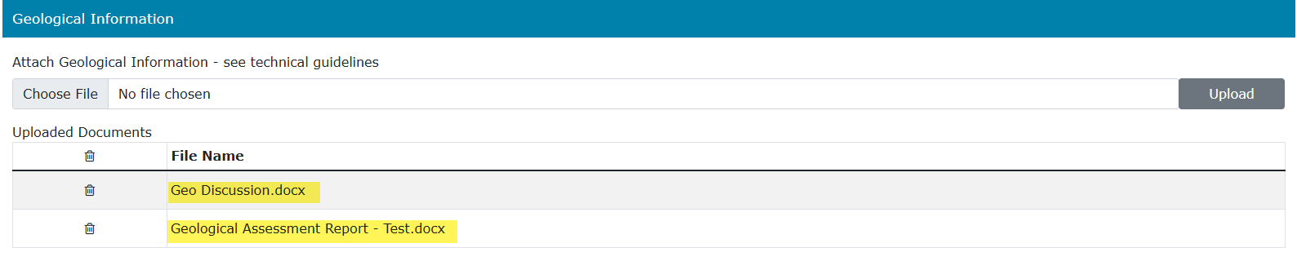

Create Continuation Application – Geological Information
6. Select Choose File and then Upload to attach a geological discussion and data. Ensure you have saved the application before attaching
If needed, use this button to remove an attached document.
To view a document already attached, click on the link.
A geological discussion must always be attached and submitted with an application. It needs to be text only and must not include any maps or diagrams. It must be a PDF or Word document. All technical data must be submitted through ETS.
Any data submitted by another company on your behalf must be authorized and received within 5 business days of the application submission, or your application will be reviewed without.

Slide 12
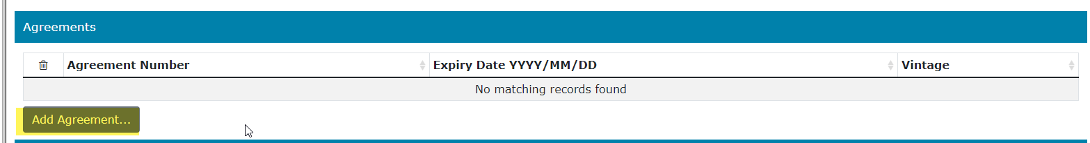
Create Continuation Application – Agreements
– Add Agreement
1. Click on Add Agreement

Slide 13
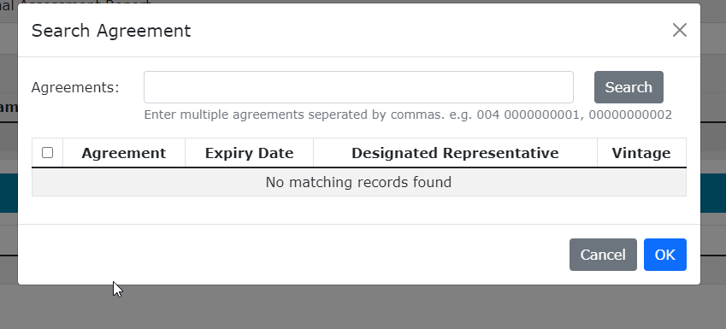
Create Continuation Application – Agreements
– Add Agreement (continued)
3. Click Search
2. Enter agreement(s), separate the agreements by a comma
6. Click OK

Slide 14
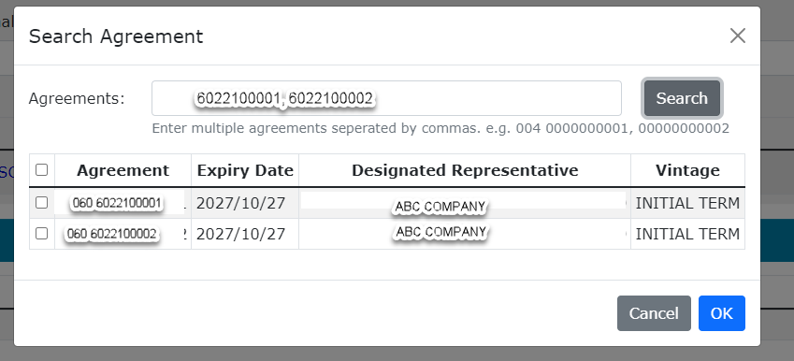
Create Continuation Application – Agreements
– Add Agreement (continued)
4. Click on Checkbox to select all agreements or each individual agreement
5. Click OK

Slide 15
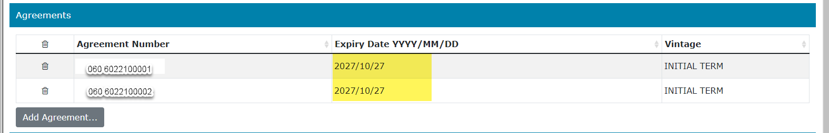
Create Continuation Application – Agreements
– Add Agreement (continued)
If needed, use this button to remove the added agreement.
After an agreement is added, the Expiry Date is automatically populated.

Slide 16
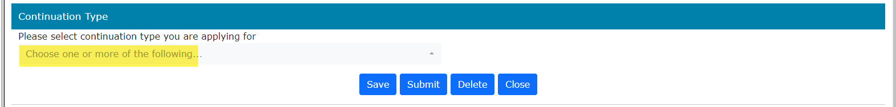
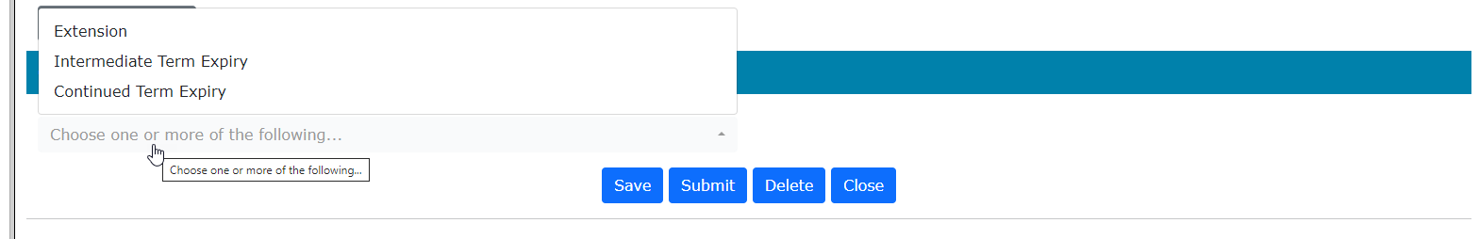
Create Continuation Application – Continuation Type
Once you have added your agreement numbers then you need to add what type of application you are submitting. Note, the screens below are for an initial term agreement expiry.
Click on “Choose one or more of the following" and a popup box will appear
You can apply for an Extension for either an initial, intermediate or continued term agreement.
You can apply for Intermediate Term Expiry IF your agreement is in its initial term.
You can apply for Continued Term Expiry IF your agreement is in it’s intermediate or continued term.

Slide 17
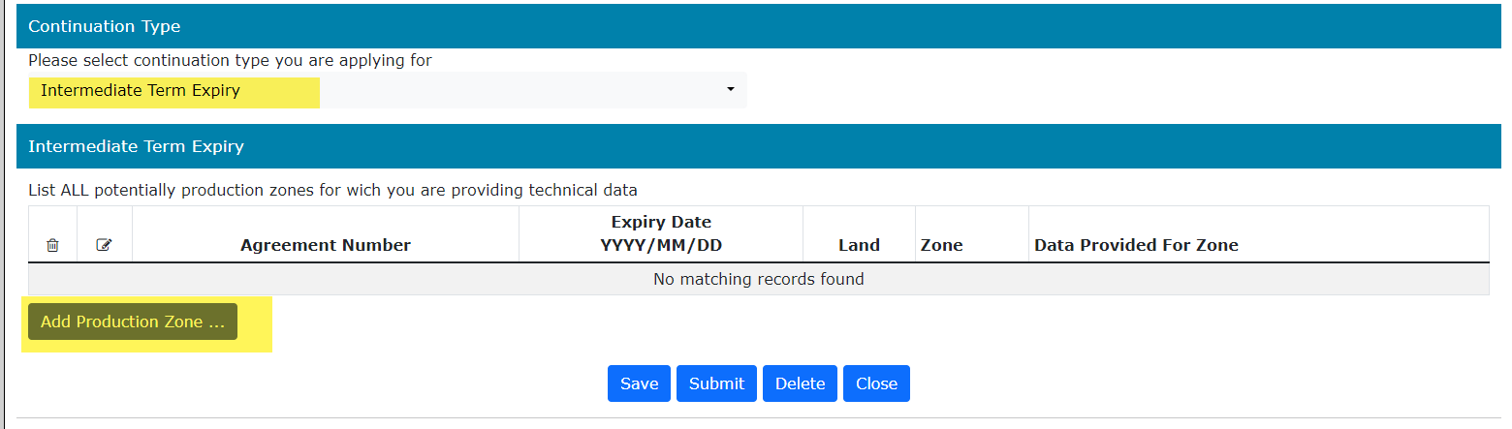
Create Continuation Application – Continuation Type
– Add Productive Zone
Sample Intermediate Term Expiry
Once your application type is added, you can now add the productive zone for each agreement by clicking on Add Productive Zone.

Slide 18
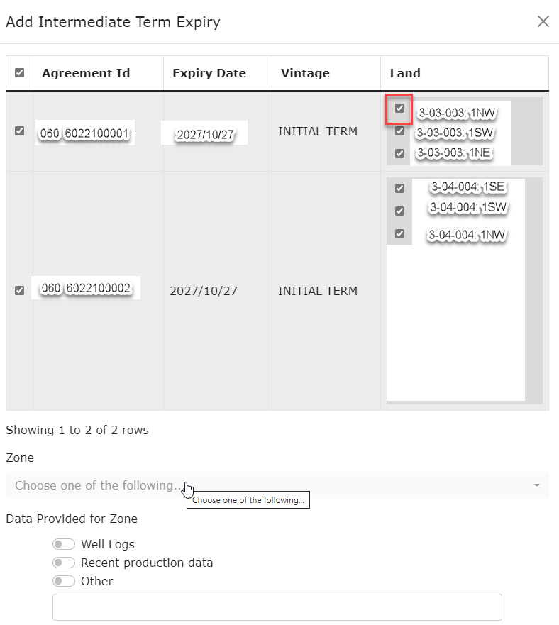
Create Continuation Application – Continuation Type
– Add Productive Zone (continued)
You can add different zones for different pieces of land by checking off the box.

Slide 19
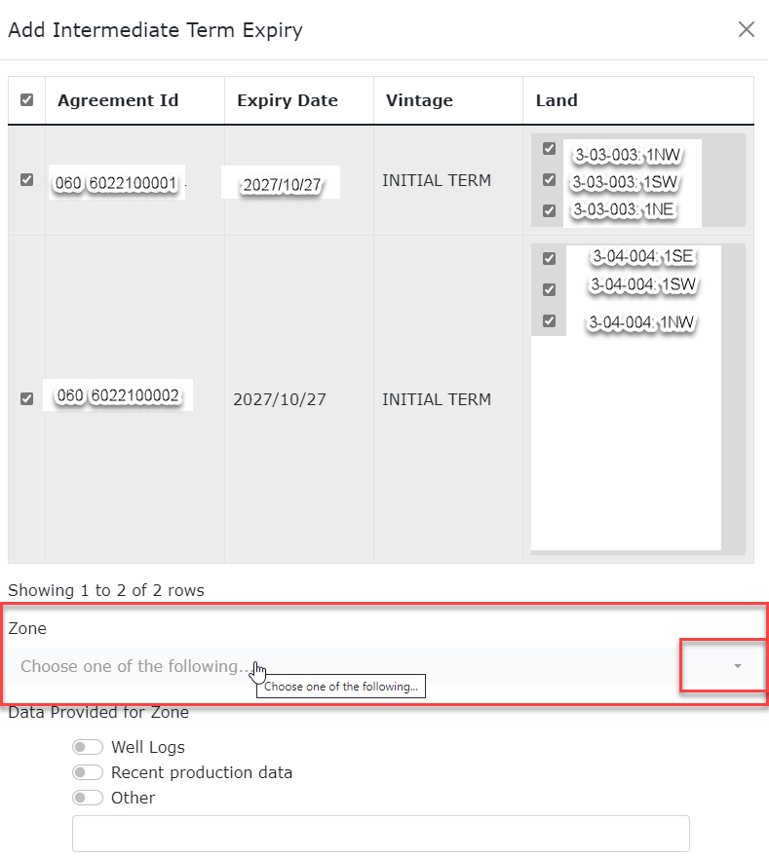
Create Continuation Application – Continuation Type
– Add Productive Zone (continued)
Choose the zone by clicking on the arrow.

Slide 20
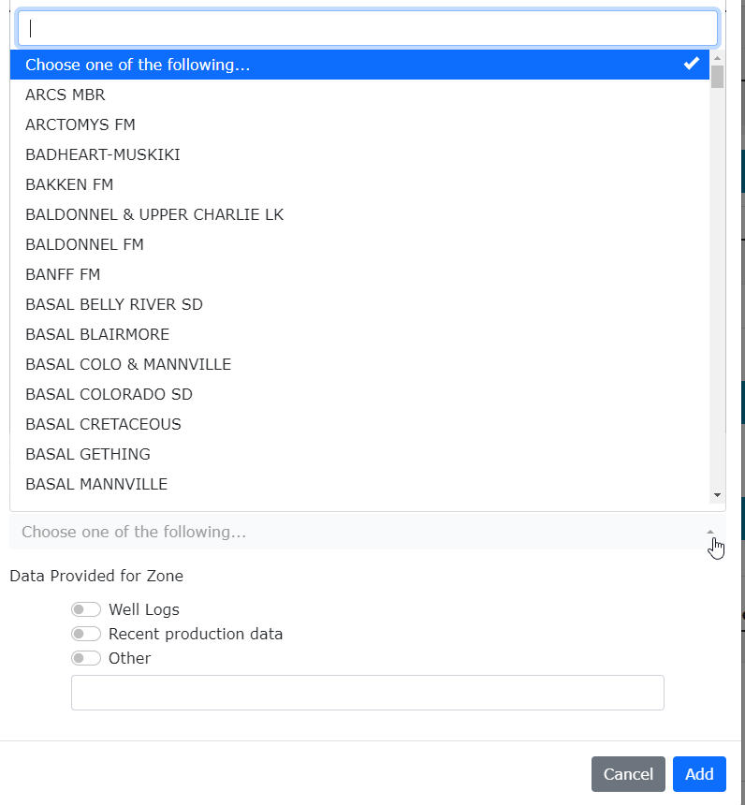
Create Continuation Application – Continuation Type
– Add Productive Zone (continued)
The zones available will display in a popup box, you can type in the name or pick from the list of zones.

Slide 21
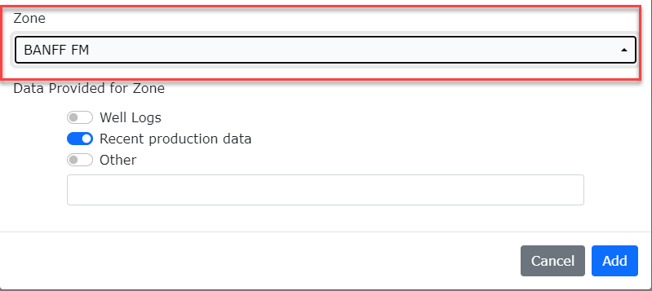
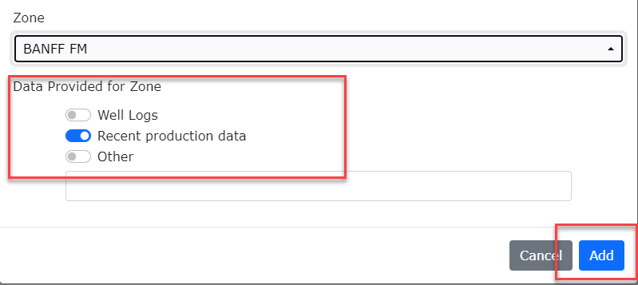
Create Continuation Application – Continuation Type
– Add Productive Zone Continued
Once you choose your zone you must choose one of the following for the Data Provided for Zone. Then click Add.

Slide 22
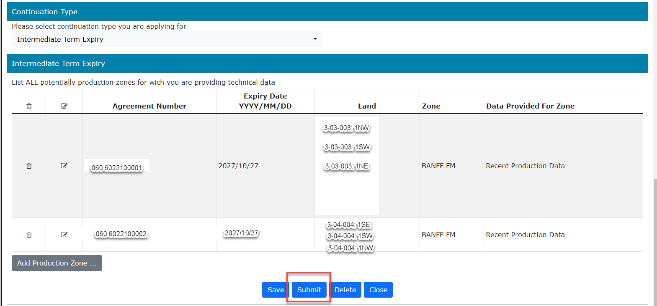
The application is now complete, and you can click Submit. Once you have submitted your application the status will change to Submitted and then Verifying. Once the status changes to Processing it means that our internal system has the application, and it will be processed in due course. If there are any errors the status will change back to Work in Progress. The status must be at Processing to be considered received by Alberta Energy and Minerals.

Slide 23
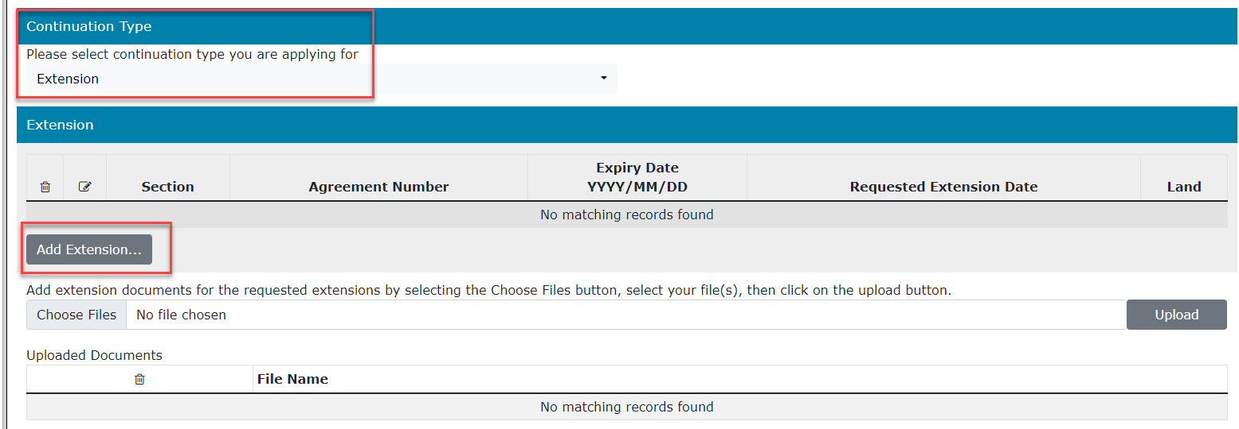
Create Continuation Application – Extension Information
– Add Extension

Slide 24
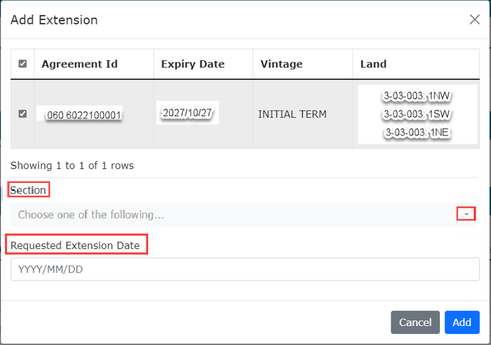
Create Continuation Application – Extension Information
– Add Extension (continued)

Slide 25
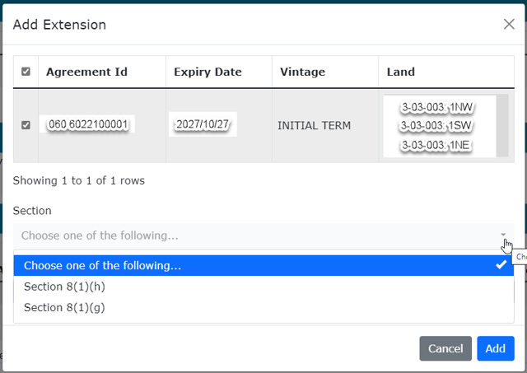
Create Continuation Application – Extension Information
– Add Extension Section Type

Slide 26
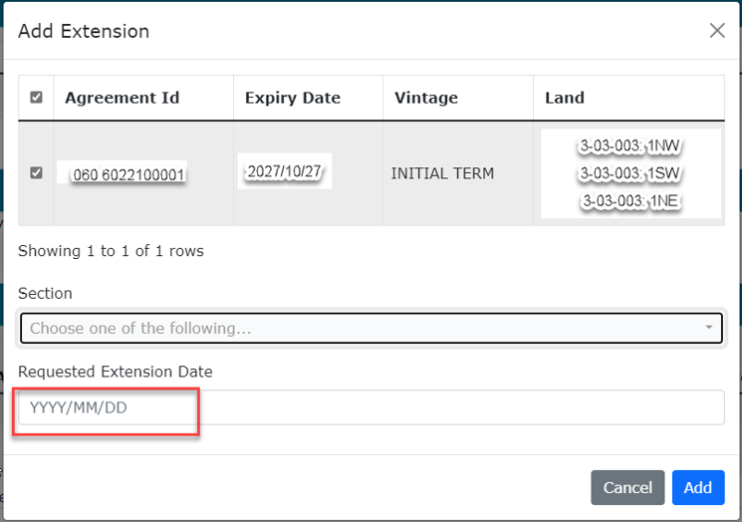
Create Continuation Application – Extension Information
– Add Extension Date
An extension date must be greater than the current expiry date.

Slide 27
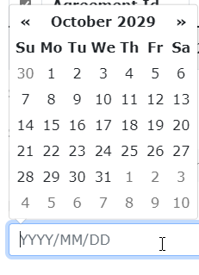
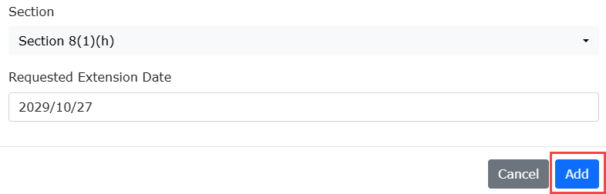
Create Continuation Application – Extension Information
– Add Extension Date

Slide 28
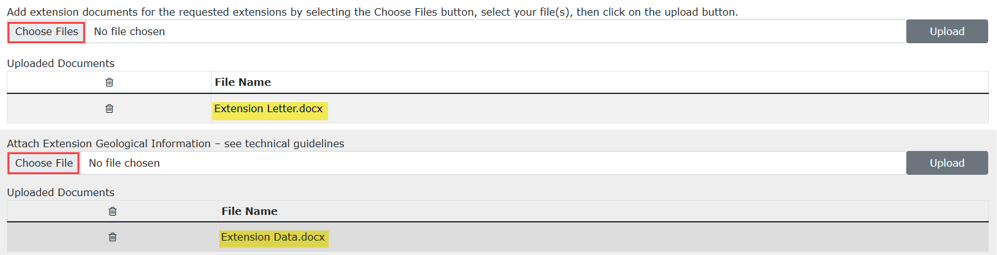
Create Continuation Application – Extension Information
– Add Extension Document and Geological Information
1. Click Choose Files to attach an extension document
2. Click Upload
3. Click Choose Files to attach supporting geological information/data for the extension request
4. Click Upload
An Extension Document, which contains the reason for needing the extension, must be attached when requesting an extension or an error will display upon submit.
Geological Information is supporting technical information for your extension request and is optional.

Slide 29
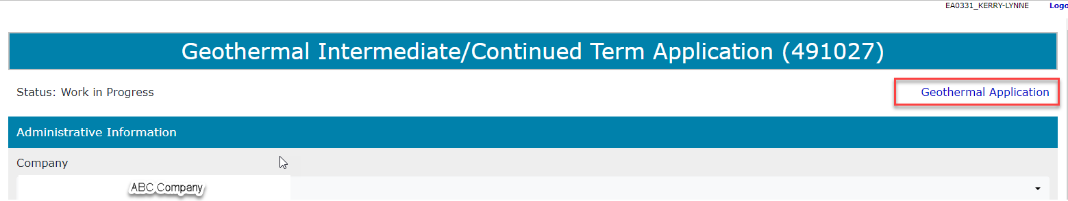
View Geothermal Continuation – Geothermal Application
The Geothermal Application is a PDF document which details the information in your application.
If an application contains multiple agreements, before it is submitted, all the agreements will show on this document. Once the application has been submitted, ETS separates the agreements, and each agreement will be assigned a separate Geothermal Application/ETS Request.
Do not mail a printed application to Alberta Energy and Minerals.
To view the document, click on this link.
The Geothermal Application can be viewed at any time after the application has been saved.

Slide 30
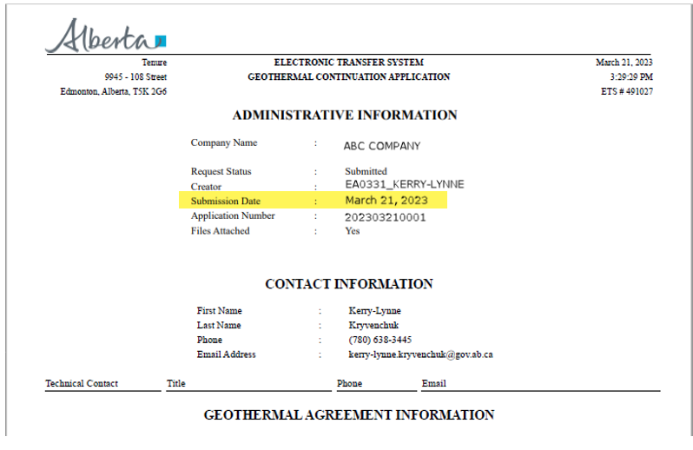

View Geothermal Continuation – Geothermal Application (continued)
After the application has been submitted, you should open the document and print a copy for your records.
The Geothermal Continuation Application must have a Submission Date confirming it has been successfully
received by Alberta Energy and Minerals.

Slide 31
Submit Continuation Application
You must have the Submitter role to submit an application.
When the application is complete, click the submit button. The application will go through the verification process and if no errors are identified, the application will automatically be submitted.
If there are errors, the application goes back into Work in Progress so it can be corrected and resubmitted. The contact person identified on the application will also receive an email indicating that action is required.
1. Click Submit

Slide 32
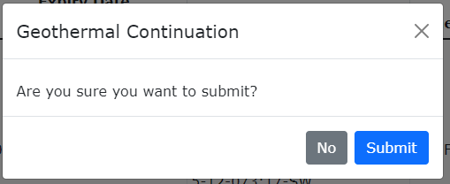
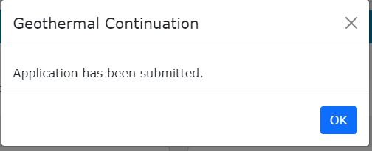
Submit Continuation Application (continued)
2. Click Submit
3. Click OK

Slide 33
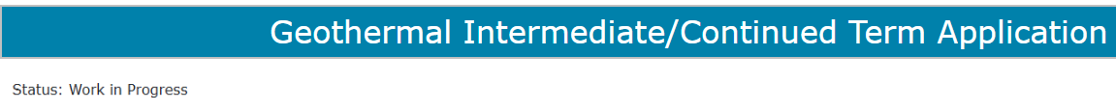
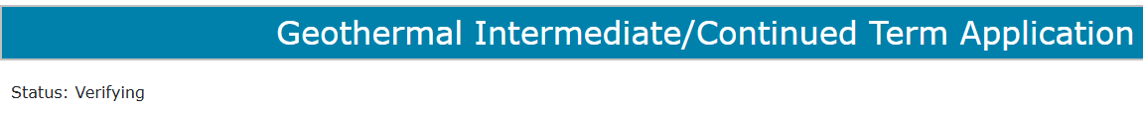
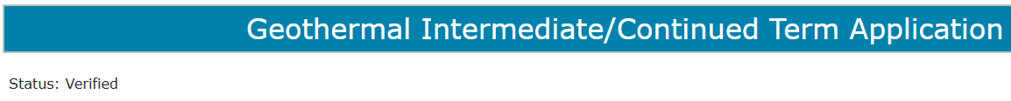
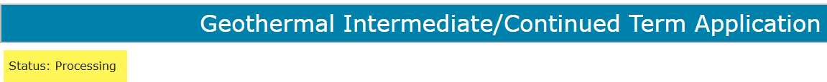
Submit Continuation Application (continued)
Once an application is submitted, the ETS Request will go through a verification process. Alberta Energy and Minerals has received the application when the status becomes Processing. The application remains in this status until the application is reviewed.

Slide 34
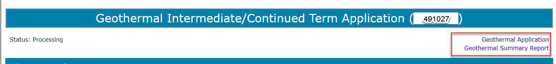
View Application Summary Report
The Application Summary Report is a PDF document which details the information contained within your application and whether it is was received by the internal system. The Application Summary Report displays all agreements that are applied for together and which share an Application Reference Number. Please note that the continuation document only displays one agreement.
Do not send a printed application to Alberta Energy and Minerals.
To view the document click on this link.

Slide 35
Work In Progress
You can use the Work In Progress screen to retrieve all active applications submitted by your company.
Please note that certain applications may have been archived and will no longer be in your Work in Progress list.

Slide 36
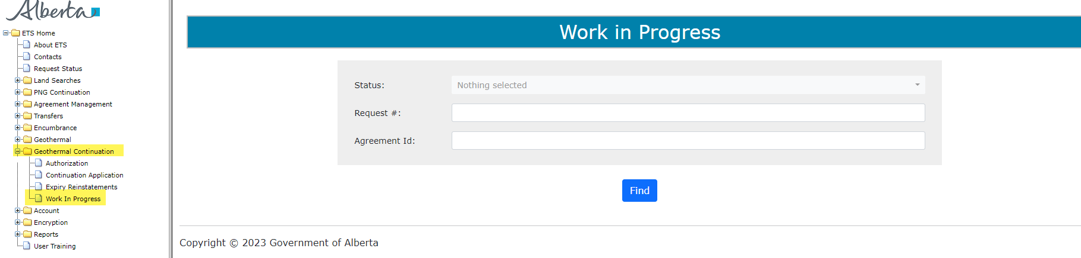
Work In Progress
2. Optionally choose your search parameters
1. Select Work In Progress
3. Click Find

Slide 37
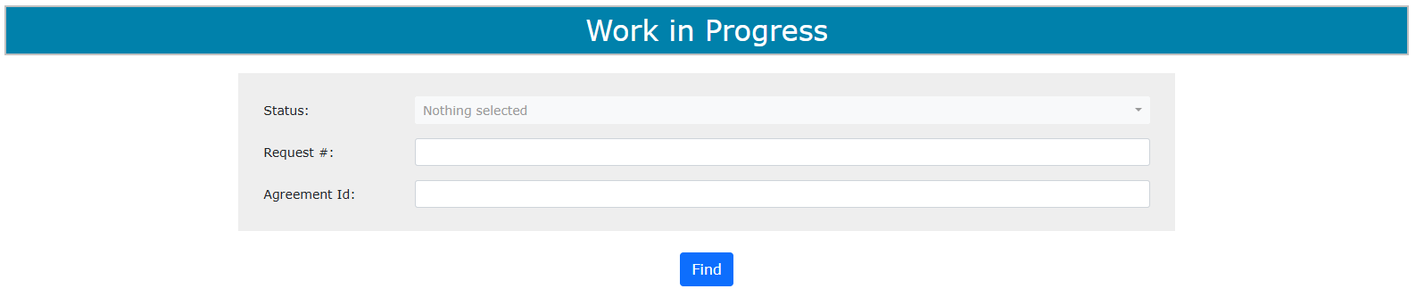
Work In Progress – Search Parameters and Result
You can search Work in Progress applications by their ETS Status, ETS Request number or by the Agreement Id number.

Slide 38
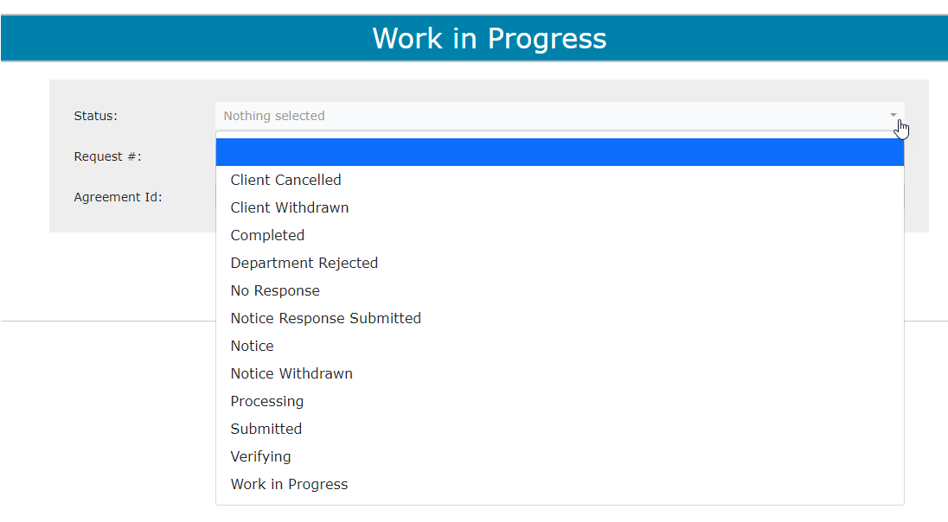
Work In Progress – Search Parameters and Result (continued)
The Request # dropdown lists the status types that can be searched.

Slide 39
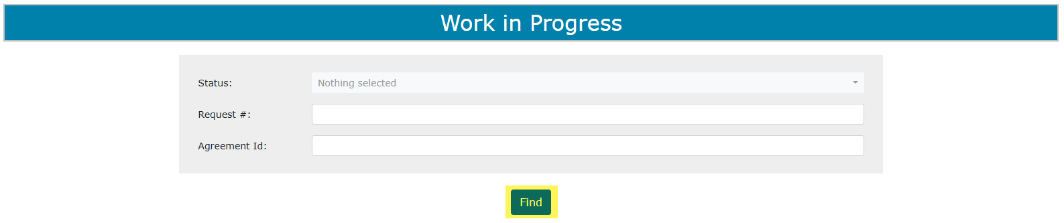
Work In Progress – Search Parameters and Result (continued)
By leaving the search fields blank and clicking Find, all your items will display in Work in Progress.

Slide 40
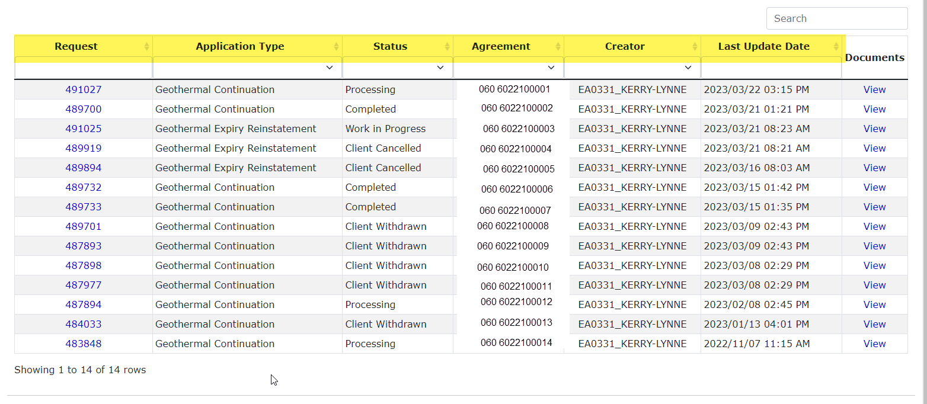
Work In Progress – Search Parameters and Result (continued)
Search Result
You can filter the list by each of the headings.

Slide 41
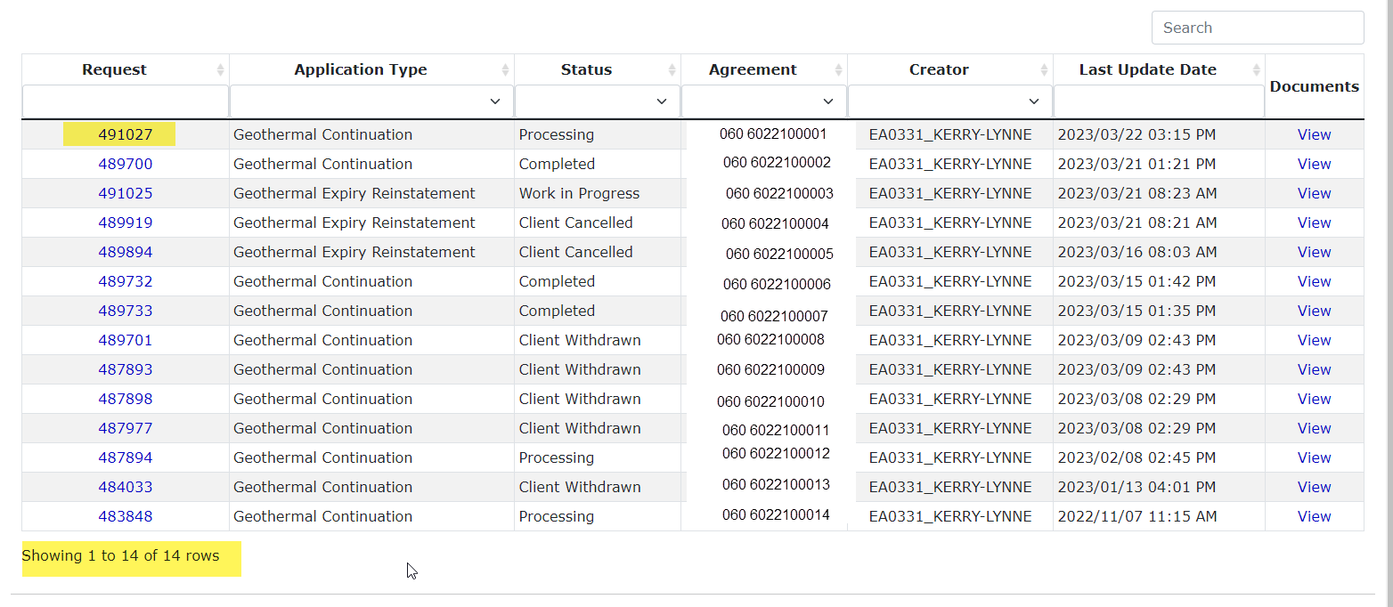
Work In Progress – Search Parameters and Result (continued)
To load an application or view a notice click on the ETS Request number link.
To open a document, click on View link.
Search Result
Navigate with these page numbers if there are multiple pages of search results.

Slide 42
Cancel or Withdraw an Application
You can:
  Cancel an application in Work in Progress status.
  Withdraw a previously submitted application prior to expiry. Please note that withdrawing an application will remove it from Alberta Energy and Mineral’s records.
You must have the Submitter role to cancel or withdraw an application.

Slide 43
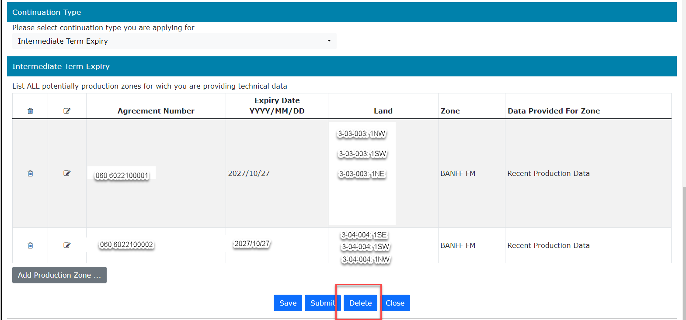
Delete an Application
If the status of your application is Work in Progress you can delete that application as any time.

Slide 44
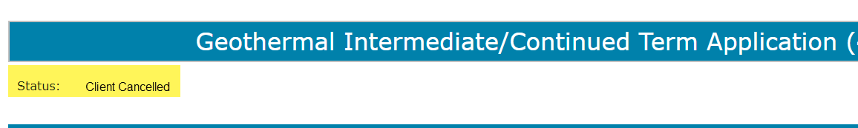
Delete an Application (continued)
When you delete an application in Work in Progress, the status becomes Client Cancelled.

Slide 45
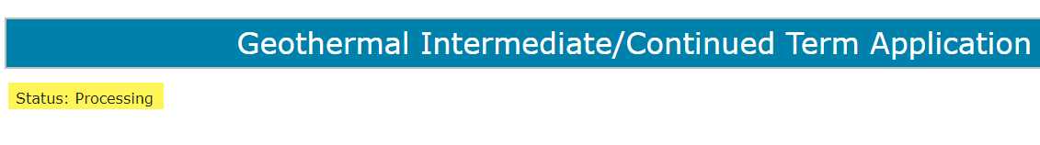
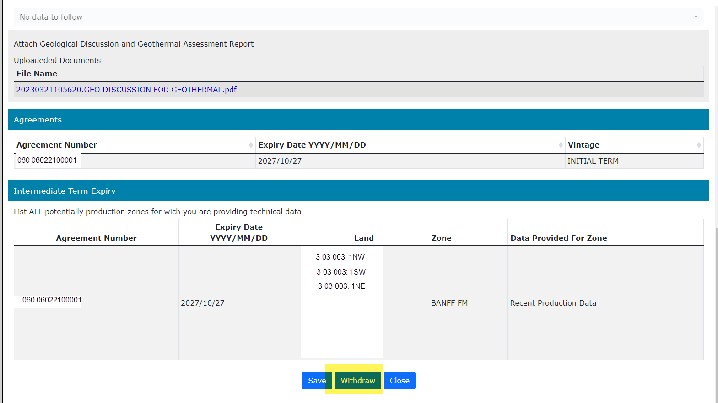
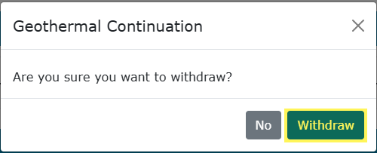
Withdraw an Application
If the status of your application is Processing you can Withdraw if it is prior to agreement expiry.
2. Click Withdraw
1. Click Withdraw

Slide 46

Withdraw an Application (continued)
When you withdraw an application, the status becomes Client Withdrawn.
When an application is withdrawn, it is removed from Alberta Energy and Mineral’s records. Any notices made by Alberta Energy and Minerals on the agreement are also rescinded. When submitting a new application for the agreement, you must apply for all lands and/or zones that you want Alberta Energy and Minerals to review.
Please refer to any previously submitted data in your new application if applicable.

Slide 47
Notice
If a notice is received by ETS, the application status becomes Notice.
An email may be sent from ETS informing your company’s contact that a notice is available for review and response. These email notifications are considered a courtesy and should not be relied on to track Geothermal Continuation Applications in ETS.
When submitting an application through ETS, it is your responsibility to continually check your Work in Progress to determine if a notice has been sent.
The notice can have one or more options for you to choose from.
You have until the Notice Expiry Date to respond to the notice.
If the Notice Expiry Date has passed without a response, the application will be sent back to the internal system, and the status will become “Processing (No Response).” The agreement expiry will be processed as set out in the notice letter.

Slide 48

Review Notice

Slide 49


Review Notice (continued)
You can view the notice letter two ways. On the Work in Process screen, you can view the document by clicking on the View link.
Or by opening the request and going to the Notice section of the application.

Slide 50

Review Notice (continued)
When a Notice is received, the status of the ETS Request becomes Notice.

Slide 51

Review Notice (continued)
The date the Agreement expires displays.
There is now a new section of the application called Notice.
The date the Notice expires.

Slide 52

Review Notice (continued)
Click this link to view the Notice letter.

Slide 53

Respond to Notice
1. Choose Response option

Slide 54
Respond to Notice (continued)
For each notice option, you can choose one of these responses:
Accept
Decline
Request for Review

Slide 55

Respond to Notice – Add Document for Request for Review
Add a supporting document
1. Select Request for Review
2. Click Choose File
3. Click Upload
Only one document is required for multiple Request for Review options. However, you may add as many documents as needed. you must add at least one supporting document.

Slide 56
View Notice Response Document
Once your notice response is completed you can review it with the Notice Response Document.
The Notice Response Document is a PDF file that shows your notice response.
To view the notice
Response Document, click on this link

Slide 57


View Notice Response Document (continued)

Slide 58



Submit Notice Response
You must have the Submitter role to submit a notice response.
Submit once the notice response is complete.
If you only save your notice response it will not come to Alberta Energy and Minerals. After the notice expiry date the status will become Processing (No Response)
1. Click Submit
3. Click OK
2. Click OK

Slide 59
Notice Withdrawn
If a notice is withdrawn, Alberta Energy and Minerals will contact the company. ETS will not send an email notification.
Once the Notice is withdrawn, it is removed and is no longer accessible.
Notice Withdrawn Applications will return to Processing status.

Slide 60
Final
If a final document is received by ETS, the application status becomes Completed.
An email may be sent from ETS informing your company, and the applicant if applicable, that a final document is available for viewing. These email notifications are considered a courtesy and should not be relied on to track Geothermal Continuation Applications in ETS.
Where the Designated Representative and the Authorized Applicant are the same, the email goes to the company’s contact person for the request.
Where the Designated Representative and the Authorized Applicant are different, the Designated Representative email goes to whomever has Geothermal Continuation Documents form type (assigned by the Site Admin) and the Authorized Applicant email goes to the company’s contact person for the request.
A final document contains a final letter and if applicable, an amended appendix.

Slide 61

View Final (as Applicant)
To view the final document click on either link.
To view the final document, click on this link.

Slide 62

View Final (as Applicant)
To open the final document, click on View/Download. This will include the final letter and an amended appendix if applicable.

Slide 63

View Final (as Designated Representative)
2. Choose your search parameters
1. Select Request Status
To view documents in Request Status you must have Geothermal Continuation Documents form type assigned.

Slide 64
No Application
If you fail to apply for continuation, a cancellation letter is sent and it will be available in the Request Status. Some of the agreements that you receive a final cancellation letter for may also appear on the monthly Agreement Cancellation Report.

Slide 65

Designated Representatives can find Completed (Finals) ETS Requests submitted by an Authorized Applicant under “Request Status”
Designated Representatives can find Completed (Finals) ETS Requests for applications that have expired without submission under “Request Status”
Designated Representatives can find all other ETS Requests under “Work in Progress”
Authorized Applicants can find all ETS Requests under “Work in Progress”

Slide 66
List of ETS Statuses
Status Group | Status Name | Description | Party | Location
Creating an Application | Work in Progress | Application has yet to be submitted to the internal system. | Designated Representative Authorized Applicant | Work in Progress
 | Verifying | Application is being verified by the internal system. | Designated Representative Authorized Applicant | Work in Progress
 | Verified | Application has been verified (no errors) and will be sent to the internal system. | Designated Representative Authorized Applicant | Work in Progress
 | Processing | Application has been received by the internal system. | Designated Representative Authorized Applicant | Work in Progress
Cancelling/ Withdrawing an Application | Client Cancelled | Application has been cancelled from your Work In Progress list by you. | Designated Representative Authorized Applicant | Work in Progress
 | Client Withdrawn | An already submitted application has been withdrawn by you prior to expiry. | Designated Representative Authorized Applicant | Work in Progress

Slide 67
List of ETS Statuses (continued)
Status Group | Status Name | Description | Party | Location
Notice | Notice | Notice has been received by ETS and is available for your action | Designated Representative Authorized Applicant | Work in Progress
 | Noticer Response Submitted | Notice response has been submitted and has not been received by the internal system. | Designated Representative Authorized Applicant | Work in Progress
 | Processing | Notice response has been received by the internal system. | Designated Representative Authorized Applicant | Work in Progress
 | No Response | Notice Expiry Date has passed without your response. This has not yet been received by the internal system. | Designated Representative Authorized Applicant | Work in Progress
 | Processing | Notice Expiry Date has passed without your response. This has been received by the internal system. | Designated Representative Authorized Applicant | Work in Progress

Slide 68
List of ETS Statuses (continued)
Status Group | Status Name | Description | Party | Location
Notice Withdrawn | Notice Withdrawn | Notice has been withdrawn by Alberta Energy and Minerals. | Designated Representative Authorized Applicant | Work in Progress
Rejected | Department Rejected | Application has been rejected by Alberta Energy and Minerals. | Designated Representative Authorized Applicant | Work in Progress

Slide 69
List of ETS Statuses (continued)
Status Group | Status Name | Description | Party | Location
Final | Completed | Application is now completed and the final document is available for your retrieval. Application was made by the Authorized Applicant, not the Designated Representative. Application is now completed and the final document is available for your retrieval. Application was made by the Authorized Applicant. Application is now completed and the final document is available for your retrieval. Application was made by the Designated Representative. Application was not made and the agreement or a portion of the agreement has expired. This includes Cancellation letters from no application files. | Designated Representative Authorized Applicant Designated Representative Designated Representative | Request Status Work in Progress Work in Progress Request Status

Slide 70

Congratulations!
Congratulations!
You have completed the ETS – Geothermal Continuation:
Continuation
Online Training Course
To access Courses, Guides and Forms for all your ETS Business please see ETS Support and Online Learning.
If you have any comments or questions on this training course,
please contact:
Crown Agreement Management
Email inquiries: Energy.GeothermalTenure@gov.ab.ca

