Slide 1

Wele
Each company has an assigned ETS Site Administrator who is responsible to create their company's user accounts. They also manage the assignment of roles within the company.
This module will highlight the different roles
required to create, amend, submit, and view the various
Geothermal Continuation form types:
Geothermal Authorization
Geothermal Continuation
Geothermal Expiry Reinstatements
Geothermal Continuation Documents
Geothermal Expiry Reinstatement Documents
Geothermal Non-Productivity Notices
To the ETS – Geothermal Continuation: Roles
Online Training Course

Slide 2
Revisions
Date | Revisions Type | Page Number
September 2025 | Initial Creation | All

Slide 3
Introduction
In this module, you will learn about the different roles for Geothermal Continuation.
Prerequisite Learning Modules
Before proceeding we recommend that you view the ETS Account Setup and Preferences module located in the Online Learning portal.

Slide 4
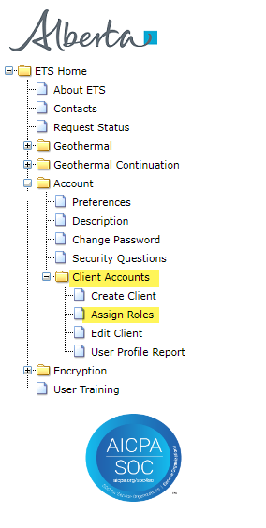
Site Administrator – Assign Roles
The Site Administrator is responsible for assigning roles to their users for the various Form Types.
This is completed in the Assign Roles screen under the Client Accounts section in ETS.
The selection of roles will vary based on the Form Type.

Slide 5
Geothermal Authorization
The Authorization process involves authorizing a company to act on behalf of the designated representative for a Crown geothermal lease.
There are three roles available for Geothermal Authorization:
 | can submit and view authorization requests.
 | can concur authorization requests.
 | can view authorization requests.

Slide 6
Geothermal Continuation
Geothermal Continuation is the process for a company to fill in and submit an Online Geothermal Continuation Application via ETS.
There are three roles available for Geothermal Continuation:
 | can create and amend applications. can view applications they created (please note if they need to view applications not created by them, Viewer role must also be assigned to them).
 | can submit and view all applications.
 | can view all applications and their related documents.

Slide 7
Request Status - Geothermal Continuation Documents
Geothermal Continuation Documents is the process for a designated representative to retrieve final documents.
There is one role available for Geothermal Continuation Documents:
 | can view all finals and their related documents.

Slide 8
Request Status – Geothermal Non-Productivity Notices
Geothermal Non-Productivity Notice is the process for a designated representative to retrieve non-productivity notices served on a Crown geothermal lease.
There is one role available for Non-Productivity Notices:
 | can view all notices.

Slide 9
Geothermal Expiry Reinstatement
Geothermal Expiry Reinstatement is the process for a company to fill in and submit an Online Expiry Reinstatement on a cancelled geothermal lease and/or rights via ETS.
There are three roles available for Geothermal Expiry Reinstatement:
 | can create applications. can view applications they created (please note if they need to view requests not created by them, Viewer role must also be assigned to them).
 | can submit and view all applications.
 | can view all applications and their related documents.

Slide 10
Request Status – Geothermal Expiry Reinstatement Documents
Geothermal Expiry Reinstatement Documents is the process for a designated representative to retrieve final documents.
There is one role available for Geothermal Expiry Reinstatement Documents:
 | can view all finals and their related documents.

Slide 11

Congratulations!
Congratulations!
Congratulations!
You have completed the ETS – Geothermal Continuation: Roles Online Training Course
To access Courses, Guides and Forms for all your ETS Business please see Alberta Online Learning .
If you have any comments or questions on this training course,
please contact: Energy.GeothermeralTenure@gov.ab.ca

