Slide 1
Welcome
Welcome!
Royalty Reporting is an online service available in the Electronic Transfer System (ETS). It provides the functionality of electronic submission of Oil Sands (OS) Project Royalty Forms and OS Audit Opinion Forms.
To the OASIS Royalty Reporting
Online Training Course

Slide 2
Revisions
Date | Revisions Type | Page Number
January 10, 2012 | Initial Creation | All
September 31, 2012 | Conversion | All

Slide 3
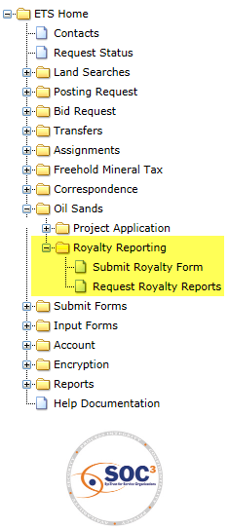
Introduction
In this module, you will learn how to:
Understand the use of ETS Login Account
Understand the ETS Roles for Royalty Reporting
Submit Oil Sands (OS) Project Royalty Forms
Submit an Audit Opinion
Retrieve Request Status
Course Pre-requisites
ETS Account Setup and Preferences (For Site Administrators)

Slide 4
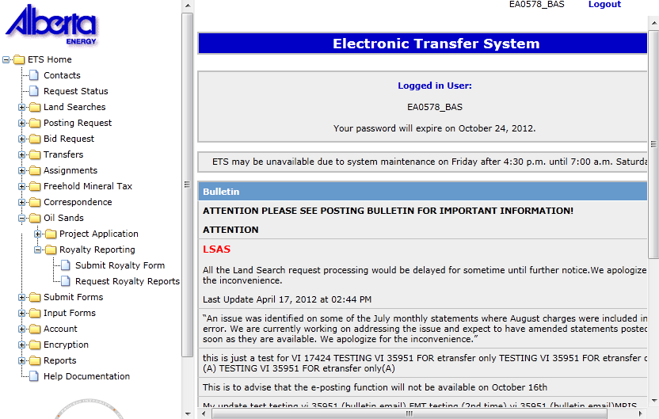
ETS Login Account General Information
An ETS Account is required in order to use ETS and can be obtained by downloading the application form from the Department of Energy (DOE) ETS website at:
http://www.energy.alberta.ca/OurBusiness/1076.asp

Slide 5
Roles
Roles are required and based on the Form Types that are available to the Site Administrator.
OASIS Royalty Reporting has two roles:
1. Submitter
  Submits Royalty Forms and Audit Opinions
  Views own submitted royalty reporting files and the system generated reports related to those submissions
2. Viewer
  Views all submitted royalty reporting files in their company and the system generated reports related to those submissions
Note:
The following features will be available in September 2012:
  Email notifications to the Submitter and Viewer when there are updates to the request status
  Access to all system generated reports (Confirmation Report is available in February 2012)
  Ability to request reports from the OASIS database

Slide 6
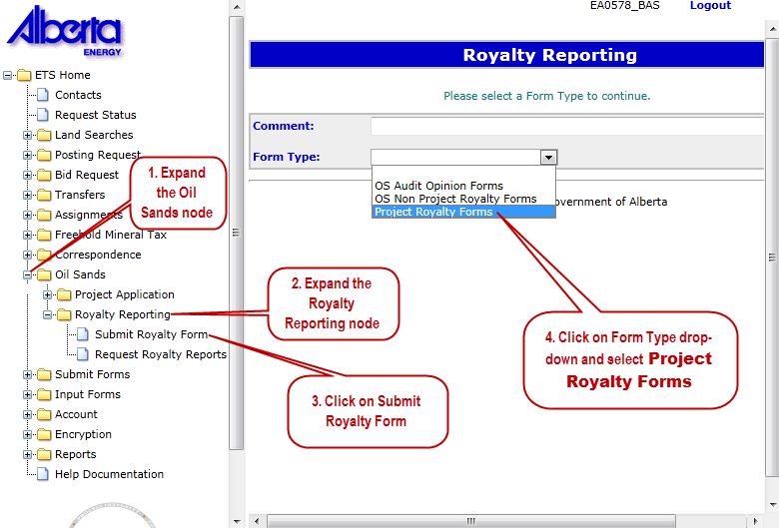
Royalty Reporting
The Royalty Form Submission Screen is displayed by clicking on the Royalty Reporting node.
To submit Oil Sands Royalty Forms, select Project Royalty Forms from the Form Type dropdown options.

Slide 7
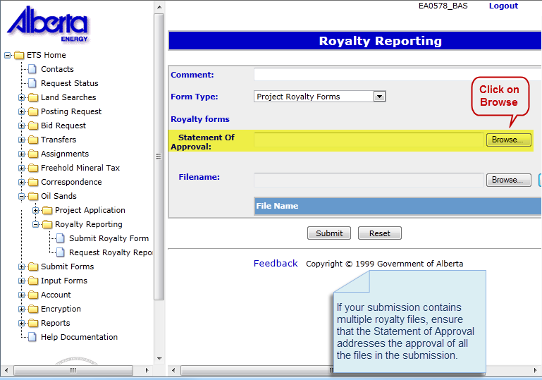
Statement of Approval
After the Project Royalty Forms Form Type is selected, the fields for uploading the Statement of Approval and Royalty forms become available.
Only one Statement of Approval is accepted per submission. The Statement of Approval must list the projects that are being approved and the royalty amount.
Click on the Browse… button to search your directory for the file to be attached. These files can be in PDF, DOC, DOCX formats.

Slide 8
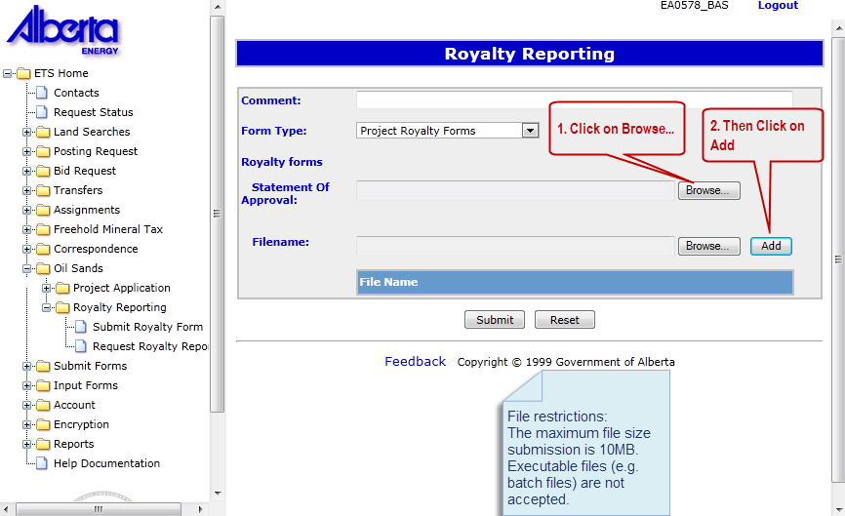
Royalty Forms
Then attach the Royalty Forms. Click on the Browse… button and search your directory for the file to be attached.
Click on the Add button to attach each file.
Multiple files and various royalty forms can be attached e.g. MRC, GFE, or EOP.
Royalty forms files must be in excel format.

Slide 9
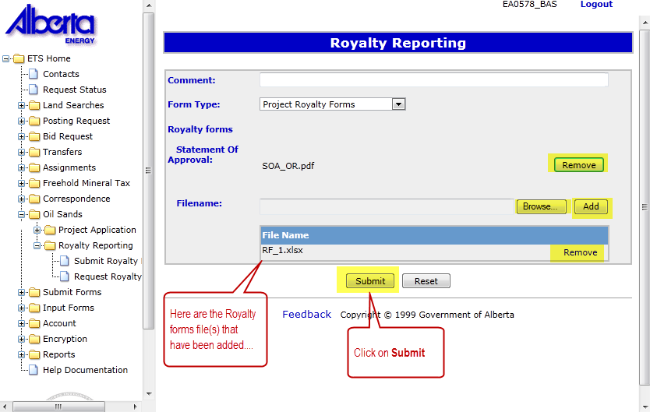
Project Royalty Forms - Submission
The selected Royalty Form file is displayed under the File Name column.
To change the files selected for the Statement of Approval and the Royalty Forms, use the Remove buttons. To add additional royalty forms, use the Browse…and Add buttons.
You are now ready to submit your royalty forms. Click on the Submit button.

Slide 10
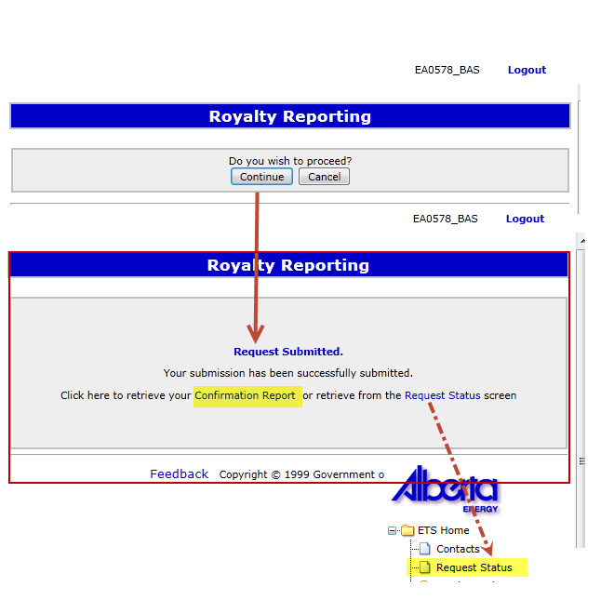
Submission Messages
A message will display upon submission. Click on the Continue button to proceed to the next screen.
When your submission is successfully submitted, a message with a link to a Confirmation Report is provided.
Click on the link provided to view the Confirmation Report or retrieve this report from the Request Status screen.
For information on Request Status, refer to the Retrieving Request Status page in this module.

Slide 11
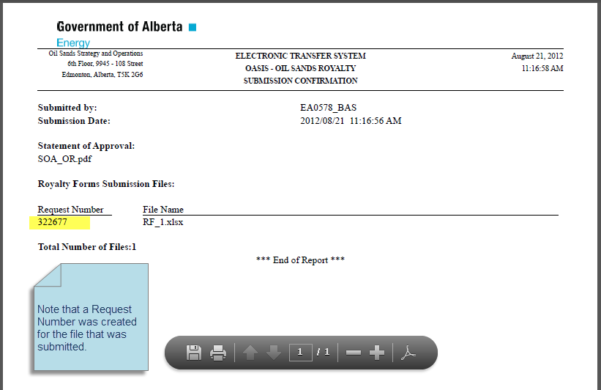
Confirmation Report for Royalty Form Submission
An example of a Confirmation Report for a Royalty Form submission is shown here.
A Confirmation Report is a submission confirmation which lists the files that were submitted. It is one of the retrievable documents attached to each request.
For Royalty Form submissions, a Request Number is assigned to each file that is included in the submission. Use this Request Number when retrieving the status of a submission.

Slide 12
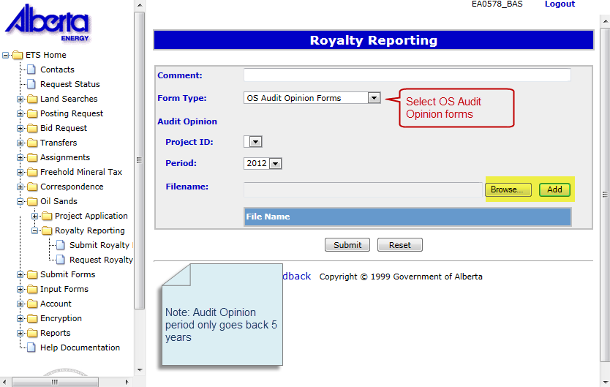
Submitting an OS Audit Opinion
To submit an Audit Opinion, select OS Audit Opinion Forms from the Form Type dropdown options.
Upon selecting OS Audit Opinion Forms Form Type, provide the following information:
• Project ID
• Audit Opinion Period
• Audit Opinion File Name
Similar to how royalty forms are uploaded, use the Browse… and Add buttons to attach additional supporting documents.
Click on the Submit button when you are ready to upload your submission.

Slide 13
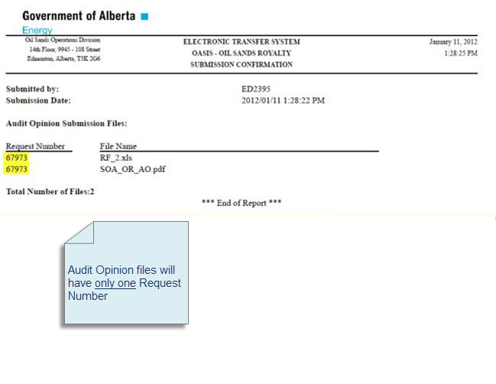
Confirmation Report for OS Audit Opinion
This is an example of a Confirmation Report for an Audit Opinion submission.
For OS Audit Opinion Forms submissions, only one Request Number will be generated for all the files contained in the submission.

Slide 14
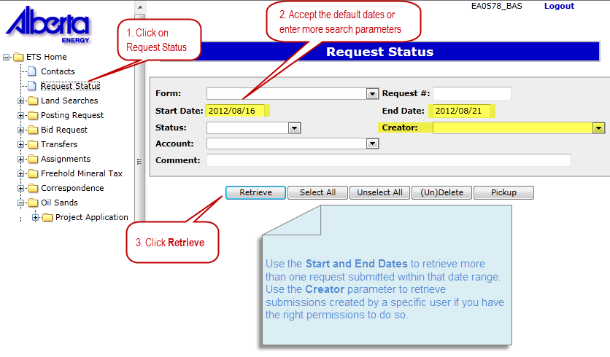
Retrieving Request Status
Use the Request Status node to retrieve the status of your submissions.
Fill in the search parameters and click on the Retrieve button.

Slide 15
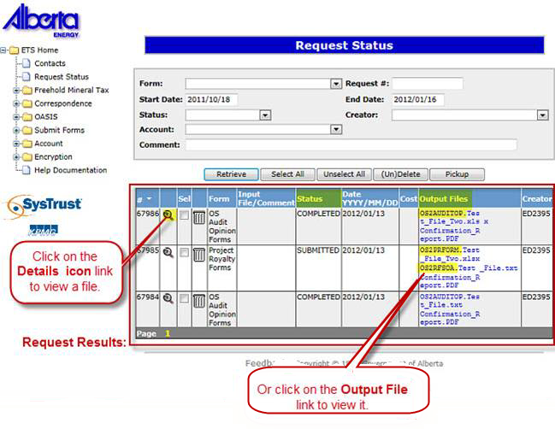
Retrieve Request Results
Request results are displayed at the bottom of the Request Status screen. A row of information is displayed for each Request Number.
The Output Files column displays the name of the file submitted with the prefix file naming convention below:
Statement of Approval: OS2RFSOA. + File name
Royalty Form File: OS2PRFORM. + File name
Audit Opinion: OS2AUDITOP. + File name
You may also refer to the Confirmation Report which also contains the Request Number and the files submitted.
Project Royalty Forms will initially have a “Submitted” status. Upon completion of processing in OASIS, the Status will be marked as “Completed”.
For an Audit Opinion that was submitted, the Request Status will have a Status of “Completed” as the submission does not require any validation or calculation in OASIS.

Slide 16

Conclusion
Congratulations!
You have completed the OASIS Royalty Reporting
Online Training Course
If you have any comments or questions on this training course,
please forward them to the following email address:
OSODmailbox@gov.ab.ca

