Slide 1
Welcome!
To the ETS – Transfers
Partial Land Transfer
Online Training Course
This module explains the process of submitting a Partial Land Transfer through the ETS system.

Slide 2

PARTIAL LAND TRANSFERS
Government of Alberta
Revision Page
Date | Revisions Type | Page Number
May 3, 2018 | Initial Creation | All
April 2020 | Cosmetic Updated | All
November 2022 | Update | Including Geothermal Agreements

Slide 3
PARTIAL LAND TRANSFERS
Government of Alberta
Introduction
In this module, you will learn how to:
Initiate and submit a Partial Land Transfer
Concur to a Partial Land Transfer
Retrieve Final Documents
Click on any of the above to be directed to the corresponding instructions in the module.
Pre-requisite:
Prior to proceeding we recommend you review the ETS Account Set up and Preferences and the ETS Client Account Set up and Maintenance modules located in the Online Learning portal.

Slide 4
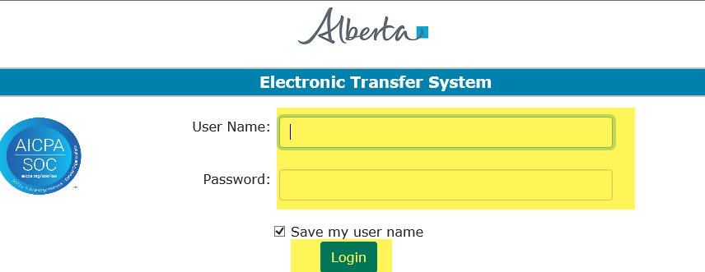
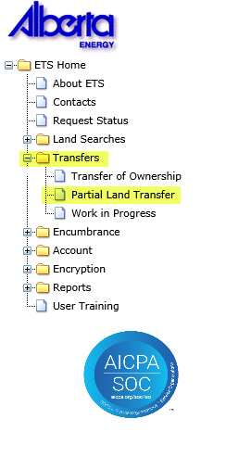
LOGIN TO ETS
1. Login to ETS with your user name and password.
2. Expand the “Transfers” Folder.
3. Select “Partial Land Transfer”.

Slide 5
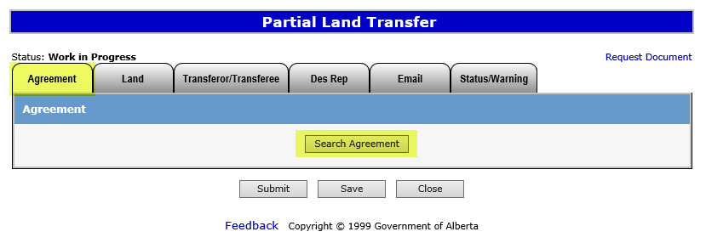
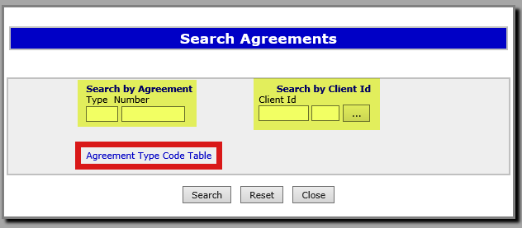
Search Agreements
1. Click on the “Agreement” tab.
2. Click on Search Agreement.
3. Agreements (including Geothermal) can be searched either by entering the agreement number OR…
Agreements can be searched by entering the client name of a participant who has a registered interest in the agreements being searched.
Click the "Agreement Type Code Table“ hyperlink to view a table of all DOE agreement types and their descriptions.

Slide 6
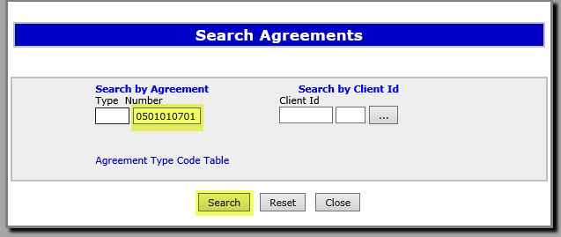
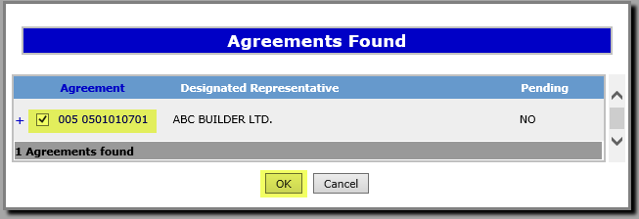
Search by Agreement
Enter the Agreement number and click Search.
2. If you leave the type field blank your results may return multiple Agreement types. Select the appropriate one by checking the box next to the desired Agreement, and click OK.

Slide 7
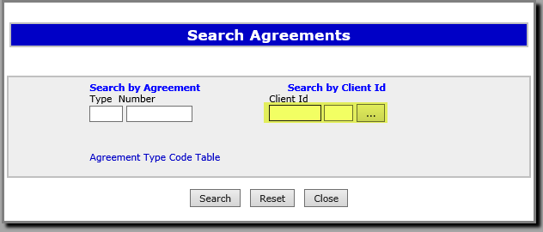
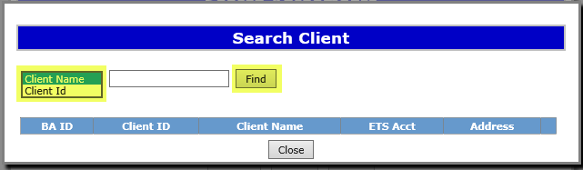
Search by Client ID
1. To search by Client ID please enter the number and click Search.
2. Alternatively you may search by the client name by clicking on the ellipsis button.
3. Select one of the options from the dropdown menu enter the Client Name or Client ID in the blank field and click Find.

Slide 8
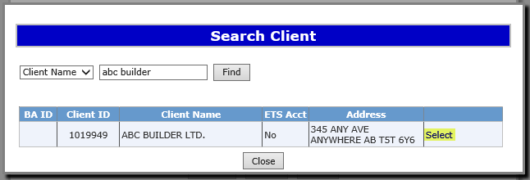
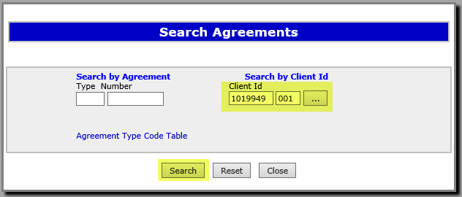
Search by Client ID cont’d
Click on the “Select” hyperlink to choose the desired client from the list.
2. The Client ID information will auto fill on the previous screen, click Search to return a list of agreements associated with that client.

Slide 9
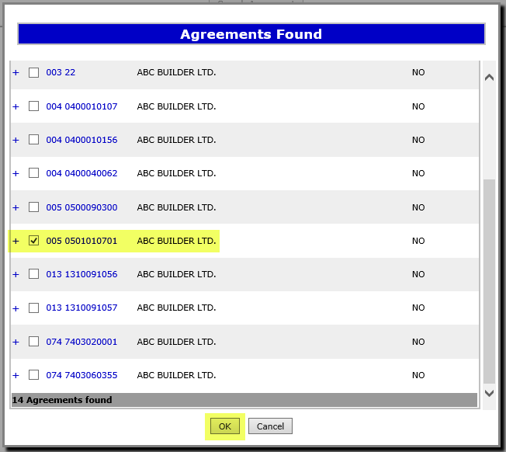
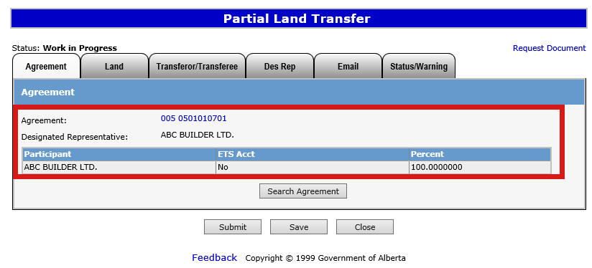
The “Agreement” tab will be updated to include the agreement you searched for.
NOTE: You can only partially transfer one agreement at a time per request.
Select the checkbox next to the relevant agreement and click OK.
2. Verify the information returned is correct and click Save.

Slide 10
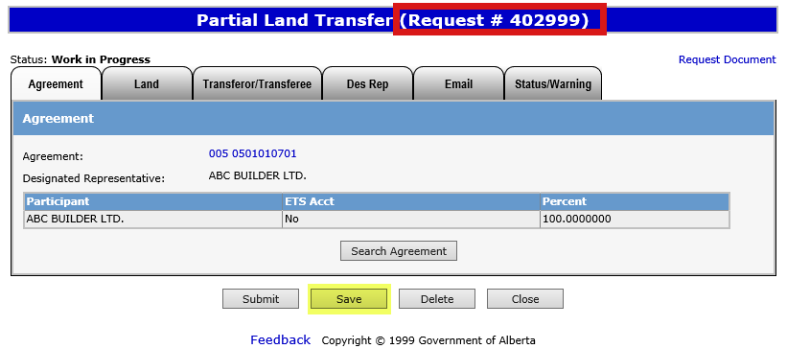

ETS Request Number
An ETS request number will be displayed at the top of the screen.
This number will be used to track your request in the Work in Progress node.
Saving your work periodically is recommended as the screen will timeout after 15 minutes of inactivity.

Slide 11
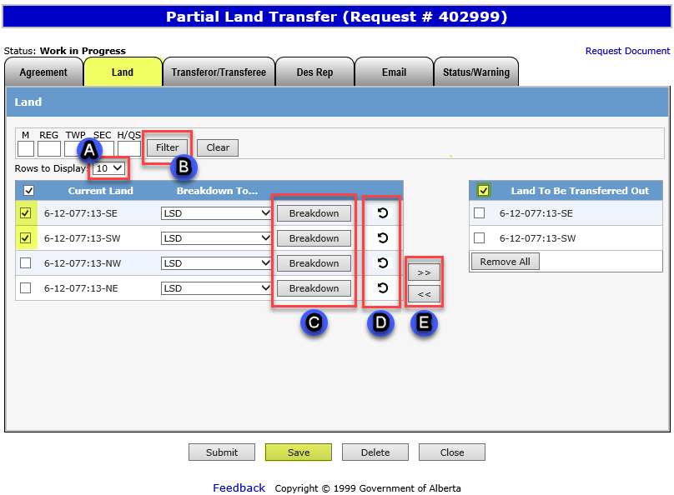
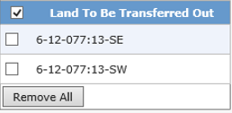
Selecting Agreement Land
Select the “Land” tab.
A. The “Rows to Display” tool is used to select how many rows of land keys are displayed.
B. The “Filter” tool can be used to show specific land keys for an Agreement and is useful when viewing Agreements that contain a large number of land keys.
C. The “Breakdown” tool is used to break down a specific land key into Quarters, LSD’s, or Quadrants.
D. The “Rollback” tool reverses any breakdown changes made.
E. The right and left pointing arrow buttons are used to add or remove land in the “Land to be Transferred Out” field.
2. After selecting the checkboxes of the lands you wish to transfer out of the Agreement, click the >> to move to the “Land To Be Transferred Out” field and click Save.

Slide 12
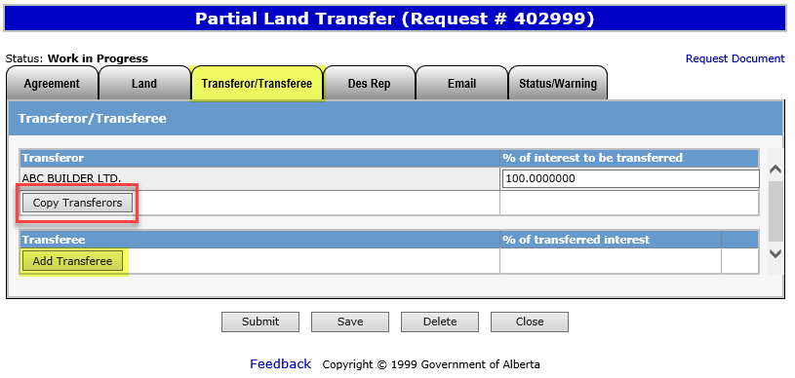
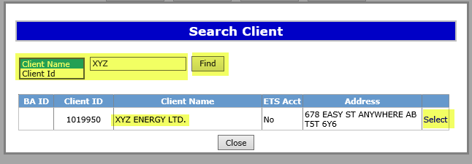
Click the “Transferor/Transferee” tab.
Selecting Transferor/Transferee
2. Click the Copy Transferors button to automatically copy the participants to the transferee section.
3. Click the Add Transferee button.
5. Click on the “Select” hyperlink next to the applicable client.
4. Enter the desired client name in the field or to search by Client ID, click Find.

Slide 13
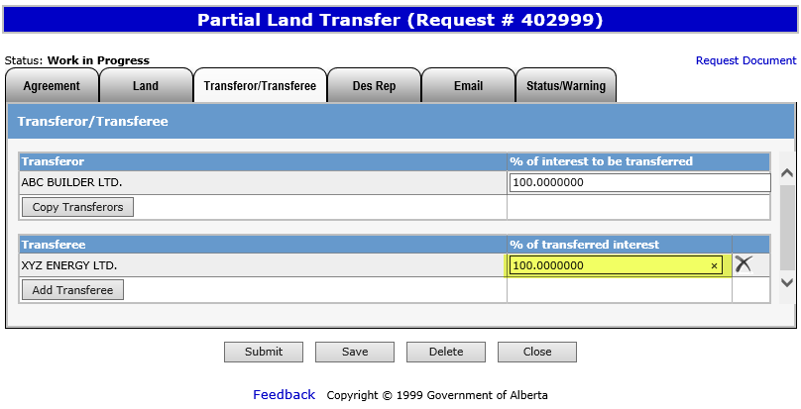
Selecting Transferor/Transferee (Cont’d.)
Set the percentage amount of the transferee in the new agreement.
NOTE: If the new agreement includes multiple participants, the percentage among all the transferees must be equal to 100%.

Slide 14
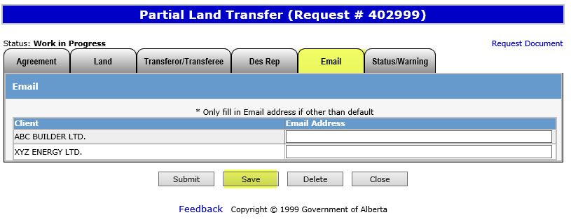
Adding Alternate Email (OPTIONAL)
1. Click the “Email” tab.
Enter new Email address and click Save.
NOTE: Only fill in an alternate Email address if other than the default address is desired. Doing this will replace the default address for email notifications related to the current request only.

Slide 15
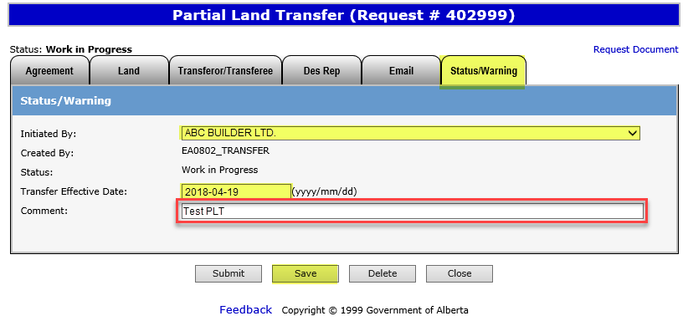
Additional Information
1. Click the “Status/Warning” tab.
2. Select the applicable Client Name initiating the Partial Land Transfer from the dropdown menu.
3. Enter the Transfer Effective Date (Optional).
Note: If future dated, the request will not be submitted to AB Energy for approval until the date indicated.
Use the “Comment” field to enter a file number or other data for your reference.
4. Click Save.

Slide 16
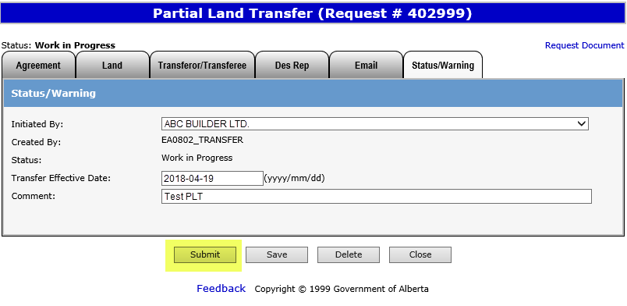
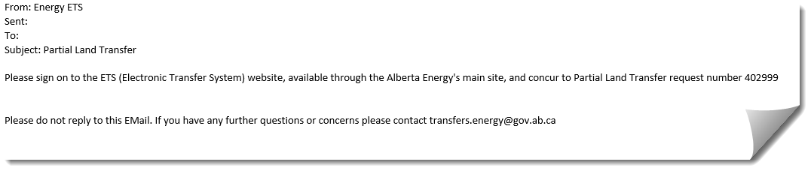
Submitting Partial Land Transfer
1. Once you’ve confirmed that all applicable information for the Partial Land Transfer has been entered and is complete, click Submit. The request status will be updated to “Concurrence”.
Sample
An email notification (sample above) will be sent to all participants involved in the Partial Land Transfer to notify ETS users to log into ETS to review and complete the concurrence process.

Slide 17
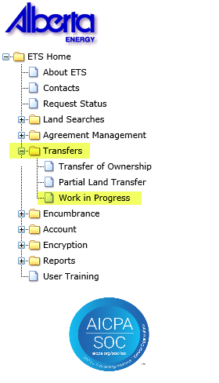
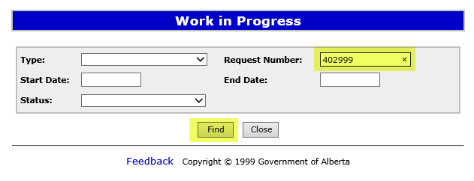
Concurrence
1. Login to ETS and select “Transfers”.
3. Enter the ETS Request Number referenced in the notification email.
2. Select “Work in Progress”.
4. Click Find.
NOTE: The Partial Land Transfer will not be submitted to AB Energy until all parties involved concur to the Transfer.

Slide 18
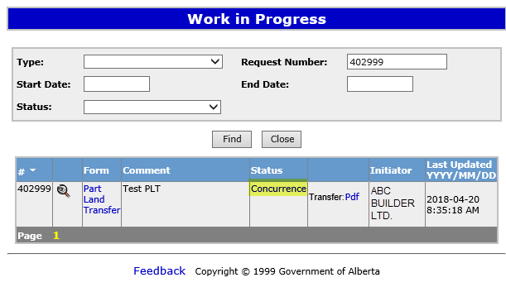
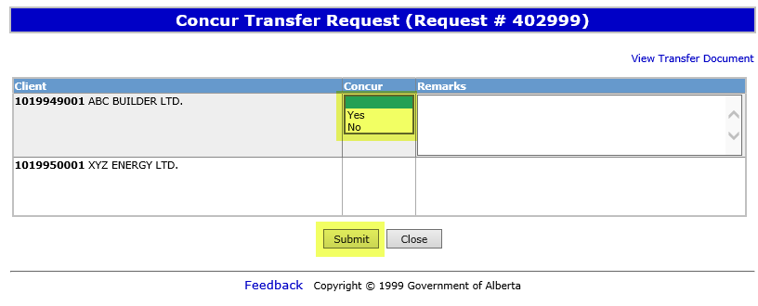
Concurrence (Cont’d.)
1. To review the details of the Partial Land Transfer click either the “Part Land Transfer” or “Pdf” hyperlink.
2. Click the “Concurrence” hyperlink to open the “Concur Transfer Request” screen.
3. Select either the “Yes” (approve) or “No” (reject) option.
3. Click Submit.

Slide 19
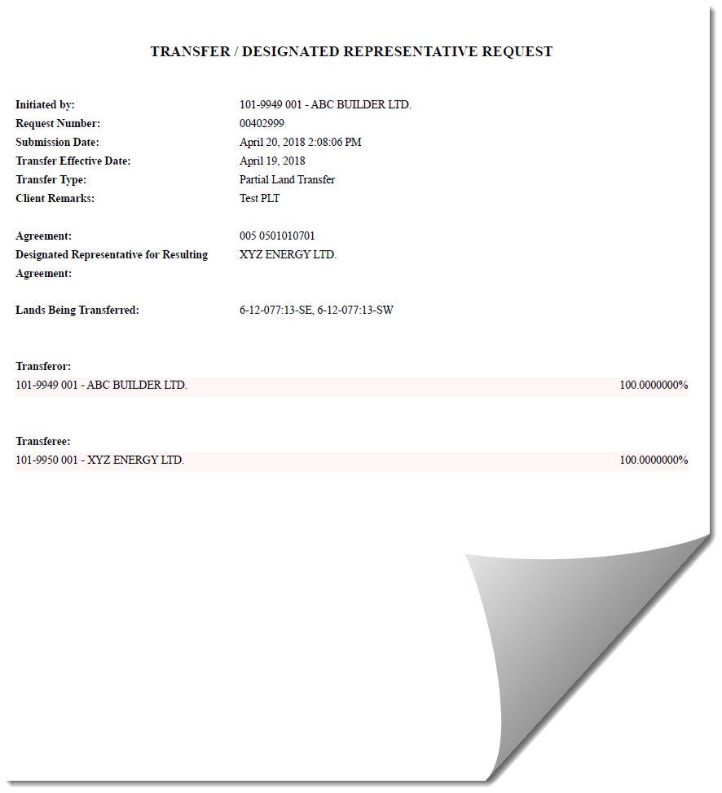
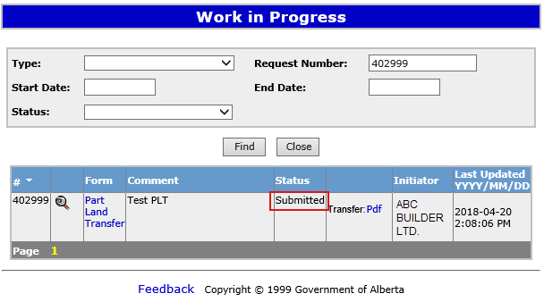
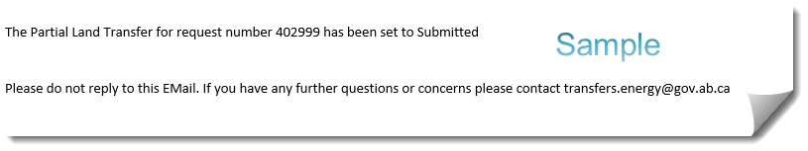
Submission
Sample
The Work in Progress status will update to “Submitted” after all parties have concurred to the Partial Land Transfer. The initiator will receive a notification email confirming that the request has been submitted to AB Energy for review.
Print the Transfer Request document from ETS for your records by selecting the “Transfer: Pdf” hyperlink (above).

Slide 20
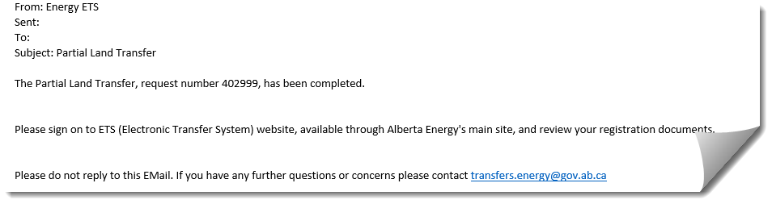
Retrieving Registration Documents
Sample
The initiator of the Partial Land Transfer will receive the sample email above once the review has been completed by AB Energy. To retrieve the referenced registration documents, you’ll need to log into ETS.
This information is also available to all participants through the relevant ETS request number, however, they will not receive an email notification advising them of the approval.

Slide 21
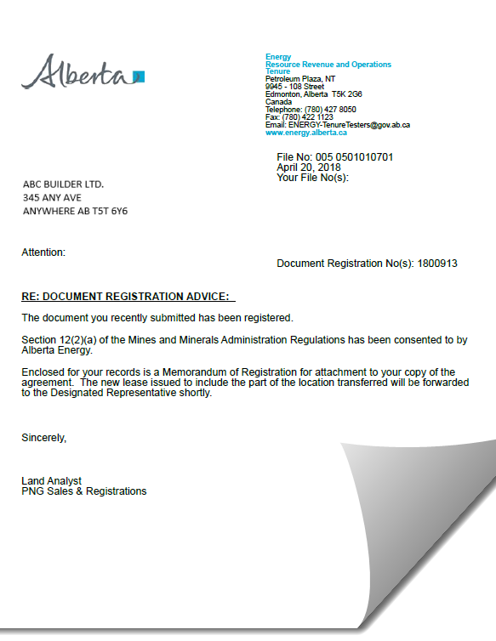
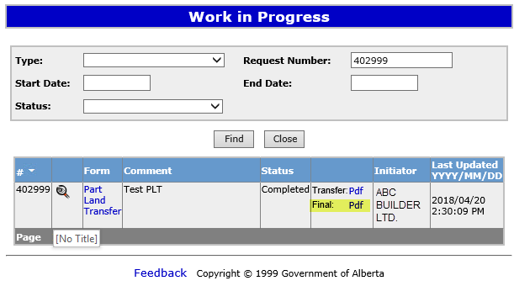
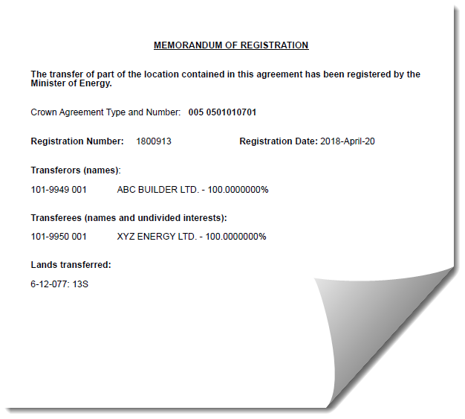
Retrieving Registration Documents (Cont’d.)
1. Retrieve the final documents by selecting the “Final: Pdf” hyperlink.
Sample
Approval documents are retrieved through ETS and include the Registration Advice letter and Memorandum Of Registration (MOR) for the originating agreement.
Sample

Slide 22
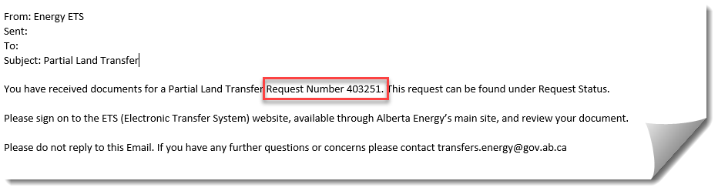
Retrieving Final Documents
Sample
Once approved, the Designated Representatives of each respective agreement will receive separate notification emails, quoting their own unique request numbers, advising them to pick up their final documents on ETS.
NOTE: This email will go to the client accounts that have a viewer role for the “Electronic Transfer – Agreement Documents” form-type.
They will be required to log into ETS to retrieve their respective amended appendix and new resulting agreement documents.

Slide 23
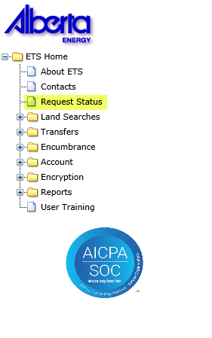
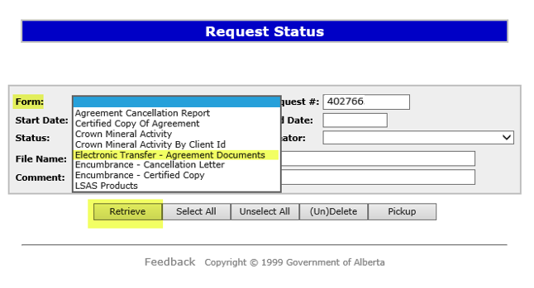
Retrieving Final Documents (Cont’d.)
1. Log into ETS and Select the “Request Status” tab.
2. In the Form dropdown menu select “Electronic Transfer – Agreement Documents”.
3. Enter the New Request number quoted in the email notification.
4. Click Retrieve.

Slide 24
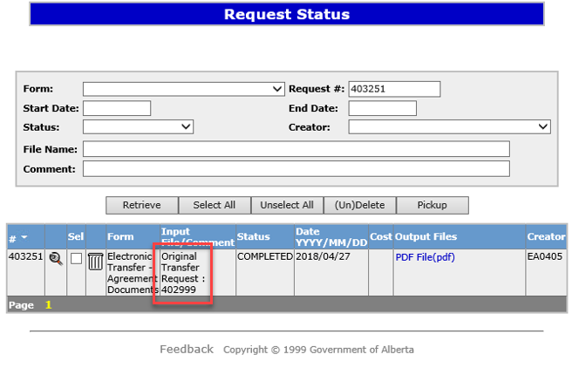
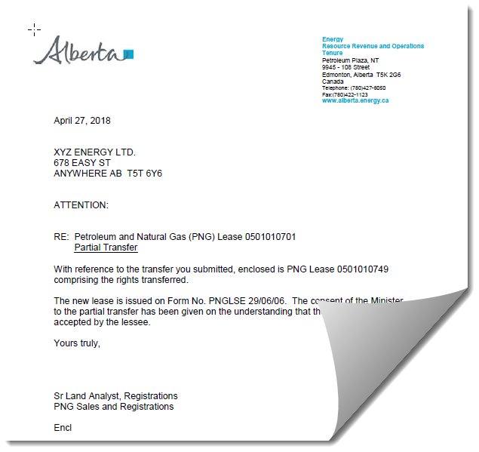
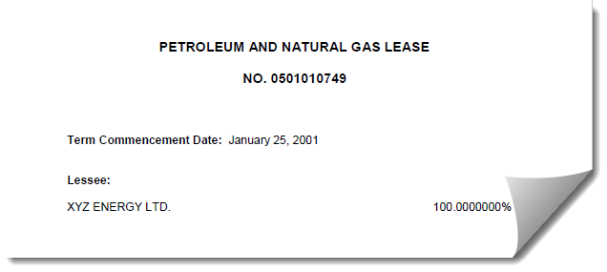
Retrieving Final Documents (Cont’d.)
Sample
The original transfer request # will be referenced under the “Input File/Comment” field.
Sample

Slide 25
Resources
ETS Support and Online Learning provides access to relevant guides, course and other information
If you have questions, please contact Transfers.Energy@gov.ab.ca or the Transfer Helpdesk at (780)644-2300
Page 25 of 26

Slide 26

Congratulations!
You have completed the ETS – Transfers
Partial Land Transfers
Online Training Course
If you have any comments or questions on this training course,
please forward them to the following email address:
Transfers.Energy@gov.ab.ca

